Slide 1

CAGI slide pack guidelines
I agree to my slides being used according to the following terms:
Warren van Loggerenberg and Frederick P. Roth
Authors: please include THIS slide at the beginning of your presentation to indicate that you agree with reuse of your slides in CAGI presentations, according to the terms below, and digitally sign by writing your name above.
To disseminate the CAGI results, I encourage all CAGI participants to remix these CAGI slides for inclusion in their oral and poster presentations
CAGI participants may use or publish any content of these slides only in compliance with the CAGI Data Use Agreement
CAGI participants may not cite or publish any content of these slides except with the written permission of the originating author or in the primary CAGI publications
CAGI participants must acknowledge the original authors of these slides and CAGI 6. Include the acknowledgement banner across the bottom
CAGI participants must include the CAGI credits slide in their presentations
Slides with a red slash (no remix) may not be included in a presentation unless all attendees are registered CAGI participants who signed the data use agreement
Slides with a red X over the entire slide may not be used in any circumstances
Slides with a blue slash (embargoed) may not be used unless the embargo is explicitly lifted
Slides without slash or X may be tweeted unless flagged with the “No tweet” icon.
CAGI participants using these slides must explain the “No tweet” icon, which means that the slide content should not be disseminated outside the presenting conference hall. If the presentation venue permits pervasive tweeting, you may not include these slides in your talk
Note for slide authors: we expect all CAGI participants to abide by these restrictions, and will make best effort to ensure they are followed. However, but bear in mind that we have limited means of enforcing them, and therefore the restrictions cannot be guaranteed

Slide 2
Permission request regarding CAGI 6 recordings and hybrid presentations
I understand that my presentation as associated with CAGI 6 will be recorded and broadcasted via the internet through CAGI’s designated technology provider.
As the copyright holder to this presentation entitled “Testing all possible HMBS missense variants to proactively detect pathogenic variation”, I hereby agree that the copyright for the online broadcast and recording of my presentation be released to CAGI and my recording be uploaded on to the CAGI website.
Created for CAGI 6
Genomeinterpretation.org

Slide 3
Testing all possible HMBS missense variants to proactively detect pathogenic variation
Warren van Loggerenberg
University of Toronto
Roth Lab
May 14, 2022
Created for CAGI 6
Genomeinterpretation.org

Slide 4

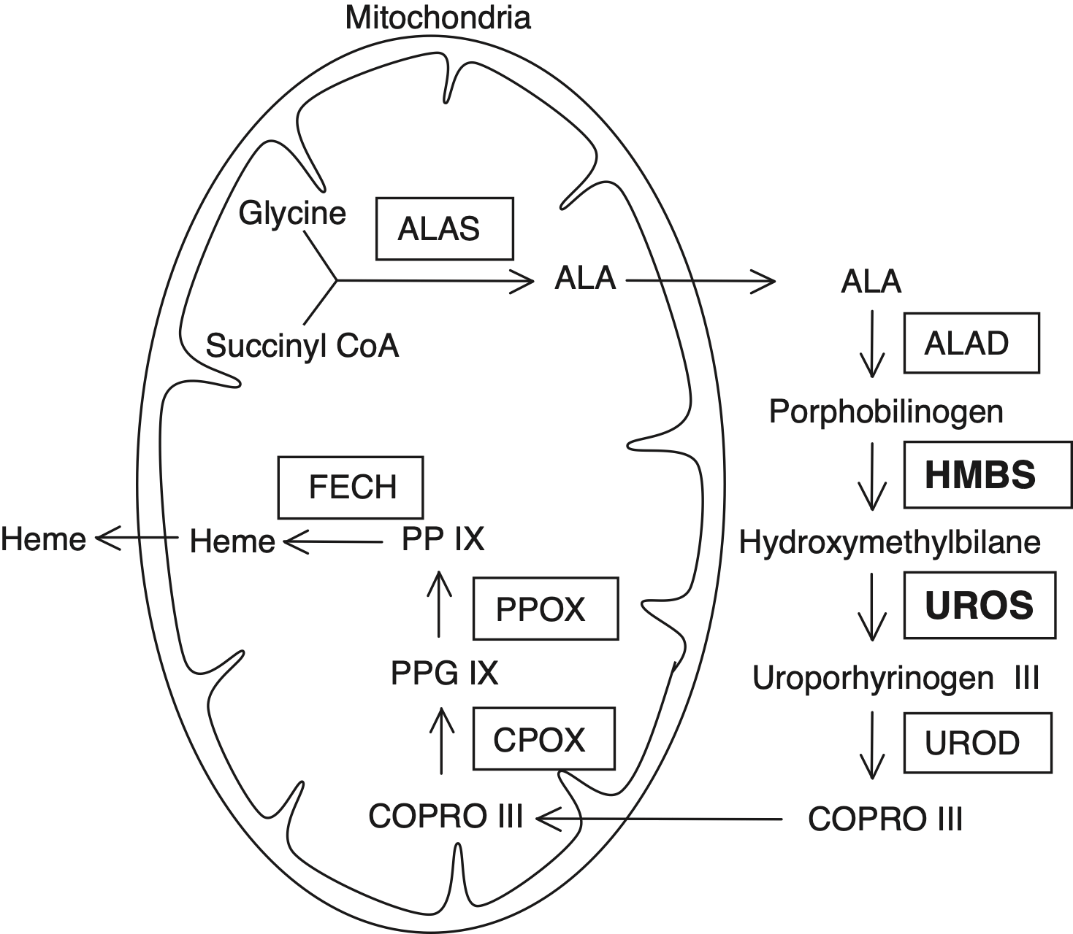

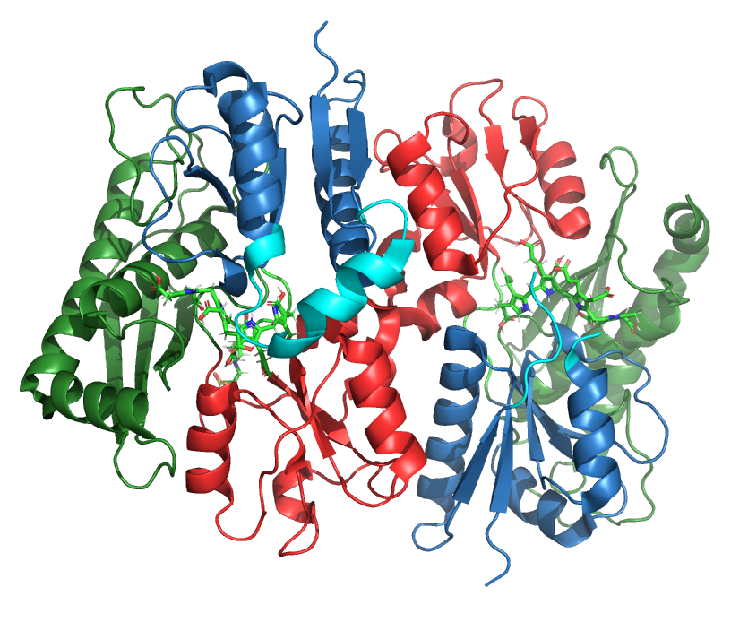
Acute Intermittent Porphyria and HMBS
CENTRAL NEUROPATHY
givosiran
RNAi Drug
PERIPHERAL NEUROPATHY
[
]
AUTONOMIC NEUROPATHY
[
]
OTHER MANIFESTATIONS
HMBS
CUTANEOUS SYMPTOMS
[
[
AIP Patient
Chen et al, 2016; Pluta et al, 2018

Slide 5
Acute Intermittent Porphyria and HMBS
dimerization
interface
surface residues
Domain1 (1-114, 219-236)
Active Loop (56-71)
Domain2 (120-212)
Domain3 (241-361)
CENTRAL NEUROPATHY
**Model based on 5m6r
givosiran
PERIPHERAL NEUROPATHY
RNAi Drug
AUTONOMIC NEUROPATHY
[
]
[
]
OTHER MANIFESTATIONS
HMBS
CUTANEOUS SYMPTOMS
[
[
AIP Patient
surface residues
C261
Chen et al, 2016; Pluta et al, 2018

Slide 6
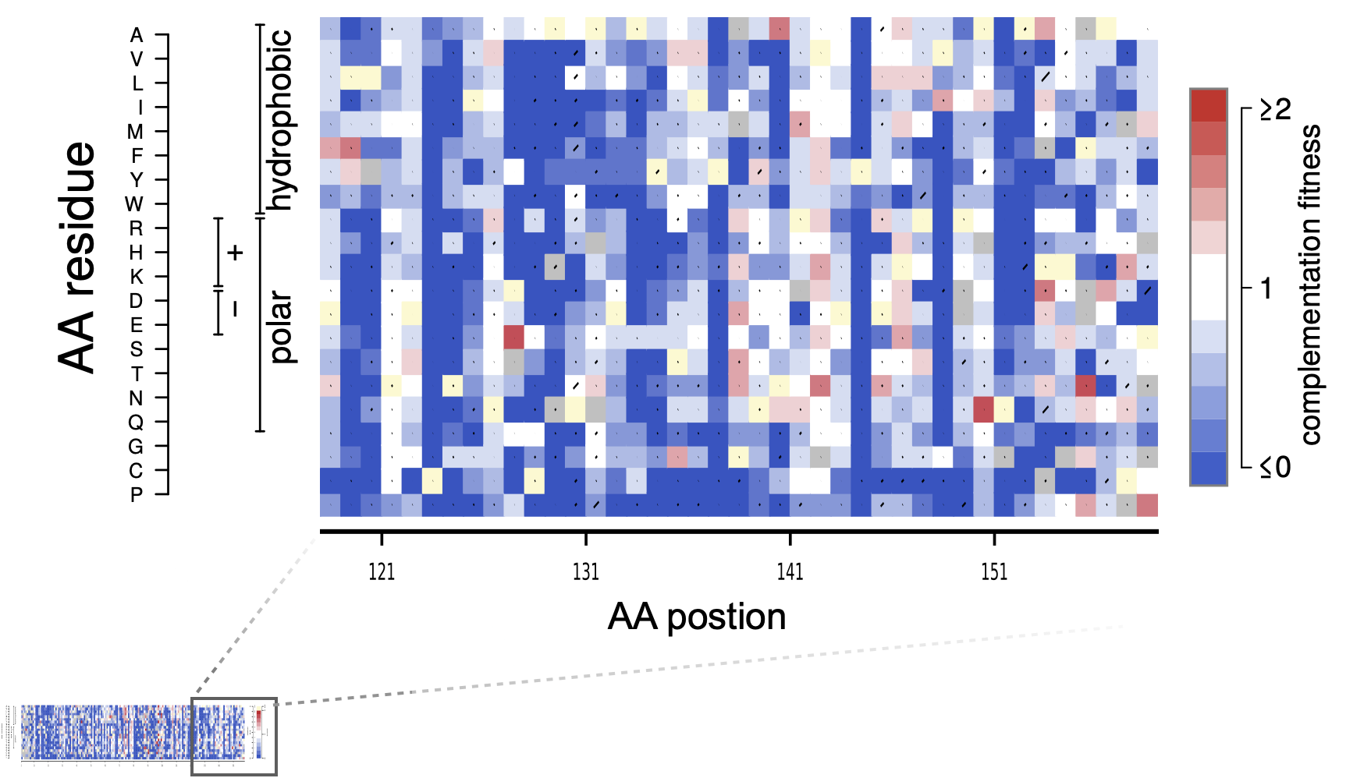
Multiplex assay of variant effect (MAVE) maps
Weile et al, 2017

Slide 7
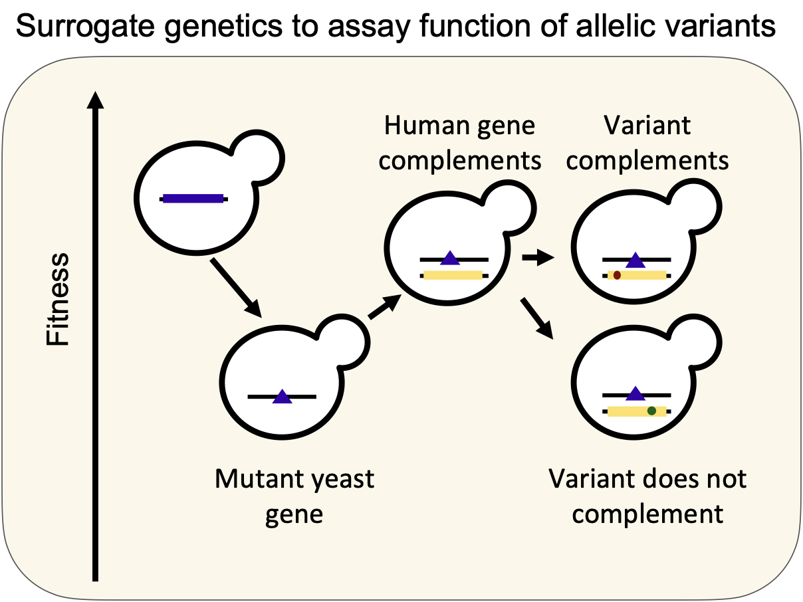
Surrogate genetics to assay function of allelic variants
Sun et al, 2016

Slide 8
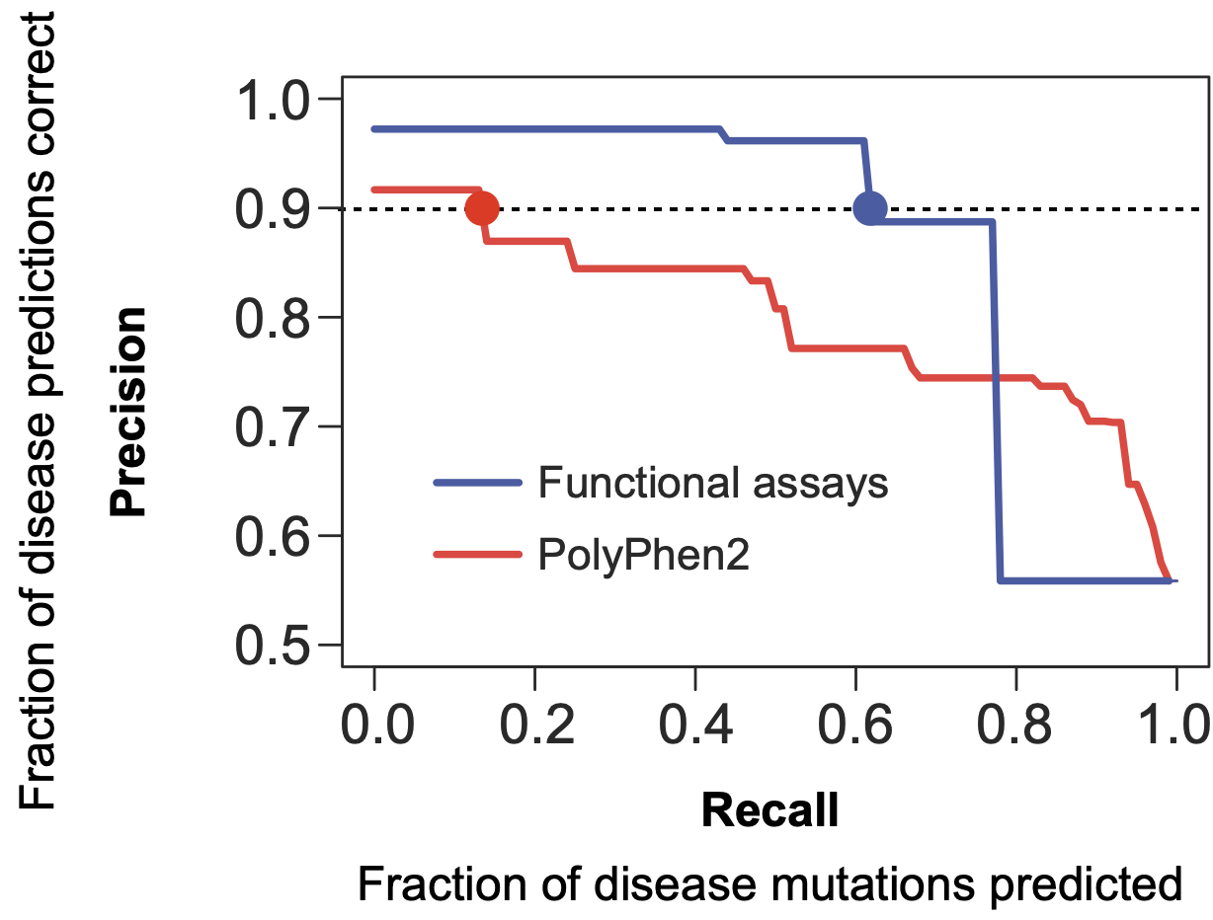
Yeast-based complementation assays accurately predict human variant pathogenicity
Sun et al, 2016

Slide 9
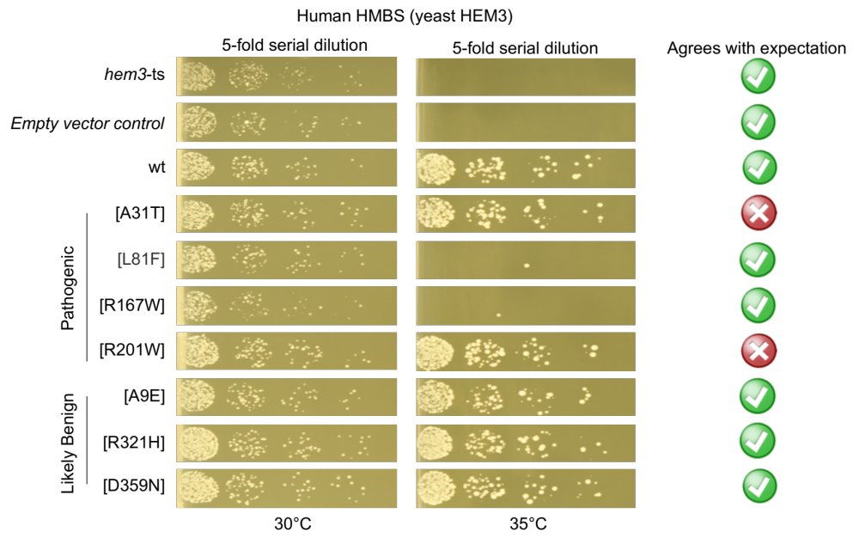
Small-scale validation of a yeast complementation assay for HMBS
Kachroo et al, 2016;
van Loggerenbereg et al, in-prep

Slide 10
Small-scale validation of a yeast complementation assay for HMBS
Kachroo et al, 2016;
van Loggerenbereg et al, in-prep

Slide 11
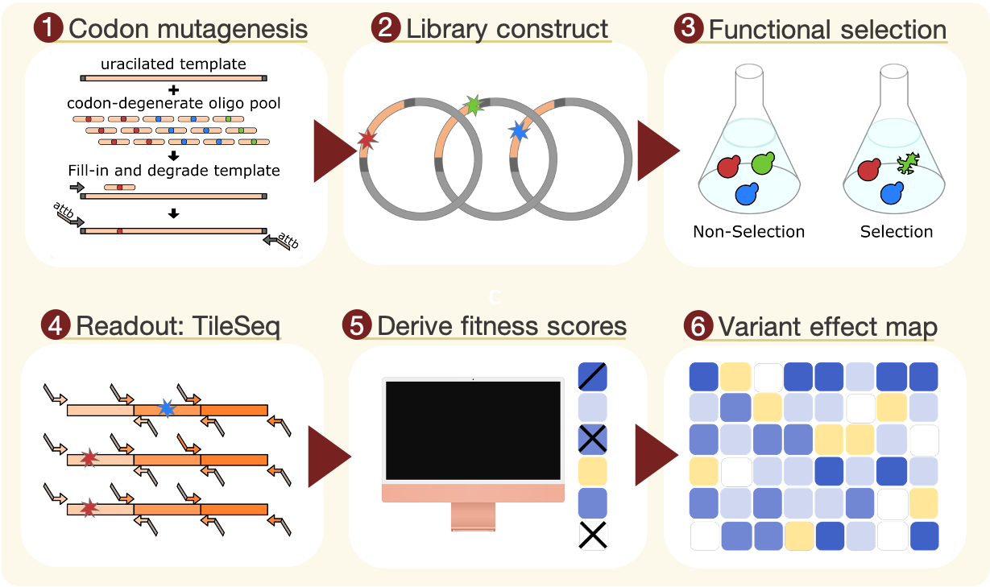
Experimental strategy for multiplexed assessment of variant effects
Weile et al, 2017

Slide 12
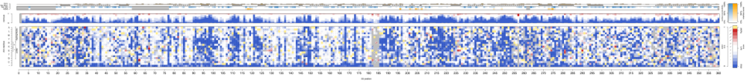
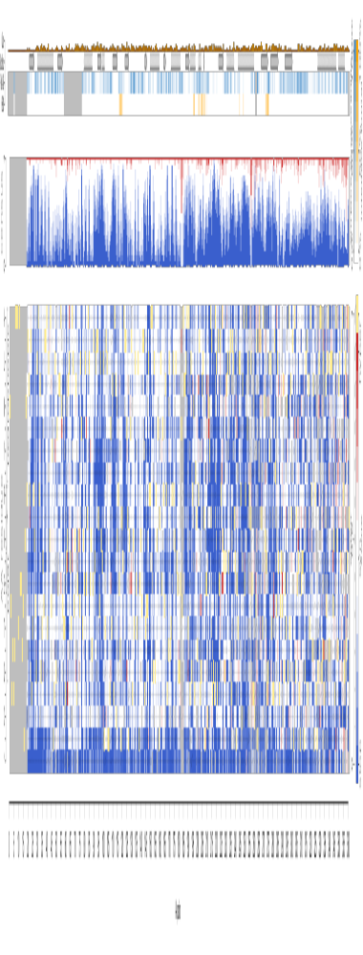
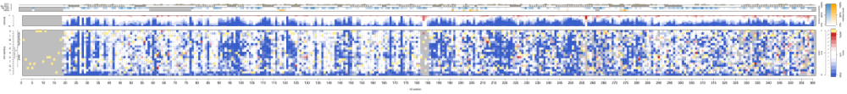

Functional maps of HMBS missense variation
Embargoed
ubiquitous
erythroid
Combined
AA position
van Loggerenbereg et al, in-prep

Slide 13
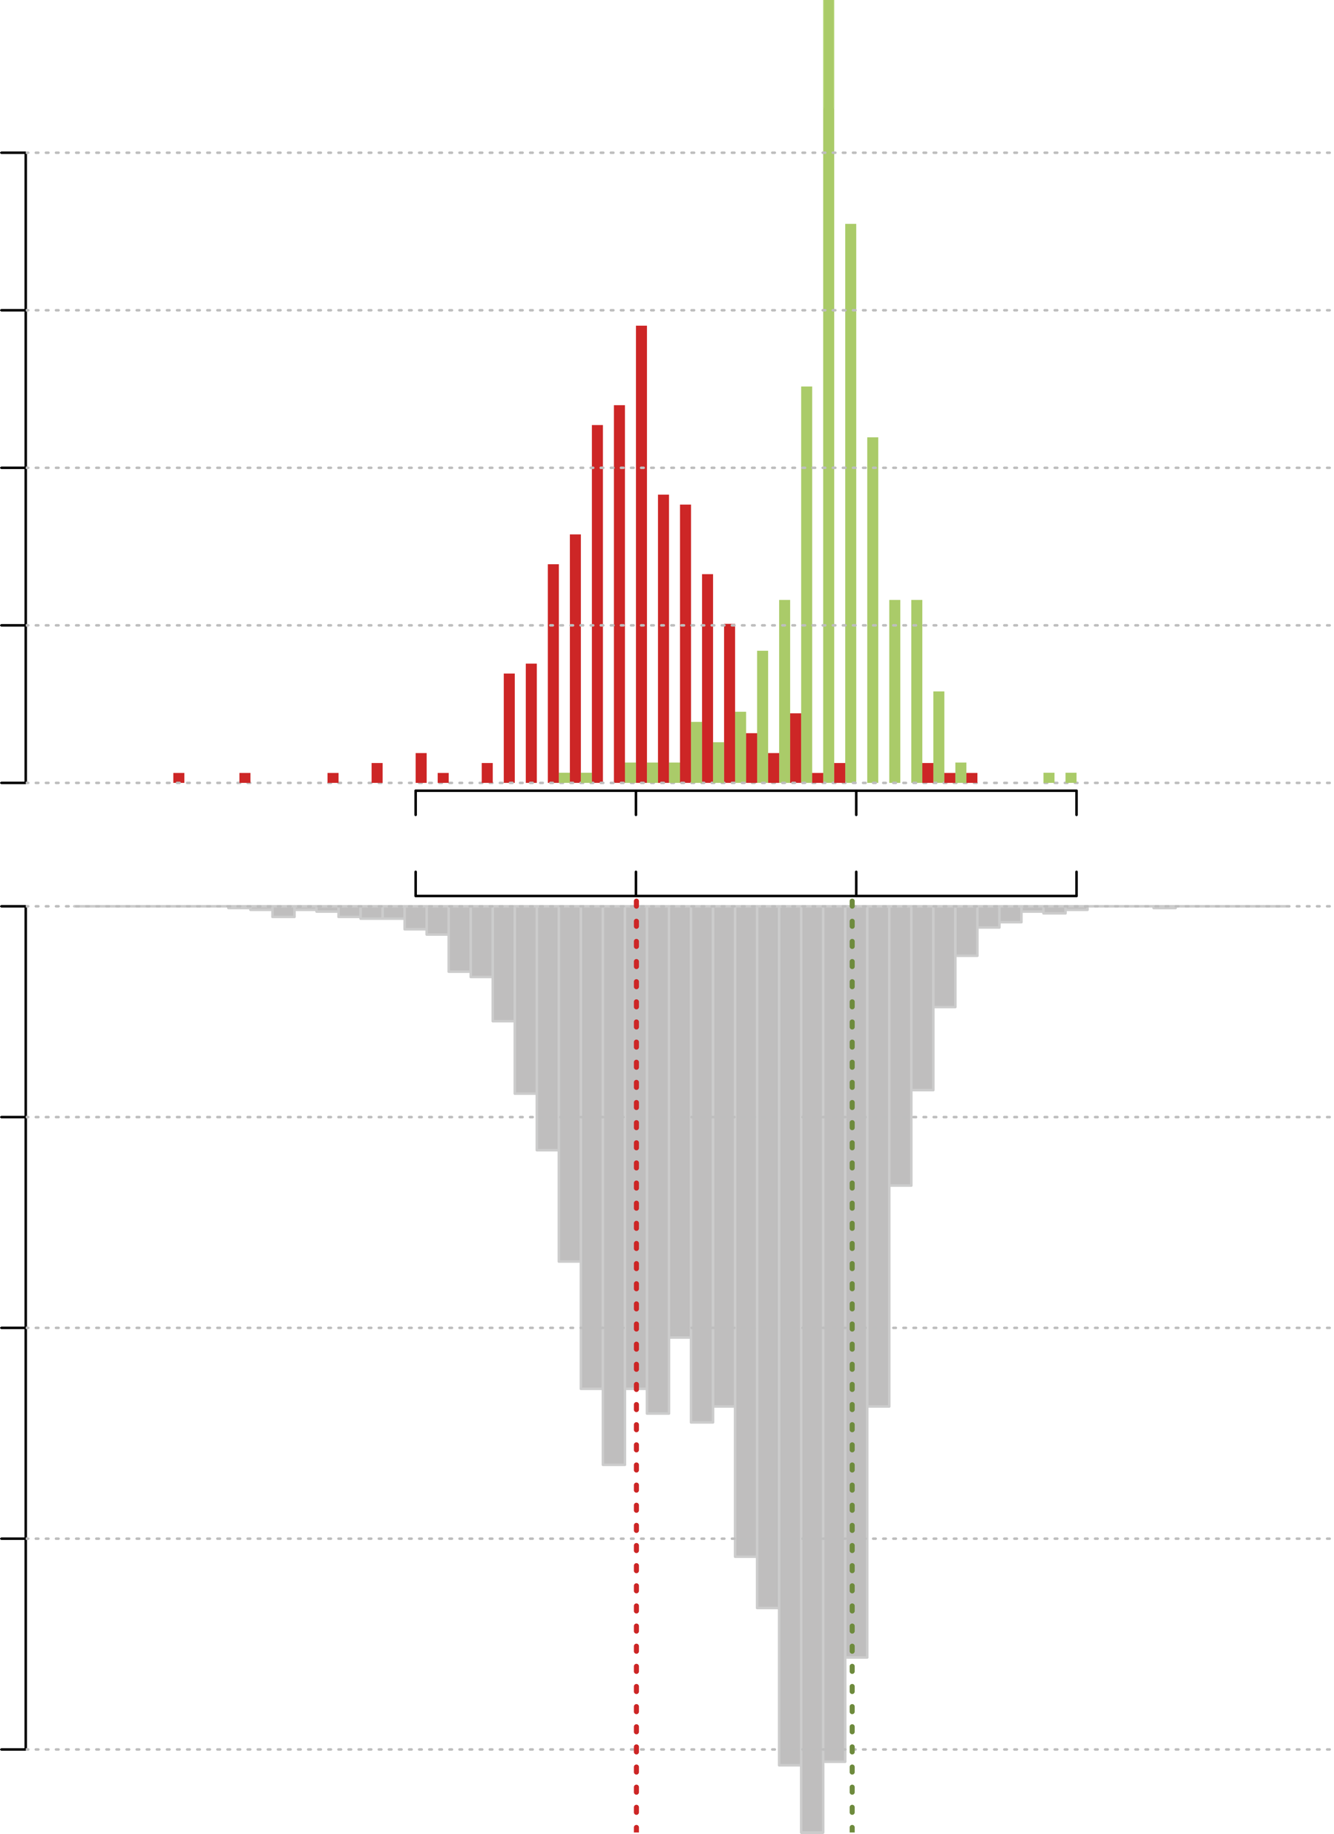
Distribution of fitness scores for combined HMBS map indicates good separation
2.0
nonsense
1.5
synonymous
missense
Density
1.0
0.5
0.0
-1
0
Score
1
2
0.0
0.2
Synonymous median
0.982
Density
0.4
0.6
Nonsense median
0.002
0.8
van Loggerenbereg et al, in-prep

Slide 14

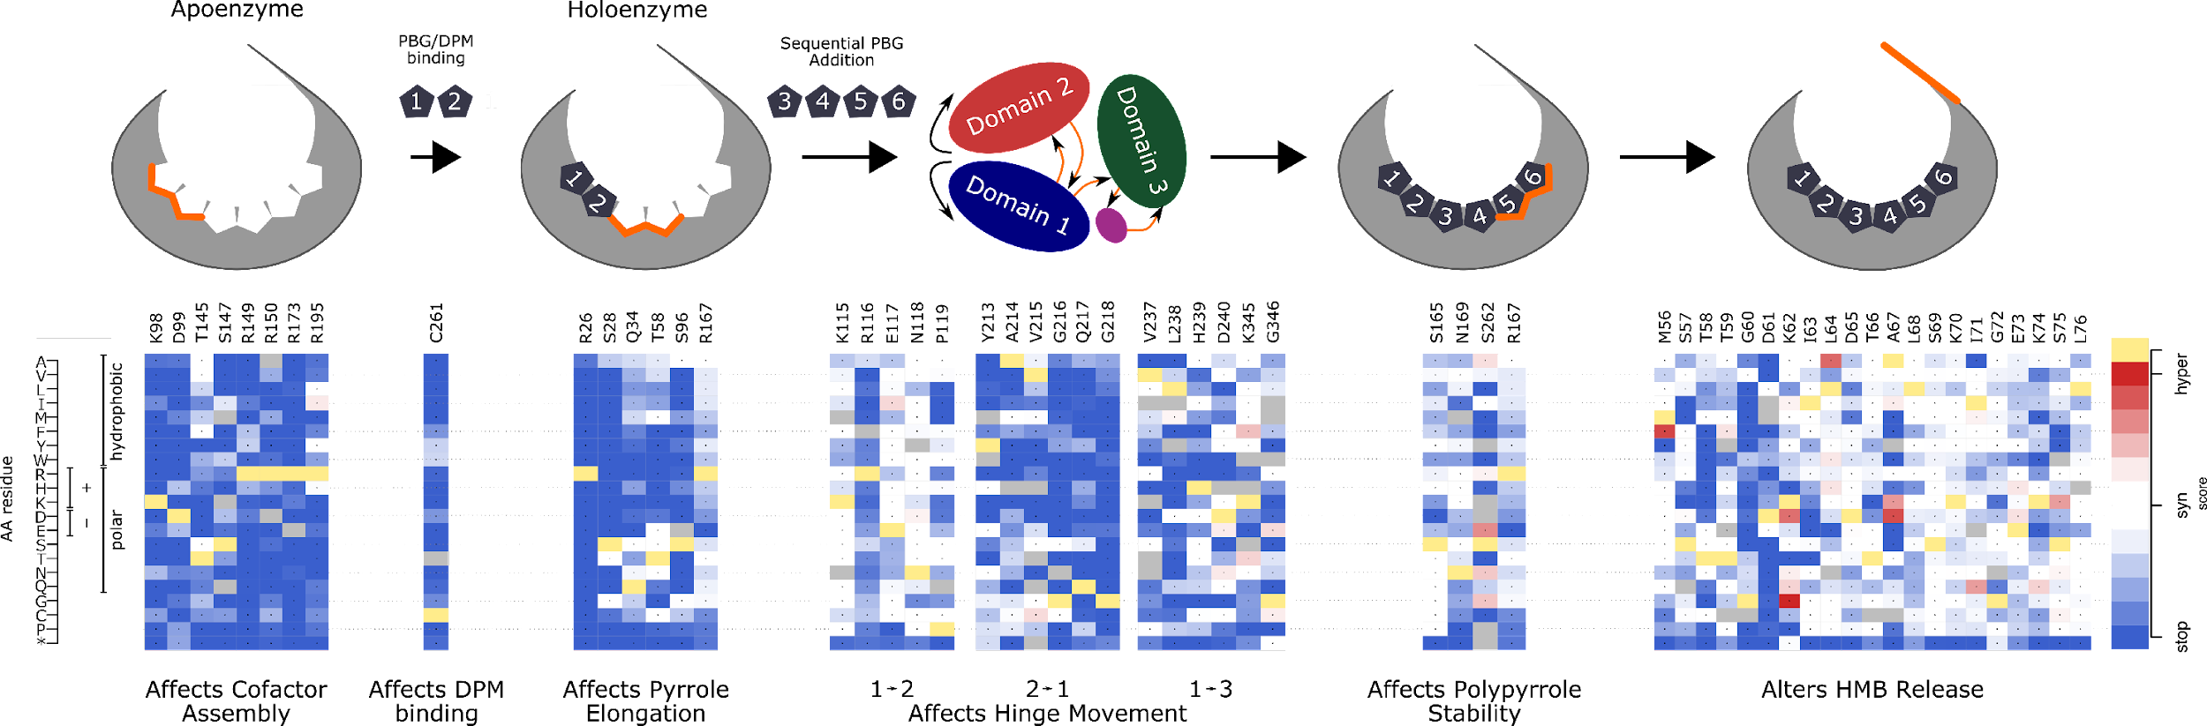
Identifying site-specific residues conditioning AIP
Bung et al, 2018;
van Loggerenbereg et al, in-prep

Slide 15
Identifying site-specific residues conditioning AIP
Bung et al, 2018;
van Loggerenbereg et al, in-prep

Slide 16
Identifying site-specific residues conditioning AIP
Bung et al, 2018;
van Loggerenbereg et al, in-prep

Slide 17
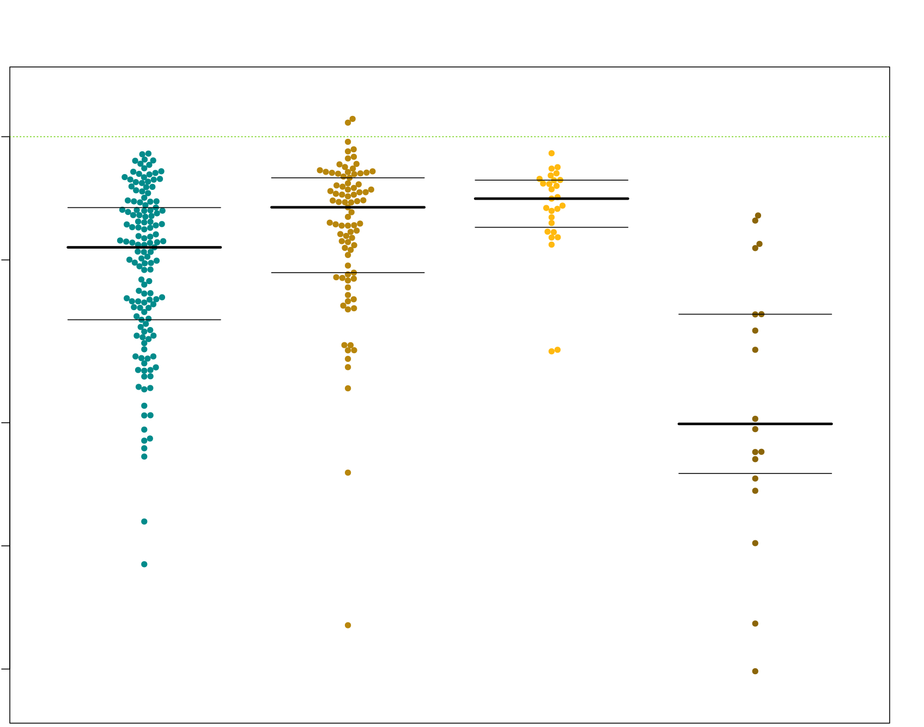
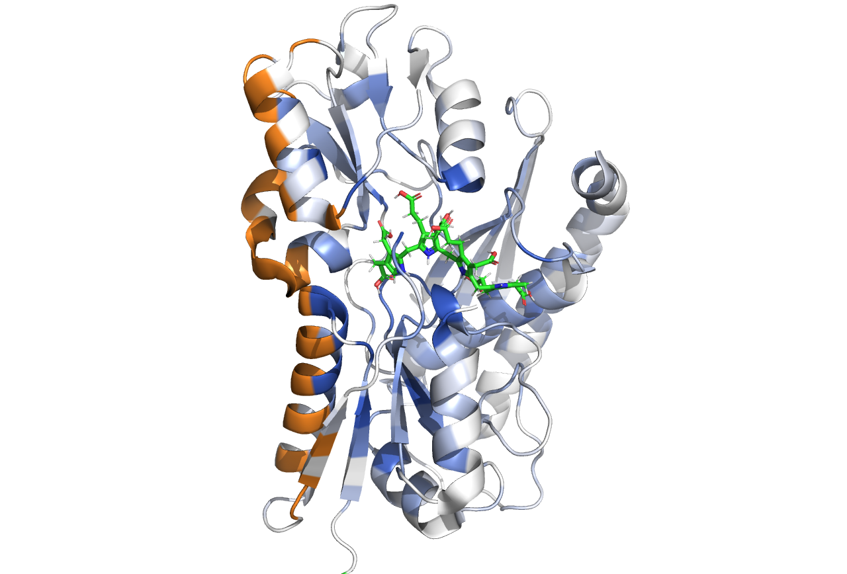
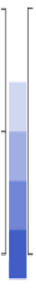
Resulting structure model revels impact of surface residues
Tetrapyrrole
p = 1.39 x 10⁻⁴
p = 2.87 x 10⁻²
1.00
Surface
0.50
Fitness Scores
0.20
1
syn.
interface
0.5
Median fitness
0.10
0
stop
0.05
Hinge
**Model based on 5m6r
Core
Surface
Interface
Active Site
Residue Positions
Chen et al, 2019;
van Loggerenbereg et al, in-prep

Slide 18
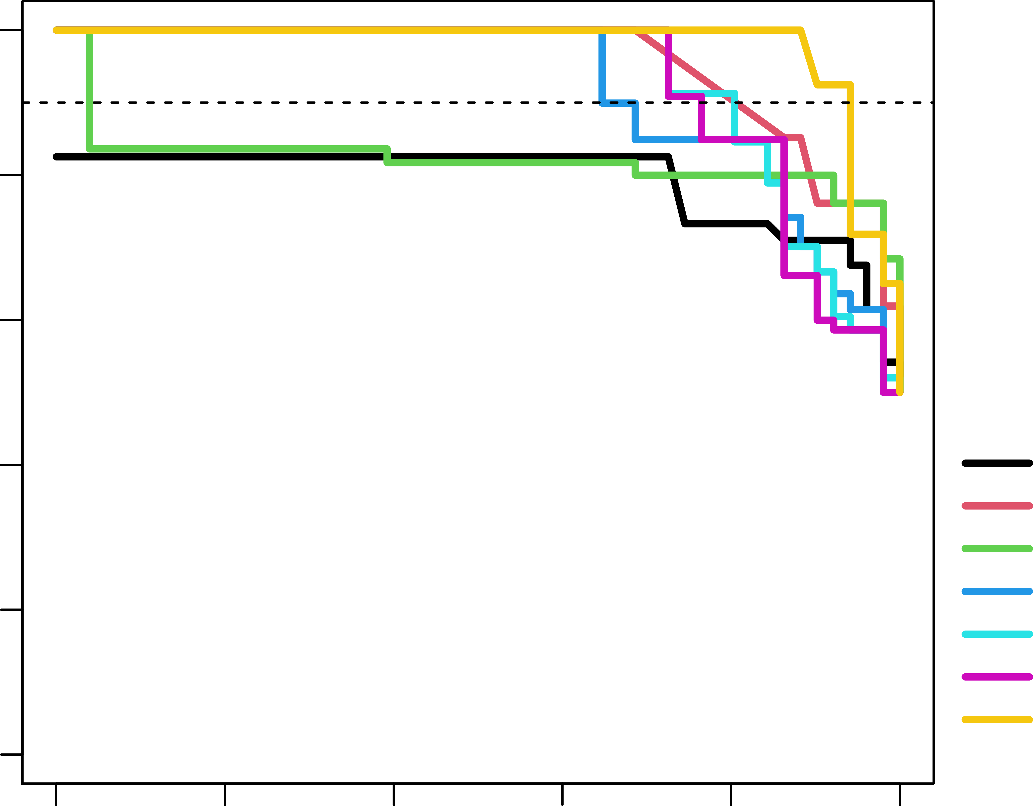
HMBS variant effect maps reliably discriminate pathogenic from benign alleles
Balanced Precision Recall Curves
100
 |  | AUBRC | R90P
 | PolyPhen2 | 0.79 | NA
 | SIFT | 0.95 | 0.69
 | PROVEAN | 0.82 | 0.04
 | eHMBS MAP | 0.92 | 0.65
 | uHMBS MAP | 0.93 | 0.80
 | Combined MAP | 0.93 | 0.76
 | VARITY R_LOO | 0.98 | 0.94
80
Fraction of disease variants
correctly predicted
Precision (%)
60
40
20
**59 annotated variants from clinical database Clinvar and EPNET, and 5 proxy benign variants from gnomad,
0
0
20
40
60
80
100
Recall (%)
Fraction of disease mutations predicted
van Loggerenbereg et al, in-prep

Slide 19
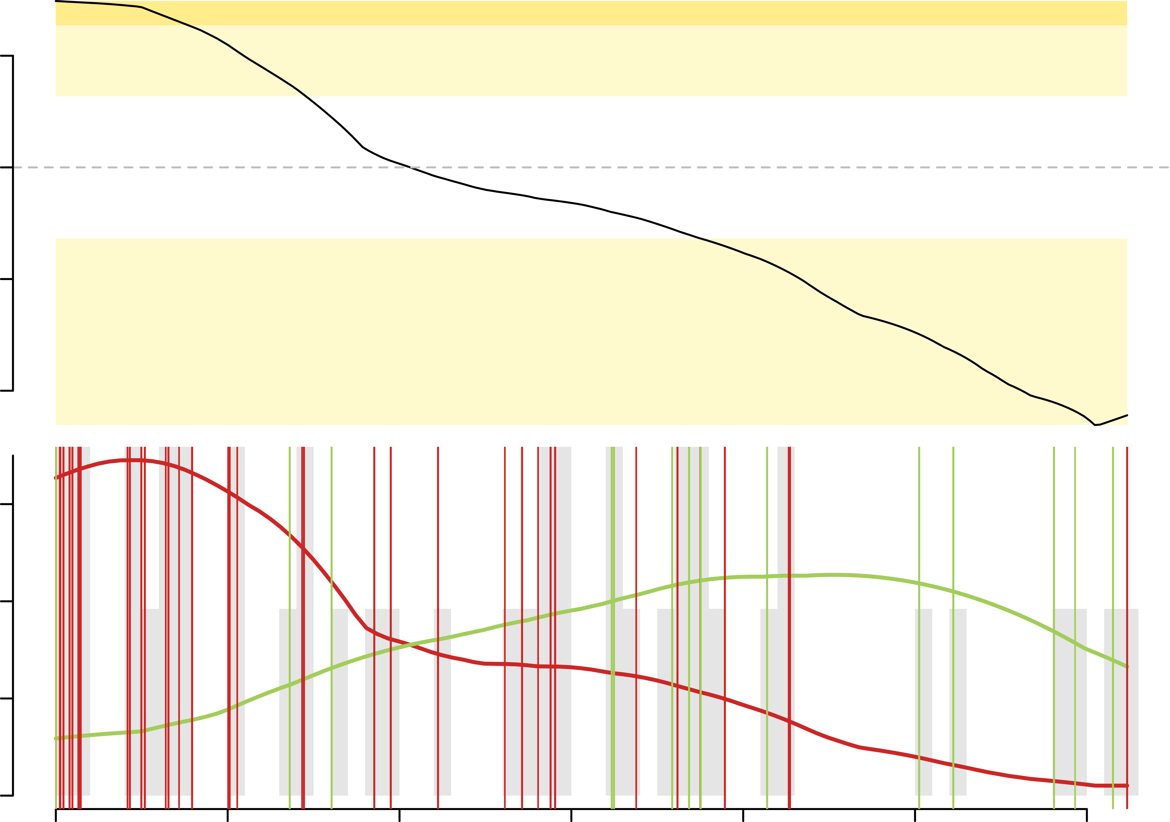
Scores restated as log-likelihood ratios of pathogenicity
provide evidence for clinical variant interpretation
Patho. moderate
1
Patho. support
0
LLR
-0.5
Benign support
-1.0
1.2
0.8
Density
0.4
0
0
0.2
0.4
0.6
0.8
1.0
1.2
scores
van Loggerenbereg et al, in-prep

Slide 20
Summary
HMBS variant effect maps reliably discriminate pathogenic from benign alleles
Shapes of the LLRp functions indicate scores more useful for predicting benignity
Some scores (e.g. dimerization interface) are surprising given current understanding
Many scores support the molecular basis for reported AIP-causing missense variants
MD simulations support hypotheses about variant effects on protein-substrate interactions

Slide 21



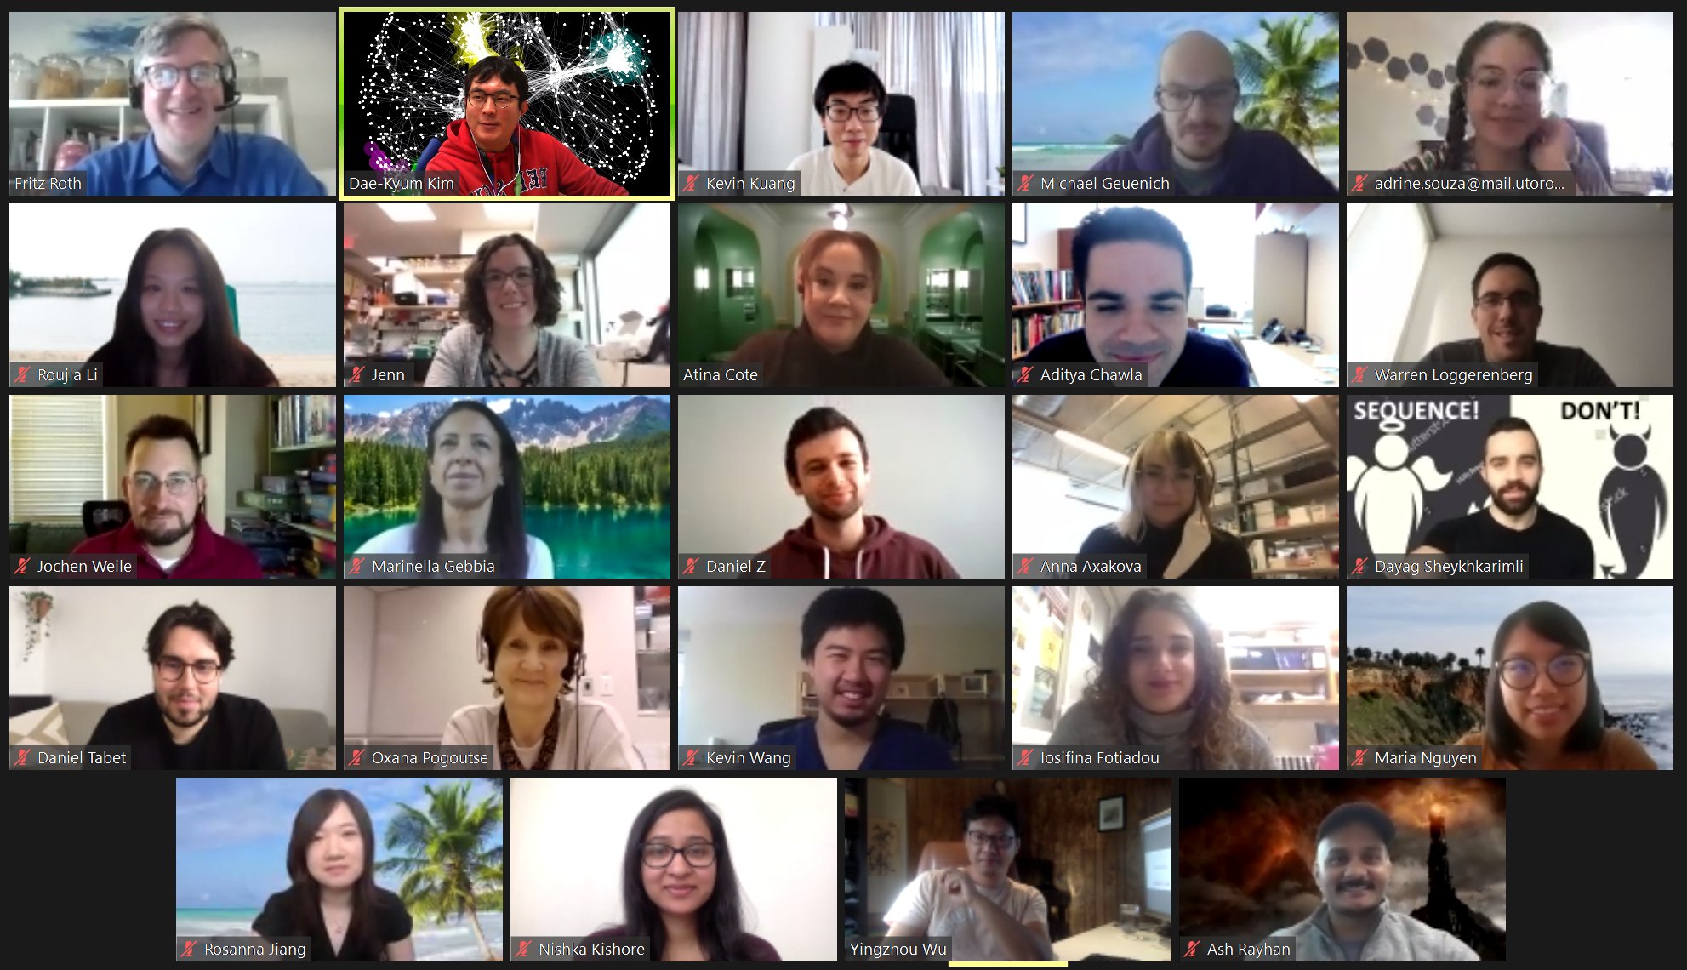



Acknowledgements
PI
COLLABORATORS
Dr. F Roth
Dr. R Desnick
ROTH LAB
EPNET
Dr. J Weile
Dr. M Garton
Dr. M Gebbia
Dr. S Sowlati-Hashjin
N Kishore
A Chawla
Created for CAGI 6
Genomeinterpretation.org

Slide 22
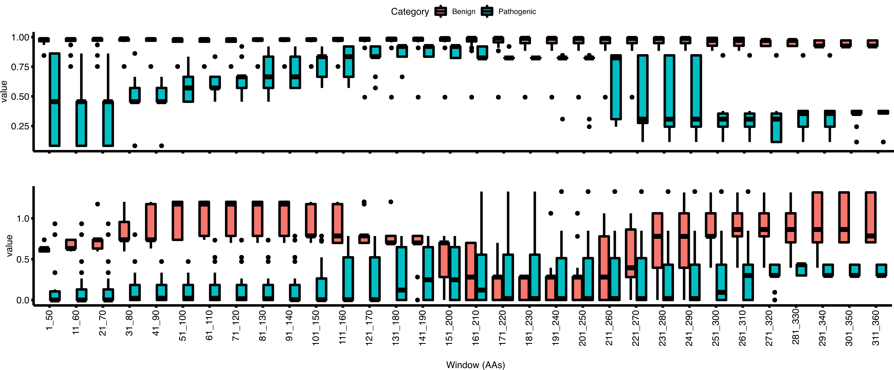
Moving window analysis of reference set functional scores
VARITY
MAP
van Loggerenbereg et al, in-prep

