Slide 1


Slide 2
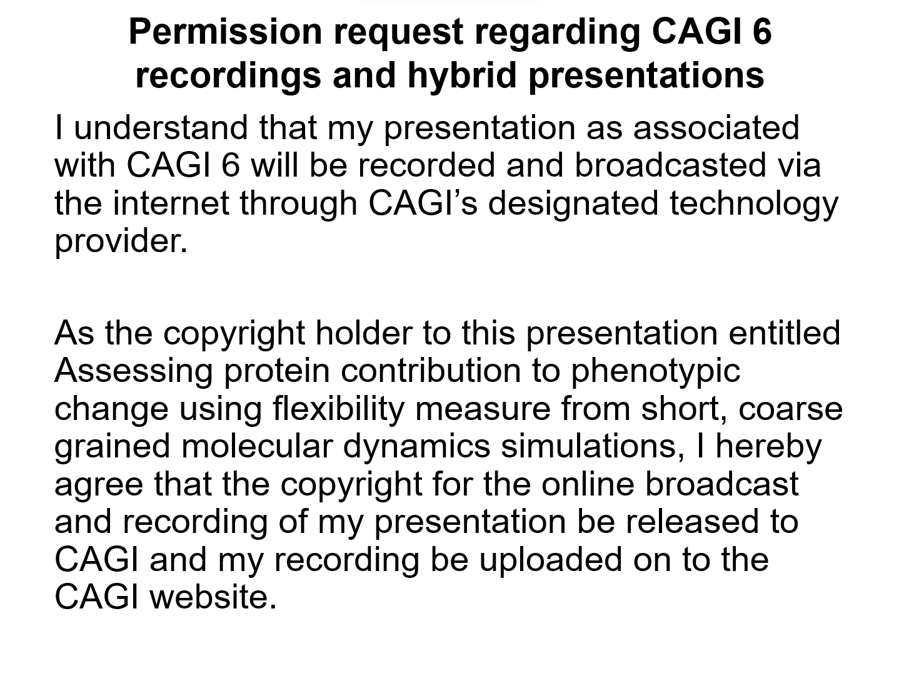

Slide 3
Assessing protein contribution to phenotypic change using flexibility measure from short, coarse grained molecular dynamics simulations
Muttaqi Ahmad Alladin, Debnath Pal

Slide 4
Introduction
Big data about protein variants is now available
Mapping variants to phenotype is a steep challenge.
While various methods exist, interpretability remains a challenge.
We use short coarse-grained Molecular Dynamics (MD) simulations (<10ns) to make a functional mapping of variants.
MD simulation is a computer simulation method for analyzing the physical movements of atoms and molecules.

Slide 5
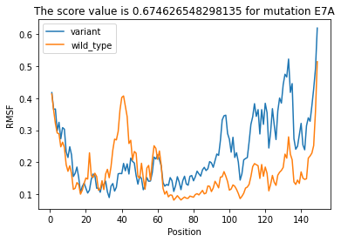
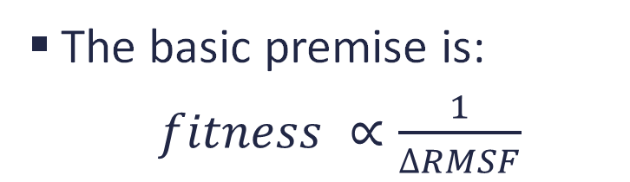



Methodology
The basic premise is:
$fitness ∝\frac{1}{∆RMSF}$
More weightage locally
  ∆𝑅𝑀𝑆𝐹 of sites spatially closer to the site of mutation are more important
  ∆𝑅𝑀𝑆𝐹 of 1st,2nd, 3rd,4th & 5th contacts
Mutation Site
residues spatially in contact with the mutation site
1st contact
residues spatially in contact with 1st contacts
2nd contact
residues spatially in contact with 2nd contacts
3rd contact
$$∆RMSF$$
4th contact
residues spatially in contact with 3rd contacts
residues spatially in contact with 4th contacts
5th contact

Slide 6
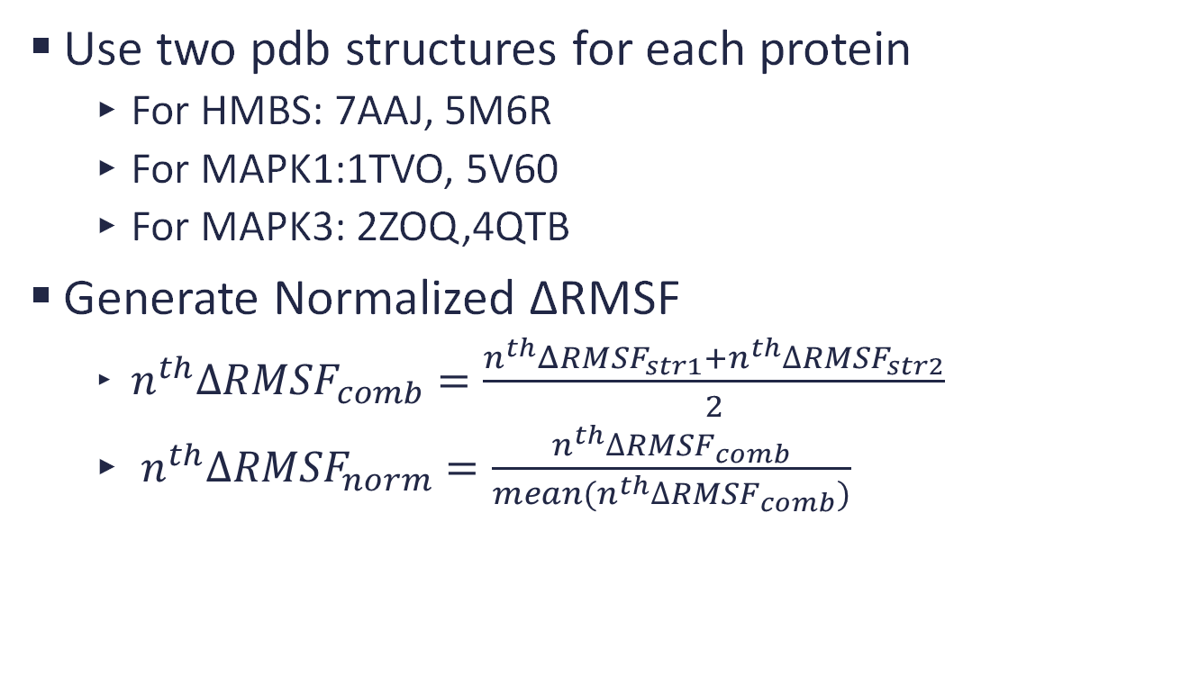
Methodology
Use two pdb structures for each protein
  For HMBS: 7AAJ, 5M6R
  For MAPK1:1TVO, 5V60
  For MAPK3: 2ZOQ,4QTB
Generate Normalized ΔRMSF
  $n^{th}∆RMSF_{comb}=\frac{n^{th}ΔRMSF_{str1}+n^{th}∆RMSF_{str2}}{2}$
  $n^{th}∆RMSF_{norm}=\frac{n^{th}∆RMSF_{comb}}{mean(n^{th}∆RMSF_{comb})}$

Slide 7
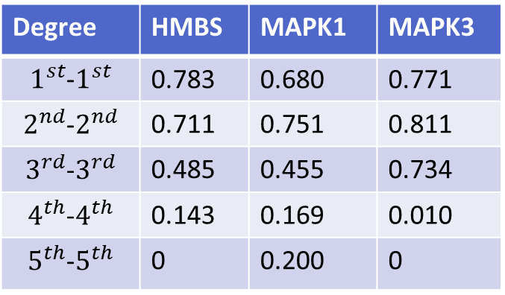
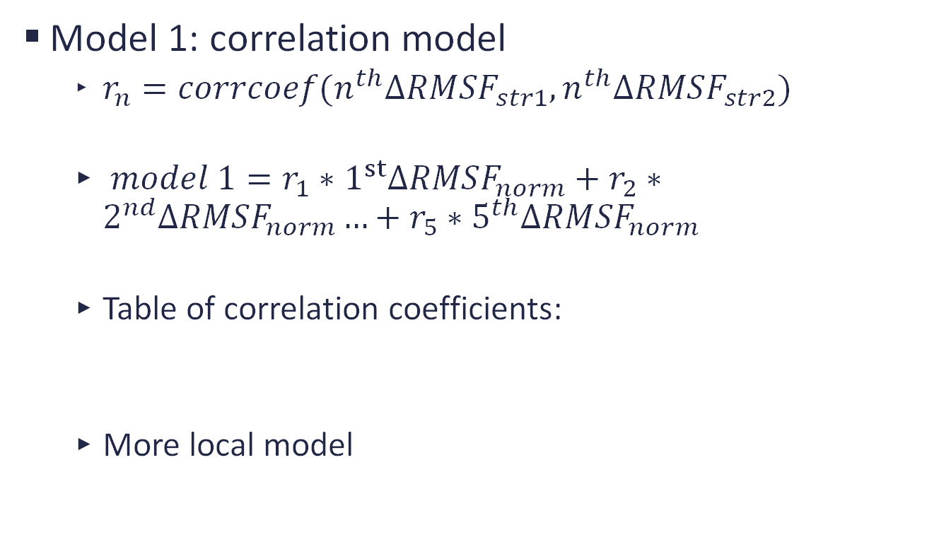
Model 1
Model 1: correlation model
  $r_{n}=corrcoef(n^{th}∆RMSF_{str1},n^{th}∆RMSF_{str2})$
  $model 1=r_{1}∗1^{st}∆RMSF_{norm}+r_{2}∗2^{nd}∆RMSF_{norm}…+r_{5}∗5^{th}∆RMSF_{norm}$
  Table of correlation coefficients:
  More local model
Degree | HMBS | MAPK1 | MAPK3
$1^{st}$-$1^{st}$ | 0.783 | 0.680 | 0.771
$2^{nd}$-$2^{nd}$ | 0.711 | 0.751 | 0.811
$3^{rd}$-$3^{rd}$ | 0.485 | 0.455 | 0.734
$4^{th}$-$4^{th}$ | 0.143 | 0.169 | 0.010
$5^{th}$-$5^{th}$ | 0 | 0.200 | 0

Slide 8
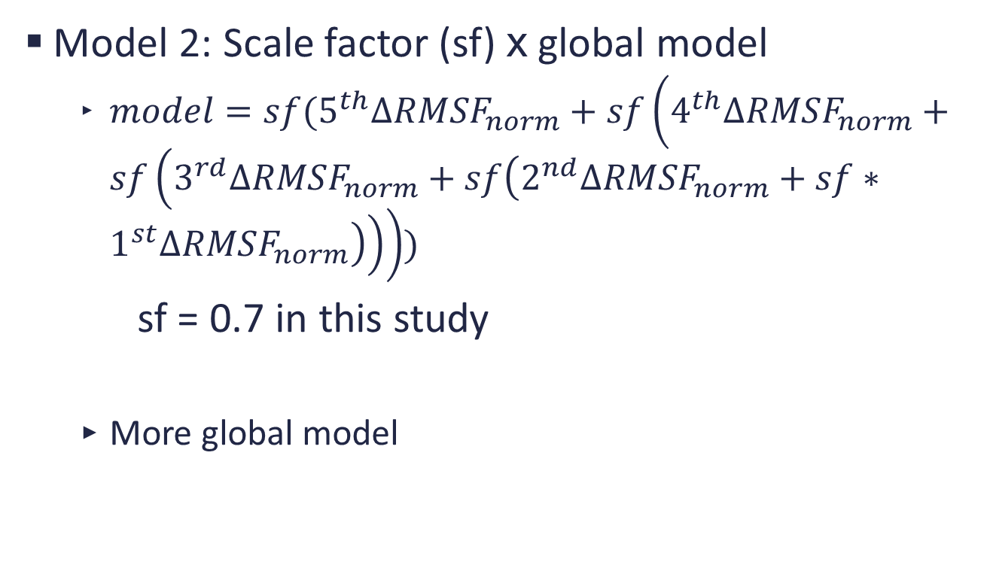
Model 2
Model 2: Scale factor (sf) x global model
  $model=sf(5^{th}∆RMSF_{norm}+sf\left(4^{th}∆RMSF_{norm}+sf\left(3^{rd}∆RMSF_{norm}+sf\left(2^{nd}∆RMSF_{norm}+sf∗1^{st}∆RMSF_{norm}\right)\right)\right))$
sf = 0.7 in this study
  More global model

Slide 9
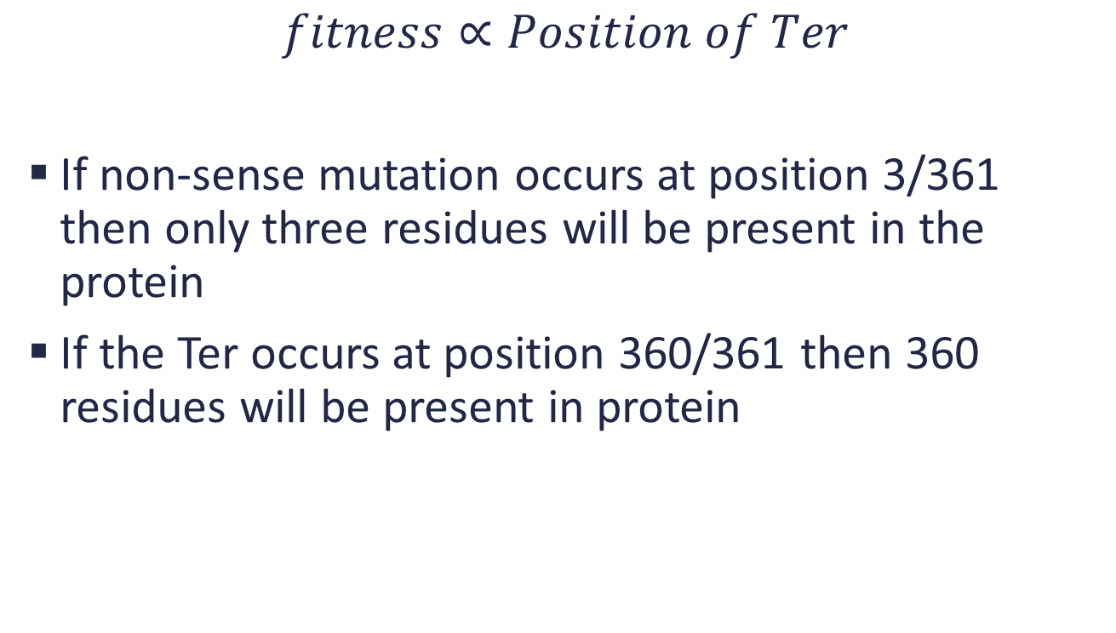
Non-sense mutation
$$fitness∝Position of Ter$$
If non-sense mutation occurs at position 3/361 then only three residues will be present in the protein
If the Ter occurs at position 360/361 then 360 residues will be present in protein

Slide 10
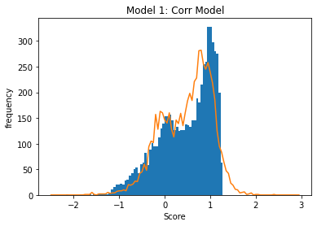
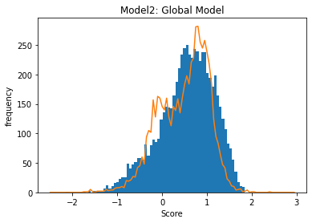
Results
Comparison of predicted and experimental score distributions:
Results of Similar Study:
  SUMO1 : 0.7 corr for about 70% data
  MTHFR: 0.6 corr for about 66% data
  Calmodulin: 0.6 corr about for 66% data
  UBE2I: 0.6 corr for 60% about data

Slide 11
Thank You

