Slide 1

CAGI slide pack guidelines
I agree to my slides being used according to the following terms:
_______Giuditta Dal Cortivo, Daniele Dell’Orco_______
Authors: please include THIS slide at the beginning of your presentation to indicate that you agree with reuse of your slides in CAGI presentations, according to the terms below, and digitally sign by writing your name above.
To disseminate the CAGI results, I encourage all CAGI participants to remix these CAGI slides for inclusion in their oral and poster presentations
CAGI participants may use or publish any content of these slides only in compliance with the CAGI Data Use Agreement
CAGI participants may not cite or publish any content of these slides except with the written permission of the originating author or in the primary CAGI publications
CAGI participants must acknowledge the original authors of these slides and CAGI 6. Include the acknowledgement banner across the bottom
CAGI participants must include the CAGI credits slide in their presentations
Slides with a red slash (no remix) may not be included in a presentation unless all attendees are registered CAGI participants who signed the data use agreement
Slides with a red X over the entire slide may not be used in any circumstances
Slides with a blue slash (embargoed) may not be used unless the embargo is explicitly lifted
Slides without slash or X may be tweeted unless flagged with the “No tweet” icon.
CAGI participants using these slides must explain the “No tweet” icon, which means that the slide content should not be disseminated outside the presenting conference hall. If the presentation venue permits pervasive tweeting, you may not include these slides in your talk
Note for slide authors: we expect all CAGI participants to abide by these restrictions, and will make best effort to ensure they are followed. However, but bear in mind that we have limited means of enforcing them, and therefore the restrictions cannot be guaranteed.

Slide 2
Permission request regarding CAGI 6 recordings and hybrid presentations
I understand that my presentation as associated with CAGI 6 will be recorded and broadcasted via the internet through CAGI’s designated technology provider.
As the copyright holder to this presentation entitled [Missense challenge: Calmodulin], I hereby agree that the copyright for the online broadcast and recording of my presentation be released to CAGI and my recording be uploaded on to the CAGI website.

Slide 3
Sample slides follow

Slide 4
University of Verona
Dep. Neuroscience Biomedicine and Movement Sciences
Missense challenge: Calmodulin
Created for CAGI 6
genomeinterpretation.org
Dal Cortivo G.

Slide 5
Missense challenge: Calmodulin
Calmodulin (CaM)
Ubiquitous Ca²⁺ sensor protein
Ca²⁺ induces conformation changes that trigger the interaction with many molecular partners
The redundant expression in human (CALM1, CALM2, CALM3) highlights its pivotal role
From 2012 seventeen missense point mutations on CaM-encoding genes have been associated with cardiac diseases.
Adapted from Dal Cortivo G., et al. CMLS (2022)
Long QT Syndrome (LQTS) and Cathecolaminergic Polymorphic Ventricular Tachicardia (CPVT)
Created for CAGI 6
genomeinterpretation.org
Dal Cortivo G.

Slide 6
Missense challenge: Calmodulin
CaM mutations associated with cardiac arrhythmias
Mutation | Gene | Phenotype | Mutation | Gene | Phenotype
N53I | CALM1 | CPVT | D129G | CALM1 CALM2 CALM3 | LQTS
F89L | CALM1 | LQTS | D129V | CALM2 | LQTS
D95H | CALM3 | LQTS | D131E | CALM2 | CPVT+LQTS
D95V | CALM2 | LQTS | D131H | CALM2 | LQTS
N97I | CALM1 | LQTS | D131V | CALM1 | LQTS
N97S | CALM1 CALM2 | CPVT CPVT+LQTS | D133H | CALM2 | LQTS
A102V | CALM3 | LQTS | Q135P | CALM2 | CPVT+LQTS
E104A | CALM1 | CPVT | E141G | CALM1 | LQTS
Created for CAGI 6
genomeinterpretation.org
Dal Cortivo G.

Slide 7
Missense challenge: Calmodulin
The Challenge
Prediction of the melting temperature (T_{m}) and percentage of unfolding (%unfold) for most disease-associated CaM variants
Created for CAGI 6
genomeinterpretation.org
Dal Cortivo G.

Slide 8
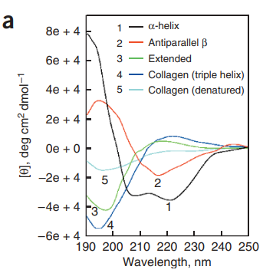
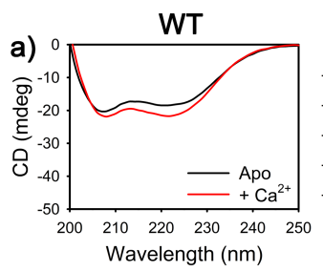
Missense challenge: Calmodulin
As “experimental data” provider
Adapted from Dal Cortivo G., et al. CMLS (2022)
Dal Cortivo G., et al. CMLS (2022)
Greenfield J. N., Nat. Protocol (2007)
Created for CAGI 6
genomeinterpretation.org
Dal Cortivo G.

Slide 9
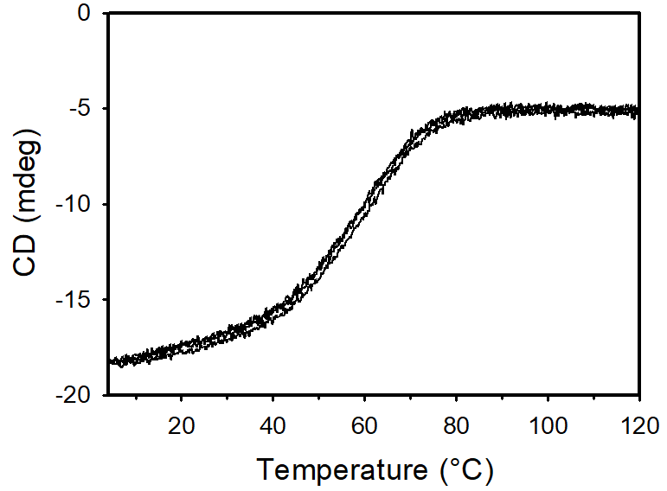
Missense challenge: Calmodulin
No Tweet
As “experimental data” provider
DATA COLLECTION
For each mutant:
Thermal denaturation profiles were collected in two conditions:
  Apo (1 mM EGTA)
  Ca²⁺-bound (1 mM Ca²⁺)
  λ = 222 nm
  Temperature range: 4-120°C
  Scanning rate: 1.5°C/min
T_{m}
Θ (mdeg)
T_{m} = inflection point
Created for CAGI 6
genomeinterpretation.org
Dal Cortivo G.

Slide 10

Missense challenge: Calmodulin
No Tweet
DATA COLLECTION
For each mutant:
Thermal denaturation profiles were collected in two conditions:
  Apo (1 mM EGTA)
  Ca²⁺-bound (1 mM Ca²⁺)
  λ = 222 nm
  Temperature range: 4-120°C
  Scanning rate: 1.5°C/min
T_{m}
Θ (mdeg)
%unfold
T_{m} = inflection point
$\%_{unfolding}=\left(\frac{θ_{222}^{120°C}−θ_{222}^{4°C}}{θ_{222}^{4°C}}\right)$*100
Created for CAGI 6
genomeinterpretation.org
Dal Cortivo G.

Slide 11
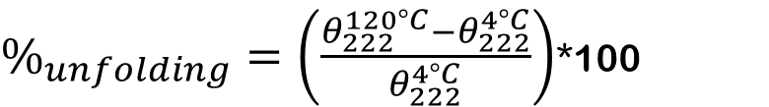
Missense challenge: Calmodulin
No Tweet
DATA ANALYSIS
Percentage of unfolding (% unfold)
Melting temperature (T_{m})
$\%_{unfolding}=\left(\frac{θ_{222}^{120°C}−θ_{222}^{4°C}}{θ_{222}^{4°C}}\right)$*100
Thermodynamic function
Numerical fitting (Polynomial)
Created for CAGI 6
genomeinterpretation.org
Dal Cortivo G.

Slide 12
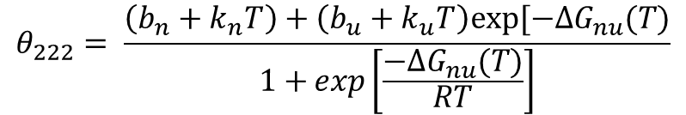
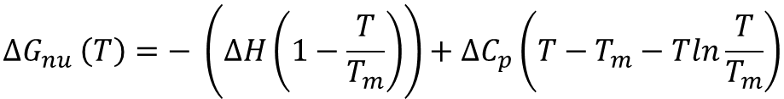
Missense challenge: Calmodulin
DATA ANALYSIS
Thermodynamic function
One transition, two states: N (native) and U (unfolded)
$$θ_{222}= \frac{\left(b_{n}+k_{n}T\right)+\left(b_{u}+k_{u}T\right)exp⁡[{−∆G}_{nu}(T)}{1+{\exp\left[\frac{{−∆G}_{nu}(T)}{RT}\right]}}$$
$${∆G}_{nu} \left(T\right)=− \left(∆H\left(1−\frac{T}{T_{m}}\right)\right)+∆C_{p}\left(T−T_{m}−Tln\frac{T}{T_{m}}\right)$$
Created for CAGI 6
genomeinterpretation.org
Dal Cortivo G.

Slide 13
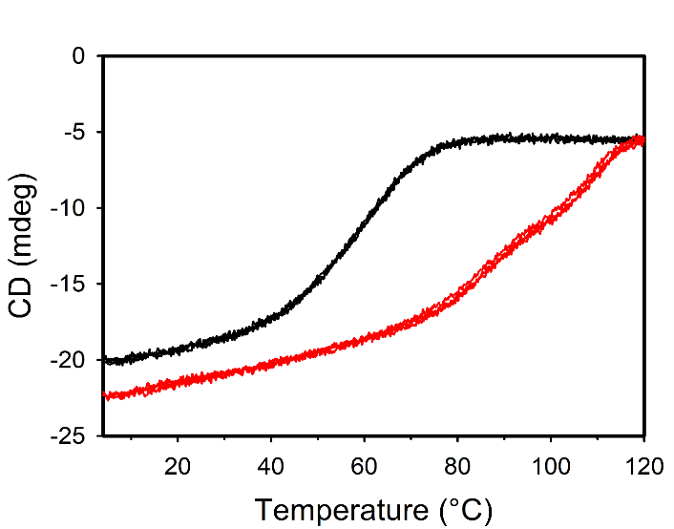
Missense challenge: Calmodulin
Embargoed
DATA ANALYSIS
Thermodynamic function
PRO
CONS
Thermodynamic parameters (ΔH, ΔG, -TΔS)
x The U state is not sampled
x Suitable only for apo forms
x For the Ca²⁺-bound curves the border between transitions is arbitrary
Apo
Ca²⁺
Created for CAGI 6
genomeinterpretation.org
Dal Cortivo G.

Slide 14
Missense challenge: Calmodulin
DATA ANALYSIS
Numerical fitting (Polynomial)
More than one transition is possibily detected, since the second derivative is considered.
Created for CAGI 6
genomeinterpretation.org
Dal Cortivo G.

Slide 15
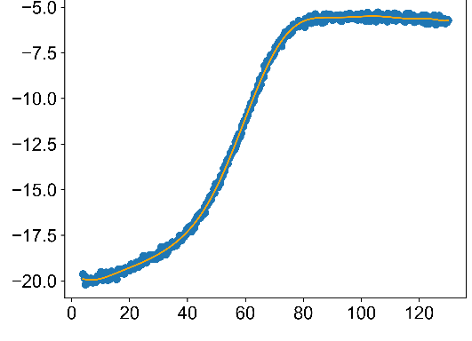
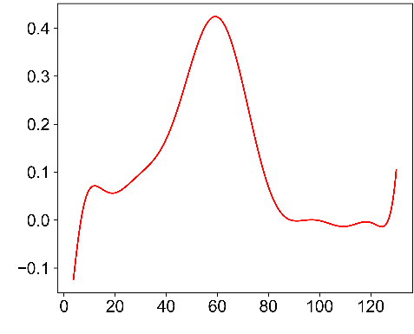
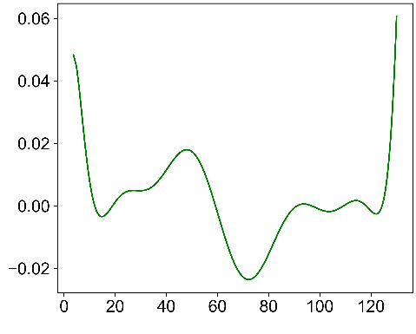
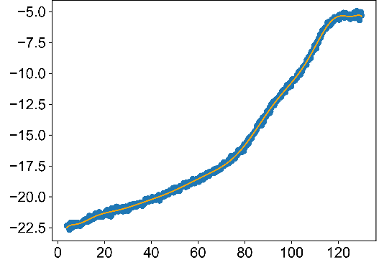
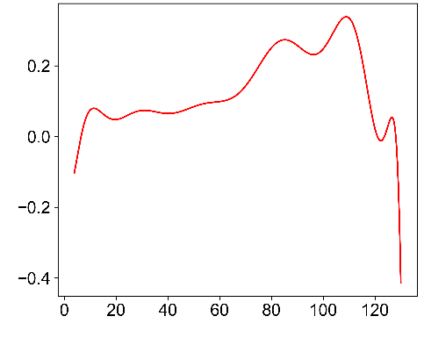
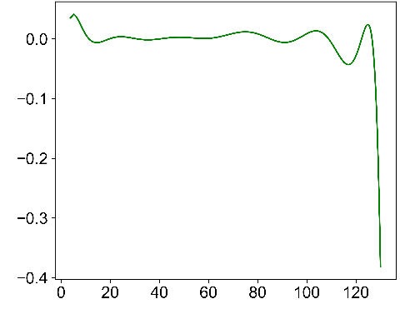
Missense challenge: Calmodulin
Embargoed
No Tweet
DATA ANALYSIS
Numerical fitting (Polynomial)
Apo
Degree 14
Coarse data
1st derivative
2nd derivative
Ca²⁺
Degree 14
Coarse data
1st derivative
2nd derivative
Created for CAGI 6
genomeinterpretation.org
Dal Cortivo G.

Slide 16
Missense challenge: Calmodulin
DATA ANALYSIS
Numerical fitting (Polynomial)
PRO
CON
The whole dataset is considered
No need for the totally unfolded state
No manual intervention is requried
x Thermodynamic parameters cannot be assessed
Created for CAGI 6
genomeinterpretation.org
Dal Cortivo G.

Slide 17

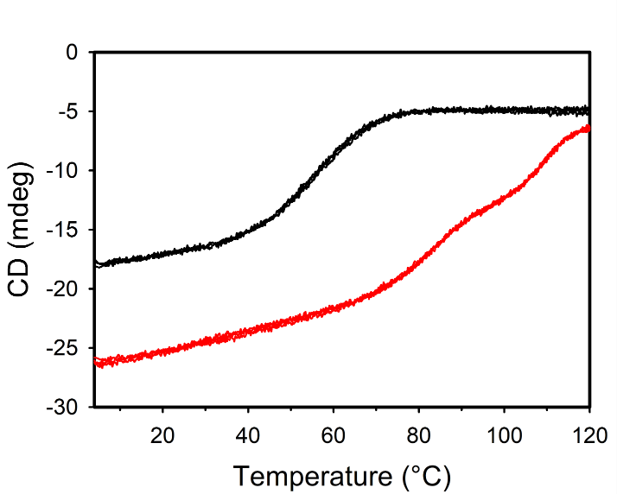
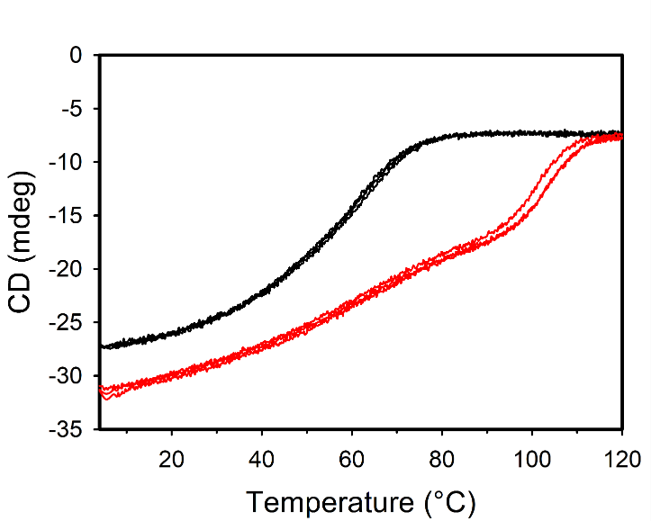
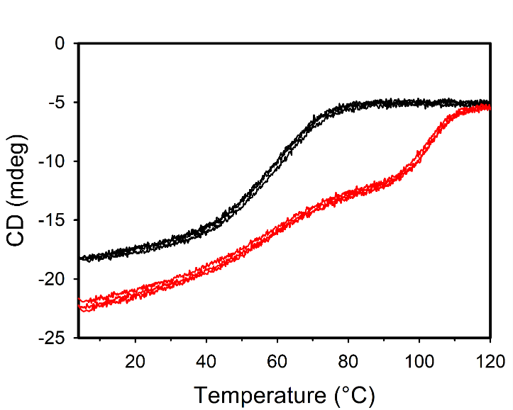
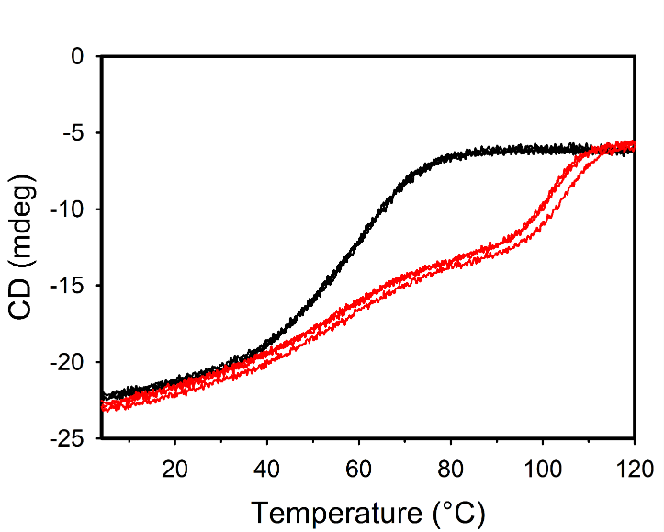
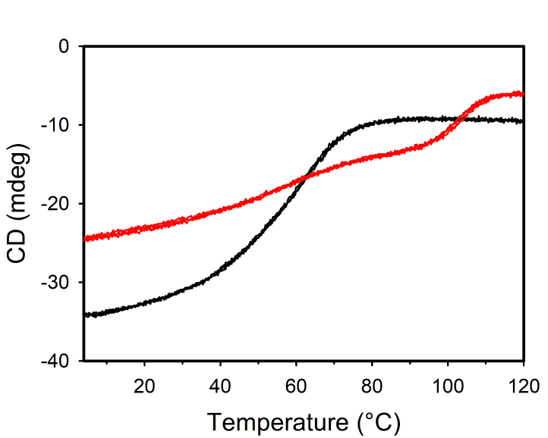
Missense challenge: Calmodulin
Embargoed
No Tweet
RESULTS – Thermal denaturation profiles
N = 3
WT
N53I
F89L
DATA ANALYSIS
Apo
Ca²⁺
Apo
Ca²⁺
Apo
Ca²⁺
D95H
D95V
N97I
Apo
Ca²⁺
Apo
Ca²⁺
Apo
Ca²⁺
Created for CAGI 6
genomeinterpretation.org
Dal Cortivo G.

Slide 18
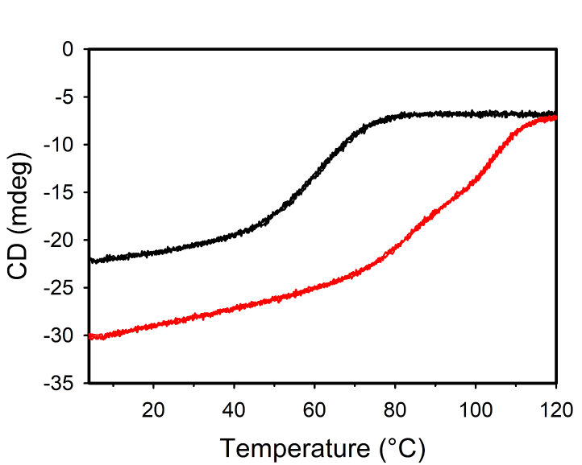
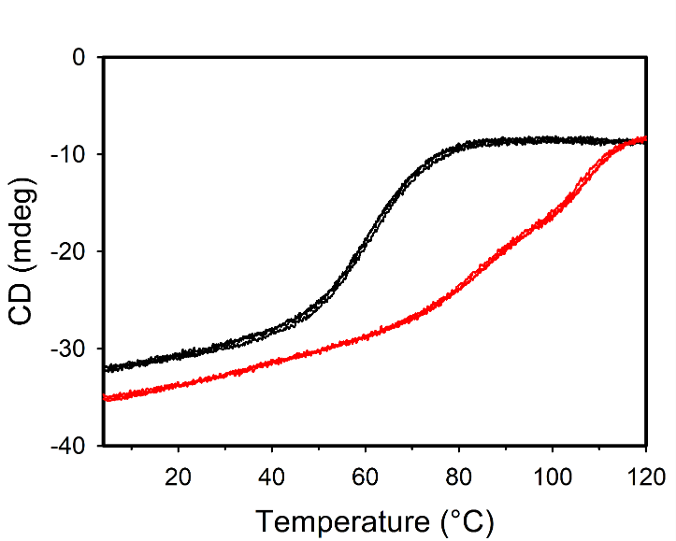
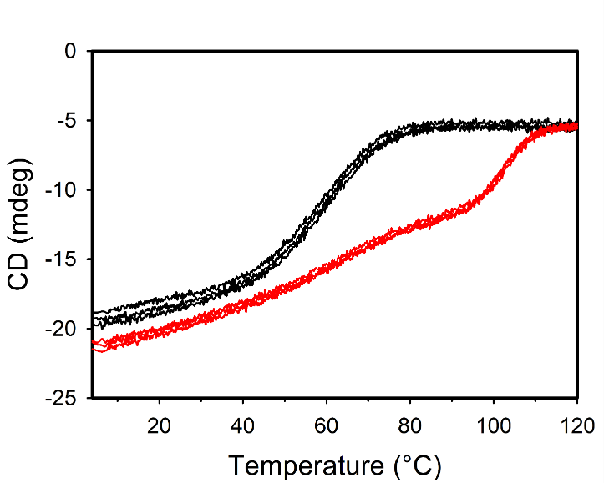
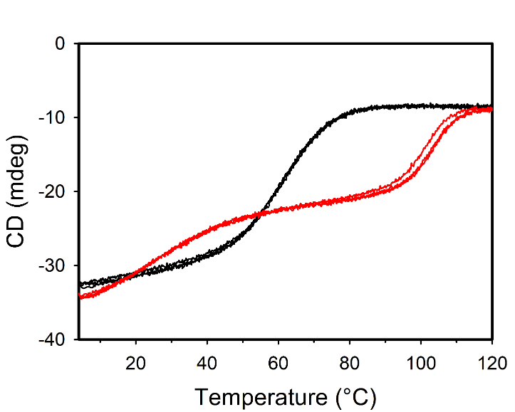
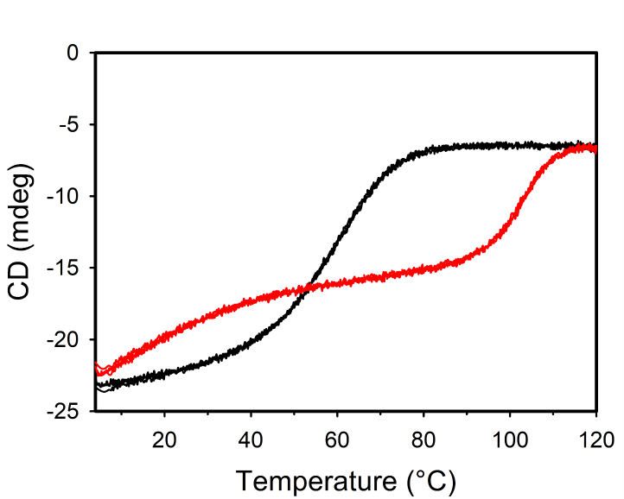
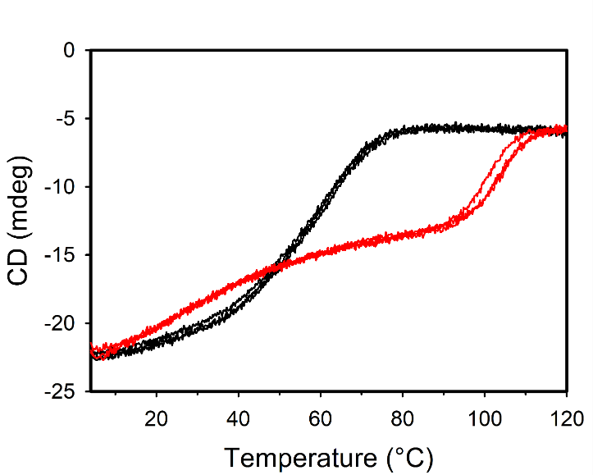
Missense challenge: Calmodulin
Embargoed
No Tweet
RESULTS – Thermal denaturation profiles
N = 3
N97S
A102V
E104A
Apo
Ca²⁺
Apo
Ca²⁺
Apo
Ca²⁺
D129G
D129V
D131E
Apo
Ca²⁺
Apo
Ca²⁺
Apo
Ca²⁺
Created for CAGI 6
genomeinterpretation.org
Dal Cortivo G.

Slide 19
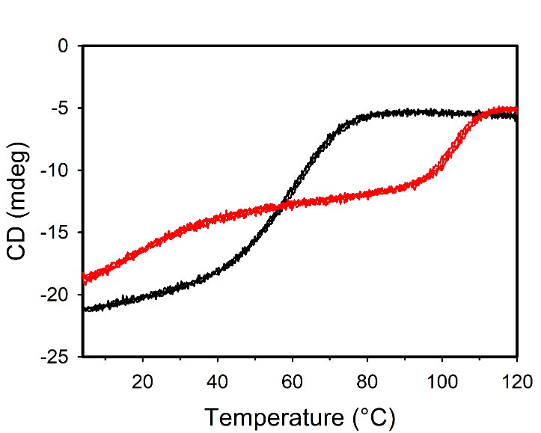
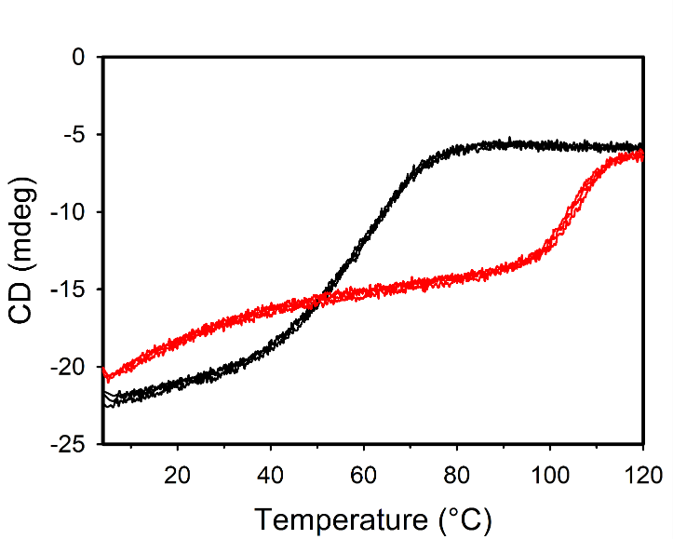
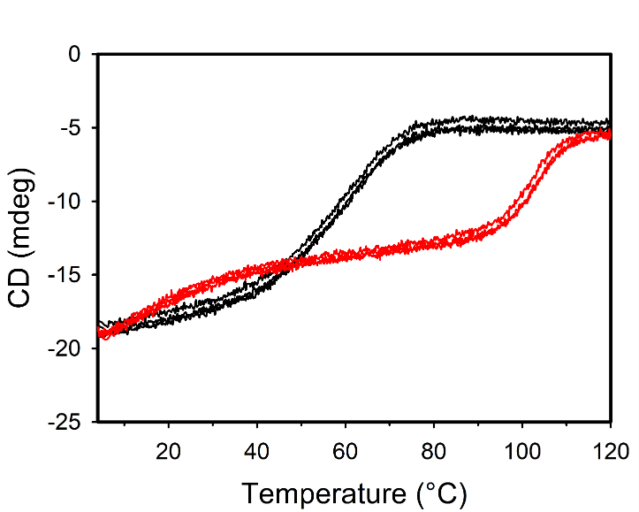
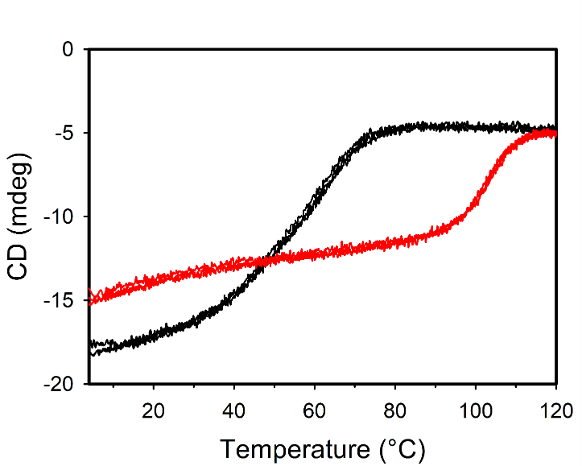
Missense challenge: Calmodulin
Embargoed
No Tweet
RESULTS – Thermal denaturation profiles
N = 3
D131H
D131V
D133H
Apo
Ca²⁺
Apo
Ca²⁺
Apo
Ca²⁺
Q135P
Apo
Ca²⁺
Created for CAGI 6
genomeinterpretation.org
Dal Cortivo G.

Slide 20

Missense challenge: Calmodulin
CONCLUSIONS
Thermal denaturation profiles in the presence of Ca²⁺ show complex behavior, difficult to fit to the conventional two-states thermodynamic function
We propose a simple method for estimating of the T_{m} when the requirements of the thermodynamic function fail
The %unfolding value was found to vary significantly from variant to variant regardless of the Ca²⁺-loading state
Created for CAGI 6
genomeinterpretation.org
Dal Cortivo G.

Slide 21
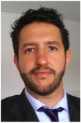



Acknowledgment
Prof. Daniele Dell’Orco
Italian Ministry of University and Research (PRIN2017, 201744NR8S to D.D.)
Dr. Valerio Marino
Created for CAGI 6
genomeinterpretation.org
Dal Cortivo G.

