Slide 1

CAGI slide pack guidelines
I agree to my slides being used according to the following terms:
_______Steven E. Brenner_______
Authors: please include THIS slide at the beginning of your presentation to indicate that you agree with reuse of your slides in CAGI presentations, according to the terms below, and digitally sign by writing your name above.
To disseminate the CAGI results, I encourage all CAGI participants to remix these CAGI slides for inclusion in their oral and poster presentations
CAGI participants may use or publish any content of these slides only in compliance with the CAGI Data Use Agreement
CAGI participants may not cite or publish any content of these slides except with the written permission of the originating author or in the primary CAGI publications
CAGI participants must acknowledge the original authors of these slides and CAGI 2013. Include the acknowledgement banner across the bottom
CAGI participants must include the CAGI credits slide in their presentations
Slides with a red slash (no remix) may not be included in a presentation unless all attendees are registered CAGI participants who signed the data use agreement
Slides with a red X over the entire slide may not be used in any circumstances
Slides with a blue slash (embargoed) may not be used unless the embargo is explicitly lifted
Slides without slash or X may be tweeted unless flagged with the “No tweet” icon.
CAGI participants using these slides must explain the “No tweet” icon, which means that the slide content should not be disseminated outside the presenting conference hall. If the presentation venue permits pervasive tweeting, you may not include these slides in your talk
Note for slide authors: we expect all CAGI participants to abide by these restrictions, and will make best effort to ensure they are followed. However, but bear in mind that we have limited means of enforcing them, and therefore the restrictions cannot be guaranteed.

Slide 2
CAGI 6
#CAGI6
The CAGI Sixth Edition
International Conference
Critical Assessment of Genome Interpretation
Conference
14-16 May 2022
Brower Center
Berkeley, CA
USA
Remote Participants
We are still setting up
the COVID protections
We will be starting soon
Created for CAGI 6
genomeinterpretation.org
Steven E. Brenner

Slide 3
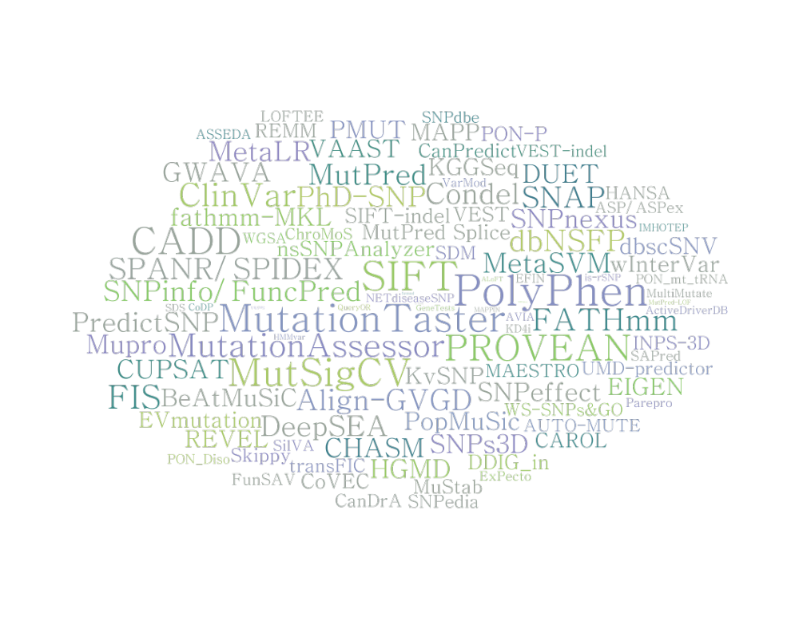
CAGI 6 Conference
Remote Participants:
We are still setting up in person with the COVID protections.
We will be starting soon.
14-16 May 2022
#CAGI6
Created for CAGI 6
genomeinterpretation.org
Steven Brenner
genomeinterpretation.org/vipdb

Slide 4
Welcome!
7th CAGI meeting from the 6th edition of CAGI.
Our last meeting was CAGI↓ Workshop 2019
  6-8 December 2019
Wonderful to be back in person,
and also to engage a large audience remotely
Thank you for joining us!
Created for CAGI 6
genomeinterpretation.org
Steven E. Brenner

Slide 5
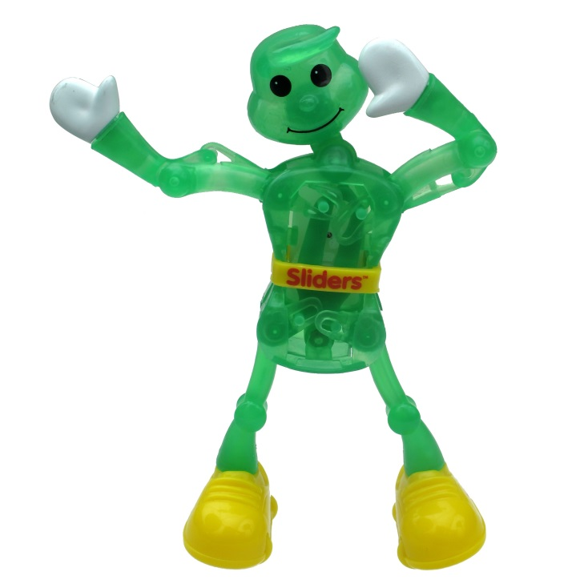
CAGI 6 is your meeting
Data provider introductions
Assessor presentations
Predictor short talks
Poster talks & session
Keynote talk
Perspectives & previews
  Clinical connections
  Benchmarking
Office hours
Poster, coffee, reception,
lunch at outdoor terrace
Discussion & what did we learn
CAGI Larry
Created for CAGI 6
genomeinterpretation.org
Steven E. Brenner

Slide 6
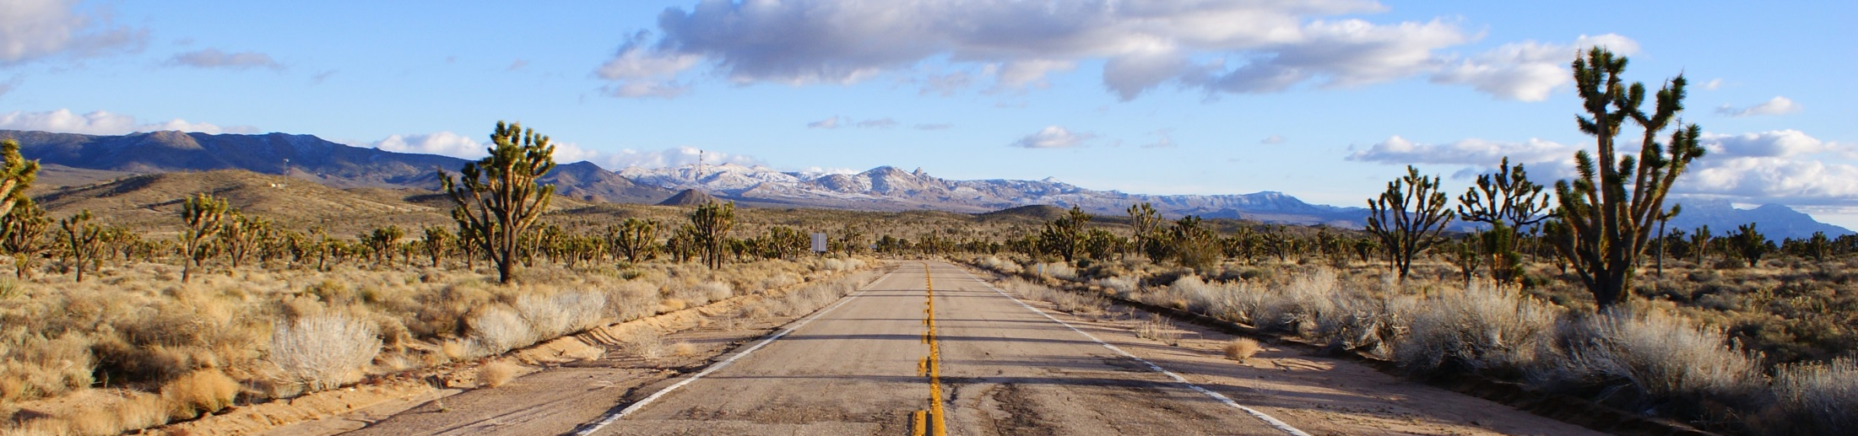
Goals of the CAGI experiment
Determine the state of the art
Identify progress and innovations
Reveal bottlenecks and guide future effort
Highlight new challenges
Collaboratively develop new approaches
Created for CAGI 2
genomeinterpretation.org
Susanna Repo
Notes:
6

Slide 7
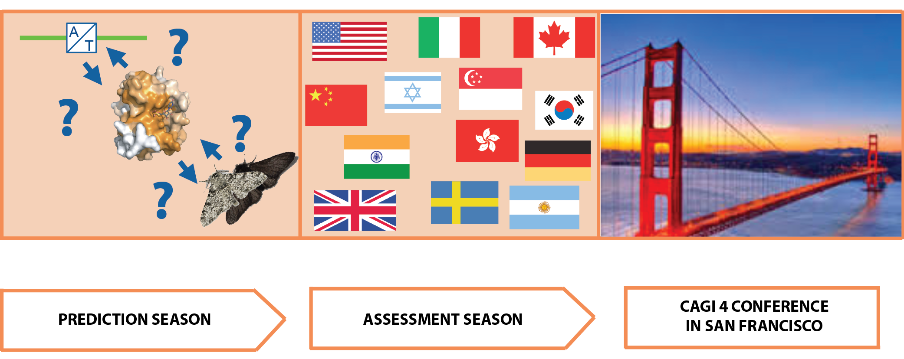
CAGI Stages
Created for CAGI 4
genomeinterpretation.org
Steven E. Brenner

Slide 8
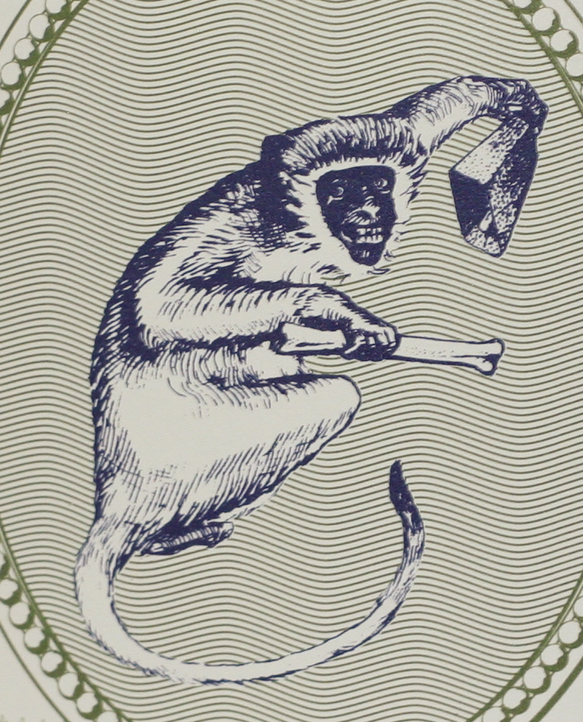
pre-pro-CAGI 2010
A community experiment in genome variation interpretation
Created for CAGI 1
genomeinterpretation.org
Steven E. Brenner

Slide 9
Created for CAGI 6
genomeinterpretation.org
Steven E. Brenner
genomeinterpretation.org/vipdb

Slide 10
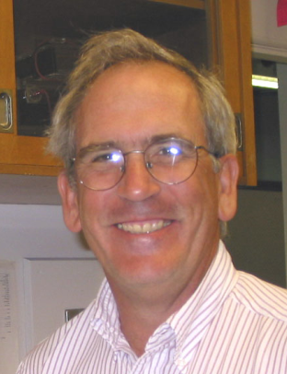
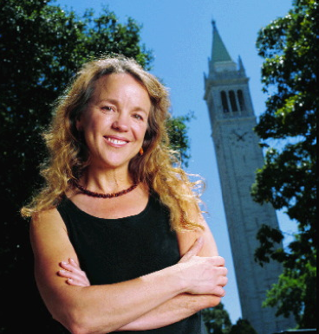
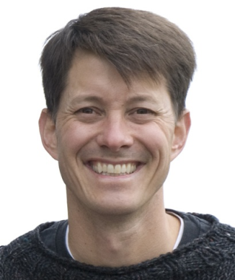
Origins
Jasper Rine
Kimmen Sjölander
Reece Hart
cagey \'kā-jē\
1. Wary; careful: a cagey avoidance of a definite answer.
2. Crafty; shrewd: a cagey lawyer.
Origin unknown.
The American Heritage Dictionary, 4th Edition
Created for CAGI 1
genomeinterpretation.org
Steven E> Brenner

Slide 11
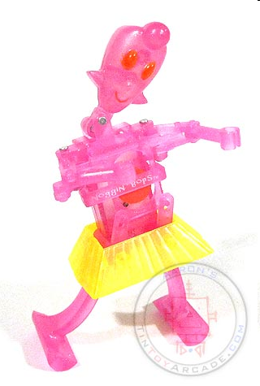
CAGI Molly
Created for CAGI 1
genomeinterpretation.org
Steven E. Brenner

Slide 12
CAGI is an Experiment
(not a competition)
CAGI challenges have no winners or losers,
and no unique top performer
  (Terms like “top” and “best” are correctly used with regard to a particular metric, but not for a challenge overall. We apologize for confusion if such phrasings have been casually and incorrectly used in the past.)
We aim to understand how predictions work in a variety of contexts for distinctive goals; a typical assessment may use a dozen different approaches for evaluation.
  Predictor speaking slots allocated for interesting results, intriguing approaches, and typically doing well on a particular metric or amalgamation of scores
  “Selected predictors” about “selected methods”
Created for CAGI 6
genomeinterpretation.org
Steven Brenner

Slide 13
COVID-19 and Protections
COVID-19 rates here appear to be the highest ever
UC Berkeley test positivity rates of 8.5%
Piedmont students may be 700 per 100,000
Protections
Wear a well-sealed high-quality mask
  N95, KN95, KF94, or double surgical with knot & tuck
  Seal is most important
Daily testing
All unmasking, including meals, outdoors only
Full hourly refresh ventilation
CO₂ monitoring
Photos of audience locations
Remote option!
Created for CAGI 6
genomeinterpretation.org
Steven Brenner

Slide 14

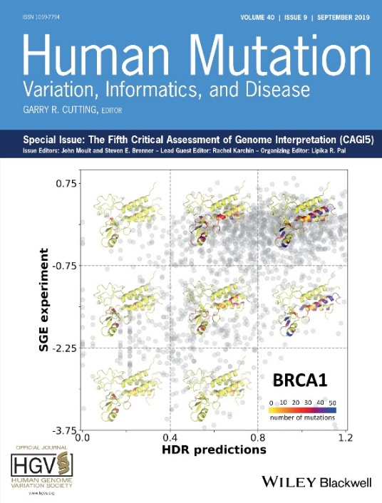
Publications
CAGI Special Issues of
Human Mutation
60 publications
Created for CAGI 6
genomeinterpretation.org
Steven E. Brenner

Slide 15
Publication
Any CAGI participant can publish anywhere
with data and results not under embargo
Challenges
  Generally one paper for each challenge written by assessor with input from provider and predictors (some challenges could merge)
  Assessors, Dataset provider, and Predictors are authors (Predictors may be banner). Organizers optionally, per assessor choice.
Predictions
  Each prediction group can have papers describing their approach for each challenge
Preprints encouraged
Please cite CAGI grant, U24 HG007346
Created for CAGI 6
genomeinterpretation.org
Steven E. Brenner

Slide 16
Title
This slide can be remixed and used in oral and poster presentations by any CAGI participant, consistent with limitations on slide 1.
Created for CAGI 6
genomeinterpretation.org
Steven Brenner

Slide 17
CAGI Sharing, Embargo, and Protections
A core principle of CAGI is knowledge sharing
We request speakers allow their slides to be reused and remixed with appropriate attribution
Personally identifiable data is restricted according to dataset requirements permanently
All datasets remain embargoed until published or otherwise released by providers
Unmarked slides can be tweeted unless noted otherwise
Unpublished or human data cannot be shared this way.
Slides have explicit ways of both
  offering the permissions
  documenting restrictions in slide templates
Slides and videos will be posted after redaction
Created for CAGI 6
genomeinterpretation.org
Steven Brenner

Slide 18
Title
This slide can be remixed and used in oral and poster presentations by any CAGI participant, consistent with limitations on slide 1.
Created for CAGI 6
genomeinterpretation.org
An Author

Slide 19
Title
No remix
This slide cannot be used except for viewing by registered CAGI participants
Created for CAGI 6
genomeinterpretation.org
An Author

Slide 20
Title
CAGI meeting ONLY
This slide cannot be used outside of the CAGI meeting.
We do not anticipate many slides of this nature
Created for CAGI 6
genomeinterpretation.org
An Author

Slide 21
Title
Embargoed
Until embargoed data are released, this slide cannot be used except for viewing by registered CAGI participants
Created for CAGI 6
genomeinterpretation.org
An Author

Slide 22
Title
No Tweet
This slide can be remixed and used in oral and poster presentations by any CAGI participant, consistent with limitations on slide 1
However, it is intended for participants of the conference hall and the CAGI live hybrid meeting only. Its content should not be tweeted, discussed, or otherwise shared outside of the conference hall
Do not use this slide in venues that give blanket permission for tweeting
Created for CAGI 6
genomeinterpretation.org
An Author

Slide 23
CAGI 6 is your meeting
Data provider introductions
Assessor presentations
Predictor short talks
Poster talks & session
Keynote talk
Perspectives & previews
  Clinical connections
  Benchmarking
Office hours
Poster, coffee, reception,
lunch at outdoor terrace
Discussion & what did we learn
CAGI Larry
Created for CAGI 6
genomeinterpretation.org
Steven E. Brenner

