Slide 1

CAGI slide pack guidelines
I agree to my slides being used according to the following terms: _Michael Beer__
Authors: please include THIS slide at the beginning of your presentation to indicate that you agree with reuse of your slides in CAGI presentations, according to the terms below, and digitally sign by writing your name above.
To disseminate the CAGI results, I encourage all CAGI participants to remix these CAGI slides for inclusion in their oral and poster presentations
CAGI participants may use or publish any content of these slides only in compliance with the CAGI Data Use Agreement
CAGI participants may not cite or publish any content of these slides except with the written permission of the originating author or in the primary CAGI publications
CAGI participants must acknowledge the original authors of these slides and CAGI 2013. Include the acknowledgement banner across the bottom
CAGI participants must include the CAGI credits slide in their presentations
Slides with a red slash (no remix) may not be included in a presentation unless all attendees are registered CAGI participants who signed the data use agreement
Slides with a red X over the entire slide may not be used in any circumstances
Slides with a blue slash (embargoed) may not be used unless the embargo is explicitly lifted
Slides without slash or X may be tweeted unless flagged with the “No tweet” icon.
CAGI participants using these slides must explain the “No tweet” icon, which means that the slide content should not be disseminated outside the presenting conference hall. If the presentation venue permits pervasive tweeting, you may not include these slides in your talk
Note for slide authors: we expect all CAGI participants to abide by these restrictions, and will make best effort to ensure they are followed. However, but bear in mind that we have limited means of enforcing them, and therefore the restrictions cannot be guaranteed.

Slide 2



Predicting Cell-type Specific Enhancer Activity and the Impact of Regulatory Mutations from Epigenomic Data
Mike Beer
BME & IGM
03/26/2016
>20,000 non-coding SNPs associated with common diseases
majority in DHS regulatory regions (Maurano Science 2012, Gusev AJHG 2014)
gkmSVM classifiers trained on Chip-seq, DHS, ATAC, histone active regions
identify unbiased TF & cofactor regulatory vocabulary
gkmSVM can predict enhancer activity and the quantitative impact of mutation
(Lee -- Beer, Nature Genetics, 2015)
gkmSVM does not train on enhancer experiments, only cell-specific epigenomic data, more widely available in disease related cell types
Created for CAGI 4
genomeinterpretation.org
Beer

Slide 3
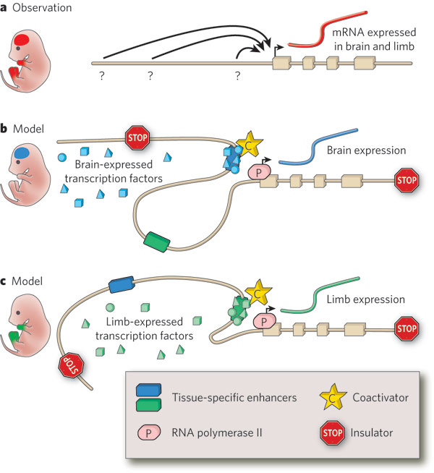
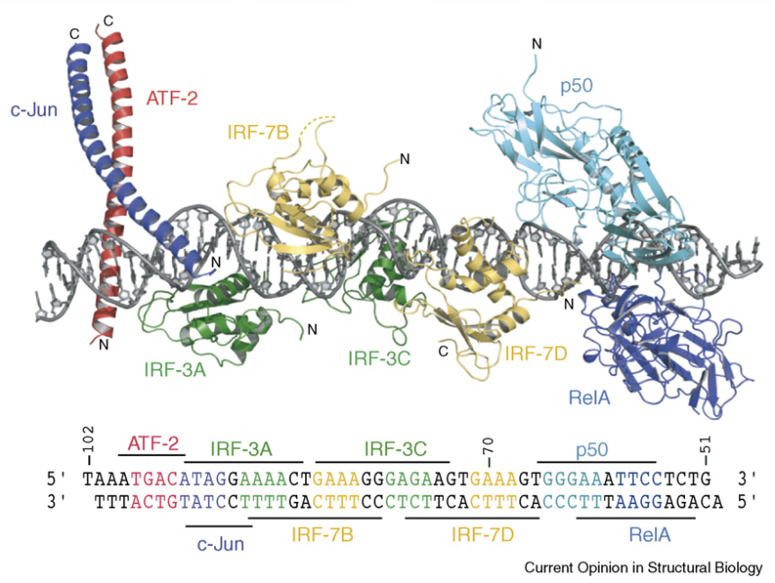
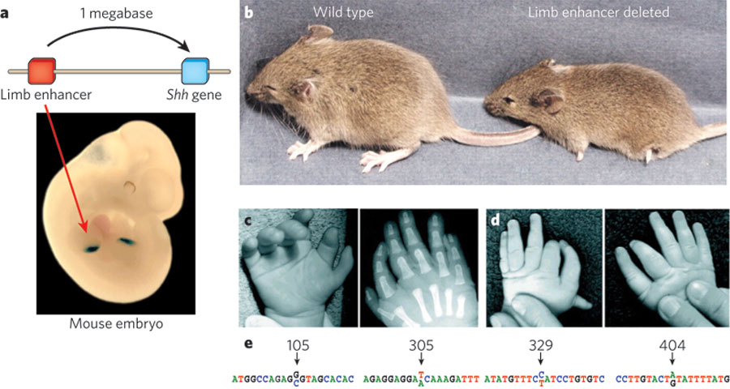
Visel Nature 2009
Lettice Hum Mol Genet 2003
Panne 2008

Slide 4
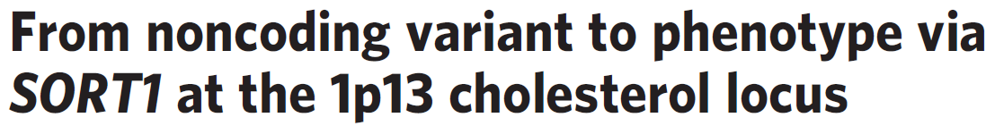
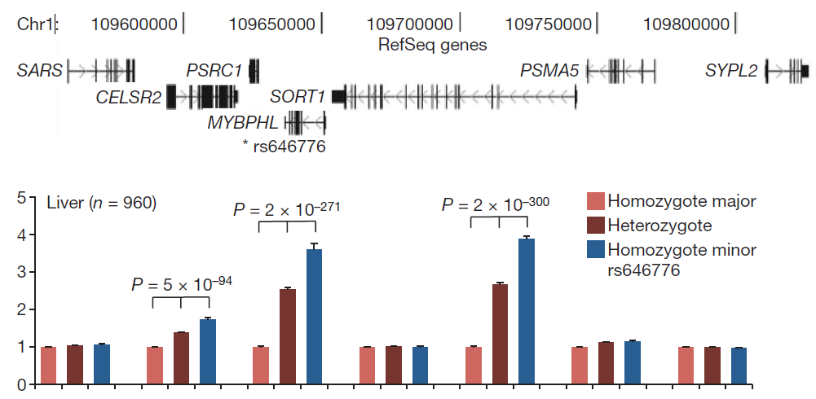
Musunuru et al Nature (2010)
rs646776 C vs T: LDL-C and MI p<10⁻¹⁷⁰ ~100,000 indiv, 24% increase LDL-VS
D’
R²
TT 60%
TC 35%
CC 5%

Slide 5
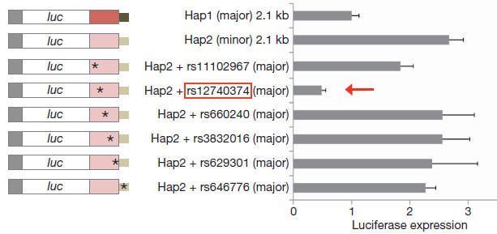
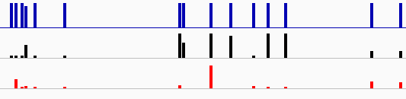
Narrowing in on causal SNP
Musunuru Nature (2010)
D’
R²
deltaSVM
HepG2 DHS
rs12740374 *
* rs646776
Created for CAGI 4
genomeinterpretation.org
Beer

Slide 6
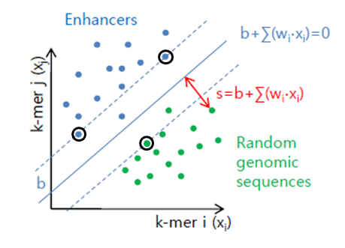
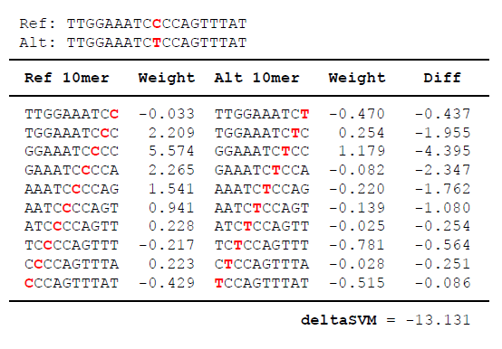


gkmSVM and deltaSVM Method Overview
Define a set of cell type specific enhancers using DHS, ATAC-seq, or chromatin state
Train gkmSVM to learn regulatory TF binding site vocabulary for given cell-type
Calculate how each SNP changes gkmSVM score to predict impact (deltaSVM)
2015 Lee - Beer Nature Genetics (deltaSVM)
2014 Lee, Ghandi, Beer, PLOS Comp Bio (gapped kmers)
2013 Fletez-Brant, Lee, Beer, NAR
2013 Ghandi, Beer, J Math Biol (gapped kmers)
2011 Lee, Karchin, Beer, Genome Research (kmers)
k-mer counts:
CACCAGGGGG
CCACCAGGGG
CCACCTGGTG
CCACCAGGTG
gapped kmer counts:
CA--AG--GG
CC-C--G-GG
CA-C-G--GG
CCA---GG-G
$4^{6}\left(\begin{matrix}10 \\ 6\end{matrix}\right)$= 860160
Created for CAGI 4
genomeinterpretation.org
Beer

Slide 7
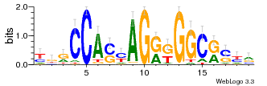
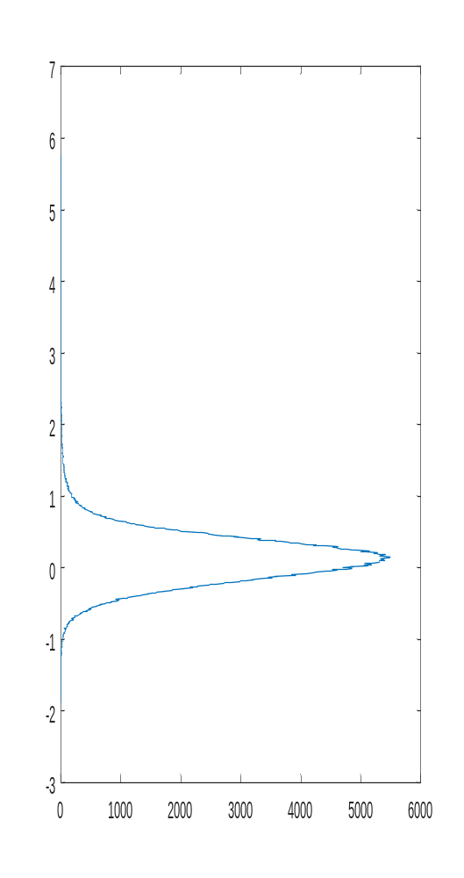
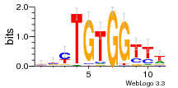
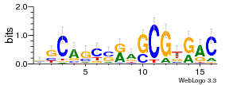
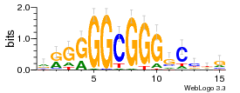
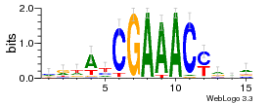
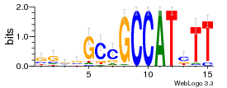
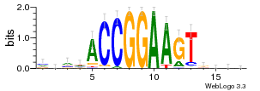
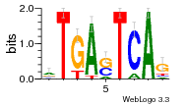
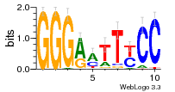
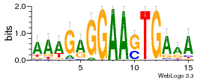
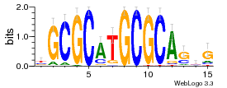
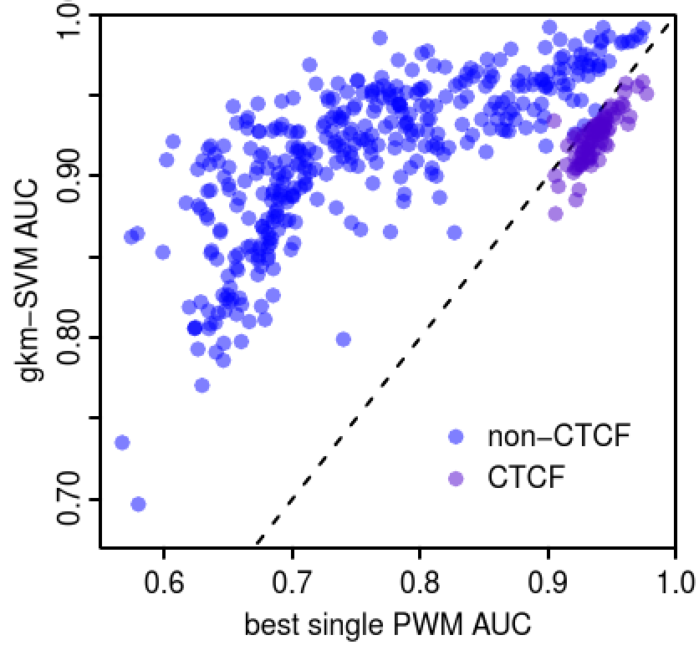
gkm-SVM Weights Encode Co-factor TFs Required to Predict Cell-specific Binding
GM12878:
kmers with positive regulatory activity
kmer reverse comp weight
CCACTAGGGG CCCCTAGTGG 5.773
CCACTAGAGG CCTCTAGTGG 5.713
CACCTAGTGG CCACTAGGTG 5.673
CACTAGAGGG CCCTCTAGTG 5.618
GGAAATCCCC GGGGATTTCC 5.574
CACTAGGGGG CCCCCTAGTG 5.529
CACTAGGTGG CCACCTAGTG 5.419
CACCAGGTGG CCACCTGGTG 5.414
CACTAGATGG CCATCTAGTG 5.388
CATCTAGTGG CCACTAGATG 5.361
...
...
CGGGGGGTCC GGACCCCCCG -1.546
GGGGGTCTCA TGAGACCCCC -1.588
CGGGGGTCCC GGGACCCCCG -1.680
CCCCCTCCCC GGGGAGGGGG -1.787
CCCCCTGCCC GGGCAGGGGG -1.893
kmers with negative regulatory activity
CTCF
Bcl11a/Runx1
Pax5
SP1
IRF4
YY1
Gabpa
Batf/AP-1
NFkB
PU1
NRF1
Distribution of 524,800 10-mer weights
467 Chip-seq datasets Wang , J GR 2012

Slide 8
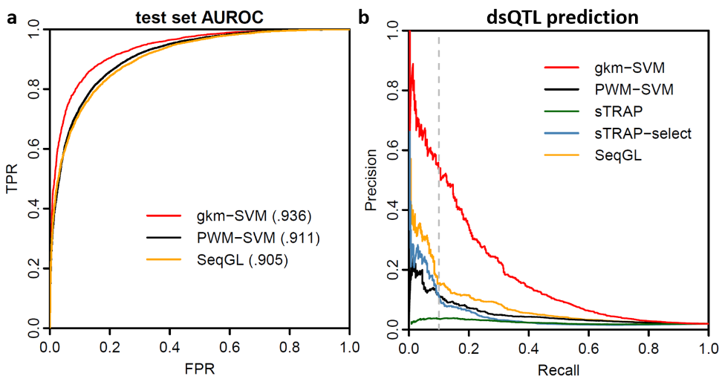
deltaSVM Predicts Functional Impact More Accurately Than PWM Methods
Positive set: 579 dsQTLs SNPs in human lymphoblasts that alter DHS accessibility
Negative set: 28,950 SNPs (50x) (Degner-Pritchard Nature 2012)
deltaSVM predicts dsQTLs more accurately than other methods: Kircher--Shendure, Nat Gen 2014, Ritchie--Flicek, Nat Meth 2014, or conservation
PWM based models less accurate: sTRAP (Manke--Vingron 2010) or PWM-SVM
SeqGL less accurate (Setty—Leslie PLOS Comp Biol 2015)
Although test set AUROC is high, prediction of impact is lower
Created for CAGI 4
genomeinterpretation.org
Beer

Slide 9
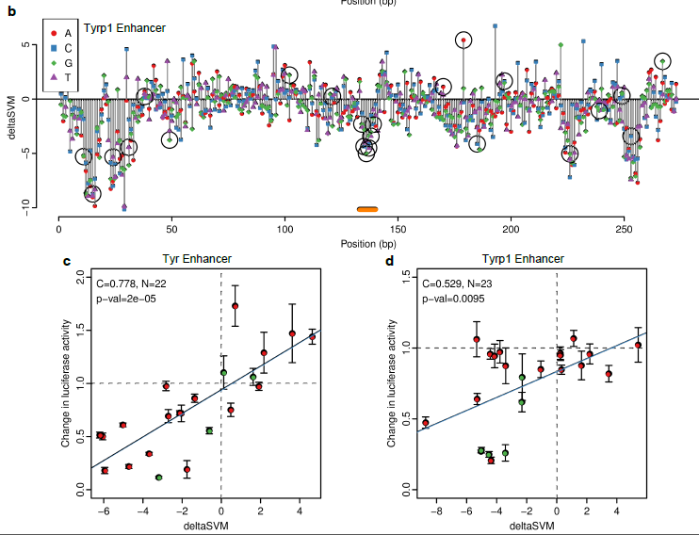
gkmSVM Predicts Effect of SNPs in melanocyte enhancers
Lee—Beer Nat Gen 2015
Created for CAGI 4
genomeinterpretation.org
Beer

Slide 10
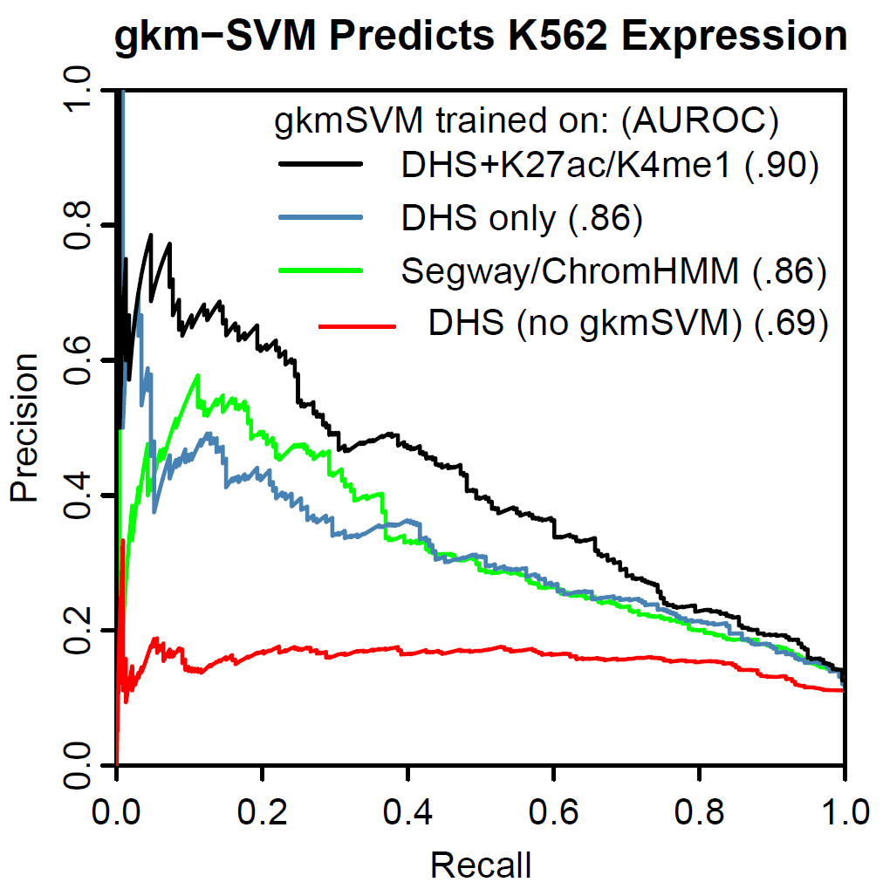
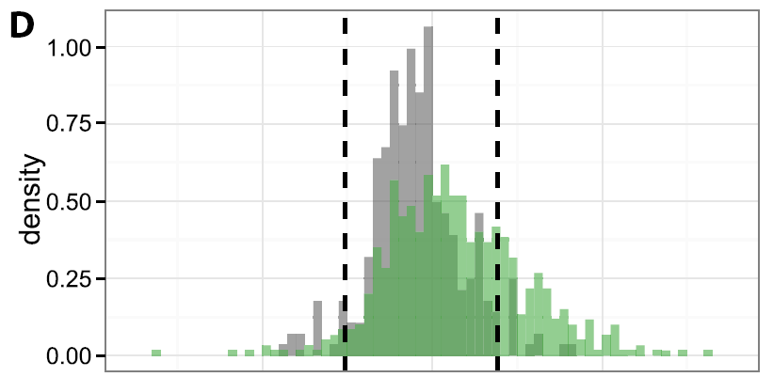
gkmSVM Predicts Expression in K562 cells
Segway enhancer predictions tested in K562 cells (130bp) (Kwasnieski—Cohen GR 2014)
Only ~20% positive
DHS signal within tested region also weakly predictive
gkmSVM trained on DHS or Segway regions does better
gkmSVM trained on DHS + H3K4K27ac/4me1 much better
neg
pos
Created for CAGI 4
genomeinterpretation.org
Beer

Slide 11
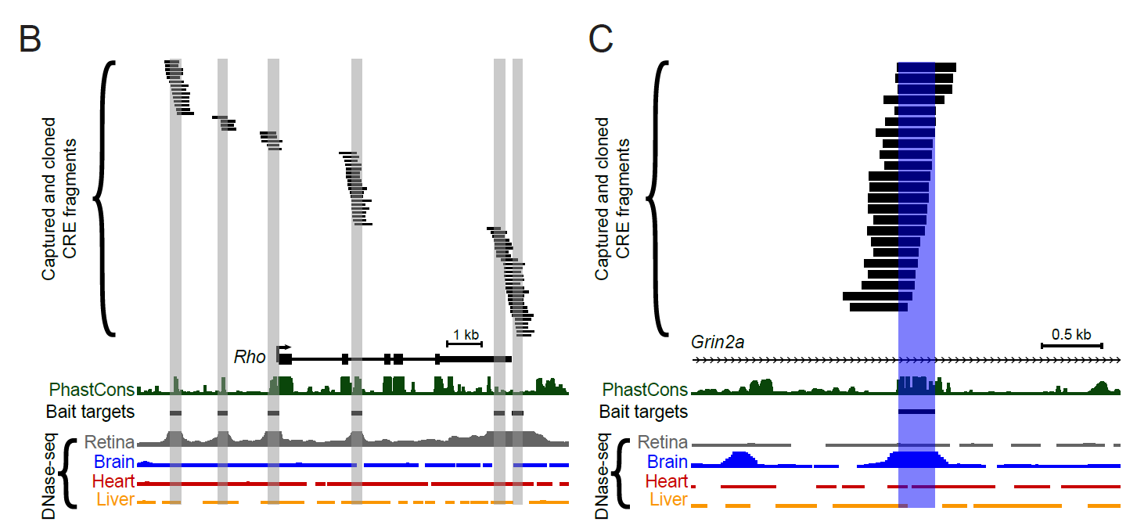
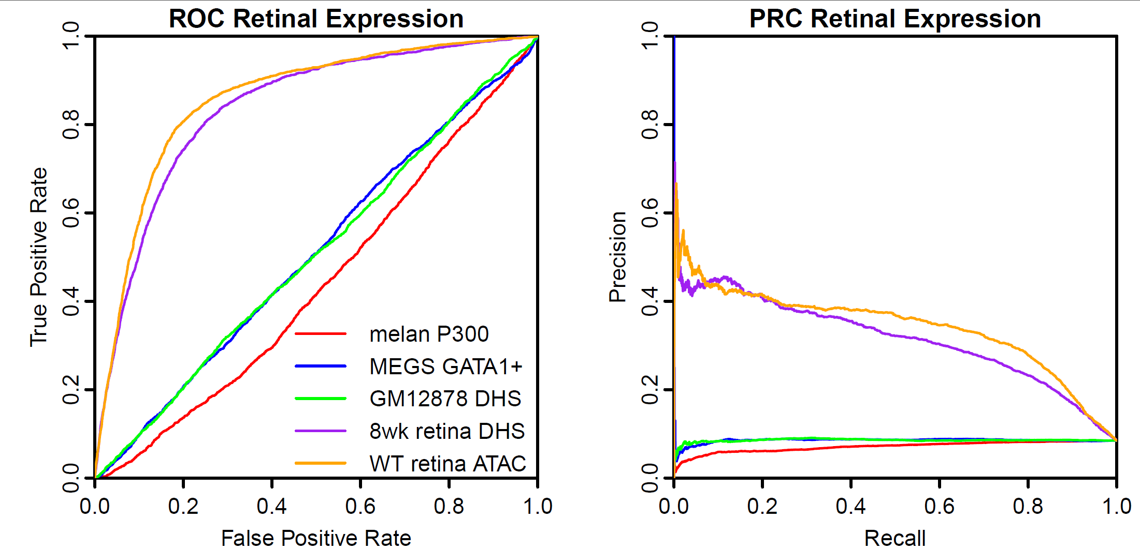
gkmSVM Predicts Expression in vivo in Mouse Retina
36005 DHS+ elements tested in mouse retina (Shen—Corbo GR 2015)
Pos: Strong expression 2156 seqs
Neg: Low expression 23147 seqs
gkmSVM trained on retina DHS or ATAC predicts expression, but not other cell types
(Mo—Beer—Nathans eLife 2016)
Created for CAGI 4
genomeinterpretation.org
Beer

Slide 12
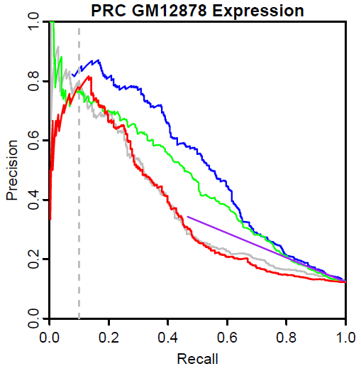
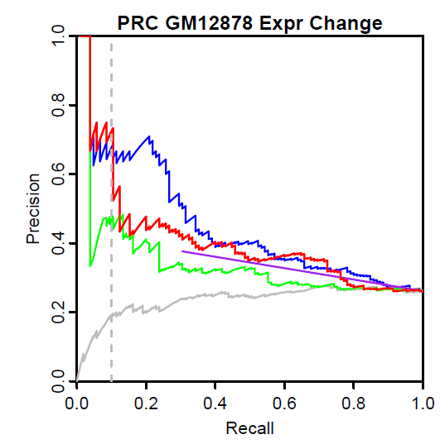
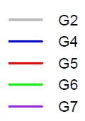
For eQTL Challenge, many groups have similar predictions for Expression, but vary for Expression Change
Can predict Expr (regions) well while having variable feature weight (esp DNN)
But prediction of SNP impact will vary
Created for CAGI 4
genomeinterpretation.org
Beer

Slide 13
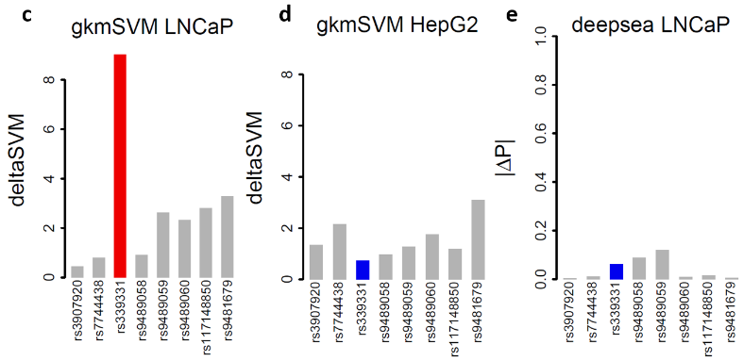
Validated causal disease SNPs only score higher than flanking negative SNPs when gkmSVM trained on relevant cell type
In many disease cell types reporter assays difficult
Deepsea (Zhou Troyanskaya 2015) trains on all cell types simultaneously, misses Rfx6 prostate cancer SNP
gkmSVM can identify causal variants in disease loci trained on epigenomic data alone
gkmSVM identifies RFX6 prostate cancer SNP rs339331 (Huang NG 2014) (red) from among flanking SNPs when trained on:
ENCODE LNCap DHS (prostate)
but not HepG2 DHS (liver, blue)
Deepsea predicts RFX6 SNP has low ΔP for LNCaP DHS.
more in (Lee—Beer Nat Gen 2015)
Created for CAGI 4
genomeinterpretation.org
Beer

