Slide 1

CAGI slide pack guidelines
I agree to my slides being used according to the following terms: _______Haoyang Zeng_______
Authors: please include THIS slide at the beginning of your presentation to indicate that you agree with reuse of your slides in CAGI presentations, according to the terms below, and digitally sign by writing your name above.
To disseminate the CAGI results, I encourage all CAGI participants to remix these CAGI slides for inclusion in their oral and poster presentations
CAGI participants may use or publish any content of these slides only in compliance with the CAGI Data Use Agreement
CAGI participants may not cite or publish any content of these slides except with the written permission of the originating author or in the primary CAGI publications
CAGI participants must acknowledge the original authors of these slides and CAGI 2013. Include the acknowledgement banner across the bottom
CAGI participants must include the CAGI credits slide in their presentations
Slides with a red slash (no remix) may not be included in a presentation unless all attendees are registered CAGI participants who signed the data use agreement
Slides with a red X over the entire slide may not be used in any circumstances
Slides with a blue slash (embargoed) may not be used unless the embargo is explicitly lifted
Slides without slash or X may be tweeted unless flagged with the “No tweet” icon.
CAGI participants using these slides must explain the “No tweet” icon, which means that the slide content should not be disseminated outside the presenting conference hall. If the presentation venue permits pervasive tweeting, you may not include these slides in your talk
Note for slide authors: we expect all CAGI participants to abide by these restrictions, and will make best effort to ensure they are followed. However, but bear in mind that we have limited means of enforcing them, and therefore the restrictions cannot be guaranteed.

Slide 2


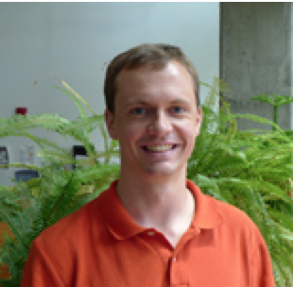



Ensemble method for predicting eQTL from sequence
Haoyang Zeng, Matthew Edwards, Yuchun Guo, and David Gifford
MIT CSAIL
{haoyangz, matted, yguo, gifford}@mit.edu
March 26, 2016
Notes:
TODO: make a better title

Slide 3
Content
Task and data overview
Feature design
Algorithm design
Post-analysis

Slide 4
Content
Task and data overview
Feature design
Algorithm design
Post-analysis

Slide 5
Data overview
Genomic location
Computational Model
Target gene expression data/label
Sequences (two alleles)
Notes:
“Regulatory hit” just means significantly large expression levels (either allele)

Slide 6
Prediction task overview
Task 1
  Task1a --- Normalized target gene expression prediction (Regression)
  Task1b --- Significant expression (“RegHit”) prediction (Binary classification)
Task 2
  Task2a --- Allele-specific expression (“LogSkew”) prediction (Regression)
  Task2b --- Significant allele-specific expression (“emVar”) prediction (Binary classification)
Notes:
“Regulatory hit” just means significantly large expression levels (either allele)

Slide 7
Content
Task and data overview
Feature design
Algorithm design
Post-analysis

Slide 8
Features --- knowledge transfer
Transcription Factor Binding
Chromatin openness
Sequence +
genome location
Task
Histone Modification
Chromatin Segmentation

Slide 9
Features
Model | Functional Prediction | Type | Trained on
KSM | TF binding | Sequence only (allele specific) | GM12878 ENCODE ChIP-seq
DeepBind | TF binding | Sequence only (allele specific) | ENCODE ChIP-seq
DeepSEA | TF binding, histone mark, chromatin openness | Sequence only (allele specific) | ENCODE and Roadmap epigenomics data
chromHMM | Chromatin segmentation | Genome position (alleles same) | Roadmap epigenomics data

Slide 10
Content
Task and data overview
Feature design
Algorithm design
Post-analysis

Slide 11
Lesson from Netflix challenge
“It was important to utilize a variety of models that compensate the shortcoming of each other…” [1]
[1] Bell, Robert M., and Yehuda Koren. "Lessons from the Netflix prize challenge." ACM SIGKDD Explorations Newsletter 9.2 (2007): 75-79.

Slide 12
Task 1 algorithms --- single model
Feature
KSM
DeepSEA
DeepBind
chromHMM
KSM+DeepSEA/DeepBind
DeepSEA/DeepBind + chromHMM
KSM + chromHMM
KSM + DeepSEA/DeepBind + chromHMM
Regressor (task1a)
LASSO regression
Random Forest Regressor
Classifier (task1b)
One layer neural network with 400 neurons

Slide 13
Task 1 algorithms --- Ensemble model
Take the average of the prediction from several single models
  DeepSEA
  DeepBind
  KSM+DeepSEA
  KSM+DeepSEA+chromHMM

Slide 14
Task 1 result --- normalized expression prediction
Model | Median R-squared *
DeepSEA_DeepBind_KSM+DeepSEA_KSM+DeepSEA+chromHMM | 0.3976
KSM+DeepSEA:lasso | 0.3803
KSM+DeepSEA+chromHMM:lasso | 0.3769
DeepSEA:lasso | 0.3728
KSM+DeepSEA:RFR | 0.3723
KSM+DeepSEA+chromHMM:RFR | 0.3714
* Evaluated by 10-fold cross-validation

Slide 15
Task 1 result --- significant expression (“RegHit”) prediction
Model | Median AUROC* | Median AUPRC*
DeepSEA_DeepBind_KSM+DeepSEA_KSM+DeepSEA+chromHMM | 0.8647 | 0.5830
DeepSEA | 0.8515 | 0.5622
KSM+DeepSEA | 0.8462 | 0.5380
DeepSEA+chromHMM | 0.8354 | 0.5498
KSM+DeepSEA+chromHMM | 0.8347 | 0.5391
KSM+DeepBind | 0.8280 | 0.4752
* Evaluated by 10-fold cross-validation
Notes:
Note: to combine two alleles (predictions p1 and p2) into one shared regHit score, we used 1 - (1-p1)*(1-p2)

Slide 16
Task 2 --- allele-specific expression
Design strategy:
Build on the model for prediction of expression in task1a, instead of predicting allele-specific expression directly from sequence.

Slide 17
Task 2 --- Allele-specific expression (“LogSkew”) prediction
reference allele
Log2FC_ref
Task1a model
LogSkew = Log2FC_ref - Log2FC_alt
alternate allele
Log2FC_alt

Slide 18
Task 2 --- Significant allele-specific expression (“emVar”) prediction
Training phase
Log2FC_ref
(observed)
new model
emVar
Log2FC_alt
(observed)

Slide 19
Task 2 --- Significant allele-specific expression (“emVar”) prediction
Test phase
reference allele
Log2FC_ref
Task1a model
new model
emVar
alternate allele
Log2FC_alt

Slide 20
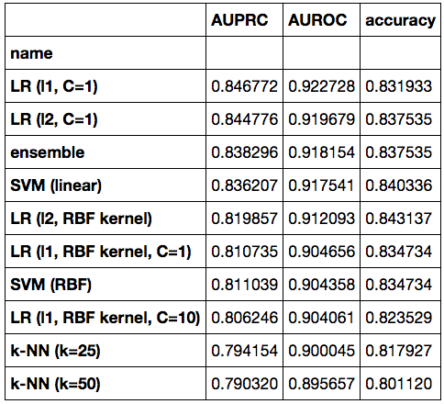
Results of emVar prediction: from single model to ensemble
Features
  Allele expression values
  Difference in expression
  Absolute difference in expression
Candidate models
  Logistic regression
  Random forest
  SVM
  One-class SVM
  K-nearest neighbor
Multiple models averaged to produce final predictions
in ensemble
final model
in ensemble
in ensemble
in ensemble
in ensemble

Slide 21
Content
Task and data overview
Feature design
Algorithm design
Post-analysis

Slide 22
Post-analysis: feature importance in expression prediction
LASSO regression : Drives coefficients for unimportant features to zero
Train on the following features
Model | Functional Prediction | Num of features
KSM | TF binding | 57
DeepSEA | TF binding, histone mark, chromatin openness | 919
chromHMM | Chromatin segmentation | 18

Slide 23
The top 10 features with largest LASSO coefficient magnitude
Feature | Biological relevance | LASSO coefficient
DNase | Chromatin openness | 0.6635
IRF1 binding | Transcriptional regulator | 0.6587
H3K4me3 | Mark associated with promoter | 0.6101
EZH2 binding | Transcriptional repression | -0.4277
H3K4me1 | Mark associated with enhancer | -0.3999
PRDM1 binding | Transcriptional repression | 0.3075
ZNF274 binding | Transcriptional repression | 0.2951
Pol3 binding | Transcription | 0.2934
NFKB binding | Transcriptional regulator | 0.2897
CTCF binding | Regulating the 3D structure of chromatin | -0.2652

Slide 24
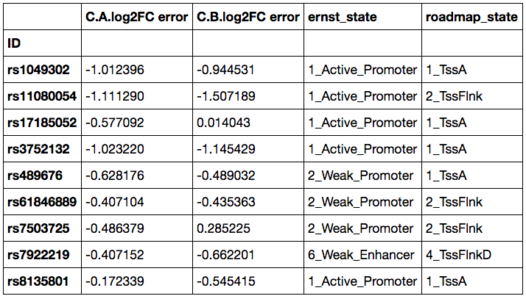
Post-analysis: specific missed predictions
Our expression prediction model (task1a) yielded overly large values for several sequences in annotated promoters:
Observed - Predicted

Slide 25
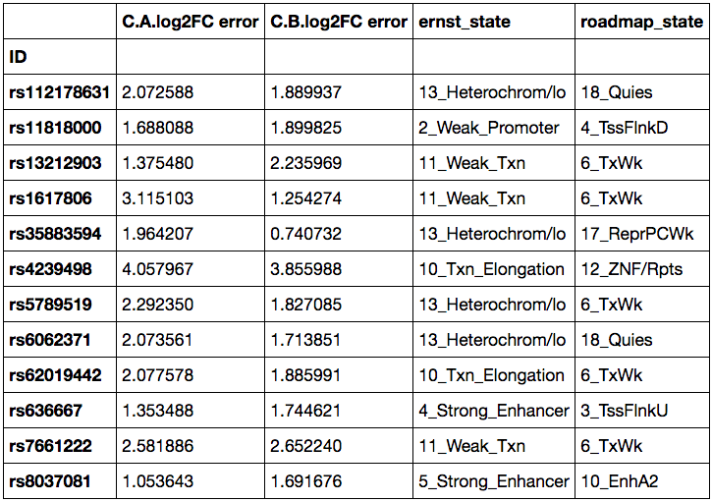
Post-analysis: specific missed predictions
It predicted values that were too low for a mixture of regions:
Observed - Predicted

Slide 26
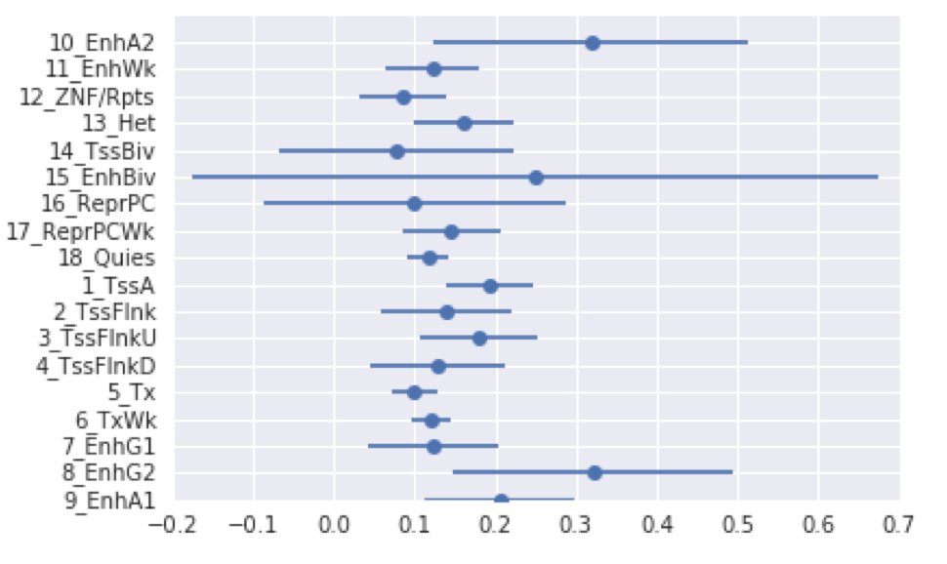
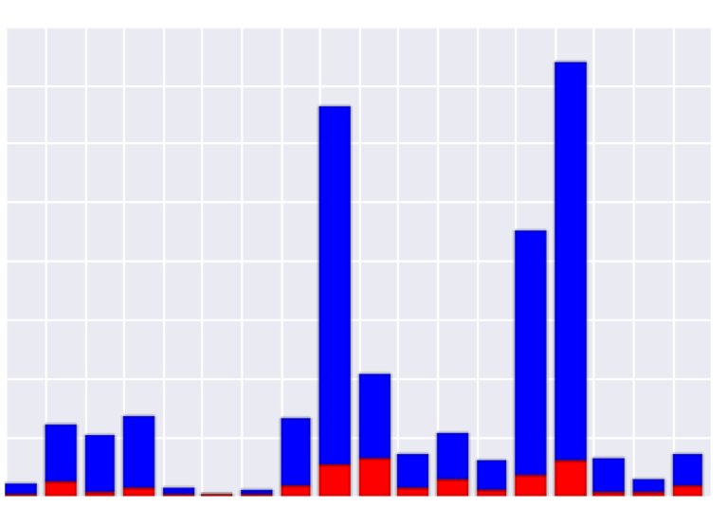
Post-analysis: Error rate for variants in different chromatin state
Significant Expression (“RegHit”) Prediction
Positive variant
Negative variant
Chromatin state
Error rate estimate
Num of variants

Slide 27
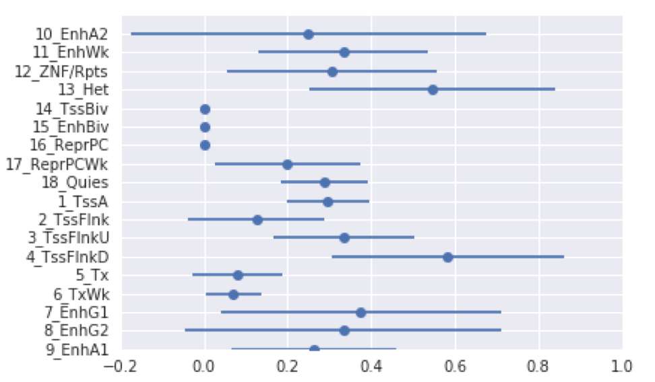
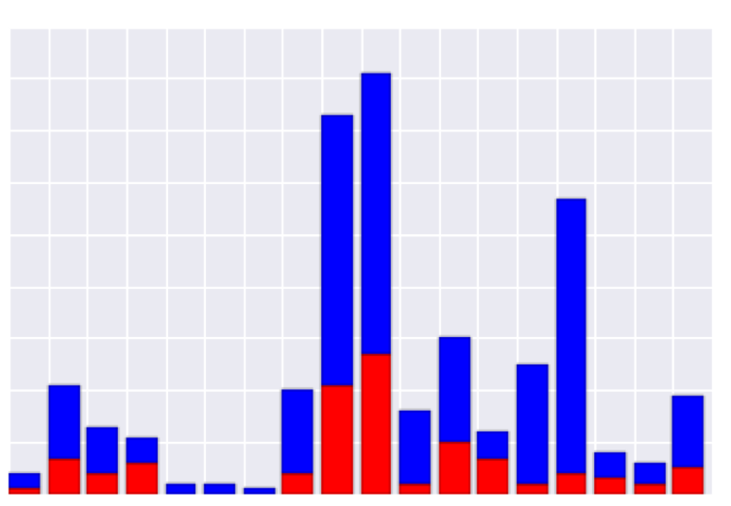
Post-analysis: Error rate for variants in different chromatin state
Significant Allele-specific Expression (“emVar”) Prediction
Positive variant
Negative variant
Chromatin state
Error rate estimate
Num of variants

Slide 28
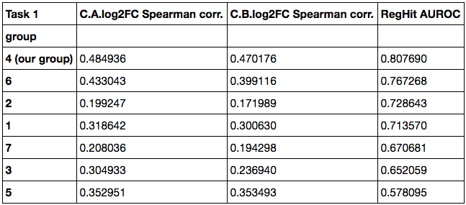
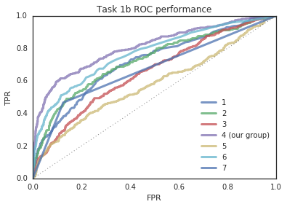
Relative performance on test set --- task1

Slide 29
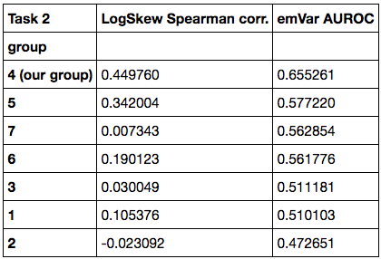
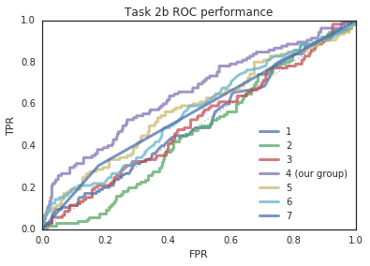
Relative performance on test set --- task2

Slide 30
Comparison of approaches
Group: | 1 | 2 | 3 | 4 (*) | 5 | 6 | 7
Sequence features (k-mers) |  |  | ✓ |  | ✓
TF binding Motif [transfer learning] | ✓ |  |  | ✓ |  | ✓
DeepBind [transfer learning] features |  |  |  | ✓ |  | ✓
DeepSEA [transfer learning] features |  |  |  | ✓ |  |  | ✓
Basset [transfer learning] features |  | ✓
Conservation features | ✓
ENCODE track features | ✓ | ✓ |  |  |  | ✓
Genome segmentation features |  |  |  | ✓
Multiple prediction models | ✓ | ✓ |  | ✓
(*) our group

Slide 31
Take-home messages
Feature transformation from sequence to functional elements is important for sequence-based tasks
An ensemble model outperforms single ones by combining complementary information
The diversity of functional data is important for expression prediction
Notes:
Final bullet note: simple linear model we used may not be appropriate… train for each possible type of element, etc.?

Slide 33
Backup slides

Slide 34
General approach --- Task1a
Control expression
Sequence +
genome location
Task1a model
Log2FC = log(expt) - log(ctl)
Expt expression

Slide 35
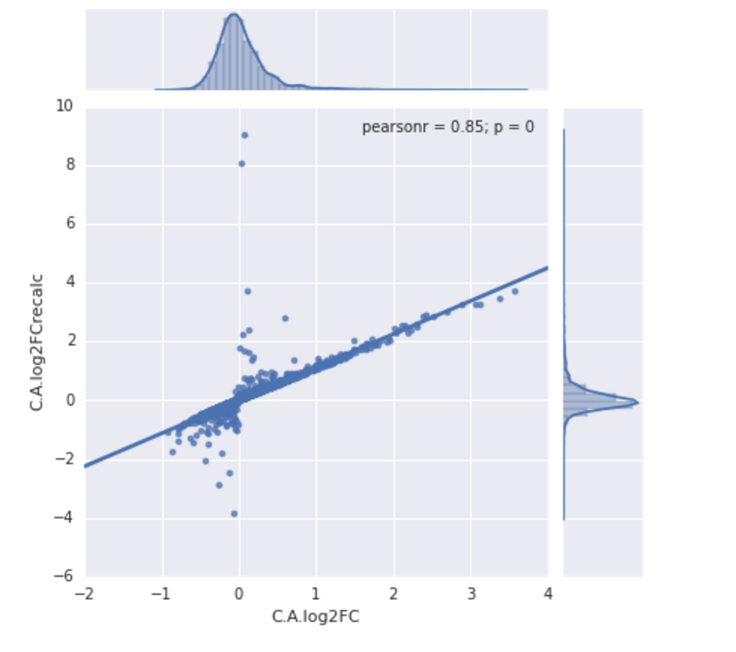
General approach --- Task1a
Log2FC is not exactly the log quotient of the raw expression values, but depends on some other (missing) normalization constant or noise measurement.

Slide 36
General approach --- Task1a
The approach used in our submission:
Sequence +
genome location
Log2FC

Slide 37
General approach --- Task1b
Task1a
Task1b
Sequence/
genome location
Log2FC
RegHit

Slide 38
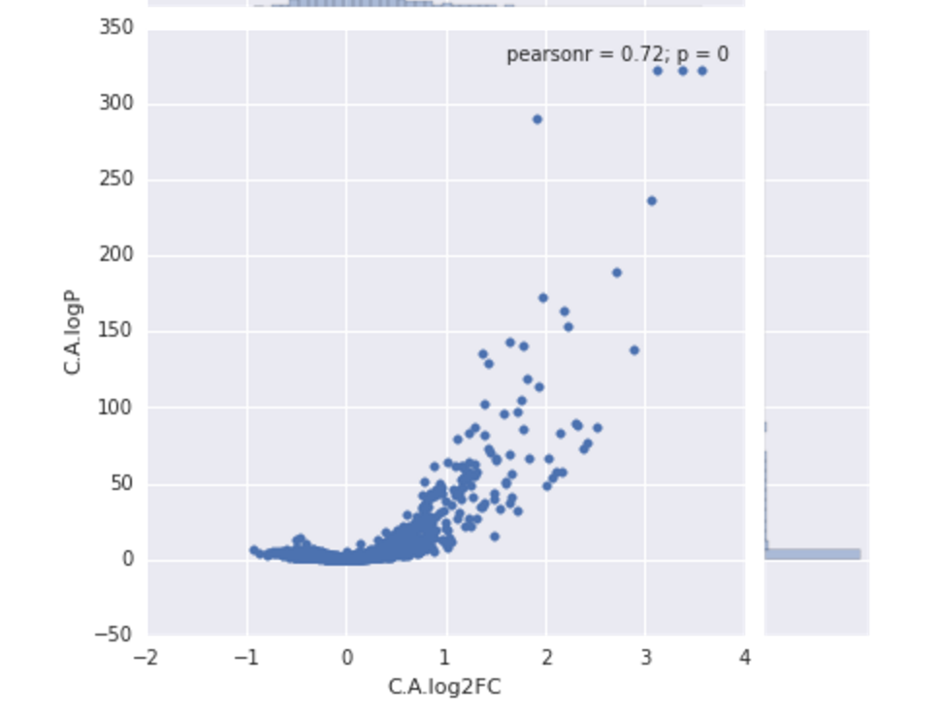
General approach --- Task1b
The relationship between log2FC and logP (therefore RegHit) is not clear

Slide 39
General approach --- Task1b
The approach used in our submission
Sequence +
genome location
RegHit

Slide 40
Task1b label clarification
logPadj of two alleles
RegHit label per variant
RegHit label per allele
Let logPadj_m = max(logPadj_ref), logPadj_alt) for any variant
For non-RegHit variant, max{logPadj_m} = 1.997103882
For RegHit variant, min{logPadj_m} = 2.036411752
A variant is RegHit if and only if at least one allele has logPadj > 2
Notes:
The math statements are pretty hard to read here

Slide 41
Task1b label clarification
RegHit label per variant
RegHit label per allele
p(RegHit_var) = 1 - [1-p(RegHit_ref)] x [1-p(RegHit_alt)]
Notes:
The math statements are pretty hard to read here

Slide 42
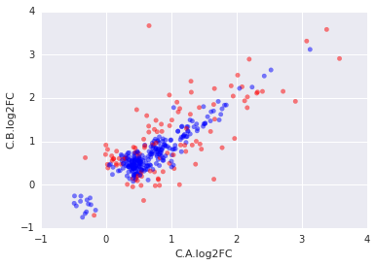
Task 2 --- Significant allele-specific expression prediction
emVar (allele-specific expression) label is a function of the expression levels (logFC) of the two alleles of a variant
emVar
not emVar
Notes:
Again, there’s probably some hidden noise measurement that’s used in the differential test that makes it hard to separate perfectly.

Slide 43
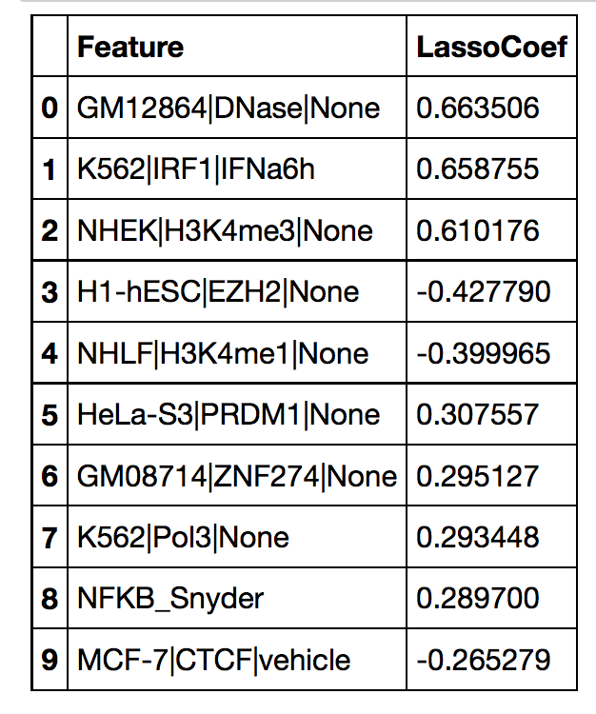
Notes:
Again, there’s probably some hidden noise measurement that’s used in the differential test that makes it hard to separate perfectly.

Slide 44
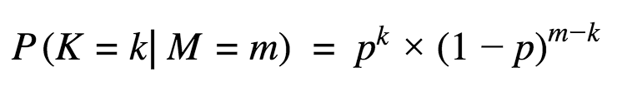


Post-analysis: Error rate for variants in different chromatin state
For a given chromatin state, let the M = # of variants in this state, K= # of them that were mistakenly classified, p= the error rate on each variant in this state

Slide 45
Unused ideas or directions
Type of tested variant (indel or SNP)
Identity of lead eQTL gene
Any eQTL statistic
Any external MPRA dataset (beyond the given one in the challenge)

