Slide 1

CAGI slide pack guidelines
I agree to my slides being used according to the following terms:
_______Ryan Tewhey_______
Authors: please include THIS slide at the beginning of your presentation to indicate that you agree with reuse of your slides in CAGI presentations, according to the terms below, and digitally sign by writing your name above.
To disseminate the CAGI results, I encourage all CAGI participants to remix these CAGI slides for inclusion in their oral and poster presentations
CAGI participants may use or publish any content of these slides only in compliance with the CAGI Data Use Agreement
CAGI participants may not cite or publish any content of these slides except with the written permission of the originating author or in the primary CAGI publications
CAGI participants must acknowledge the original authors of these slides and CAGI 2013. Include the acknowledgement banner across the bottom
CAGI participants must include the CAGI credits slide in their presentations
Slides with a red slash (no remix) may not be included in a presentation unless all attendees are registered CAGI participants who signed the data use agreement
Slides with a red X over the entire slide may not be used in any circumstances
Slides with a blue slash (embargoed) may not be used unless the embargo is explicitly lifted
Slides without slash or X may be tweeted unless flagged with the “No tweet” icon.
CAGI participants using these slides must explain the “No tweet” icon, which means that the slide content should not be disseminated outside the presenting conference hall. If the presentation venue permits pervasive tweeting, you may not include these slides in your talk
Note for slide authors: we expect all CAGI participants to abide by these restrictions, and will make best effort to ensure they are followed. However, but bear in mind that we have limited means of enforcing them, and therefore the restrictions cannot be guaranteed.

Slide 2


Direct identification of expression modifying variants using a multiplexed reporter assay
Ryan Tewhey
Laboratory of Pardis Sabeti
Harvard University & Broad Institute
CAGI 4 Conference
March 24th, 2016
Notes:
GWAS loci

Slide 3
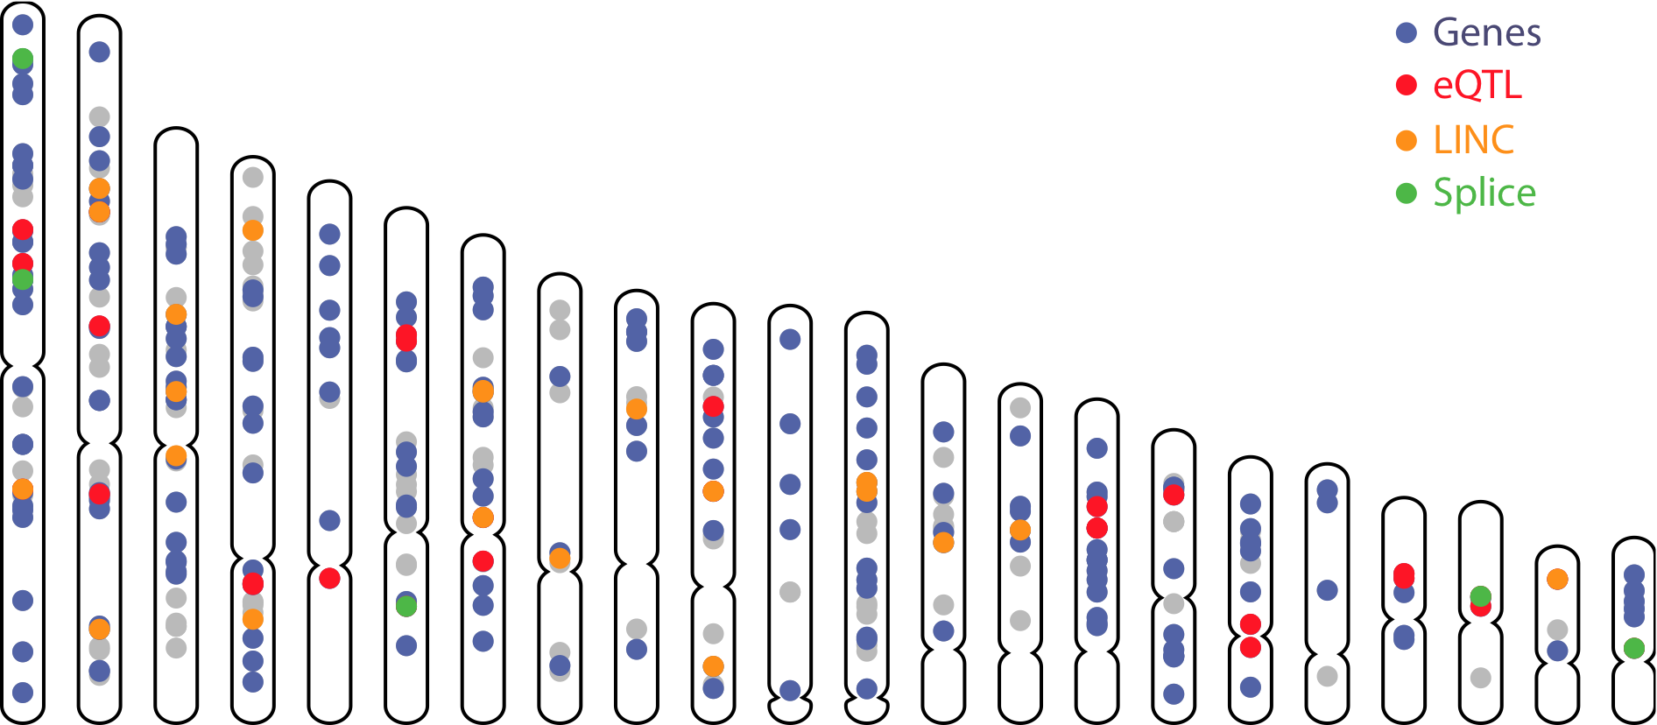
The Success of Genome Wide Association Studies
Created for CAGI 4
R. Tewhey
genomeinterpretation.org
Notes:
GWAS loci

Slide 4
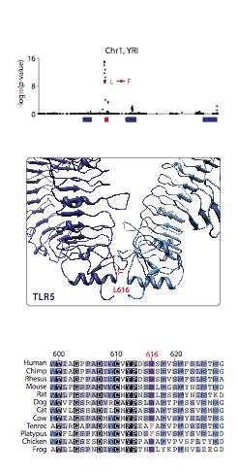
The Success of Genome Wide Association Studies
Computational Annotation
Created for CAGI 4
R. Tewhey
genomeinterpretation.org
Notes:
GWAS loci

Slide 5
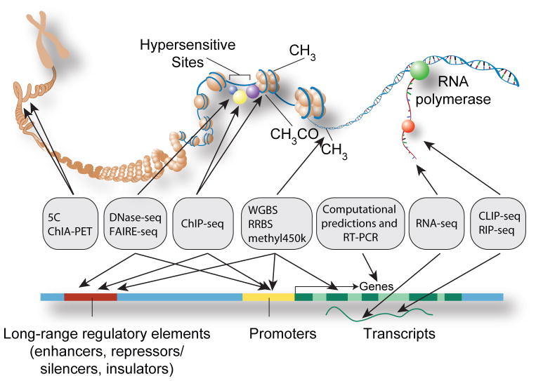
The Success of Genome Wide Association Studies
Computational Annotation
Pazin M.J.
Created for CAGI 4
R. Tewhey
genomeinterpretation.org
Notes:
GWAS loci

Slide 6
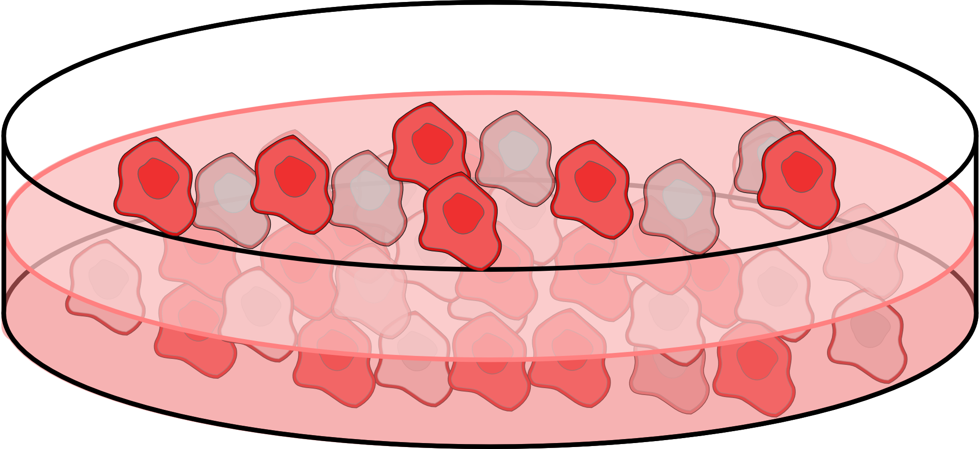
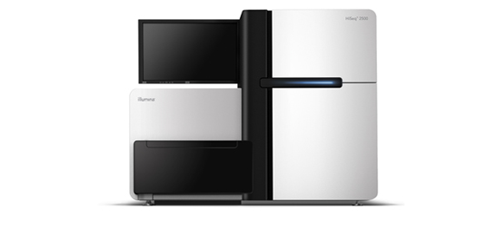
The Success of Genome Wide Association Studies
Computational Annotation
High Throughput
Characterization
Created for CAGI 4
R. Tewhey
genomeinterpretation.org
Notes:
GWAS loci

Slide 7




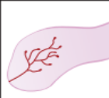
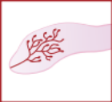


The Success of Genome Wide Association Studies
Computational Annotation
High Throughput
Characterization
Phenotype Models
Created for CAGI 4
R. Tewhey
genomeinterpretation.org
Notes:
GWAS loci

Slide 8
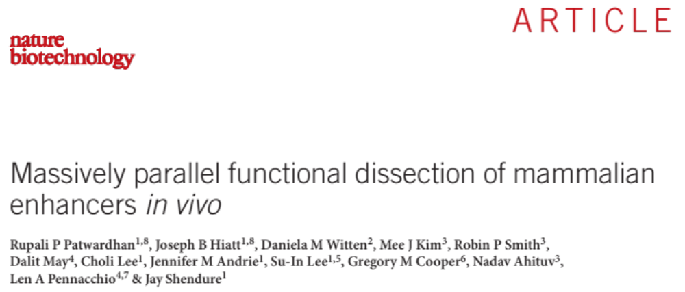
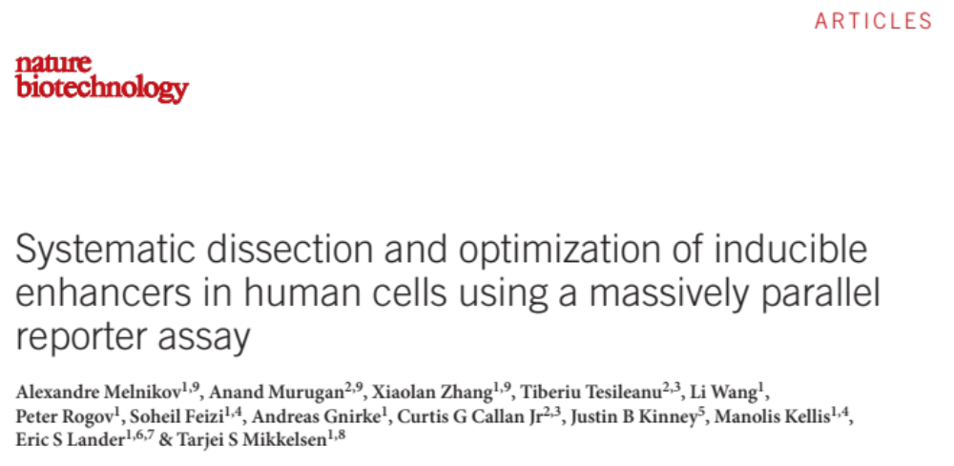
Testing Non-coding Sequence
Created for CAGI 4
R. Tewhey
genomeinterpretation.org
Notes:
MPRA – method overview

Slide 9
Benchmarking MPRA for Identifying Causal Variants
Analyzed the Geuvadis Consortium’s RNA-seq of lymphoblastoid cell lines
  Called eQTL peaks in EUR (3171) & YRI (471) populations
Targeted 29k SNPs and small indels
  For every eQTL peak in the Geuvadis dataset (EUR & YRI) selected the top associated variant and all variants in perfect LD. (EUR = CAGI)
  For 209 eQTLs that overlap GWAS variants we selected all variants with an r² of 0.9 or greater.
  Additional smaller subprojects
Created for CAGI 4
R. Tewhey
genomeinterpretation.org
Notes:
Experimental Setup (Geuvadis)

Slide 10
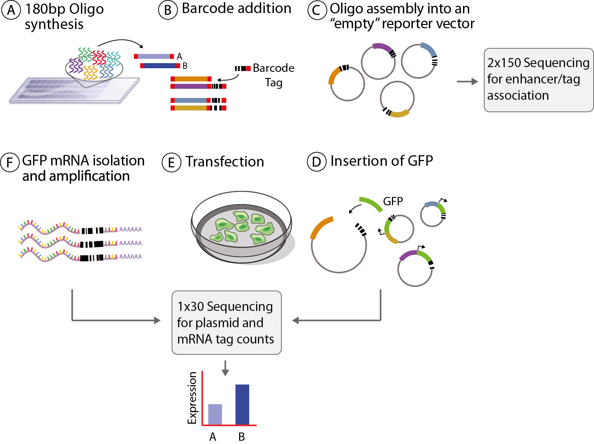
Massively Parallel Reporter Assay (MPRA)
Created for CAGI 4
R. Tewhey
genomeinterpretation.org
Notes:
MPRA – method overview

Slide 11
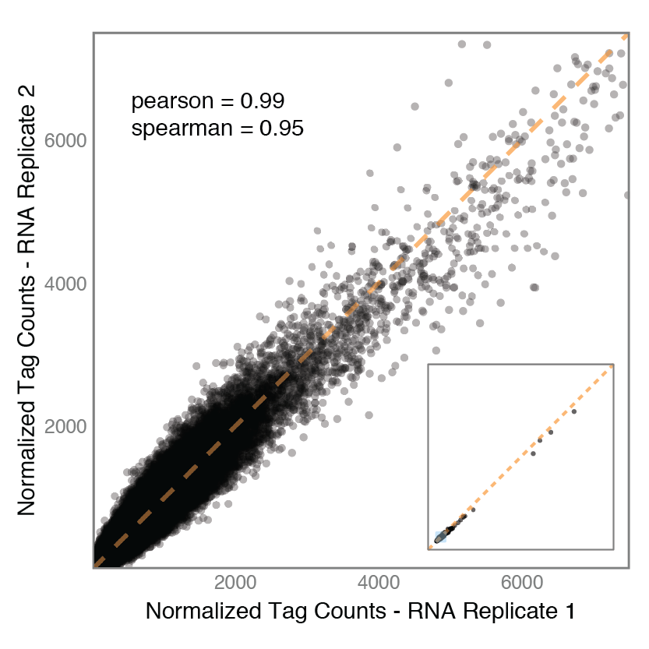
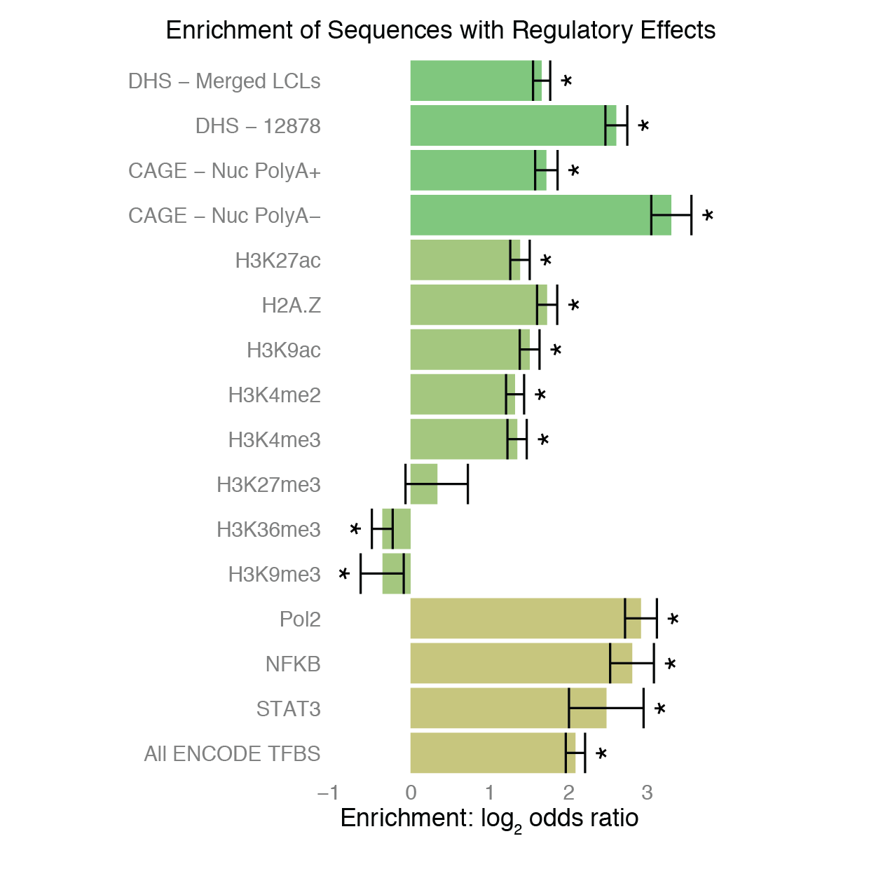
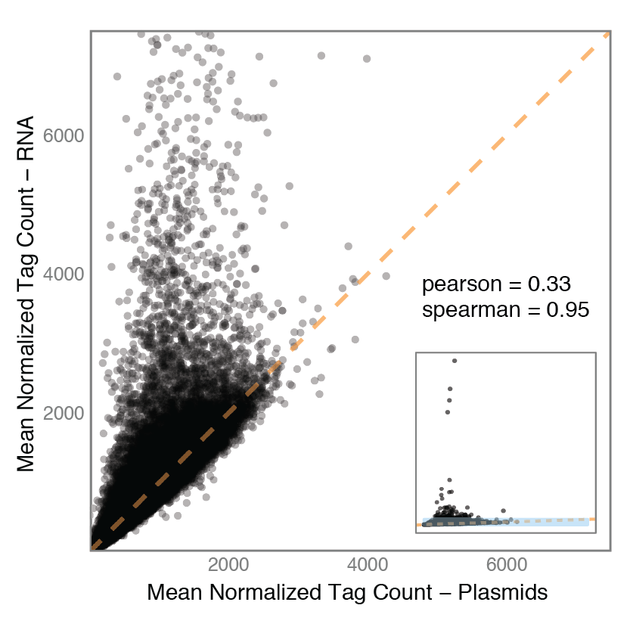
Measuring Expression Activity
Created for CAGI 4
R. Tewhey
genomeinterpretation.org
Notes:
Data quality

Slide 12
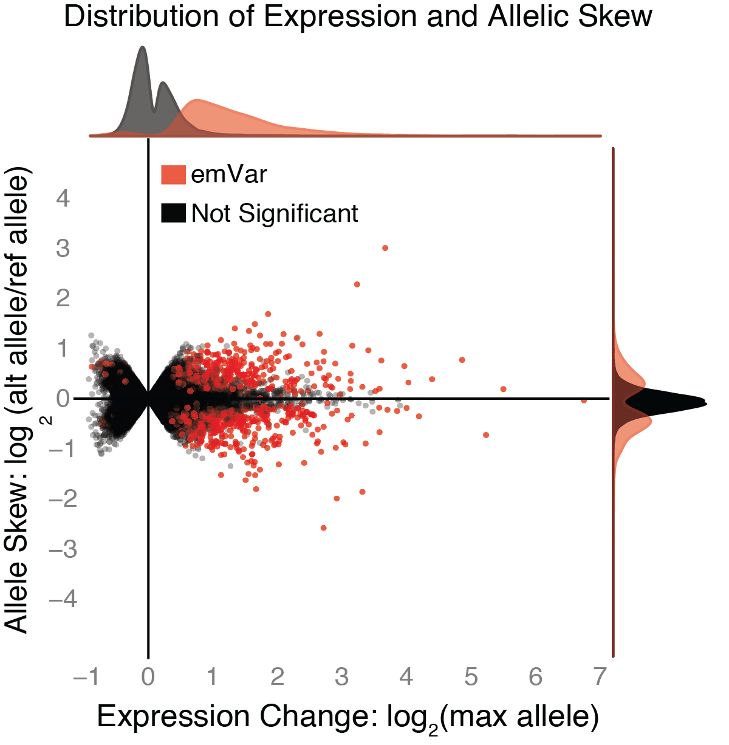
Detecting Expression Modifying Variants (emVars)
In the total dataset we detected 842 emVars.
Only 46 emVars had a 2-fold change or greater between the two alleles.
Created for CAGI 4
R. Tewhey
genomeinterpretation.org
Notes:
GWAS loci

Slide 13
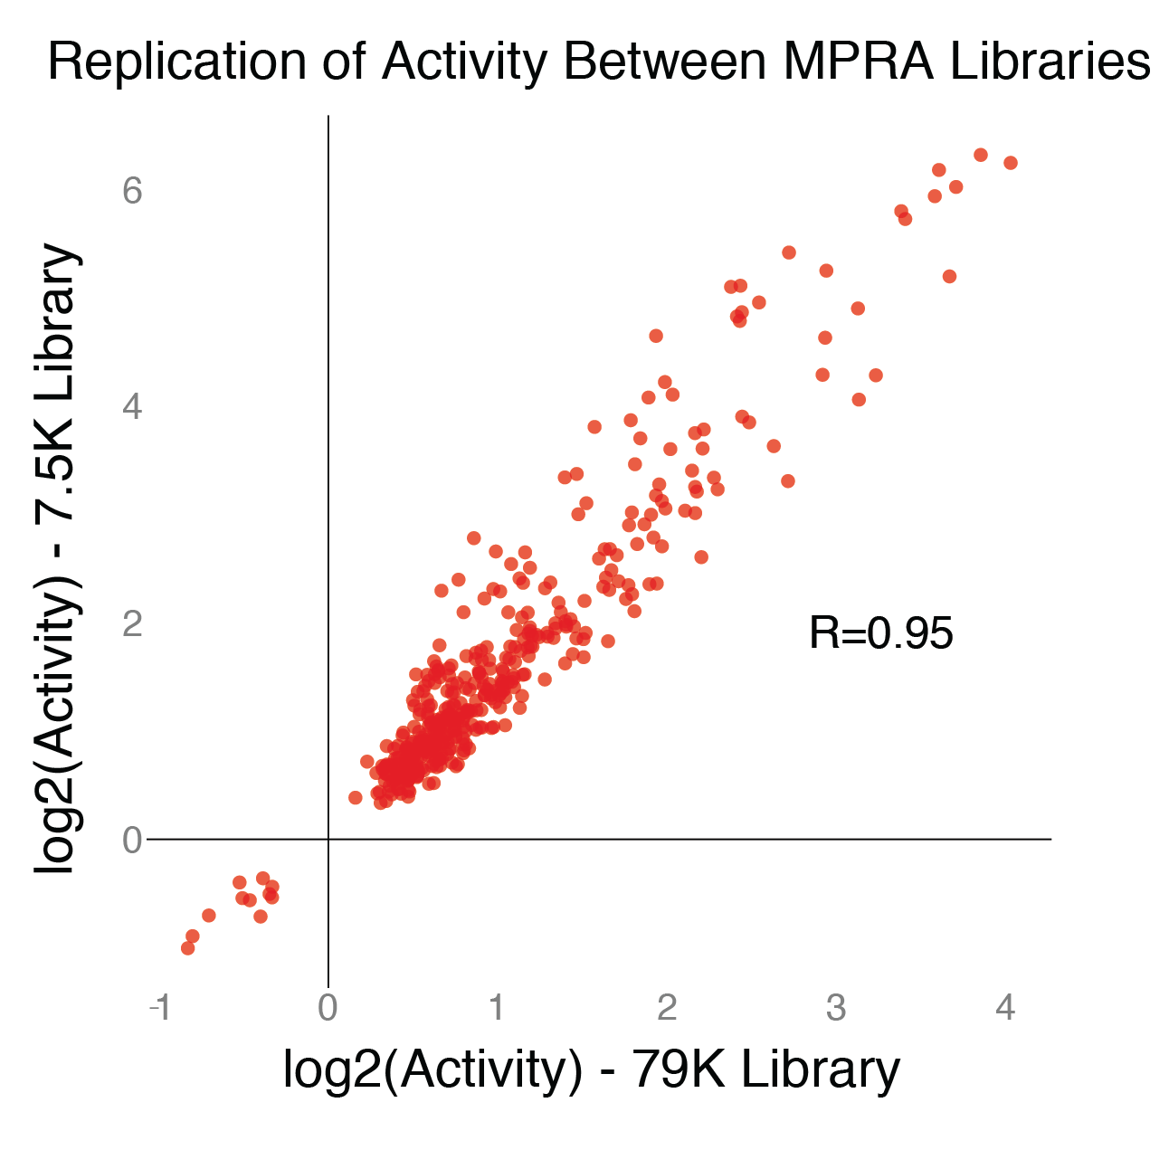
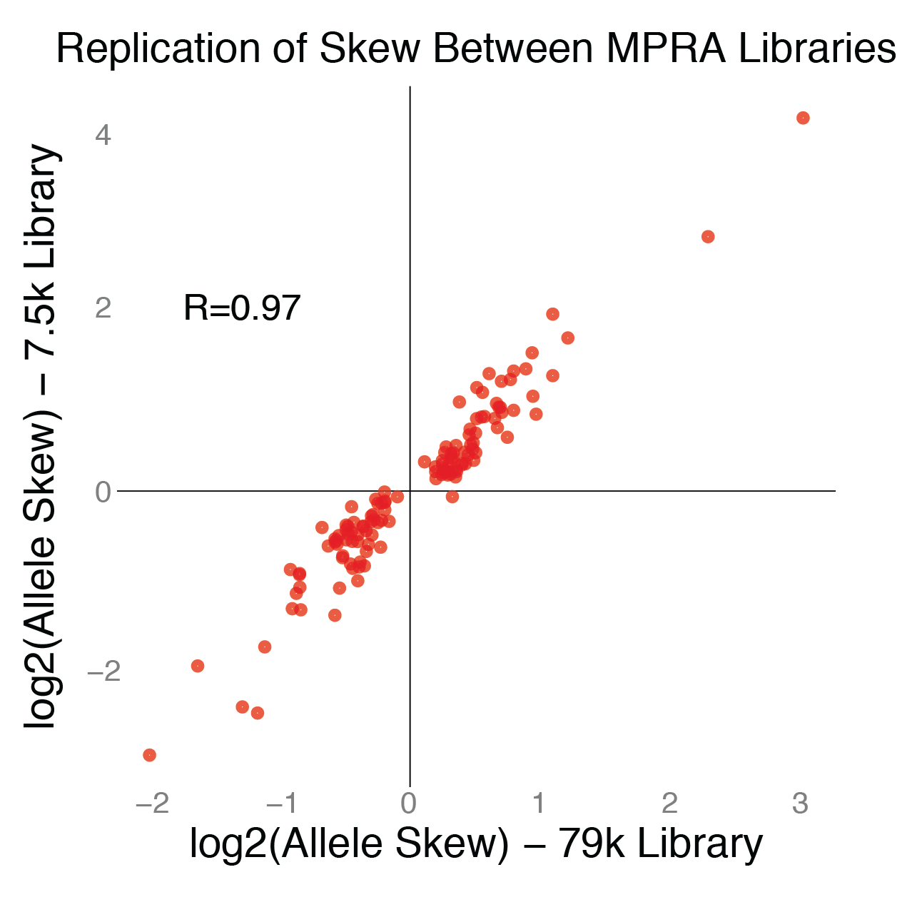
Detecting Expression Modifying Variants (emVars)
Activity and skew measurements are highly reproducible across unique libraries
Created for CAGI 4
R. Tewhey
genomeinterpretation.org
Notes:
GWAS loci

Slide 14
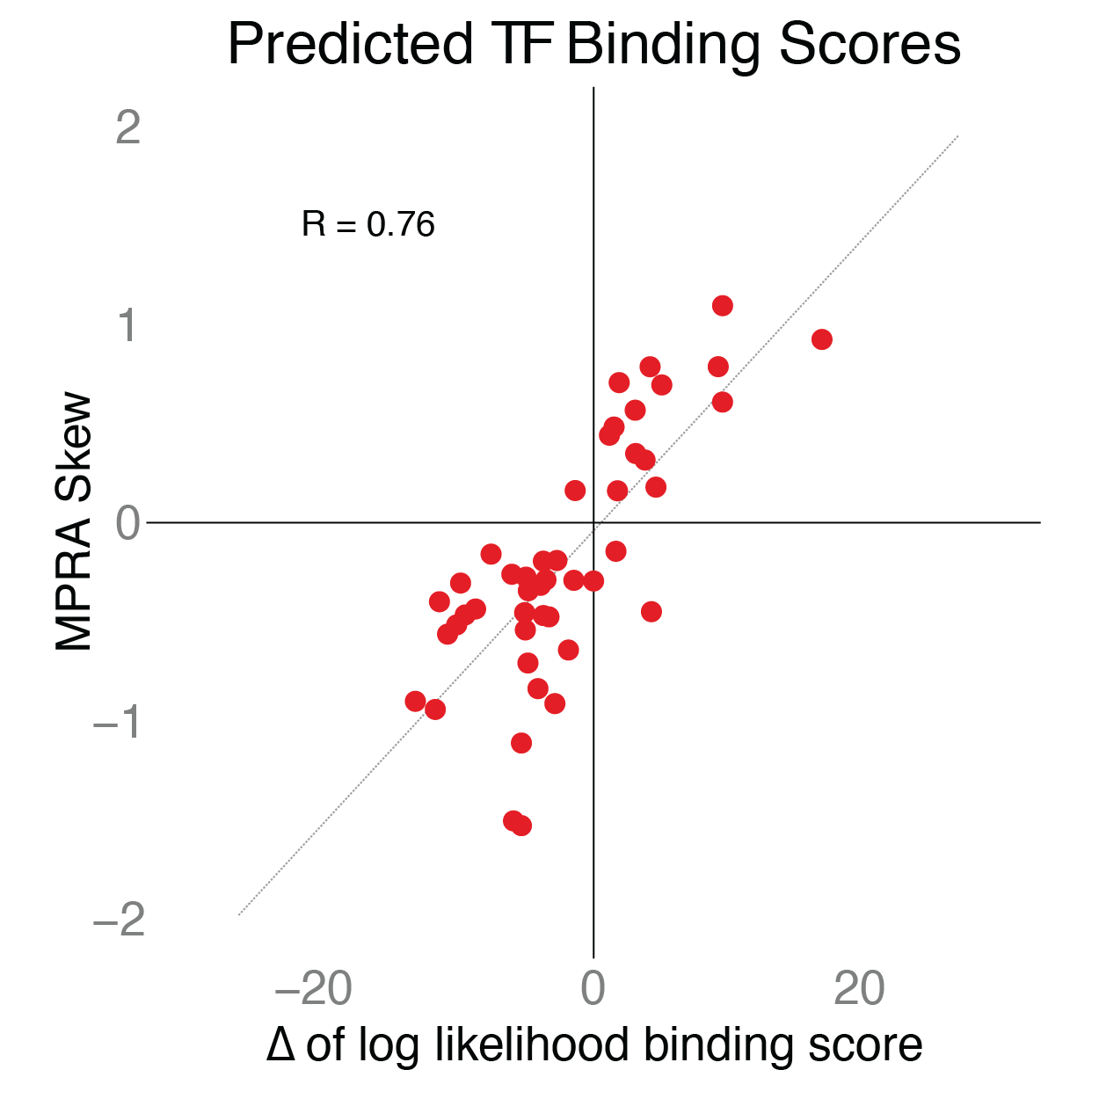
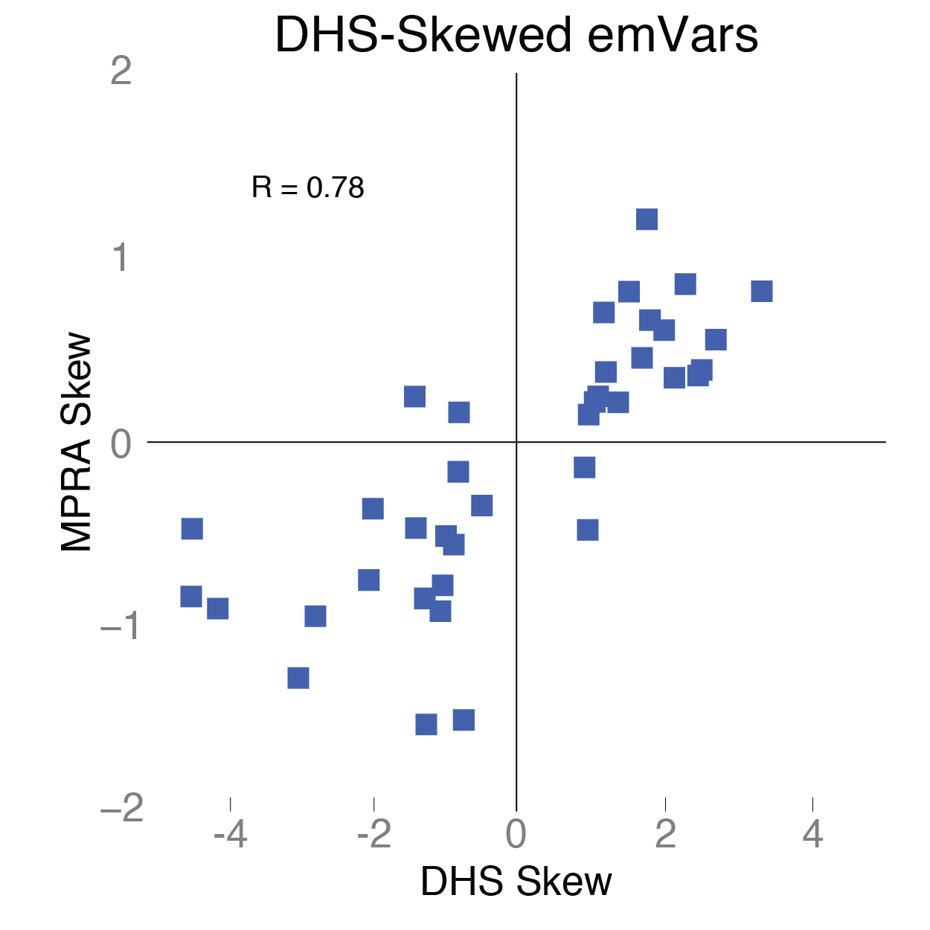
Detecting Expression Modifying Variants (emVars)
emVars are correlated with existing measures of allelic skew
Created for CAGI 4
R. Tewhey
genomeinterpretation.org
Notes:
GWAS loci

Slide 15
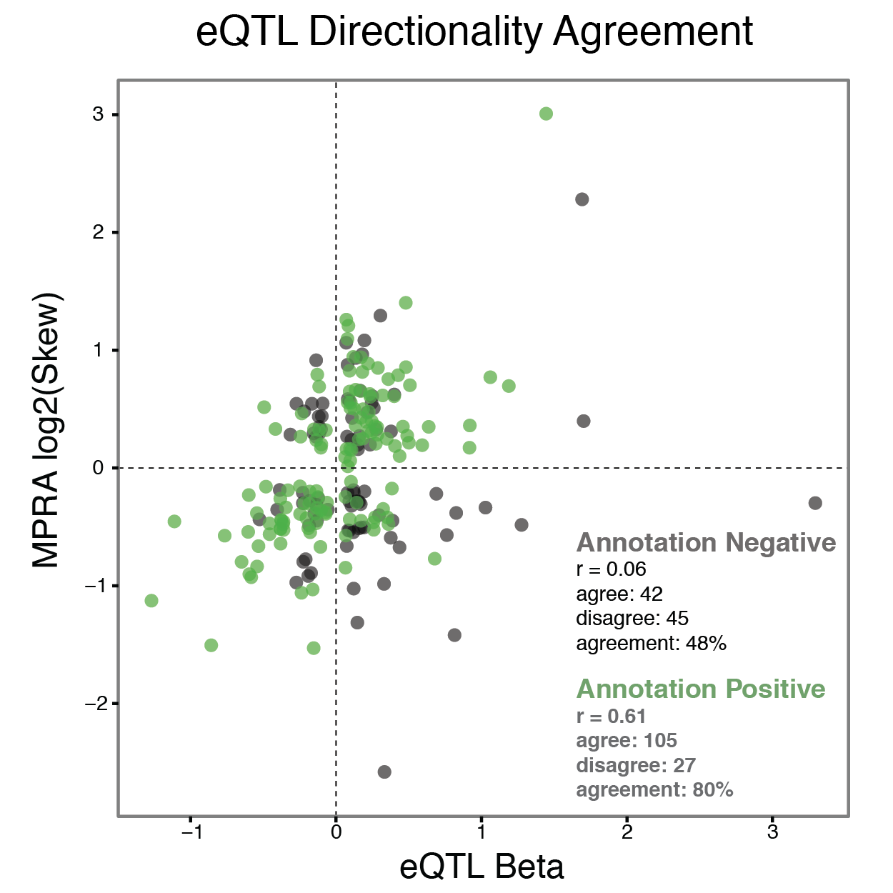
Detecting Expression Modifying Variants (emVars)
Estimating the PPV
eQTL Directionality: 34% (annot + 59%)
Negative Controls: 58-68%
Created for CAGI 4
R. Tewhey
genomeinterpretation.org
Notes:
GWAS loci

Slide 16
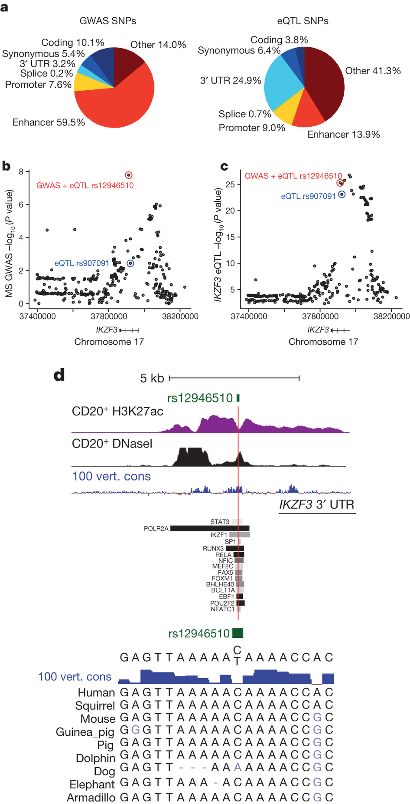
Detecting Expression Modifying Variants (emVars)
Estimating the PPV
eQTL Directionality: 34% (annot + 59%)
Negative Controls: 58-68%
Estimating the Sensitivity
Experimental Sensitivity
273/3171 EUR eQTL peaks (8.6%)
65/471 YRI eQTL peaks (13.8%)
Assay Sensitivity
Adjusted for PPV & LD: 9-24%
Farh et al. Nature 2015
Created for CAGI 4
R. Tewhey
genomeinterpretation.org
Notes:
Enhancer/Promoter eQTLs
23-64%

Slide 17
Detecting Expression Modifying Variants (emVars)
Estimating the PPV
eQTL Directionality: 34% (annot + 59%)
Negative Controls: 58-68%
Estimating the Sensitivity
Experimental Sensitivity
273/3171 EUR eQTL peaks (8.6%)
65/471 YRI eQTL peaks (13.8%)
Assay Sensitivity
Adjusted for PPV & LD: 9-24%
Farh et al. Nature 2015
Created for CAGI 4
R. Tewhey
genomeinterpretation.org
Notes:
GWAS loci

Slide 18
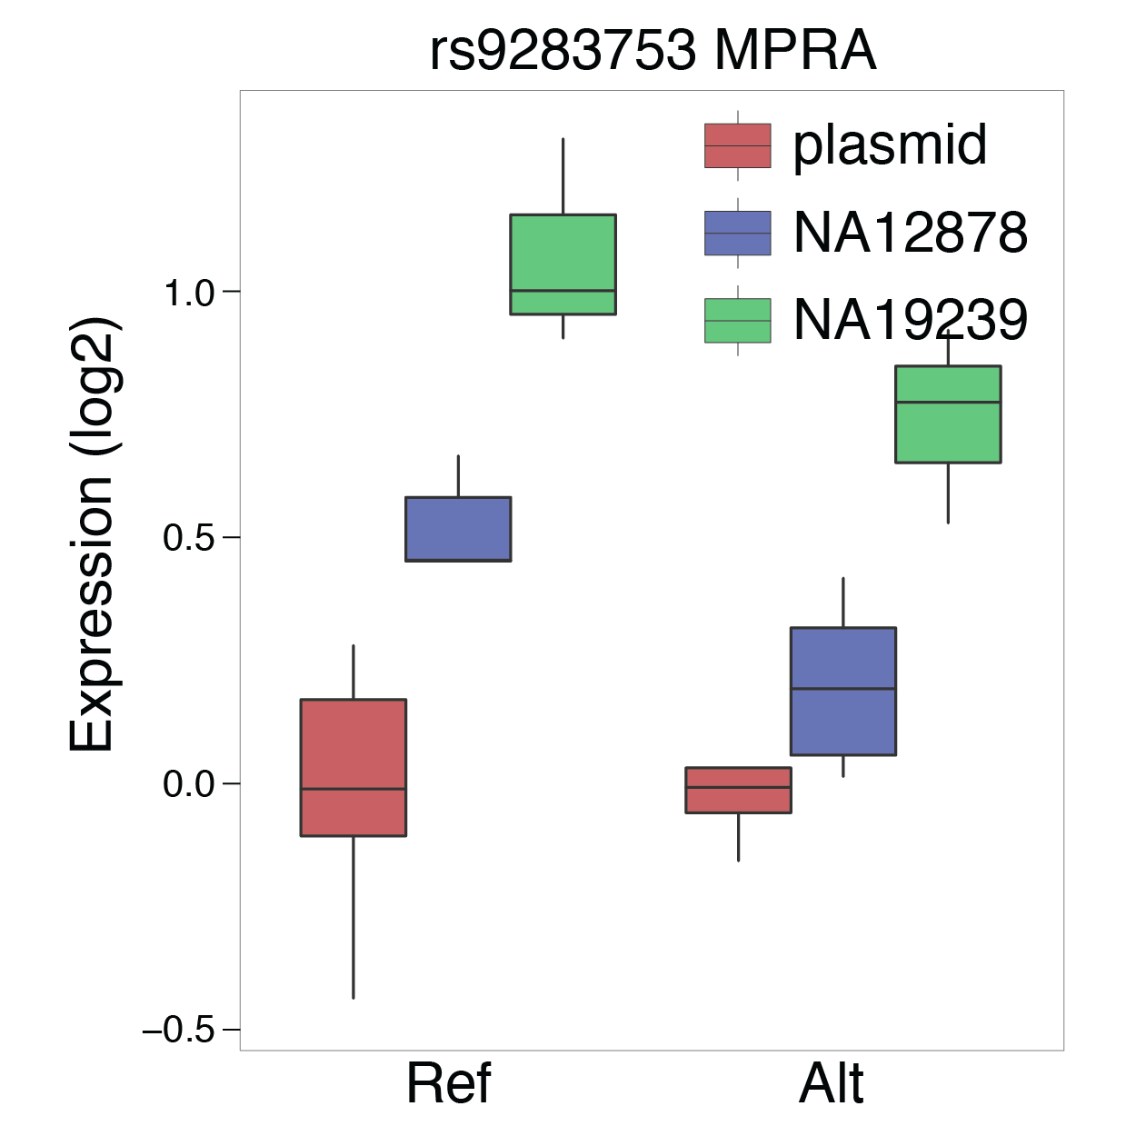
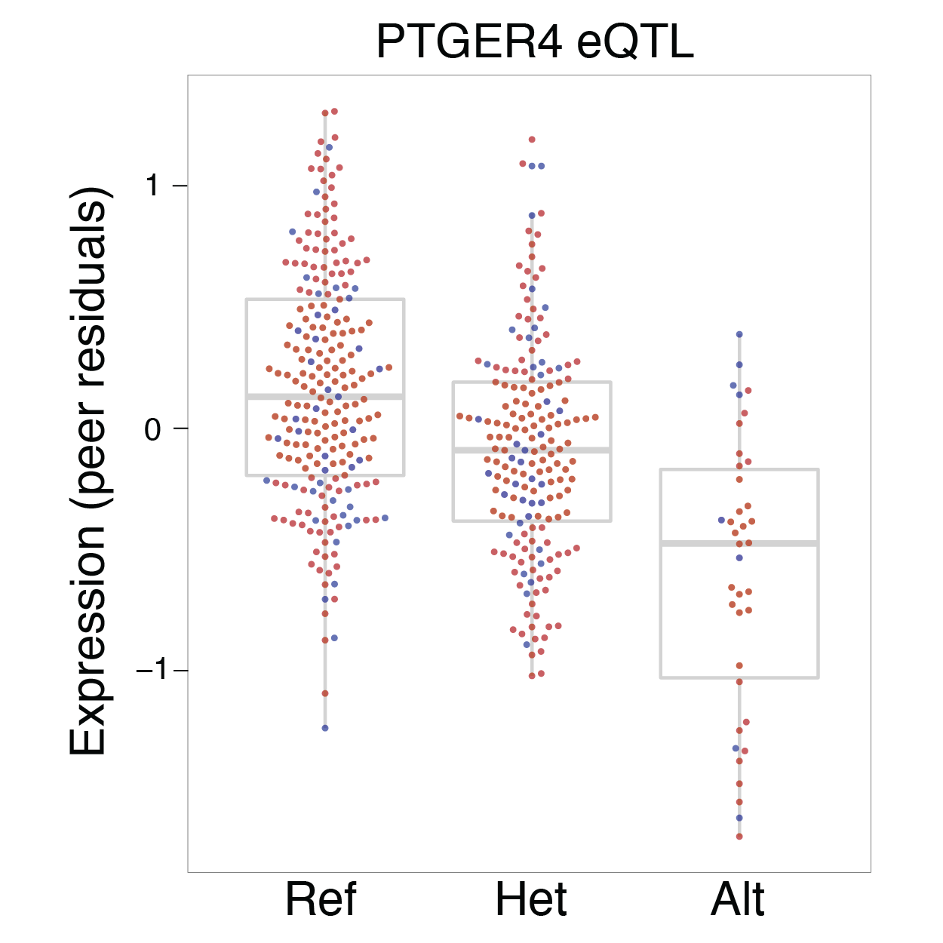
eQTL Variant at PTGER4
Distal enhancer with haplotype association with ankylosing spondylitis
Created for CAGI 4
R. Tewhey
genomeinterpretation.org
Notes:
GWAS loci

Slide 19
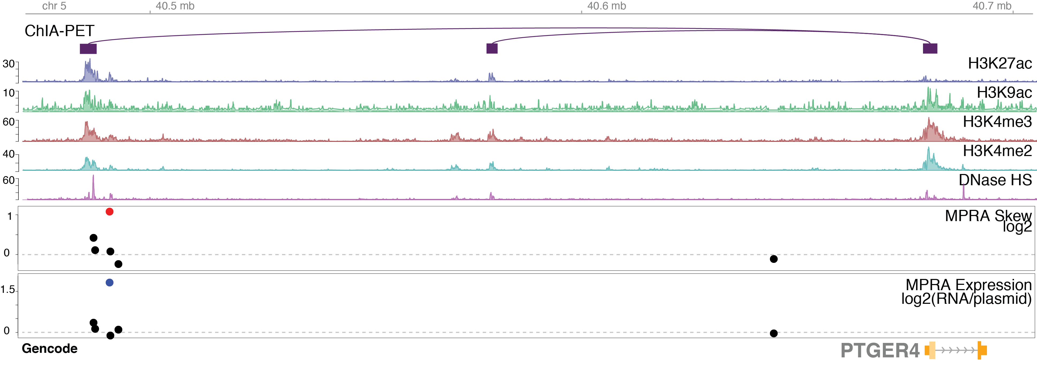
eQTL Variant at PTGER4
Created for CAGI 4
R. Tewhey
genomeinterpretation.org
Notes:
GWAS loci

Slide 20
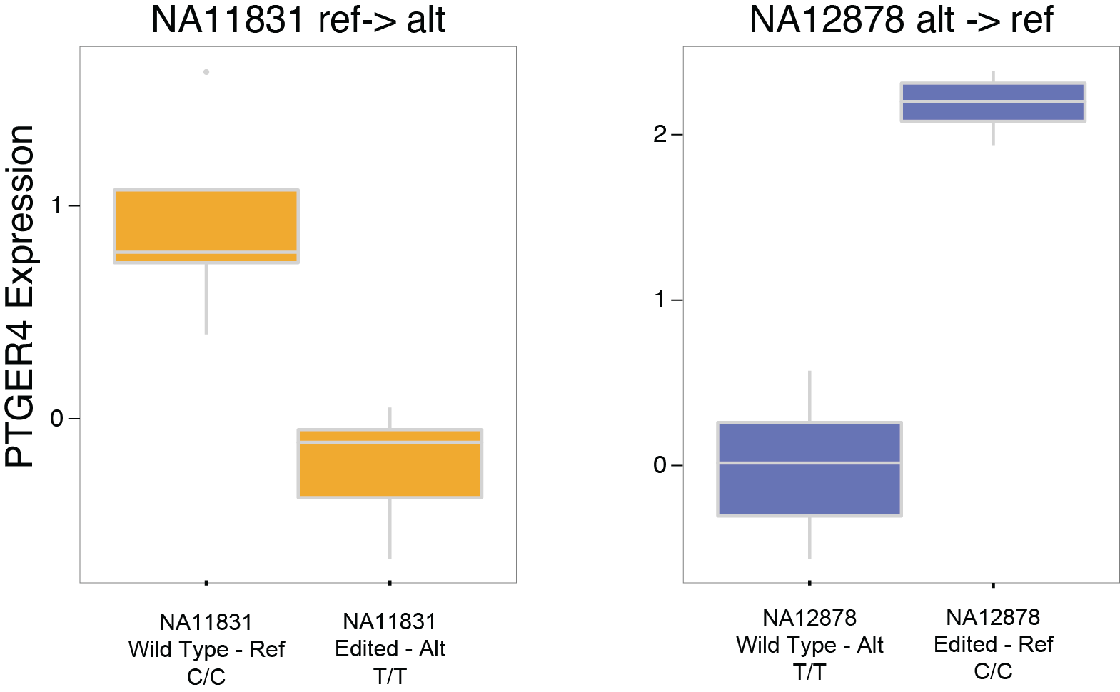
eQTL Variant at PTGER4
Created for CAGI 4
R. Tewhey
genomeinterpretation.org
Notes:
GWAS loci

Slide 21



Acknowledgements
Pardis Sabeti
Daniel S. Park
Dylan Kotliar
Tarjei Mikkelsen
Brandon Liu
Created for CAGI 4
R. Tewhey
genomeinterpretation.org
Notes:
GWAS loci

