Slide 1

CAGI slide pack guidelines
I agree to my slides being used according to the following terms:
_______ Anat Kreimer_______
Authors: please include THIS slide at the beginning of your presentation to indicate that you agree with reuse of your slides in CAGI presentations, according to the terms below, and digitally sign by writing your name above.
To disseminate the CAGI results, I encourage all CAGI participants to remix these CAGI slides for inclusion in their oral and poster presentations
CAGI participants may use or publish any content of these slides only in compliance with the CAGI Data Use Agreement
CAGI participants may not cite or publish any content of these slides except with the written permission of the originating author or in the primary CAGI publications
CAGI participants must acknowledge the original authors of these slides and CAGI 2013. Include the acknowledgement banner across the bottom
CAGI participants must include the CAGI credits slide in their presentations
Slides with a red slash (no remix) may not be included in a presentation unless all attendees are registered CAGI participants who signed the data use agreement
Slides with a red X over the entire slide may not be used in any circumstances
Slides with a blue slash (embargoed) may not be used unless the embargo is explicitly lifted
Slides without slash or X may be tweeted unless flagged with the “No tweet” icon.
CAGI participants using these slides must explain the “No tweet” icon, which means that the slide content should not be disseminated outside the presenting conference hall. If the presentation venue permits pervasive tweeting, you may not include these slides in your talk
Note for slide authors: we expect all CAGI participants to abide by these restrictions, and will make best effort to ensure they are followed. However, but bear in mind that we have limited means of enforcing them, and therefore the restrictions cannot be guaranteed.

Slide 2

CAGI 2016 eQTL causal SNPs Assessment
Anat Kreimer
Nir Yosef’s lab
UC Berkeley
Created for CAGI 4
genomeinterpretation.org
Anat Kreimer

Slide 3
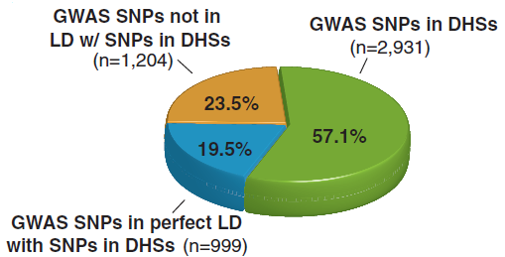
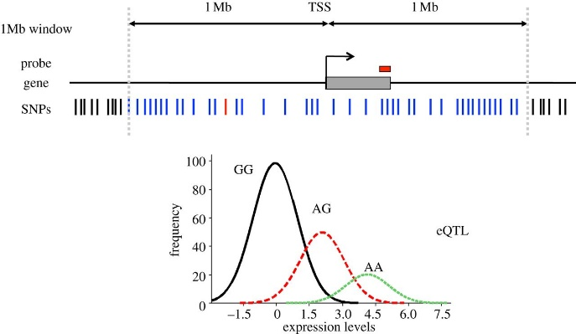
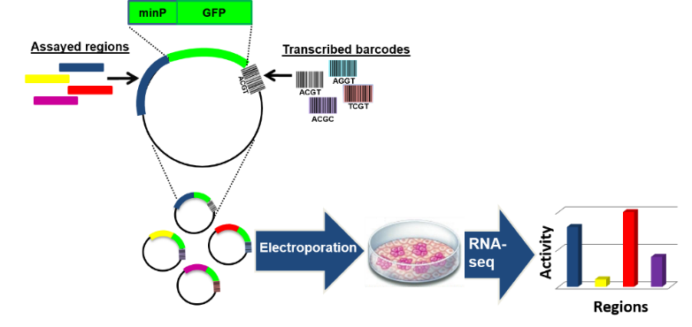
Introduction - Motivation
A significant portion of genetic aberrations that are associated with human disease are located in regulatory regions.
(Maurano et al. 2012)
Systematic investigation of variants associated with gene expression in such loci can therefore contribute to the identification of important polymorphisms.
The data provided for this challenge comes from exactly such screen, whereby thousands of potential regulatory sequences harboring a SNP or a small insertion/deletion polymorphism were directly tested for activity using massive parallel reporter assays (MPRA).
(Nica et al. 2013)
(Tewhey et al.)
Created for CAGI 4
genomeinterpretation.org
Anat Kreimer
Notes:
A massively parallel reporter assay (MPRA) has been applied to thousands of single nucleotide polymorphisms (SNPs) and small insertion/deletion polymorphisms in linkage disequilibrium (LD) with cis-expression quantitative trait loci (eQTLs). The results identify variants showing differential expression between alleles.
The eQTLs were drawn from the Geuvadis RNA-seq dataset of lymphoblastoid cell lines (LCLs) from individuals of European ancestry [7,8].
For each eQTL, all variants (range = 1 to 205, mean = 2.87, median = 1) in perfect LD with the top eQTL variant were identified.
The plasmid library was electroporated into two lymphoblastoid cell lines: five and three technical replicate experiments were performed using the cell lines NA12878 and NA19239, respectively. The assay results were averaged across the eight replicates.

Slide 4
Introduction - Data
9,116 variants linked to 3,157 eQTLs
SNPs or small insertion-deletion variants
Sample
3,044 variants associated with 1,052 eQTLs
Task 1
3,006 variants associated with 1,050 eQTLs
Task 2
401 variants
(3,066 variants associated with 1,055 eQTLs)
Ref
Alt
SNP
75NT
A
74NT
75NT
G
74NT
Deletion
74NT
TC
74NT
74NT
T
74NT
Insertion
74NT
A
74NT
74NT
AT
74NT
Created for CAGI 4
genomeinterpretation.org
Anat Kreimer
Notes:
Sample – training set
For each variant, a pair of 150-nt candidate regulatory sequence oligonucleotides was synthesized with the variant located at the central position (i.e. SNP at position 76). For insertion-deletion variants, the longer of the two alleles was designed as a 150-nt oligonucleotide; the shorter allele was then designed with the same flanking sequences as the longer allele (e.g., for a single-nucleotide InDel TC/C: 74N[TC]74N and 74N[T]74N).

Slide 5
Introduction – Data input
The training set provides for each variant:
Polymorphism | Expression | Regulatory effect | eQTL
rsID chromosome and position of the centered variant in hg19 sequences of the reference allele and alternate allele. | For the reference allele (C.A.) and the alternative allele (C.B.): log2 fold expression level (log2FC; RNA/plasmid). log2 ratio (alt/ref) of expression (LogSkew.Comb). Corresponding p-values. | Regulatory_Hit (0 = no significant effect, 1 = regulatory effect) emVar_Hit (0 = no significant effect, 1 = allelic skew) *em – expression modulating | eQTL associated gene eQTL beta eQTL t-statistic eQTL p-value
*Predicators could use any other type of data (e.g. histone marks, motif hits, etc.) based on genomic location
Created for CAGI 4
genomeinterpretation.org
Anat Kreimer
Notes:
A regulatory hit is a variant where one of the two alleles shows activity which is determined by having a BF corrected p-value if <= 0.01 (we use a negative binomial for sig testing via the DESeq2 package).
An emVar are regulatory variants where differential expression of the two alleles passes our q-value cutoff of 0.05 (we use a t-test to compare the ref/alt allele).
expression-modulating variants

Slide 6
Introduction – task 1
Data
Group | #Submissions | Methods
1 | 6 | Elasticnet, gbm, lasso, ridge, random forest, SVM
2 | 6 | gradient boosting
3 | 1 | SVM
4 | 1 | ensemble of regularized regression and classification
5 | 2 | gkm-SVM
6 | 3 | random forest
7 | 1 | random forest
3,006 variants (sequences)
Polymorphism and eQTL details
Output
Participants are asked to submit:
Predicted log2 expression level for the reference allele (C.A.) and the alternate allele (C.B.) (i.e. log2FC).
The probability that each sequence is a Regulatory Hit.
Standard deviation indicating confidence.
* Different submissions from the same group use different methods/features
Created for CAGI 4
genomeinterpretation.org
Anat Kreimer
Notes:
large SD means low confidence, and small SD means high confidence in the submitted prediction.

Slide 7
Introduction – task 2
Data
401 variants (sequences) defined as Regulatory hit
Polymorphism and eQTL details
Group | #Submissions | Methods
1 | 6 | Elasticnet, gbm, lasso, ridge, random forest, SVM
3 | 1 | SVM
4 | 1 | ensemble of regularized regression and classification
5 | 2 | gkm-SVM
6 | 2 | random forest
7 | 1 | random forest
Output
Participants are asked to submit:
Predictions of the log2 ratio of the expression level of the alt relative to ref allele (i.e. LogSkew.Comb).
The probability that each variant is an emVar hit.
Standard deviation indicating confidence.
* Different submissions from the same group use different methods/features
Created for CAGI 4
genomeinterpretation.org
Anat Kreimer

Slide 8
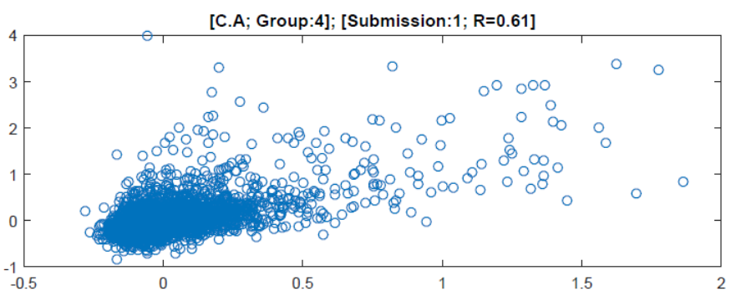
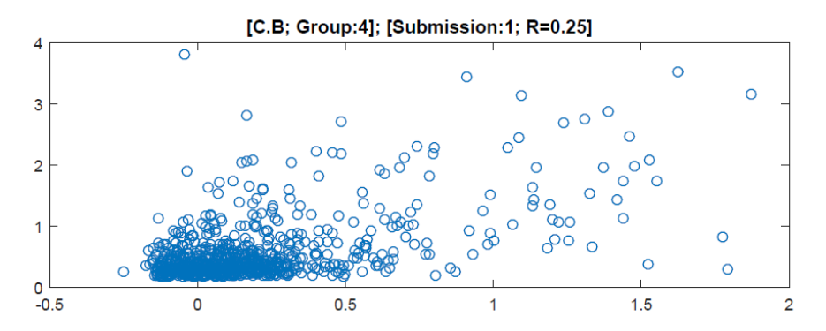
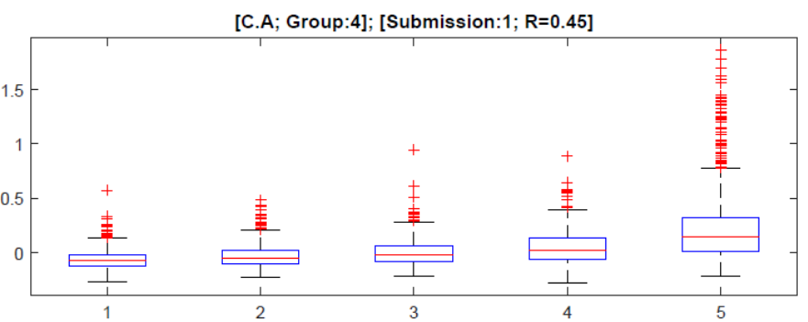
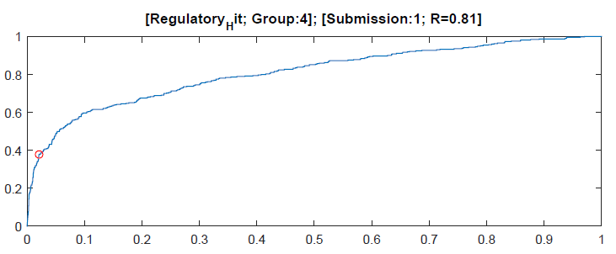
Performance assessment – task1
Quantitative (C.A., C.B.) Binary (regulatory hit)
Pearson correlation (Spearman/Kendall)
Kendall correlation top 25% (Pearson)
Spearman correlation of bin-transformed data
Area under the ROC
* Observed vs. expected (best preforming group)
Created for CAGI 4
genomeinterpretation.org
Anat Kreimer
Notes:
Quantitative fields:
Pearson correlation; figure: scatter plot
Spearman correlation of bin-transformed data (data is transformed into five bins); figure: box plot of predicted values (original, not binned) for the five reference bins.
Binary fields:
Area under the ROC; figure ROC with the optimal point (FP vs. TP) highlighted.

Slide 9
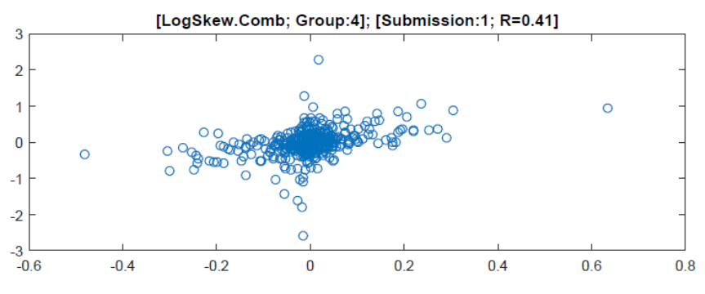
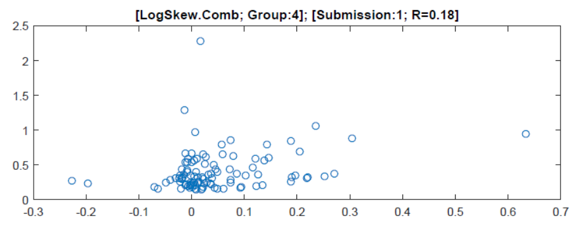
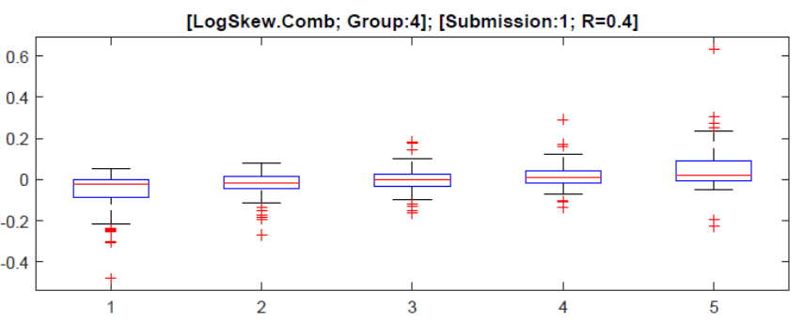
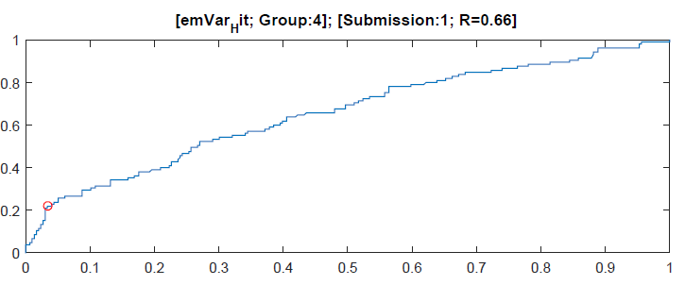
Performance assessment – task2
Quantitative (LogSkew.Comb) Binary (emVar hit)
Pearson correlation (Spearman/Kendall)
Kendall correlation top 25% (Pearson)
Spearman correlation of bin-transformed data
Area under the ROC
* Observed vs. expected (best preforming group)
Created for CAGI 4
genomeinterpretation.org
Anat Kreimer

Slide 10
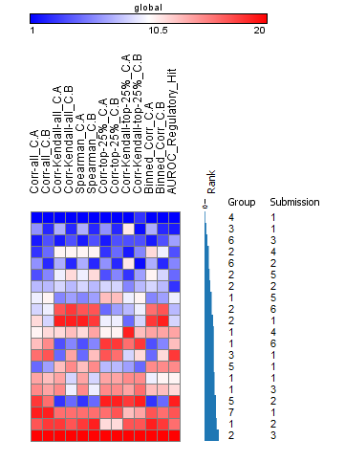
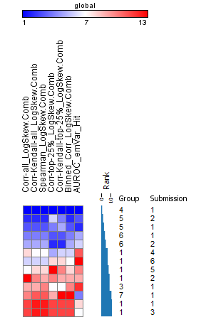
Comparison of results between groups
Task 1
Task 2
Relative performance (comparing the different submissions to each other), is overall maintained across most prediction tasks.
There is no indication for a specific class of methods that is doing extremely well.
Overall performance is substantially lower in task 2.
*Hitmap of ranked correlation coefficients. For each test rank the groups. Group rank – median.
Created for CAGI 4
genomeinterpretation.org
Anat Kreimer
Notes:
Ranked correlation coefficient/AUC (FP vs. TP) out of each statistical test
Rank: rank of each group in each test, take mean rank to score the group
In task 2 one of the groups had a wrong submission, so it was removed from the analysis
If you are the best in one test, you are probably the best in the others

Slide 11
Meta analysis: features and performance
For each submission and each task we record:
Features considered:
  Motifs
  Kmers
  Epigenetic marks
  SNP info:
    Task 1: information regarding the polymorphism (e.g. -log10 P-val of eQTL, GWAS and HGMD probabilities)
    Task 2: use of expression prediction from task 1 (reference/alternate allele).
Method type
Created for CAGI 4
genomeinterpretation.org
Anat Kreimer
Notes:
Meta features

Slide 12
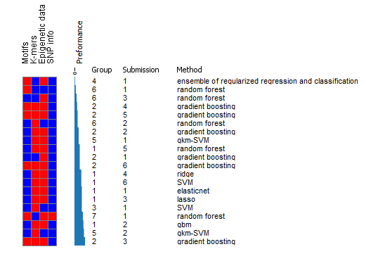
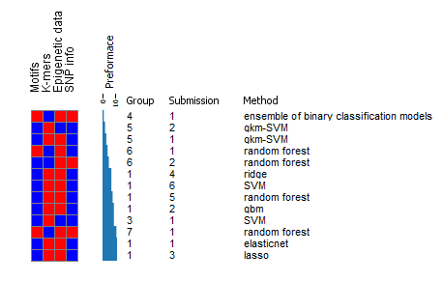
Meta analysis: features and performance
Task 1
Task 2
We could not conclude that there is a specific category of features that leads to more accurate predictions, and that it is rather the specific details of the implementation that matter
Created for CAGI 4
genomeinterpretation.org
Anat Kreimer
Notes:
Binary hit maps
Performance – median correlation coefficient of all the tests for each submission

Slide 13
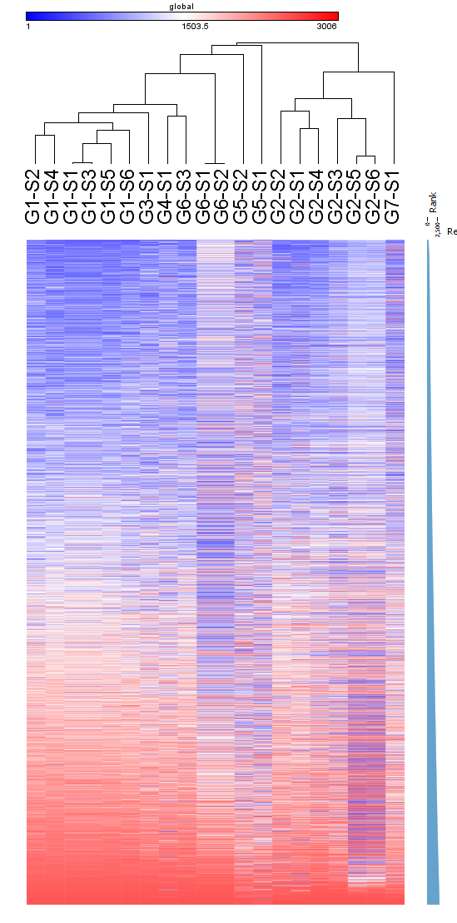
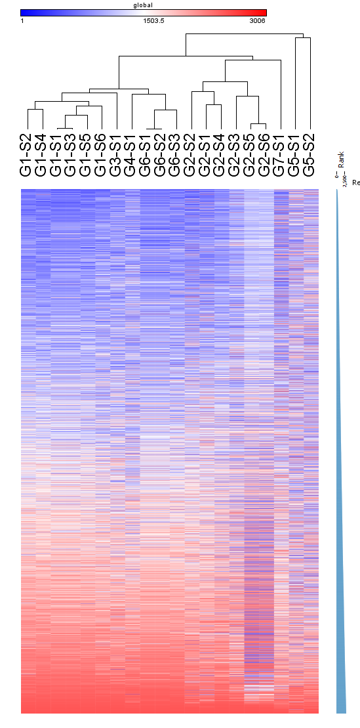
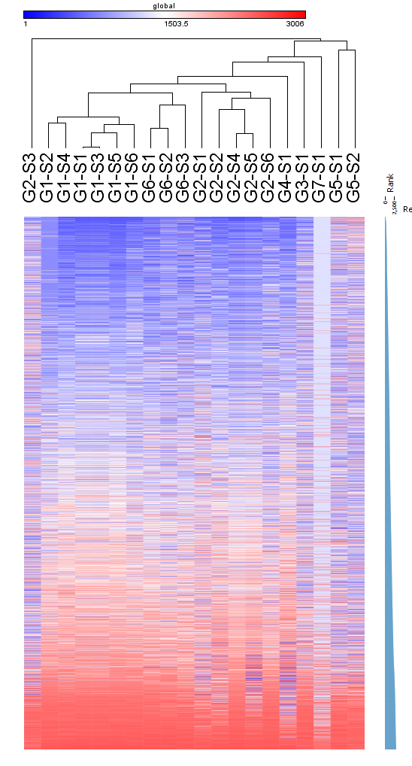
Meta analysis: regions “hardness” – task 1
Reference allele expression
Alternate allele expression
Regulatory hit
* Performance within a region (per prediction) – the absolute value of subtracting the predicted from observed values
* For each region – we take the median performance – defining it’s “hardness”
Created for CAGI 4
genomeinterpretation.org
Anat Kreimer
Notes:
Blue is easy

Slide 14
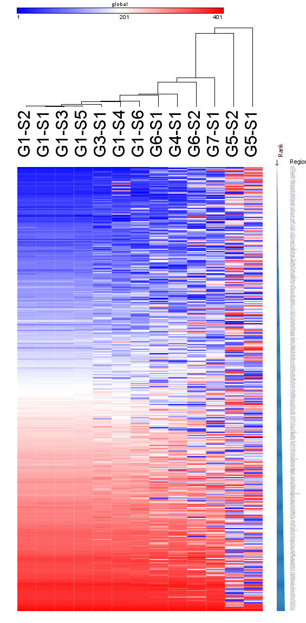
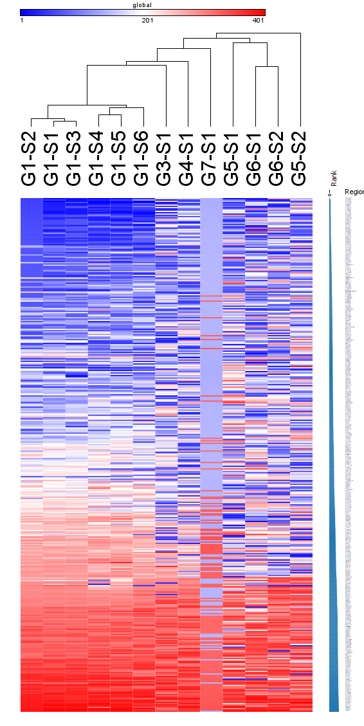
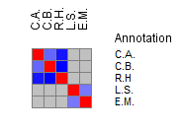
Meta analysis: regions “hardness” – task 2
Log skew
emVar hit
Correlation of regions rank across different predictions
Task 1:
C.A. - C.B r=0.4008
C.A. - R.H r=0.2806
C.B. - R.H r=0.2480
Task 2:
LogSkew - emVar r=0.4277
* Performance within a region (per prediction) – the absolute value of subtracting the predicted from observed values
* For each region – we take the median performance – defining it’s “hardness”
Created for CAGI 4
genomeinterpretation.org
Anat Kreimer
Notes:
Are the same hard/easy regions repeating themselves?
For the expression of the ref/alt allele we see a higher correlation than with regulatory hit regions.
Task 1:
C.A. - C.B r=0.4008
C.A. - R.H r=0.2806
C.B. - R.H r=0.2480
Task 2:
LogSkew - emVar r=0.4277

Slide 15
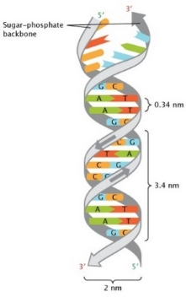


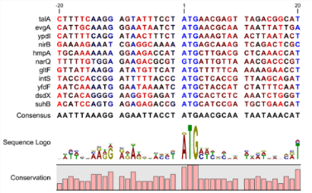
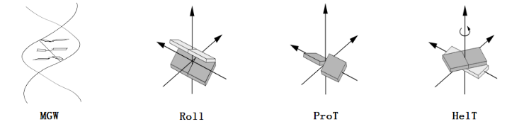
Genomic features
TFBS Sequence DNA structure/shape Conservation
#motifs (ENCODE) (fimo hits) (Grant et al.)
min distance to TSS
max polyA/T sub-sequence (nucleosome disfavoring sequences)
GC content
Minor groove width
Roll
Propeller twist
Helix twist
(Zhou et al. 2013)
Evolutionary conservation score
Created for CAGI 4
genomeinterpretation.org
Anat Kreimer
Notes:
We next wanted to characterize these regions using different genomic categories
Fimo 10-6 p-value – unique with best p-val

Slide 16
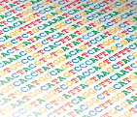

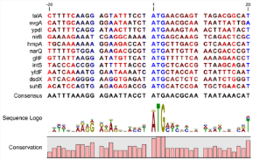
Regions analysis – top “hard” vs. “easy” task 1
 | 200 easiest | 200 hardest
#motifs
min distance to TSS
max poly A
max poly T
GC content
HelT
MGW
ProT
Roll
Conservation
* NS for regulatory hit
* NS for ref/alt expression
Created for CAGI 4
genomeinterpretation.org
Anat Kreimer
Notes:
hydroxyl radical cleavage patterns
This analysis can be extended to different histone modifications.
For the paper: we can look specifically at features focused on the ref/alt allele and not an average of the 150bp region, dig into mutation type.
Results are pretty robust.

Slide 17
Regions analysis – top “hard” vs. “easy” task 2
 | 100 easiest | 100 hardest
#motifs
min distance to TSS
max poly A | NS | NS
max poly T
GC content
HelT
MGW | NS | NS
ProT
Roll | NS | NS
Conservation | NS | NS
* NS for log skew
* NS for log skew
* Opposite for log skew
* Opposite for log skew
* Opposite for log skew
Created for CAGI 4
genomeinterpretation.org
Anat Kreimer
Notes:
The results that are significant are consistent with the first challenge for emVar prediction, but not for log skew.
hydroxyl radical cleavage patterns
This analysis can be extended to different histone modifications.
For the paper: we can look specifically at features focused on the ref/alt allele and not an average of the 150bp region, dig into mutation type.

Slide 18
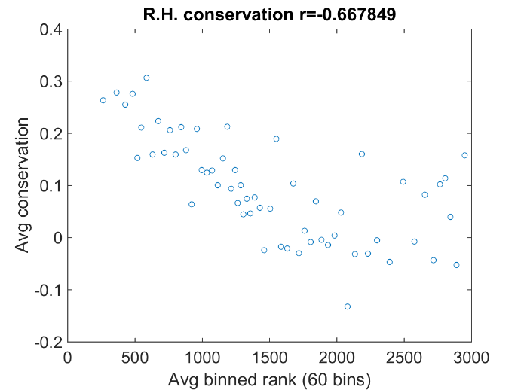
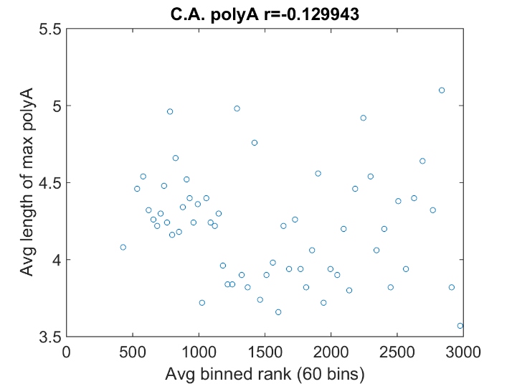
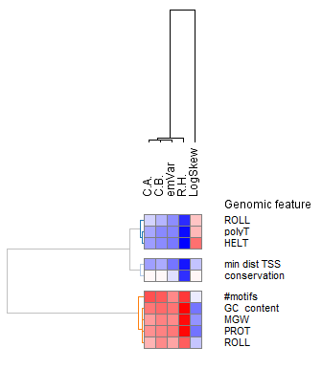
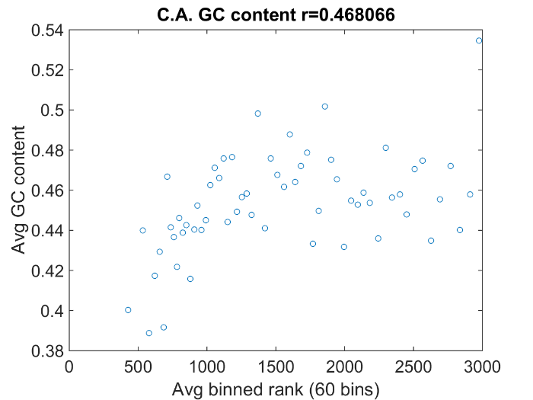
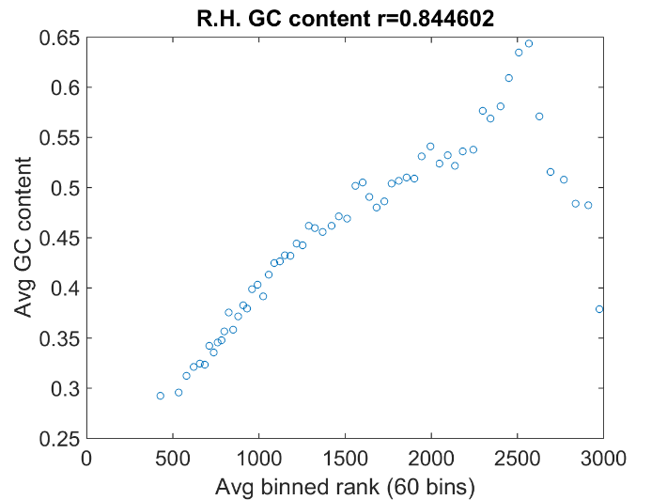
Can we extend these results to call a trend?
Yes
No
Correlation coefficient of binned data
Prediction dependent
Created for CAGI 4
genomeinterpretation.org
Anat Kreimer
Notes:
Not such a clear cut
Plotted the correlation coefficient of the binned data.
Log sqew is the big outlier here

Slide 19
Distribution of regulatory regions
 | Task 1 | Task 2
# regions | 3006 | 401
# regulatory hit | 369 | 401
# emVar hit | 92 | 105
Most of the hardest regions are regulatory/emVar hits
 | C.A. | C.B. | L.S.
# easy regions | 200 | 200 | 100
# hard regions | 200 | 200 | 100
# regulatory hit “hard” | 156 | 143 | 100
# emVar hit “hard” | 51 | 45 | 72
# regulatory hit “easy” | 3 | 0 | 100
# emVar hit “easy” | 2 | 0 | 1
Created for CAGI 4
genomeinterpretation.org
Anat Kreimer
Notes:
Methods are doing better at predicting the non-active regions
1. To report the fold hangs (ca, cb) levels of the extreme loci sets (compared to the rest)
C.A. and C.B. are not statistically different between the hardest and easiest 200 regions
2. Say what types of mistakes are we making in those bad loci (over or under estimation?)
Predictions are over estimating a bit, but this is not significantly more than any of the other loci, or comparing to the good ones, same for log skew
3. Repeat the analysis with the top/ bottom 30 regions out of the regulatory hits in challenge 1. (matlab WS)

Slide 20
Conclusions
Best performance - group 4 - Gifford lab, MIT
Relative performance (comparing the different submissions to each other), is overall maintained across most prediction tasks.
There is no indication for a specific class of methods that is doing extremely well.
Overall performance is substantially lower in task 2.
We could not conclude that there is a specific category of features that leads to more accurate predictions, and that it is rather the specific details of the implementation that matter.
Regions analysis:
  Overall consistency in defining a “hard region” across submissions (per prediction).
  Hard regions are not replicated at high rates across predictions.
  The results of genomic features are consistent for the different predictions in the first task.
  For the second task: emVar prediction (but not for log skew) - significant results are consistent with the first task.
  Harder to define a trend.
  Most of the hard regions are regulatory hits.
Created for CAGI 4
genomeinterpretation.org
Anat Kreimer
Notes:
The best groups will present their methods after me

Slide 21
Additional analysis
The genomic features analysis can be extended to different types of data: e.g. histone modifications.
Specifically examine features focused on the ref/alt allele and not an average of the 150bp region and look into mutation type.
Incorporating SD in the analysis.
Meta-classifier.
Created for CAGI 4
genomeinterpretation.org
Anat Kreimer
Notes:
Can the meta-classifier (consensus) perform better?

Slide 22
Thanks
Steven Brenner
Stephen Yee
John Moult
Roger Hoskins
Andrew Neumann
Nir Yosef
Pardis Sabeti
Ryan Tewhey
CAGI Participants
Created for CAGI 4
genomeinterpretation.org
Anat Kreimer
Notes:
Organizers,
my advisor
The data providers
and the conference participants

