Slide 1

CAGI slide pack guidelines
I agree to my slides being used according to the following terms:
Matt Edwards
  Authors: please include THIS slide at the beginning of your presentation to indicate that you agree with reuse of your slides in CAGI presentations, according to the terms below, and digitally sign by writing your name above.
  To disseminate the CAGI results, I encourage all CAGI participants to remix these CAGI slides for inclusion in their oral and poster presentations
  CAGI participants may use or publish any content of these slides only in compliance with the CAGI Data Use Agreement
  CAGI participants may not cite or publish any content of these slides except with the written permission of the originating author or in the primary CAGI publications
  CAGI participants must acknowledge the original authors of these slides and CAGI 2013. Include the acknowledgement banner across the bottom
  CAGI participants must include the CAGI credits slide in their presentations
  Slides with a red slash (no remix) may not be included in a presentation unless all attendees are registered CAGI participants who signed the data use agreement
  Slides with a red X over the entire slide may not be used in any circumstances
  Slides with a blue slash (embargoed) may not be used unless the embargo is explicitly lifted
  Slides without slash or X may be tweeted unless flagged with the “No tweet” icon.
  CAGI participants using these slides must explain the “No tweet” icon, which means that the slide content should not be disseminated outside the presenting conference hall. If the presentation venue permits pervasive tweeting, you may not include these slides in your talk
  Note for slide authors: we expect all CAGI participants to abide by these restrictions, and will make best effort to ensure they are followed. However, but bear in mind that we have limited means of enforcing them, and therefore the restrictions cannot be guaranteed.
Created for CAGI 4 genomeinterpretation.org Matt Edwards

Slide 2

Ensemble approaches using literature-selected features to predict warfarin dosage
Matt Edwards
matted@mit.edu
Gifford laboratory
MIT CSAIL
Created for CAGI 4 genomeinterpretation.org Matt Edwards

Slide 3
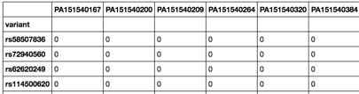

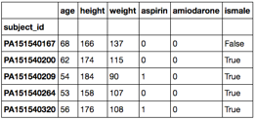
Prediction challenge setup
Genotypes (VCF file)
…
Optimal warfarin dosage
…
…
Clinical covariates
…
…
…
Created for CAGI 4 genomeinterpretation.org Matt Edwards

Slide 4
Learning challenges
Complex underlying biological problem
  Noisy target output and candidate features
  Power and limitations of exome sequencing data
  “Interactive” prediction target
Dimensionality:
  50 training samples in challenge dataset
  ~600k genetic features
  6 clinical features
Created for CAGI 4 genomeinterpretation.org Matt Edwards

Slide 5
Modeling approaches
Regression models
using genetic data
Regression models
using clinical covariates
Classification models
using genetic data
Classification models
using clinical covariates
(Set the binary threshold at 44, per challenge description)
Created for CAGI 4 genomeinterpretation.org Matt Edwards

Slide 6
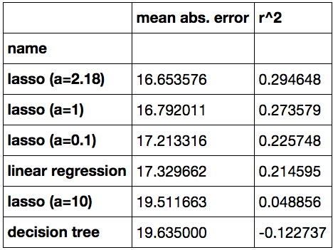
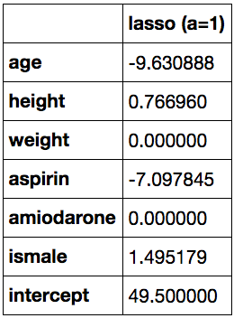
Regression model using clinical covariates
Apply a variety of regularized linear regression models
Average test (hold-out) results from 10-fold cross-validation:
Sample model parameters:
Created for CAGI 4 genomeinterpretation.org Matt Edwards

Slide 7
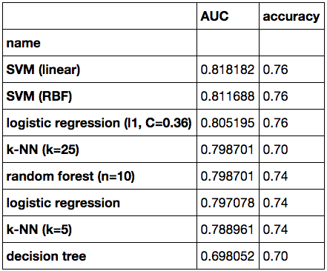
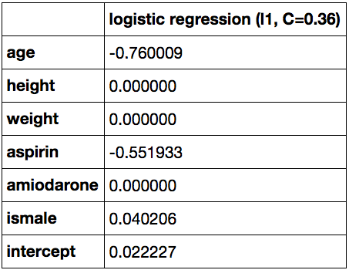
Classification model using clinical covariates
Use given binary threshold to train multiple two-class classifiers
Average test (hold-out) results from 10-fold cross-validation:
Sample model parameters:
Created for CAGI 4 genomeinterpretation.org Matt Edwards

Slide 8
Classification model using genetic data
Heuristic pre-screening approach: restrict to variants affecting genes with known associations with warfarin dosage or tolerance
(Using challenge description references and NHGRI-EBI GWAS catalog)
  VKORC1 (used in IWPC model)
  CALU (Voora et al. 2010)
  GGCX (King et al. 2010)
  CYP2C9 (used in IWPC model)
  CYP4F2 (Caldwell et al. 2008)
  FPGS (Daneshjou et al. 2014)
  CDHR3 (Cha et al. 2010)
  HNF4GP1 (Cha et al. 2010)
  CACNA1C (Cooper et al. 2008)
Results in a filtered set of 75 variants (down from ~600k)
Created for CAGI 4 genomeinterpretation.org Matt Edwards

Slide 9
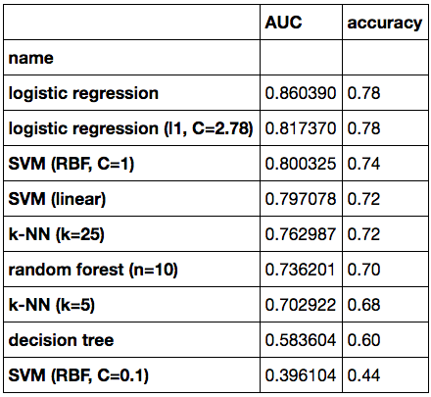
Classification model using genetic data
Start with 75 candidate variants, pre-screen and reduce to 11 using
L₁ regularized logistic regression with a weak penalty
Use the number of non-reference alleles in a sample as feature value
Apply a range of classification models
Average test (hold-out) results from 10-fold cross-validation:
Created for CAGI 4 genomeinterpretation.org Matt Edwards

Slide 10
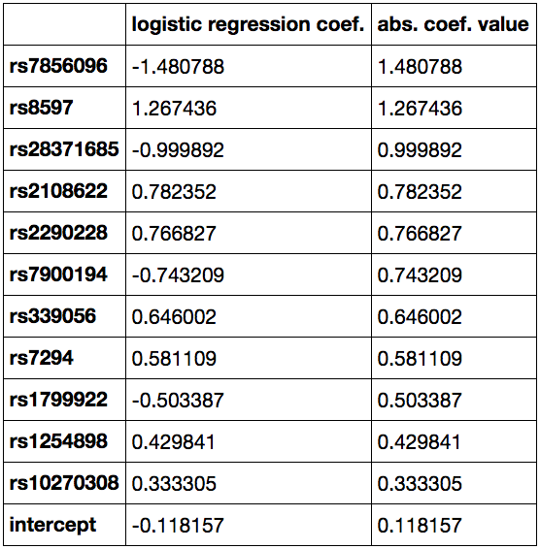
Classification model using genetic data
Model coefficient values from sample classification model:
FPGS regulatory
CALU 5’ UTR
CYP2C9*11
also used in IWPC model
CYP4F2 V433M
CALU R4Q
CYP2C9*8
also used in IWPC model
CALU 5’ UTR
CALU 3’ UTR
CALU downstream
GGCX intronic
CDHR3 D778D
(Coefficient values sorted
by magnitude)
Created for CAGI 4 genomeinterpretation.org Matt Edwards

Slide 11
Combining separate models
Regression models
using clinical covariates
Linear regression and lasso regression
Classification models
using clinical covariates
Average to form
submitted model, use standard deviation as uncertainty estimate
Regularized logistic regression and
SVM (linear kernel)
Classification models
using genetic data
Logistic regression and SVM (RBF kernel)
(Use target dose distribution to convert classification model outputs to dosages)
Created for CAGI 4 genomeinterpretation.org Matt Edwards

Slide 12
Results
Evaluation on challenge test set of 53 individuals:
(Binary error)
(Binary error)
Regression-style evaluation
Classification-style evaluation
Created for CAGI 4 genomeinterpretation.org Matt Edwards

Slide 13
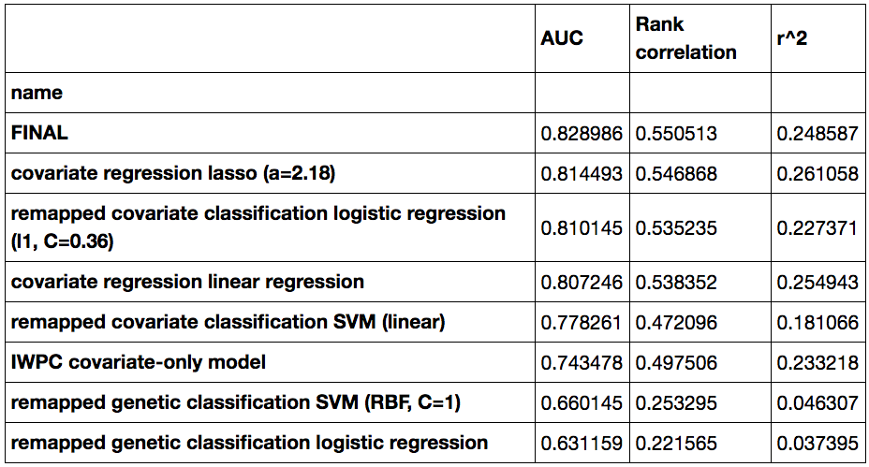
Results
Evaluation of submodels that were combined in the ensemble:
Submitted model
Regression model using clinical covariates
Classification model using clinical covariates
Regression model using clinical covariates
Classification model using clinical covariates
Classification model using genetic data
Classification model using genetic data
(Approaches sorted by AUC)
Created for CAGI 4 genomeinterpretation.org Matt Edwards

Slide 14
Unexplored (future?) directions
Use population genetics
  Estimate and use percentage of African ancestry
  Admixture mapping or ancestry labeling for informative genes
Increase effective sample size
  Use imputation to increase number of variants
  Search for other cohorts to use
Improve feature (variant) pre-screening
  Use functional genomics data to highlight certain genes
  Expand pool to regulators or interaction partners of known genes
Improve models
  Combine submodels into final ensemble in a more nuanced way
  Model dominance effects or any other departure from additivity
Use the power of exome sequencing
  Pool variants by gene or pathway
  Prioritize variants using rarity or type of impact
Created for CAGI 4 genomeinterpretation.org Matt Edwards

Slide 15
Conclusions
Verified the power of predictive models in determining optimal warfarin dosage
Demonstrated the effectiveness of an ensemble approach that combines regression and classification methods
Supported the promise of exome sequencing studies, even with relatively small sample sizes
Thanks to CAGI organizers, dataset providers, and study participants!
Created for CAGI 4 genomeinterpretation.org Matt Edwards

Slide 16
Ensemble approaches using literature-selected features to predict warfarin dosage
Matt Edwards
matted@mit.edu
Gifford laboratory
MIT CSAIL
Created for CAGI 4 genomeinterpretation.org Matt Edwards

Slide 18
Challenge-specific observations
Training and testing data files should be randomized
instead of sorted by target value
Created for CAGI 4 genomeinterpretation.org Matt Edwards

Slide 19
Challenge-specific observations
Results obtained if the given target distribution was submitted as-is:
Created for CAGI 4 genomeinterpretation.org Matt Edwards

