Slide 1

CAGI slide pack guidelines
I agree to my slides being used according to the following terms: ____Roxana Daneshjou_______
Authors: please include THIS slide at the beginning of your presentation to indicate that you agree with reuse of your slides in CAGI presentations, according to the terms below, and digitally sign by writing your name above.
To disseminate the CAGI results, I encourage all CAGI participants to remix these CAGI slides for inclusion in their oral and poster presentations
CAGI participants may use or publish any content of these slides only in compliance with the CAGI Data Use Agreement
CAGI participants may not cite or publish any content of these slides except with the written permission of the originating author or in the primary CAGI publications
CAGI participants must acknowledge the original authors of these slides and CAGI 2013. Include the acknowledgement banner across the bottom
CAGI participants must include the CAGI credits slide in their presentations
Slides with a red slash (no remix) may not be included in a presentation unless all attendees are registered CAGI participants who signed the data use agreement
Slides with a red X over the entire slide may not be used in any circumstances
Slides with a blue slash (embargoed) may not be used unless the embargo is explicitly lifted
Slides without slash or X may be tweeted unless flagged with the “No tweet” icon.
CAGI participants using these slides must explain the “No tweet” icon, which means that the slide content should not be disseminated outside the presenting conference hall. If the presentation venue permits pervasive tweeting, you may not include these slides in your talk
Note for slide authors: we expect all CAGI participants to abide by these restrictions, and will make best effort to ensure they are followed. However, but bear in mind that we have limited means of enforcing them, and therefore the restrictions cannot be guaranteed.

Slide 2
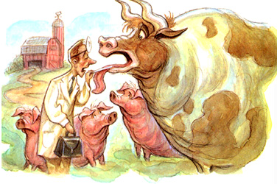
CAGI Challenge: Warfarin Exomes
Roxana Daneshjou, Ph.D
Twitter: @RoxanaDaneshjou
Russ Altman Lab, Stanford University

Slide 3
Disclosures
Nothing to disclose

Slide 4
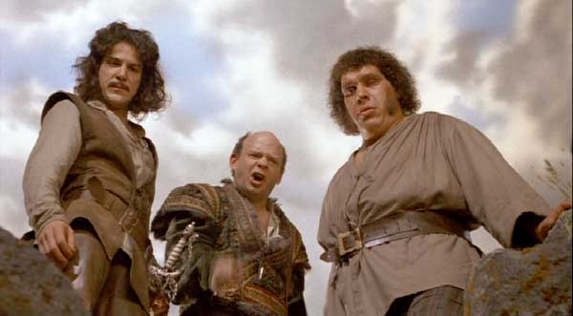
Phenotype: Warfarin dosing
Commonly prescribed “blood thinner” (>30 million prescriptions/year)
Narrow therapeutic index and high inter-individual variability in dose (up to 20x)
Phenotype dependent on both clinical and genetic factors
35 mg/week
10 mg/week
100 mg/week

Slide 5
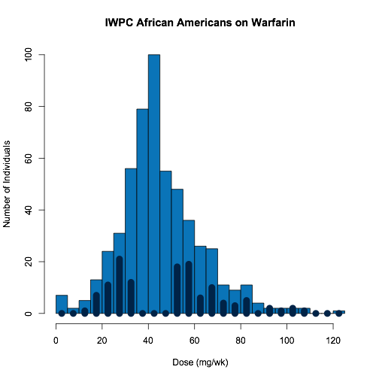
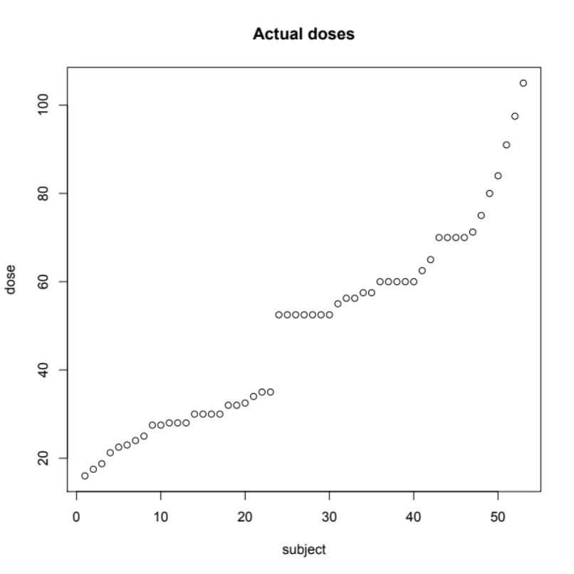
The Data
103 high coverage exomes of African Americans on warfarin
Dosing: ≤35 mg/week and ≥49 mg/week.
Daneshjou et al, Blood 2014

Slide 6
The Data
Clinical data: gender, age, height, weight aspirin usage, and amiodarone usage
Exome data: 155,186 variants
Daneshjou et al, Blood 2014

Slide 7
The Submission
A predicted weekly dose (mg/week) with a standard deviation

Slide 8
A mistake
12 samples in the “prediction” set had their doses available publicly in a different dataset
However, no group appears to have actually used this
  Compared dose “error” (actual dose – predicted dose) of 12 samples vs. 41 without data publicly available using t-test
  No significant difference

Slide 9
Groups
3 Groups, 9 predictions
All used some amount of “biological” information in their model

Slide 10
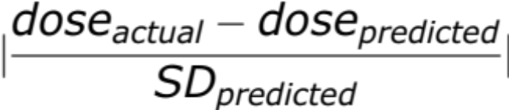
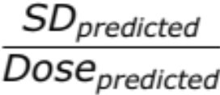
Prediction performance assessment
Linear regression of dose vs. predicted dose: r² and sum of squared errors
Mean abs(z-score):
Coefficient of variation:
Mean abs(z-score)*coefficient of variation
Spearman’s rank correlation coefficient between predicted dose and actual dose

Slide 11
International Warfarin Pharmacogenetic (IWPC) Consortium Algorithm
Predictive algorithm created on a cohort of 4043, validated on 1009
Included variables: age, height, weight, VKORC1, CYP2C9, race, enzyme inducer status, amiodarone status
R² : 43-47%
Klein et al, NEJM 2009

Slide 12
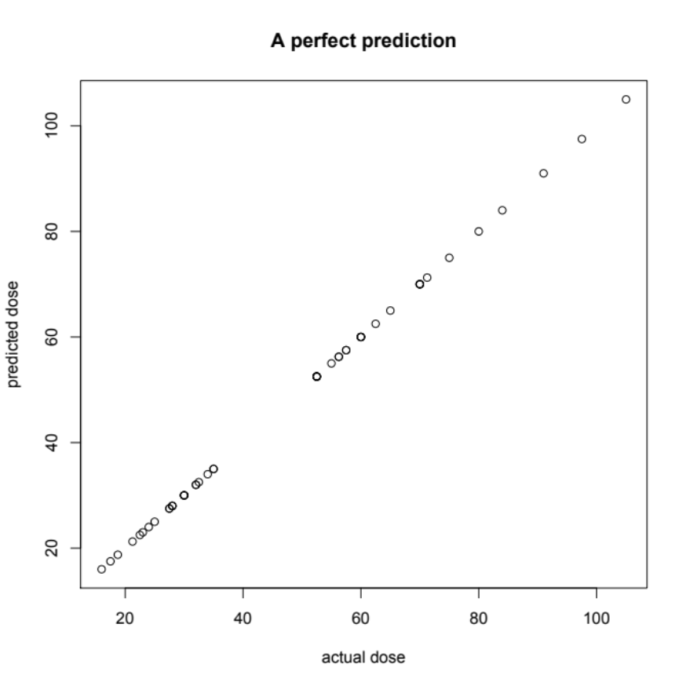
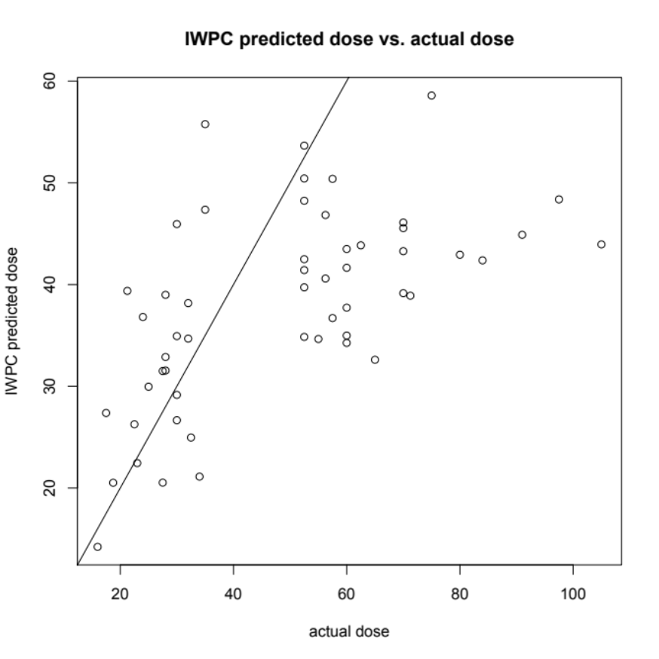
IWPC Algorithm Applied to Warfarin Challenge

Slide 13
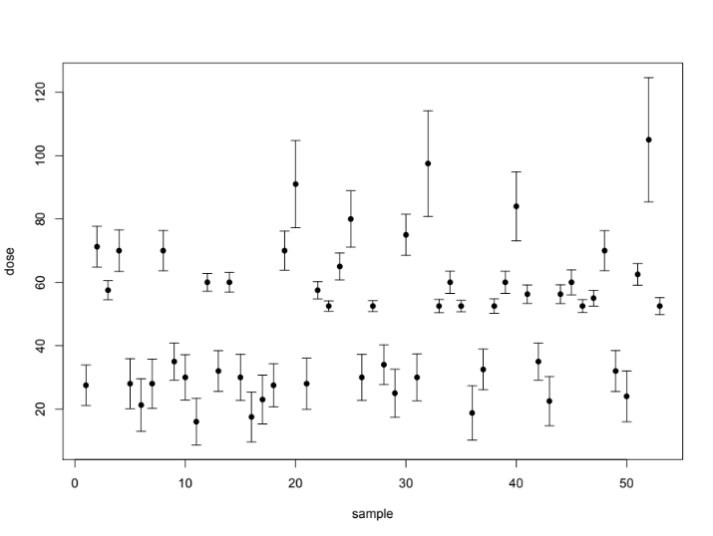
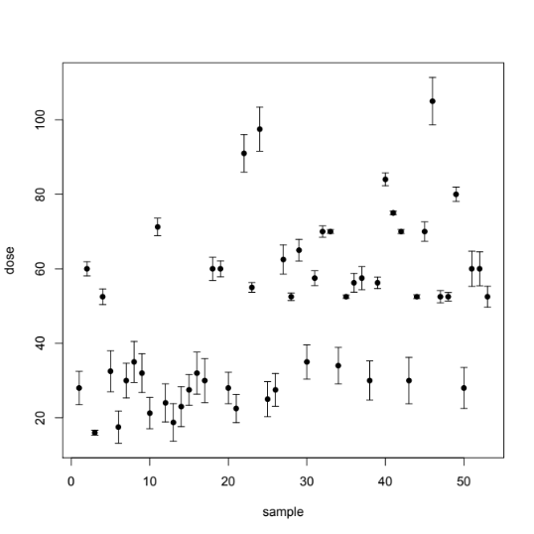
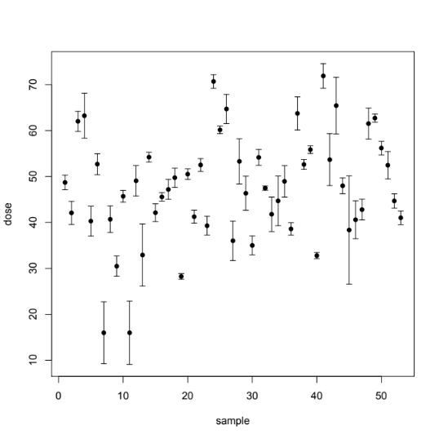
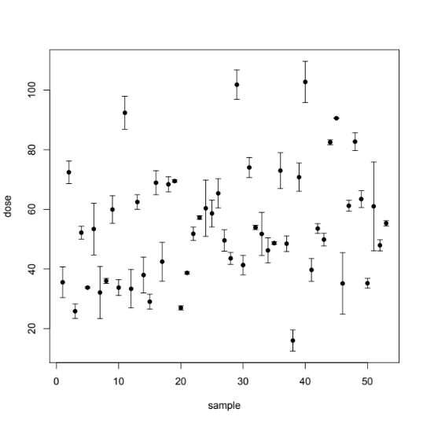
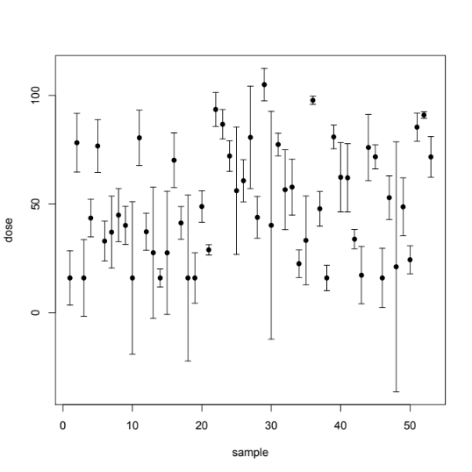
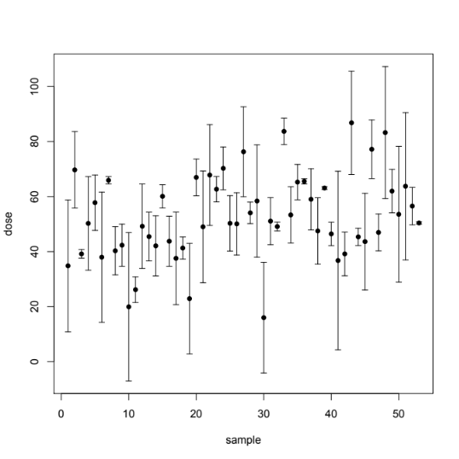
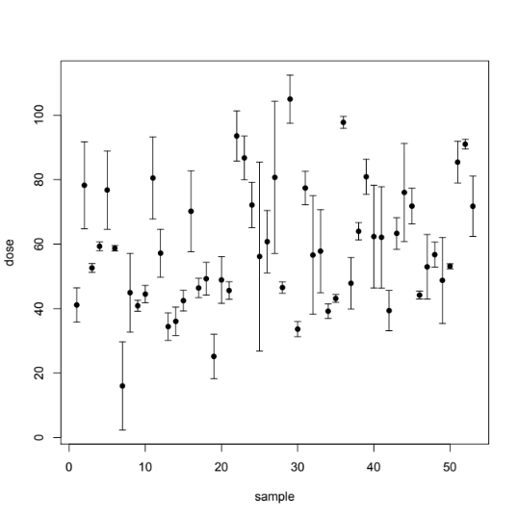
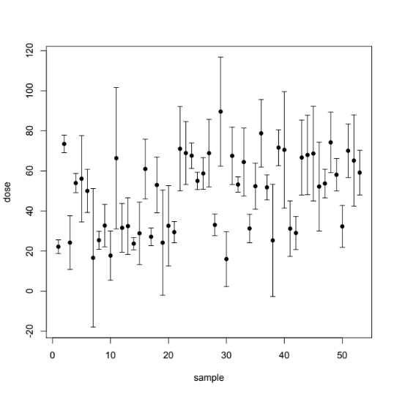
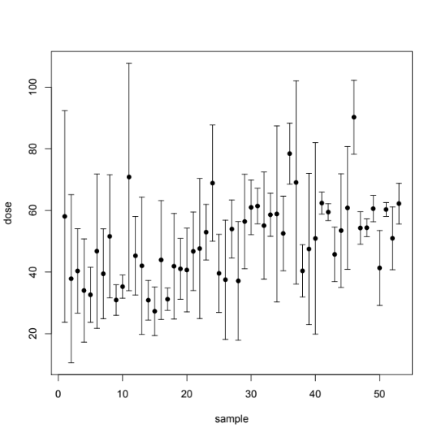

Slide 14
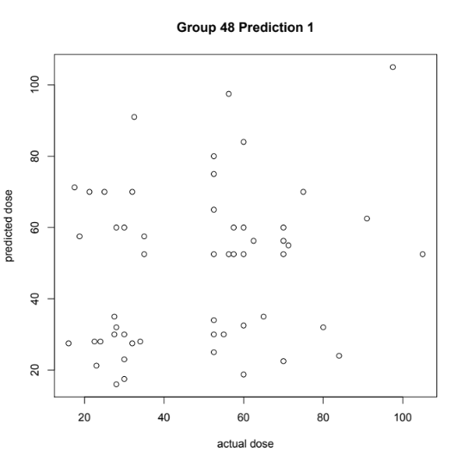
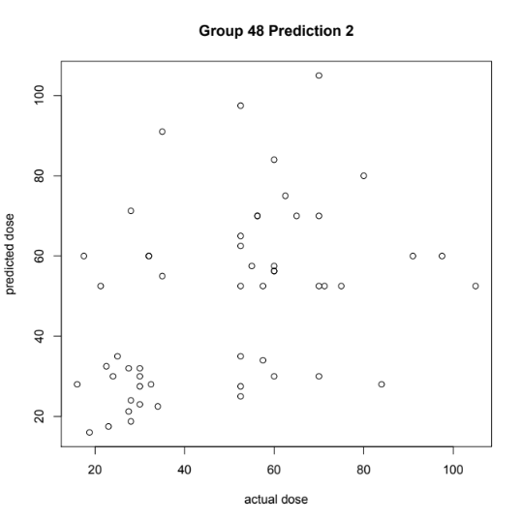
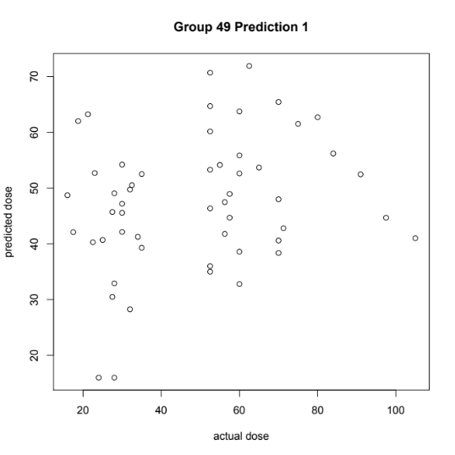
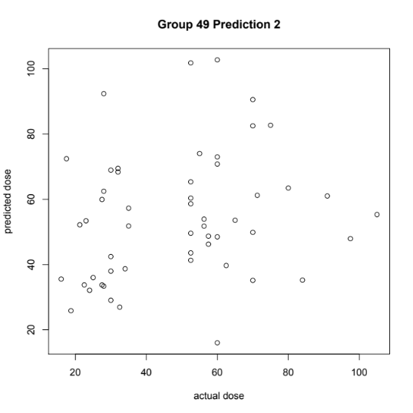
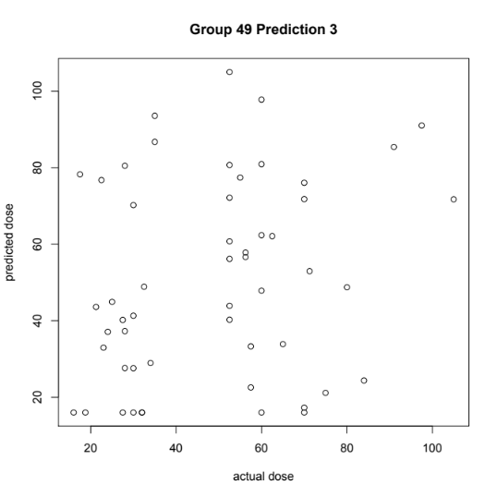
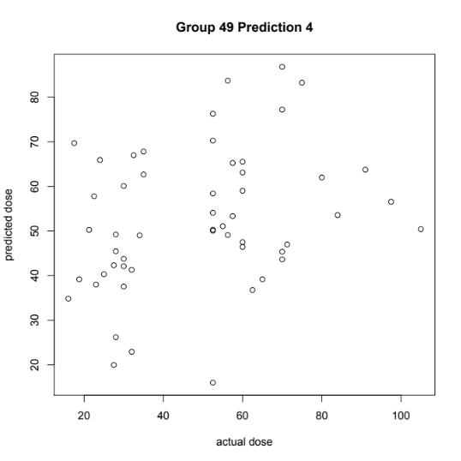
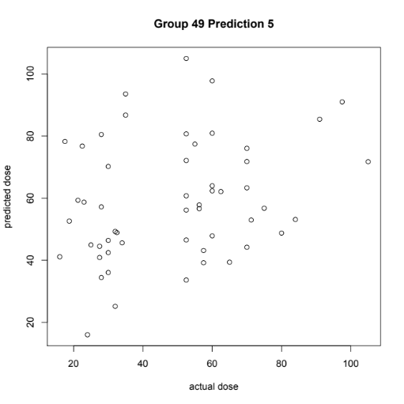
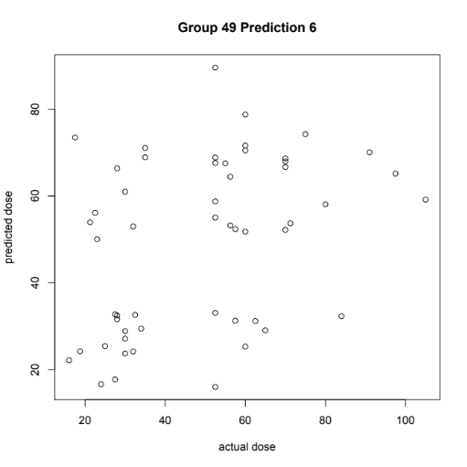
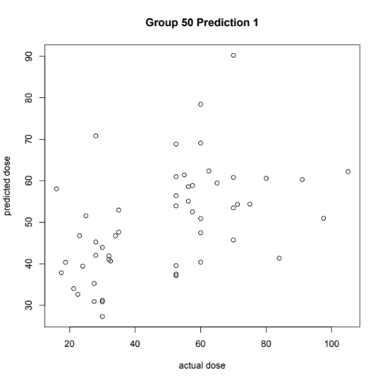

Slide 15
R²
Sum of squared errors

Slide 16
Z-scores

Slide 17
Spearman’s Rank Correlation Coefficient, rho
P value for predicted vs. actual
Group 48 Prediction 1 | 0.22
Group 48 Prediction 2 | 7.50E-04
Group 49 Prediction 1 | 0.12
Group 49 Prediction 2 | 0.053
Group 49 Prediction 3 | 0.11
Group 49 Prediction 4 | 0.016
Group 49 Prediction 5 | 0.058
Group 49 Prediction 6 | 0.0045
Group 50 Prediction 1 | 1.60E-05

Slide 18
Conclusions
Difficult phenotype, small dataset
Yet overall, top predictor did get close to best model
Problem: Standard deviations of predictions

Slide 19
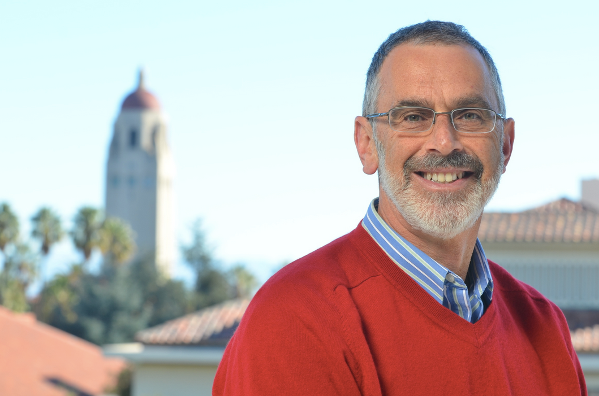
Acknowledgements
Russ Altman
Teri Klein, Larissa Cavalari, Minoli Perera, Julie Johnson, Eric Gamazon
CAGI team
David Searls
Alexander Morgan

