Slide 1

CAGI slide pack guidelines
I agree to my slides being used according to the following terms: _______Yizhou Yin_______
Authors: please include THIS slide at the beginning of your presentation to indicate that you agree with reuse of your slides in CAGI presentations, according to the terms below, and digitally sign by writing your name above.
To disseminate the CAGI results, I encourage all CAGI participants to remix these CAGI slides for inclusion in their oral and poster presentations
CAGI participants may use or publish any content of these slides only in compliance with the CAGI Data Use Agreement
CAGI participants may not cite or publish any content of these slides except with the written permission of the originating author or in the primary CAGI publications
CAGI participants must acknowledge the original authors of these slides and CAGI 2013. Include the acknowledgement banner across the bottom
CAGI participants must include the CAGI credits slide in their presentations
Slides with a red slash (no remix) may not be included in a presentation unless all attendees are registered CAGI participants who signed the data use agreement
Slides with a red X over the entire slide may not be used in any circumstances
Slides with a blue slash (embargoed) may not be used unless the embargo is explicitly lifted
Slides without slash or X may be tweeted unless flagged with the “No tweet” icon.
CAGI participants using these slides must explain the “No tweet” icon, which means that the slide content should not be disseminated outside the presenting conference hall. If the presentation venue permits pervasive tweeting, you may not include these slides in your talk
Note for slide authors: we expect all CAGI participants to abide by these restrictions, and will make best effort to ensure they are followed. However, but bear in mind that we have limited means of enforcing them, and therefore the restrictions cannot be guaranteed.

Slide 2


Interpretation of SUMO ligase and NAGLU missense mutations
Yizhou Yin, Kunal Kundu, Lipika R. Pal, John Moult*
IBBR, University of Maryland College Park
CAGI4 Conference, San Francisco, CA
25th March, 2016
Notes:
Introduce myself

Slide 3

Methods
PAHvdb – http://www.biopku.org/pah/
PAH – 92 human disease related mutation and 139 interspecies variants
SVM Rregression
Polyphen-2
SIFT
SNPs3d Profile
CADD
Panther
PON-P2
SNAP2
Provean
LRT
VEST3
MutationTaster
SUMO Ligase and NAGLU challenge mutations
Calibration
Databases and literature
Predictions
Notes:
grantSEP2015/mutation_consensus/hgmd_consensus/HGMD_tp_VS_consensus1.xlsx
More explanation on the ppv plot
SNPs3d profile, polyphen2, sift, cadd
Remove the examples in the text:
: Polyphen-2, SIFT, SNPs3D, CADD, Panther, PON-P2, SNAP2, Provean, LRT, VEST3, MutationTaster
– SVM, Random Forest, Neural Network, Logistic Regression, etc
PAH: Phenylalanine hydroxylase
#Better transition from ppv to activity

Slide 4
NAGLU Prediction Performance
61%

Slide 5
Results analysis and simulations
R = 0.83
R = 0.39
R = 0.83
R = 0.5
R = 0.83
R = 0.39
R = 0.39
R = 0.5
R = 0.5
Training
Cross Validation
Testing
Real Challenge
Notes:
#Bottom lines of the left plots
# Remove E251K
# Change R2 to R

Slide 6
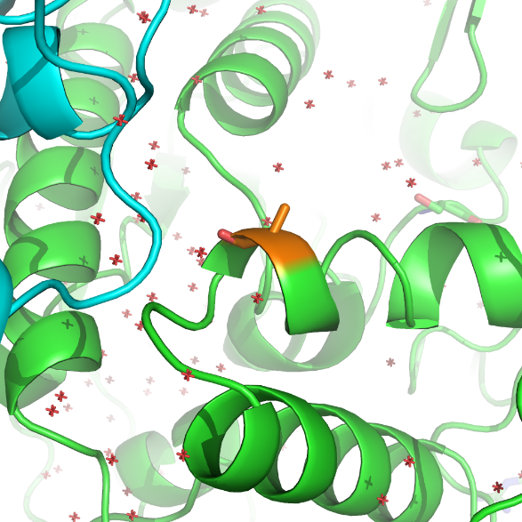
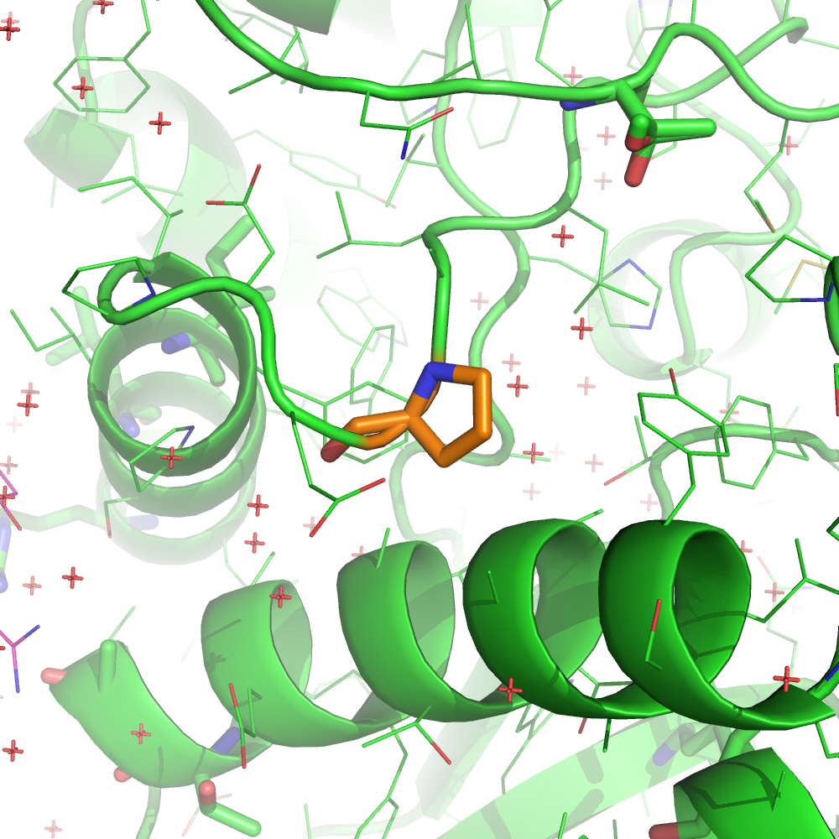
NAGLU prediction outlier examples
A627V
P283L
Variable position
High impact: 1 / 11 methods
Conserved position
High impact: 11 / 11 methods
FOLDX ddg: +2.7 kcal/mol
Notes:
A627V: variable position, conserved only in close species homolog
E251K: very variable position with both types of charges, no co-evolving position
P283L: conserved position
#Remove the E251K
# remove foldx ddg for A627V
#?add position conservation
A627
Entropy: 3.15, relative_entropy: 1.43
3 hits in the 300 alignment, no hits in homologs
SNPs3d profile predict high impact
FOLDX ddg +0.64 kcal/mol
P283L
Entropy: 0.87, relative_entropy: 0.39
1 hit in both 300 alignment and homologs

Slide 7
SUMO Ligase Prediction Performance
Notes:
UBI4 ubiquitin set

Slide 8
Results analysis and simulations
R = 0.59
R = 0.59
R = 0.27
R = 0.27
R = 0.29
R = 0.29
R = 0.35
R = 0.35
Training
Cross Validation
Testing
Real Challenge
Notes:
# Change R2 to R
# Remove the green and yellow examples
# Recolor the outlier’s circles

Slide 9
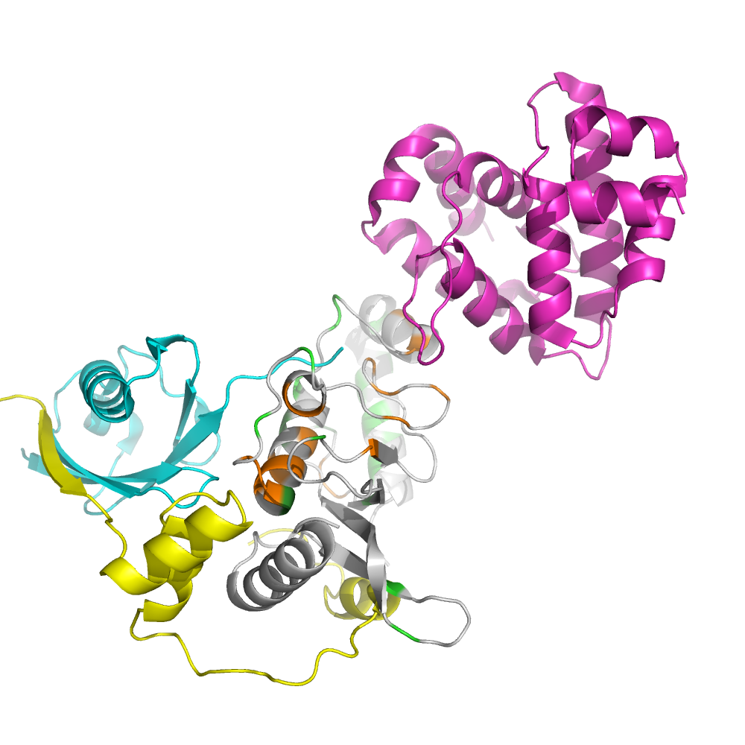
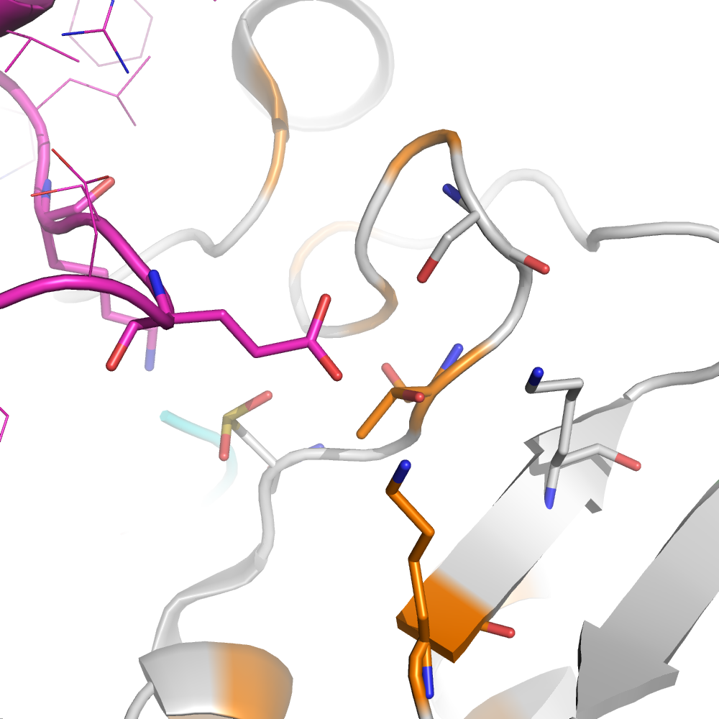
Clusters of prediction outliers in the SUMO-E2-E3-Substrate complex
RANGAP1
(substrate)
Conserved position
High impact: 7 / 10 methods
FOLDX ddg: +0.34 kcal/mol
T91A
SUMO1
K74S
Conserved position
High impact: 6 / 6 methods
FOLDX ddg: +1.50 kcal/mol
RANBP2 (E3)
Notes:
# Try superimposition of the substrate
No available structure of RANGAP1 yeast homolog, actually yeast homolog RAN1 doesn’t have this E2 binding domain (RANGAP1_C superfamily)

Slide 10
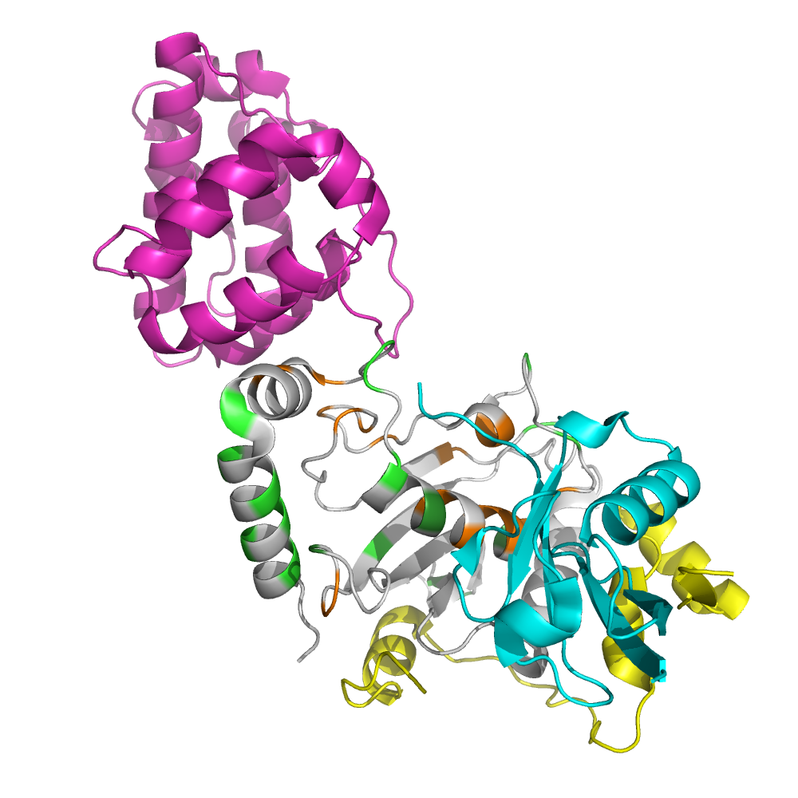
Clusters of prediction outliers in the SUMO-E2-E3-Substrate complex
RANGAP1
(substrate)
SUMO1
RANBP2 (E3)
Notes:
Sumo_outliers_4.pse
D100G: conserved, 7/9 high impact, FOLDX -0.0366, SNPs3d stability 0.1287
D127G: conserved, 9/10 high impact, FOLDX 0.981, SNPS3d stability 0.6173
E118K: conserved, 8/10 high impact, FOLDX 0.431, SNPs3d stability -0.0552, incorrectly assigned Gain-of-function
E122S: variable, conserved in close species, 2/5 high impact, FOLDX -0.2971, SNPs3d stability 1.2766, incorrectly assigned Gain-of-function
# Remove the right panel

Slide 11
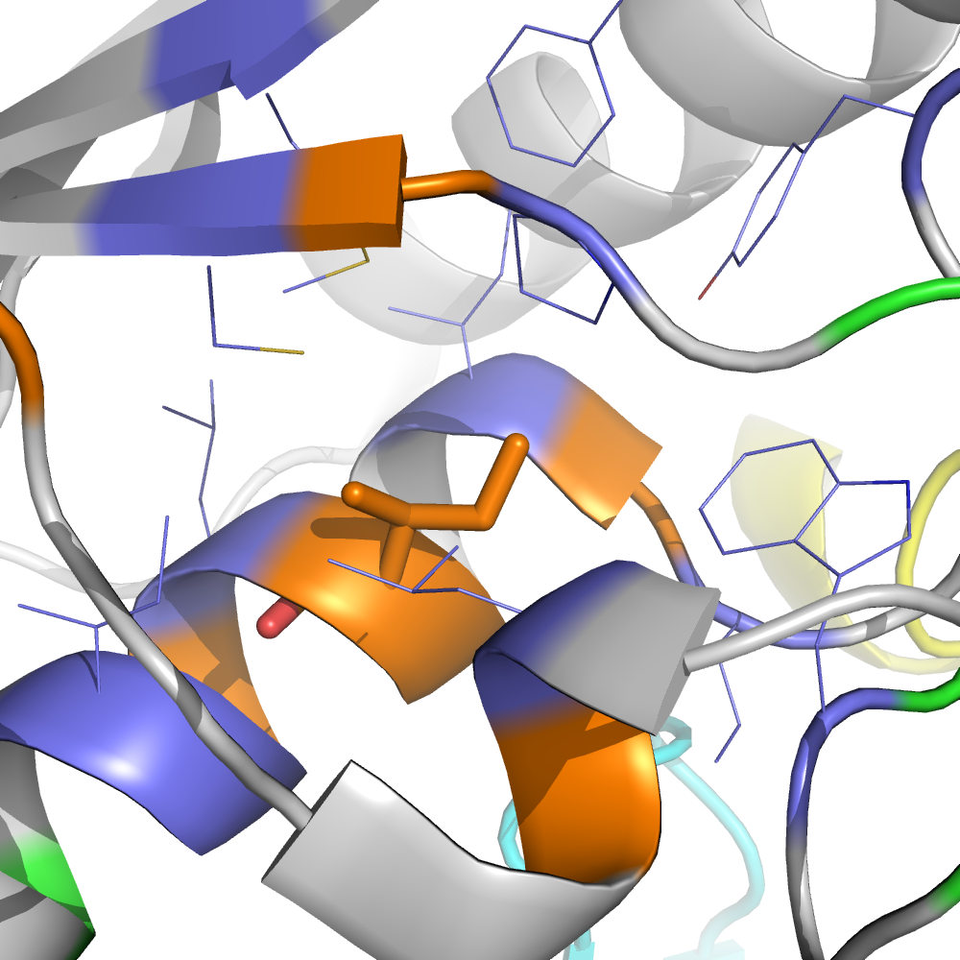
SUMO ligase prediction outlier examples (cont.)
Conserved position
High impact: 9 / 10 methods
FOLDX ddg: +3.04kcal/mol
I112T
Notes:
Sumo_outliers_5.pse
#? Check if any possible to form sc-bb hydrogen bond, and express the conclusion

Slide 12
Summary
Consensus methods can generate useful information for predicting mutation effect, e.g. effect on protein activity from destabilizing of the protein
The prediction performance is far from the theoretical limit
Increasing training data size and reducing experimental error will lead to only minor improvement of prediction accuracy
A gene specific model incorporating extra biological information may be necessary to supplement the sequence or structure based predictors
Systematic bias by training on a different protein can be calibrated

Slide 13
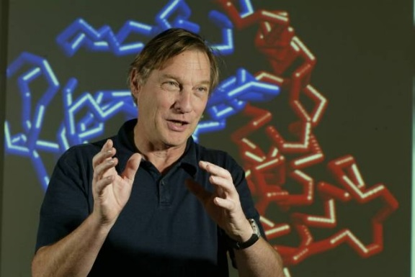
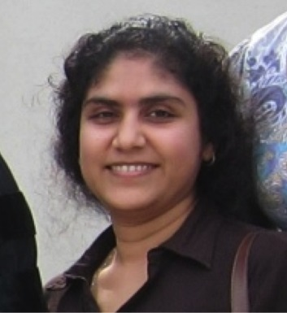
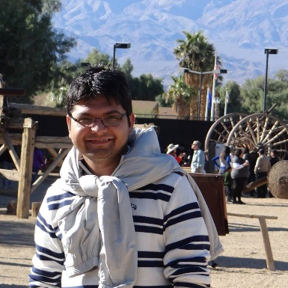
Acknowledgements
Data Providers
NAGLU
Jonathan H. LeBowitz
Wyatt T. Clark
Karen Yu
SUMO ligase
Weile J
Cote AG
Sun S
Knapp J
Verby M
Yang F
Tan G
Mellor J
Andrews B
Vidal M
Hill D
Boone C
Roth FP
Moult Lab
John Moult
Lipika R. Pal
Kunal Kundu
CAGI
John Moult
Steven E. Brenner
Roger A. Hoskins
Other organizers

