Slide 1

CAGI slide pack guidelines
Fritz Roth_______
Authors: please include THIS slide at the beginning of your presentation to indicate that you agree with reuse of your slides in CAGI presentations, according to the terms below, and digitally sign by writing your name above.
To disseminate the CAGI results, I encourage all CAGI participants to remix these CAGI slides for inclusion in their oral and poster presentations
CAGI participants may use or publish any content of these slides only in compliance with the CAGI Data Use Agreement
CAGI participants may not cite or publish any content of these slides except with the written permission of the originating author or in the primary CAGI publications
CAGI participants must acknowledge the original authors of these slides and CAGI 2016. Include the acknowledgement banner across the bottom
CAGI participants must include the CAGI credits slide in their presentations
Slides with a red slash (no remix) may not be included in a presentation unless all attendees are registered CAGI participants who signed the data use agreement
Slides with a red X over the entire slide may not be used in any circumstances
Slides with a blue slash (embargoed) may not be used unless the embargo is explicitly lifted
Slides without slash or X may be tweeted unless flagged with the “No tweet” icon.
CAGI participants using these slides must explain the “No tweet” icon, which means that the slide content should not be disseminated outside the presenting conference hall. If the presentation venue permits pervasive tweeting, you may not include these slides in your talk
Note for slide authors: we expect all CAGI participants to abide by these restrictions, and will make best effort to ensure they are followed. However, but bear in mind that we have limited means of enforcing them, and therefore the restrictions cannot be guaranteed.

Slide 2
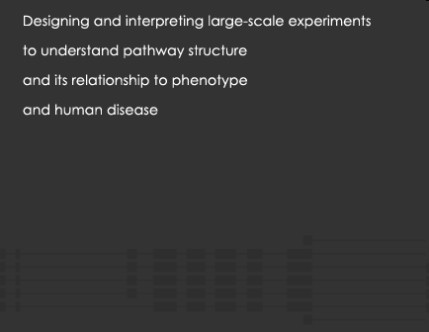
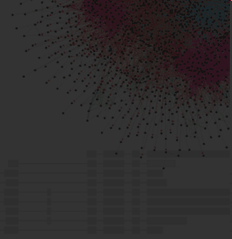


An Atlas of Functional Amino Acid Changes
in the Human SUMO Conjugase UBE2I
Fritz Roth
        Donnelly Centre
        Departments of Molecular Genetics & Computer Science
Lunenfeld-Tanenbaum Research Institute
CAGI 4
March 25, 2016
UCSF, San Francisco, CA

Slide 3
Full disclosure
No Tweet
Scientific Advisory Board Member:
SeqWell, Inc., Beverly MA, USA
Long-read next-generation sequencing services)
Ranomics, Inc, Toronto, ON, Canada
Functional assessment of human variation

Slide 4
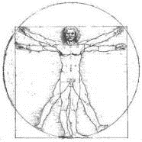

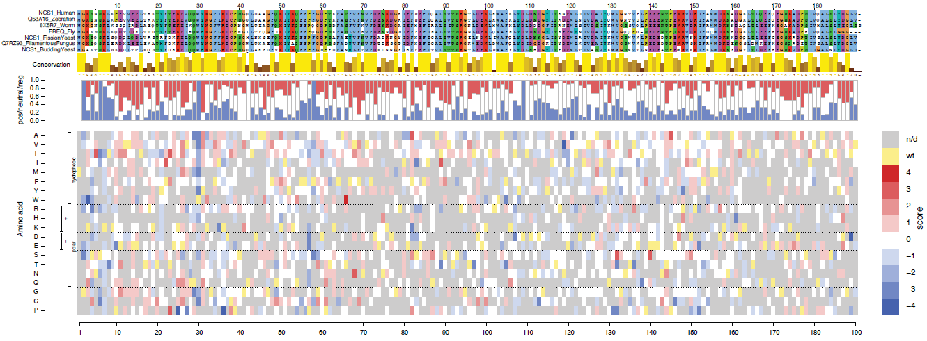
Outline
  Functional assay
  Mutagenesis method
  Sequence-identifying mutagenized clones and their unique DNA barcodes
  Pooled fitness measurements by barcode sequencing
  Results on UBE2I
No Tweet

Slide 5
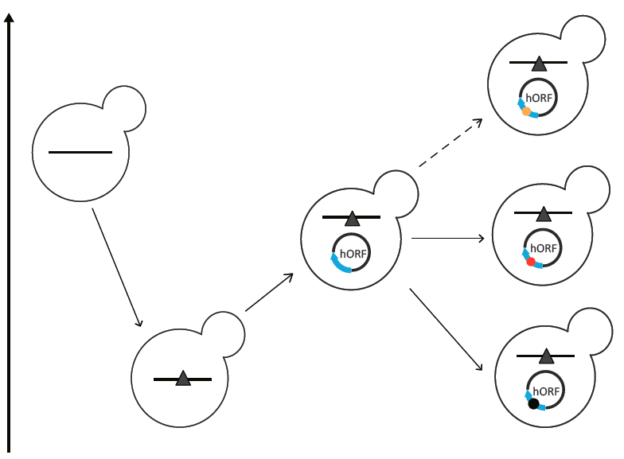
Trans-species complementation
No Tweet
Normal
yeast gene
Variant that still rescues
Human gene rescues
Growth rate
Mutant yeast gene
Variant that no longer rescues
(Reviewed by J. Rine, MBC 2014)
Notes:
The idea is to take a yeast cell, mutate the yeast cousin of a human disease gene, and then see if the human gene rescues.
If it does, you can try variants of the human gene. If the gene no longer rescues, then the variant was functional

Slide 6
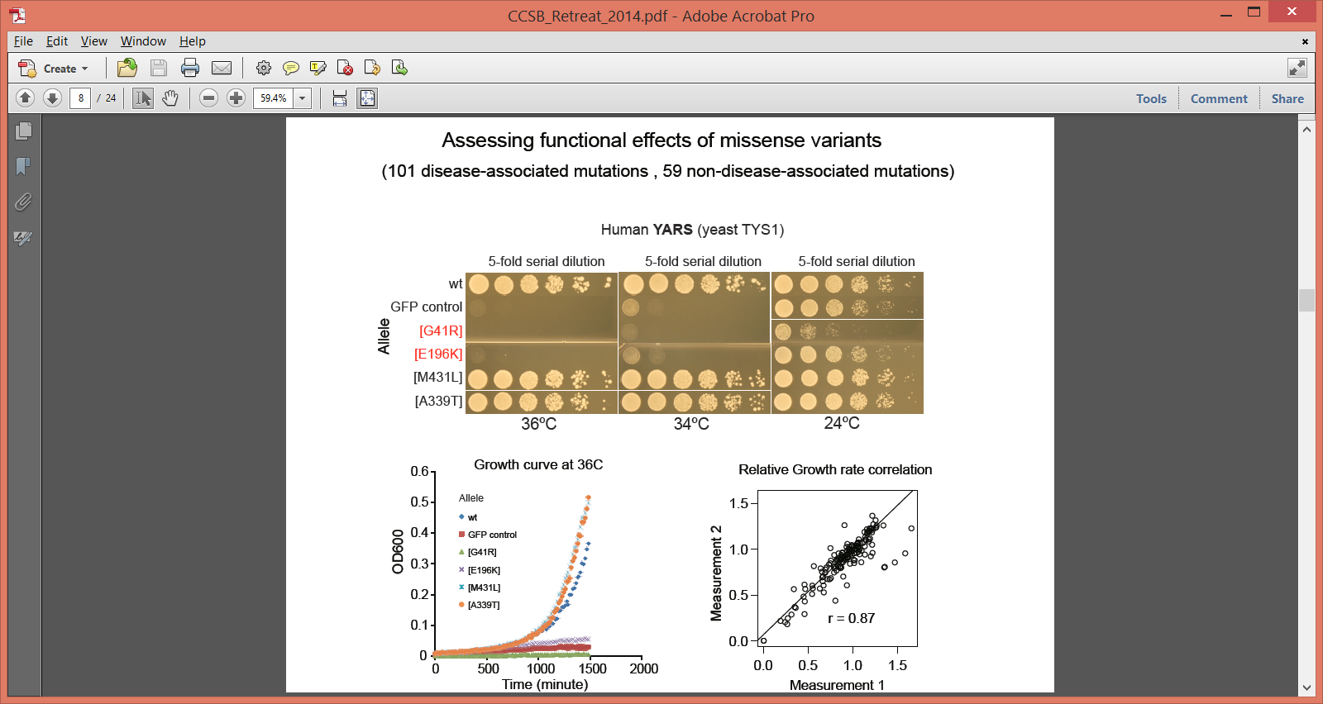
Assessing effects of human variation
Can yeast complementation separate disease
from non-disease variants?
permissive
non-permissive
Does it work in general?
(Sun et al, Genome Research 2016)

Slide 7
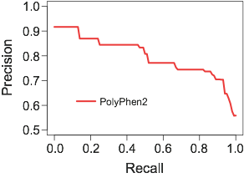
Precision and recall curve - PolyPhen-2
Fraction of disease predictions
that are correct
Fraction of disease mutations
that are predicted
(Sun et al, Genome Research 2016)

Slide 8
Precision and recall curve - PolyPhen-2
Fraction of disease predictions
that are correct
Fraction of disease mutations
that are predicted
(Sun et al, Genome Research 2016)

Slide 9
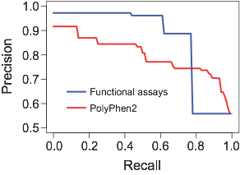
Yeast functional assays outperform PolyPhen-2
Based on 138 variants in 21 genes: 76 disease, 62 non-disease
Fraction of disease predictions
that are correct
Fraction of disease mutations
that are predicted
(Sun et al, Genome Research 2016)

Slide 10
Outline
  Functional assay
  Mutagenesis method
  Sequence-identifying mutagenized clones and their unique DNA barcodes
  Pooled fitness measurements by barcode sequencing
  Results on UBE2I
No Tweet

Slide 11
POPcode
No Tweet
Precision Oligo-Pool-guided code alteration
aka
POPcode
(Variant of Seyfang & Jin, Analytical Biochemistry 2004)

Slide 12
POPcode: One codon change
Hybe codon-altered oligo to uracilated ORF template
Fill and ligate gaps
Uracil DNA glycosylase to kill template
PCR amplify
No Tweet
Variant of Seyfang & Jin, (Analytical Biochemistry 2004)

Slide 13
POPcode: Random codon mutagenesis
No Tweet
One codon-swap oligo for EACH codon
Central degenerate sequence NNK
(all 20 amino acids and only TAG stop*)
ATG STOP
(Weile et al., in preparation)

Slide 14
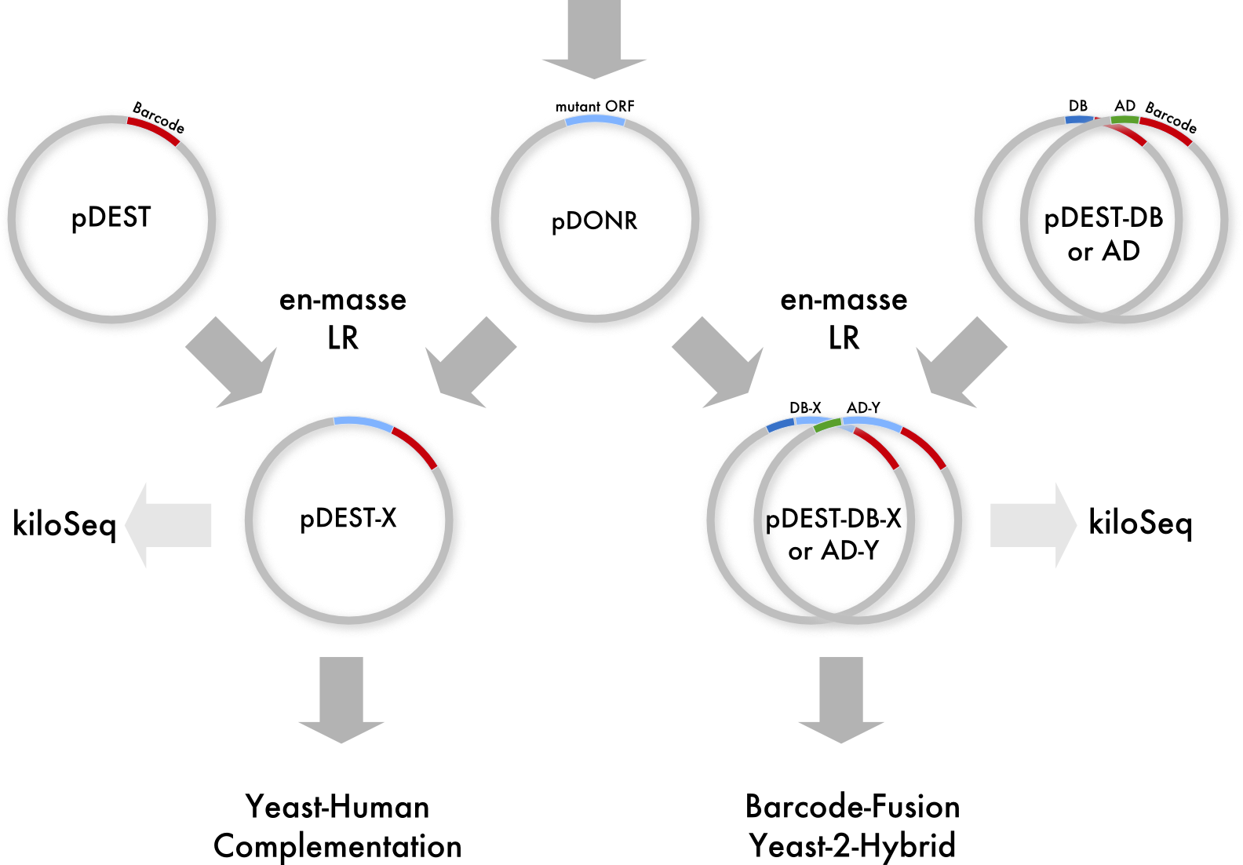
POPcode: Cloning strategy
No Tweet
POPcode
Gateway BP Cloning
(Weile et al., in preparation)

Slide 15
Outline
  Functional assay
  Mutagenesis method
  Sequence-identifying mutagenized clones and their unique DNA barcodes
  Pooled fitness measurements by barcode sequencing
  Results on UBE2I
No Tweet

Slide 16
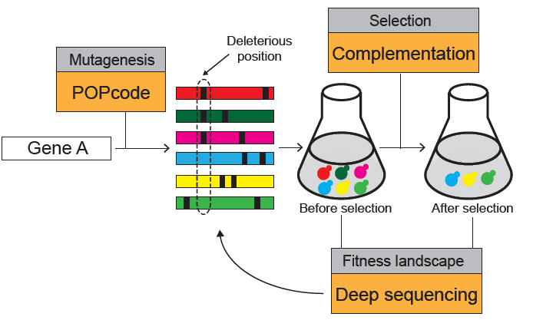
En masse complementation scheme
No Tweet
Like “Deep mutational scanning” ala Fowler, Fields Shendure except:
-complementation selection instead of Y2H
-barcode sequencing instead of direct sequencing
(Weile et al., in preparation)

Slide 17
Outline
  Functional assay
  Mutagenesis method
  Sequence-identifying mutagenized clones and their unique DNA barcodes
  Pooled fitness measurements by barcode sequencing
  Results on UBE2I
No Tweet

Slide 18
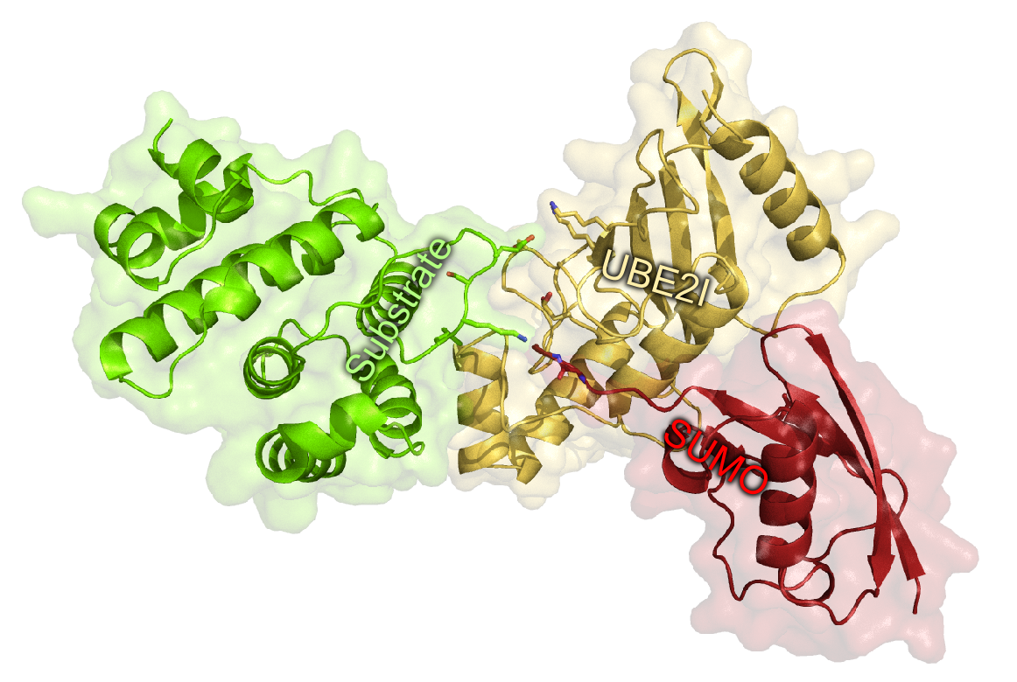
POPCode Pilot 1: Sumo conjugase UBE2I
No Tweet
Why UBE2I?
Yeast functional complementation
19 Y2H interactions
Co-crystal structures
Somatic cancer mutations of unknown significance

Slide 19
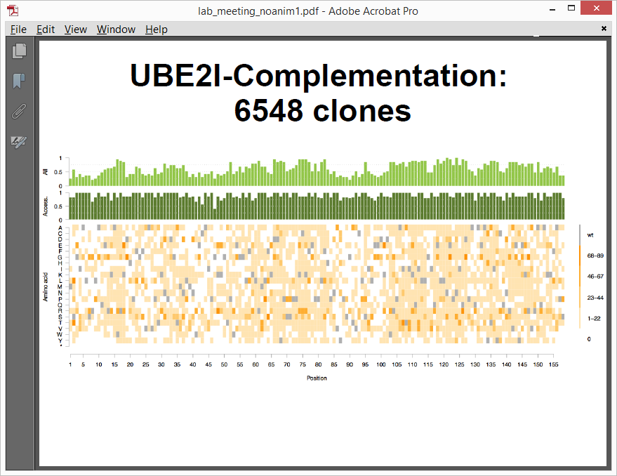
UBE2I: Pilot complementation project
No Tweet
UBE2I: Set of 6548 DNA-barcoded expression clones
(1847 unique amino acid changes)
(Weile et al., in preparation)

Slide 20
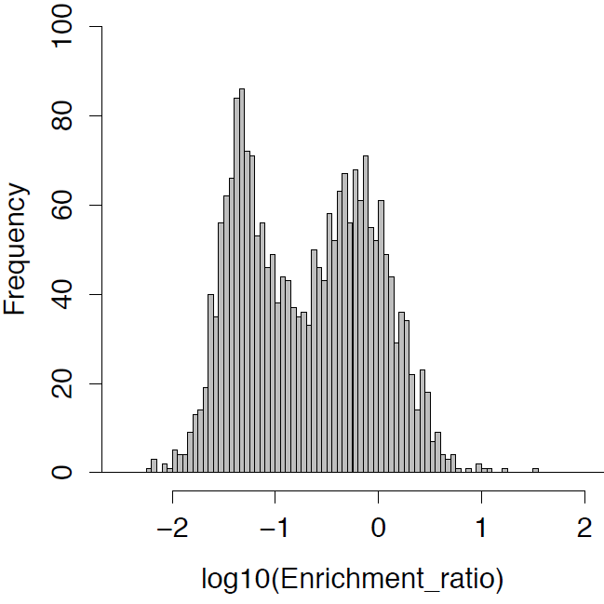
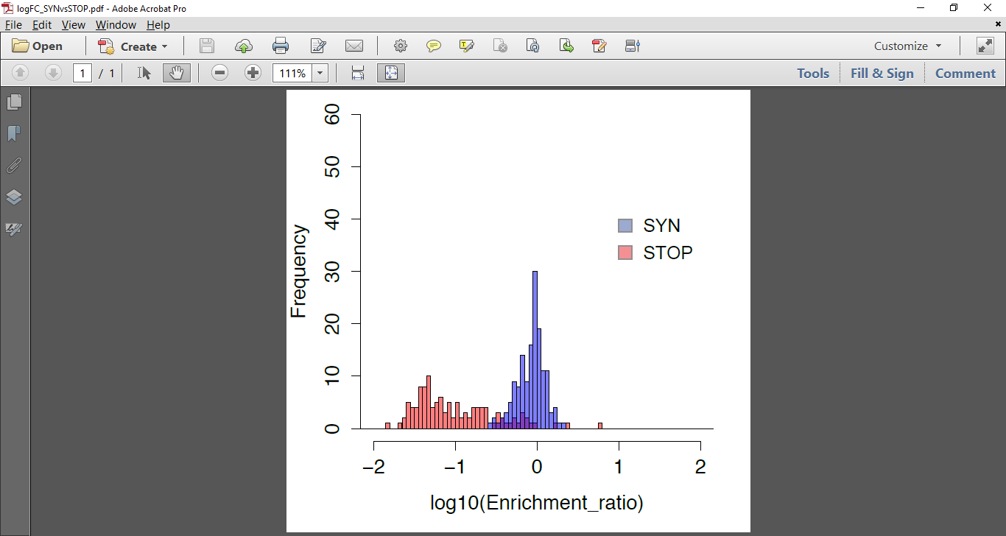
UBE2I*: Scoring
No Tweet
All Non-Synomymous
Synomymous
and
Nonsense
*This is a different UBE2I dataset than CAGI
(Weile et al., in preparation)

Slide 21
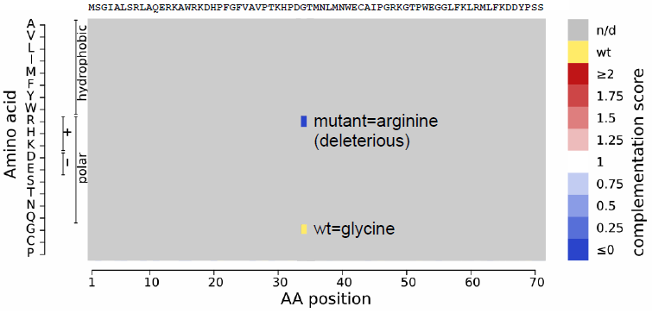
UBE2I: Genophenogram
No Tweet

Slide 22
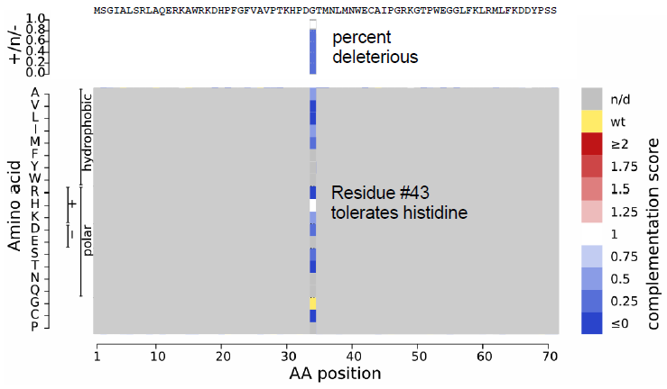
UBE2I: Genophenogram
No Tweet

Slide 23
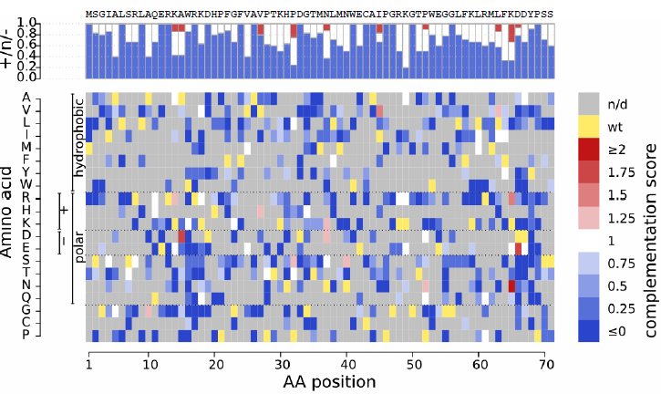
UBE2I: Genophenogram
No Tweet

Slide 24
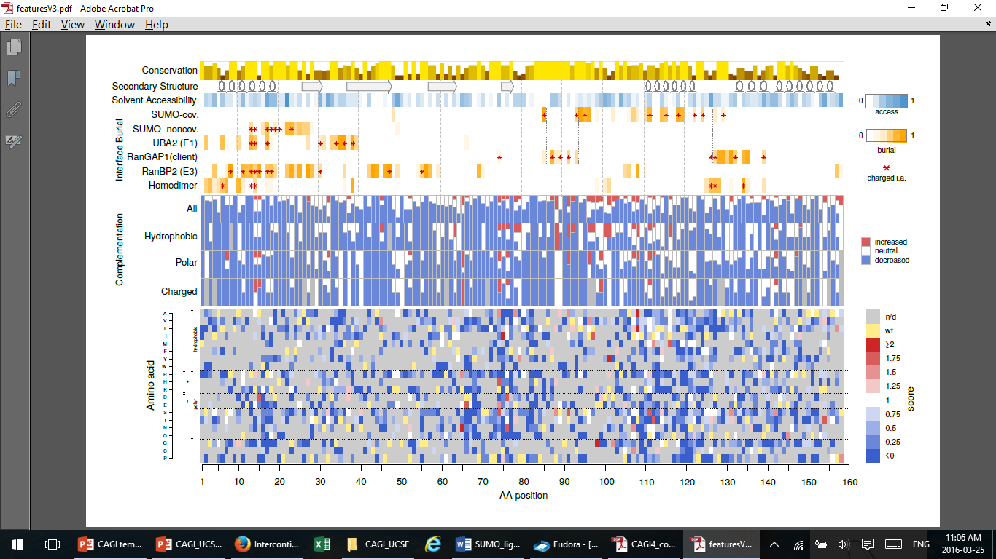
UBE2I: A marked-up genophenogram
No Tweet

Slide 25
UBE2I: A marked-up genophenogram
No Tweet

Slide 26
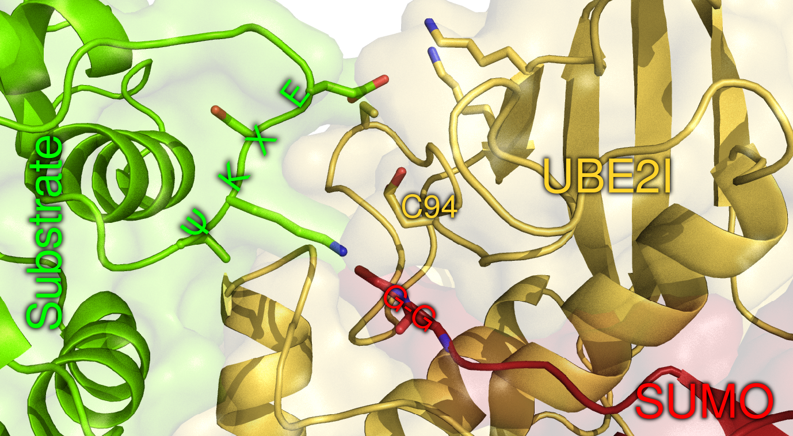
Cysteine 94 performs catalysis
No Tweet
Notes:
This is because the cysteine in question is responsible for performing the creating the peptide bond between SUMO and its substrate and is thus absolutely vital for the central function of UBE2I.

Slide 27
UBE2I: A marked-up genophenogram
No Tweet

Slide 28
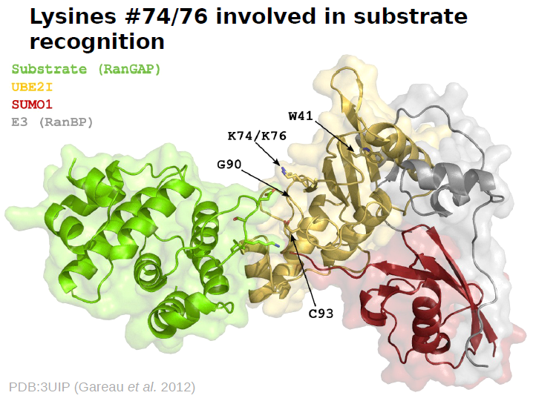
UBE2I: Adaptation to yeast clients?
No Tweet
Notes:
When we compare the results to sequence conservation though, they do seem to make sense. For example if we pick out this cysteine residue here, we see that it any changes show up blue across the board.

Slide 29
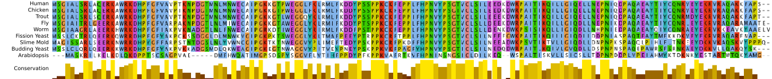
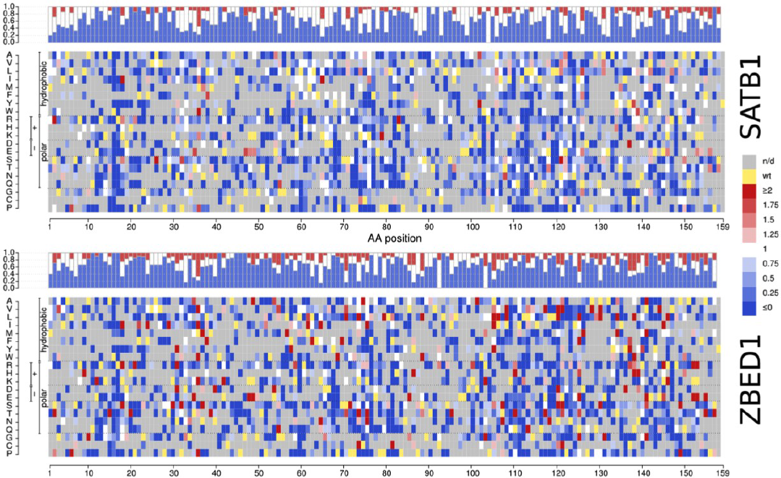
UBE2I interaction genophenograms (2 + 4 coming)
Conserv.
No Tweet
n/d
wt
log(ratio) +
-
Amino acid
Amino acid Position
(Weile et al., in preparation)
Notes:
When we compare the results to sequence conservation though, they do seem to make sense. For example if we pick out this cysteine residue here, we see that it any changes show up blue across the board.

Slide 30

Progress on other genophenograms
No Tweet
 | Oligos | Closed ENTRY | POPCode | pENTRY Library | POPCode check | pDEST Library | Yeast TS Library | Screens | NextGen Seq
NCS1 oligo set 1 | ✔ | ✔ | ✔ | ✔ | ✔ | ✔ | ✔ | ✔ | ✔
NCS1 oligo set 2 | ✔ | ✔ | ✔ | ✔
SUMO1 | ✔ | ✔ | ✔ | ✔ | ✔ | ✔ | ✔ | ✔ | ✔
UBE2I | ✔ | ✔ | ✔ | ✔ | ✔ | ✔ | ✔ | ✔ | ✔
CALM1 | ✔ | ✔ | ✔
TBK1 | ✔ | ✔
SPAST | ✔ | ✔
GDL1 | ✔ | ✔ | ✔
TPK1 | ✔ | ✔ | ✔
TECR | ✔ | ✔ | ✔

Slide 31
Acknowledgments
Dana-Farber Center for Cancer Systems Biology
  David Hill
  Marc Vidal
Support
  NIH/NHGRI Center for Excellence in Genome Science (CEGS)
  Canada Excellence Research Chairs Program
  Canada Foundation for Innovation
  Canadian Institute for Advanced Research
  Ontario Research Fund
  Krembil Foundation
  Avon Foundation
  Swedish Research Council
Roth Lab
  Jochen Weile
  Song Sun
  Atina Cote
  Sunny Fan
  Jennifer Knapp
  Marinella Gebbia
  Marta Verby
  Paul Bansal
  Joe Mellor
  Cassandra Wong
  Nozomu Yachie
  Anjali Gopal
  Others
Others at Donnelly Centre
  Charlie Boone
  Brenda Andrews
  Guihong Tan

