Slide 1

CAGI slide pack guidelines
I agree to my slides being used according to the following terms: _______Author Name Here_______
Authors: please include THIS slide at the beginning of your presentation to indicate that you agree with reuse of your slides in CAGI presentations, according to the terms below, and digitally sign by writing your name above.
To disseminate the CAGI results, I encourage all CAGI participants to remix these CAGI slides for inclusion in their oral and poster presentations
CAGI participants may use or publish any content of these slides only in compliance with the CAGI Data Use Agreement
CAGI participants may not cite or publish any content of these slides except with the written permission of the originating author or in the primary CAGI publications
CAGI participants must acknowledge the original authors of these slides and CAGI 2013. Include the acknowledgement banner across the bottom
CAGI participants must include the CAGI credits slide in their presentations
Slides with a red slash (no remix) may not be included in a presentation unless all attendees are registered CAGI participants who signed the data use agreement
Slides with a red X over the entire slide may not be used in any circumstances
Slides with a blue slash (embargoed) may not be used unless the embargo is explicitly lifted
Slides without slash or X may be tweeted unless flagged with the “No tweet” icon.
CAGI participants using these slides must explain the “No tweet” icon, which means that the slide content should not be disseminated outside the presenting conference hall. If the presentation venue permits pervasive tweeting, you may not include these slides in your talk
Note for slide authors: we expect all CAGI participants to abide by these restrictions, and will make best effort to ensure they are followed. However, but bear in mind that we have limited means of enforcing them, and therefore the restrictions cannot be guaranteed.

Slide 2
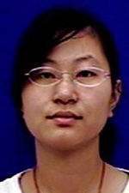

SUMO ligase challenge assessment
Jing Zhang
Lisa N. Kinch
Nick V. Grishin
Departments of Biophysics and Biochemistry, x
University of Texas Southwestern Medical Center at Dallas,
Howard Hughes Medical Institute

Slide 3
Ubc9 Sumoylation Pathway
Sumo
AMP
+ ATP + PPi
E1
E1
Cys
Cys
Sumo
E2
Cys
Substrates:
ΨKxE(xxS)
E2
Cys
Sumo
E3s
Sumo

Slide 4
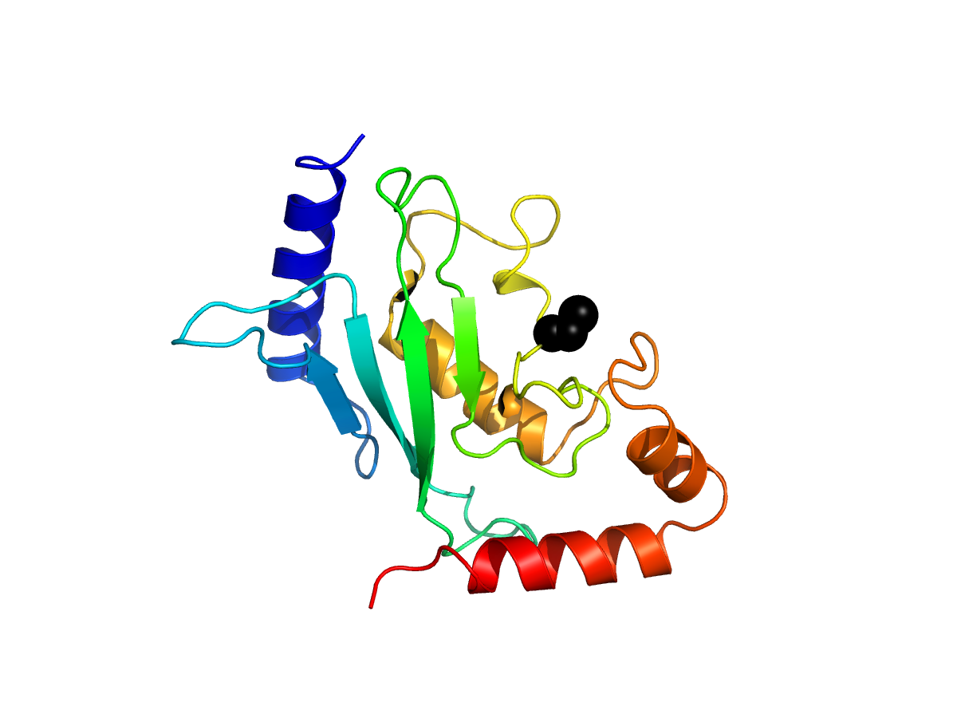
Ubc9 Sumoylation Pathway
Sumo
AMP
+ ATP + PPi
Cys 93
E1
E1
Cys
Cys
Sumo
E2
Cys
Substrates:
ΨKxE(xxS)
E2
Cys
Sumo
Sumo

Slide 5
Ubc9 Mutation Datasets
Subset 1: high-accuracy subset of 219 single amino acid variants for which at least three independent barcoded clones are represented, providing internal replicates of the experiment. (Main focus)
Subset 2: remaining 463 (of 682 total) single amino acid variants.
Subset 3: the additional 4,427 alleles corresponding to clones containing two or more amino acid variants.

Slide 6
9 groups participated (39 to 47)
Some groups submitted several predictions,
e.g. 44_1 and 44_2

Slide 7
Our tasks:
1. Develop a comprehensive and rigorous assessment scheme, with positive and negative controls, and ranks the groups by their performance;
2. Compare predictions for different mutations and see what works and what does not.

Slide 8
Our tasks:
1. Develop a comprehensive and rigorous assessment scheme, with positive and negative controls, and ranks the groups by their performance;
2. Compare predictions for different mutations and see what works and what does not.

Slide 9
Ubc9 Mutation Datasets
Subset3 has relatively few wild type Mutations
Deleterious +/- Wild Type Advantagous
Categories

Slide 10
Predictors were given the scores.
The task was to assign mutations to them!

Slide 11
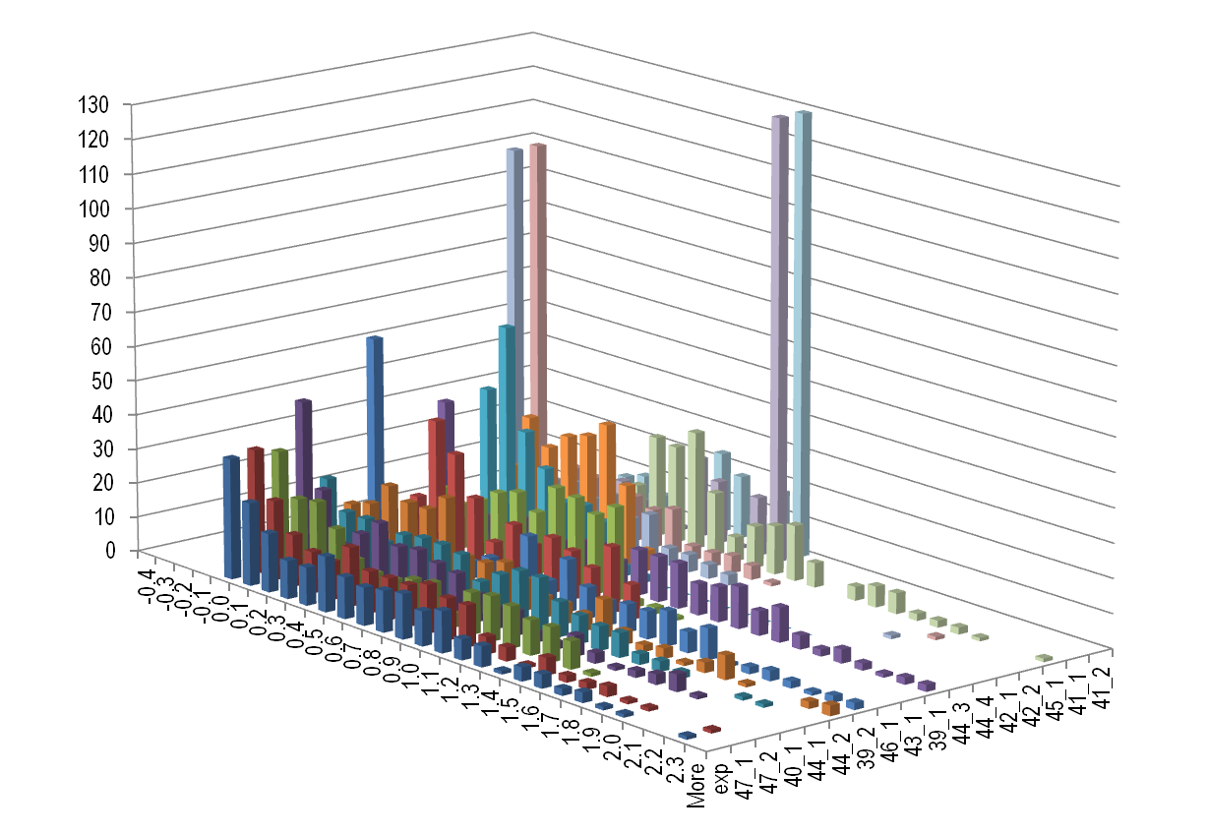
Prediction Score Distributions
KS Tests
Group | static(D) | p
47-1 | 0.02 | 1.0
47-2 | 0.08 | 0.49
40-1 | 0.09 | 0.29
44-1 | 0.13 | 0.06
44-2 | 0.15 | 0.01
39-2 | 0.17 | 3E-03
46-1 | 0.21 | 1E-04
43-1 | 0.23 | 2E-05
39-1 | 0.25 | 2E-06
44-3 | 0.33 | 6E-11
44-4 | 0.34 | 3E-11
42-1 | 0.34 | 1E-11
42-2 | 0.34 | 1E-11
45-1 | 0.36 | 8E-13
41-1 | 0.43 | 1E-17
41-2 | 0.43 | 1E-17
Number of mutations
Competitive Growth Score
(ordered by KS)
Only 3 are very similar to experimental score distribution!

Slide 12
Considerations
Only three groups have distribution of predicted scores very similar to the distribution of experimental scores;
Differences in distributions wouldn’t matter for evaluation based on comparing ranks;
For RMSD-like measures to be meaningful, assessors had to transform prediction scores: don’t let it happen next time!

Slide 13
Quantile-like transformation of predicted values
to match experimental values
Assign experimental value to predicted mutation
Mutations ranked by predicted scores
Experimental values ranked low-to-high
mutation | Pred transformed
S56K | 0
A165D | 0.12
K45F | 0.21
C89G | 0.34
L214A | 0.48
mutation | Pred rank
S56K | 1
A165D | 2
K45F | 3
C89G | 4
L214A | 5
rank | Exper score
1 | 0
2 | 0.12
3 | 0.21
4 | 0.34
5 | 0.48

Slide 14
Performance Evaluation
Since no single score captures all aspects of predictions, we used many scores measuring different properties
1. Rank-based scores. These don’t depend on the scale of predictions.
2. Value-based scores computed on predictions transformed by us.
3. Value-based scores computed on original predictions.

Slide 15
General idea about which scores to use
1. What effect is caused by a mutation: deleterious, advantageous.
Performance on a binary classification.
E.g., using ROC curves and areas under them.
2. Strength of the effect: comparison of values and their ranks.
E.g., Kendall tau or RMSD-like measures.

Slide 16
Measures for evaluation
Three groups of measures:
Categories performance:
ROC (Receiver operating characteristic) of deleterious mutations
ROC-like curve for overall mutations categories
F1 score for overall categories identification
MCC (Matthews correlation coefficient) for deleterious mutations identification
Rank performance:
Spearman's rank correlation coefficient
Kendall tau
Rank difference test
Value comparison:
Pearson correlation
RMSD
Value distance test
ROC-like curve for correctly predicted mutations

Slide 17

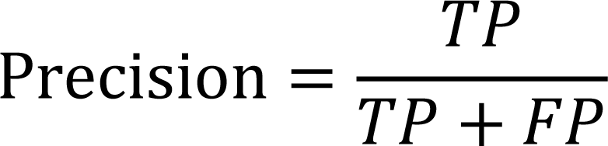
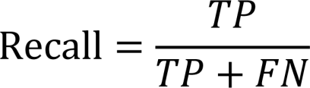
Description of each measure
ROC (Receiver operating characteristic) of deleterious mutations
It is plot of the true positive rate versus the false positive. Mutations with experimental scores less than 0.3 are regarded as deleterious mutations (true). Others are not-deleterious (false) Mutations are ranked by their predicted scores from low to high, that is, from most mutations predicted to be deleterious to least deleterious. The area under the curve was used as measure.
ROC-like curve for overall mutations categories
It is plot of the number of true positives versus the number of false positives. To make the scores comparable, we extend the plateau at the end and use the area under curve as the measure
F1 score
Mutations are classified into 4 categories based on predicted and experimental scores. <=0.3: highly deleterious, 0.3~0.7: moderately deleterious, 0.7 ~ 1.3: benign, >1.3: advantageous mutations. The mutations classified in the same categories by experimental scores and predicted scores are considered correctly predicted.

Slide 18

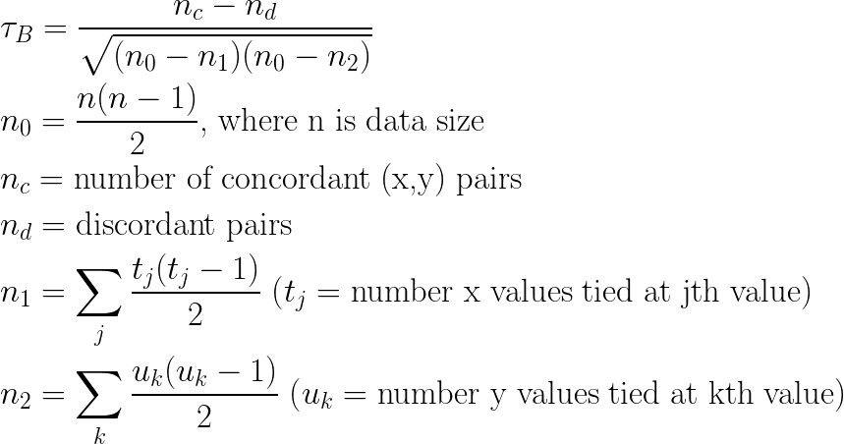

MCC (Matthews correlation coefficient)
Kendall Tau-b
Spearman’s rank correlation
ρ is correlation;
cov: covariance between rank variables
σ : standard deviation of rank variables.

Slide 19
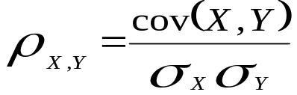
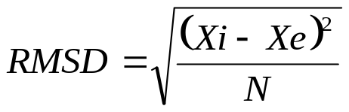
Rank difference test
The ranks of mutation based on predicted score and experimental score are calculated. The measure is the area under the curve of the percentage of mutations versus absolute rank difference. (This is GDT-TS-like measure)
Pearson correlation coefficient
cov is covariance of X and Y
σ is standard deviation
RMSD (Root-mean-square deviation)
Xi is predictive scores
Xe is experimental scores
N is the number of mutations
Value difference test
It is the area under the curve of the percentage of mutations against the absolute difference between experimental score and predicted score of mutations.

Slide 20
ROC-like curve for correctly predicted mutations
Mutations with absolute value difference between experimental scores and predicted scores less than 0.222 are considered correctly predicted. Mutations are ranked by predicted scores from low to high. The measure is the area under curve of the number of correctly predicted mutations against the number of incorrectly predicted mutations. To make it comparable, the plateau at the end of the curve extends to the certain position.

Slide 21
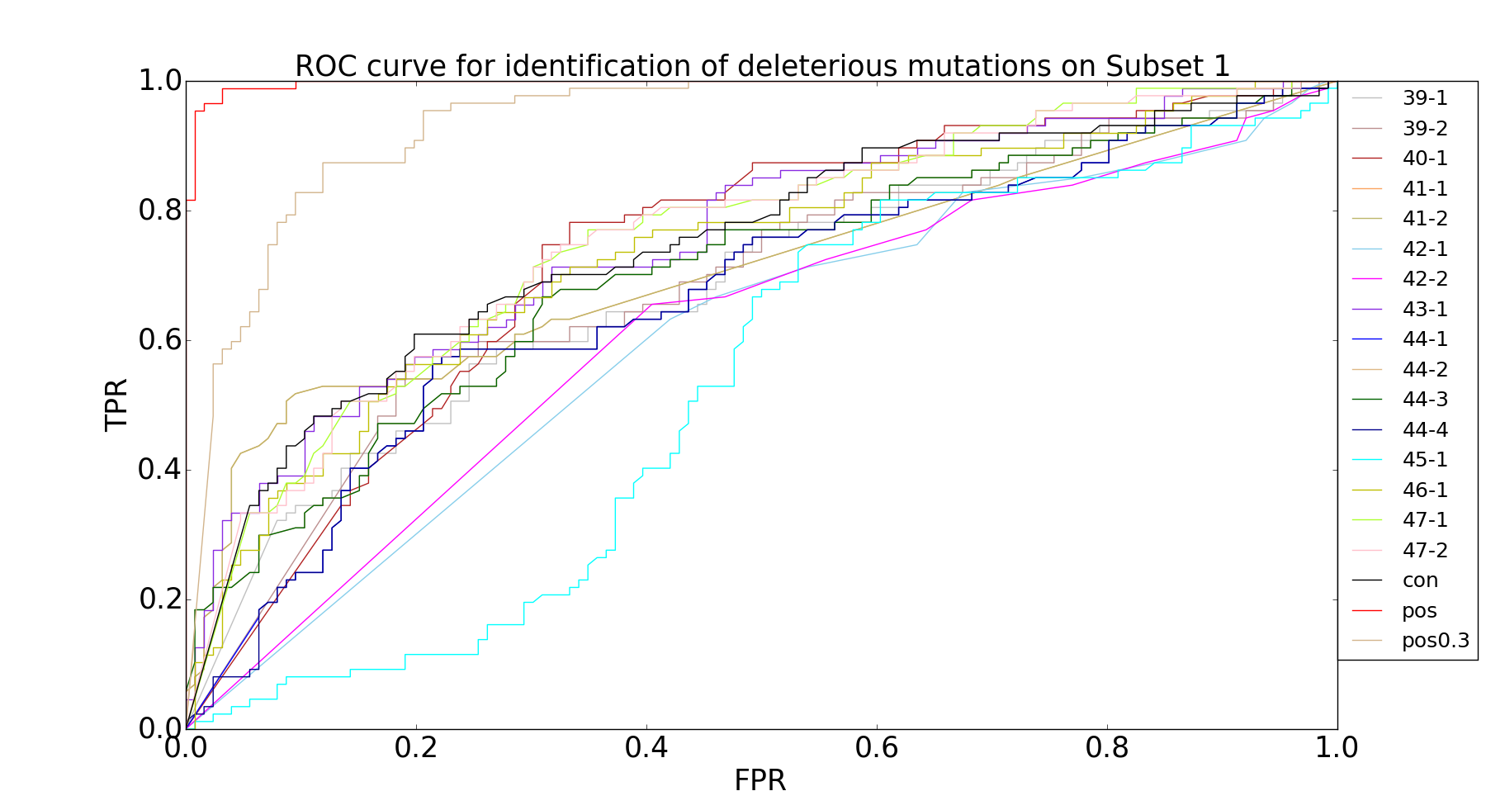
ROC (deleterious vs. non-deleterious)
The mutations are ranked by prediction scores from low to high (most deleterious to least deleterious).
Sub | AUC
39-1 | 0.685
39-2 | 0.686
40-1 | 0.732
41-1 | 0.71
41-2 | 0.71
42-1 | 0.603
42-2 | 0.614
43-1 | 0.755
44-1 | 0.67
44-2 | 0.701
44-3 | 0.701
44-4 | 0.668
45-1 | 0.527
46-1 | 0.734
47-1 | 0.757
47-2 | 0.757
conserv | 0.748
pos | 0.997
pos0.3 | 0.938

Slide 22
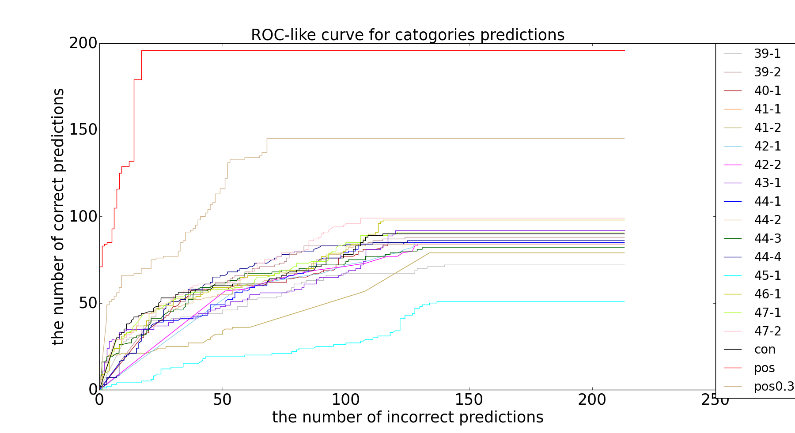
ROC like curve for performance of category identification of mutations
Mutations identified into same category are considered correctly predicted, otherwise incorrectly predicted.
Deleterious <=0.3; middle 0.3~0.7; benign (wild type) 0.7~1.3; advantageous >1.3
Sub | AUC
39-1 | 12528
39-2 | 15584
40-1 | 14496
41-1 | 11756
41-2 | 11756
42-1 | 13832
42-2 | 13866
43-1 | 14829
44-1 | 14424
44-2 | 14754
44-3 | 14559
44-4 | 15428
45-1 | 6815
46-1 | 16479
47-1 | 15829
47-2 | 17290
conserv | 15682
pos | 40451
pos0.3 | 27214

Slide 23
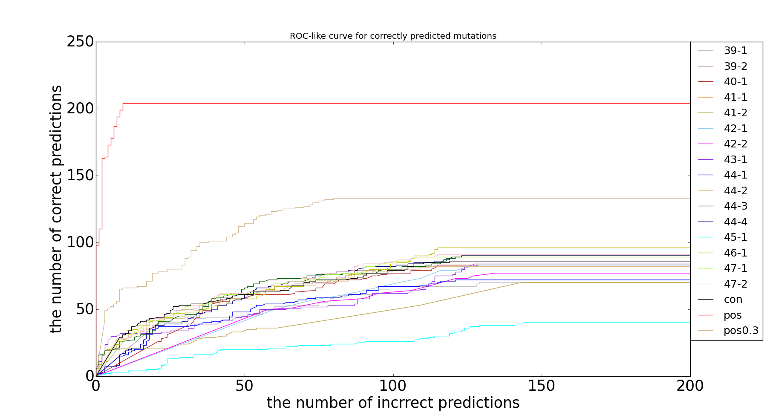
ROC-like curve for correctly predicted mutations
Sub | AUC
39-1 | 11417
39-2 | 13779
40-1 | 13166
41-1 | 9795
41-2 | 9795
42-1 | 11987
42-2 | 11256
43-1 | 12397
44-1 | 11561
44-2 | 13688
44-3 | 14609
44-4 | 14324
45-1 | 5364
46-1 | 15089
47-1 | 14673
47-2 | 14929
conserv | 14216
pos | 40430
pos0.3 | 23639
The mutations with prediction scores less than about 0.222 away from experimental scores are considered correctly predicted, otherwise incorrectly predicted.
ROC-like curve for correctly predicted mutations
The number of incorrect predictions

Slide 24
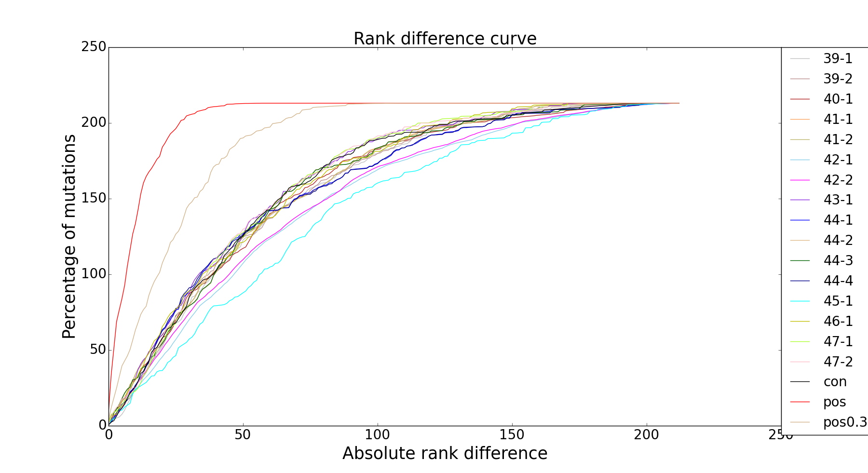
Percentage of mutations vs. rank difference
Difference between ranks of mutations in prediction and experiment and percentage of mutations that with this rank difference less than a certain cutoff (GDT-like).
Sub | AUC
39-1 | 0.749
39-2 | 0.751
40-1 | 0.751
41-1 | 0.755
41-2 | 0.754
42-1 | 0.709
42-2 | 0.715
43-1 | 0.771
44-1 | 0.748
44-2 | 0.756
44-3 | 0.756
44-4 | 0.748
45-1 | 0.675
46-1 | 0.764
47-1 | 0.769
47-2 | 0.77
conserv | 0.762
pos | 0.955
pos0.3 | 0.886

Slide 25
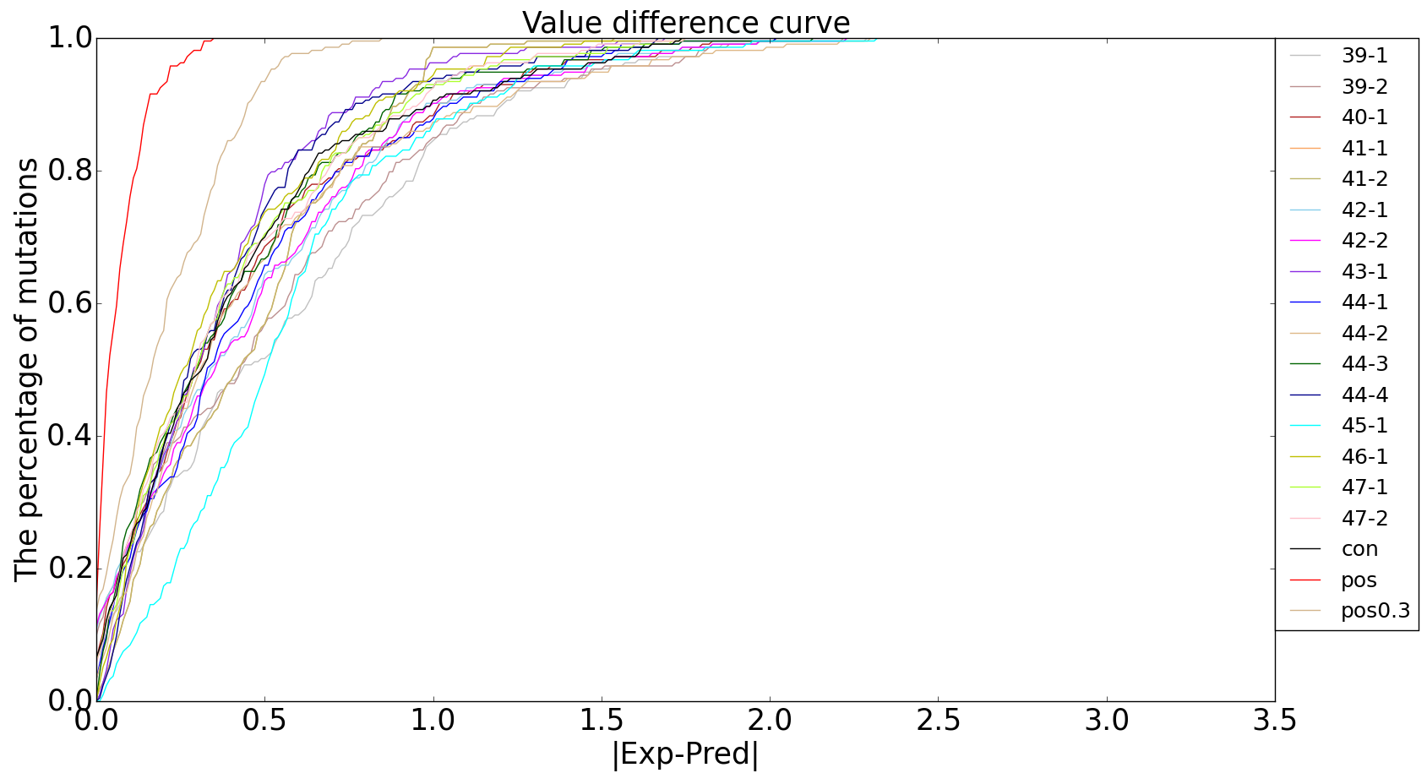
Percentage of mutations vs. value difference
Absolute difference between values of mutations in prediction and experiment and percentage of mutations that with this rank difference less than a certain cutoff (GDT-like).
Sub | AUC
39-1 | 0.832
39-2 | 0.846
40-1 | 0.87
41-1 | 0.867
41-2 | 0.867
42-1 | 0.861
42-2 | 0.86
43-1 | 0.891
44-1 | 0.863
44-2 | 0.859
44-3 | 0.879
44-4 | 0.885
45-1 | 0.829
46-1 | 0.889
47-1 | 0.88
47-2 | 0.881
conserv | 0.875
pos | 0.98
pos0.3 | 0.938

Slide 26
Matthews correlation coefficient (deleterious vs. non-deleterious)
Group | MCC | MCC | AUC
47-2 | 0.378 | 0.380 | 0.757
47-1 | 0.378 | 0.367 | 0.757
43-1 | 0.359 | 0.365 | 0.755
46-1 | 0.359 | 0.348 | 0.734
40-1 | 0.328 | 0.366 | 0.732
41-1 | 0.309 | 0.308 | 0.710
41-2 | 0.309 | 0.308 | 0.710
44-3 | 0.290 | 0.220 | 0.701
44-2 | 0.290 | 0.306 | 0.701
39-2 | 0.320 | 0.351 | 0.686
39-1 | 0.300 | 0.307 | 0.685
44-1 | 0.300 | 0.278 | 0.670
44-4 | 0.300 | 0.351 | 0.668
42-2 | 0.246 | 0.136 | 0.614
42-1 | 0.208 | 0.118 | 0.603
45-1 | -0.002 | -0.021 | 0.527

Slide 27
Groups of scores
Measures were grouped into three categories:
(1) Rank-based (don’t change with score transformation):
Spearman's rank correlation coefficient
Kendall tau
Rank distance test
ROC for deleterious mutations
Value-based (differ between original and transformed prediction scores) applied to (2) transformed prediction scores and
(3) original prediction scores:
ROC-like curve for overall mutations categories
F1 score for overall categories identification
MCC (Matthews correlation coefficient) for deleterious mutations
Pearson correlation
RMSD
Value distance test
ROC-like curve for correctly predicted mutations

Slide 28
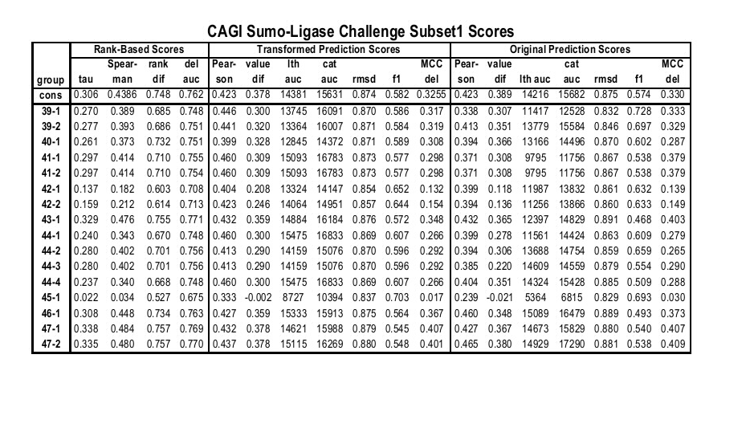

Slide 29
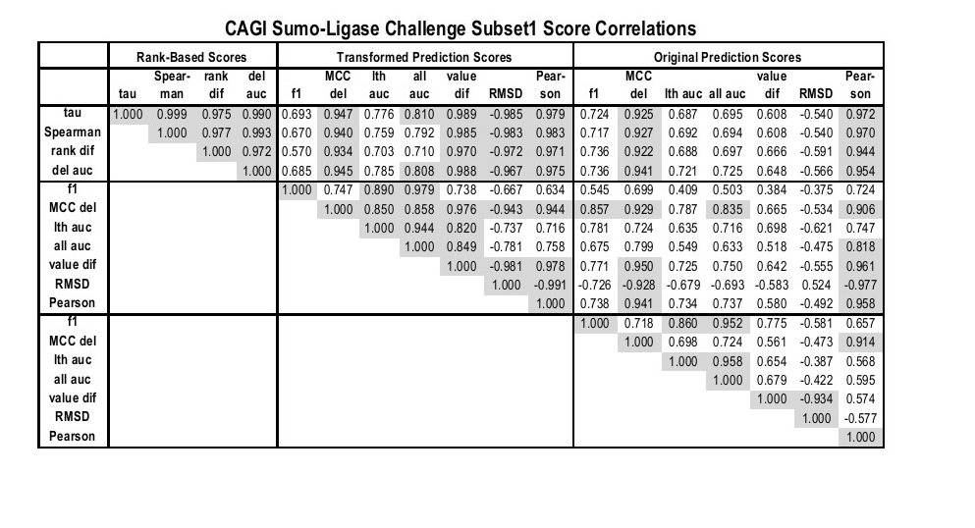

Slide 30
Combine Scores:
Average Z-scores within each category;
Sum for categories in each subset;
Overall score = 2*S1sum + S2sum + S3sum

Slide 31
Controls!
“Control ought to be stupid.”
V. M. Stepanov
(1) Positive control
To answer the question:
How do errors in experimental measurements affect the scores?
I251K 1.24 +/- 0.32
standard deviation
mean
assume Gaussian distribution
Generate a “perfect” prediction:
for each mutation, generate a Gaussian random variable with the mean and standard deviation set to experimental values

Slide 32

Controls!
“Control ought to be stupid.”
V. M. Stepanov
(2) Negative control
To answer the question:
How does a predictor based on amino acid usage in positions of
a multiple sequence alignment compares to submitted predictions?
Generate a “dummy” prediction:
for each mutation, compute the score:
Pw, the probability of wild type or Pm mutated residue in multiple sequence alignment; q, the background amino acid frequencies of Robinson and Robinson. If more than one mutation – add these values. Rank mutations by these scores and assign experimental value with that rank (the same as quantile transformation we apply to predictions).

Slide 33
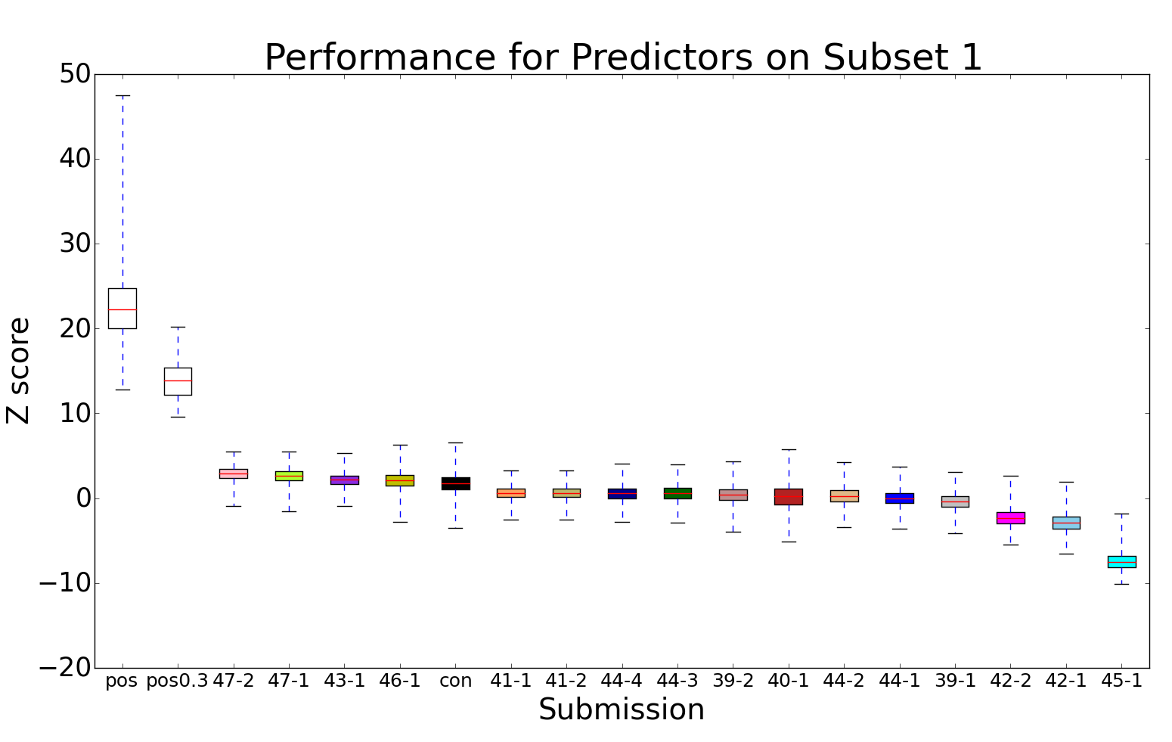
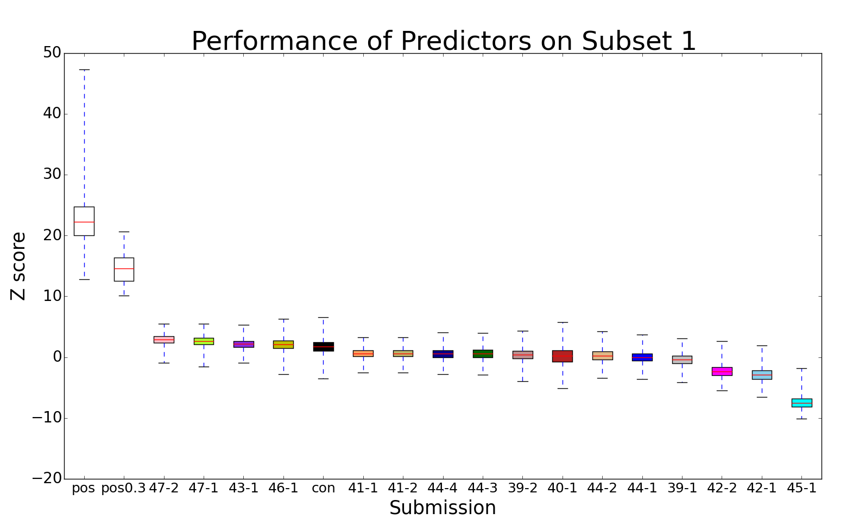
Let’s see the results!

Slide 34
Let’s see the results!
“negative”
control
Only 4 groups (3 people) did better than negative control!

Slide 35
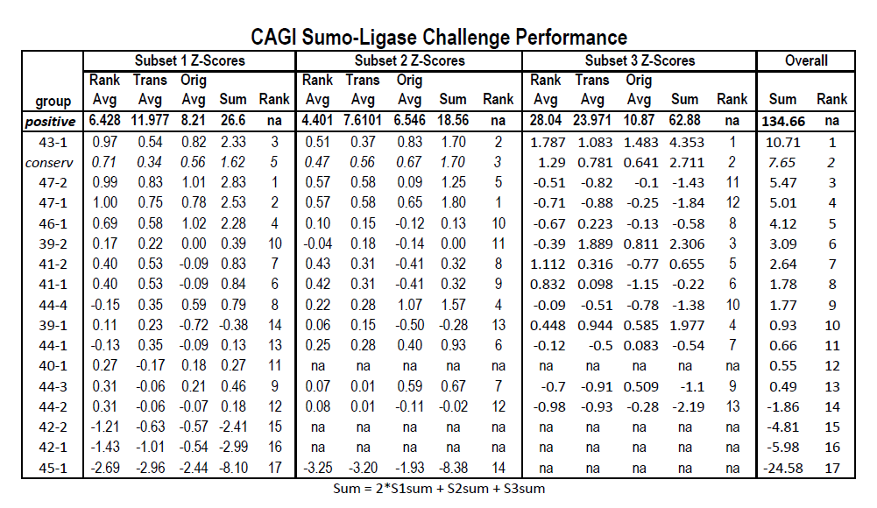
Final ranking for the SUMO-lig

Slide 36
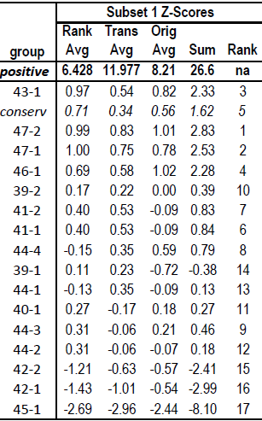

Slide 37

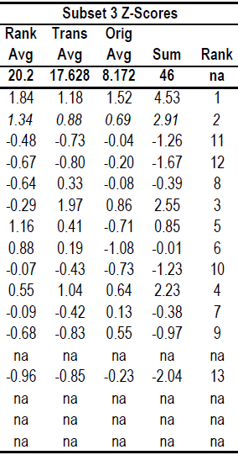
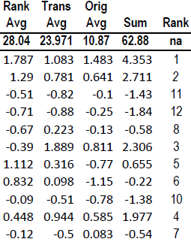

Slide 38

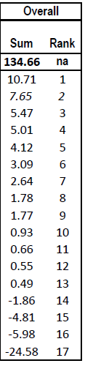
Final ranking

Slide 39
Statistics and confidence
To estimate the confidence of performance of predictors, we simulated 1000 experimental datasets assuming the experimental score for each mutation has a distribution
Guassian~(exp score, exp stderr)
and for each dataset, 40 bootstrap replicates on mutations were generated. In total, we have 40000 datasets to compute confidence intervals and head-to-head tests.

Slide 40
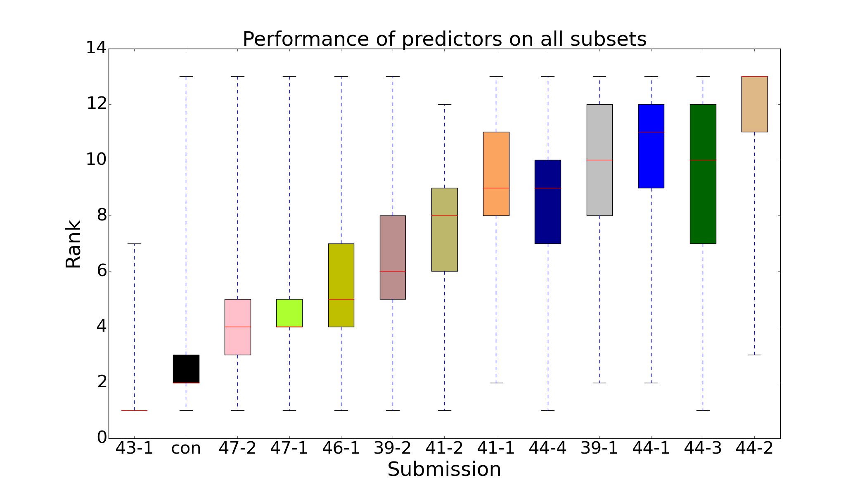
Ranks distribution
Combined Scores: Average Z-scores for each Category & Sum for each subset; Overall Sum= 2*S1sum + S2sum + S3sum

Slide 41
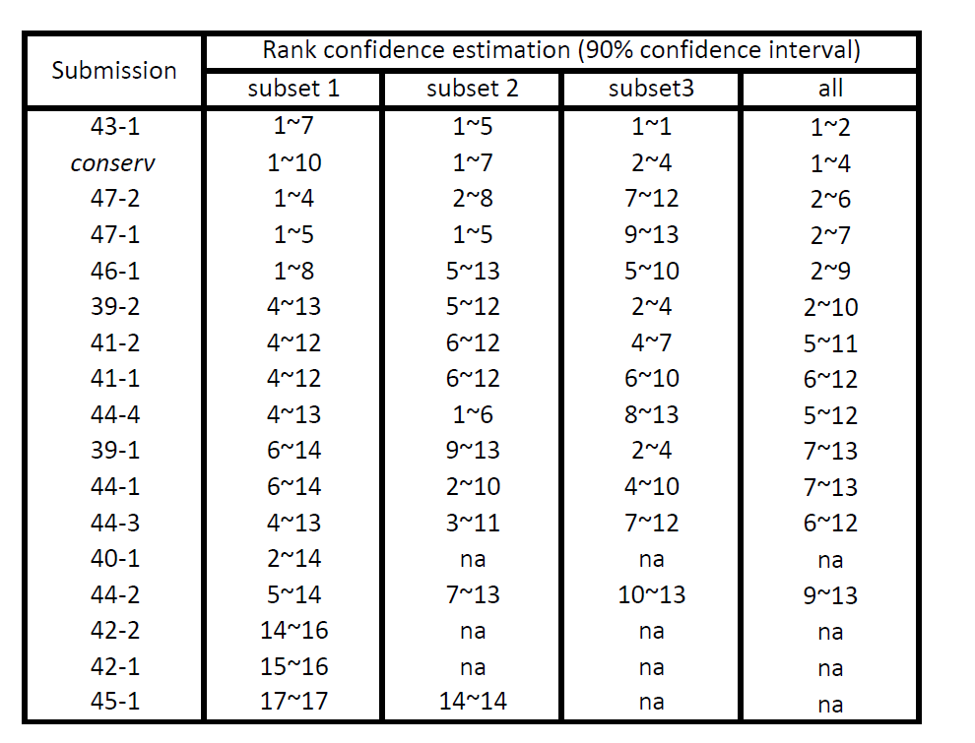
90% confidence interval of ranks
Combined Scores: Average Z-scores for each Category & Sum for each subset; Overall Sum= 2*S1sum + S2sum + S3sum

Slide 42
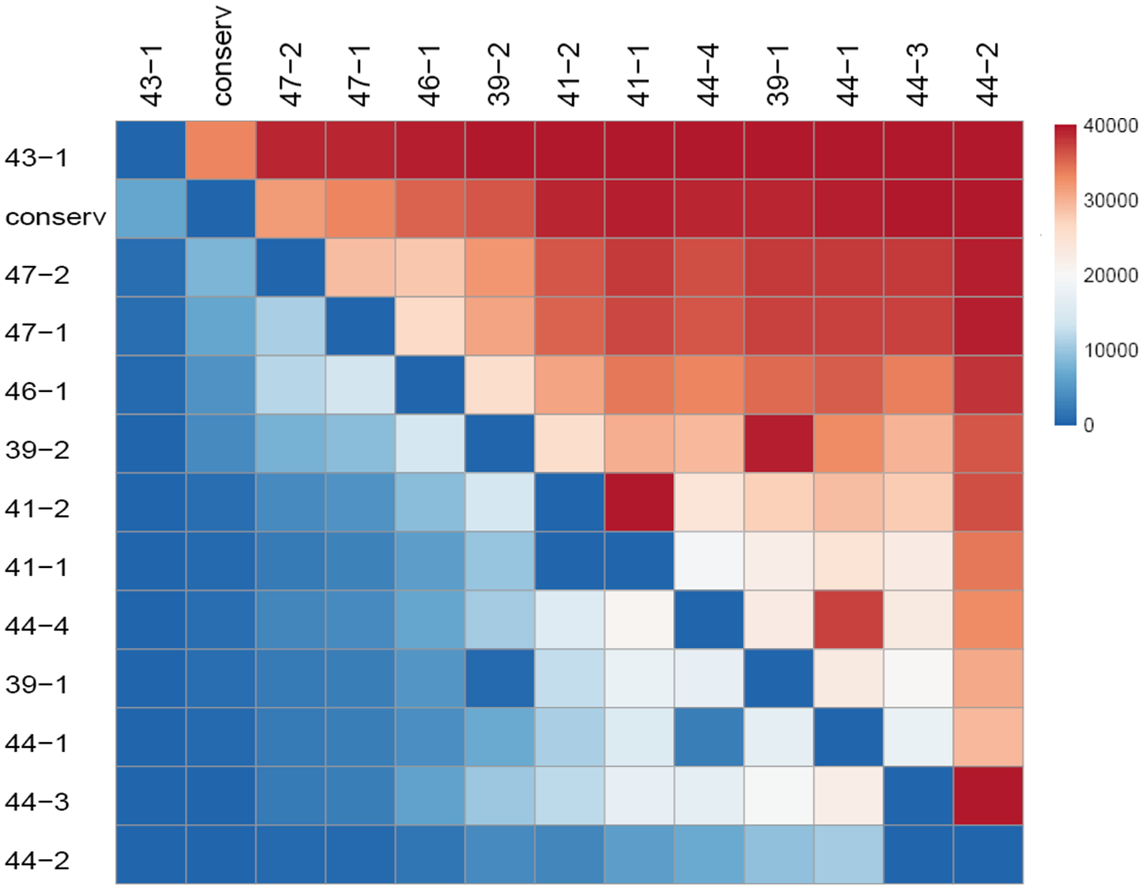
Head-to-head test

Slide 43
Conclusions about ranking
For subsets 1 and 2, performance of predictors
47, 43 & 46 almost tied and was better than others, while in subset 3, 43 was noticeably better than others.
Interestingly, except for 43 in subset 3, the performance of predictors is not significantly better than a “negative” control based on positional occurrence of amino acids in a multiple sequence alignment.
Notes:
Only in subset 1, 47, 43 and 46 almost tied. 47 and 43 almost tied in both subset 1 and 2 while 46 made a worse performance in subset 2.

Slide 44
Evaluation on standard deviation prediction
(on subset 1)
Only five groups assigned different standard deviation to each mutation and they didn’t perform very well
submission | R | P value
39-1 | -0.083 | 0.230
39-2 | -0.111 | 0.105
41-1 | -0.098 | 0.151
41-2 | -0.098 | 0.151
46-1 | 0.066 | 0.338
NO CORRELATION !!
Correlation between predictive standard deviation and rank difference for submission 39-1.

Slide 45
Predicted standard deviations are strongly correlated with predicted scores
pearson test
Submission | R | p value
39-1 | -0.985 | 2.21E-164
39-2 | -0.966 | 2.94E-126
41-1 | -0.372 | 2.15E-08
41-2 | -0.372 | 2.15E-08
46-1 | 0.798 | 3.17E-48
Correlation between predicted scores and predicted standard deviation for submission 39-1

Slide 46
Requests to predictors for the next time
Following these suggestions will help the assessors to give you the results you want!
Don’t provide scores in arbitrary scale! Use the data provided by the organizers. If you are given experimental measurements, just assign mutations to them!
Experimental measurements usually don’t tie (if for no other reasons than experimental errors). So, don’t provide ties as predicted values. It is better that you resolve your ties yourself than let an assessor mess them up for you.
Don’t assign the same standard error to all measurements and don’t assign error proportionally to the value itself. Here, errors don’t scale with values.

Slide 47
Q1: What contributes to good predictions?
Well predicted mutations
vs.
Badly predicted mutations

Slide 48
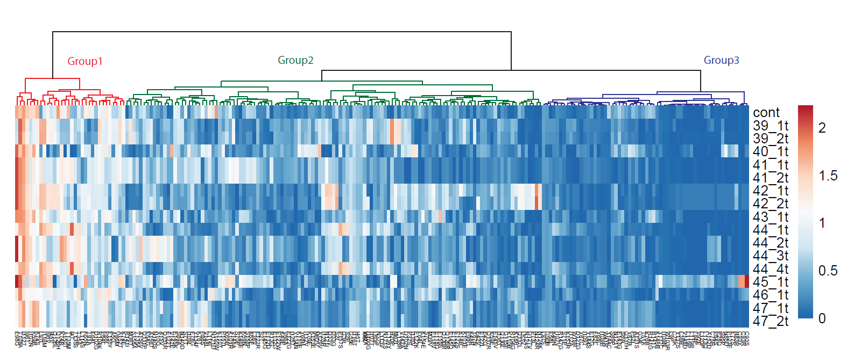
Clustering of Score Difference:
|Exp-Pred|
Worst-predicted
Mutations
Best-predicted mutations
Medium

Slide 49
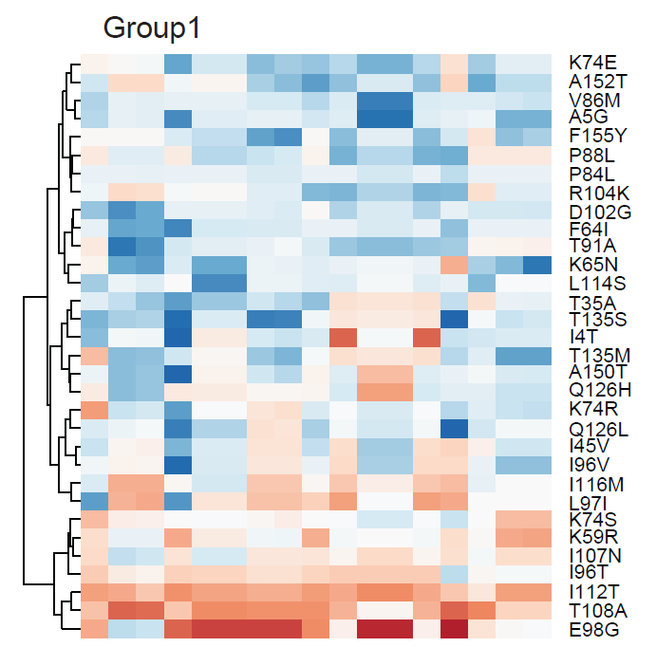
Worst-predicted
Mutations

Slide 50
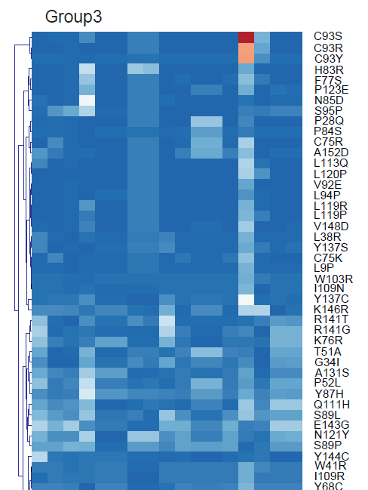
Best-predicted mutations

Slide 51
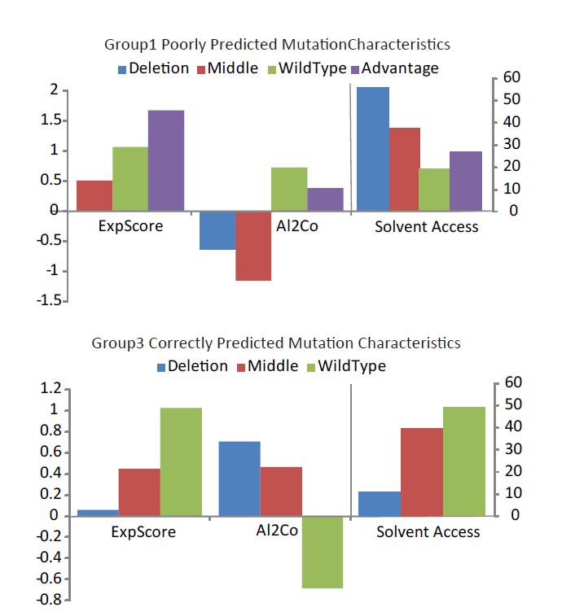

Slide 52
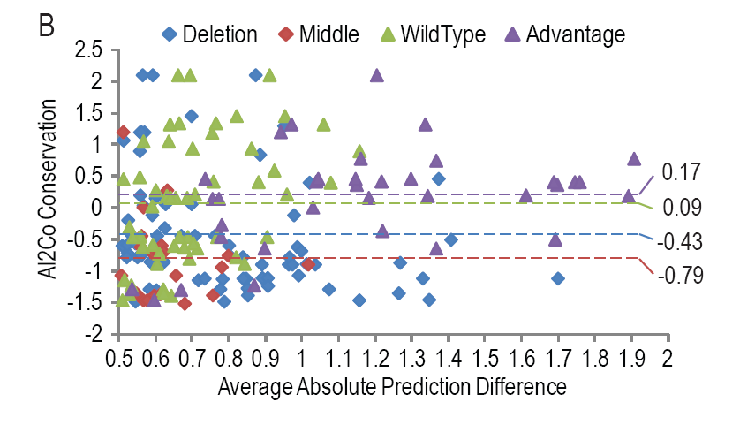
Distribution of Single Mutation Score Difference:
|Exp-Pred|
Worst Performing Mutations
>0.5

Slide 53
Distribution of Single Mutation Score Difference:
|Exp-Pred|
Exp<0.3
0.3<Exp<0.7
0.7<=Exp<=1.3
Exp>1.3
Conserved Advantagous/WT mutations
>0.5

Slide 54
Distribution of Single Mutation Score Difference:
|Exp-Pred|
Unconserved Deleterious Mutations
>0.5

Slide 55
Conclusion
Poorly predicted mutations are advantageous that are relatively conserved, or deleterious that are relative unconserved.
Predictions are highly dependent on conservations

Slide 56
Ubc9 Mutation: Overall Prediction Performance on Subset1 Mutations
Overall performance = number of groups with predictions within the confidence interval of each mutation
(experimental standard error * 1.96)
Overall performance should correlate with standard error
Plot Overall Performance against Standard Error and inspect outliers

Slide 57
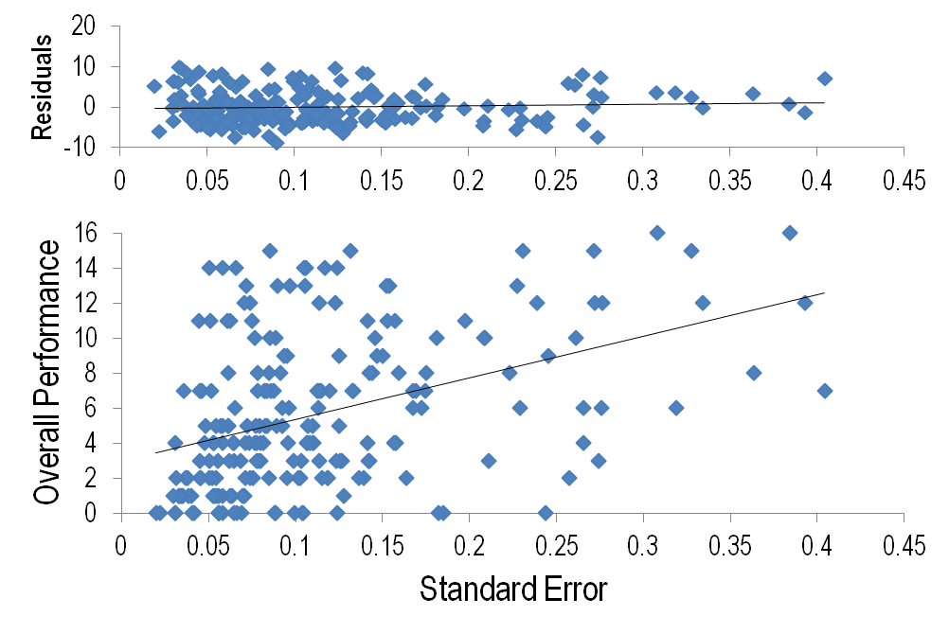
Performance on Subset1 Mutations
Original Predictions within
Experimental Confidence Interval
Linear Fit to Data

Slide 58
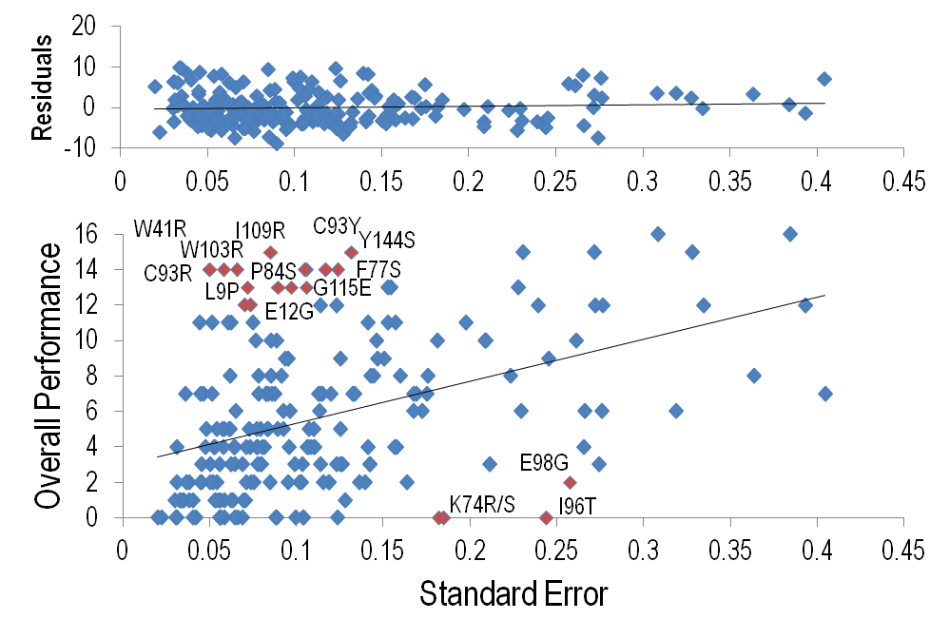
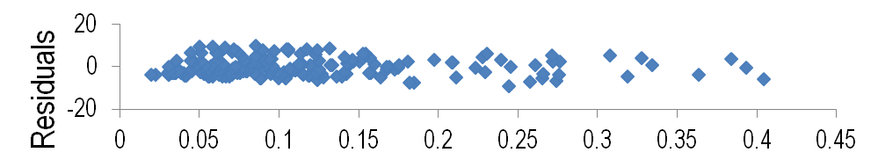
Performance on Subset1 Mutations
Original Predictions within
Experimental Confidence Interval
Mutations with Residual > 7
Y144C L1119R
C93S
L120P

Slide 59
Performance on Subset1 Mutations
Original Predictions within
Experimental Confidence Interval
Better than expected Performance
Y144C L1119R
C93S
L120P

Slide 60
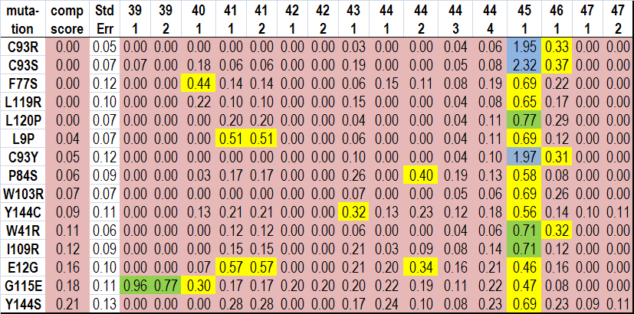
Performance on Subset1 Mutations
Predictions for Mutations with Better than Expected Performance
Active Site

Slide 61

Performance on Subset1 Mutations
Predictions for Mutations with Better than Expected Performance
Conservation Scores

Slide 62
Performance on Subset1 Mutations
Predictions for Mutations with Better than Expected Performance
Burried Residues
Large WT to
Small Mutation

Slide 63
Performance on Subset1 Mutations
Predictions for Mutations with Better than Expected Performance
Burried Residues
Hydrophobic WT to
Large Charged Mutation

Slide 64
Performance on Subset1 Mutations
Original Predictions within
Experimental Confidence Interval
Worse than expected Performance
Y144C L1119R
C93S
L120P

Slide 65
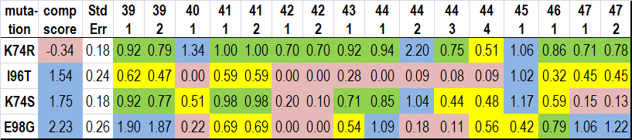
Sumo-Ligase Structure Function
Predictions for Mutations with Worse than Expected Performance
activating
mutations

Slide 66
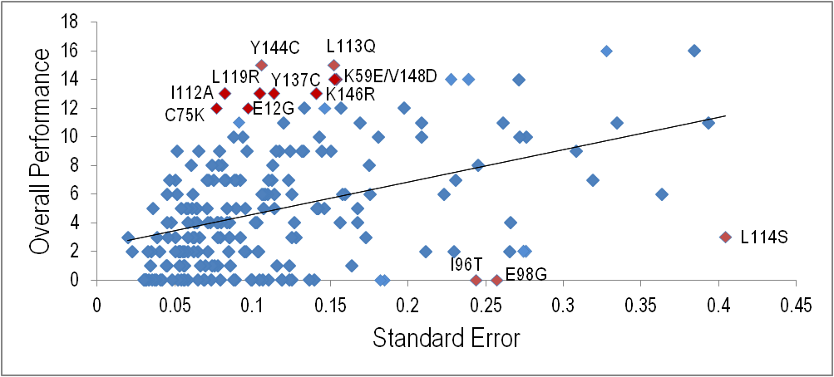
Performance on Subset1 Mutations
Transformed Predictions within
Experimental Confidence Interval
Mutations with Residual > 7
Many Alternate Residues in Set due to treatment of Ties for 0’s
Similar Poor Prediction Performance Residues

Slide 67
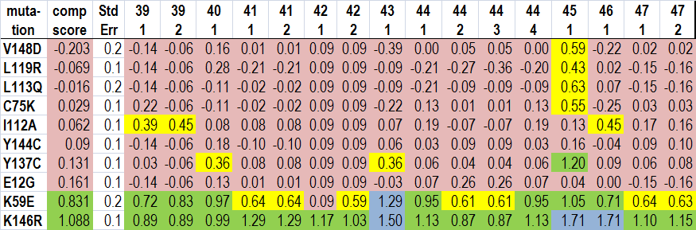
Sumo-Ligase Structure Function
Predictions for Mutations with Better than Expected Performance on Transformed Data
Less deleterious Mutations; Added WT Mutations

Slide 68
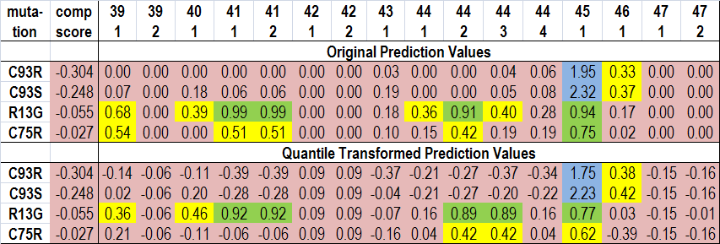
Ubc9 Mutation Datasets
Performance of Groups on Deleterious Mutations from the Literature
Deleterious +/- WT Advantagous
Categories

Slide 69
Function & structural annotation of mutations

Slide 70
Ubc9 Sumoylation Pathway
Sumo
AMP
+ ATP + PPi
Cys 93
E1
E1
Cys
Cys
Sumo
E2
Cys
Substrates:
ΨKxE(xxS)
E2
Cys
Sumo
Sumo

Slide 71
Ubc9 Sumoylation Structures
E2: UBC9 (right)
E2 with E1 “cys” domain
E2 with E1 ubiquitin fold domain
E2 with RanGap1 substrate
E2 with substrate, sumo, and IR1 E3
E2 with substrate, sumo, and znf45 E3 SIM
Sumo modified E2
E2 with sumo-like domain
E2 with importin
Cys 93

Slide 72
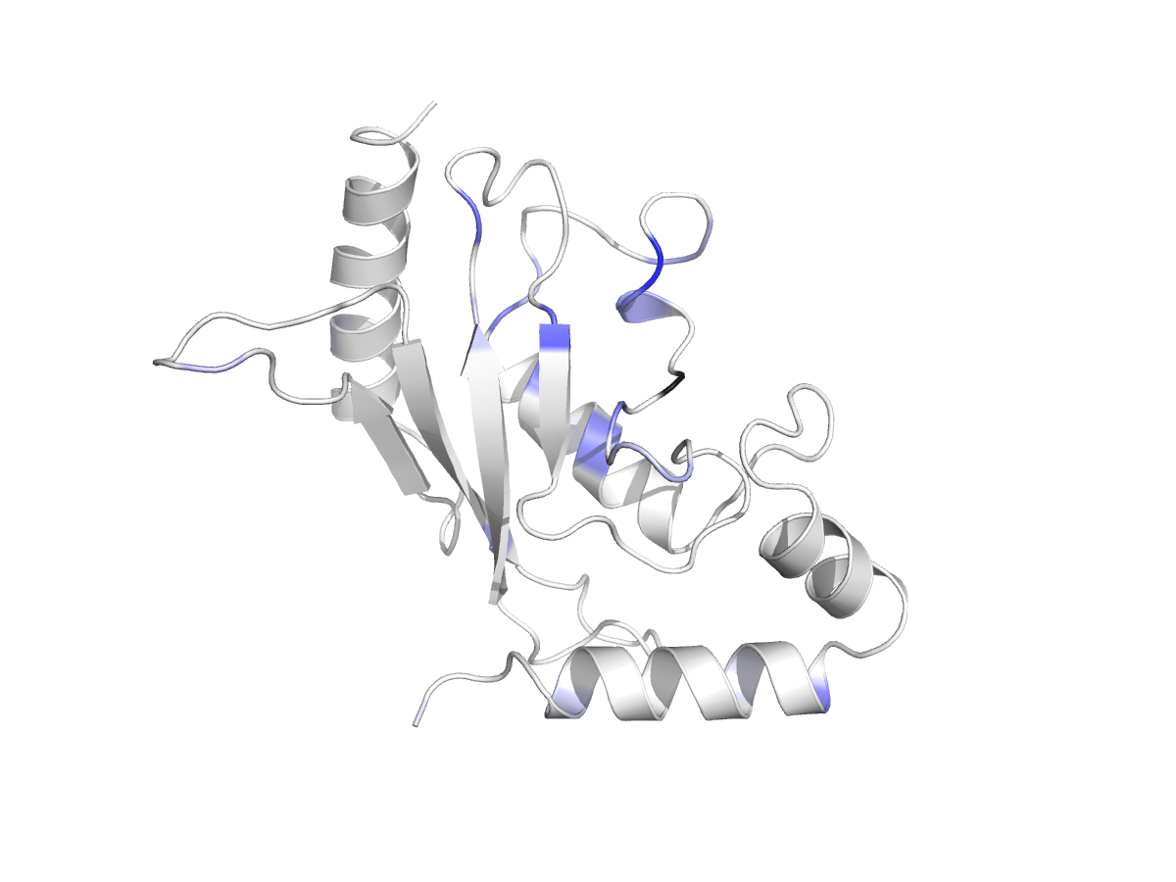
Ubc9 Mutation Mapping
Sumo-Ligase structure 1a3s
Deleterious +/- Wild Type Advantagous
Categories

Slide 73
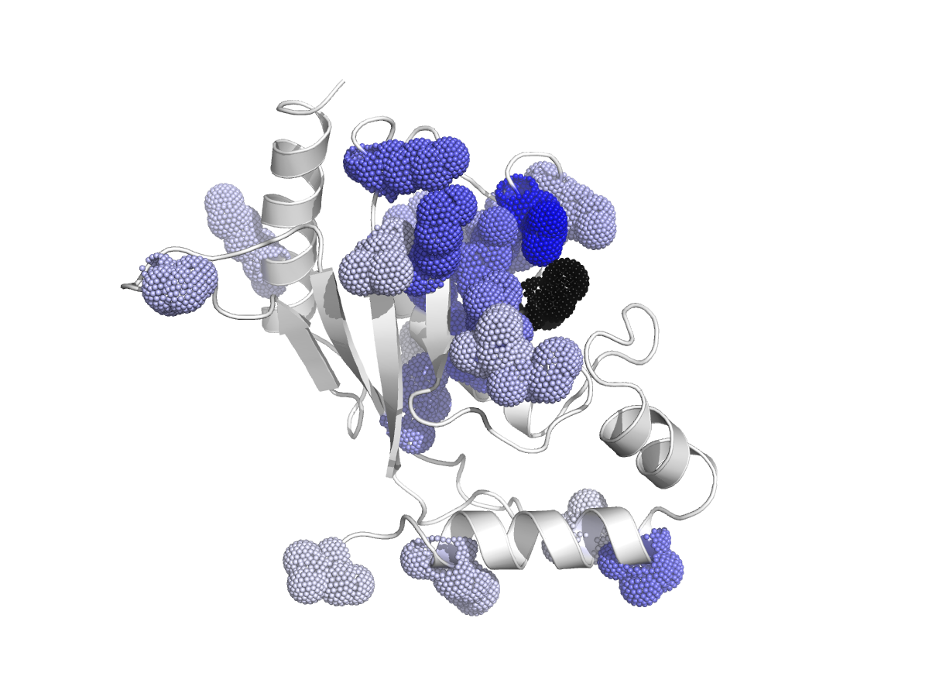
Ubc9 Mutation Mapping
Deleterious +/- Wild Type Advantagous
Categories

Slide 74
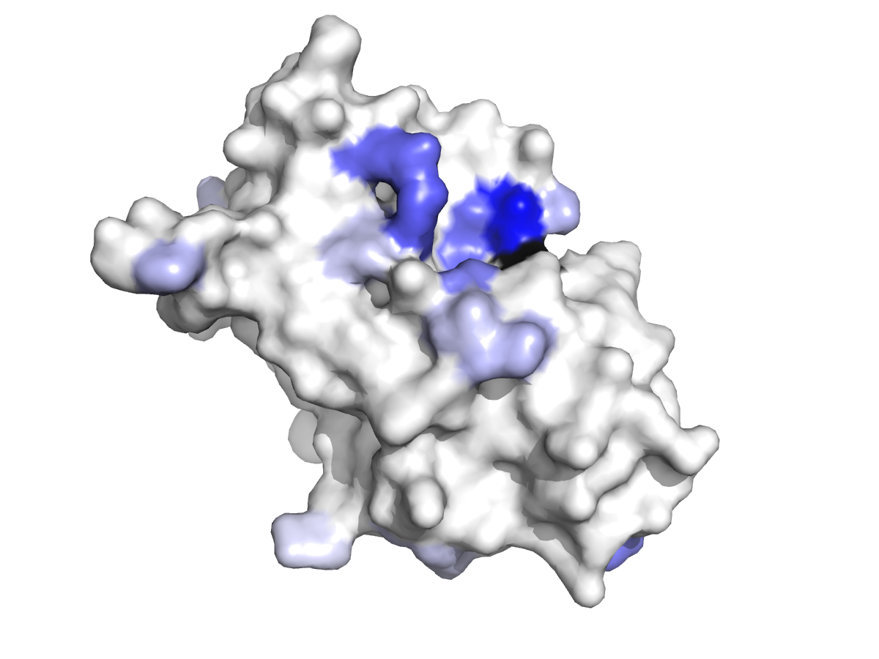
Ubc9 Mutation Mapping
Deleterious +/- Wild Type Advantagous
Categories

Slide 75
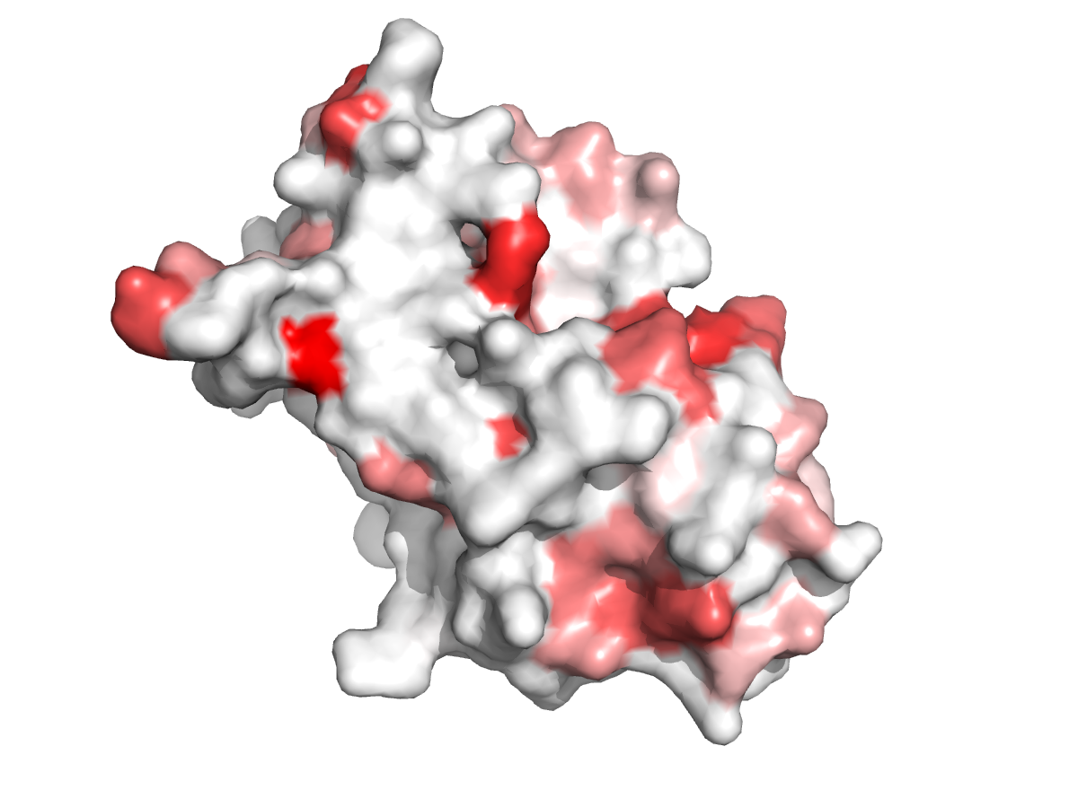
Ubc9 Mutation Mapping
K74R
Deleterious Advantagous
Categories

Slide 76
Ubc9 Mutation Mapping
K74E or K74S
Deleterious +/- Wild Type Advantagous
Categories

Slide 77
Ubc9 Mutation Mapping
K74R
Deleterious Advantagous
Categories

Slide 78
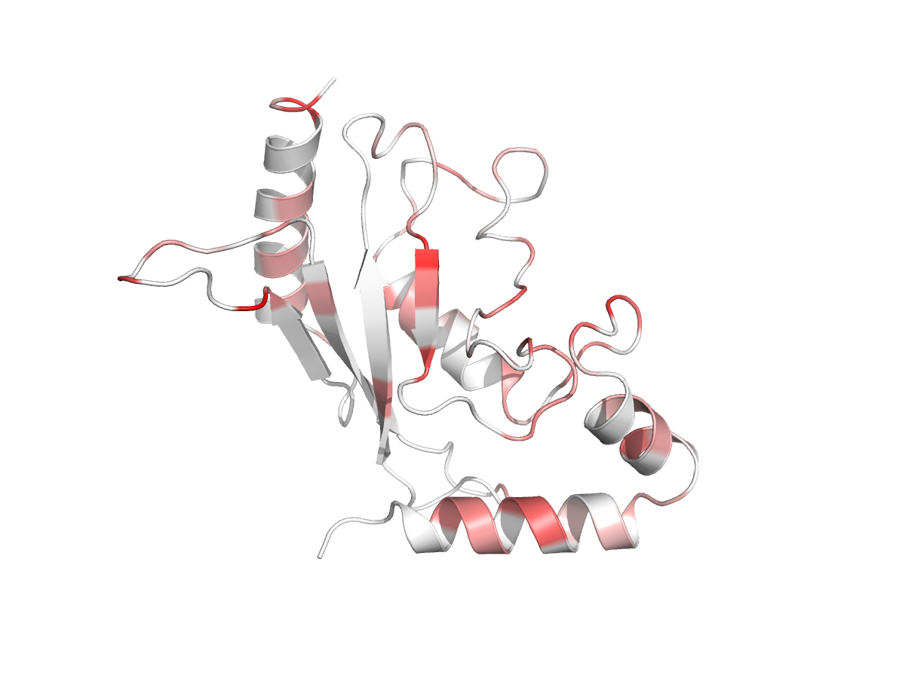
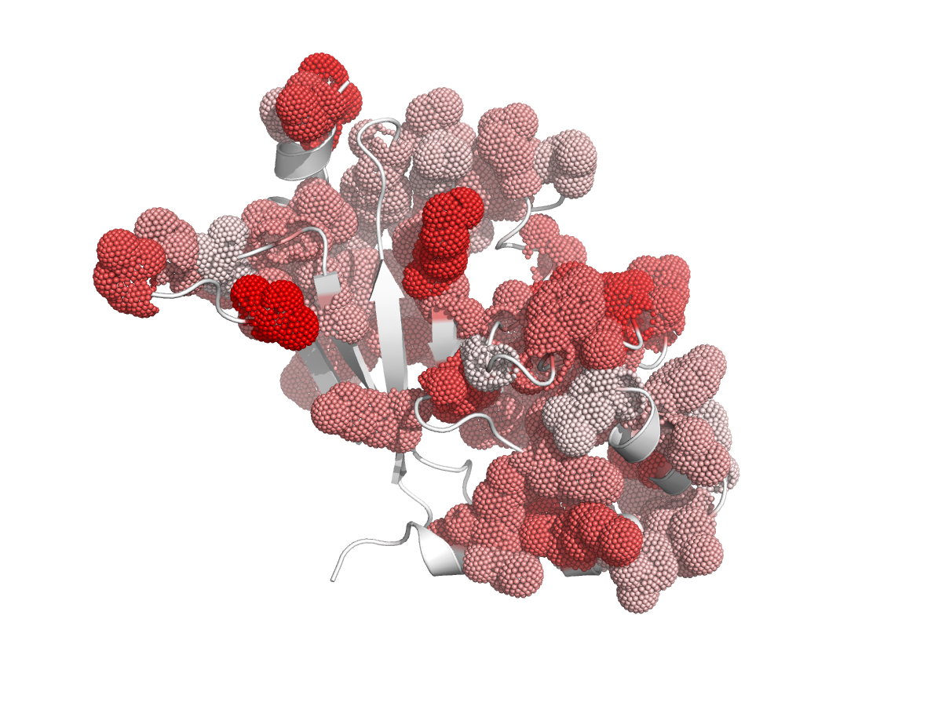
Ubc9 Mutation Mapping
Deleterious Advantagous
Categories

Slide 79
Ubc9 Mutation Mapping
C93
Deleterious Advantagous
Categories

Slide 80
Ubc9 Mutation Datasets
Rescue Yeast UBC9?
Deleterious Advantagous
Categories

Slide 81
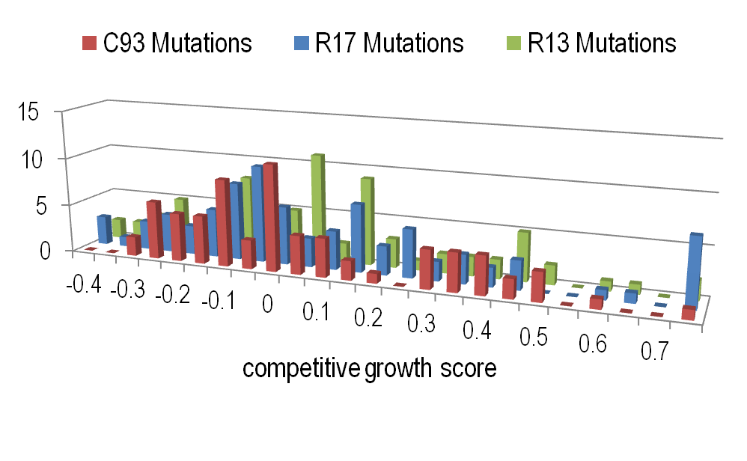
Ubc9 Mutation Datasets
Additional Deleterious Mutations from Literature Prevent Nuclear Import
Deleterious Advantagous
Categories

Slide 82
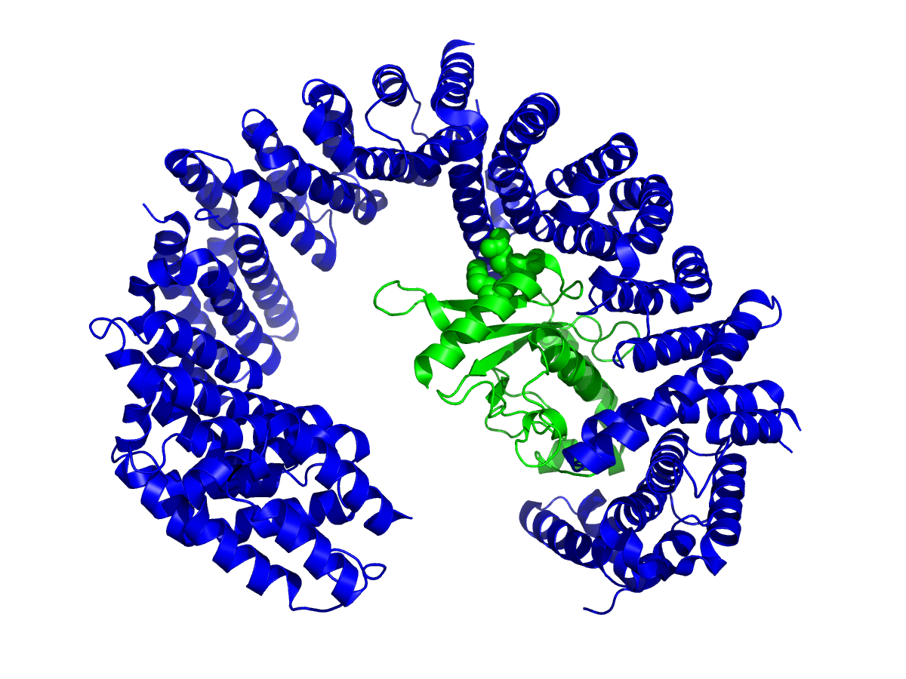
Ubc9 Mutation Datasets
Additional Deleterious Mutations from Literature Prevent Nuclear Import
R17
R13
Deleterious Advantagous
Categories

Slide 83
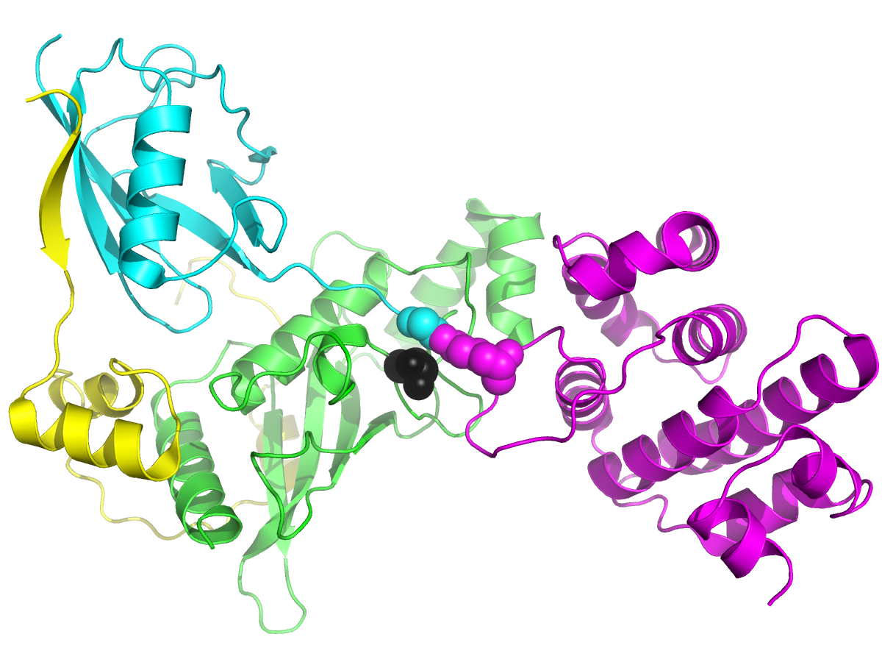
Sumo-Ligase Structure Function
Sumo2
E2:
Ube2I
Substrate
(RanGap1)
E3:
IR1-M-IR2
E2 with substrate, sumo, and IR1 E3
PubMed: 22194619

Slide 84
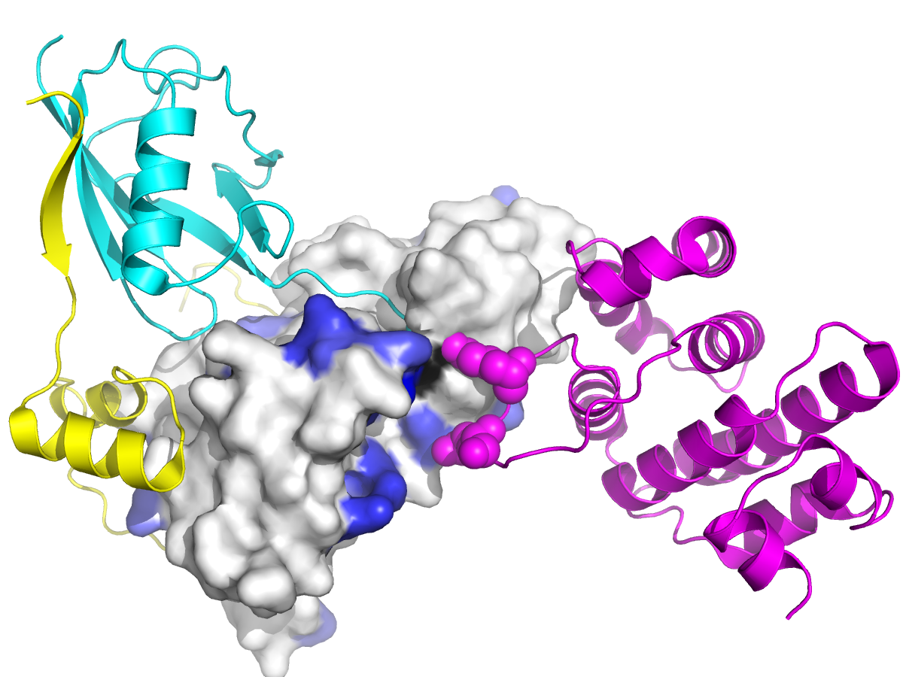
Sumo-Ligase Structure Function
Surface
colored by
activating
mutations
Sumo2
E2:
Ube2I
Substrate
(RanGap1)
E3:
IR1-M-IR2
E2 with substrate, sumo, and IR1 E3

Slide 85
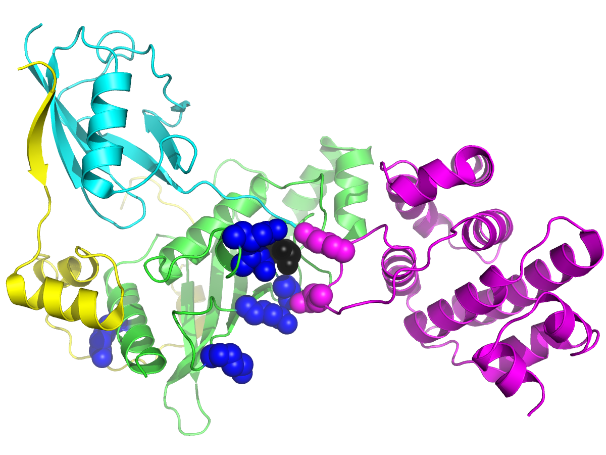
Sumo-Ligase Structure Function
Surface
colored by
activating
mutations
Sumo2
E2:
Ube2I
K101
Substrate
(RanGap1)
E3:
IR1-M-IR2
E98
K74
T91
K14
K65
I96T not surface exposed
Poorly Predicted

Slide 86
Sumo-Ligase Structure Function
Surface
colored by
activating
mutations
Sumo2
E2:
Ube2I
K101
Substrate
(RanGap1)
E3:
IR1-M-IR2
E98
Auto-
sumoylated
K74
T91
K14
K65
PubMed: 22194619

Slide 87
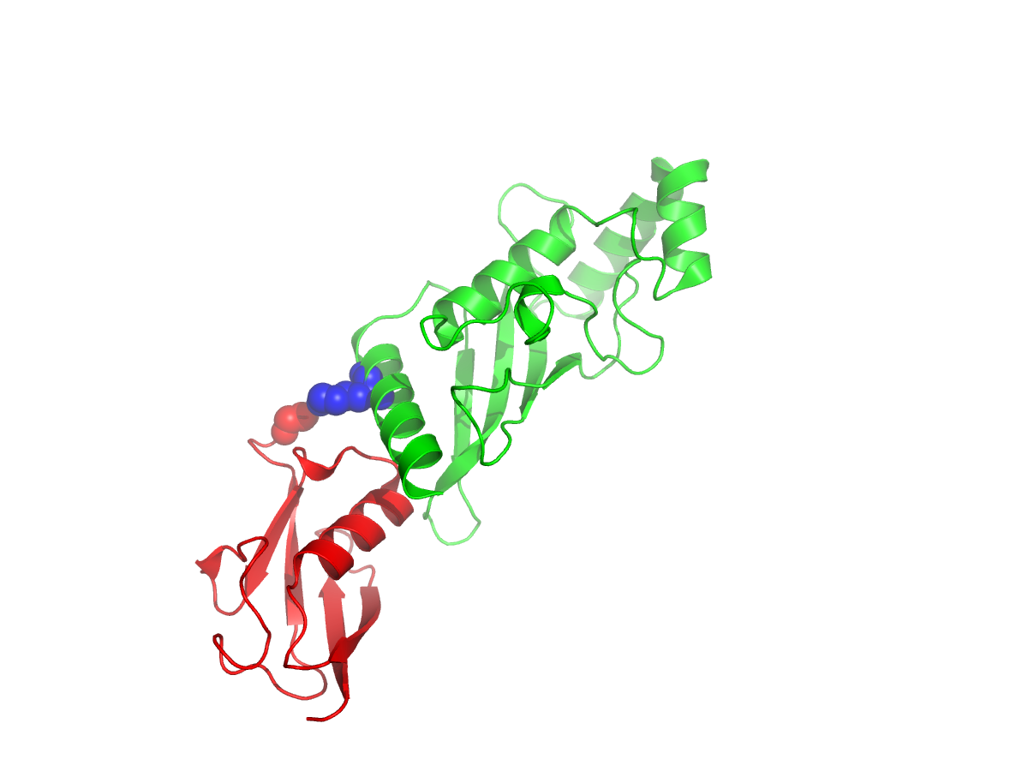
Sumo-Ligase Structure Function
Surface
colored by
activating
mutations
Sumoylated UBC9 at K14
E2:
Ube2I
Blocks E3
interaction
K14
Auto-
sumoylated
Regulates Target Interaction
PubMed: 18691969

Slide 88

Sumo-Ligase Structure Function
Interaction with Sumo-like Domain (SLD)
E2:
Ube2I
Blocks E3
interaction
Regulates Target Interaction
PubMed: 21444718

Slide 89
Sumo-Ligase Structure Function
Surface
colored by
activating
mutations
Sumo2
E2:
Ube2I
K101
Substrate
(RanGap1)
E3:
IR1-M-IR2
E98
K74
T91
K14
K65
Acetylated
PubMed: 22194619

Slide 90
Sumo-Ligase Structure Function
Surface
colored by
activating
mutations
Sumo2
E2:
Ube2I
K101
Substrate
(RanGap1)
E3:
IR1-M-IR2
E98
K74
T91
K14
Substrate
Specificity
K65
PubMed: 22194619

Slide 91

Sumo-Ligase Structure Function
Surface
colored by
activating
mutations
Sumo2
E2:
Ube2I
K101
Substrate
(RanGap1)
E3:
ZNF451
E98
K74
T91
K14
Substrate
Specificity
K65
PubMed: 26524494

Slide 92
Sumo-Ligase Structure Function
Surface
colored by
activating
mutations
Sumo2
E2:
Ube2I
K101
Substrate
(RanGap1)
E3:
ZNF451
E98
K74
T91
K14
K65
Bind phosphorylated Substrate
Activating mutations shift balance of sumoylated substrates?
PMID: 19684601

Slide 93
Ubc9 Sumoylation Pathway
Substrates:
ΨKxE(xxS)
E3
SLD
E3
E2 WT
Cys
Sumo
Activating mutations shift balance of sumoylated substrates?

Slide 94
Ubc9 Sumoylation Pathway
Substrates:
ΨKxE(xxS)
E3
SLD
E3
E2 M1
Cys
Sumo
Activating mutations shift balance of sumoylated substrates?

Slide 95
Ubc9 Sumoylation Pathway
Substrates:
ΨKxE(xxS)
E3
SLD
E3
E2 M2
Cys
Sumo
Activating mutations shift balance of sumoylated substrates?

Slide 96
Ubc9 Sumoylation Pathway
Substrates:
ΨKxE(xxS)
Activating
mutations
=
Elevated cell
growth
E3
SLD
E3
E2 M2
Cys
Sumo
Activating mutations might contribute to human disease?

Slide 97


Sumo-Ligase Structure Function
COSMIC Catalogue of somatic mutations in Cancer: Ube2I
Surface
colored by
activating
mutations
E2:
Ube2I
Substrate
(RanGap1)
E3:
ZNF451
Q111P
Q111P
Activating mutations might contribute to human disease?

Slide 98
Sumo-Ligase Structure Function
Sumo2
Surface
colored by
activating
mutations
E2:
Ube2I
Substrate
(RanGap1)
E3:
ZNF451
Q111P
Activating mutations might contribute to human disease?

Slide 99

Sumo-Ligase Structure Function
Sumo2
Surface
colored by
activating
mutations
E2:
Ube2I
Substrate
(RanGap1)
E3:
IR1-M-IR2
Q111P
Activating mutations might contribute to human disease?

Slide 100
Sumo-Ligase Structure Function
Shift towards
Activating =
Higher growth rate
Activating mutations might contribute to human disease?

Slide 101
Sumo-Ligase Structure Function
Comparison to Catalytic Cys Mutations in CAGI Data
Q111
C93
Activating mutations might contribute to human disease?

