Slide 1

CAGI slide pack guidelines
I agree to my slides being used according to the following terms:
_______Gyu Rie Lee_______
Authors: please include THIS slide at the beginning of your presentation to indicate that you agree with reuse of your slides in CAGI presentations, according to the terms below, and digitally sign by writing your name above.
To disseminate the CAGI results, I encourage all CAGI participants to remix these CAGI slides for inclusion in their oral and poster presentations
CAGI participants may use or publish any content of these slides only in compliance with the CAGI Data Use Agreement
CAGI participants may not cite or publish any content of these slides except with the written permission of the originating author or in the primary CAGI publications
CAGI participants must acknowledge the original authors of these slides and CAGI 2013. Include the acknowledgement banner across the bottom
CAGI participants must include the CAGI credits slide in their presentations
Slides with a red slash (no remix) may not be included in a presentation unless all attendees are registered CAGI participants who signed the data use agreement
Slides with a red X over the entire slide may not be used in any circumstances
Slides with a blue slash (embargoed) may not be used unless the embargo is explicitly lifted
Slides without slash or X may be tweeted unless flagged with the “No tweet” icon.
CAGI participants using these slides must explain the “No tweet” icon, which means that the slide content should not be disseminated outside the presenting conference hall. If the presentation venue permits pervasive tweeting, you may not include these slides in your talk
Note for slide authors: we expect all CAGI participants to abide by these restrictions, and will make best effort to ensure they are followed. However, but bear in mind that we have limited means of enforcing them, and therefore the restrictions cannot be guaranteed.

Slide 2
Predicting allosteric regulation using GALAXY protein modeling programs
Gyu Rie Lee, Minkyung Baek, Beom Chang Kang,
Taeyong Park, Lim Heo, and Chaok Seok*
Lab of computational biology and biomolecular engineering
Seoul National University, Seoul, Korea

Slide 3
Liver pyruvate kinase challenge
Single amino acid mutations on human liver pyruvate kinase protein
  Predict the effect on allosteric regulation
  : based on structure prediction and protein-ligand docking
  Predict the effect on enzyme activity
  : based on sequence conservation
Notes:
Problem outline

Slide 4
Liver pyruvate kinase challenge
Single amino acid mutations on human liver pyruvate kinase protein
  Predict the effect on allosteric regulation
  based on structure prediction and protein-ligand docking
  Predict the effect on enzyme activity
  based on sequence conservation
Notes:
Problem outline. I would like to focus on predicting allosteric regulation. Application of GALAXY protein modeling programs. Lab research is focused on structure and interaction modeling. New to this field.

Slide 5
Outline of predicting allosteric regulation
For each of Alanine and F-1,6-BP
Structure prediction of WT kinase-modulator complex
For every mutation
Structure prediction of mutated kinase
Protein-ligand docking of the modulator
Convert binding affinity to allosteric coupling
Notes:
Method summary

Slide 6
Structure prediction of wildtype kinase
Template-based modeling using GalaxyTBM
  Alanine bound WT kinase:
  using the structure of M2-PYK bound to Phe
  (PDB ID: 4FXJ)
  F-1,6-BP (FBP) bound WT kinase:
  using the structure of hL-PYK bound to FBP
  (PDB ID: 4IP7)
Notes:
Structure preparation – docking each modulator and refinement

Slide 7
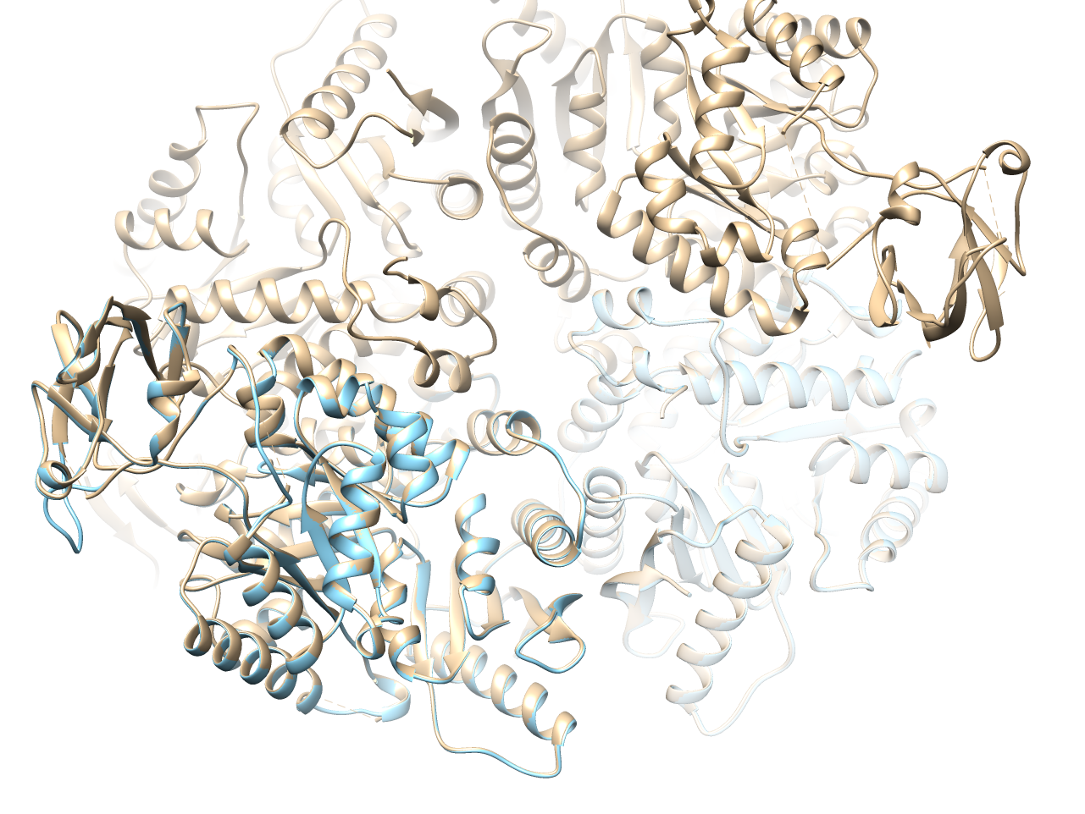
Structure prediction of wildtype kinase
FBP bound PYK
Crystal structure (4IP7)
Template-based model

Slide 8
Structure prediction of wildtype kinase
Predicting the binding pose of Ala / FBP to WT kinase
  Protein-ligand docking using GalaxyDock
  Refer to the experimental structures
Structure relaxation with bound modulators
  Structure refinement using GalaxyRefine (19.2 cpu hours)
  Both receptor and ligand treated as flexible
Notes:
Structure relaxation 왜 필요한지?!

Slide 9
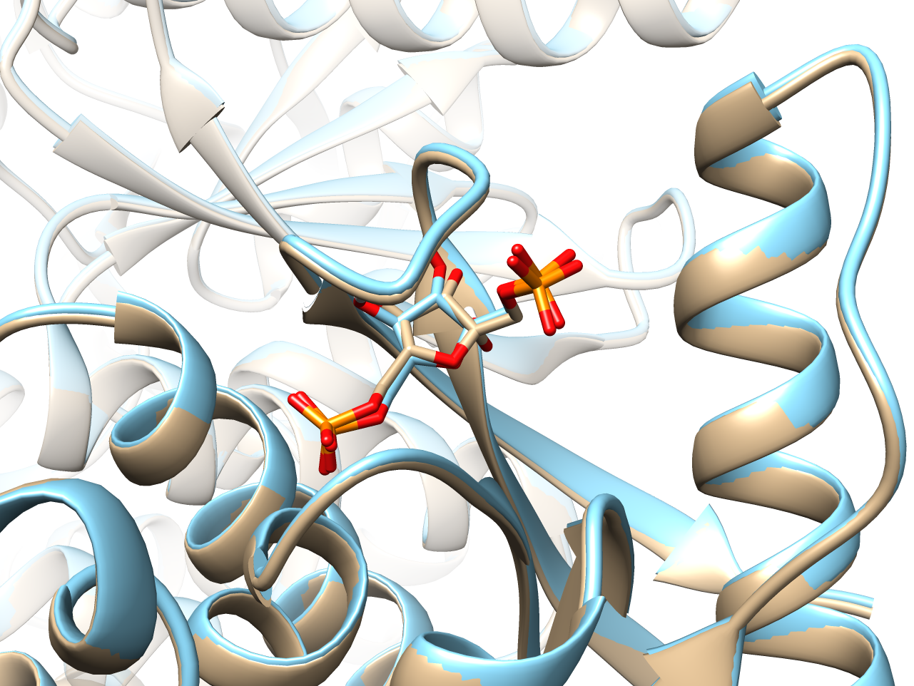
Wildtype kinase structure prediction
Crystal structure
Templated-based model / docked FBP
Relaxed structure
Notes:
redocking

Slide 10
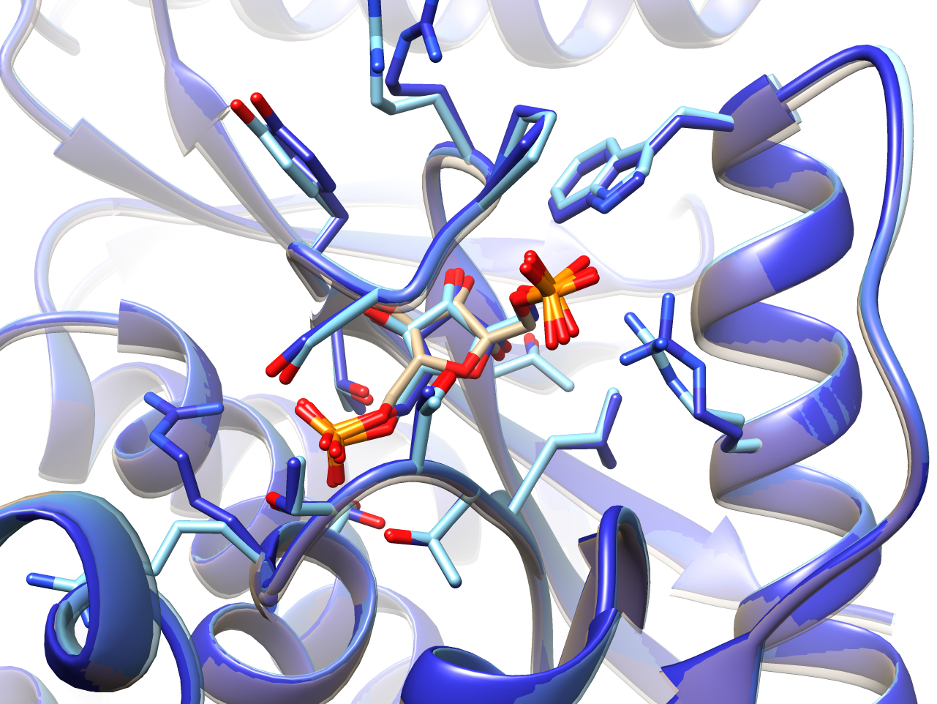
Wildtype kinase structure prediction
Crystal structure
Templated-based model / docked FBP
Relaxed structure
Notes:
redocking

Slide 11
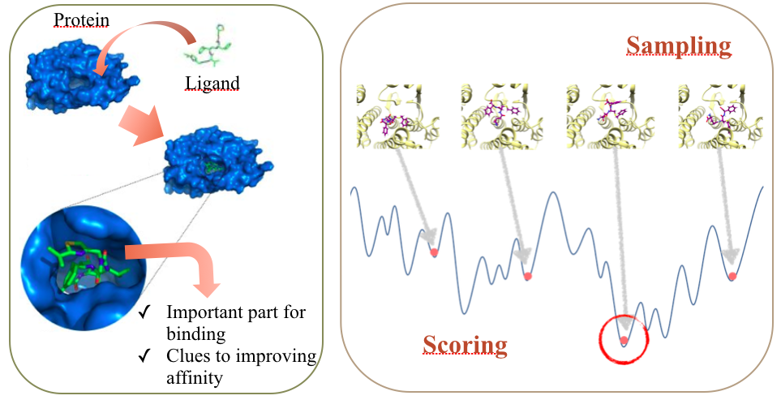
Docking modulator to mutated kinase
Predict the binding pose of the modulator to the mutated kinase structure
Flexible-sidechain protein-ligand docking using GalaxyDock
Figure from
M. Baek
Notes:
Binding affinity -> conversion to allosteric coupling

Slide 12
Embargoed
Notes:
Binding affinity -> conversion to allosteric coupling

Slide 13
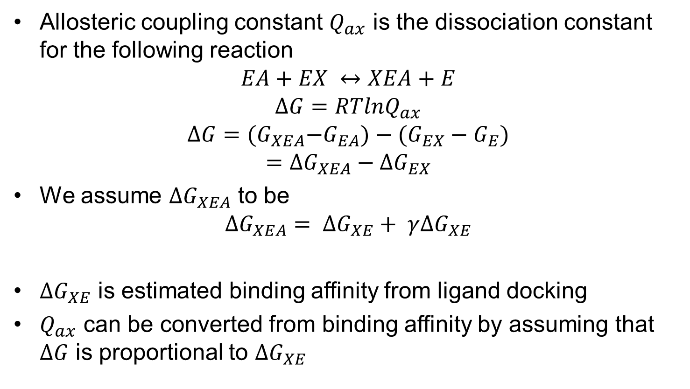
Conversion of binding affinity to allosteric regulation
Allosteric coupling constant $Q_{ax}$ is the dissociation constant for the following reaction
$$EA+EX ↔XEA+E$$
$$∆G=RTlnQ_{ax}$$
$$∆G={(G}_{XEA}−G_{EA})−(G_{EX}−G_{E})$$
$$=∆G_{XEA}−∆G_{EX}$$
We assume $∆G_{XEA}$ to be
$$∆G_{XEA}= ∆G_{XE}+ γ∆G_{XE}$$
$∆G_{XE}$ is estimated binding affinity from ligand docking
$Q_{ax}$ can be converted from binding affinity by assuming that $∆G$ is proportional to $∆G_{XE}$
Introducing cooperativity
Fenton AW. (2008). Trends Biochem Sci, 33, 420-5
Notes:
This assumption can be our limitation

Slide 14
Embargoed
Notes:
This assumption can be our limitation

Slide 15
Embargoed
Notes:
This assumption can be our limitation

Slide 16
Embargoed
Notes:
This assumption can be our limitation

Slide 17
Embargoed
Notes:
This assumption can be our limitation

Slide 18
Limitation and future prospect
Cooperativity needs to be considered by predicting structural changes induced by mutation and modulator binding
  Development of structure relaxation or docking methods that can predict more global structural changes
  Using allosteric network information to predict structural change propagation
  Training on experimental data
Notes:
Limitation

Slide 19
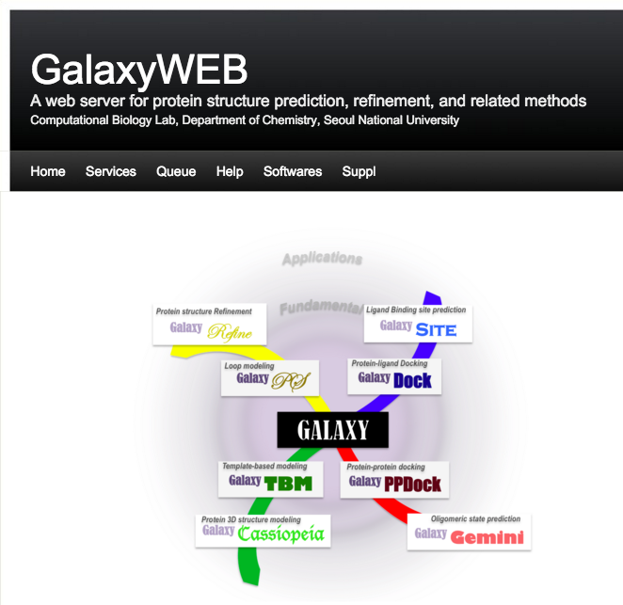
GALAXY protein modeling programs
Available at http://galaxy.seoklab.org
GalaxyTBM
GalaxyDock
GalaxyRefine
Notes:
Limitation, future prospect, server advertize

Slide 20
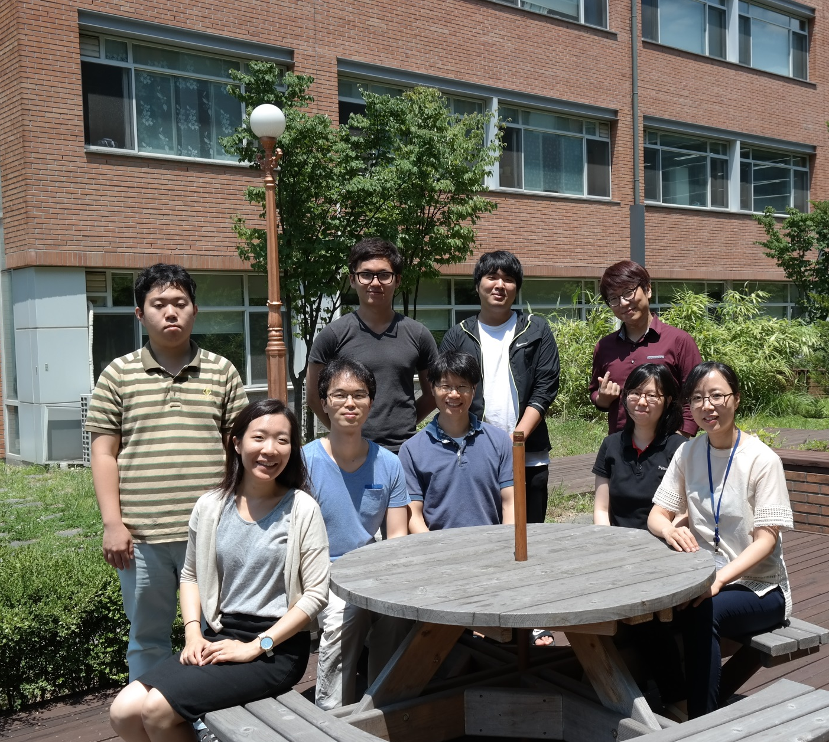
Acknowledgement
CAGI organizers
Data providers
Assessors
Prof. Chaok Seok
Seok lab members
National Research Foundation of Korea

