Slide 1

CAGI slide pack guidelines
I agree to my slides being used according to the following terms: _______Author Name Here_______
Authors: please include THIS slide at the beginning of your presentation to indicate that you agree with reuse of your slides in CAGI presentations, according to the terms below, and digitally sign by writing your name above.
To disseminate the CAGI results, I encourage all CAGI participants to remix these CAGI slides for inclusion in their oral and poster presentations
CAGI participants may use or publish any content of these slides only in compliance with the CAGI Data Use Agreement
CAGI participants may not cite or publish any content of these slides except with the written permission of the originating author or in the primary CAGI publications
CAGI participants must acknowledge the original authors of these slides and CAGI 2013. Include the acknowledgement banner across the bottom
CAGI participants must include the CAGI credits slide in their presentations
Slides with a red slash (no remix) may not be included in a presentation unless all attendees are registered CAGI participants who signed the data use agreement
Slides with a red X over the entire slide may not be used in any circumstances
Slides with a blue slash (embargoed) may not be used unless the embargo is explicitly lifted
Slides without slash or X may be tweeted unless flagged with the “No tweet” icon.
CAGI participants using these slides must explain the “No tweet” icon, which means that the slide content should not be disseminated outside the presenting conference hall. If the presentation venue permits pervasive tweeting, you may not include these slides in your talk
Note for slide authors: we expect all CAGI participants to abide by these restrictions, and will make best effort to ensure they are followed. However, but bear in mind that we have limited means of enforcing them, and therefore the restrictions cannot be guaranteed.

Slide 2

Pyruvate Kinase Challenge Assessment
Qifang Xu
Roland Dunbrack
Created for CAGI 4 genomeinterpretation.org Roland Dunbrack

Slide 3
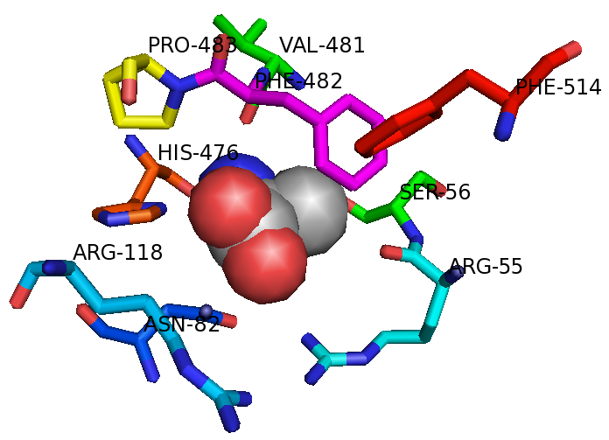
Experiment 1
113 mutations at 9 sites, near allosteric inhibitor, ALA
R55(1), S56(1), N82(4), R118(0), H476(0), V481(0), F482(0), P483(10/11), F514(1), V481(6/14)
90 active (80%), 23 inactive (20%)
KPYR_HUMAN (PDB:4ip7), ALA from KPYM_RABIT (PDB:2g50)
Created for CAGI 4 genomeinterpretation.org Roland Dunbrack

Slide 4
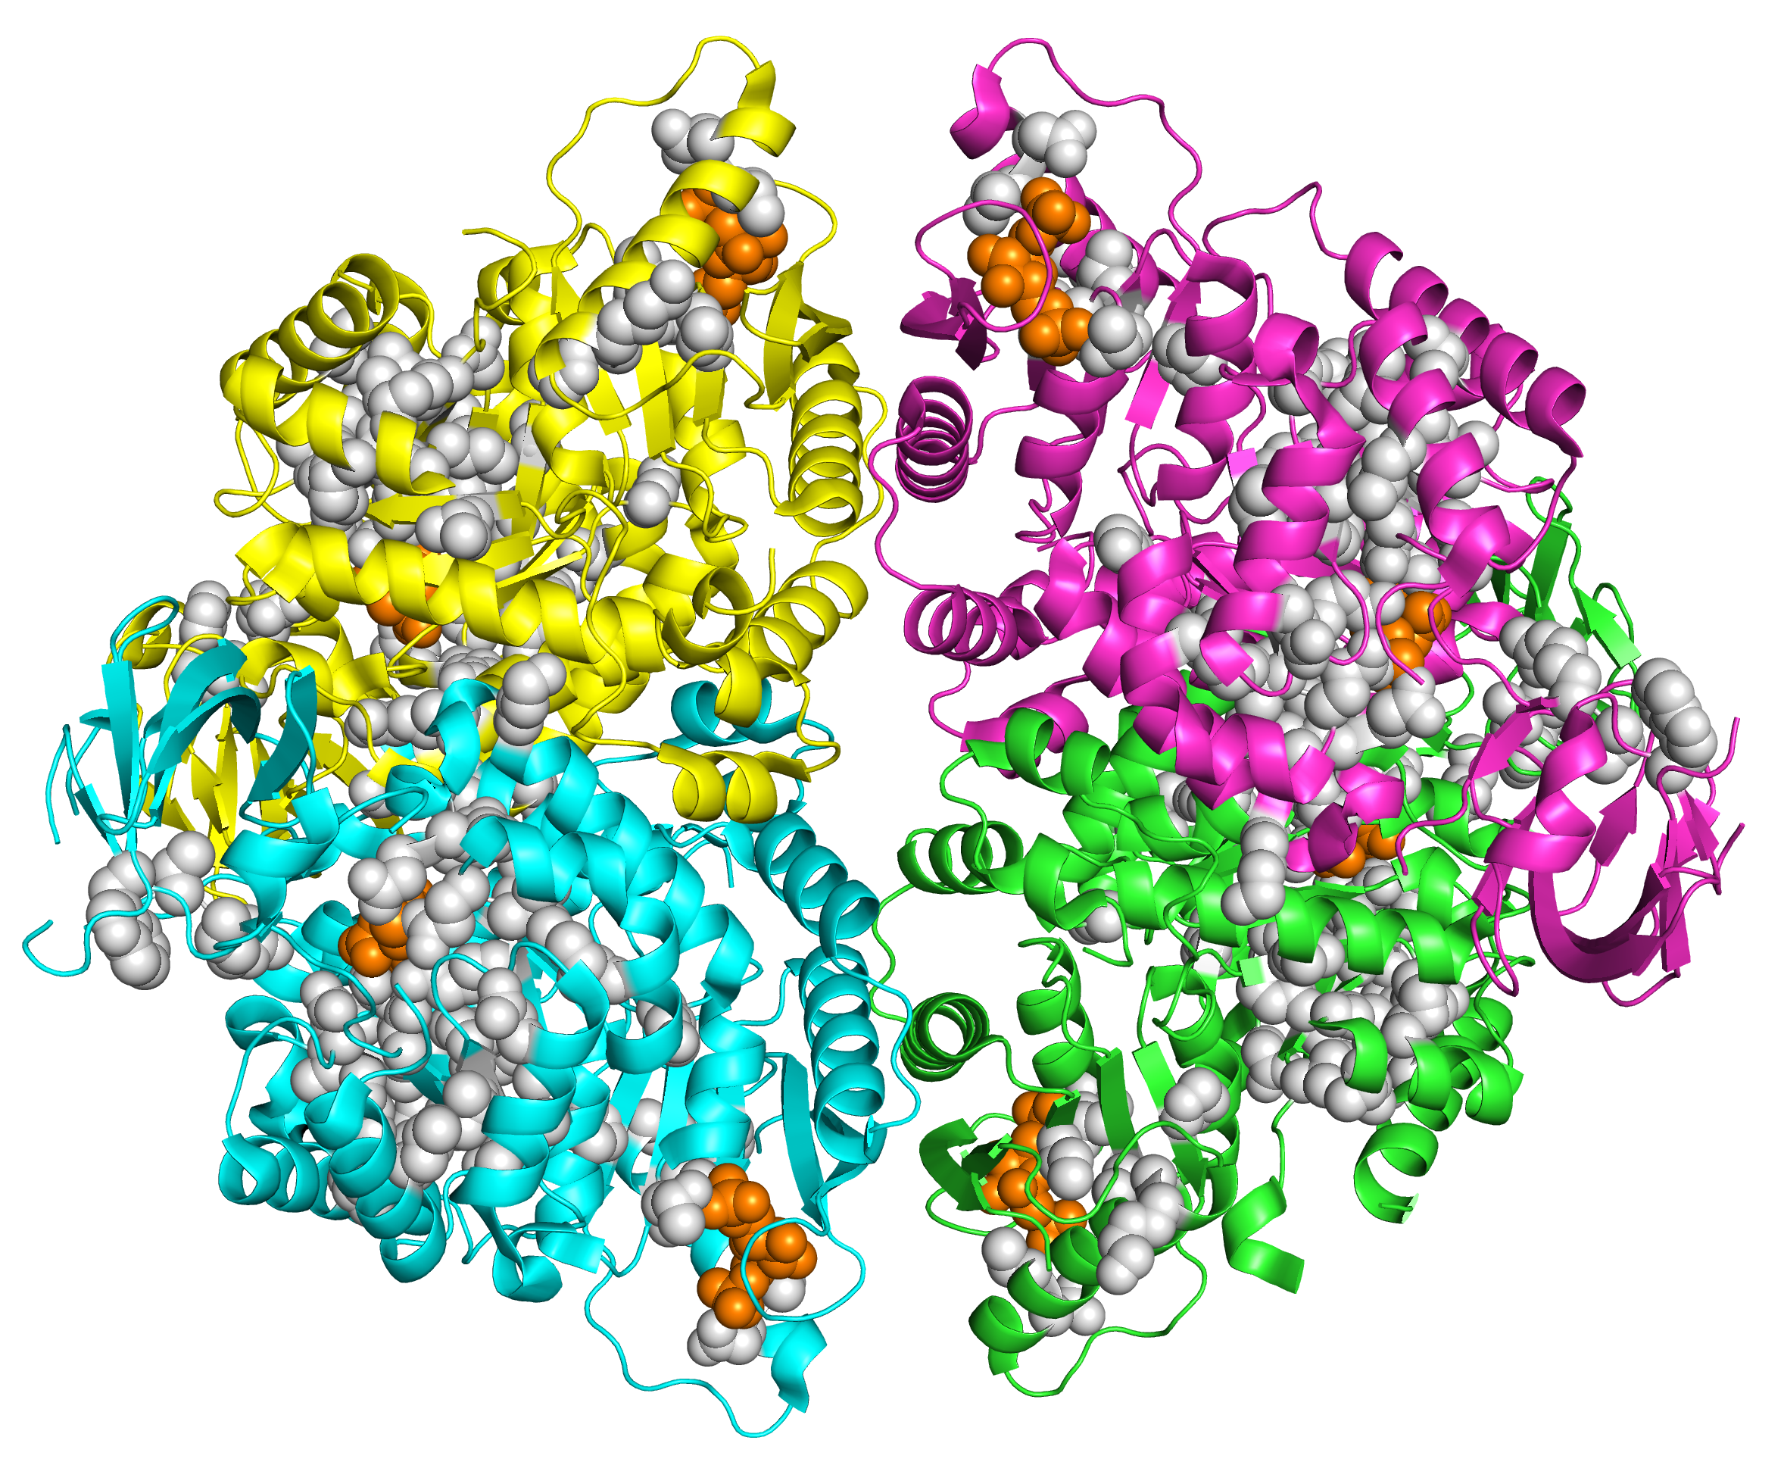
Experiment 2
Mutation to ALA: 382 active (90%), 44 inactive (10%)
Created for CAGI 4 genomeinterpretation.org Roland Dunbrack

Slide 5
Created for CAGI 4 genomeinterpretation.org Roland Dunbrack

Slide 6
Created for CAGI 4 genomeinterpretation.org Roland Dunbrack

Slide 7
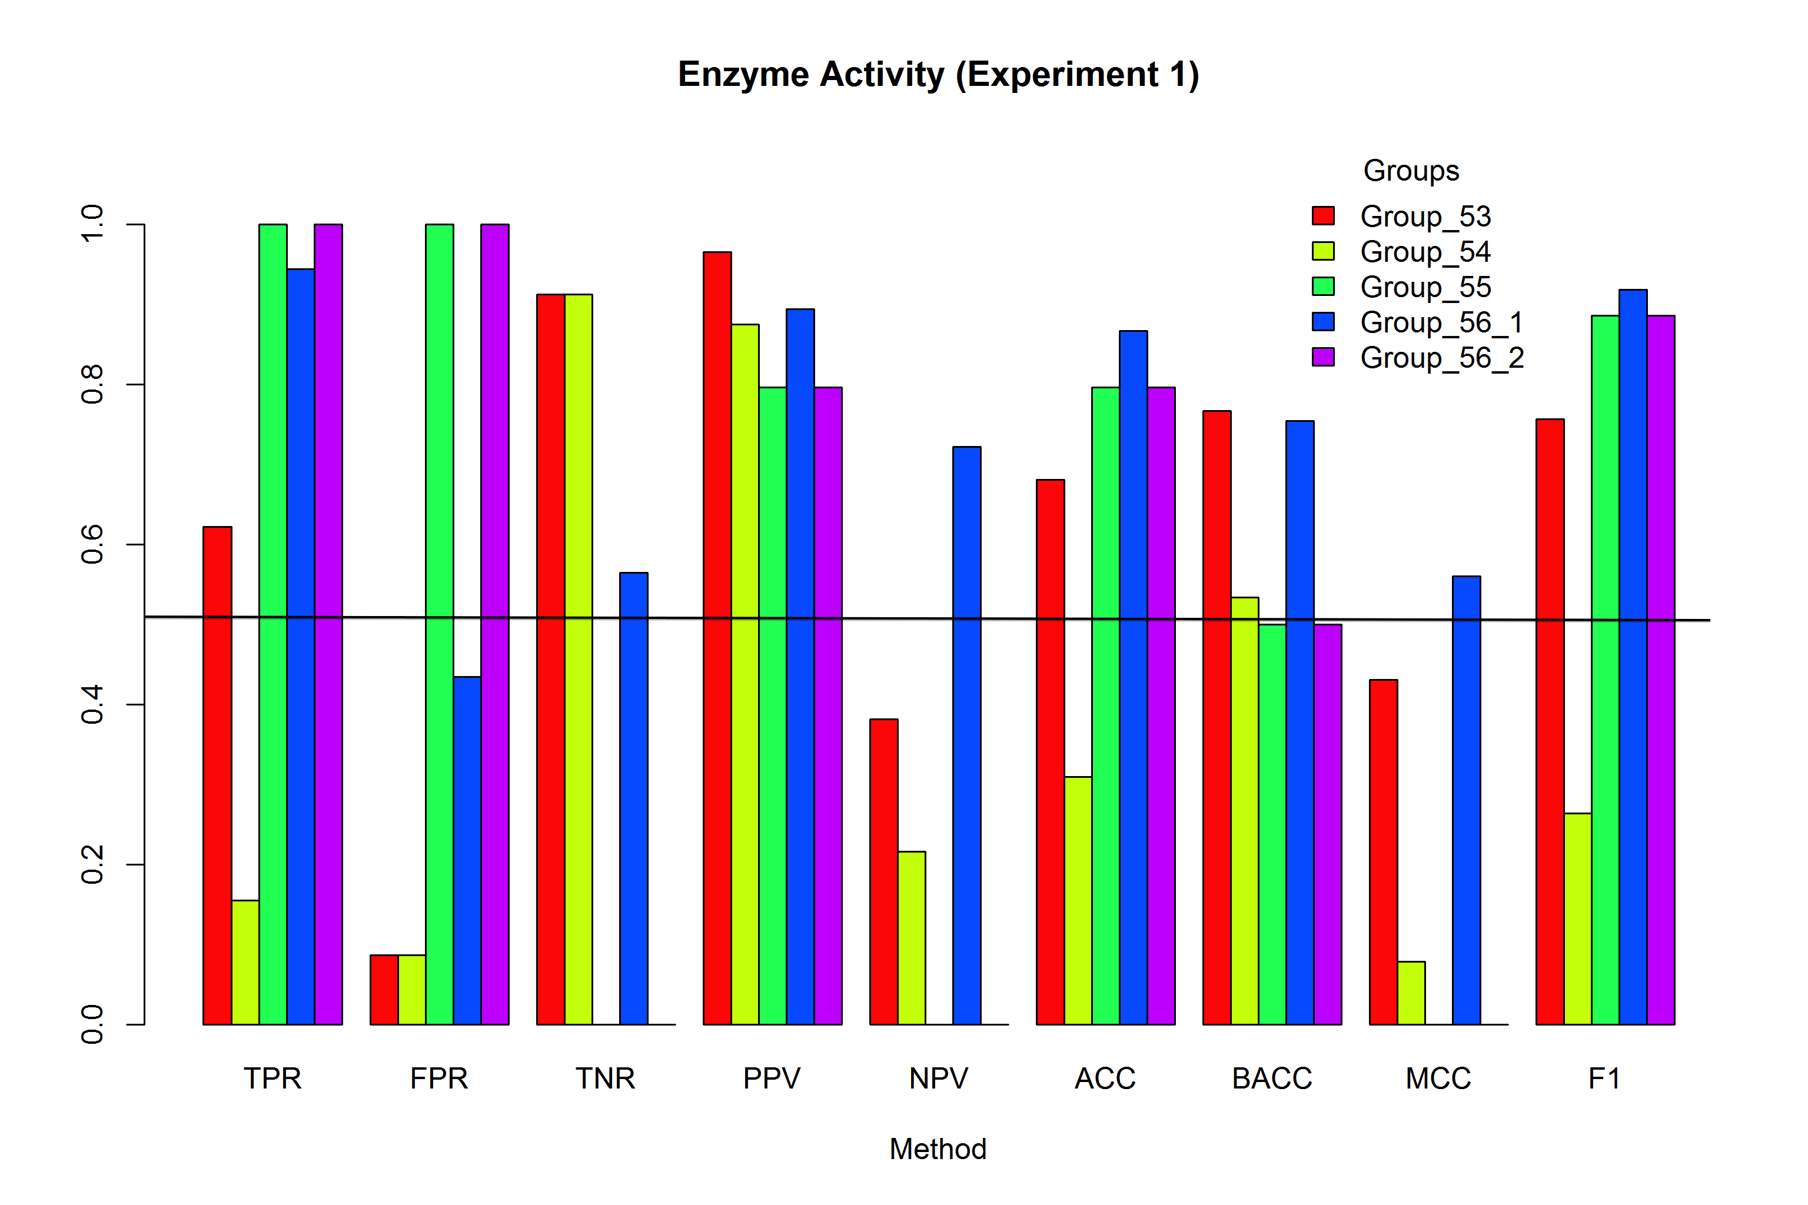
Experiment 1: Enzyme Activity
Using cutoff 0.5 for groups 53 and 54
Created for CAGI 4 genomeinterpretation.org Roland Dunbrack

Slide 8
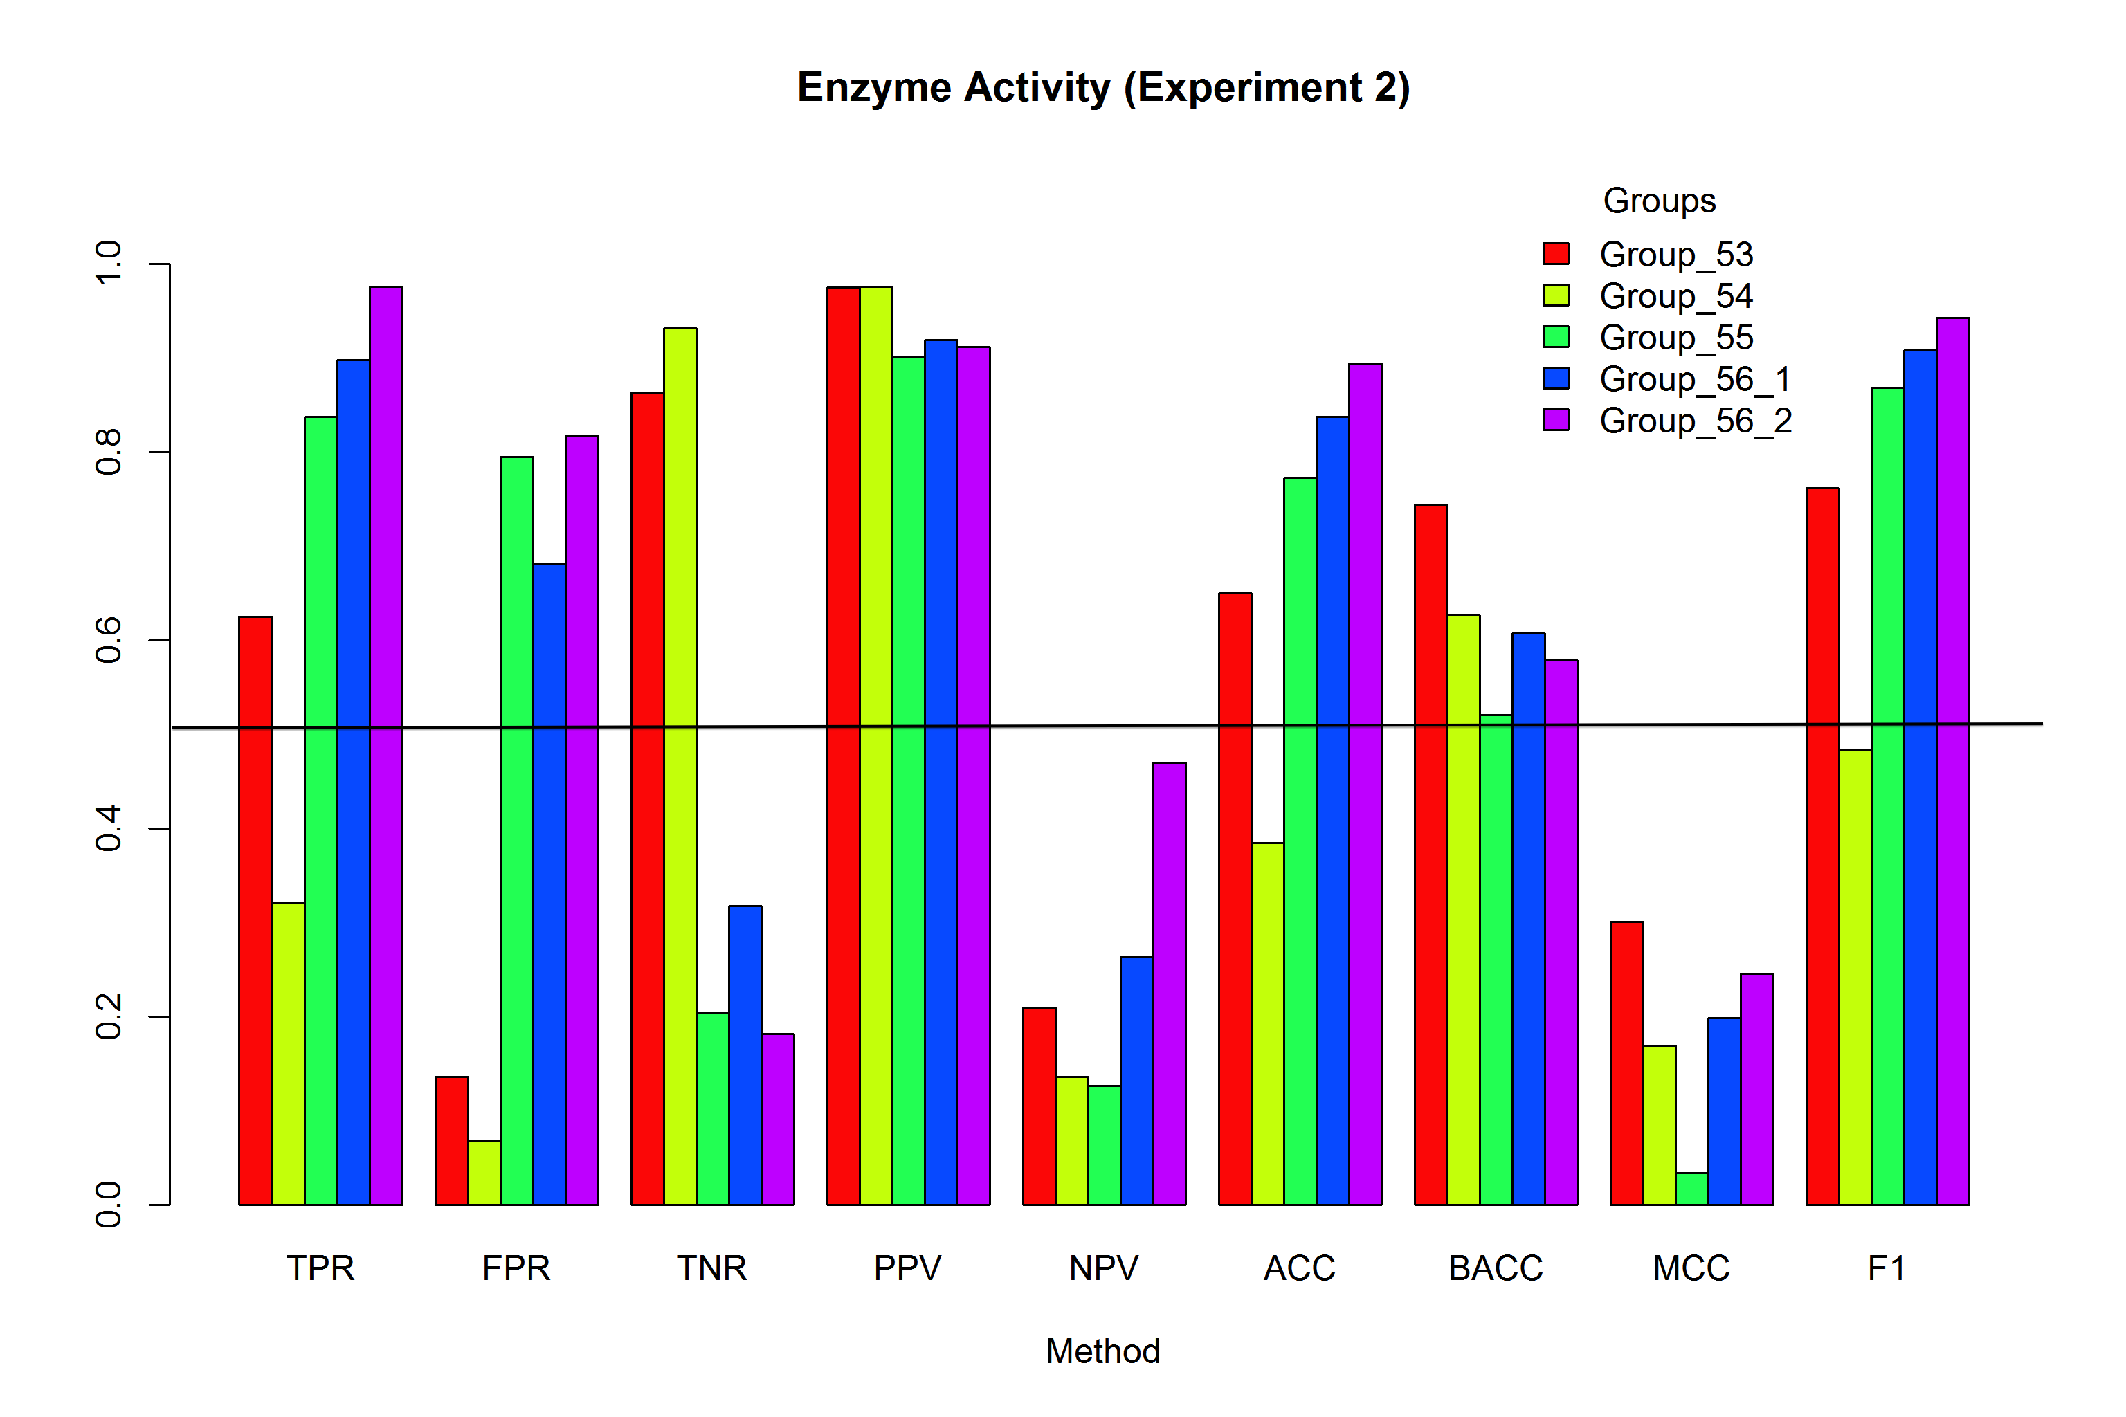
Experiment 2
Using cutoff 0.5 for groups 53 and 54
Created for CAGI 4 genomeinterpretation.org Roland Dunbrack

Slide 9
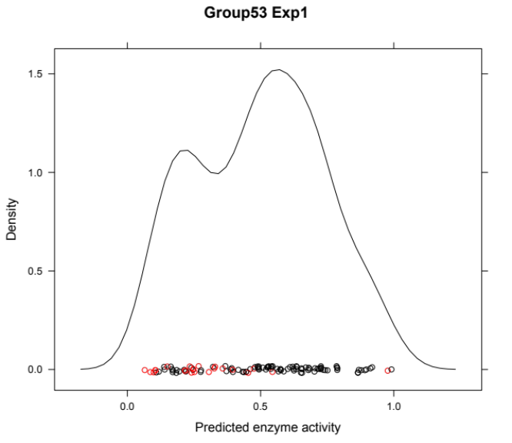
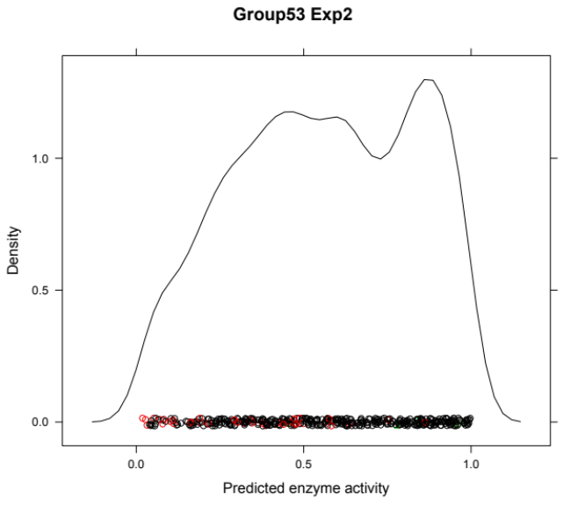
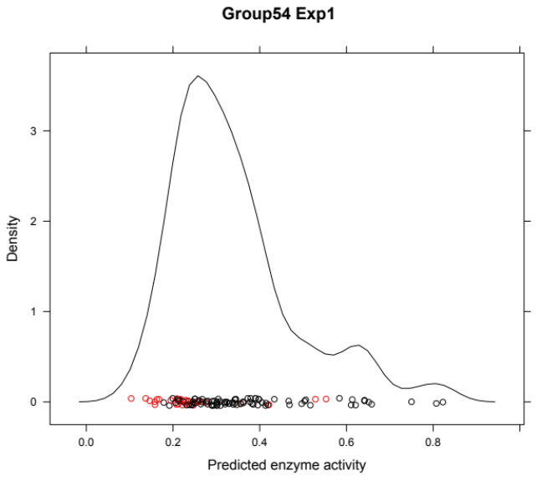
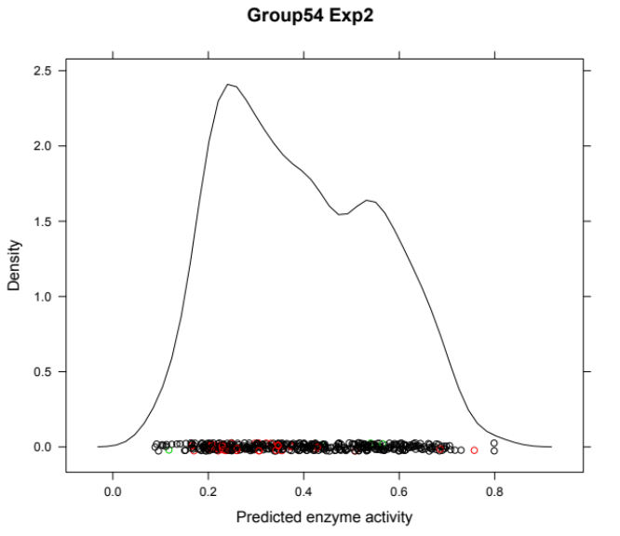
Cutoffs by Density for Groups 53 and 54
Experiment 1
Experiment 2
Group 53
Group 54
Created for CAGI 4 genomeinterpretation.org Roland Dunbrack

Slide 10
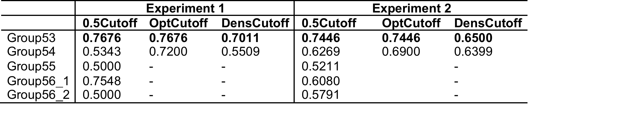
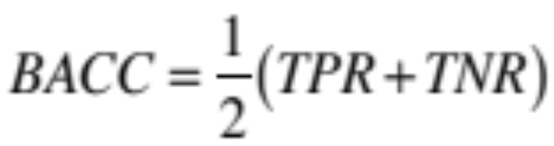
Enzyme Activity Balanced Accuracy
OptCutoff – determined as highest BACC possible
DensCutoff – determined as minimum density between modes
Group 53 performs well in both experiments
Group 56_1 performs well only in the first experiment but not in the second
Group 54 performs better if the cutoff is chosen for them optimally given the data, but not very well if the bimodal distribution is used to choose a cutoff at the minimum between modes.
Created for CAGI 4 genomeinterpretation.org Roland Dunbrack

Slide 11
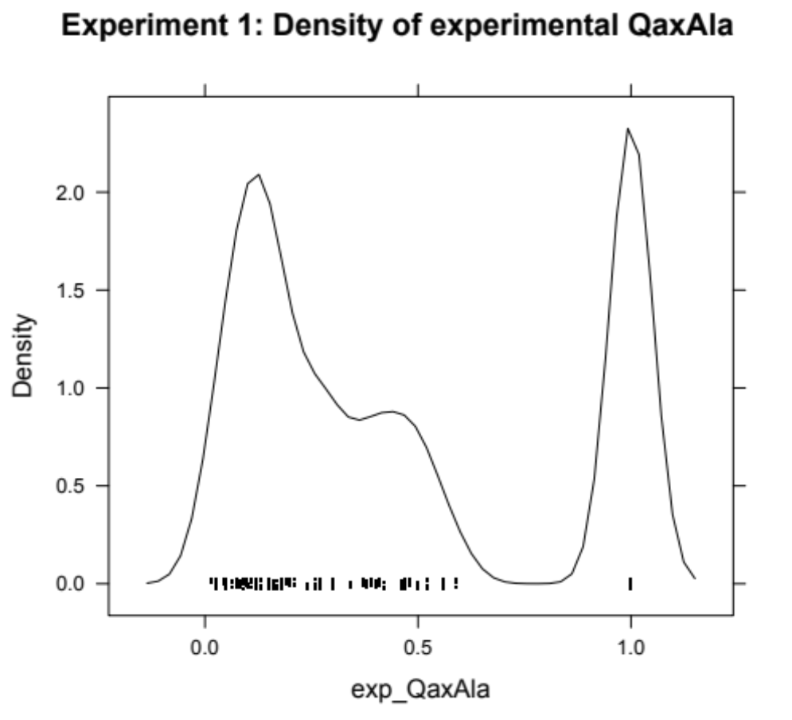
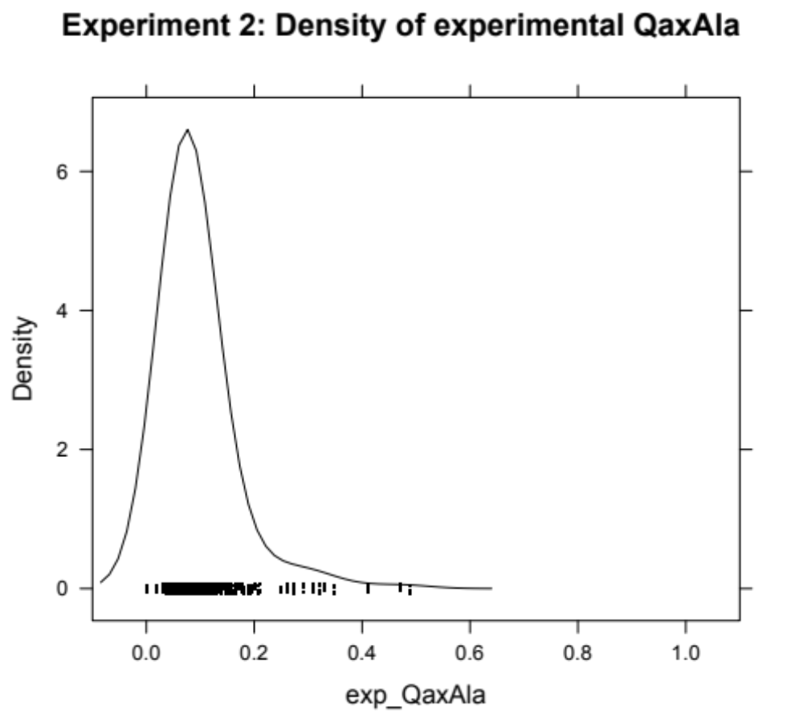
QaxAla Experimental Densities
Experiment 1 (#Qax<1/Total): F482(4/13) F514(11/12) H476(1/5) N82(6/8) R118(15/15) R55(4/10) S56(8/8) V481(6/7)
Created for CAGI 4 genomeinterpretation.org Roland Dunbrack

Slide 12
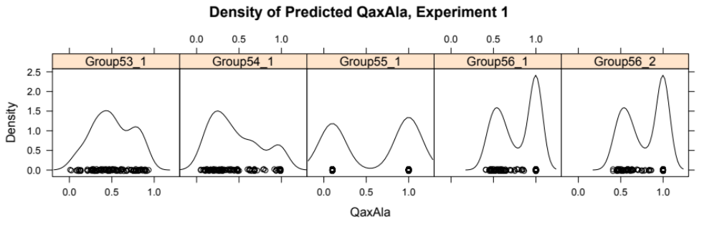
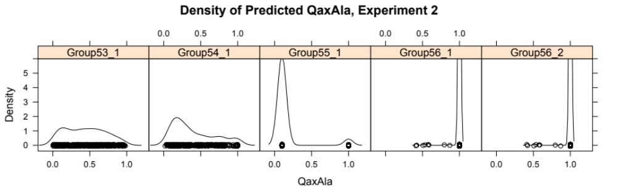
QaxAla Predicted Densities
Created for CAGI 4 genomeinterpretation.org Roland Dunbrack

Slide 13
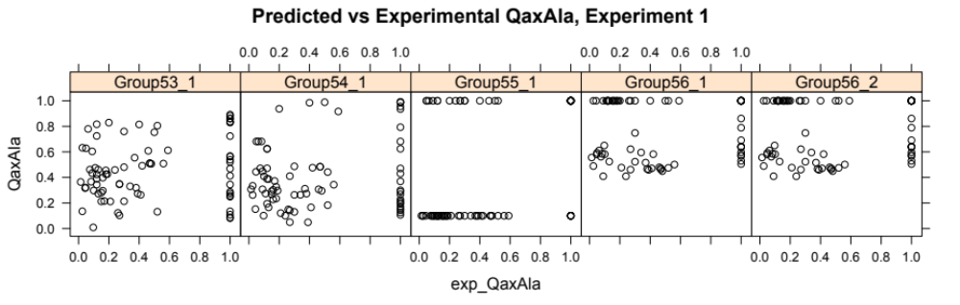
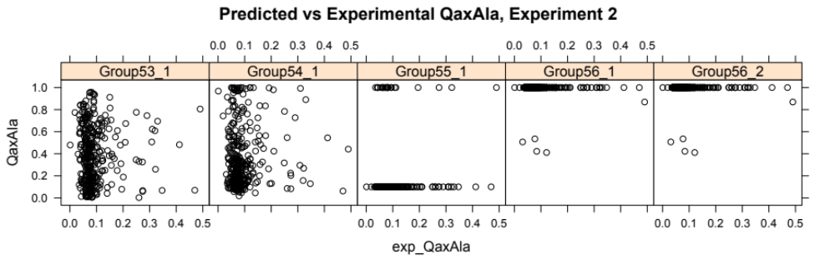
Predicted vs Experimental QaxAla
Created for CAGI 4 genomeinterpretation.org Roland Dunbrack

Slide 14
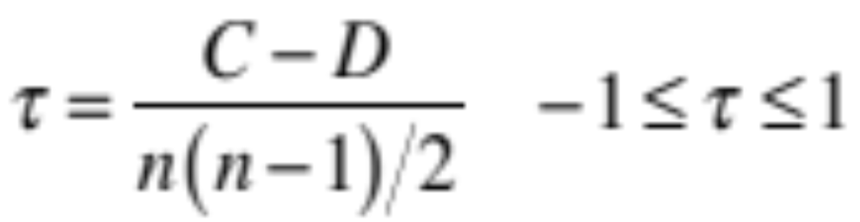
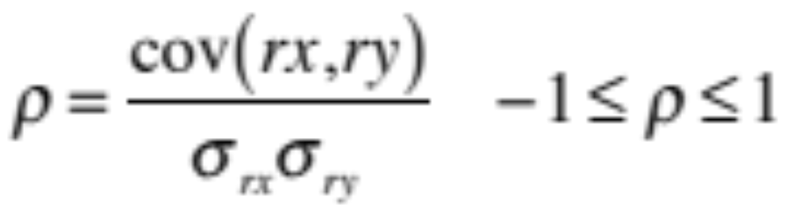
Non-parametric Rank Coefficients
Kendall's tau: for (x_{i},y_{i}):
#concordant pairs: C={x_{i}>x_{j} & y_{i}>y_{j}} or {x_{i}<x_{j} & y_{i}<y_{j}}
#discordant pairs: D={x_{i}>x_{j} & y_{i}<y_{j}} or {x_{i}<x_{j} & y_{i}>y_{j}}
Spearman's rho: for (x_{i},y_{i}):
Convert x_{i} into ranks rx_{i}; convert y_{i} into ranks ry_{i}
Created for CAGI 4 genomeinterpretation.org Roland Dunbrack

Slide 15
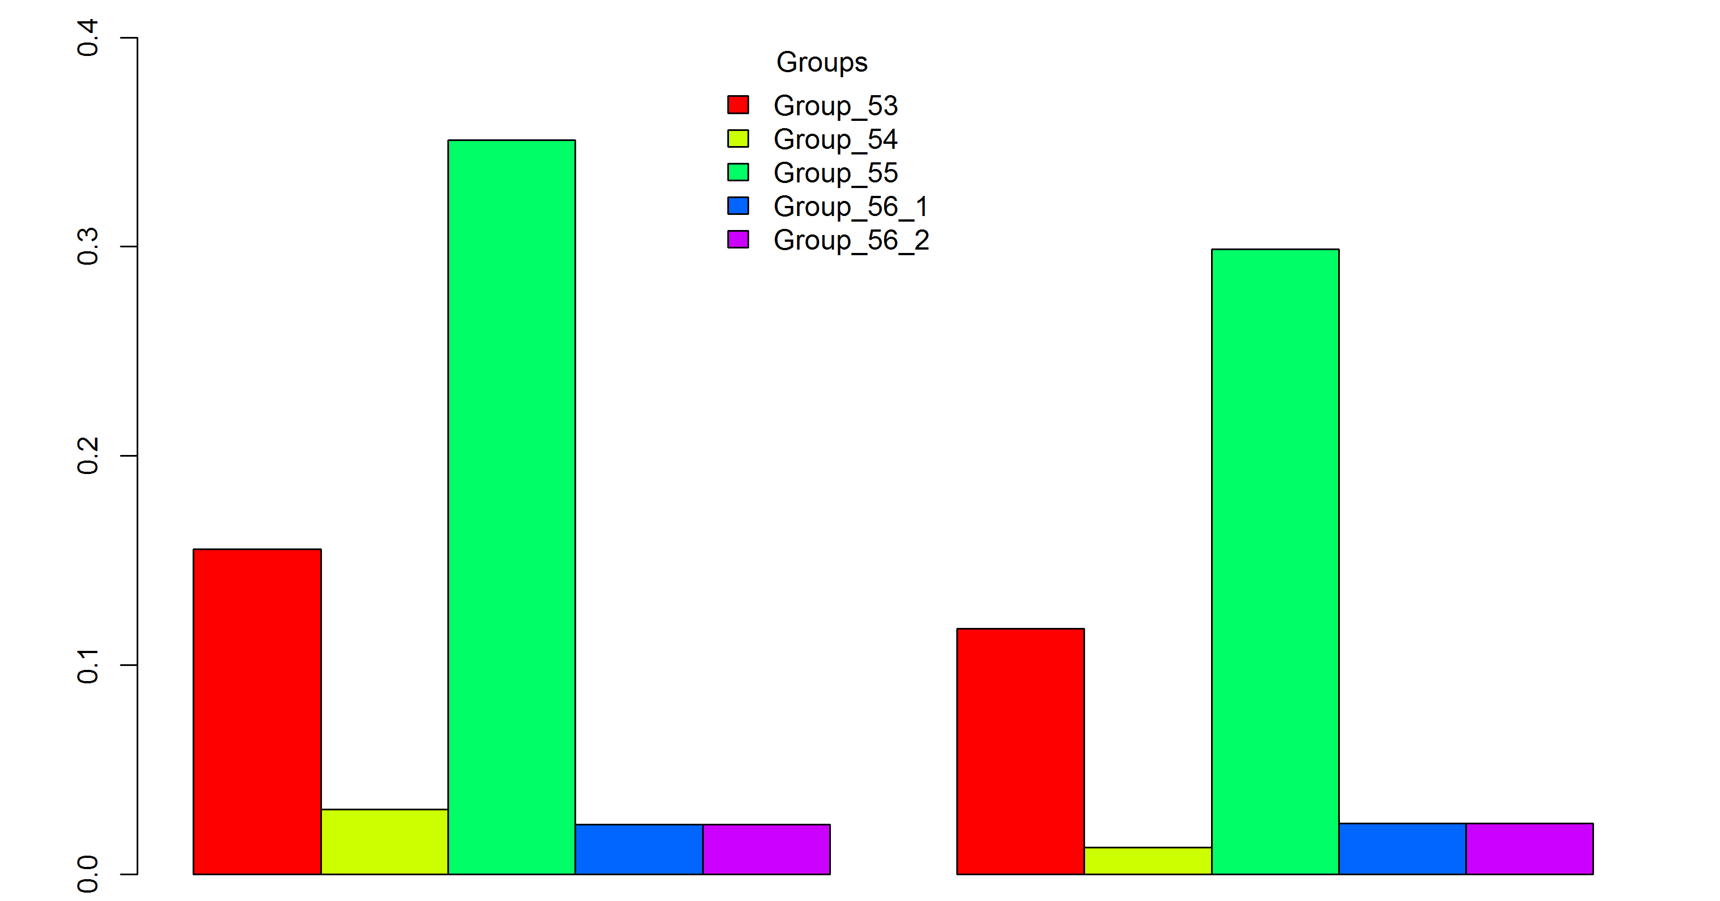
Correlation Coefficients: QaxAla Experiment 1
rho
tau
P-values for group 55=0.002; all others 0.17-0.88
Created for CAGI 4 genomeinterpretation.org Roland Dunbrack

Slide 16
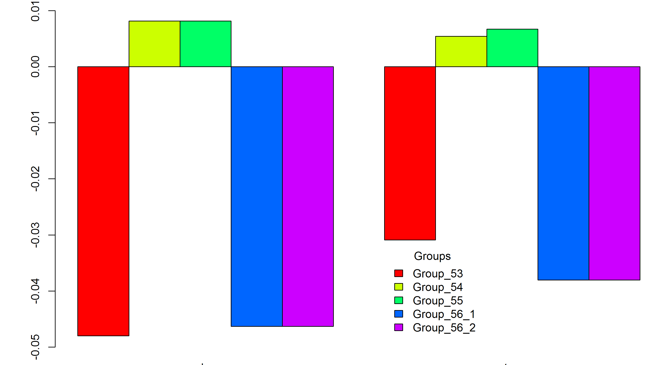
Correlation Coefficients: QaxAla Experiment 2
rho
tau
P-values: 0.38-0.88
16
Created for CAGI 4 genomeinterpretation.org Roland Dunbrack

Slide 17
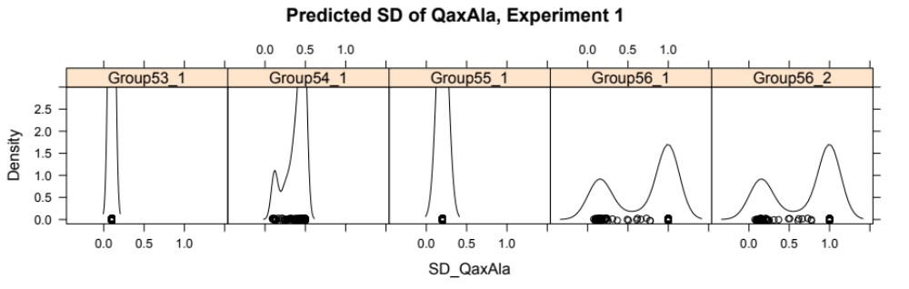
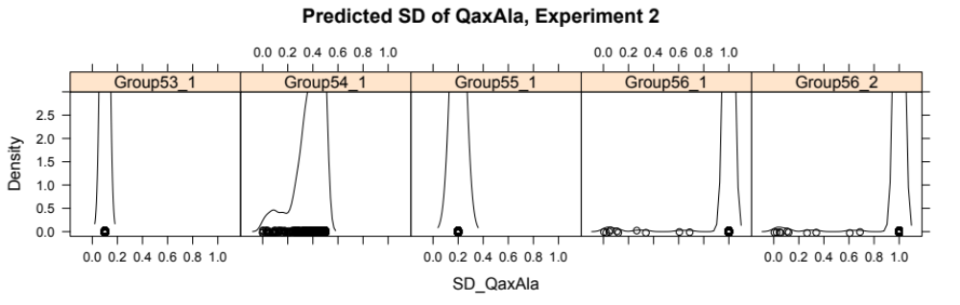
Predicted Standard Deviations of QaxAla Don't Help
Created for CAGI 4 genomeinterpretation.org Roland Dunbrack

Slide 18
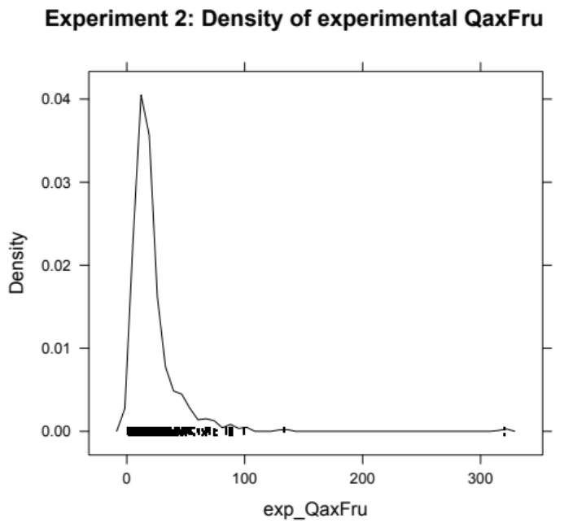
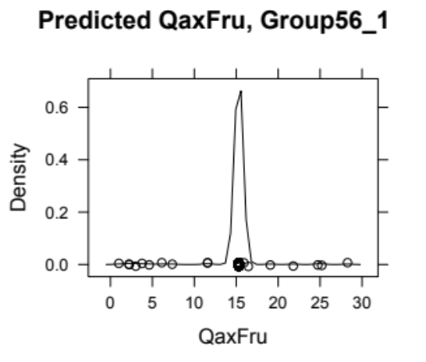
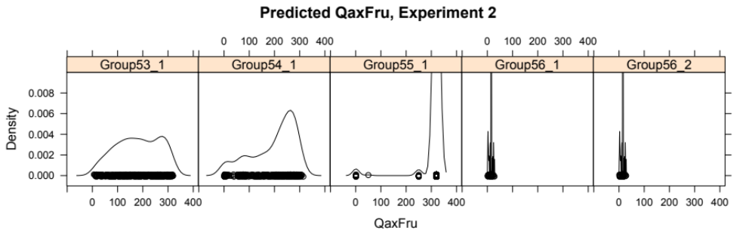
QaxFru Experimental and Predicted Densities
(Experiment 2)
Created for CAGI 4 genomeinterpretation.org Roland Dunbrack

Slide 19
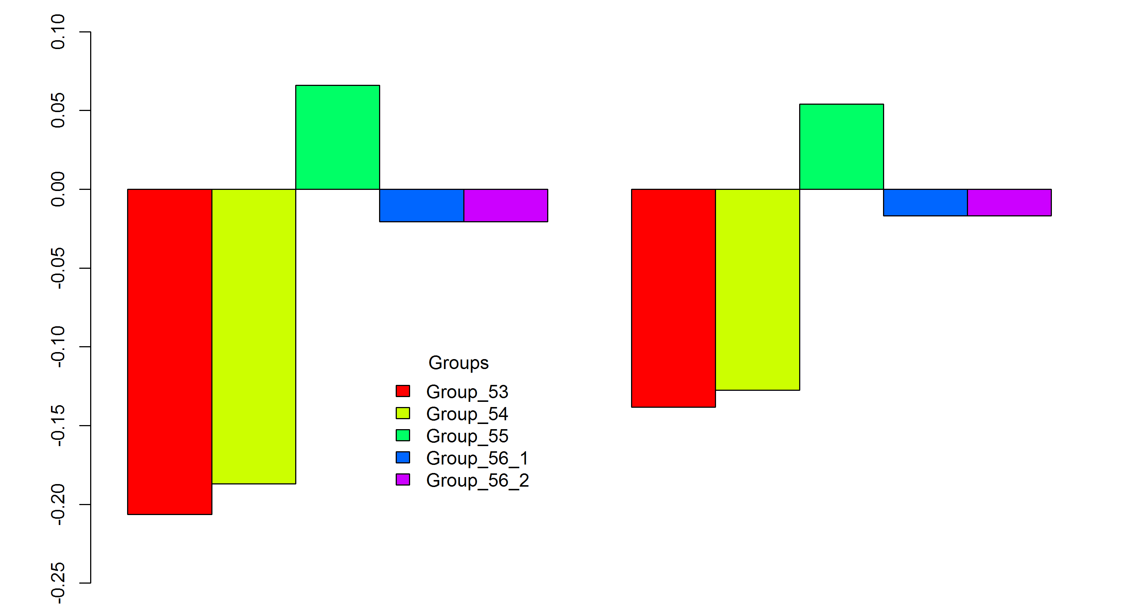
Correlation Coefficients, QaxFru (Experiment 2)
rho
tau
P-value for group 55: 0.20
Created for CAGI 4 genomeinterpretation.org Roland Dunbrack

Slide 20
Summary
Group 53 performed well in both experiments for enzyme activity
Group 55 and Group 53 (more marginally) had positive correlations for the QaxAla challenge in Experiment #1.
No group had useful predictions for QaxAla in Experiment #2 or QaxFru in Experiment #2.
Created for CAGI 4 genomeinterpretation.org Roland Dunbrack

Slide 21
Acknowledgments
Qifang Xu
NIH R01 GM084453
Created for CAGI 4 genomeinterpretation.org Roland Dunbrack

