Slide 1





Genome Interpretation using Bayesian Inference: Application to Matching Anonymized Genomes to Phenotypic Profiles
Rachel Karchin, Ph.D. Johns Hopkins University and Medicine

Slide 2

CAGI slide pack guidelines
I agree to my slides being used according to the following terms:
_______Author Name Here___Rachel Karchin____
Authors: please include THIS slide at the beginning of your presentation to indicate that you agree with reuse of your slides in CAGI presentations, according to the terms below, and digitally sign by writing your name above.
To disseminate the CAGI results, I encourage all CAGI participants to remix these CAGI slides for inclusion in their oral and poster presentations
CAGI participants may use or publish any content of these slides only in compliance with the CAGI Data Use Agreement
CAGI participants may not cite or publish any content of these slides except with the written permission of the originating author or in the primary CAGI publications
CAGI participants must acknowledge the original authors of these slides and CAGI 2013. Include the acknowledgement banner across the bottom
CAGI participants must include the CAGI credits slide in their presentations
Slides with a red slash (no remix) may not be included in a presentation unless all attendees are registered CAGI participants who signed the data use agreement
Slides with a red X over the entire slide may not be used in any circumstances
Slides with a blue slash (embargoed) may not be used unless the embargo is explicitly lifted
Slides without slash or X may be tweeted unless flagged with the “No tweet” icon.
CAGI participants using these slides must explain the “No tweet” icon, which means that the slide content should not be disseminated outside the presenting conference hall. If the presentation venue permits pervasive tweeting, you may not include these slides in your talk
Note for slide authors: we expect all CAGI participants to abide by these restrictions, and will make best effort to ensure they are followed. However, but bear in mind that we have limited means of enforcing them, and therefore the restrictions cannot be guaranteed.

Slide 3
Outline
The Genome Interpretation through Bayesian Inference (GIBI) model
How we applied GIBI in CAGI 2012-2013
Updates to our approach in CAGI 2016

Slide 4
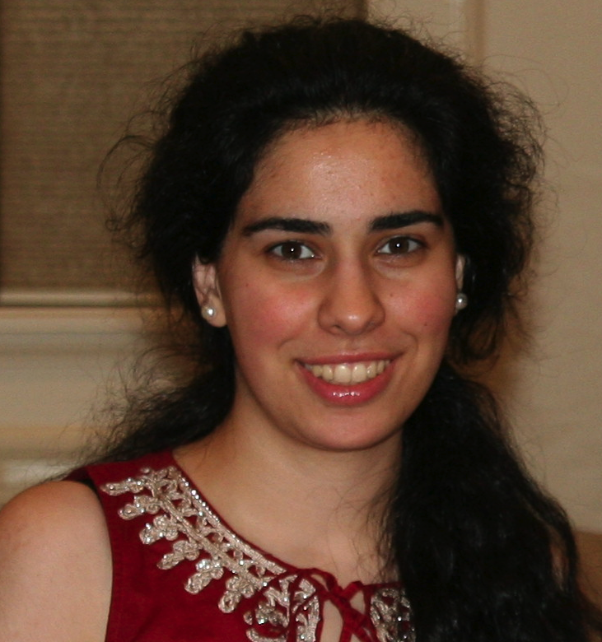




The team
Noushin Niknafs
Yun-Ching Chen
Collin Tokheim
Rohit Bhattacharya
Chris Douville

Slide 5

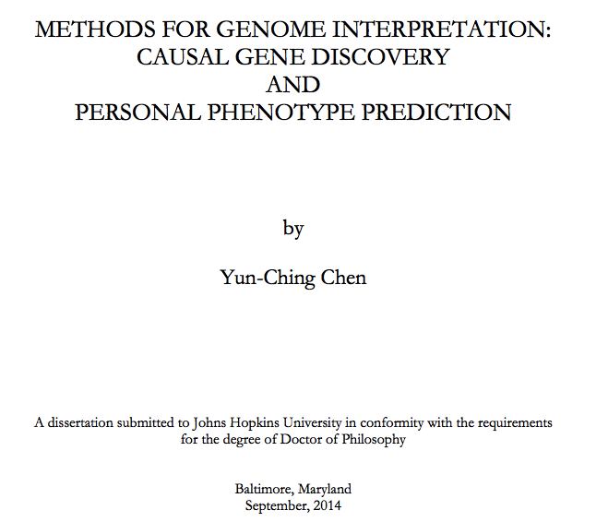
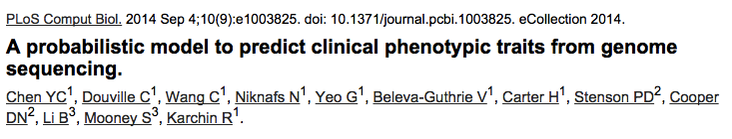
Genome Interpretation through Bayesian Inference

Slide 6

Genome Interpretation through Bayesian Inference
Personal genome
Model for a selected phenotype
Genetic variation associated with Phenotype Y
Phenotype
Prevalence
Generalizable
Probabilistic
Framework
(Age, gender and ancestry specific)
Annotation sources:
HGMD, OMIM,
Jensen’s disease-gene database
NHGRI GWAS catalog
. . .
P(Phenotype Y | genome)

Slide 7
GIBI model
Curated causal variants
Non-synonymous rare variants (MAF < 0.01)
GWAS hits
V_{H}
V_{H}
V_{F}
V_{F}
V_{F}
V_{F}
V_{F}
V_{F}
V_{L}
V_{L}
Curated causal genes
Disease-associated genes
G_{H}
G_{H}
G_{L}
G_{L}
G_{L}
G_{L}
S_{VH}
S_{GH}
S_{GL}
S_{VL}
Observed data
Phenotype Y
Estimated data
Random variable

Slide 8
GIBI model
Curated causal variants
Non-synonymous rare variants (MAF < 0.01)
GWAS hits
V_{H}
V_{H}
V_{F}
V_{F}
V_{F}
V_{F}
V_{F}
V_{F}
V_{L}
V_{L}
Curated causal genes
Disease-associated genes
G_{H}
G_{H}
G_{L}
G_{L}
G_{L}
G_{L}
S_{VH}
S_{GH}
S_{GL}
S_{VL}
Hidden layer
of the model
Observed data
Phenotype Y
Estimated data
Random variable

Slide 9
Probability of gene function affected
For each non-synonyous rare variant i, we predict its pathogenicity using bioinformatics tool (VEST)
A gene level statistic of pathogenicity is computed by aggregating p-values using Fisher’s method
Probability a gene’s function is affected is calibrated using annotated disease and benign variants and Bayes’ Rule.
V_{F}
V_{F}
V_{F}
G

Slide 10
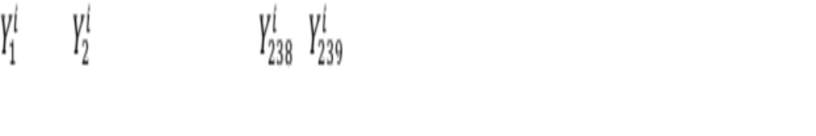
CAGI 2012-2013 predictions
239 phenotypes
Phenotypic profile
 |  | …
Phenotypes predicted
for a genome
 |  | …
CAGI 2012-2013
i : indexes genomes [1,77]
j: indexes phenotypes [1,239]
k: indexes profiles [1,291]
X: binary random variable for phenotype status
Y: posterior probability of a phenotype

Slide 11
CAGI 2012-2013 predictions
239 phenotypes
Phenotypic profile
 |  | …
291 profiles provided (77 real, 214 were decoys)

Slide 12

Phenotypes predicted for a genome
Phenotypes predicted
for a genome
 |  | …
i : indexes genomes [1,77]
j: indexes phenotypes [1,239]
Y: posterior probability of a phenotype
CAGI 2012-13
genome 1
Phenotype 1

Slide 13
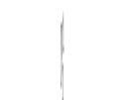
Phenotypes predicted for a genome
Phenotypes predicted
for a genome
 |  | …
i : indexes genomes [1,77]
j: indexes phenotypes [1,239]
Y: posterior probability of a phenotype
CAGI 2012-13
genome 1
Phenotype 1
Phenotype 2

Slide 14


Phenotypes predicted for a genome
Phenotypes predicted
for a genome
 |  | …
i : indexes genomes [1,77]
j: indexes phenotypes [1,239]
Y: posterior probability of a phenotype
CAGI 2012-13
genome 1
Phenotype 1
Phenotype 2
Phenotype 3
Phenotype 239

Slide 15




Auxilliary phenotypes
PGP public profiles
Phenotypic profile
 |  | …
Phenotypes predicted
for a genome
 |  | …
SNP sets / Chr Y
CAGI 2012-2013
240: Blood group A
241: Blood Group B
242: Blood Group O
243: Blood Group AB
244: Maleness

Slide 16


Predicting the match of a genome and a phenotype profile
Likelihood that profile k
is a match to genome i
...
Phenotype profiles
1
101
P(1,1)
P(1,2)
P(1,101)
Match probabilities of
profiles to genomes
Genomes
P(23,1)
P(23,2)
P(23,101)

Slide 17
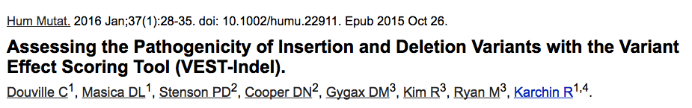
Updates applied in CAGI 2016 predictions
Latest versions of underlying annotation databases (ExAC, HGMD, OMIM, NHGRI catalog)
VEST now handles all non-silent variants*
Phenotype set restricted to 18 phenotypes best predicted by GIBI plus 10 auxilliary phenotypes (6 new auxilliary phenotypes)
Matching algorithm modified to consider genotype-based predicted ancestry
*

Slide 18
Restricted list of phenotypes
Best GIBI-predicted phenotypes
18
Phenotypic profile
 |  | …
Phenotypes predicted
for a genome
 |  | …

Slide 19
New auxilliary phenotypes
PGP public profiles
Blood groups, Maleness, Hair color, Eye color
Best GIBI-predicted phenotypes
Auxilliary phenotypes
18
10
Phenotypic profile
 |  | …
 | …
Phenotypes predicted
for a genome
 |  | …
 | …
SNP sets, Chr Y,
HirisPlex algorithm

Slide 20
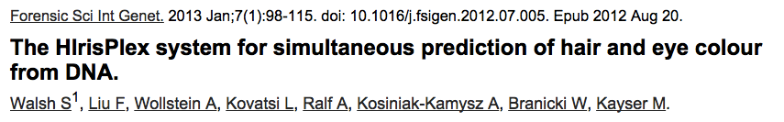
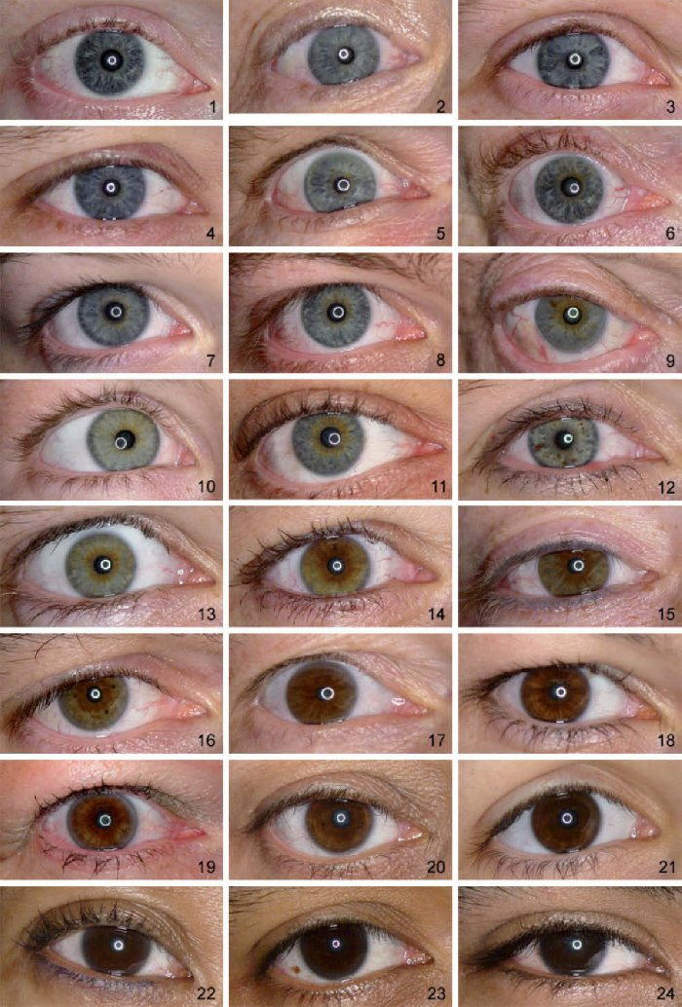
Multinomial logistic regression model based on genotypes of a selected set of SNPs
Numeric values for eye color and hair color descriptions provided as part of PGP public profiles

Slide 21
Matching algorithm considers predicted ancestry
29 phenotypes
Phenotypic profile
 |  | …
Phenotypes predicted
for a genome
 |  | …
i : indexes genomes [1,23]
j: indexes phenotypes [1,28]
k: indexes profiles [1,101]
X: binary random variable for phenotype status
Y: posterior probability of a phenotype
CAGI 2015
Likelihood that profile k
is a match to genome i

Slide 22
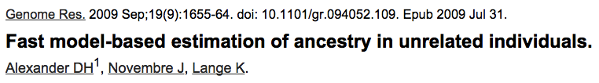
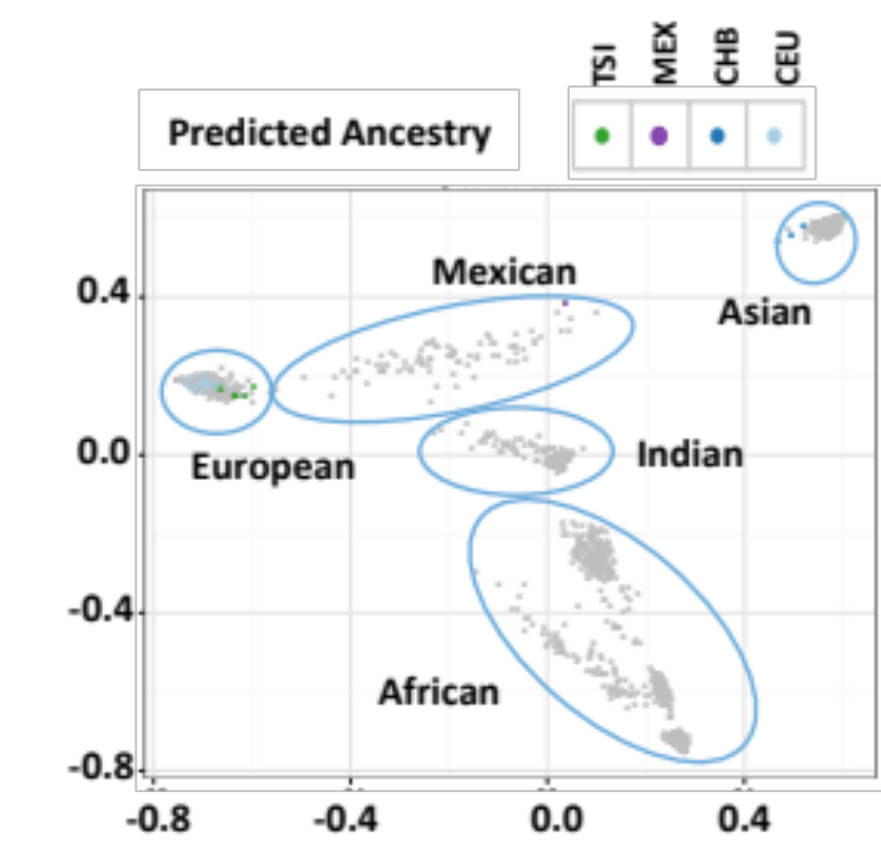
Predicting ancestry of PGP genomes and 1417 HapMap samples
ADMIXTURE used to predict
underlying admixture
proportions from sample
genotypes
PGP genomes assigned
to the ancestral group of
nearest k=20 HapMap
neighbors

Slide 23
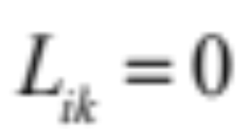
Matching algorithm considers predicted ancestry
Each public profile lists self-identified ancestry.
If predicted ancestry is not consistent with self-identified ancestry, the likelihood of a match is set to zero.
Likelihood that profile k
is a match to genome i

Slide 24
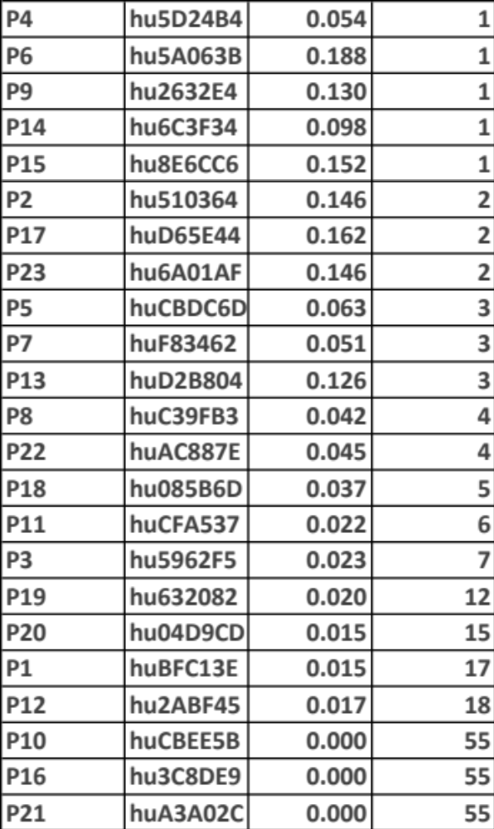
CAGI 2016 Challenge Results
Correct
Profile
(CP)
Genome
P(CP)
Rank(CP)
Improvement over our performances in previous CAGI years.
Raw probabilities of match less useful than ranks.
P10, P16, P21 are worst predictions.

Slide 25
CAGI 2016 Challenge Results
Correct
Profile
(CP)
Genome
P(CP)
Rank(CP)
Improvement over our performances in previous CAGI years.
Raw probabilities of match less useful than ranks.
P10, P16, P21 are worst predictions.
?

Slide 26
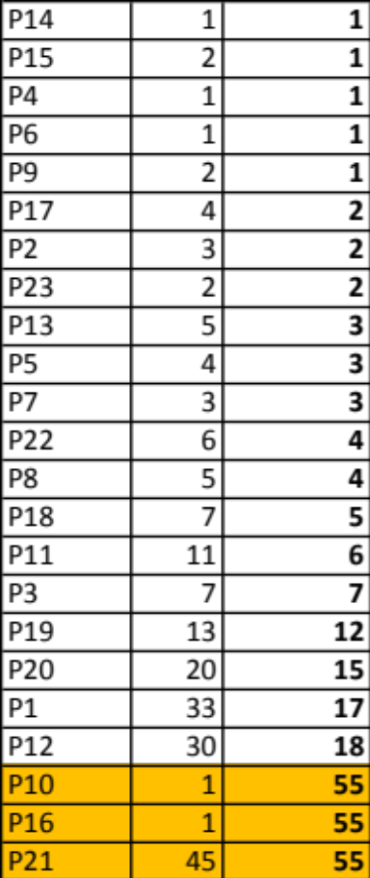
Increasing flexibility of ancestry match constraint rescues P10, P16
New
Rank
Old
Rank
Genome

Slide 27
Acknowledgments
Noushin Niknafs
Collin Tokheim

Slide 28
Questions?

Slide 29

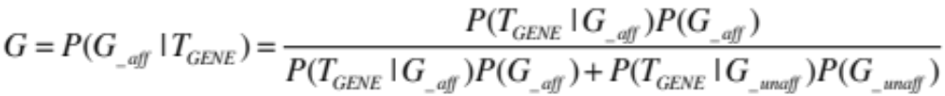



Full details: Probability of gene function affected
For each non-synonyous rare variant (V_{F}) i, we predict its pathogenicity using bioinformatics tool (VEST)
VEST reports a score and its associated p-value
A gene level statistic indicating pathogenicity is computed by aggregating p-values using Fisher’s method
Probability a gene is affected is calibrated using Bayes’ Rule
V_{F}
V_{F}
V_{F}
G
Implementation:
: N common variants randomly drawn from 1000 genomes
: N-1 common variants + 1 disease causing variant from HGMD DM class

