Slide 1

CAGI slide pack guidelines
I agree to my slides being used according to the following terms: Sean Mooney
Authors: please include THIS slide at the beginning of your presentation to indicate that you agree with reuse of your slides in CAGI presentations, according to the terms below, and digitally sign by writing your name above.
To disseminate the CAGI results, I encourage all CAGI participants to remix these CAGI slides for inclusion in their oral and poster presentations
CAGI participants may use or publish any content of these slides only in compliance with the CAGI Data Use Agreement
CAGI participants may not cite or publish any content of these slides except with the written permission of the originating author or in the primary CAGI publications
CAGI participants must acknowledge the original authors of these slides and CAGI 2013. Include the acknowledgement banner across the bottom
CAGI participants must include the CAGI credits slide in their presentations
Slides with a red slash (no remix) may not be included in a presentation unless all attendees are registered CAGI participants who signed the data use agreement
Slides with a red X over the entire slide may not be used in any circumstances
Slides with a blue slash (embargoed) may not be used unless the embargo is explicitly lifted
Slides without slash or X may be tweeted unless flagged with the “No tweet” icon.
CAGI participants using these slides must explain the “No tweet” icon, which means that the slide content should not be disseminated outside the presenting conference hall. If the presentation venue permits pervasive tweeting, you may not include these slides in your talk
Note for slide authors: we expect all CAGI participants to abide by these restrictions, and will make best effort to ensure they are followed. However, but bear in mind that we have limited means of enforcing them, and therefore the restrictions cannot be guaranteed.

Slide 2
CAGI: PGP Challenge Assessment
Sean D. Mooney, PhD
Binghuang Cai, PhD
Nikki Kiga

Slide 3


OUTLINE
Introduction
CAGI 2011 – predicting traits from genome
CAGI 2013 – matching trait profiles to genome
CAGI 2015 – matching trait profiles to genome
CAGI 2015 Result Assessments
Acknowledgment

Slide 4
The PGP Challenge
2015 is the 4th iteration of the CAGI: Personal Genome Project challenge
Few goals are more pure to genome interpretation than predicting traits from raw sequence (or genotype) data
In this challenge, phenotypes/traits are predicted for real people with genetic data
Dataset provided by Personal Genome Project and George Church, Harvard Medical School
Phenotypes provided by CAGI organizers in consultation with George Church

Slide 5
PERSONAL GENOME PROJECT
Genome
Binary Traits: Leukemia, Cavities etc. Y / N
Numerical Traits: age, triglyceride etc.
Categorical Traits: blood type, eye color,
ancestry etc.

Slide 6
CAGI 2011
4 groups and 5 submissions

Slide 7
ABOUT CAGI 2011
Challenge 2011
  Predict probability of 10 genomes (participants) having 32 binary traits and 8 numerical traits
  We also invite predictions on any additional genetic phenotypes.
Additional:
  One the of PGP10 individuals has irritable bowel syndrome. Predict who that individual is.
  One of the PGP10 individuals is color-blind. Predict who he is.
  One of the PGP10 individuals is not color-blind but she has a color-blind father and an affected son. Predict who that individual is.

Slide 8
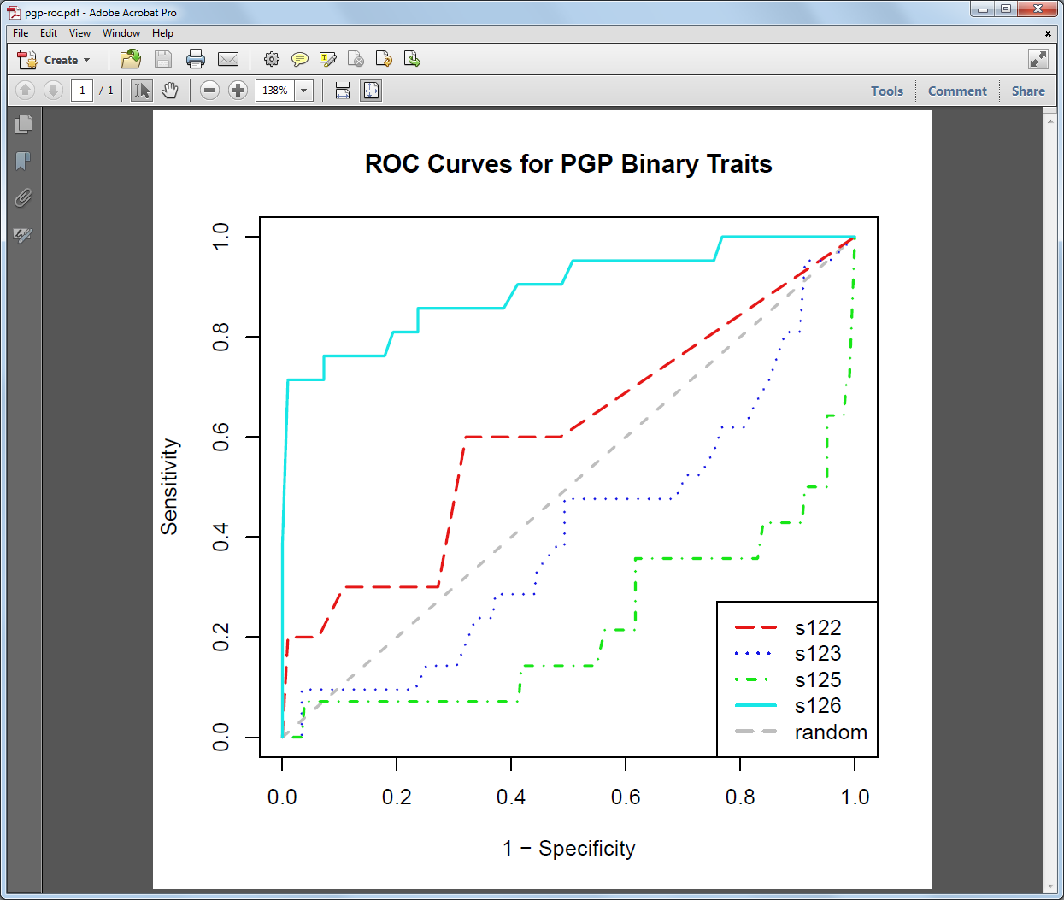
The binary traits - ROC
Only S126 (Karchin lab) was statistically significant in PGP Challenge 2011

Slide 9
CAGI 2013
16 Submissions

Slide 10
CAGI challenge became a matching game in 2013
Participant Genome 1
Profile 1
Participant Genome 2
Profile 2
Participant Genome 3
Profile 3
Participant Genome 77
Profile 291
Each profile contains 239 binary traits.
There are 214 decoy profiles that match no given genome data.
Each genome contains variants covering the whole genome.
Predicted profiles are assigned probability values.

Slide 11
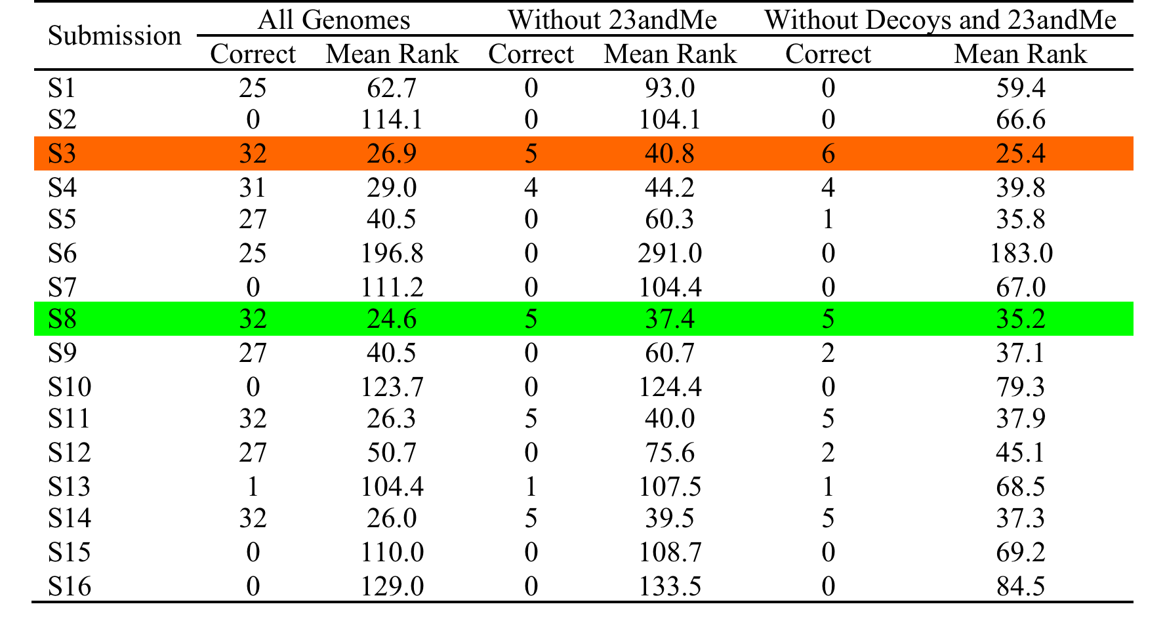
PGP Challenge 2013

Slide 12
PGP Challenge 2015
Challenge 2015 has the format same as Challenge 2013
  Predict match of 23 genomes (participants) to 101 profiles (78 decoys)
  Each profile is a self-reported list of 239 binary traits
  Includes both Mendelian traits and “complex” traits
Optional, “interest only” submission was available to predict individual traits from genomes – however no group submitted

Slide 13
CAGI 2015
From 4 teams and 5 submissions

Slide 14
Submissions
Example submission – each submission is in the form of a CSV and contains probabilities for each Participant Genome to 101 profiles
Participant Genome | hu0165DF-P | hu048C92-P | hu04D9CD-P | hu085B6D-P | hu093F8B-P | hu0BCA45-P | hu156E46-P | hu1725A5-P | hu1A4E62-P
P1 | 0.007 | 0.005 | 0.017 | 0.000 | 0.000 | 0.020 | 0.017 | 0.004 | 0.004
P2 | 0.005 | 0.008 | 0.010 | 0.000 | 0.000 | 0.016 | 0.011 | 0.008 | 0.005
P3 | 0.011 | 0.008 | 0.015 | 0.000 | 0.000 | 0.020 | 0.015 | 0.008 | 0.006
P4 | 0.009 | 0.005 | 0.018 | 0.000 | 0.000 | 0.027 | 0.020 | 0.005 | 0.008
P5 | 0.007 | 0.008 | 0.009 | 0.000 | 0.000 | 0.012 | 0.010 | 0.008 | 0.003
P6 | 0.000 | 0.000 | 0.000 | 0.078 | 0.032 | 0.000 | 0.000 | 0.000 | 0.000
P7 | 0.000 | 0.000 | 0.000 | 0.016 | 0.006 | 0.000 | 0.000 | 0.000 | 0.000
P8 | 0.023 | 0.004 | 0.018 | 0.000 | 0.000 | 0.022 | 0.017 | 0.004 | 0.006
P9 | 0.011 | 0.029 | 0.007 | 0.000 | 0.000 | 0.001 | 0.006 | 0.026 | 0.003
P10 | 0.002 | 0.003 | 0.015 | 0.000 | 0.000 | 0.026 | 0.015 | 0.003 | 0.009
P11 | 0.018 | 0.004 | 0.025 | 0.000 | 0.000 | 0.035 | 0.025 | 0.004 | 0.011
P12 | 0.010 | 0.002 | 0.016 | 0.000 | 0.000 | 0.020 | 0.015 | 0.002 | 0.007
P13 | 0.013 | 0.006 | 0.017 | 0.000 | 0.000 | 0.026 | 0.019 | 0.006 | 0.007
P14 | 0.000 | 0.000 | 0.000 | 0.048 | 0.017 | 0.000 | 0.000 | 0.000 | 0.000
P15 | 0.000 | 0.000 | 0.000 | 0.021 | 0.007 | 0.000 | 0.000 | 0.000 | 0.000
P16 | 0.016 | 0.003 | 0.015 | 0.000 | 0.000 | 0.017 | 0.013 | 0.003 | 0.005
P17 | 0.002 | 0.001 | 0.013 | 0.000 | 0.000 | 0.020 | 0.013 | 0.001 | 0.007
P18 | 0.000 | 0.000 | 0.000 | 0.014 | 0.016 | 0.000 | 0.000 | 0.000 | 0.000
P19 | 0.017 | 0.015 | 0.024 | 0.000 | 0.000 | 0.004 | 0.023 | 0.014 | 0.018
P20 | 0.012 | 0.008 | 0.009 | 0.000 | 0.000 | 0.011 | 0.009 | 0.006 | 0.002
P21 | 0.012 | 0.013 | 0.011 | 0.000 | 0.000 | 0.014 | 0.010 | 0.012 | 0.003
P22 | 0.010 | 0.008 | 0.013 | 0.000 | 0.000 | 0.018 | 0.013 | 0.009 | 0.005
P23 | 0.007 | 0.004 | 0.017 | 0.000 | 0.000 | 0.026 | 0.018 | 0.004 | 0.008

Slide 15
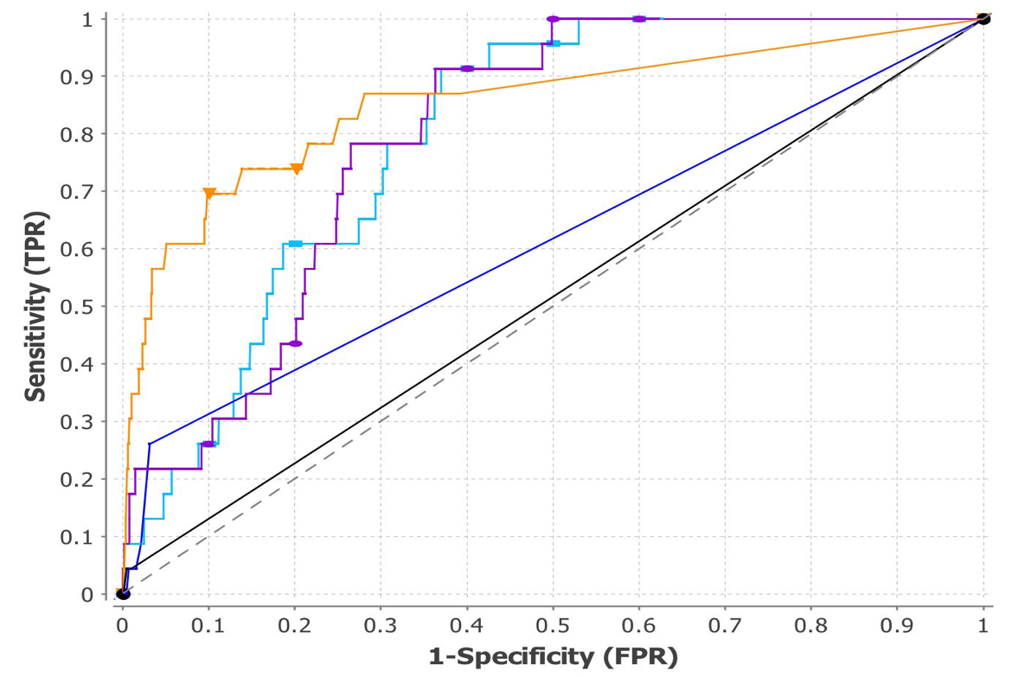
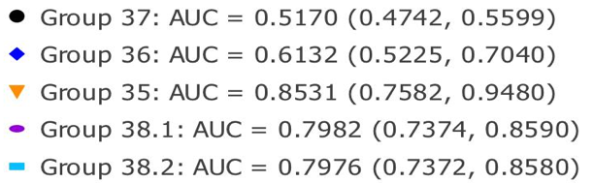
ROC AUC – Group 35 performed better
Notes:
The numbers are generated by the AUC package. If we need to format them to 2 decimals, I will process the image itself.
Binghuang Understand I think what they are trying to convey but need major editing to be included.

Slide 16
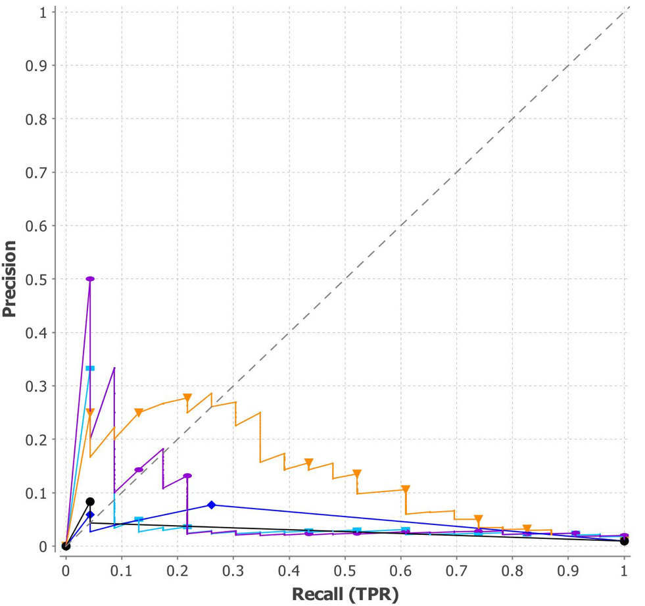
Binghuang
Notes:
Binghuang

Slide 17
Correct prediction run through
Person to Profile | Group 35 | Group 36 | Group 37 | Group 38.1 | Group 38.2
Non-zero 23 | 20 | 6 | 1 | 23 | 23
Number in Top 50 of 2323 | 8 | 2 | 1 | 5 | 2
Number of Matches as Top Probability | 5 | 1 | 1 | 3 | 3
Notes:
Average ranking* see later slide on exploring averages

Slide 18
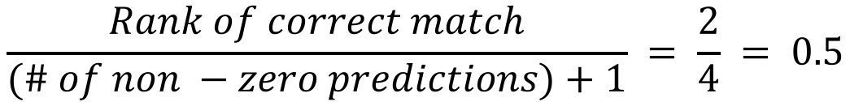
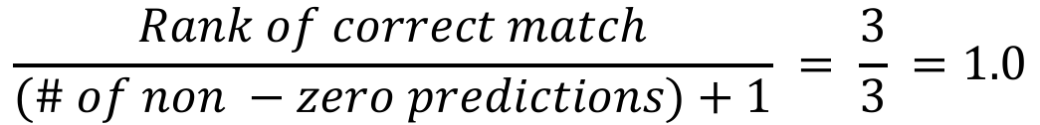
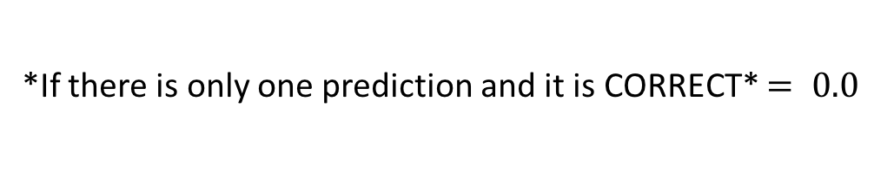
Calculating normalized rank EXAMPLES
Match Status | Genome 1
Correct Match | 0.1
False Match | 0.0
False Match | 0.0
*If there is only one prediction and it is CORRECT* $= 0.0$
Match Status | Genome 2
False Match | 0.5
Correct Match | 0.4
False Match | 0.1
False Match | 0.0
False Match | 0.0
$$\frac{Rank of correct match}{(\# of non −zero predictions)+1} = \frac{2}{4} = 0.5$$
Match Status | Genome 3
False Match | 0.5
False Match | 0.4
Correct Match | 0.0
False Match | 0.0
$$\frac{Rank of correct match}{(\# of non −zero predictions)+1} = \frac{3}{3} =1.0$$
Notes:
*Only occurs once all five submissions on one of the genomes in Group 37

Slide 19
Group 35 – lowest average normalized rank
Average ranking of the TRUE MATCH for each of 23 genomes in each submission
Recall earlier examples: rank ranges from 0 to 1
 | Group 35 | Group 36 | Group 37 | Group 38.1 | Group 38.2
Average Normalized Rank | 0.321 | 0.857 | 0.957 | 0.352 | 0.345
Score | 1 | 4 | 5 | 3 | 2
Notes:
*This slide needs to be corrected to have the correct calculation picture

Slide 20
BEST PREDICTED PARTICIPANT
 | Group 35 | Group 36 | Group 37 | Group 38.1 | Group 38.2 | Average Participant Normalized Rank
Participant 1 | 0.309 | 1.000 | 1.000 | 0.411 | 0.162 | 0.576
Participant 2 | 0.018 | 1.000 | 1.000 | 0.892 | 0.486 | 0.679
Participant 3 | 0.109 | 1.000 | 1.000 | 0.135 | 0.257 | 0.500
Participant 4 | 0.073 | 1.000 | 1.000 | 0.257 | 0.824 | 0.631
Participant 5 | 0.185 | 1.000 | 1.000 | 0.097 | 0.387 | 0.534
Participant 6 | 0.036 | 1.000 | 1.000 | 0.125 | 0.031 | 0.438
Participant 7 | 0.054 | 1.000 | 1.000 | 0.013 | 0.267 | 0.467
Participant 8 | 0.073 | 1.000 | 1.000 | 0.247 | 0.108 | 0.485
Participant 9 | 0.018 | 1.000 | 1.000 | 0.192 | 0.189 | 0.480
Participant 10 | 1.000 | 1.000 | 1.000 | 0.014 | 0.257 | 0.654
Participant 11 | 0.109 | 0.333 | 1.000 | 0.356 | 0.446 | 0.449
Participant 12 | 0.327 | 0.571 | 1.000 | 0.297 | 0.014 | 0.442
Participant 13 | 0.375 | 0.333 | 1.000 | 0.446 | 0.216 | 0.474
Participant 14 | 0.107 | 0.143 | 0.000 | 0.065 | 0.063 | 0.075
Participant 15 | 0.018 | 1.000 | 1.000 | 0.627 | 0.267 | 0.582
Participant 16 | 1.000 | 1.000 | 1.000 | 0.577 | 0.806 | 0.877
Participant 17 | 0.037 | 1.000 | 1.000 | 0.710 | 0.452 | 0.640
Participant 18 | 0.089 | 1.000 | 1.000 | 0.480 | 0.373 | 0.589
Participant 19 | 1.000 | 1.000 | 1.000 | 0.157 | 0.611 | 0.754
Participant 20 | 0.673 | 1.000 | 1.000 | 0.662 | 0.041 | 0.675
Participant 21 | 1.000 | 1.000 | 1.000 | 0.662 | 0.635 | 0.859
Participant 22 | 0.750 | 1.000 | 1.000 | 0.219 | 0.452 | 0.684
Participant 23 | 0.018 | 0.333 | 1.000 | 0.459 | 0.581 | 0.478
Average Normalized Rank for Submission | 0.321 | 0.857 | 0.957 | 0.352 | 0.345 | 0.566
Score | 1 | 4 | 5 | 3 | 2
Notes:
Denotes the only participant match that all teams ranked as the highest probability for that participant

Slide 21
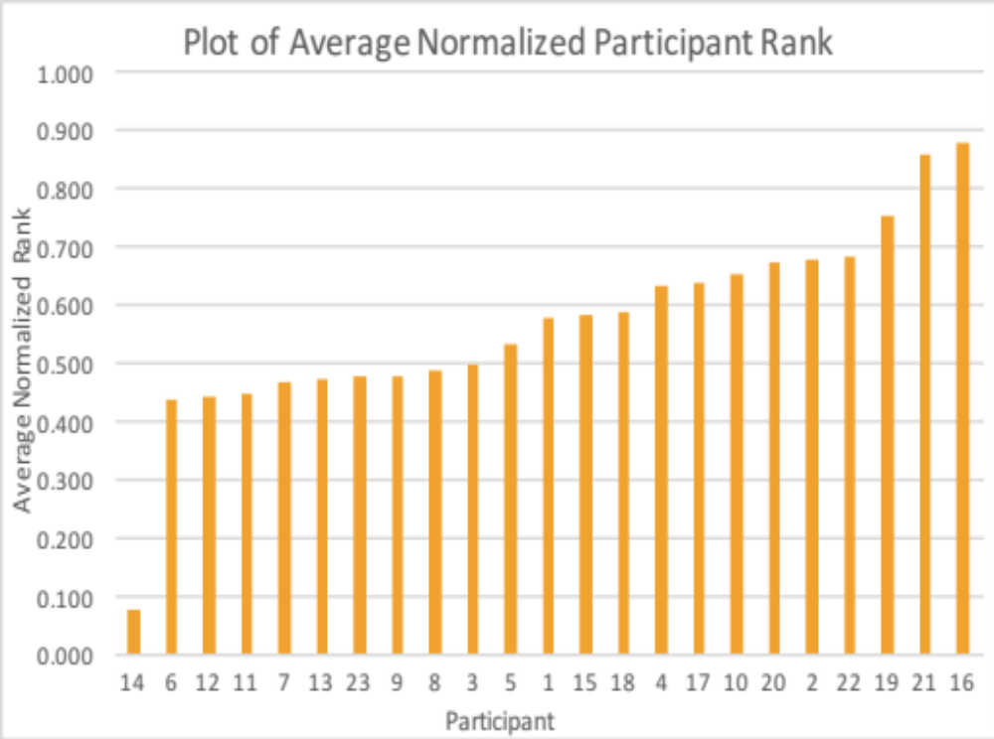
How the participant predictions compare
Best predicted participant
  Participant 14*
Worst predicted participants
  Participant 16
  Participant 21
Notes:
Denotes the only participant match that all teams ranked as the highest probability for that participant

Slide 22
Participant info. ranked by submissions
Normalized Ranking | Profile | Blood type | Left eye | Maternal grandmother | Paternal grandmother | Paternal grandfather | Maternal grandfather | Age | Sex/Gender | Race/Ethnicity
1 | 14 | AB + | light brown | Italy | Russian Federation | Poland | Italy | 50-59 years | Female | White
2 | 6 | N/A | N/A | United Kingdom | Germany | Ireland | United Kingdom | 30-39 years | Male | White
3 | 12 | N/A | N/A | Netherlands | United States | United States | Netherlands | 1992 | Male | White
4 | 7 | B + | hazel | United States | Other | Germany | United States | 1947 | Female | White
5 | 9 | A + | blue | Germany | Germany | Germany | Germany | 40-49 years | Male | White
6 | 11 | A + | aqua | United States | United States | United States | United States | 1991 | Neutrois | White
7 | 8 | N/A | N/A | United States | Turkey | Turkey | United States | 1967 | Male | White
8 | 23 | N/A | N/A | Viet Nam | Viet Nam | Viet Nam | Viet Nam | 1982 | Male | Asian
9 | 13 | N/A | N/A | China | China | China | China | 1975 | Male | Asian
10 | 3 | O + | N/A | United States | United States | United States | United States | 40-49 years | Male | White
11 | 5 | A + | Blue | United States | United States | Ireland | United States | 1948 | Male | White
12 | 1 | N/A | N/A | United States | United States | Canada | United States | 21-29 years | Male | White
13 | 15 | O + | brown | United States | United States | United States | United States | 30-39 years | Female | White
14 | 18 | N/A | N/A | United States | France | France | United States | 1974 | Female | White
15 | 4 | N/A | N/A | Canada | United States | United States | United States | 1983 | Male | White
16 | 17 | N/A | N/A | Peru | Peru | Peru | Peru | 1989 | Male | Hispanic or Latino
17 | 10 | O + | dark brown | United States | Puerto Rico | Puerto Rico | United States | 1988 | Male | Hispanic or Latino, White
18 | 20 | N/A | N/A | United States | United States | United States | United States | 21-29 years | Male | White
19 | 2 | N/A | N/A | China | China | China | China | 1988 | Male | Asian
20 | 22 | N/A | N/A | United States | United States | Canada | United States | 21-29 years | Male | White
21 | 19 | N/A | N/A | United States | United States | United States | United States | 1951 | Male | White
22 | 21 | N/A | N/A | United States | United States | Other | Other | 1981 | Male | American Indian / Alaska Native, White
23 | 16 | A - | blue | United States | Denmark | Denmark | Canada | 50-59 years | Male | American Indian / Alaska Native, White

Slide 23
Simulation procedure:
  Generate 100,000 random results based on randomized permutation of submission
  Calculate p-values
  Calculate the AUCs of the randomized results
  Calculate the distance of submission's AUC from the average AUCs of simulative results
Hypothesis: Submission is no different from random

Slide 24
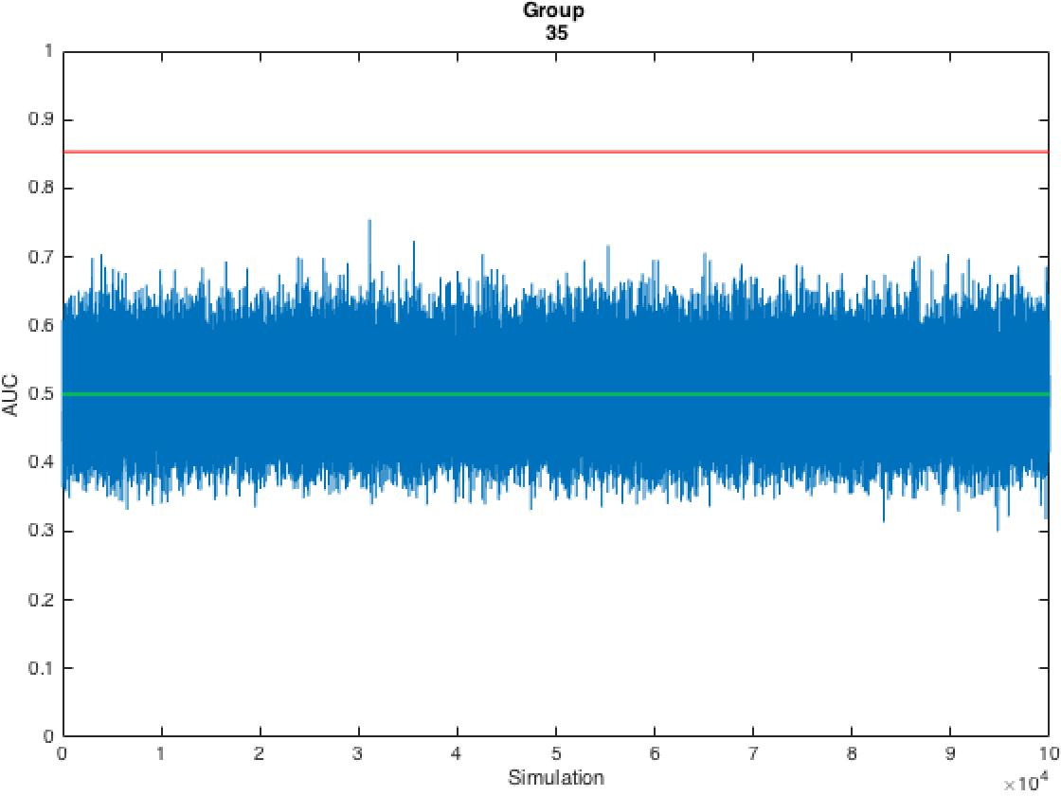
AUC of Group 35
Submission AUC
Average AUC of Simulations

Slide 25
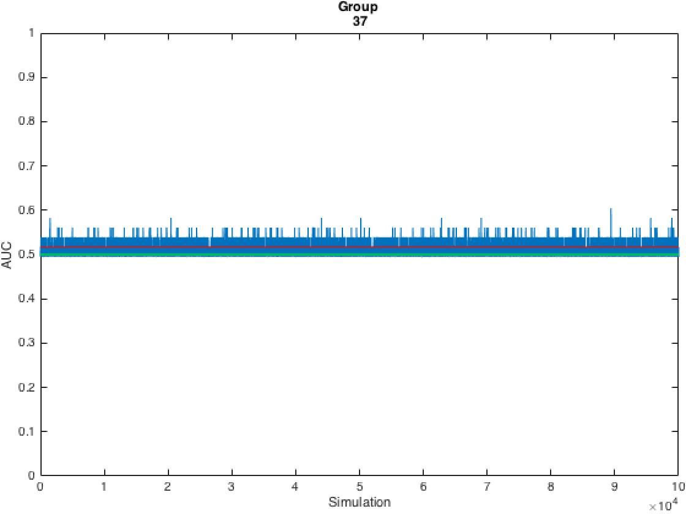
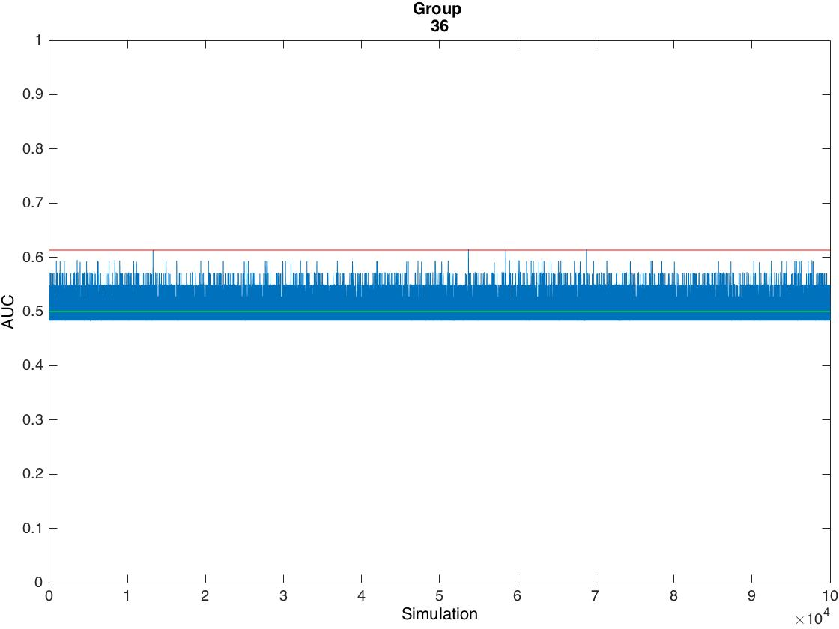
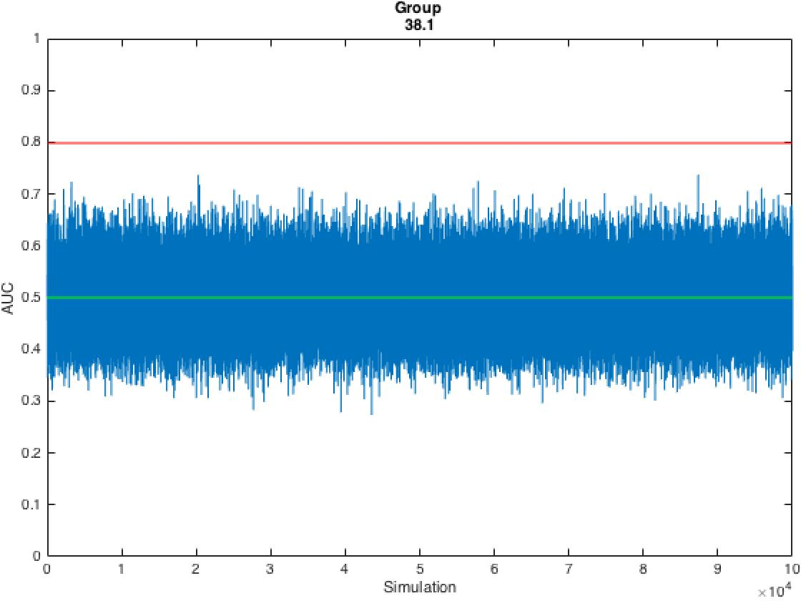
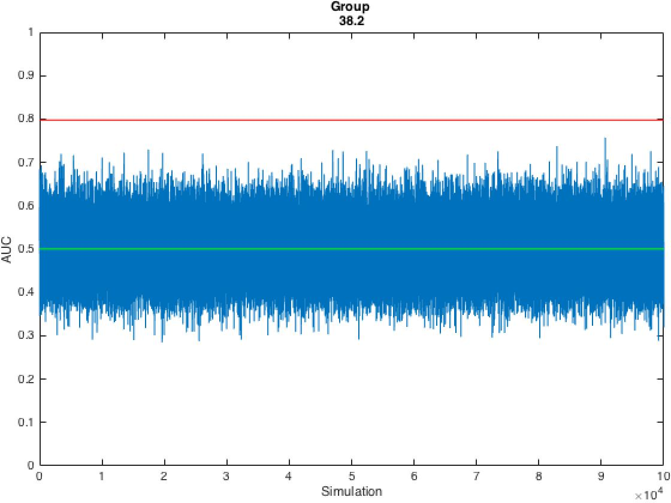
Differences in AUC

Slide 26
Differences in AUC
 | Group 35 | Group 36 | Group 37 | Group 38.1 | Group 38.2
AUC Distance | 0.3534 | 0.1134 | 0.0170 | 0.2981 | 0.2971
P-value | < 1.0 x 10⁻⁵ | 0.0001 | 0.0387 | < 1.0 x 10⁻⁵ | < 1.0 x 10⁻⁵
Score | 1 | 4 | 5 | 2 | 3
Distance of submission's AUC from the average AUCs of 100,000 simulative results generated based on same normal distribution
P-values: the number of random results with bigger AUCs, dividing by the number of simulations.

Slide 27
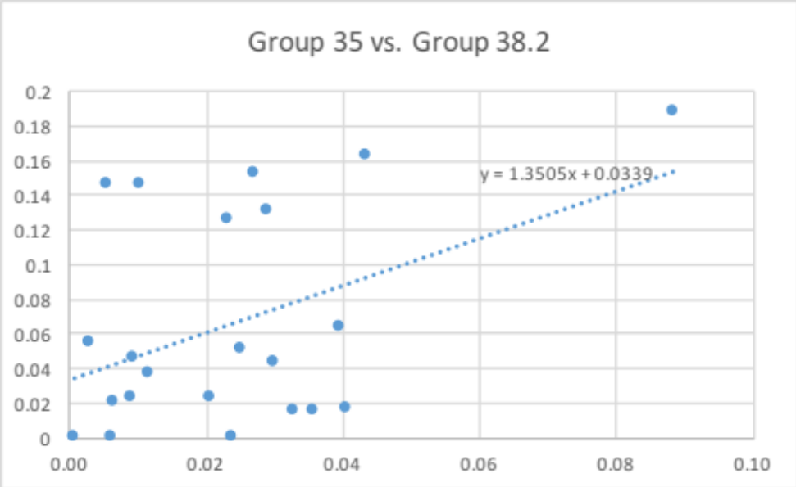
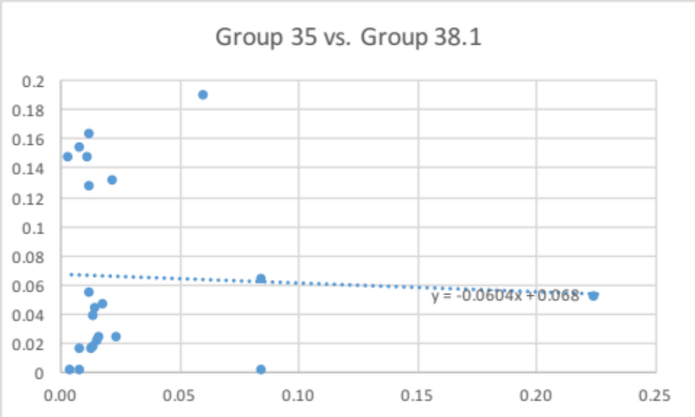
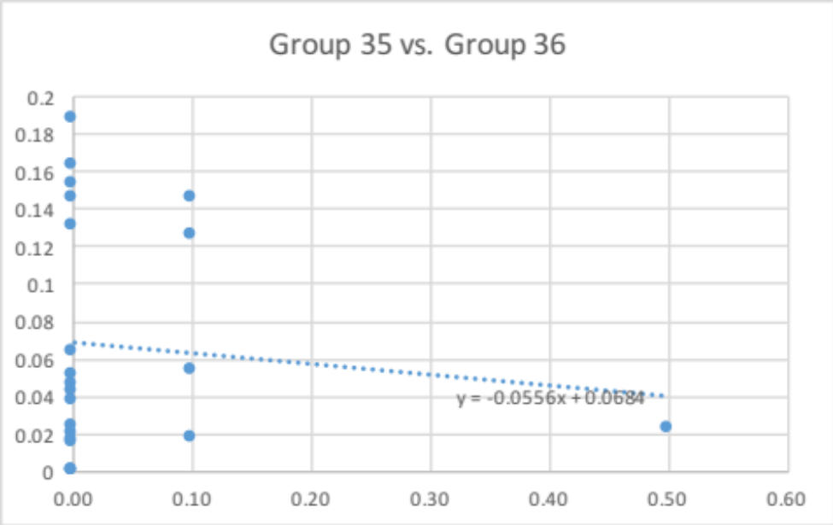
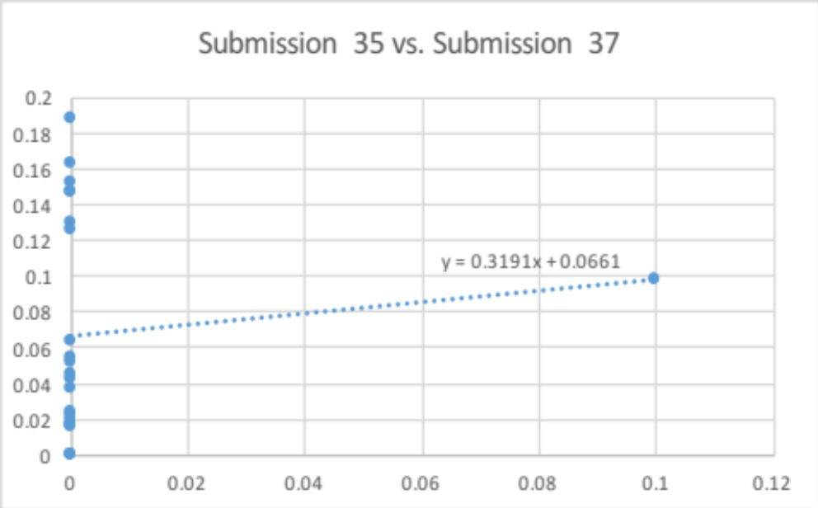
Correlation plots of each submission
*Does not include submission for Participant 14
*Does not include submission for Participant 14
*Does not include submission for Participant 14
*Includes submission for Participant 14

Slide 28
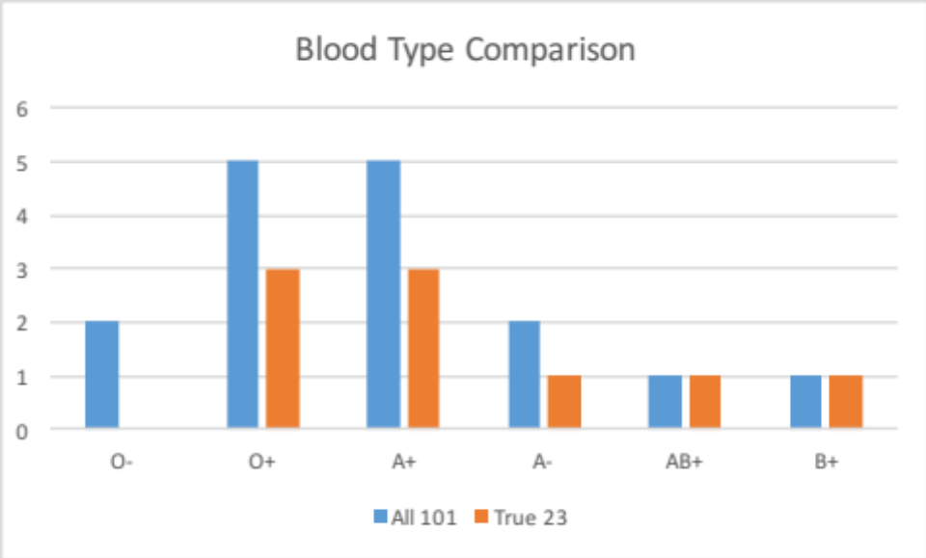
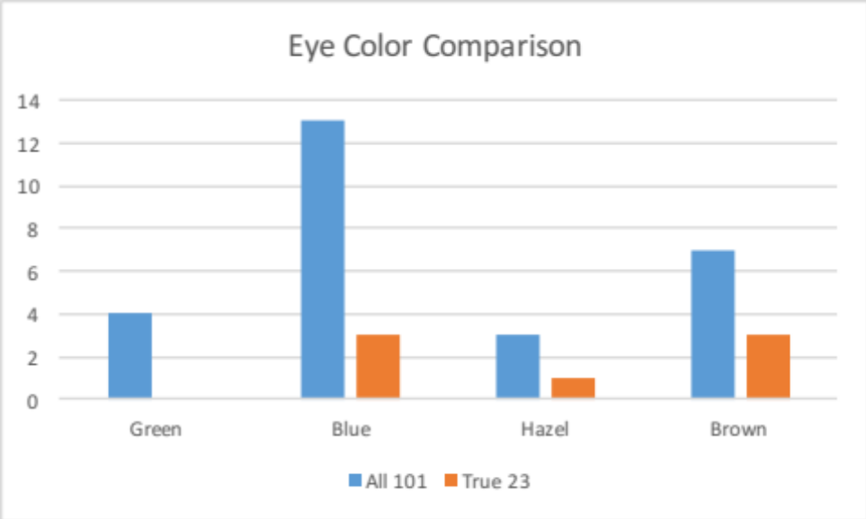
Characteristics distribution
A fair amount of N/A values for blood type and eye color…
Of 29 females, 5 have known blood types, and only one AB+ (Participant 14) and one B+ (Participant 7 – the 4th highest predicted participant)
Participant 6 (2nd highest) is a White Male with unknown eye color, blood type, and self-identified as having very few conditions
Notes:
BLOOD TYPE PREVALENCE IN US: AB+ 3% of people, A- in 6%, B+ in 9% → so makes sense that AB+ (1st highest predicted) and B+ (4th highest) predicted on normalized rank average basis
*Percentages from American Red Cross
Participant 6 is 30-39 years old and has self-identified as having Rheumatoid arthritis – possible people are predicting off of this?

Slide 29
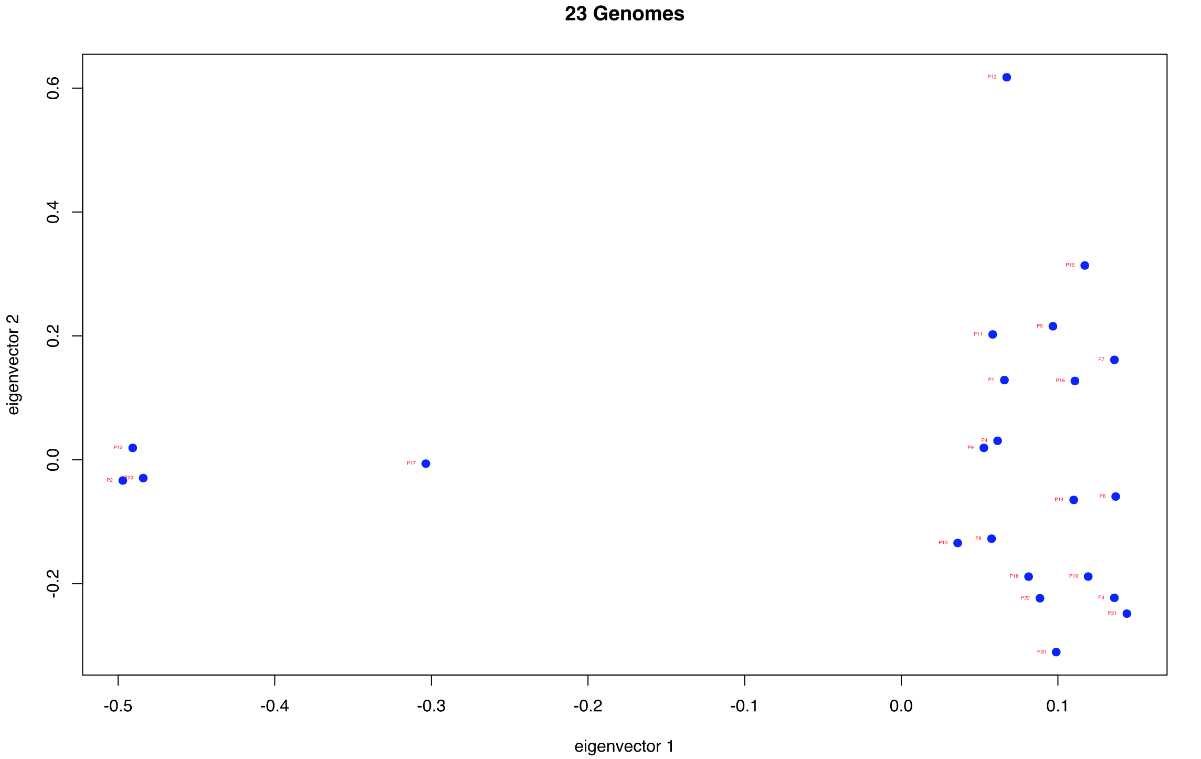
Ancestry – could be used for predictions?
Three self-identified full Asian participants
Only S.I. full Hispanic / Latino participant
S.I. Hispanic / Latino / White participant
Notes:
*IMPORTANT TO NOTE* Group 37 PREDICTED a value of 1.0 for the Participant 16 genome to match the profile (hu3C8DE9) (Which is really the Participant 21 match)– it seems that they mixed up the two Native American participants (16 and 21 both self-identify as Native American)
In 23: there are only 3 Asians, in 101: there are 7
In 23: only 1 full Hispanic / Latino, in 101: also only 1
In 23: only 1 Hispanic / Latino / White, in 101: there are 4

Slide 30
Ancestry
Worst predicted participants (self-identified as Native American)
Notes:
In 23: there are only 3 Asians, in 101: there are 7
In 23: only 1 full Hispanic / Latino, in 101: also only 1
In 23: only 1 Hispanic / Latino / White, in 101: there are 4

Slide 31
Summary – Ranking
 | Group 35 | Group 36 | Group 37 | Group 38.1 | Group 38.2
AUC | 1 | 4 | 5 | 2 | 3
Number of Matches in Top 23 | 1 | 4 | 4 | 3 | 2
Number of Matches as Top Probability | 1 | 3 | 3 | 2 | 2
Average Normalized Ranking | 1 | 4 | 5 | 3 | 2
Sum of Probabilities for True Match | 1 | 5 | 3 | 2 | 4
Sum of Probabilities for False Match | 2 | 4 | 1 | 3 | 5
Average Ranking for True Matches in 2323 | 1 | 4 | 5 | 2 | 3
Average Ranking of Correct Profile in 101 | 1 | 4 | 5 | 3 | 2
AUC Distance from Simulative Results | 1 | 4 | 5 | 2 | 3
Overall Score | 10 | 36 | 36 | 22 | 26
Overall Placement | 1 | 5 | 4 | 2 | 3

Slide 32


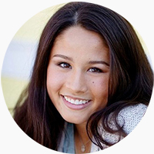
Acknowledgements
Sean D. Mooney
Binghuang Cai
Nikki Kiga

