Slide 1

CAGI slide pack guidelines
I agree to my slides being used according to the following terms: _______Steven E. Brenner_______
Authors: please include THIS slide at the beginning of your presentation to indicate that you agree with reuse of your slides in CAGI presentations, according to the terms below, and digitally sign by writing your name above.
To disseminate the CAGI results, I encourage all CAGI participants to remix these CAGI slides for inclusion in their oral and poster presentations
CAGI participants may use or publish any content of these slides only in compliance with the CAGI Data Use Agreement
CAGI participants may not cite or publish any content of these slides except with the written permission of the originating author or in the primary CAGI publications
CAGI participants must acknowledge the original authors of these slides and CAGI 2013. Include the acknowledgement banner across the bottom
CAGI participants must include the CAGI credits slide in their presentations
Slides with a red slash (no remix) may not be included in a presentation unless all attendees are registered CAGI participants who signed the data use agreement
Slides with a red X over the entire slide may not be used in any circumstances
Slides with a blue slash (embargoed) may not be used unless the embargo is explicitly lifted
Slides without slash or X may be tweeted unless flagged with the “No tweet” icon.
CAGI participants using these slides must explain the “No tweet” icon, which means that the slide content should not be disseminated outside the presenting conference hall. If the presentation venue permits pervasive tweeting, you may not include these slides in your talk
Note for slide authors: we expect all CAGI participants to abide by these restrictions, and will make best effort to ensure they are followed. However, but bear in mind that we have limited means of enforcing them, and therefore the restrictions cannot be guaranteed.

Slide 2
CAGI 4
The Fourth
International Conference
Critical Assessment of Genome Interpretation
Conference
25 – 27 July 2016
Byers Auditorium
Genentech Hall
UCSF Mission Bay
San Francisco, CA
USA

Slide 3
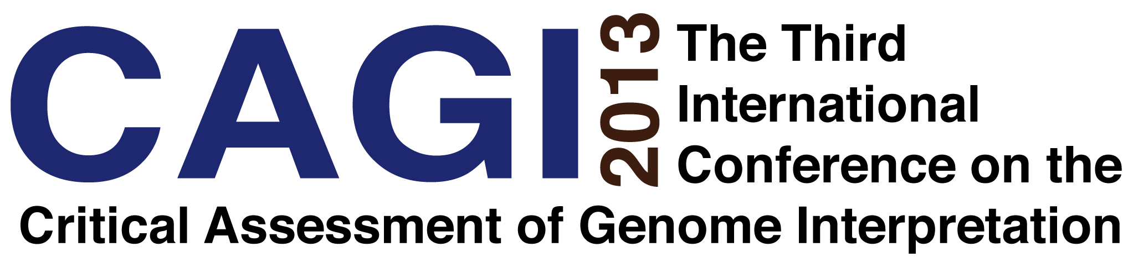
17 – 18 July 2013
Max Planck Institute for Molecular Genetics
Berlin, Germany

Slide 4
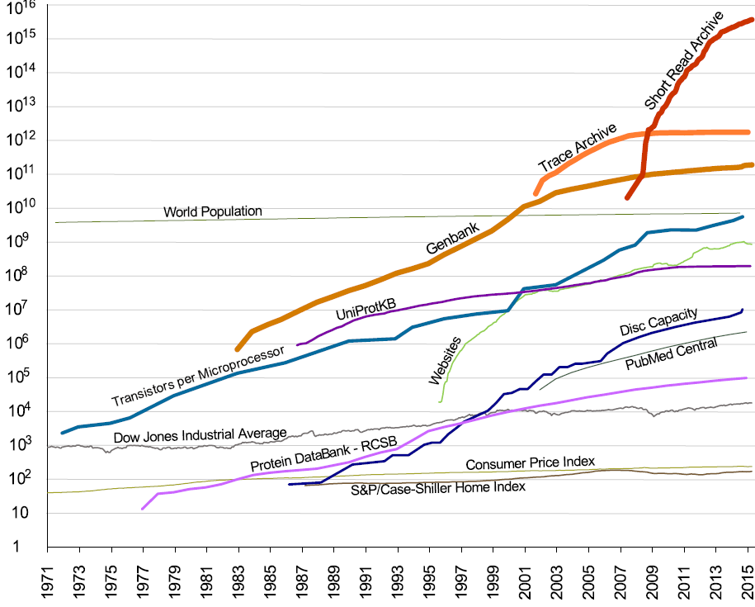
No remix
People, Nucleotides, Residues, Transistors, Mb, Papers, $, etc.
Logarithmic Scale
Year

Slide 5
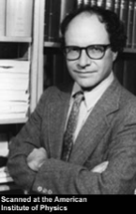
No remix
10¹⁹ bp
Year 2040
People, Nucleotides, Residues, Transistors, Mb, Papers, $, etc.
Logarithmic Scale
Year

Slide 6
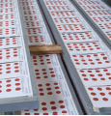
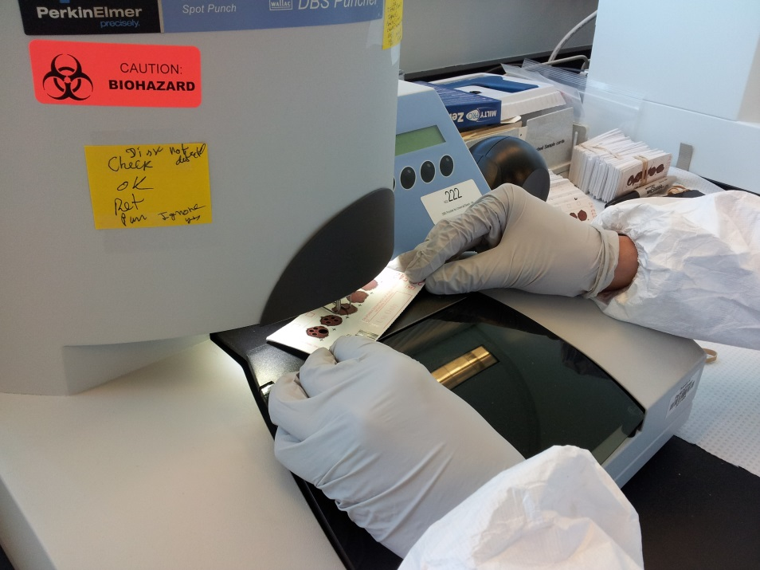
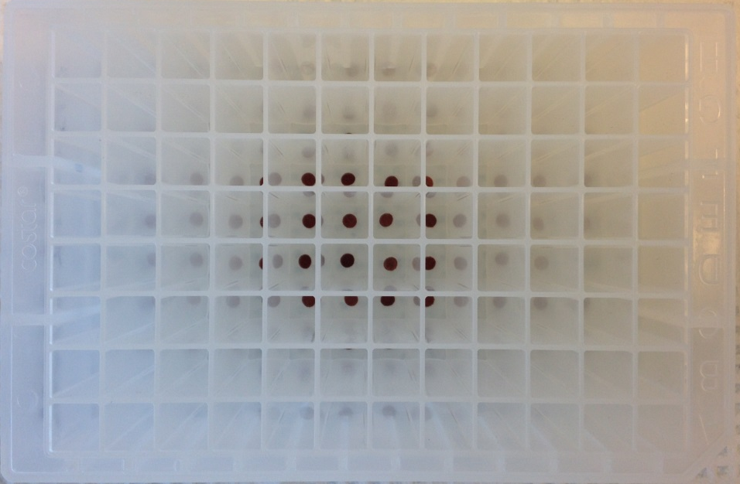

No remix
Carol Fraser-Browne

Slide 7
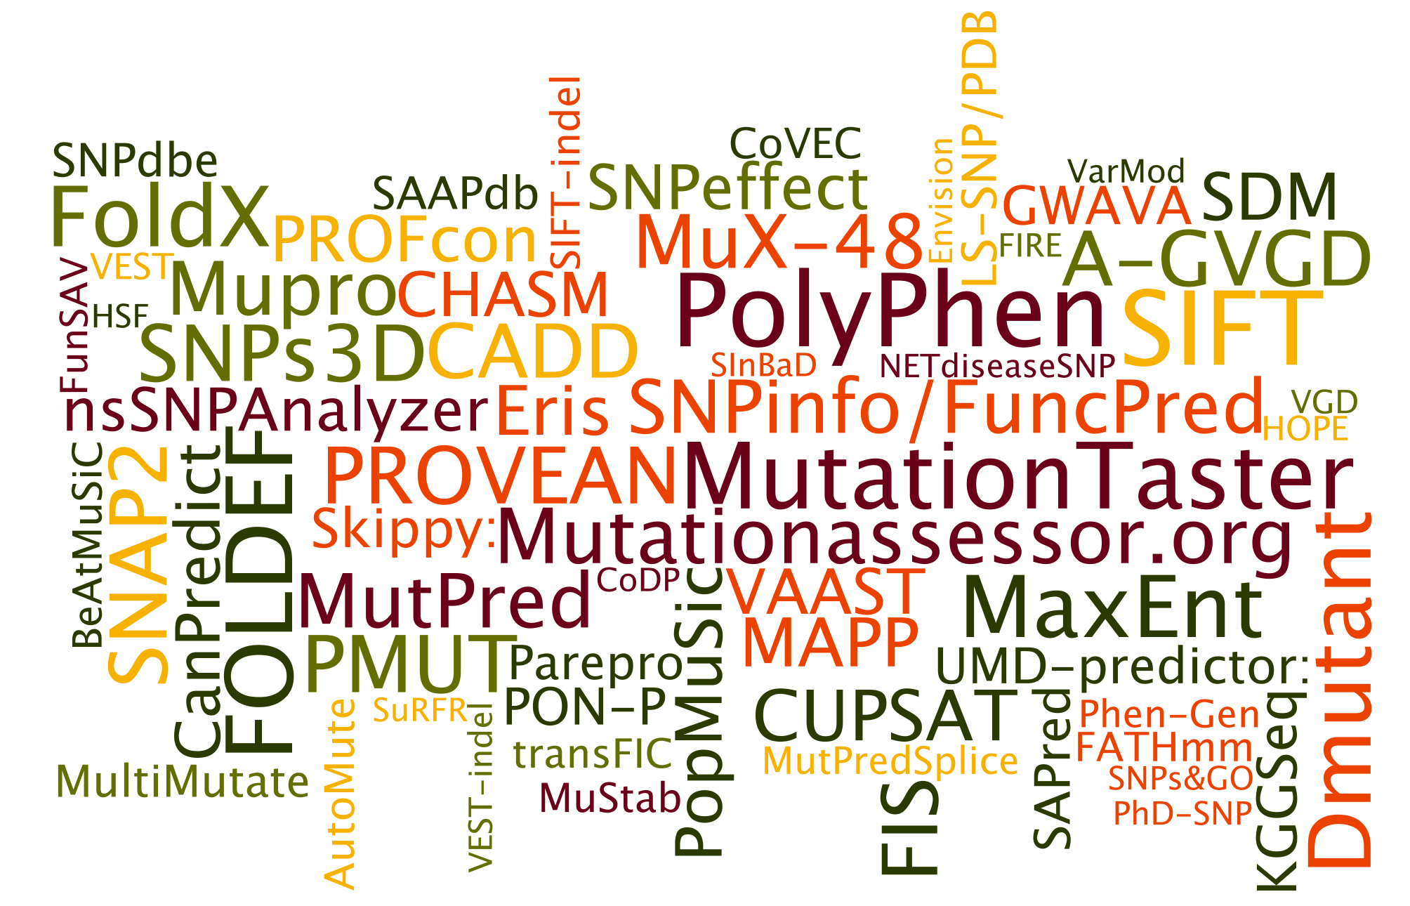
Some variant effect prediction methods
Created for CAGI 4
genomeinterpretation.org
Steven E. Brenner

Slide 8
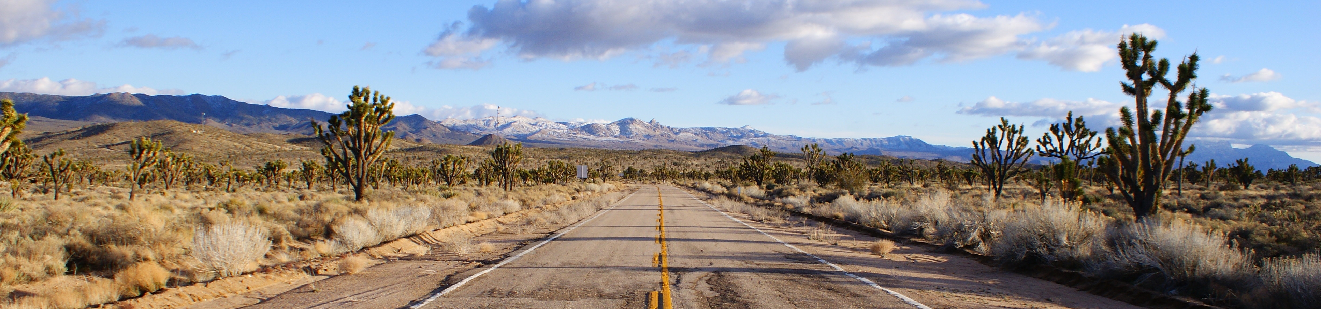
Goals of the CAGI experiment
Determine the state of the art
Identify progress and innovations
Reveal bottlenecks and guide future effort
Highlight new challenges
Collaboratively develop new approaches
Created for CAGI 4
genomeinterpretation.org
Steven E. Brenner
Notes:
8

Slide 9
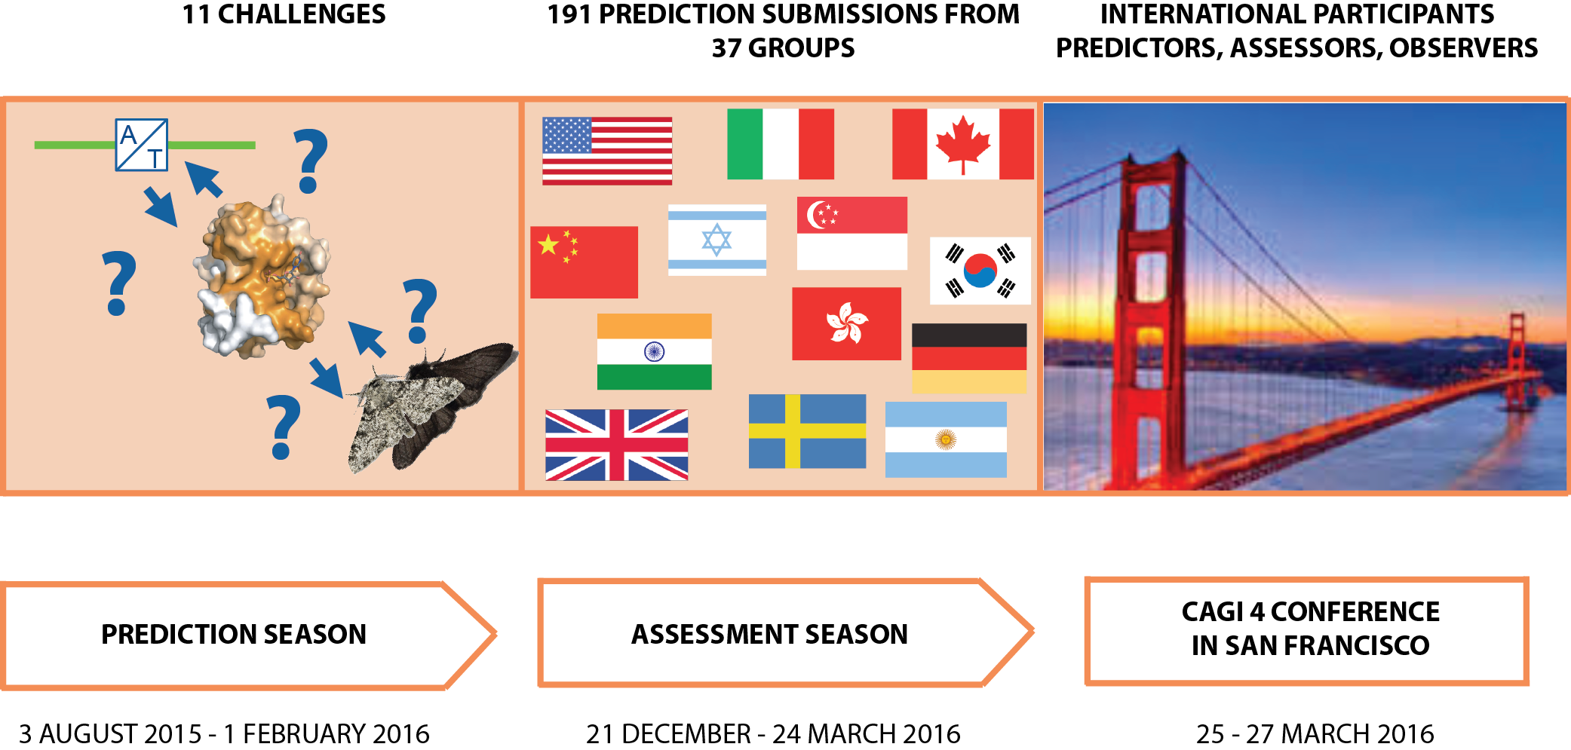
CAGI 4 Stages
Created for CAGI 4
genomeinterpretation.org
Steven E. Brenner

Slide 10
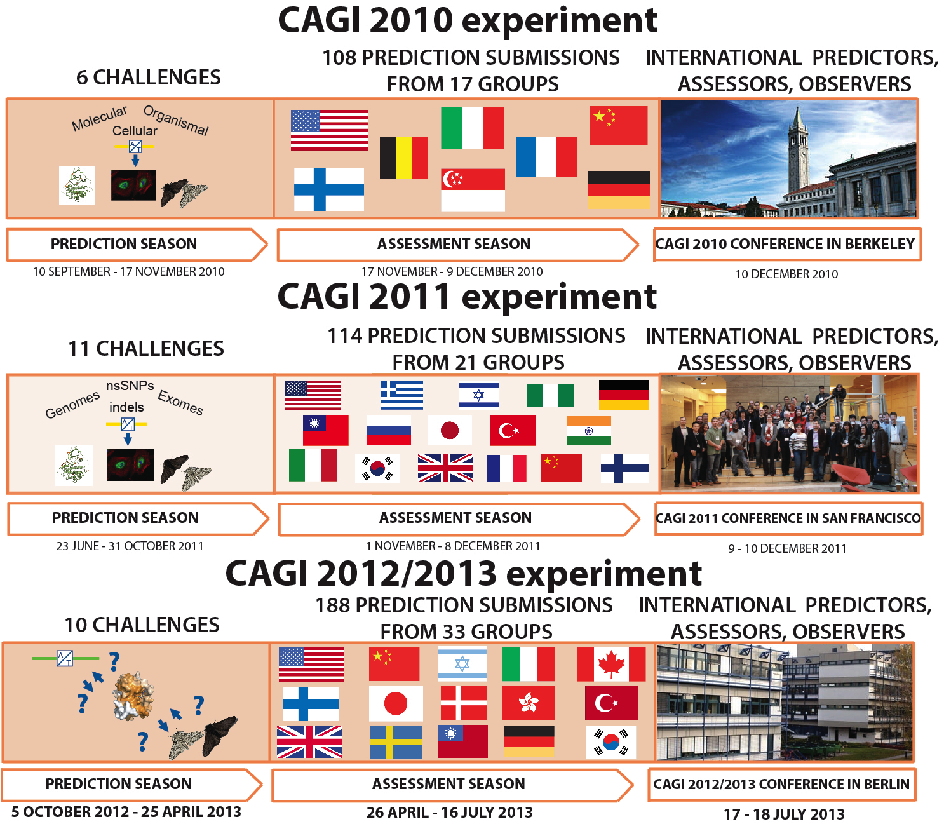

Slide 11
Submissions for CAGI 4
2010: 108 total submissions from 17 groups
2011: 114 total submissions from 21 groups
2013: 188 total submissions from 33 groups
CAGI 4: 174 total submissions from 38 groups
2010: 8 countries
2011: 16 countries
2013: 15 countries
CAGI 4: 13 countries
USA, Argentina, Australia ,Canada, China, Germany, Hong Kong, Israel, Italy, Japan, South Korea, Sweden, United Kingdom
(Lost Finland, Norway, Taiwan, Turkey)
2011: 72 members of groups that submitted
2013: 82 members of groups that submitted
CAGI 4: 101 members of groups that submitted
2010: ~60 registered to website
2011: ~160 registered to website
2013: 424 registered users
CAGI 4: 662 registered users
Notes:
2011:
117 total submissions
7 countries
USA, Italy, Israel, South Korea,
Belgium, Turkey, Finland
56 named predictors

Slide 12
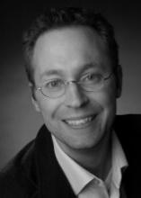
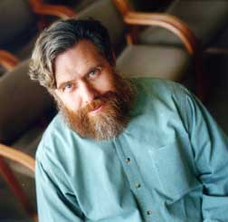
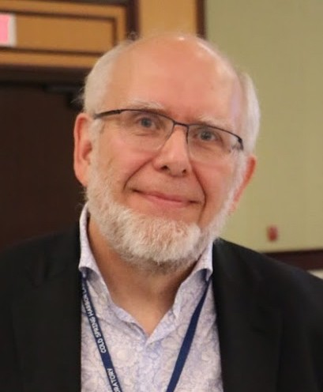
CAGI 4 Challenges
Crohn’s exomes. Distinguish between Crohn's disease patients and healthy individuals, and predict age of disease onset in a sample of 111 exomes.
Data provided by: Andre Franke, Christian-Albrechts-Universität zu Kiel
Warfarin exomes. Estimate patients’ therapeutic warfarin doses from their exomes.
Data provided by: Russ Altman, Stanford University
PGP. Match the genomes of 21 consenting Personal Genome Project participants to their respective phenotypic profiles from a set of 239 binary traits and 71 “decoys”.
Data provided by: George Church, Harvard University
NAGLU variants. Predict the effect of naturally occurring missense mutations in N-acetyl-glucosaminidase on cellular enzymatic activity.
Data provided by: Jon LeBowtiz, Biomarin Pharmaceuticals
SUMO ligase variants. Predict the effects of missense mutations in human SUMO ligase (UBE2l) on competitive growth in a high-throughput yeast complementation assay.
Data provided by: Frederick "Fritz" Roth, University of Toronto
NPM-ALK variants. Predict the effect of mutations in the kinase domain of the Nucleophosmin - Anaplastic Lymphoma Kinase fusion protein on kinase activity and Hsp90 binding affinity.
Data provided by: Paolo Bonvini, Padua Children's Hospital
eQTL-causal SNPs. Identify regulatory sequences and eQTL-causal variants, and estimate their effects on activation of transcription in a massively parallel reporter assay. Data provided by: Pardis Sabeti, Broad Institute
Pyruvate kinase variants. Predict the effects of single-amino-acid mutations on enzyme activity, and allosteric activation and inhibition in cell extracts.
Data provided by: Aron Fenton, University of Kansas Medical Center
Bipolar exomes. From exomes, identify which individuals have BD and which individuals are unaffected. Data provided by: Peter Zandi and colleauges, Johns Hopkins University
Hopkins clinical gene panel. Match the patients’ gene panel sequences to their clinical descriptions and predict the causal pathogenic variants.
Data provided by: Garry Cutting, Johns Hopkins University
SickKids clinical genomes. Match the patients’ exomes to their clinical descriptions and predict the causal pathogenic variants.
Data provided by: Stephen Meyn & colleagues, SickKids

Slide 13
CAGI 4 Challenges
Challenge | CAGI 4 Groups | CAGI 4 Submissions | 2013 Groups | 2013 Submissions
Bipolar exomes | 10 | 29 | - | -
Crohn’s exomes | 14 | 46 | 13 | 58
eQTL-causal SNPs | 7 | 22 | - | -
Hopkins clinical panel | 5 | 16 | - | -
NAGLU | 10 | 18 | - | -
NPM-ALK | 4 | 4 | - | -
PGP | 4 | 5 | 9 | 22
Pyruvate kinase | 4 | 5 | - | -
SickKids genomes | 4 | 4 | - | -
SUMO ligase | 9 | 16 | - | -
Warfarin exomes | 3 | 9 | - | -
Created for CAGI 4
genomeinterpretation.org
Steven E. Brenner

Slide 14
CAGI 4 Predictors: Ogun Adebali, Talal Amin, Johnathan Roy Azaria, Giulia Babbi, Eraan Bachar, Minkyung Baek, Michael Beer, Rajendra Bhat, Rohit Bhattacharya, Samuele Bovo, Marcus Breese, Aharon S. Brodie, Yana Bromberg, Binghuang Cai, Colin Campbell, Marco Carraro, Rita Casadio, Billy Heung Wing Chang, Yun-Ching Chen, Pietro Di Lena, Christopher Douville, Ian Driver, Roland Dunbrack, Matthew Edwards, Gokcen Eraslan, Hai Fang, Lukas Folkman, Colby Tyler Ford, Yao Fu, Alessandra Gasparini, Tom Gaunt, Manuel Giollo, Valer Gotea, Julian Gough, Yuchun Guo, Marcia Hasenahuer, Lim Heo, Peter Huwe, Jules Jacobsen, Chan-Seok Jeong, Yuxiang Jiang, David Jones, Beomchang Kang, Rachel Karchin, Panagiotis Katsonis, Sunduz Keles, Nikki Kiga, Dongsup Kim, Andreas Kraemer, Kunal Kundu, Dae Lee, Gyu Rie Lee, Emanuela Leonardi, Biao Li, Yue Li, Olivier Lichtarge, Rhonald C. Lua, Pier Luigi Martelli, Aziz Mohammed Mezlini, Alexander Miguel Monzon, Sean Mooney, Matthew Mort, John Moult, Nikola Mueller, Noushin Niknafs, Abhishek Niroula, Conor M. L. Nodzak, Yanay Ofran, Kymberleigh Pagel, Taeyong Park, Vikas Pejaver, Aditya R. Rao, Lipika Ray, Chaok Seok, Sohela Shah, Ron Shigeta, Hashem A. Shihb, Sunyoung Shin, Nasa Sinnott-Armstrong, Ben Smithers, Mario Stanke, Laksshman Sundaram, Natalie Thurlby, Kevin Tian, Collin Tokheim, Silvio C. E. Tosatto, Ron S. Unger, Aneeta Uppal, Mauno Vihinen, Jouni Valiaho, Meng Wang, Yanran Wang, Maggie Wang, Liping Wei, Rene Welch, Qifang Xu, Yuedong Yang, Yizhou Yin, Jan Zaucha, Haoyang Zeng, Maya Zuhl
Created for CAGI 4
genomeinterpretation.org
Steven E. Brenner

Slide 15
CAGI 2013 CHALLENGES
Challenge | 2013 Groups | 2013 Submissions | 2011 Groups | 2011 Submissions
BRCA | 6 | 14 | - | -
Crohn’s Disease | 13 | 58 | 10 | 33
FCH | 11 | 21 | - | -
HA | 11 | 18 | - | -
MR-1 (Bacterial growth) | 0 | 0 | 0 | 0
MRN mutation pathogenicity | 12 | 22 | - | -
p16 variants | 9 | 22 | - | -
Personal genomes | 4 | 16 | 4 | 5
riskSNPs | 5 | 12 | 5 | 11
Splicing variants | 3 | 5 | - | -

Slide 16
CAGI 2013 CHALLENGES
Challenge | # Groups 2013/2011/2010 | # Submissions 2013/2011/2010
BRCA | 6 / - / - | 14 / - / -
Crohn’s Disease | 13 / 10 / - | 58 / 33 / -
FCH | 11 / - / - | 21 / - / -
HA | 11 / - / - | 18 / - / -
MR-1 (Bacterial growth) | 0 / 0 / - | 0 / 0 / -
MRN mutation pathogenicity | 12 / - / - | 22 / - / -
p16 variants | 9 /- / - | 22 / - / -
Personal genomes | 4 / 4 / 1 | 16 / 5 / 1
riskSNPs | 5 / 5 / 5 | 12 / 11 / 64
Splicing variants | 3 / - / - | 5 / - / -

Slide 17
CAGI 4 Participating Groups
BOGUS DATA
Group | Challenges | Subs
B (Capriotti) | 2 | 6
Biu (Unger) | 3 | 13
Bina | 1 | 2
Bologna Biocomputing | 7 | 8
cbvar (Sanger) | 4 | 4
Cisbio (Yates) | 2 | 3
FoxChase (Dunbrack) | 2 | 2
Gough lab | 2 | 6
Independent (Brodie) | 1 | 1
ISB compbio | 2 | 2
Jones-UCL | 8 | 21
Karchin lab | 1 | 1
Kwok lab | 1 | 2
Lichtarge lab | 6 | 11
LU bioinfo (Vihinen) | 3 | 12
METU-SNP | 1 | 1
MEW | 1 | 4
Group | Challenges | Subs
Mooney lab | 1 | 1
Mooney-Radivojac labs | 5 | 12
Moult lab | 5 | 12
MutationTaster2 | 1 | 1
Nelson lab | 1 | 6
NMTF_Disease | 1 | 2
NTUH_CC | 1 | 12
Qiagen (Kraemer) | 1 | 1
Rogan-Mucaki | 1 | 1
Seoul Natl University (Seok) | 1 | 2
SFSU (Piryatinska) | 1 | 1
SPARKS-LAB | 1 | 4
SplicePort | 1 | 1
TCS (Rao) | 1 | 1
Buck Institute (Li) | 1 | 4
UNCC (Ford) | 1 | 1
U of Toronto (Mezlini) | 1 | 6
ySNAP? (Bromberg Lab) | 5 | 16
Yol (Azaria) | 1 | 1
Anonymous group | 5 | 9

Slide 18
CAGI 2013 PARTICIPATING GROUPS
Group | Challenges | Subs
BioFolD (Capriotti) | 2 | 6
Biu (Unger) | 3 | 13
Bologna Biocomputing | 7 | 8
cbvar (Sanger) | 4 | 4
Cisbio (Yates) | 2 | 3
FoxChase (Dunbrack) | 2 | 2
Gough lab | 2 | 6
Ingenuity | 2 | 2
ISB compbio | 2 | 2
Junwen lab | 1 | 1
Karchin lab | 1 | 1
Kwok lab | 1 | 2
Lichtarge lab | 6 | 11
LU bioinfo (Vihinen) | 3 | 12
METU-SNP | 1 | 1
MEW | 1 | 4
Group | Challenges | Subs
Mooney lab | 1 | 1
Mooney-Radivojac labs | 5 | 12
Moult lab | 8 | 23
MutationTaster2 | 1 | 1
Nelson lab | 1 | 6
NMTF_Disease | 1 | 2
NTUH_CC | 1 | 12
Rogan-Mucaki | 1 | 1
SFSU (Piryatinska) | 1 | 1
SPARKS-LAB | 1 | 4
SplicePort | 1 | 1
Tokai | 2 | 2
UniPD | 4 | 17
ySNAP? (Bromberg Lab) | 5 | 16
Anonymous group 1 | 1 | 1
Anonymous group 2 | 6 | 11

Slide 19
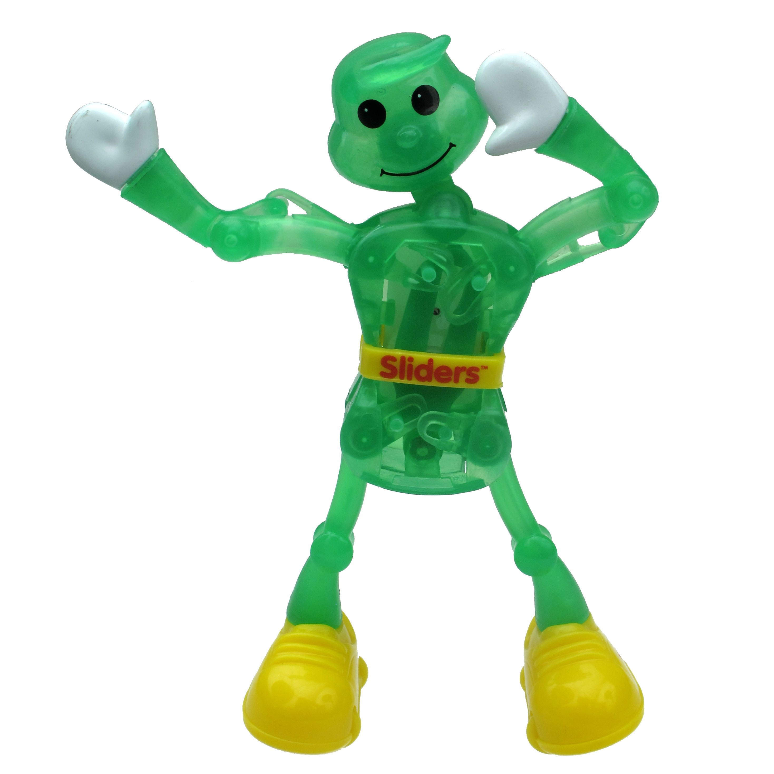
CAGI is your meeting
Data provider introductions
Assessor presentations
Predictor short talks
Poster sessions
Office hours
Unconference
Poster, coffee, reception, lunch in lobby
Discussion & what did we learn
CAGI Larry
Created for CAGI 4
genomeinterpretation.org
Steven E. Brenner

Slide 20
Dissemination and Embargo
Dissemination of CAGI results is essential, but…
Personally identifiable data is restricted according to dataset requirements permanently
All datasets remain embargoed until published or otherwise released by providers
Slides will be posted and unmarked slides can be remixed by CAGI participants
Unmarked slides can be tweeted #CAGI4 unless noted otherwise either by icon or by speaker
Created for CAGI 4
genomeinterpretation.org
Steven E. Brenner
Notes:
Embargo date?

Slide 21
CAGI slide pack guidelines
I agree to my slides being used according to the following terms: _______Author Name Here_______
Authors: please include THIS slide at the beginning of your presentation to indicate that you agree with reuse of your slides in CAGI presentations, according to the terms below, and digitally sign by writing your name above.
To disseminate the CAGI results, I encourage all CAGI participants to remix these CAGI slides for inclusion in their oral and poster presentations
CAGI participants may use or publish any content of these slides only in compliance with the CAGI Data Use Agreement
CAGI participants may not cite or publish any content of these slides except with the written permission of the originating author or in the primary CAGI publications
CAGI participants must acknowledge the original authors of these slides and CAGI 2013. Include the acknowledgement banner across the bottom
CAGI participants must include the CAGI credits slide in their presentations
Slides with a red slash (no remix) may not be included in a presentation unless all attendees are registered CAGI participants who signed the data use agreement
Slides with a red X over the entire slide may not be used in any circumstances
Slides with a blue slash (embargoed) may not be used unless the embargo is explicitly lifted
Slides without slash or X may be tweeted unless flagged with the “No tweet” icon.
CAGI participants using these slides must explain the “No tweet” icon, which means that the slide content should not be disseminated outside the presenting conference hall. If the presentation venue permits pervasive tweeting, you may not include these slides in your talk
Note for slide authors: we expect all CAGI participants to abide by these restrictions, and will make best effort to ensure they are followed. However, but bear in mind that we have limited means of enforcing them, and therefore the restrictions cannot be guaranteed.

Slide 22
Title
This slide can be remixed and used in oral and poster presentations by any CAGI participant, consistent with limitations on slide 1.
Created for CAGI 4
genomeinterpretation.org
An Author

Slide 23
Title
No Tweet
This slide can be remixed and used in oral and poster presentations by any CAGI participant, consistent with limitations on slide 1.
However, it is intended for participants of the conference hall only. Its content should not be tweeted, discussed, or otherwise shared outside of the conference hall
Do not use this slide in venues that give blanket permission for tweeting
Created for CAGI 4
genomeinterpretation.org
An Author

Slide 24
Title
Embargoed
Until embargoed data are released, this slide cannot be used except for viewing by registered CAGI participants
Created for CAGI 4
genomeinterpretation.org
An Author

Slide 25
Title
No remix
This slide cannot be used except for viewing by registered CAGI participants
Created for CAGI 4
genomeinterpretation.org
An Author

Slide 26
Title
CAGI meeting ONLY
This slide cannot be used outside of the CAGI meeting.
We do not anticipate many slides of this nature
Created for CAGI 4
genomeinterpretation.org
An Author

Slide 27
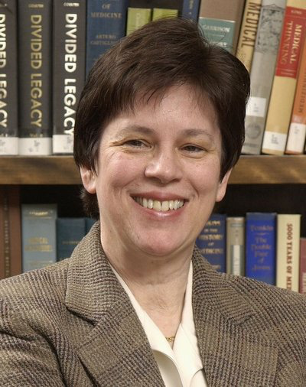
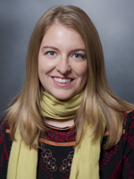
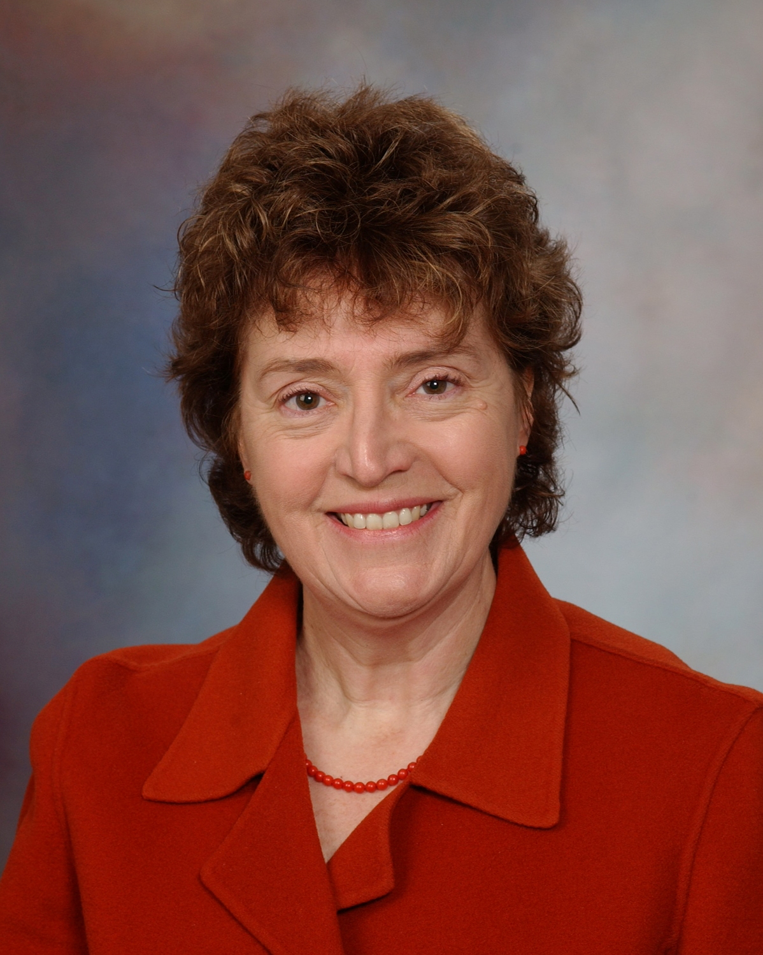
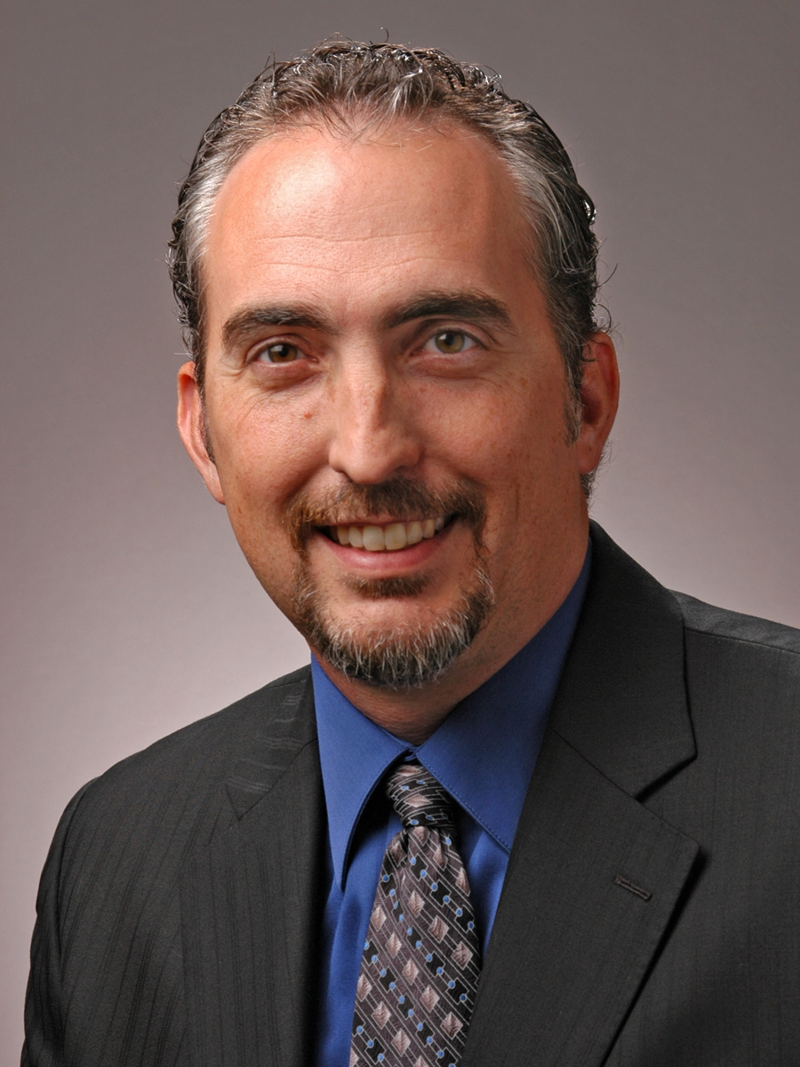
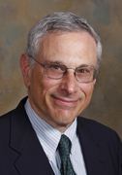
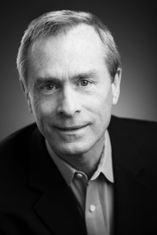
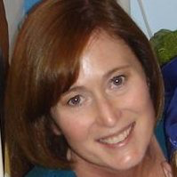
CAGI Ethics Forum
Wylie Burke, University of Washington
Julie N. Harris-Wai, Kaiser Permanente
Barbara A. Koenig, UC San Francisco
Mark Yarborough, UC Davis
Robert Nussbaum, Invitae, Inc.
Lay Disease Advocates
Mark Murray, Inflammatory Bowl Disease
Temre Phipps, Kabuki Syndrome
Created for CAGI 4
genomeinterpretation.org
Steven E. Brenner

Slide 28
Publication
Anyone can publish anywhere with data and results not under embargo.
Flagship targeted for Nature Methods
  all participants (banner authorship for most)
CAGI collection with Wiley for other papers, submission deadline of 30 June 2016
High profile papers for Human Mutation
  Challenge introduction & assessment
  New methods that performed well
General papers for Annals of Human Genetics
All papers free online (but pay for Open Access)
Preprints at bioRxiv and arXiv permitted
Created for CAGI 4
genomeinterpretation.org
Steven E. Brenner

Slide 29
Welcome to CAGI 4!

Slide 30
CAGI is not CASP
CAGI was built closely on the CASP model.
CAGI has stayed the same for four rounds.
Time to evolve.
Things to think about during the meeting.

Slide 31
CAGI 4 Challenges classes
4 Missense mutations/continuous impact scale
4 Exomes/PGP disease/phenotype
1 Non-coding (eQTL)
2 Clinical rare disease diagnosis

Slide 32
Better methods (we need them!)
Long running challenges with phased prediction/release.
Encourage and reward radially new methods (cf molecular dynamics in CASP).
Hands-on workshop sessions.
Methods sessions.

Slide 33
Reproducibility
Major emphasis at the NIH and in Europe.
Particularly for clinical use, essential to have fully automated and recorded methods.
Fast challenges (3 days) to encourage automation of methods.
Archive workflows.
Include tutorials - Teach-Discover-Treat model.

Slide 34
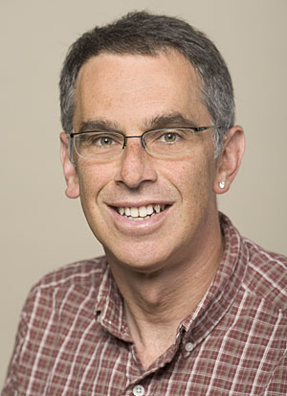
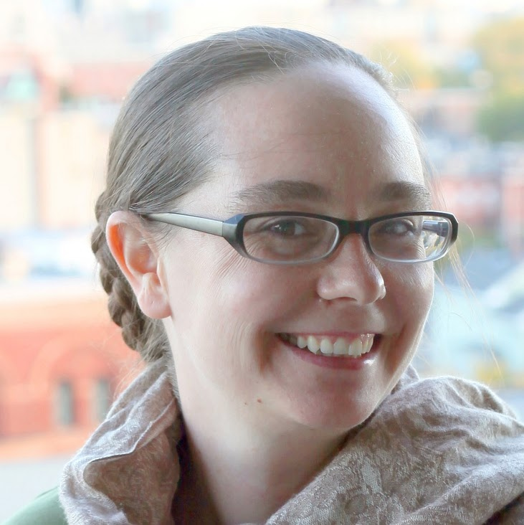
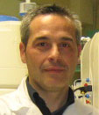
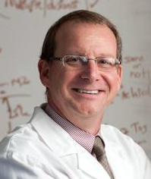
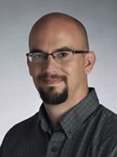
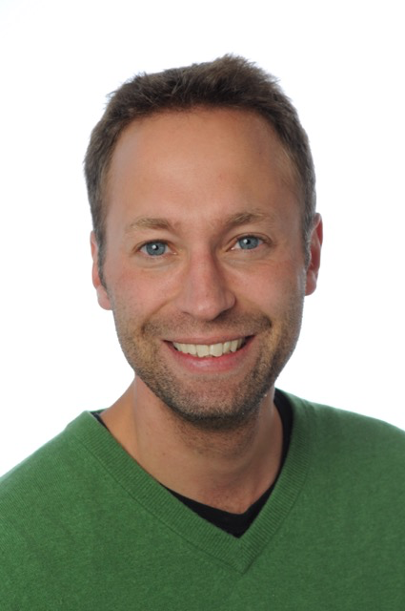
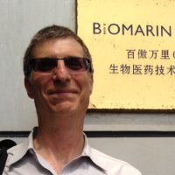
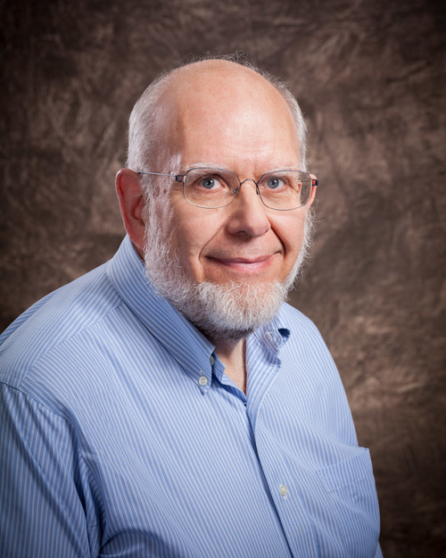
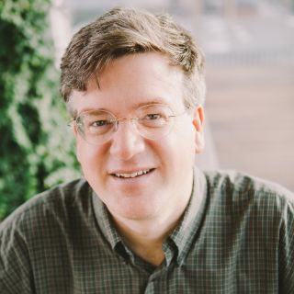
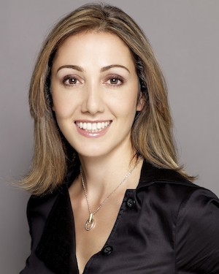
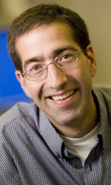
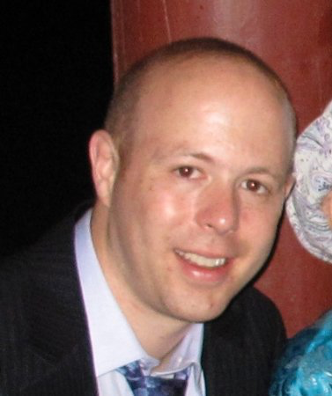
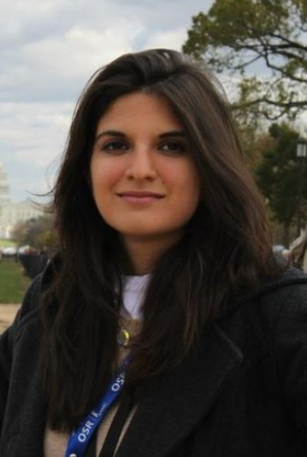
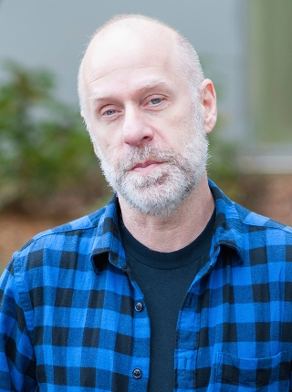
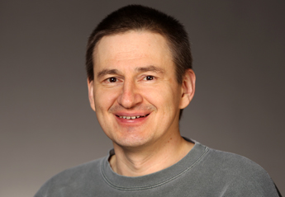
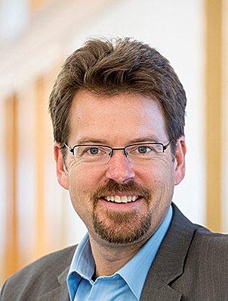
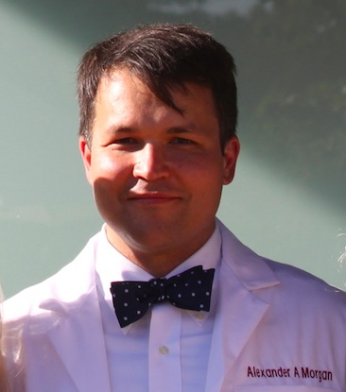
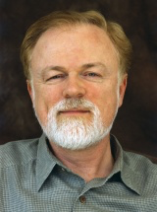
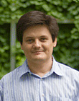
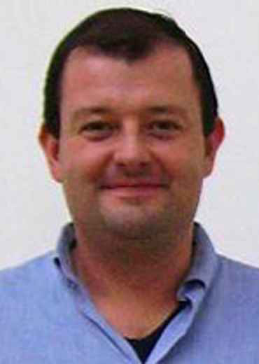
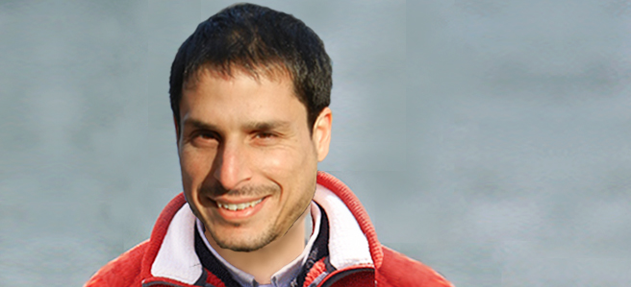
Data Providers
Russ Altman, Stanford University
Madeleine Price Ball, PGP & Harvard University
Paolo Bonvini, University of Padua
Gary Cutting, Johns Hopkins University
Aron Fenton, Kansas University
Andre Franke, Christian-Albrechts-University, Kiel
Jon LeBowitz, BioMarin Pharmaceuticals, Inc.
M. Stephen Meyn, The Hospital for Sick Children
Frederick Roth, University of Toronto
Pardis Sabeti, Broad Institute
Peter Zandi, Johns Hopkins University
Assessors
Wyatt Clark, BioMarin Pharmaceutical Inc.
Roxana Daneshjou, Stanford University
Roland Dunbrack, Fox Chase Cancer Center
Nick Grishin, University of Texas Southwestern
Stephen M. Meyn, Hospital for Sick Children
Sean Mooney, The University of Washington
Alexander Morgan, Stanford University
David B. Searls, retired
Shamil Sunyaev, Harvard University
Silvio Tosatto, University of Padua
Nir Yosef, UC Berkeley
David Searls
Notes:
PGP: Madeleine Price Ball, Jason Bobe, George Church, Tom Clegg, Ward Vandewege, Alexander Wait Zaranek
MR-1: Adam P. Arkin
BRCA1/2: Robert Nussbaum
Crohn’s: Andre Franke
MRN: Sean Tavtigian
FCH/HA: Angel C.Y. Mak, Nina Gonzaludo, Paul L. F. Tang, John P. Kane, Pui-Yan Kwok, Mary J. Malloy, Clive R. Pullinger,
Splicing: Linnea Jannson, Tim Sterne-Weiler (not pictured), Jeremy Sanford
Risk-SNPs: Lipika R. Pal, John Moult
P16: Maria Chiara Scaini, Lisa Elefanti, Emma D’Andrea, Chiara Menin and Silvio CE Tosatto
34

Slide 35
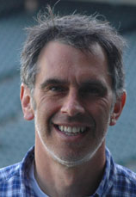


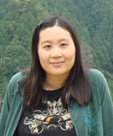
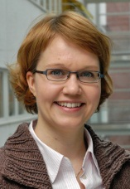
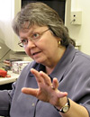
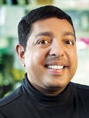
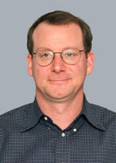
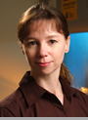

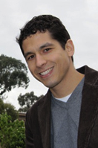






CAGI Advisory Board
Russ Altman, Stanford University
George Church, Harvard University
Tim Hubbard, Wellcome Trust Sanger Institute
John Shon, Illumina, Inc.
Sean Mooney, University of Washington
Pauline Ng, Genome Institute of Singapore
Susanna Repo, European Bioinformatics Institute
CAGI Scientific Council
Patricia Babbitt, UC San Francisco
Atul Butte, Stanford University
Garry Cutting, Johns Hopkins University
Laura Elnitski, NIH/NHGRI
Reece Hart, Invitae, Inc.
Ryan Hernandez, UC San Francisco
Rachel Karchin, Johns Hopkins University
Robert Nussbaum, UC Invitae, Inc.
Michael Snyder, Stanford University
Shamil Sunyaev, Harvard Medical School
Joris Veltman, Radboud University Nijmegen
Liping Wei, Peking University

Slide 36
CAGI 4 Experiment Lead Scientist
Roger Hoskins, University of California, Berkeley
TCS
Ajithavalli Chellappan, TATA consulting Services
Experiment and meeting Support
John-Marc Chandonia, University of California, Berkeley
Stephen Yee, University of California, Berkeley
Andrew J Neumann, University of California, Berkeley
Flavia Chen, UCSF

Slide 37



We gratefully acknowledge in-kind support for the CAGI Experiment from
TATA Consultancy Services.
CAGI is supported in part by U01HG007346 and the
CAGI 4 Conference was made possible in part by R13 HG006650, both from the National Human Genome Research Institute and the National Cancer Institute.
INVITAE
We gratefully acknowledge conference support from INVITAE Inc.
Notes:
Add MPI

Slide 38




Distinguish between exomes of Crohn's disease patients and healthy individuals
Dataset provided by Prof. Dr. Andre Franke & Dr Britt-Sabina Petersen, Institute,
Clinical Molecular Biology, Christian-Albrechts-University Kiel, Germany
Notes:
-corhn’s stomach: https://www.organicfacts.net/wp-content/uploads/crohnsdisease.jpg
-bag: http://i2.wp.com/stolencolon.com/wp-content/uploads/2014/11/stoma-steph-e1415755519665.jpg

Slide 39





NAGLU: predict the effect of naturally occurring missense mutations on cellular enzymatic activity
GlcNac
NAGLU
GlcNAcb1–6Lactose
+
Lactose
Dataset provided by Jonathan H. LeBowitz, Wyatt T. Clark, and G. Karen Yu,
BioMarin Pharmaceutical, Inc.
Notes:
Cloning NAGLU: http://www.tandfonline.com/doi/pdf/10.1271/bbb.67.646
Sanfilippo children: http://www.mpssociety.ca/images_mps/photo_right.gif
3-panel children: http://musculardystrophynews.com/wp-content/uploads/2014/12/mucopolysaccharidosis-I.jpg

Slide 40






NPM-ALK: predict the effect of mutations in the kinase domain on kinase activity and Hsp90 binding affinity
Anaplastic Large Cell Lymphoma
Dataset provided by Paolo Bonvini and Federica Lovisa,
Oncohematology Unit, Padua Children's Hospital, Italy
Notes:
Anaplastic kinase: http://cancergrace.org/lung/files/2011/10/eml4-alk-figure.jpg
NPM-ALK fusion gene: http://atlasgeneticsoncology.org/Genes/Images/IL22RA1Fig8.png

Slide 41








Estimate patients’ therapeutic warfarin doses from their exome sequences
Dataset provided by Roxana Daneshjou and Russ Altman,
Stanford University School of Medicine
Notes:
Warfarin tablets: https://upload.wikimedia.org/wikipedia/en/5/59/Warfarintablets5-3-1.jpg
Blood clot: http://hhpblog.s3.amazonaws.com/blog/wordpress/wp-content/uploads/2012/06/Blood-clot.jpg
Warfarin affects blood clots: http://elcaminogmi.dnadirect.com/img/content/tests/drug_response/howWarfarinAffectsBloodClotting.gif
Warfarin for elderly patient: https://www.cardiosmart.org/~/media/Images/NewsEvents/2014/159379232.ashx

Slide 42




Human SUMO ligase: predict the effects of missense mutations on competitive growth in a high-throughput yeast complementation assay
UBE21
SUMO ligase
+
Target Protein
SUMOylated Protein
Dataset provided by Frederick "Fritz" Roth, University of Toronto
Notes:
Sumolyation: http://www2.mrc-lmb.cam.ac.uk/ccsb/wp-content/uploads/2012/08/PTM-1.png
Sumo ligase targeting proteins: http://www.cytoskeleton.com/media/wysiwyg/Aug-Diagram-for-web-v3.jpg
Graph: http://d2jkam0hji0nkb.cloudfront.net/content/embor/10/7/748/F2.large.jpg

Slide 43





Identify regulatory sequences and eQTL-causal variants, and estimate their effects on activation of transcription in a massively parallel reporter assay
Dataset provided by Ryan Tewhey and Pardis Sabeti, Broad Institute
Notes:
Heart diagram: http://www.nature.com/ng/journal/v44/n10/images/ng.2420-F1.jpg
Snp w/ gwas: http://sherlock.ucsf.edu/images/Causal.jpg
Phenotype triangles: http://www.frontiersin.org/files/Articles/41866/fgene-04-00084-HTML/image_m/fgene-04-00084-g003.jpg

Slide 44








The Personal Genome Project (PGP): predict individuals' phenotypes
Dataset provided by George Church, Madeleine Price Ball, Abram Connelly, Preston Estep, Nancy Ouyang, Ward Vandewege,
the rest of the PGP staff (Harvard Medical School), and all of the PGP participants who lent their genomes to the CAGI 4 experiment.
Notes:
Heart diagram: http://www.nature.com/ng/journal/v44/n10/images/ng.2420-F1.jpg
Snp w/ gwas: http://sherlock.ucsf.edu/images/Causal.jpg
Phenotype triangles: http://www.frontiersin.org/files/Articles/41866/fgene-04-00084-HTML/image_m/fgene-04-00084-g003.jpg

Slide 45






Distinguish between exomes of bipolar disorder patients and unaffected individuals
?
Dataset provided by Mehdi Pirooznia and Peter Zandi, The Johns Hopkins University
Richard McCombie, Cold Spring Harbor Laboratory
James B. Potash, University of Iowa
Notes:
Masks: http://uwf.edu/media/university-of-west-florida/offices/student-affairs/counseling--psychological-services/bipolar.jpg
Woman: http://img2.timeinc.net/health/images/gallery/condition-centers/bipolar-symptoms-300x200.jpg
NIMH: https://cdn.psychologytoday.com/sites/default/files/styles/article-inline-half/public/blogs/3251/2013/05/124008-122607.png?itok=r14XOO_z
Helix: https://0.s3.envato.com/files/1286147/dna%20strand%20with%20alpha%2001%20vid%20prev.png

Slide 46




Liver pyruvate kinase (L-PYK): predict the effects of missense mutations on kinase activity and allosteric regulation
Dataset provided by Aron Fenton, University of Kansas Medical Center
Notes:
Allostery: https://classconnection.s3.amazonaws.com/318/flashcards/11318/png/screen_shot_2013-04-30_at_115414_pm1367391269542.png
Anemia: http://www.medicalnewstoday.com/articles/158800.php
Gluconeogenesis: http://static1.squarespace.com/static/52e2b127e4b01f6b1305117b/52e86d1be4b0fa0698b72f83/5501f095e4b057e54b7e67c8/1426638064992/cori+cyclehumanweb.jpg
Magnitude allostery: http://www.ncbi.nlm.nih.gov/pmc/articles/instance/3062439/bin/nihms273926f2.jpg
Binding: http://pubs.acs.org/doi/abs/10.1021/bi501426w

Slide 47





Predict patients’ clinical descriptions and pathogenic variants from gene panel sequences
Child with Cystic Fibrosis
Dataset provided by Bethany Buckley, Molly Sheridan, and Garry R. Cutting,
Johns Hopkins University
Notes:
Lungs x-ray: http://belljarnews.com/wp-content/uploads/2015/07/Gene-therapy-for-cystic-fibros.png
Child: http://www.sigmalive.com/en/uploads/images/news/cystic-fibrosis.jpg

Slide 48



SickKids clinical genomes: predict children’s clinical presentations from their genomes
Dataset provided by M. Stephen Meyn and colleagues, The Hospital
for Sick Children, Toronto
Notes:
Doctor and kid: http://www.pamf.org/findadoctor/feature-locations.jpg

Slide 49
Commence
Created for CAGI 4
genomeinterpretation.org
Steven E. Brenner

Slide 50
OLD slides follow

Slide 51
CAGI 2011 Predictors: Allison Abad, Ivan Adzhubey, Yesim Aydin Son, Benjamin Bachman, Violeta Beleva-Guthrie, Bonnie Berger, Brady Bernard, Yana Bromberg, Chen Cao, Rita Casadio, Yun-Ching Chen, Melissa Cline, Andrea Corredor, Greet De Baets, Mark Diekhans, Rezarta Islamaj Dogan, Andrea Eakin, Anna Flynn, Zaneta Franklin, Manuel Giollo, Nina Gonzaludo, Ramin Homayouni, Raghavendra Hosur, Cheng Lai Victor Huang, Sohyun Hwang, Daniel Jordan, Rachel Karchin, Panagiotis Katsonis, Eiru Kim, Jack Kirsch, Pui-Yan Kwok, Ernest Lam, Insuk Lee, Emanuela Leonardi, Biao Li, Olivier Lichtarge, Chiao-Feng Lin, Angel Mak, David Masica, Zev Medoff, Steve Mount, Noushin Niknafs, Yanay Ofran, Ayodeji Olatubosun, Jian Peng, Lipika Ray, Frederic Rousseau, Joost Schymkowitz, George Shackelford, Maxim Shatsky, Jung Eun Shim, Junha Shin, Ilya Shmulevich, Brad Silver, Nathan Stitziel, Andrew Su, Paul Tang, Nuttinee Teerakulkittipong, Janita Thusberg, Silvio Tosatto, Yemliha Tuncel, Tychele Turner, Ron Unger, Gurkan Ustunkar, Jouni Valiaho, Joost Van Durme, Mauno Vihinen, Xinyuan Wang, Li-San Wang, Chunlei Wu, Lijing Xu, Yizhou Yin, Chen-Shin Yu
CAGI 2012/2013 Predictors: Benjamin Bachman, Brady Bernard, Marcus Breese, Yana Bromberg, Chen Cao, Emidio Capriotti, Rita Casadio, Shann-Ching Chen, Chien-Yuan Chen, Chien-Yuan Chen, Carla Davis, Roland Dunbrack, Carlo Ferrari, Adam Frankish, Manuel Giollo, Nina Gonzaludo, Julian Gough, Jen Harrow, Tadashi Imanishi, Yuxiang Jiang, Panagiotis Katsonis, Dongsup Kim, Michael Kleyman, Emanuela Leonardi, Jun Li, Biao Li, Olivier Lichtarge, Chiao-Feng Lin, Rhonald Lua, Angel Mak, David Masica, Zev Medoff, Sean Mooney, Matthew Mort, John Moult, Steve Mount, Eliseos Mucaki, Jonathan Mudge, Katsuhiko Murakami, Yoko Nagai, Abhishek Niroula, Yanay Ofran, Kymberleigh Pagel, Nathaniel Pearson, Vikas Pejaver, Alexandra Piryatinska, Catherine Plotts, Aliz Rao, Lipika Ray, Graham Ritchie, Aharon Rodie, Peter Rogan, Mary Same, Jana Marie Schwarz, Nuttinee Teerakulkittipong, Janita Thusberg, Silvio Tosatto, Ron Unger, Jouni Väliaho, Mauno Vihinen, Mary Wahl, Qiong Wei, Yuedong Yang, Christopher Yates, Yizhou Yin, Chen-Hsin Yu, Maya Zuhl, 7 anonymous predictors

Slide 52
Moving CAGI further towards clinical relevance
What are the clinical problems where computational methods of genome interpretation are relevant?
Cancer: assessing risk and prognosis to assist in deciding prophylactic action.
Cancer: What genes in an individual genes are affected by somatic changes, and so what drug regimes are most appropriate?
Mendelian disease: can the causative mutations be found?
Complex trait disease: can potential new therapeutic strategies be derived?

Slide 53
Cancer Mutations
MRN: 12 groups
Mutations contributing to cancer via DNA repair.
Two ‘intermediate susceptibly genes’, part of the same complex as the 2011 challenge with RAD50.
The gap between calling impact on biochemical function of a domain, and relevance to cancer.
P16: 9 groups
Mutations found in cancer, assayed for cell growth effects.
A small protein with structure – does that help?

Slide 54
Cancer Mutations (2)
BRCA 1 and 2: 6 groups
Mutations in classical breast cancer genes.
Predictions compared with information from the Myriad database.
Can computational methods extend the set of mutations to which risk can be assigned?
Cancer discussion
How well do the methods work?
How useful for clinical applications?
What do we need to do in future CAGIs?

Slide 55
Structure versus Evolution
Discussion:
What are the strengths and weaknesses of structure and evolution based methods for missense variants in CAGI?

Slide 56
Community Annotation - riskSNPs
5 groups
Molecular mechanisms underlying risk loci for complex trait disease.
Which mechanisms contribute how much: missense, expression, splicing.
What fraction of loci can currently have plausible mechanisms assigned?
Would you dare get an experimentalist involved on the basis of these prediction?
Is community annotation useful?

Slide 57
Control of splicing
3 groups
Can the effect of variants on splicing modifiers be predicted?
Turns out to highly relevant for interpreting GWAS data.
–

Slide 58
Exome data and Mendelain disease
Familial combined hyperlipidemia and hypoalphalipoproteinemia: 11 groups
Identify afflicted individuals, causative mutations, and phenotypes with families.
Directly relevant to clinical practice.
Are CAGI participants as good as those that do this for a living?

Slide 59
Exome data and complex trait disease
Crohn’s Disease: 13 groups
A refinement of the 2011 challenge.
Can case and control really be distinguished for a moderate heritability disease?
Less issues with data sources than in 2011.
How definitive should the answer be from sequence anyway?

Slide 60
PGP: Matching genomes to trait profiles
4 groups
Complete genomes, not exomes.
To be matched to 239 traits
Requires building genome level models for many traits – Mendelian and complex.
In some ways the ultimate in clinical relevance?

Slide 61


































CAGI Acknowledgements
Data Providers
Adam P. Arkin, UC Berkeley
Andre Franke, Christian-Albrechts-
University Kiel
Jeremy Sanford, UC Santa Cruz
Sean Tavtigian, University of Utah
Joe W. Gray, OHSU⁺
Rick Lathrop, UC Irvine⁺
Jasper Rine, UC Berkeley⁺
Nicole Schmitt, Univ. of Copenhagen⁺
Jay Shendure, Univ. of Washington⁺
Michael Snyder, Stanford University⁺
Pui Kwok, UC San Francisco*
John Kane, UC San Francisco*
Robert Nussbaum, UC San Francisco*
Silvio CE Tosatto, Università di Padova*
Assessors
Rui Chen, Stanford University⁺
Gad Getz, Broad Institute⁺
Iddo Friedberg, Miami University⁺
Alex Morgan, Stanford University
Artem Sokolov, UC Santa Cruz⁺
Josh Stuart, UC Santa Cruz⁺
Sean Mooney, Buck Institute
Sean Tavtigian, University of Utah
John Moult, University of Maryland*
Jeremy Sanford, UC Santa Cruz*
Silvio CE Tosatto, Università di Padova*
Organizers
John Moult, University of Maryland
Daniel Barsky, UC Berkeley*
Susanna Repo, EMBL-EBI⁺
Advisory Board
Russ Altman, Stanford University
George Church, Harvard Medical School
Tim Hubbard, Wellcome Trust Sanger Inst.
Scott Kahn, Illumina Inc.
Sean Mooney, Buck Institute
Pauline Ng, Genome Institute of Singapore
Susanna Repo, EMBL-EBI*
Scientific Council
Patricia Babbitt, UC San Francisco
Atul Butte, Stanford University
Garry Cutting, Johns Hopkins University
Laura Elnitski, NIH/NHGRI
Reece Hart, Locus Development
Ryan Hernandez, UC San Francisco*
Rachel Karchin, Johns Hopkins University
Robert Nussbaum, UC San Francisco
Michael Snyder, Stanford University
Shamil Sunyaev, Harvard Medical School
Joris Veltman, Radboud University Nijmegen
Liping Wei, Peking University
Website Development and Data Analysis
Sadhna Rana, TCS*
Navya Dabbiru, TCS*
Stephen Yee, UC Berkeley*
Maya Zuhl, IBBR, University of Maryland⁺
Sri Jyothsna Yeleswarapu, TCS⁺
Gaurav Pandey, Mount Sinai School of Medicine⁺
* = CAGI 2012/2013
+ = CAGI 2011
Results at http://genomeinterpretation.org

