Slide 1

CAGI slide pack guidelines
I agree to my slides being used according to the following terms:
_______Silvio Tosatto_______
Authors: please include THIS slide at the beginning of your presentation to indicate that you agree with reuse of your slides in CAGI presentations, according to the terms below, and digitally sign by writing your name above.
To disseminate the CAGI results, I encourage all CAGI participants to remix these CAGI slides for inclusion in their oral and poster presentations
CAGI participants may use or publish any content of these slides only in compliance with the CAGI Data Use Agreement
CAGI participants may not cite or publish any content of these slides except with the written permission of the originating author or in the primary CAGI publications
CAGI participants must acknowledge the original authors of these slides and CAGI 2013. Include the acknowledgement banner across the bottom
CAGI participants must include the CAGI credits slide in their presentations
Slides with a red slash (no remix) may not be included in a presentation unless all attendees are registered CAGI participants who signed the data use agreement
Slides with a red X over the entire slide may not be used in any circumstances
Slides with a blue slash (embargoed) may not be used unless the embargo is explicitly lifted
Slides without slash or X may be tweeted unless flagged with the “No tweet” icon.
CAGI participants using these slides must explain the “No tweet” icon, which means that the slide content should not be disseminated outside the presenting conference hall. If the presentation venue permits pervasive tweeting, you may not include these slides in your talk
Note for slide authors: we expect all CAGI participants to abide by these restrictions, and will make best effort to ensure they are followed. However, but bear in mind that we have limited means of enforcing them, and therefore the restrictions cannot be guaranteed.

Slide 2

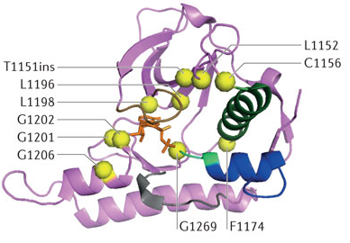
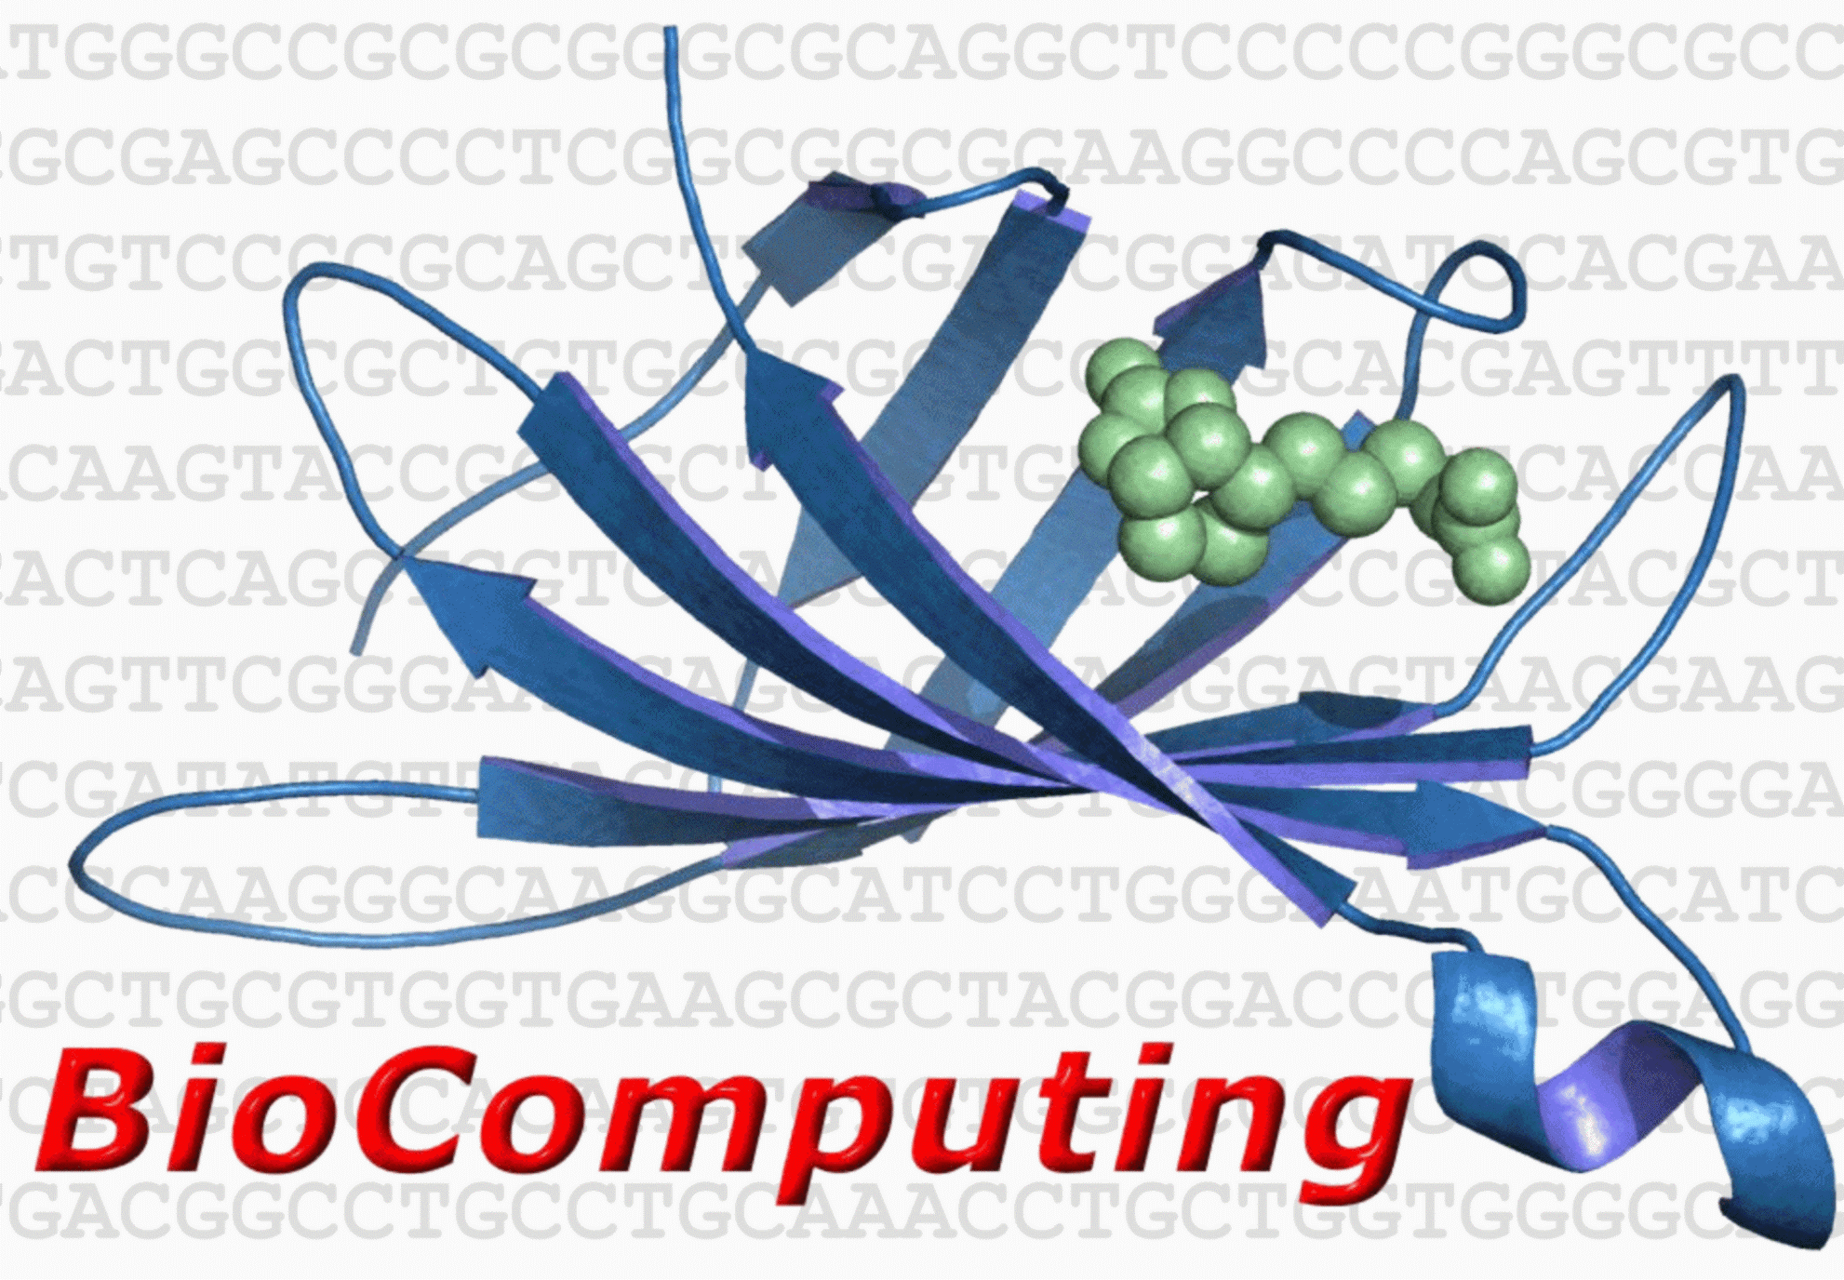

NPM-ALK Challenge
Silvio Tosatto
BioComputing UP, Department of Biomedical Sciences,
University of Padova, Italy
URL: http://protein.bio.unipd.it/

Slide 3
Overview
NPM-ALK dataset description
Assessment metrics
Kinase activity
Significance
HSP-90 binding
Created for CAGI 4
genomeinterpretation.org
Silvio Tosatto

Slide 4





The Nucleophosmin - Anaplastic Lymphoma Kinase fusion protein (NPM-ALK): predict the effect of mutations in the kinase domain on kinase activity and Hsp90 binding affinity
Federica Lovisa and Paolo Bonvini
Haematology and Oncology Clinic of Paediatrics
Hospital-University of Padova
Istituto Ricerca Pediatrica Città della Speranza
Created for CAGI 4
genomeinterpretation.org
Federica Lovisa and
Paolo Bonvini

Slide 5
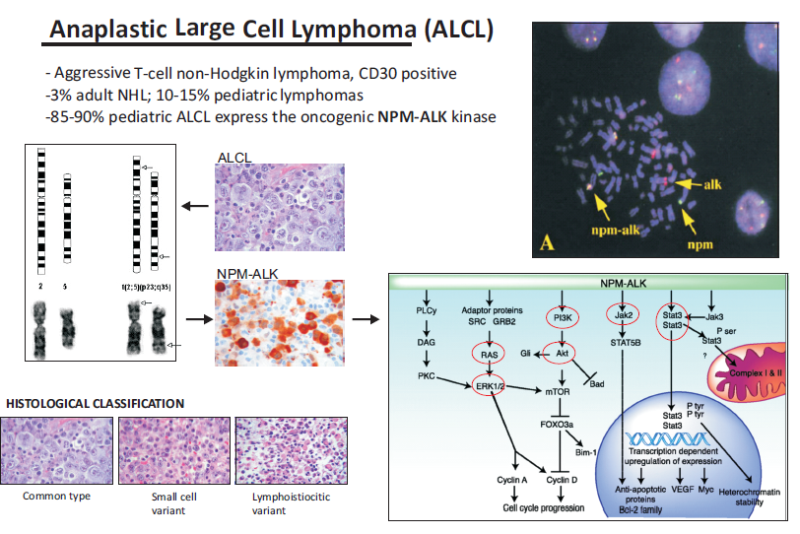
THE DISEASE: ANAPLASTIC LARGE CELL LYMPHOMA (ALCL)
NPM-ALK Signaling
Created for CAGI 4
genomeinterpretation.org
Federica Lovisa and
Paolo Bonvini

Slide 6
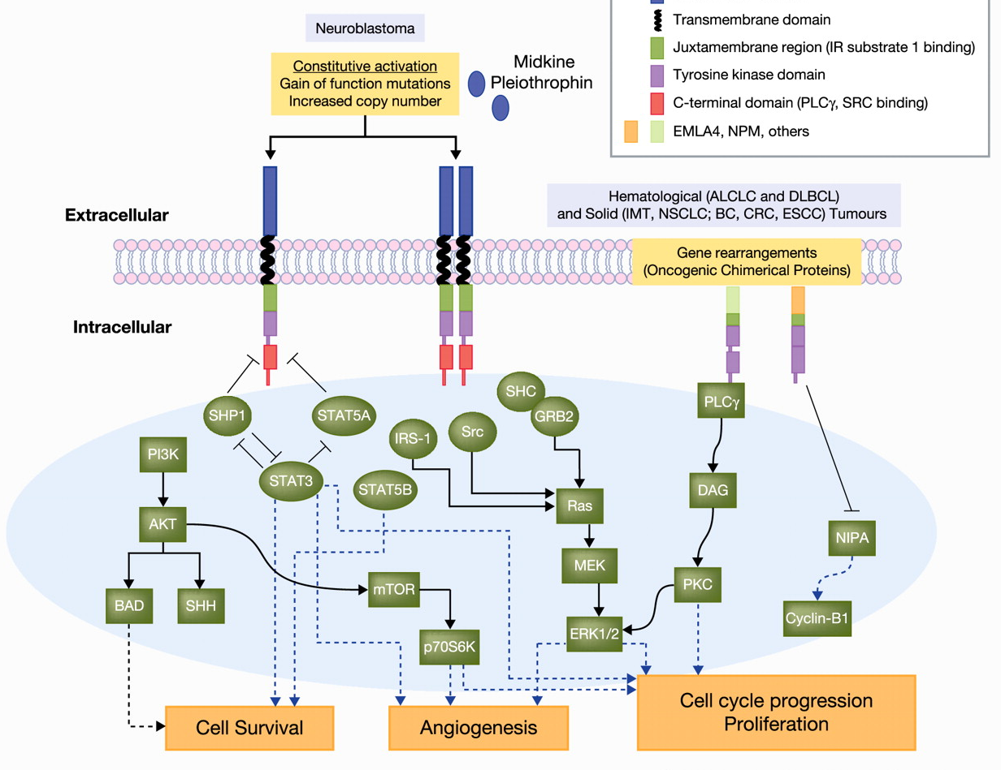
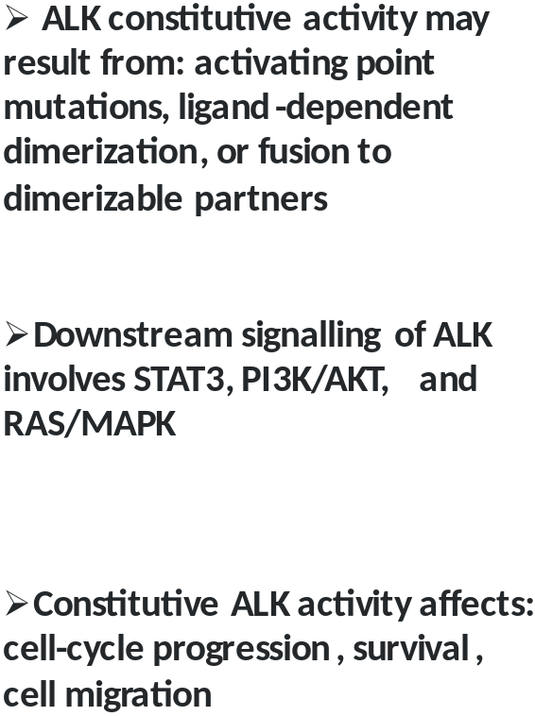
THE ONCOGENE: NUCLEOPHOSMIN-ANAPLASTIC
LYMPHOMA KINASE (NPM-ALK)
Created for CAGI 4
genomeinterpretation.org
Federica Lovisa and
Paolo Bonvini

Slide 7
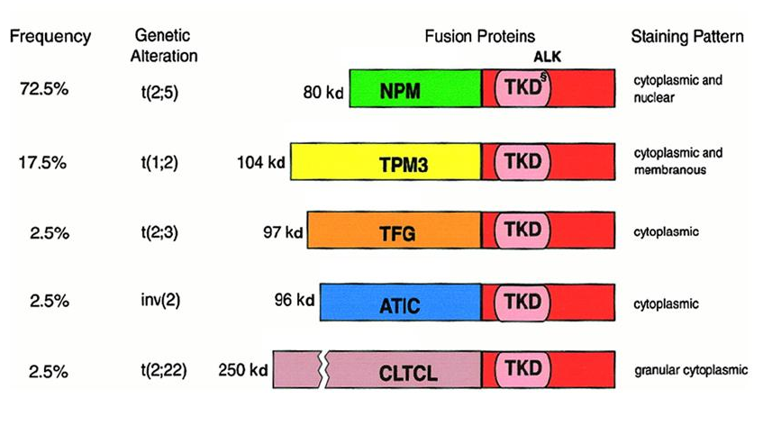
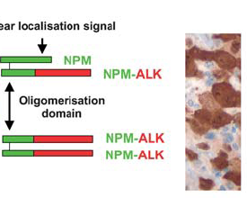
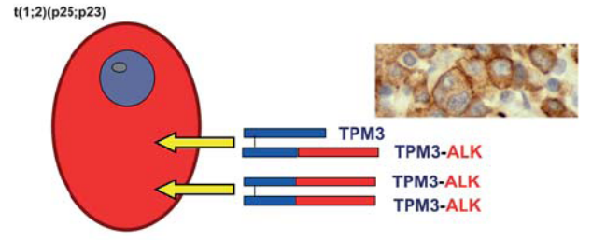
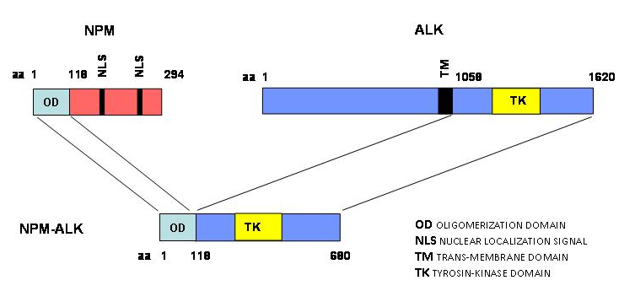
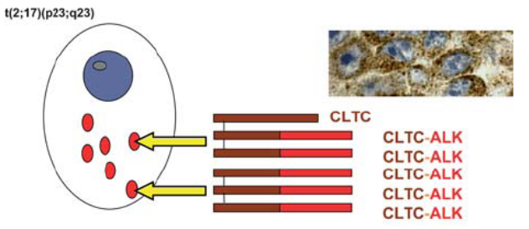
THE ONCOGENE: NUCLEOPHOSMIN-ANAPLASTIC
LYMPHOMA KINASE (NPM-ALK)
ALK fusion proteins in ALCL
t(2;5)
Nuclear and Cytoplasmic
NPM-ALK
TPM3-ALK
TFG-ALK
ATIC-ALK
Cytoplasmic (diffuse)
t(1;2)
CLTCL-ALK
NPM-ALK
t(2;22)
Cytoplasmic (localized)
Created for CAGI 4
genomeinterpretation.org
Federica Lovisa and
Paolo Bonvini

Slide 8
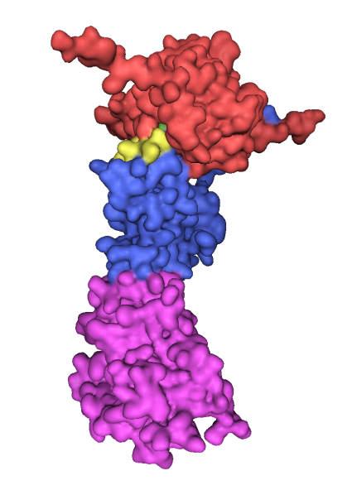
THE CHAPERONE: HEAT SHOCK
PROTEIN 90 (HSP90)
N-ter domain
Middle Domain
C-ter domain
Properties of HSP90
HSP90 belongs to a large group of unrelated protein families whose role is to stabilize unfolded proteins, unfold them for translocation across membranes or for degradation, and/ or to assist in their correct folding and assembly.
Hsp90 prevents inappropriate association or aggregation of exposed hydrophobic surfaces and direct their substrates into productive folding
Hsp90 does not interact with native proteins, nor it forms part of the final folded structures.
Hsp90 couples ATP binding/hydrolysis to the folding process
Activated Hsp90 is critical for proliferation and survival of tumor cells
In cancer cells, Hsp90 interacts in a transformation-specific manner with kinases, hormone receptors, and transcription factors that are directly involved in driving multistep malignancy and also with mutated oncogenic proteins required for the transformed phenotype.
Created for CAGI 4
genomeinterpretation.org
Federica Lovisa and
Paolo Bonvini

Slide 9
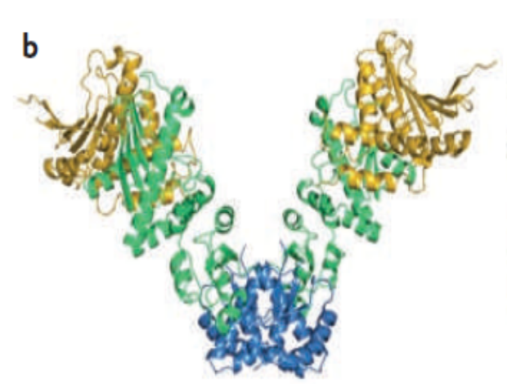
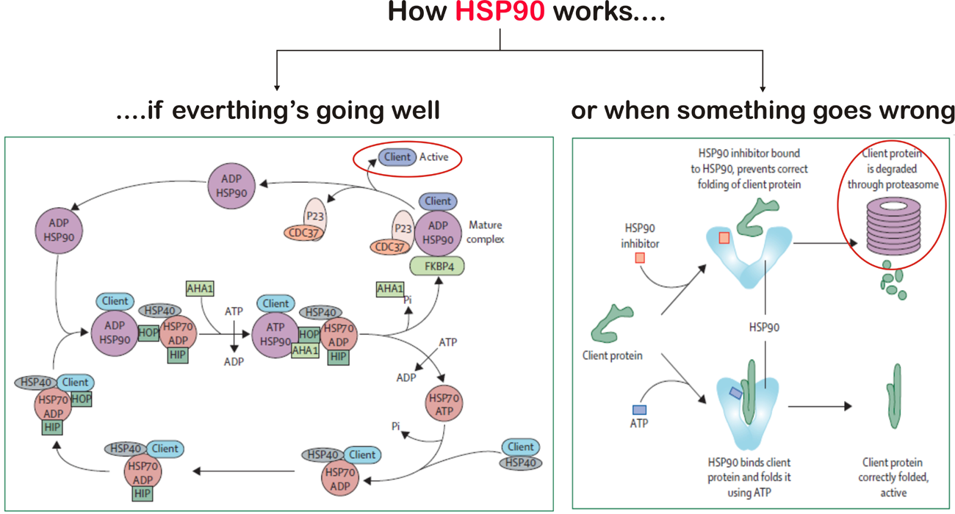
Upon Hsp90 inhibition, client proteins undergo rapidly to ubiquitin-dependent proteasomal degradation, or accumulate insoluble in perinuclear structures termed aggresomes
Hsp90 inhibitors display preferential activity toward malignant or rapidly proliferating cells, such those became addicted to oncogenic protein kinases
Created for CAGI 4
genomeinterpretation.org
Federica Lovisa and
Paolo Bonvini

Slide 10
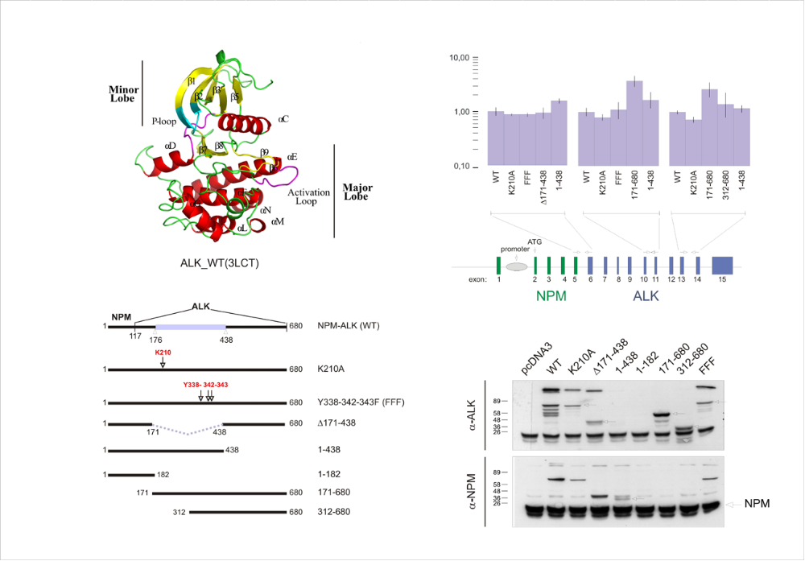

THE INTERACTION: NPM-ALK/HSP90
NPM-ALK
Hsp90
QUESTIONS
    IS ALK KINASE DOMAIN NECESSARY AND SUFFICIENT TO BIND Hsp90 ?
    DOES HSP90 BIND TO NPM-ALK IRRESPECTIVE ALK KINASE ACTIVITY ?
    TO IDENTIFY THE NPM-ALK/HSP90 “BINDING SITE”
    TO INDUCE NPM-ALK DEGRADATION BY SELECTIVE INHIBITION OF THE NPM-ALK/HSP90 INTERACTION
AIMS
Created for CAGI 4
genomeinterpretation.org
Federica Lovisa and
Paolo Bonvini

Slide 11
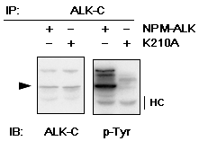
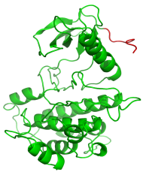
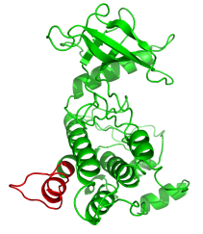
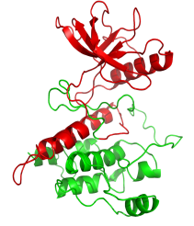
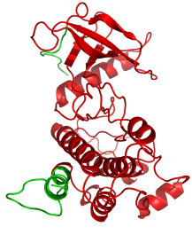
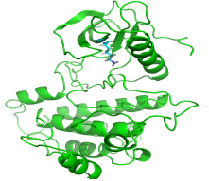
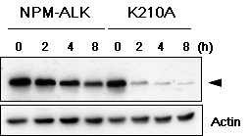
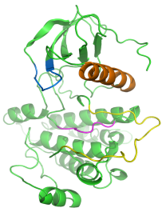
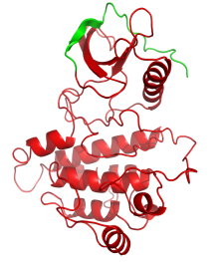
THE CHALLENGE: EXPERIMENT
A
K210
B
First evidence of kinase-dead K210A NPM-ALK (A) sensitivity to 17-AAG (B). Indirect evidence of stronger affinity of K210A NPM-ALK for Hsp90 compared to wild type NPM-ALK kinase.
NPM
ALK
0 = no activity (no phosphorylation of ALK, no increase of STAT3 basal phosphorylation)
0.5 = less activity than WT (lower levels of phosphorylated ALK and STAT3)
1 = same activity as WT (comparable levels of phosphorylated ALK and STAT3)
2 = more activity than WT (increased levels of phosphorylated ALK and STAT3)
0 = mutant protein does not bind to Hsp90
0.5 = mutant protein binds to Hsp90 less than WT NPM-ALK
1 = mutant protein binds to Hsp90 as much as WT NPM-ALK
2 = mutant protein binds to Hsp90 more than WT NPM-ALK
KINASE ACTIVITY
HSP90 BINDING
Created for CAGI 4
genomeinterpretation.org
Federica Lovisa and
Paolo Bonvini

Slide 12
Embargoed
Embargoed
Created for CAGI 4
genomeinterpretation.org
Federica Lovisa and
Paolo Bonvini

Slide 13

Marco Carraro
NPM-ALK CHALLENGE
ASSESSMENT
Created for CAGI 4
genomeinterpretation.org
Silvio Tosatto

Slide 14

SUBMISSIONS
4
SUBMISSIONS - Kinase Activity:
    Casadio (pred 1)
    Jones (pred 2)
    Dunbrack (pred 3)
    Parisi (pred 4)
2
SUBMISSIONS - HSP90 binding:
    Casadio (pred 1)
    Jones (pred 2)
Created for CAGI 4
genomeinterpretation.org
Silvio Tosatto

Slide 15
Who did better?
Created for CAGI 4
genomeinterpretation.org
Silvio Tosatto

Slide 16

ASSESSMENT METRICES
CORRELATION
Pearson correlation coefficient
Spearman correlation coefficient
Kendall correlation coefficient
DISTANCE MEASURE
Root mean square deviation (RMSD)
VISUAL INSPECTION
Predicted/Observed plot
Created for CAGI 4
genomeinterpretation.org
Silvio Tosatto

Slide 17
KINASE ACTIVITY
CORRELATION
 | Pearson | Spearman | Kendall | RMSD
Pred1 | 0.888 | 0.809 | 0.754 | 0.284
Pred2 | 0.816 | 0.884 | 0.798 | 0.352
Pred3 | 0.696 | 0.809 | 0.688 | 0.738
Pred4 | 0.534 | 0.712 | 0.599 | 0.659
DISTANCE MEASURE
Created for CAGI 4
genomeinterpretation.org
Silvio Tosatto

Slide 18
KINASE ACTIVITY
CORRELATION
 | Pearson | Spearman | Kendall | RMSD
Pred1 | 0.888 | 0.809 | 0.754 | 0.284
Pred2 | 0.816 | 0.884 | 0.798 | 0.352
Pred3 | 0.696 | 0.809 | 0.688 | 0.738
Pred4 | 0.534 | 0.712 | 0.599 | 0.659
DISTANCE MEASURE
… and the better performers are…
PREDICTOR 1 (Casadio group)
PREDICTOR 2 (Jones group)
Created for CAGI 4
genomeinterpretation.org
Silvio Tosatto

Slide 19
Embargoed
Embargoed

Slide 20
Embargoed
Embargoed

Slide 21
Is the performance random ?
Created for CAGI 4
genomeinterpretation.org
Silvio Tosatto

Slide 22
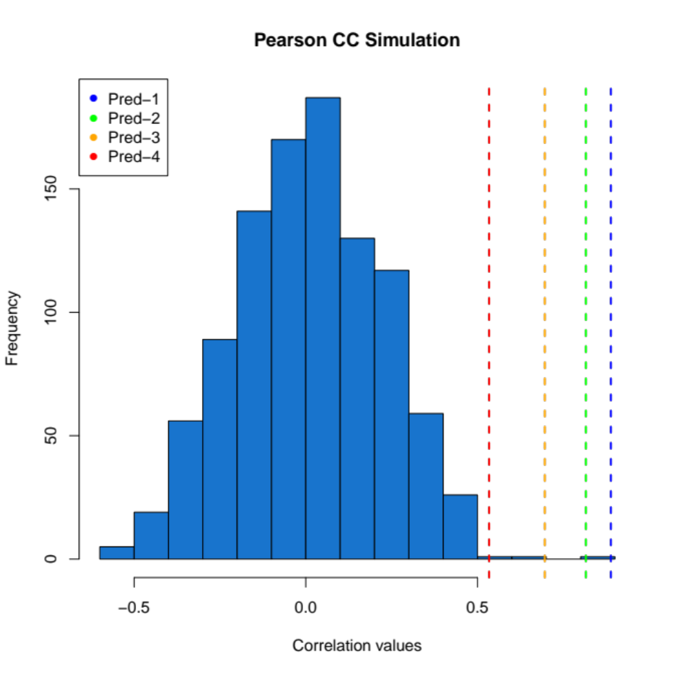
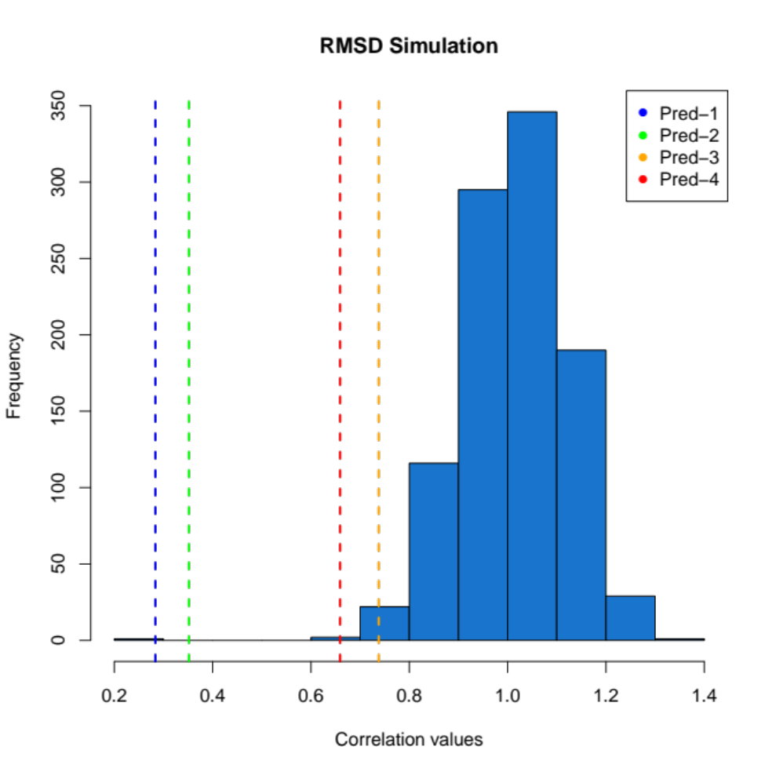
1,000 simulations
NON-RANDOM PERFORMANCE
Created for CAGI 4
genomeinterpretation.org
Silvio Tosatto

Slide 23
Are methods improving?
SIFT
PolyPhen 2
Provean
Created for CAGI 4
genomeinterpretation.org
Silvio Tosatto

Slide 24
Online Tool Performance
 | Pearson | Spearman | Kendall | RMSD
Pred1 | 0.888 | 0.809 | 0.754 | 0.284
Pred2 | 0.816 | 0.884 | 0.798 | 0.352
Pred3 | 0.696 | 0.809 | 0.688 | 0.738
Pred4 | 0.534 | 0.712 | 0.599 | 0.659
SIFT
PolyPhen 2
Provean
 | Pearson | Spearman | Kendall | RMSD
SIFT | 0.219 | 0.261 | 0.234 | 0.716
PolyPhen2 | 0.366 | 0.467 | 0.401 | 0.649
Provean | 0.583 | 0.394 | 0.369 | 0.669
(All) CAGI predictions are better...
Created for CAGI 4
genomeinterpretation.org
Silvio Tosatto

Slide 25
HSP-90 binding
Created for CAGI 4
genomeinterpretation.org
Silvio Tosatto

Slide 26
Embargoed
Embargoed

Slide 27
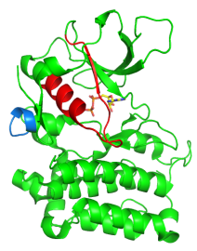
HSP-90 BINDING
 | Pearson | Spearman | Kendall | RMSD
Pred1 | 0.046 | 0.054 | 0.048 | 1.283
Pred2 | -0.115 | -0.065 | -0.065 | 1.028
CAGI Predictions
 | Pearson | Spearman | Kendall | RMSD
SIFT | -0.231 | -0.162 | -0.157 | 1.530
PolyPhen2 | -0.131 | -0.121 | -0.116 | 1.464
Provean | -0.219 | -0.219 | -0.214 | 1.577
Online Tools
All predictions are essentially random...
Created for CAGI 4
genomeinterpretation.org
Silvio Tosatto

Slide 28
Conclusions
Kinase activity can be predicted fairly well
  Predictors add value compared to standard tools
Short deletions were easier to predict
  All kinase dead
HSP-90 binding prediction is random
  Not only kinase dead prediction
  Novel methods needed
Created for CAGI 4
genomeinterpretation.org
Silvio Tosatto

Slide 29


Acknowledgements
Marco Carraro
(Assessment)
CAGI Organizers
&
All submitters
Dr. Paolo Bonvini
(Data Provider)
Funding
Dr. Federica Lovisa
(Data Provider)
URL: http://protein.bio.unipd.it/

