Slide 1

CAGI slide pack guidelines
I agree to my slides being used according to the following terms: _______Roland Dunbrack_______
Authors: please include THIS slide at the beginning of your presentation to indicate that you agree with reuse of your slides in CAGI presentations, according to the terms below, and digitally sign by writing your name above.
To disseminate the CAGI results, I encourage all CAGI participants to remix these CAGI slides for inclusion in their oral and poster presentations
CAGI participants may use or publish any content of these slides only in compliance with the CAGI Data Use Agreement
CAGI participants may not cite or publish any content of these slides except with the written permission of the originating author or in the primary CAGI publications
CAGI participants must acknowledge the original authors of these slides and CAGI 2013. Include the acknowledgement banner across the bottom
CAGI participants must include the CAGI credits slide in their presentations
Slides with a red slash (no remix) may not be included in a presentation unless all attendees are registered CAGI participants who signed the data use agreement
Slides with a red X over the entire slide may not be used in any circumstances
Slides with a blue slash (embargoed) may not be used unless the embargo is explicitly lifted
Slides without slash or X may be tweeted unless flagged with the “No tweet” icon.
CAGI participants using these slides must explain the “No tweet” icon, which means that the slide content should not be disseminated outside the presenting conference hall. If the presentation venue permits pervasive tweeting, you may not include these slides in your talk
Note for slide authors: we expect all CAGI participants to abide by these restrictions, and will make best effort to ensure they are followed. However, but bear in mind that we have limited means of enforcing them, and therefore the restrictions cannot be guaranteed.

Slide 2

NAGLU Challenge
Qifang Xu
Roland Dunbrack
Created for CAGI 4 genomeinterpretation.org Roland Dunbrack

Slide 3
NAGLU Challenge
Challenge: predict enzyme activity from 0 to 1
Ability to fold
Ability to make trimer (if required for activity)
Ability to bind substrate
Ability to catalyze reaction
Ability to release product
Assume enzyme activity may correlate with features used in deleterious/neutral phenotype predictors
Alter some predictions? (as noted above)
Created for CAGI 4 genomeinterpretation.org Roland Dunbrack

Slide 4
Gene-specific classifier
79 "deleterious" missense mutations from Human Gene Mutation Database related to Sanfilippo Syndrome B
80 "neutral" sequence differences between human protein and primate sequences down to 80% sequence identity
  No sequence differences ±2 aa
  No gaps ± 3 aa
  Could be improved if we modeled primate structures and chose only mutations not in contact with other mutations
Created for CAGI 4 genomeinterpretation.org Roland Dunbrack

Slide 5
Primate Sequence Differences
Comparison of primate mutations and SwissVar polymorphisms
Primate mutations appear to be closer to what’s expected on biophysical grounds.
WT
Mutant
Created for CAGI 4 genomeinterpretation.org Roland Dunbrack

Slide 6
Train on Balanced Data
Test with Balanced Measures
ACC
BACC
Train on 50%
MCC
AUC
Wei and Dunbrack
PLOS ONE, 2013
Created for CAGI 4 genomeinterpretation.org Roland Dunbrack

Slide 7
SVM Features
Scores from general predictors
Polyphen2
Provean
SIFT
SVM-BA (Wei and Dunbrack, Proteins 2013)
Features of SVM-BA
PSSM difference (Mut-WT)
AL2CO
rASA of WT residue in protein monomer
rASA of WT residue in biological assembly
Change in side-chain volume
Change in hydrophobicity
FoldX score difference
Created for CAGI 4 genomeinterpretation.org Roland Dunbrack

Slide 8
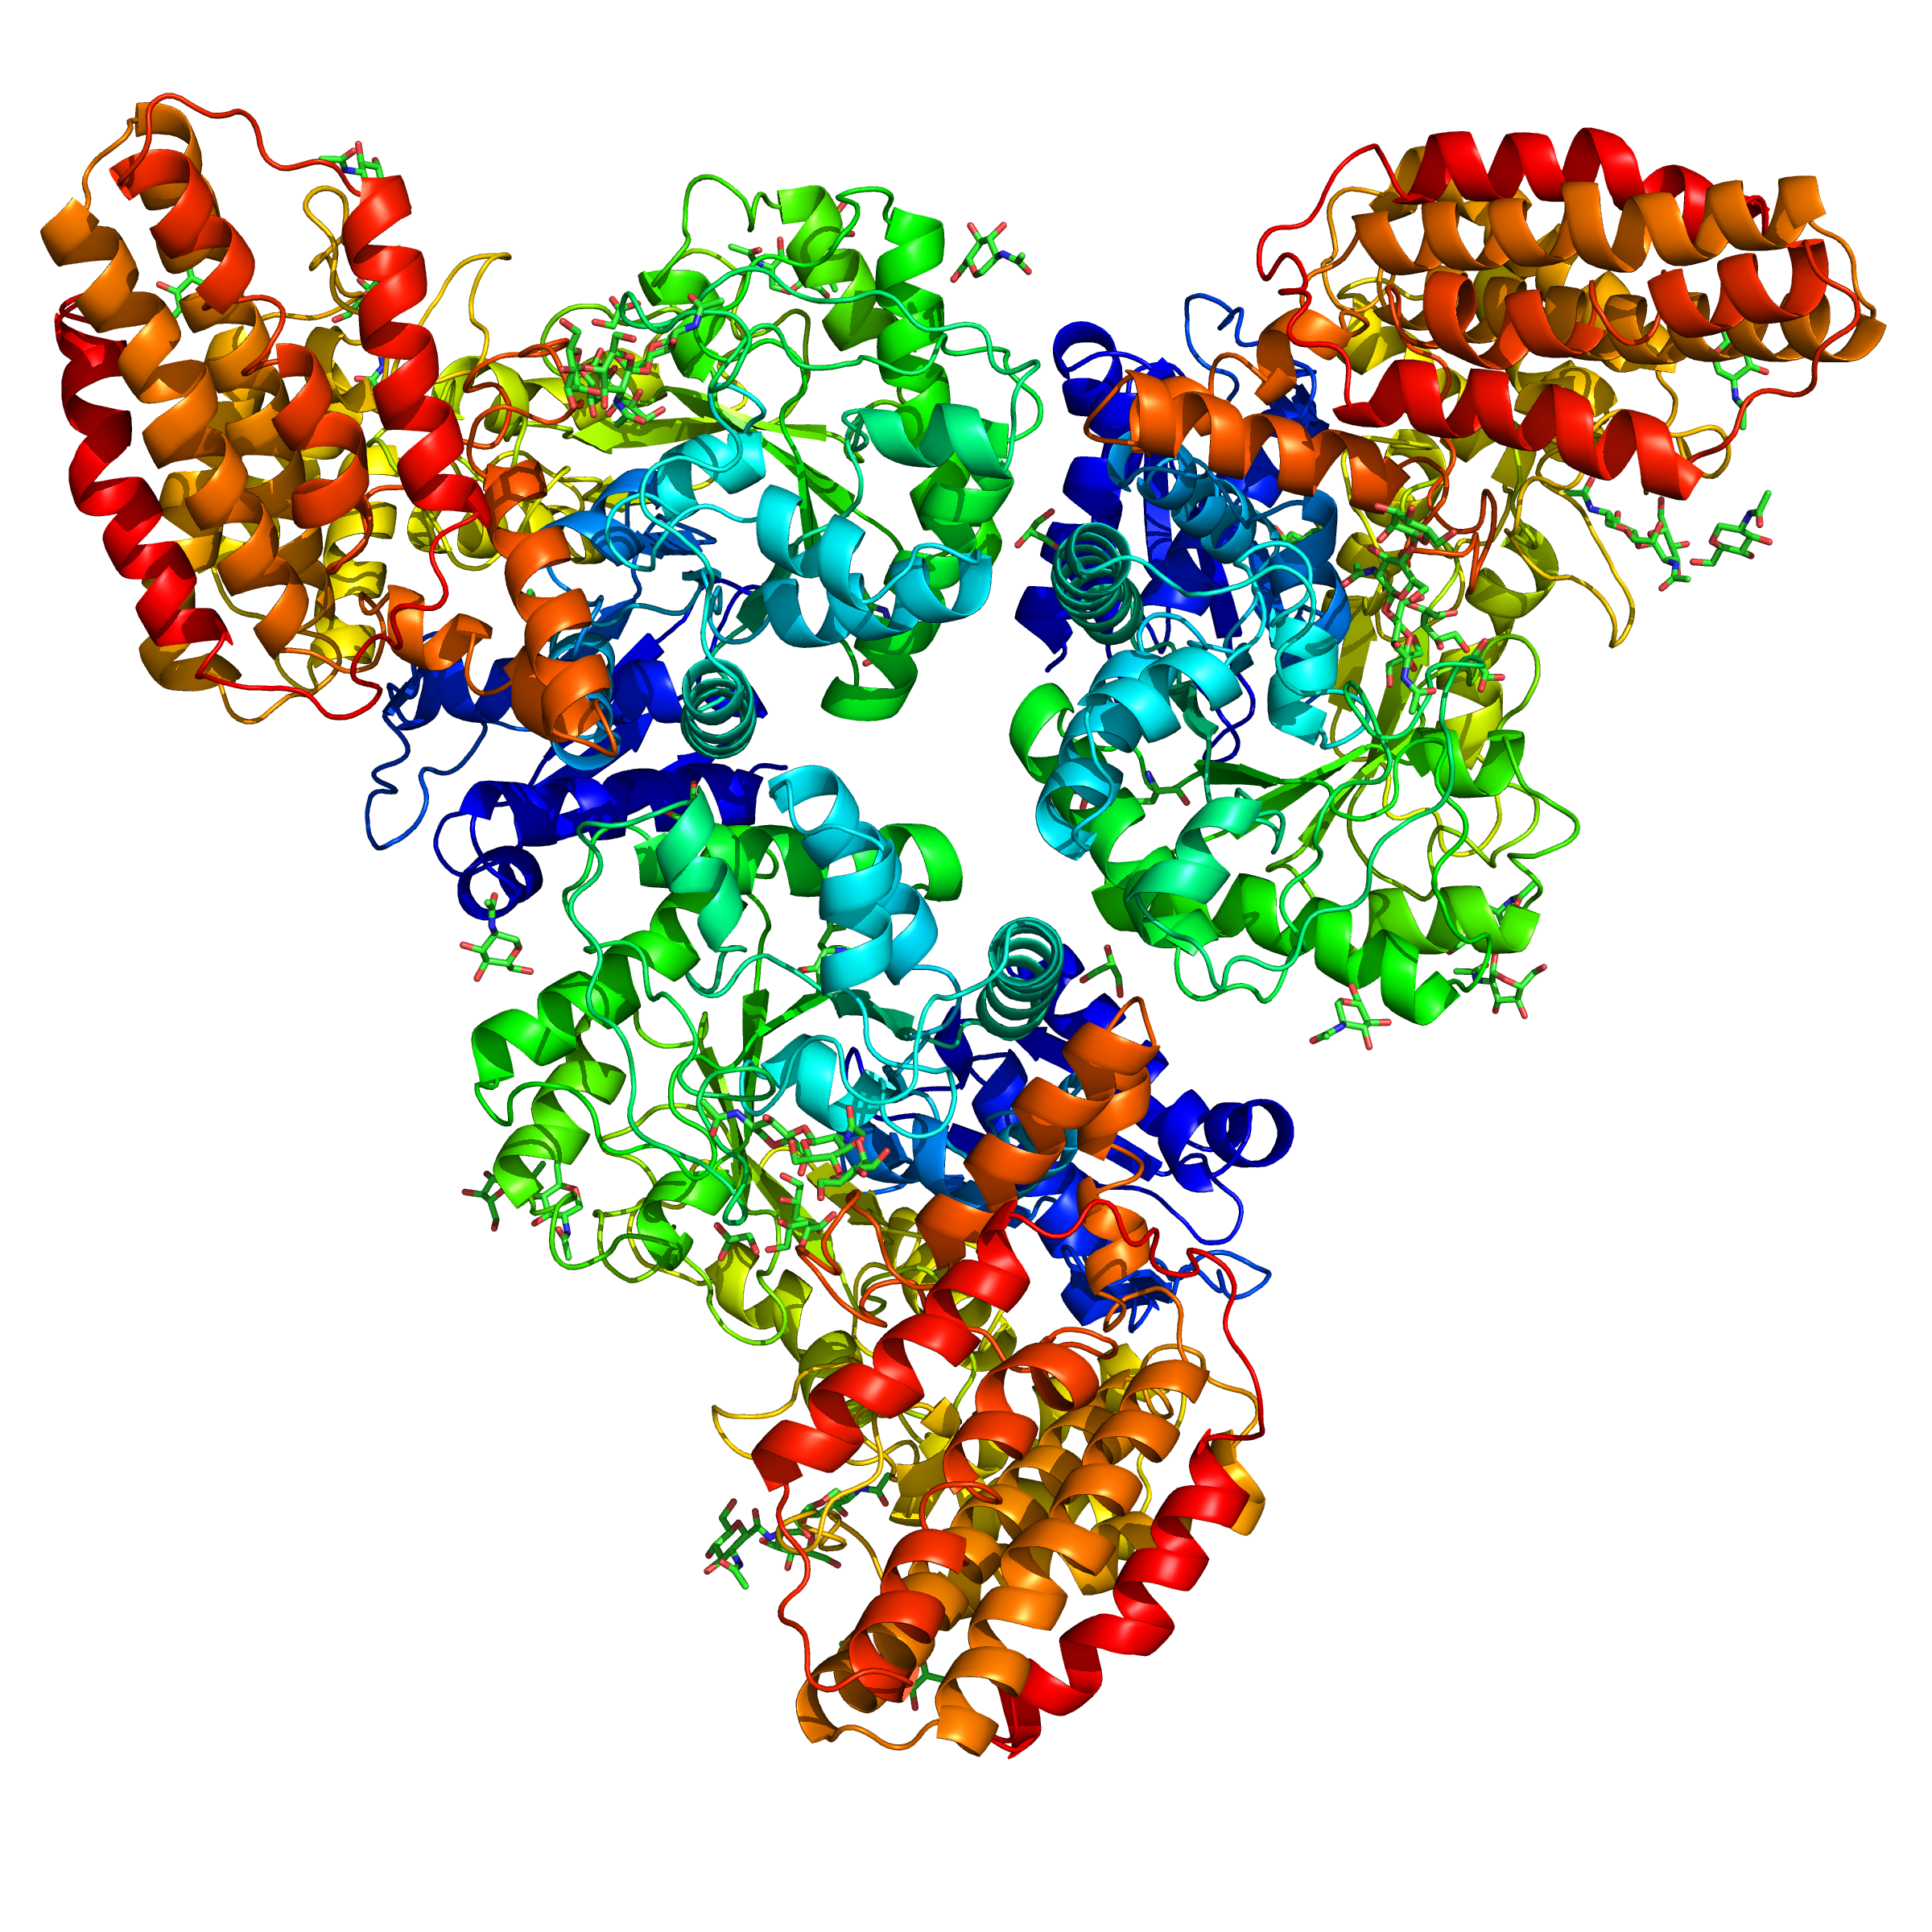
Structure of trimer
Structure from patent US08775146B2 (2nd trimer, higher resolution);
Now in PDB: 4XWH (Feb 2, 2016)
Trimer not in NAGLU structures from other species
Created for CAGI 4 genomeinterpretation.org Roland Dunbrack

Slide 9
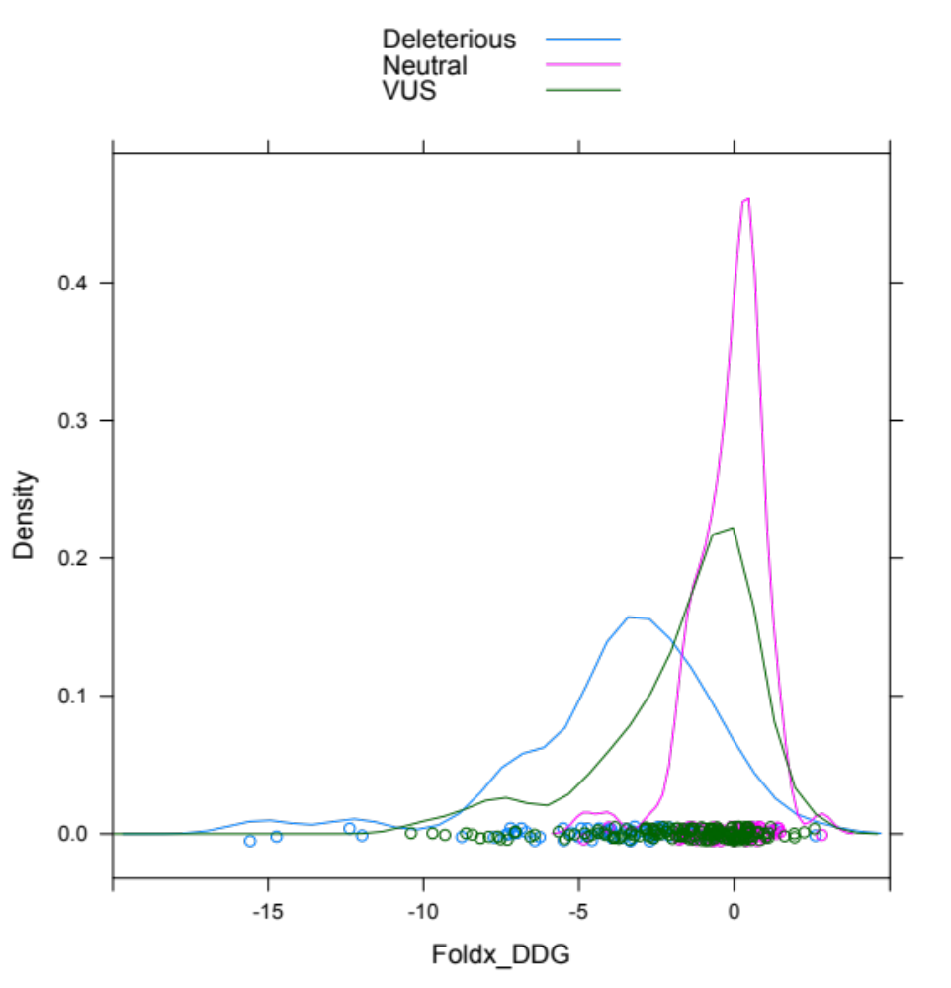
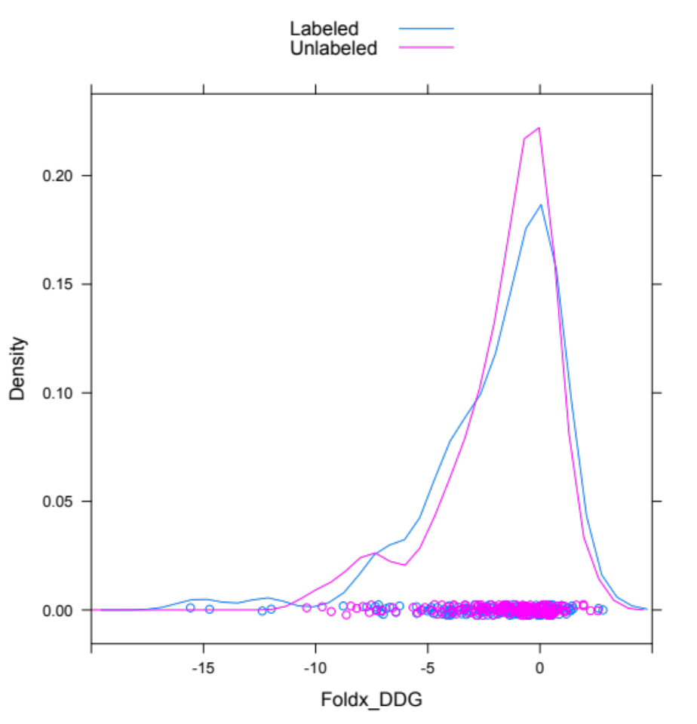
Comparing Labeled and
Unlabeled Mutations (VUS)
Created for CAGI 4 genomeinterpretation.org Roland Dunbrack

Slide 10
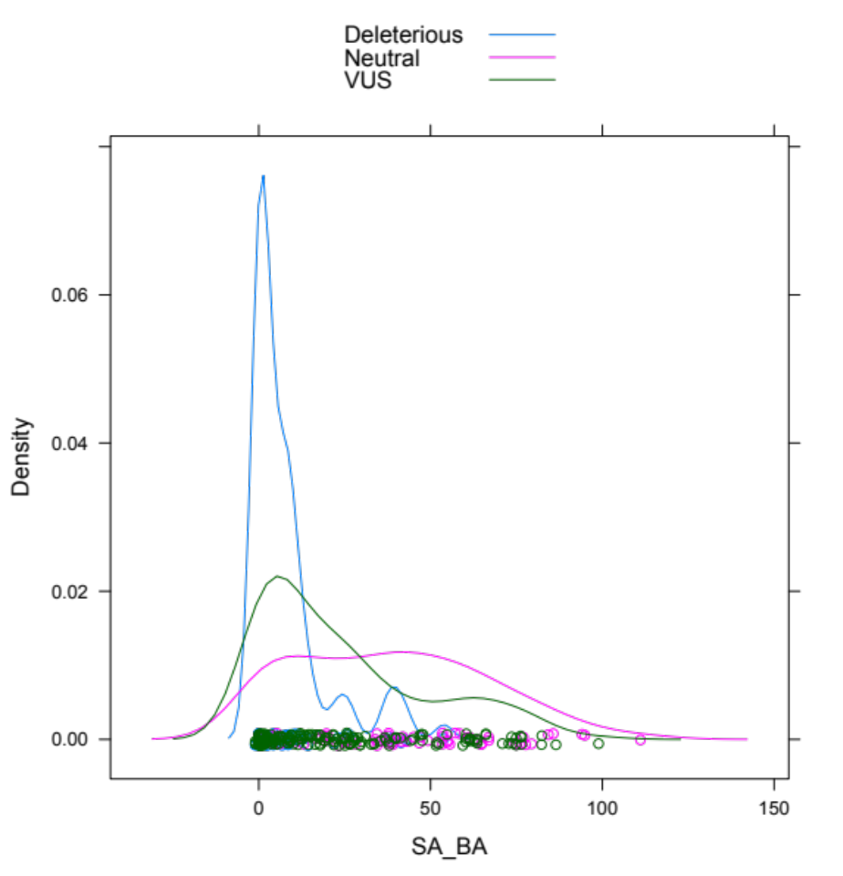
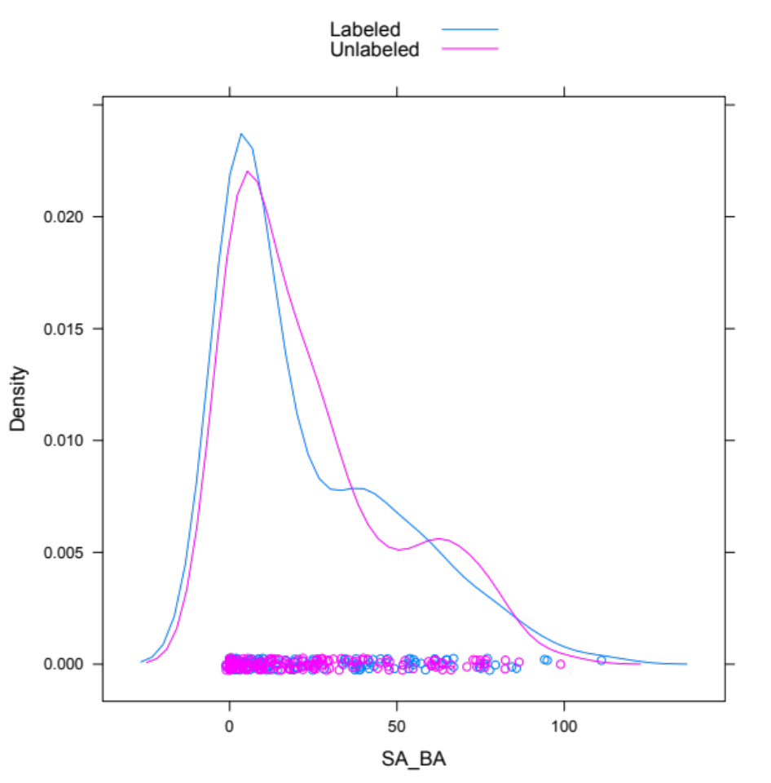
Biological Assembly Surface Area
Created for CAGI 4 genomeinterpretation.org Roland Dunbrack

Slide 11
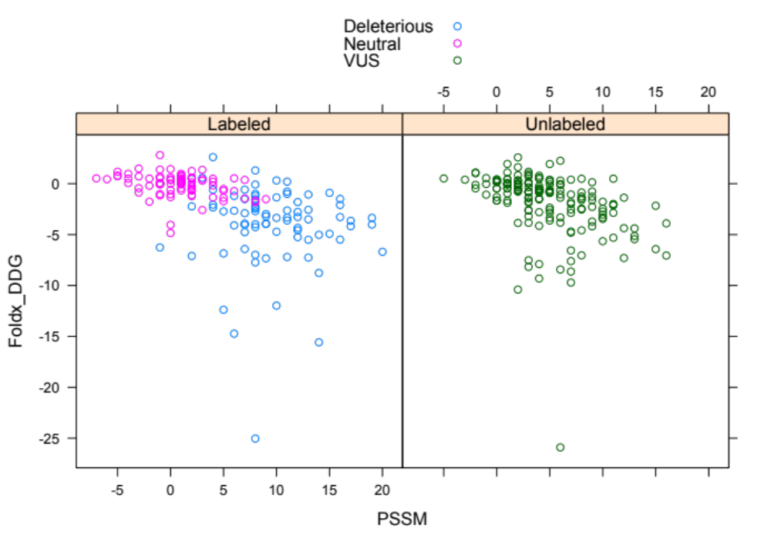
PSSM vs FoldX
Created for CAGI 4 genomeinterpretation.org Roland Dunbrack

Slide 12
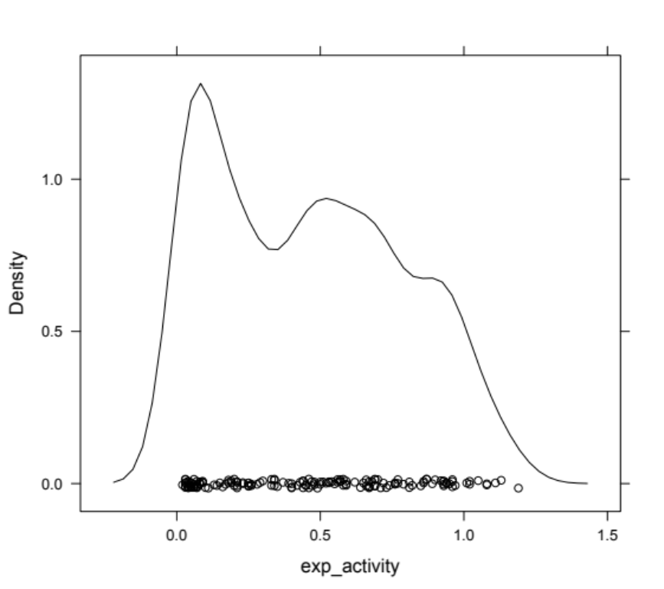
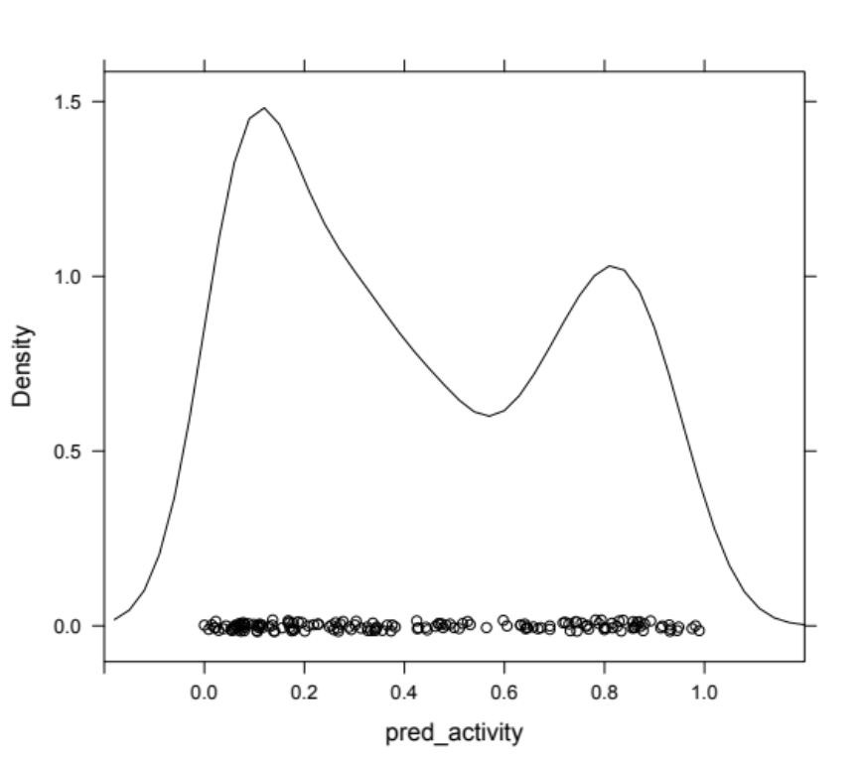
Densities of experimental activity and predicted activity
Experimental activity
Predicted activity
Created for CAGI 4 genomeinterpretation.org Roland Dunbrack

Slide 13
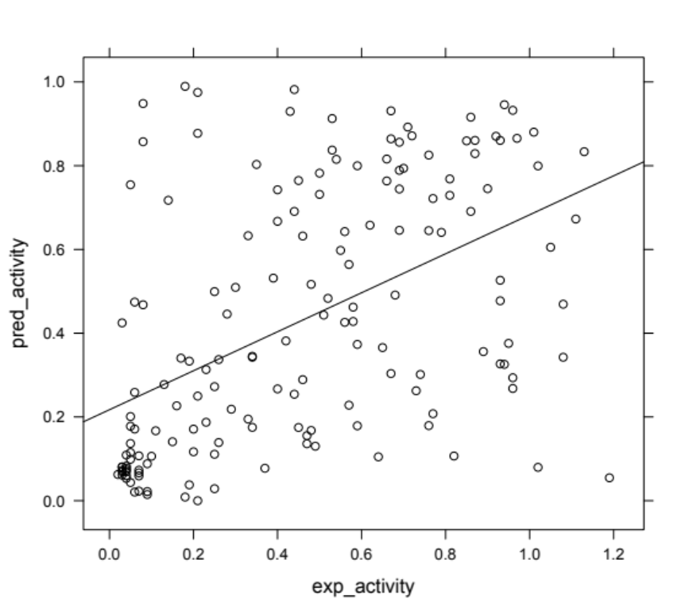
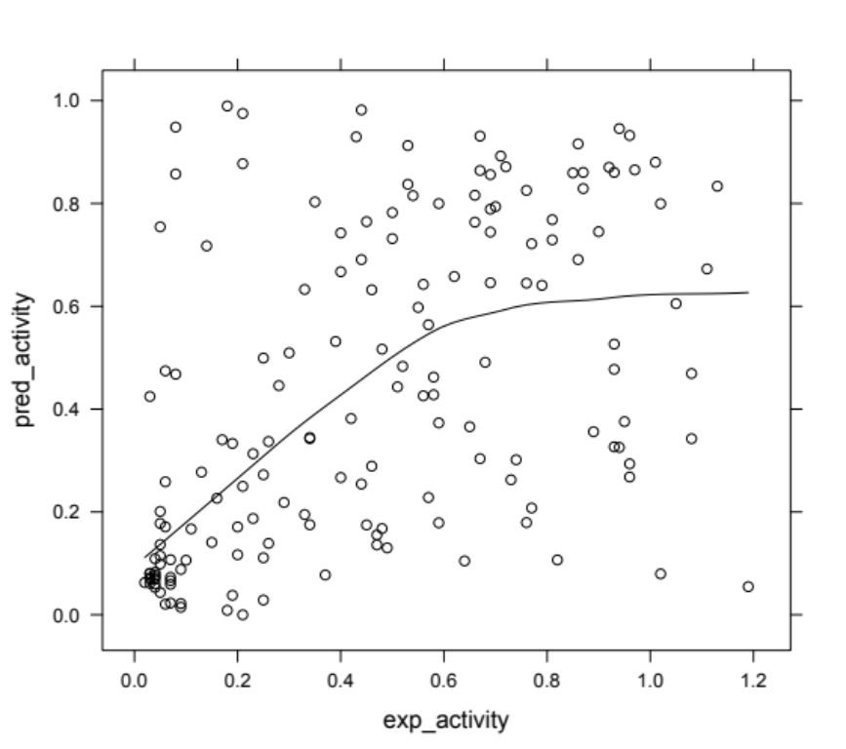
Regressions
Estimate Std.Error t-value Pr(>|t|)
(Intercept) 0.24011 0.03827 6.275 3.11e-09
Slope 0.49995 0.07009 7.133 3.16e-11
Residual standard error: 0.287 on 161 degrees of freedom
Multiple R-squared: 0.2401, Adjusted R-squared: 0.2354
F-statistic: 50.88 on 1 and 161 DF, p-value: 3.159e-11
Created for CAGI 4 genomeinterpretation.org Roland Dunbrack

Slide 14
Binary Predictor
Positives (active enzyme, ≥0.5) 74
Negatives (inactive enzyme, <0.5) 98
Predictor TPR TNR BACC
GeneSpecific 0.622 0.787 0.704
SVM-BA 0.635 0.798 0.716
Polyphen2 0.554 0.787 0.670
Sift 0.743 0.607 0.675
Provean 0.811 0.607 0.709
FoldX 0.838 0.472 0.655
Created for CAGI 4 genomeinterpretation.org Roland Dunbrack

Slide 15
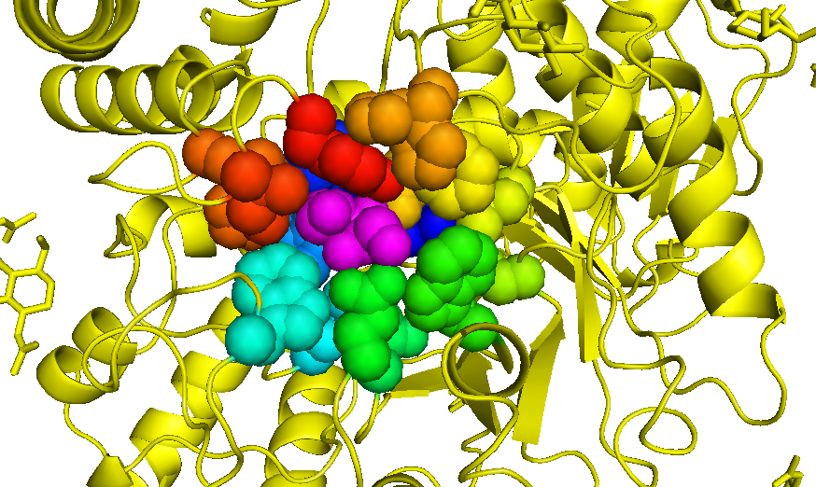
Active Site
Created for CAGI 4 genomeinterpretation.org Roland Dunbrack

Slide 16
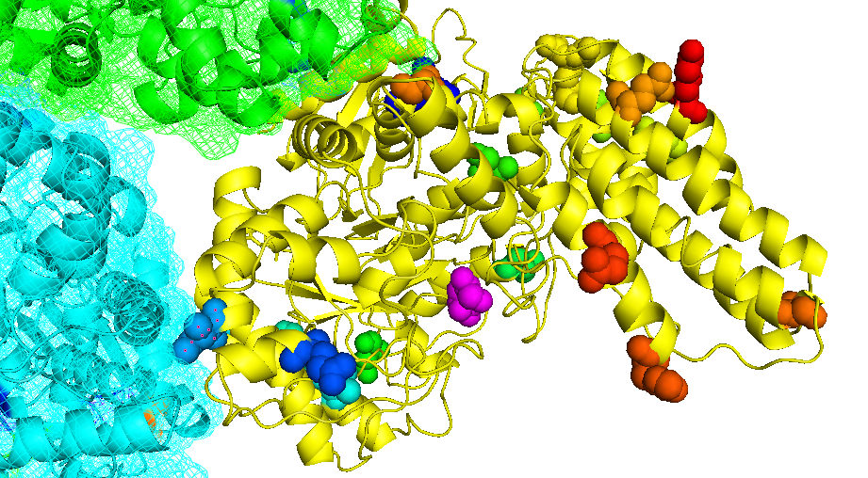
False Positives Are Far from Active Site
Created for CAGI 4 genomeinterpretation.org Roland Dunbrack

Slide 17
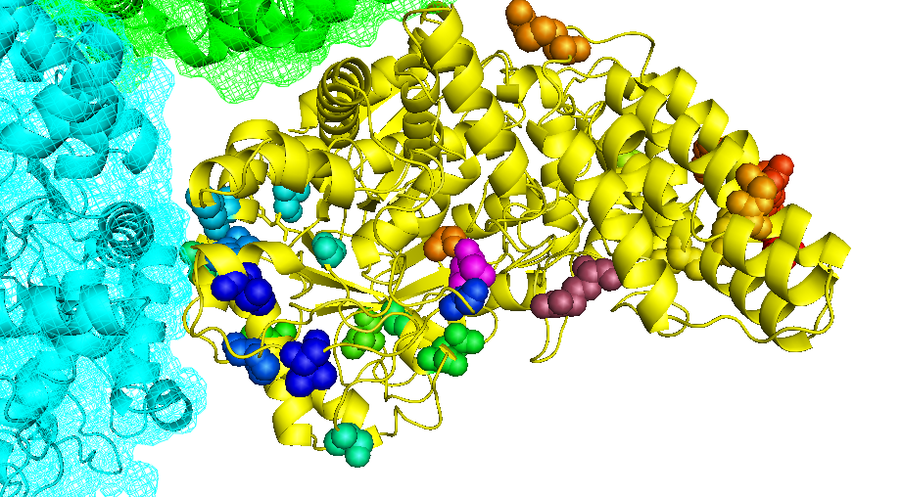
Some false negatives are near active site
Created for CAGI 4 genomeinterpretation.org Roland Dunbrack

Slide 18
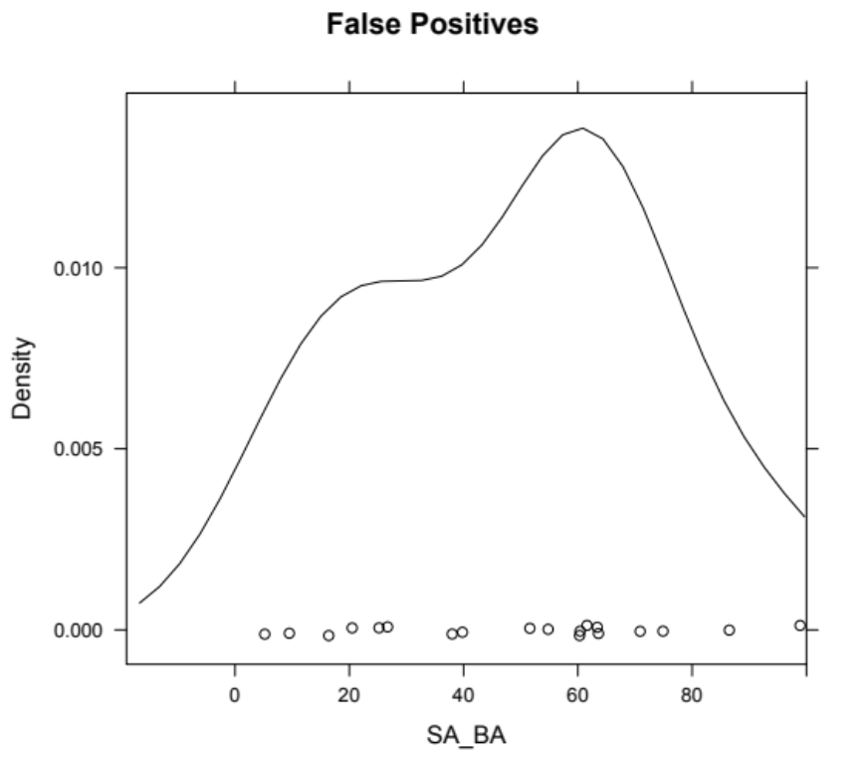
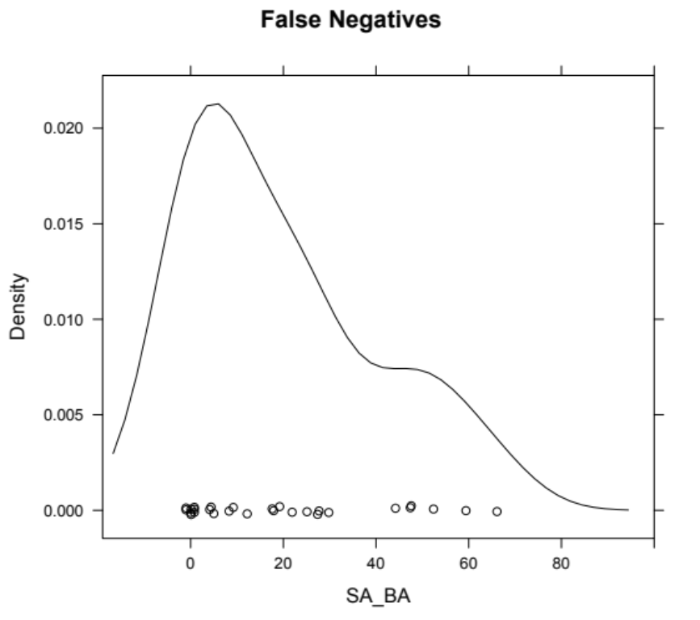
Biological assembly surface areas
Created for CAGI 4 genomeinterpretation.org Roland Dunbrack

Slide 19
Acknowledgments
Qifang Xu
Peter Huwe
NIH R01 GM084453
Created for CAGI 4 genomeinterpretation.org Roland Dunbrack

