Slide 1
Utilizing activity assays and population-wide allele frequencies to assess the contribution of novel mutations in NAGLU to MPS IIIB incidence
Jonathan H. LeBowitz, Wyatt T. Clark, G. Karen Yu, Mika Aoyagi-Scharber BioMarin Pharmaceutical Inc. Novato, CA

Slide 2
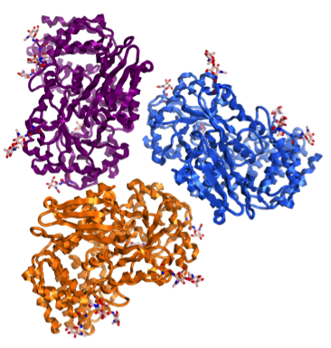
MPS IIIB (Sanfilippo Type B)
Autosomal recessive lysosomal storage disease
α-N-acetylglucosaminidase (NAGLU)
Severe neurological disease
  Birth incidence: ~0.5 per 100,000
  Global MPS IIIB patient population: 1,000~2,000
H₂COSO₃⁻
OH
O
O
IDU GlcNAc
OH
HNSO₃⁻
IIIA
H₂COSO₃⁻
OH
O
O
IIID
IDU GlcNAc
OH
NH₂
IIIC
MPS IIIB
H₂COSO₃⁻
OH
O
O
IDU GlcNAc
OH
HNAc
H₂COH
O
OH
O
Iduronic
acid
GlcNAc
OH
α1 4
HNAc
Heparan Sulfate (HS)
Glycosaminoglycan (GAG)
Human
NAGLU
(Trimer)
N-acetylglucosamine(GlcNAc)
Haust. Connect Tissue Res (1986); Meikle. JAMA (1999); Poorthuis. Hum Genet (1999); Baehner. J Inherit Metab Dis (2005); Heron. Am J Med Genet (2010); Valstar. J Inherit Metab Dis (2008, 2010); Poupetova. J Inherit Metab Dis (2010)

Slide 3
MPS IIIB Clinical Characteristics
Severe neurological manifestations with mild somatic phenotype
Severe behavioral problems
(ADD, hyperactivity, aggressiveness, anxiety, sleep/wake)
Progressive intellectual decline
Death
Cause: pneumonia, cachexia
Developmental delay
(Speech)
Severe dementia
Progressive motor retardation
Age (yrs) 1~4 3~4
13~20 (mean 16.6)
Attenuated phenotype: 40s
Brain atrophy, abnormal myelination, ventricular enlargement
Accumulation of Heparan Sulfate

Slide 4
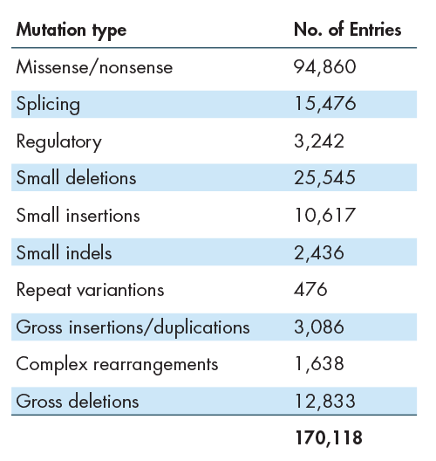
Can we use whole exome sequence data to calculate disease incidence?
Identify known disease-associated alleles for a particular gene.
  HGMD 170,118 disease associated mutation
Use Genome data to find allele frequency of known mutations in normal population.
  ExAC 60,706 human exomes
Calculate predicted incidence.
  Assume Hardy-Weinberg
Human Gene Mutation Database (HGMD) v2015 Q2
http://www.hgmd.cf.ac.uk/ac/index.php
170,118 Disease Variants
6,868 Genes
Exome Aggregation Consortium (ExAC), Cambridge, MA Release 0.3 (URL: http://exac.broadinstitute.org) 60,706 exomes
Stenson, P. D., Mort, M., Ball, E. V., Shaw, K., Phillips, A., and Cooper, D. N. (2014) Hum Genet 133, 1-9
http://dx.doi.org/10.1101/030338

Slide 5
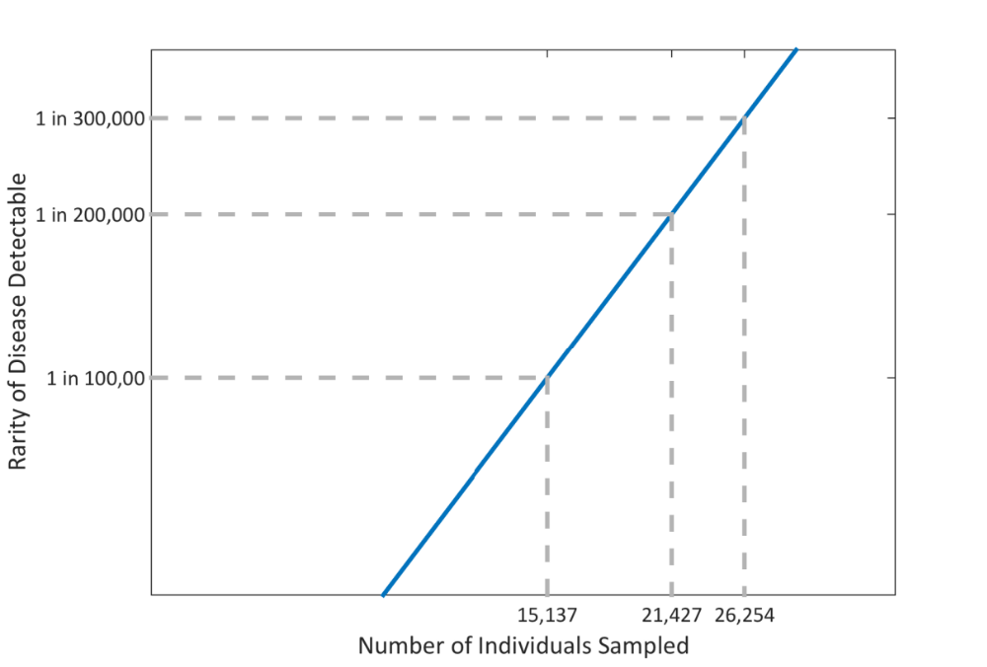
How many exomes do we need to get a good estimate of incidence?
For disease incidence of 1/200,000 (disease allele frequency p=0.0022) and 95% confidence level, a population size of 21,426 is needed to achieve a 20% margin of error in the disease associated allele estimation.
Notes:
95% confidence interval.

Slide 6
Many VUS are observed in ExAC: contributions to disease are unknown
Missense mutations in lysosomal genes
Disease | Gene | HGMD only | ExAC only | Both
Gaucher | GBA | 226 | 77 | 42
MPS II | IDS | 284 | 106 | 3
MLD | ARSA | 92 | 140 | 44
MPS VI | ARSB | 102 | 147 | 18
Morquio A | GALNS | 166 | 165 | 46
MPS IIIB | NAGLU | 66 | 165 | 24
CLN2 disease | TPP1 | 43 | 192 | 14
MPS IIIA | SGSH | 57 | 193 | 37
MPS I | IDUA | 90 | 202 | 21
Krabbe | GALC | 51 | 216 | 23
Niemann-Pick C | NPC1 | 190 | 352 | 58
Pompe | GAA | 177 | 356 | 61
NAGLU missense mutations
ExAC
N=190
HGMD
N=90
165
24
66
?
≤10% activity
Address the VUS problem with the NAGLU VUS experiment: Make all 165 VUS in ExAC and test for activity.
VUS = Variants of unknown significance

Slide 7
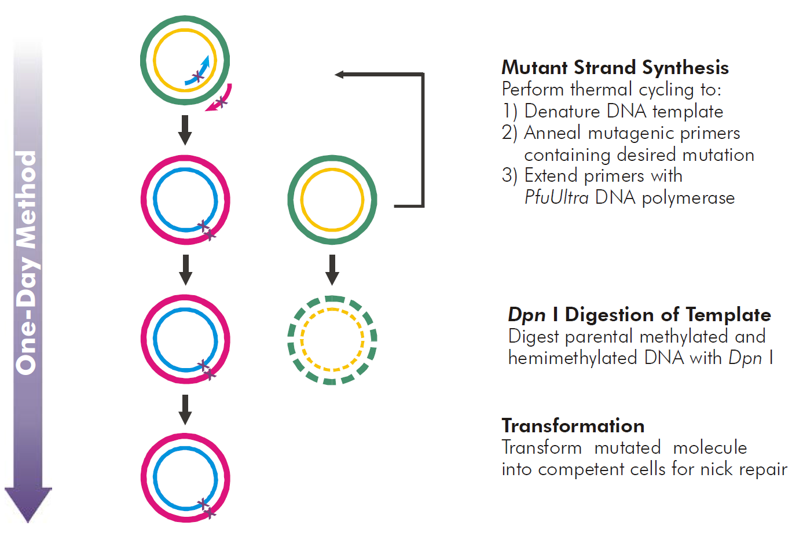
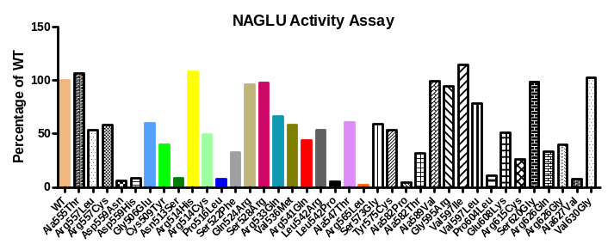
NAGLU enzymatic activity assay to characterize VUSs
Mutagenesis
Sequence to verify
Transfect HEK293 cells
  3 independent transfections 12 well plates
Assay NAGLU activity in lysates 72 hrs post-transfection
  4-Methylumbelliferyl N-acetyl-α-D-glucosaminide substrate
    Normalize to lysate protein
    Subtract background activity
  Western blots to look for processing
Normalize activity to wildtype transfected plasmid
  Report activity as % wildtype activity

Slide 8
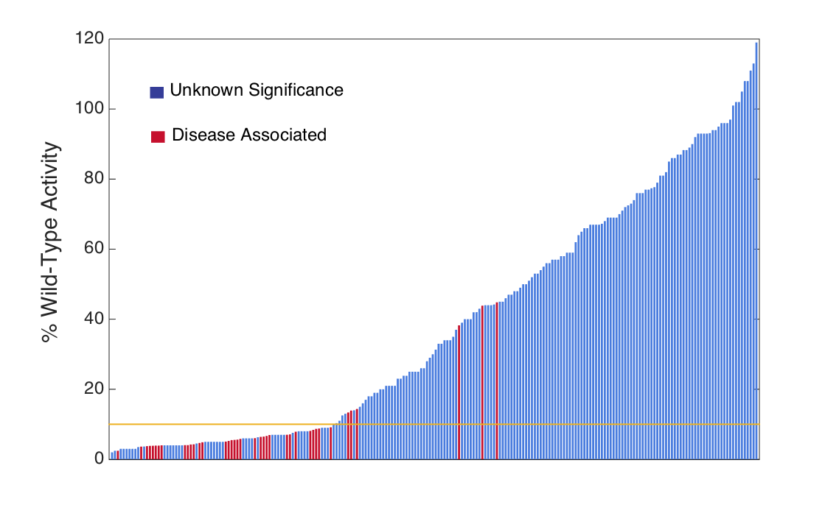
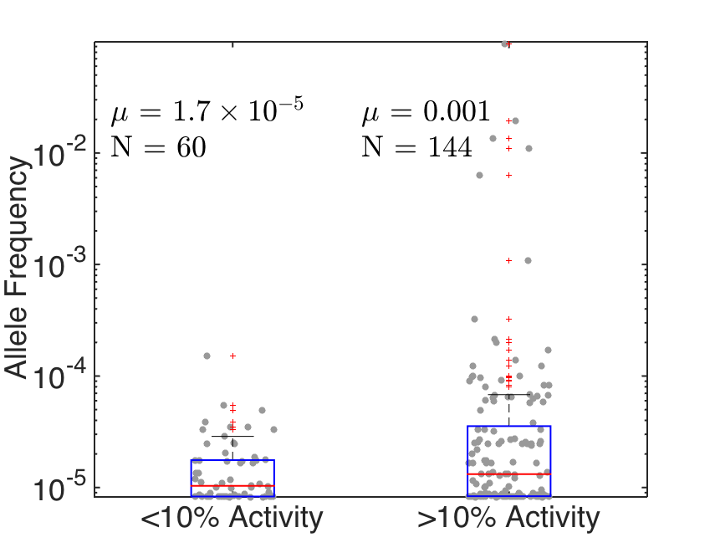
Activity profile of mutant NAGLU proteins: Deleterious variants are rare
Use of empirically determined mutants improves incidence calculation of MPS IIIB due to mutations in NAGLU
Higher than expected activity
1/2,224,527
1/425,863
1/236,523
Attenuated phenotype
1/1,442,647
1/813,877
1/304,195
10% activity cut-off
MPS IIIB birth prevalence estimate for Europe is 1:321,729. Heron, 2010

Slide 9
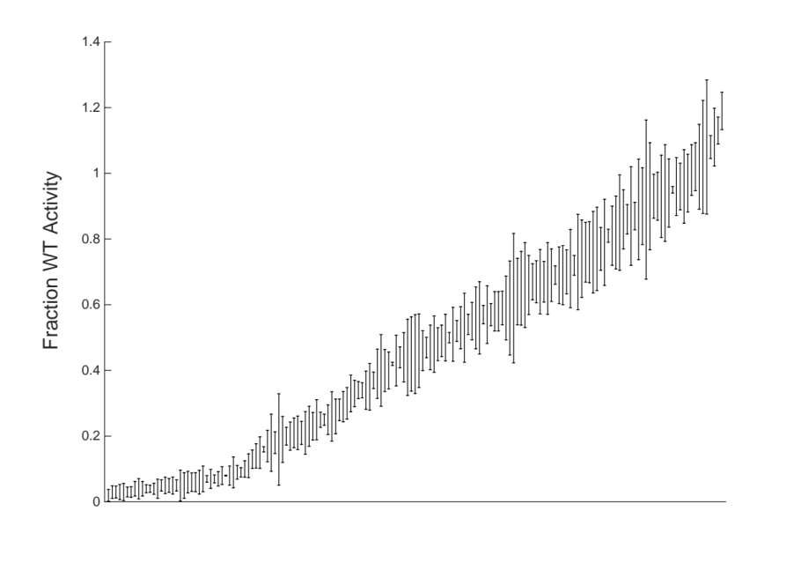
Experimental variation scales proportionally with observed fraction of WT activity

Slide 10
Incidence estimate is insensitive to threshold for deleterious mutations

Slide 11
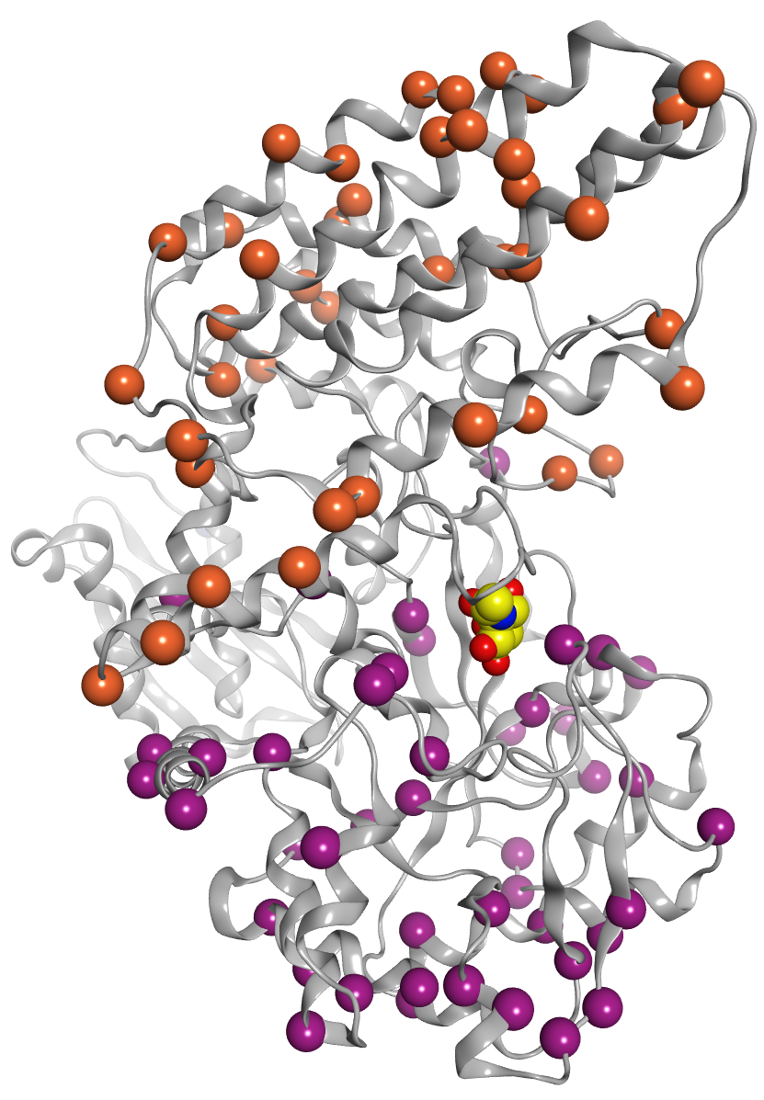
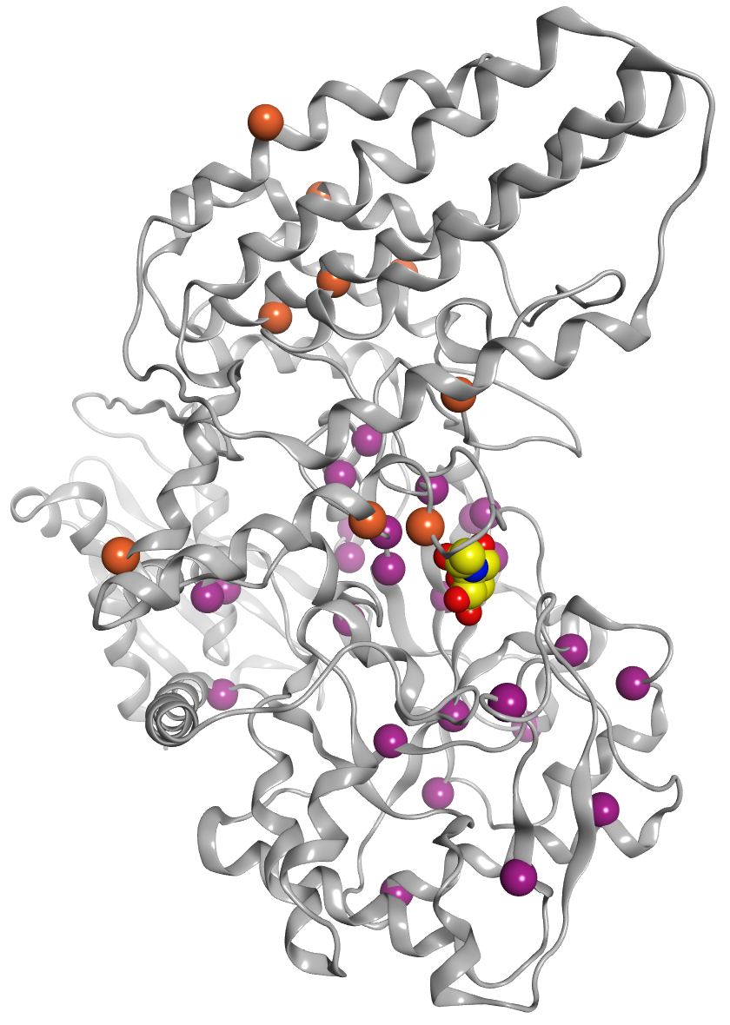
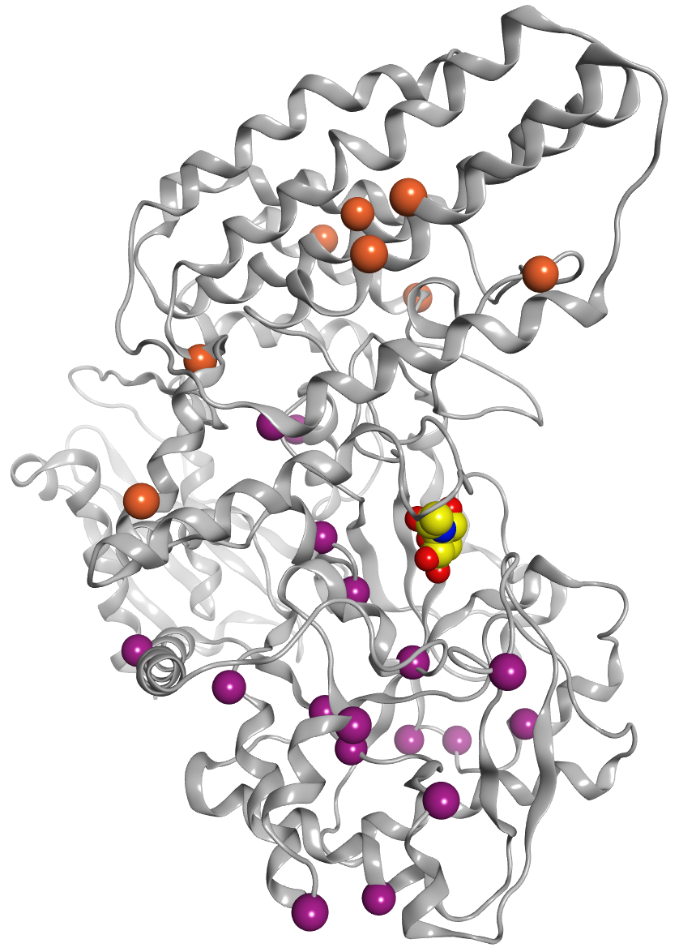
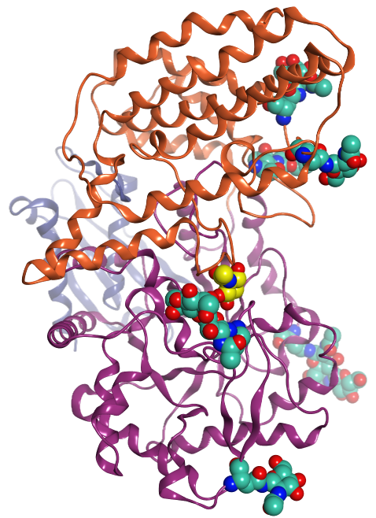
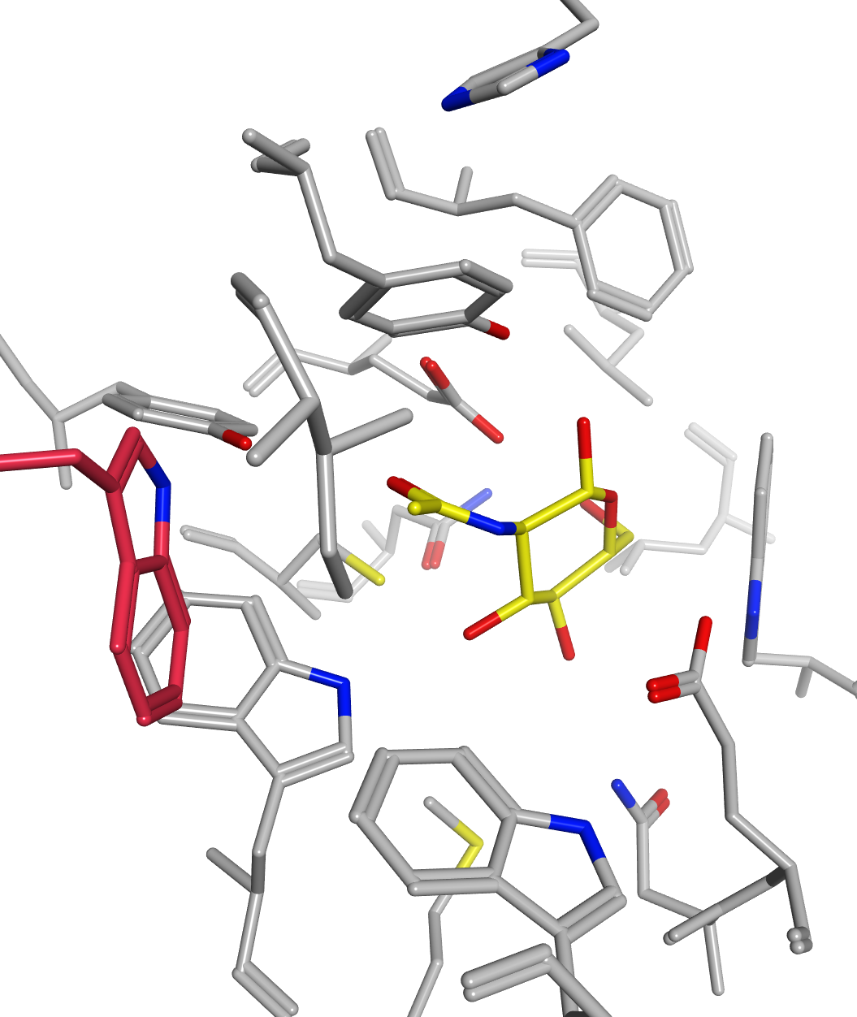
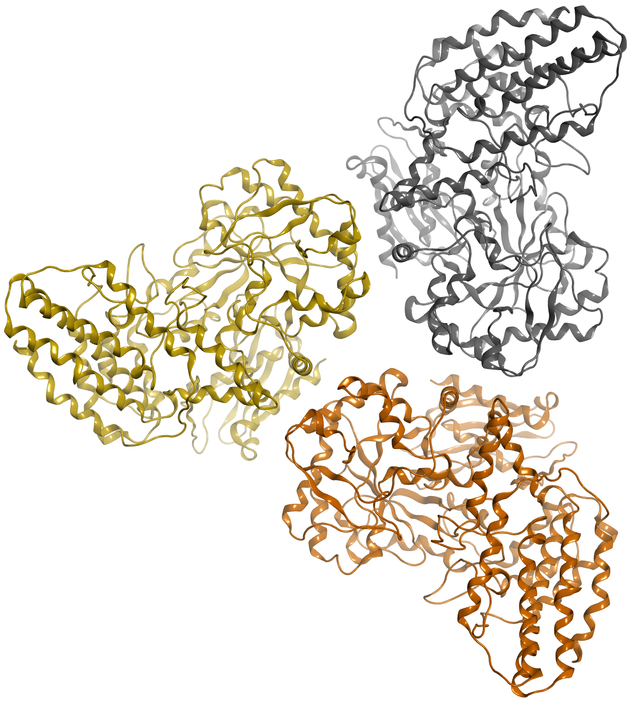
Mutations resulting in <10% wild-type NAGLU activity are scattered throughout the catalytic domain, and relatively near (NOT within) the active site, compared to less deleterious mutations
Helical Domain (III)
N-terminal
Domain (I)
β-D-GlcNAc
(modeled in active site)
2VCA.PDB. Ficko-Blean, E. et al
PNAS. 105:6560. 2008.
Catalytic
Domain (II)
W649
Glycans
NAGLU Monomeric Unit
Mutations are found near, but not within the active-site
(except for W649)
Mutation sites that lead to <10%
wild-type NAGLU enzyme activity
10-30%
>30%
NAGLU Trimer
Meiyappan et al. US 8,775,146 B2, 2014

Slide 12
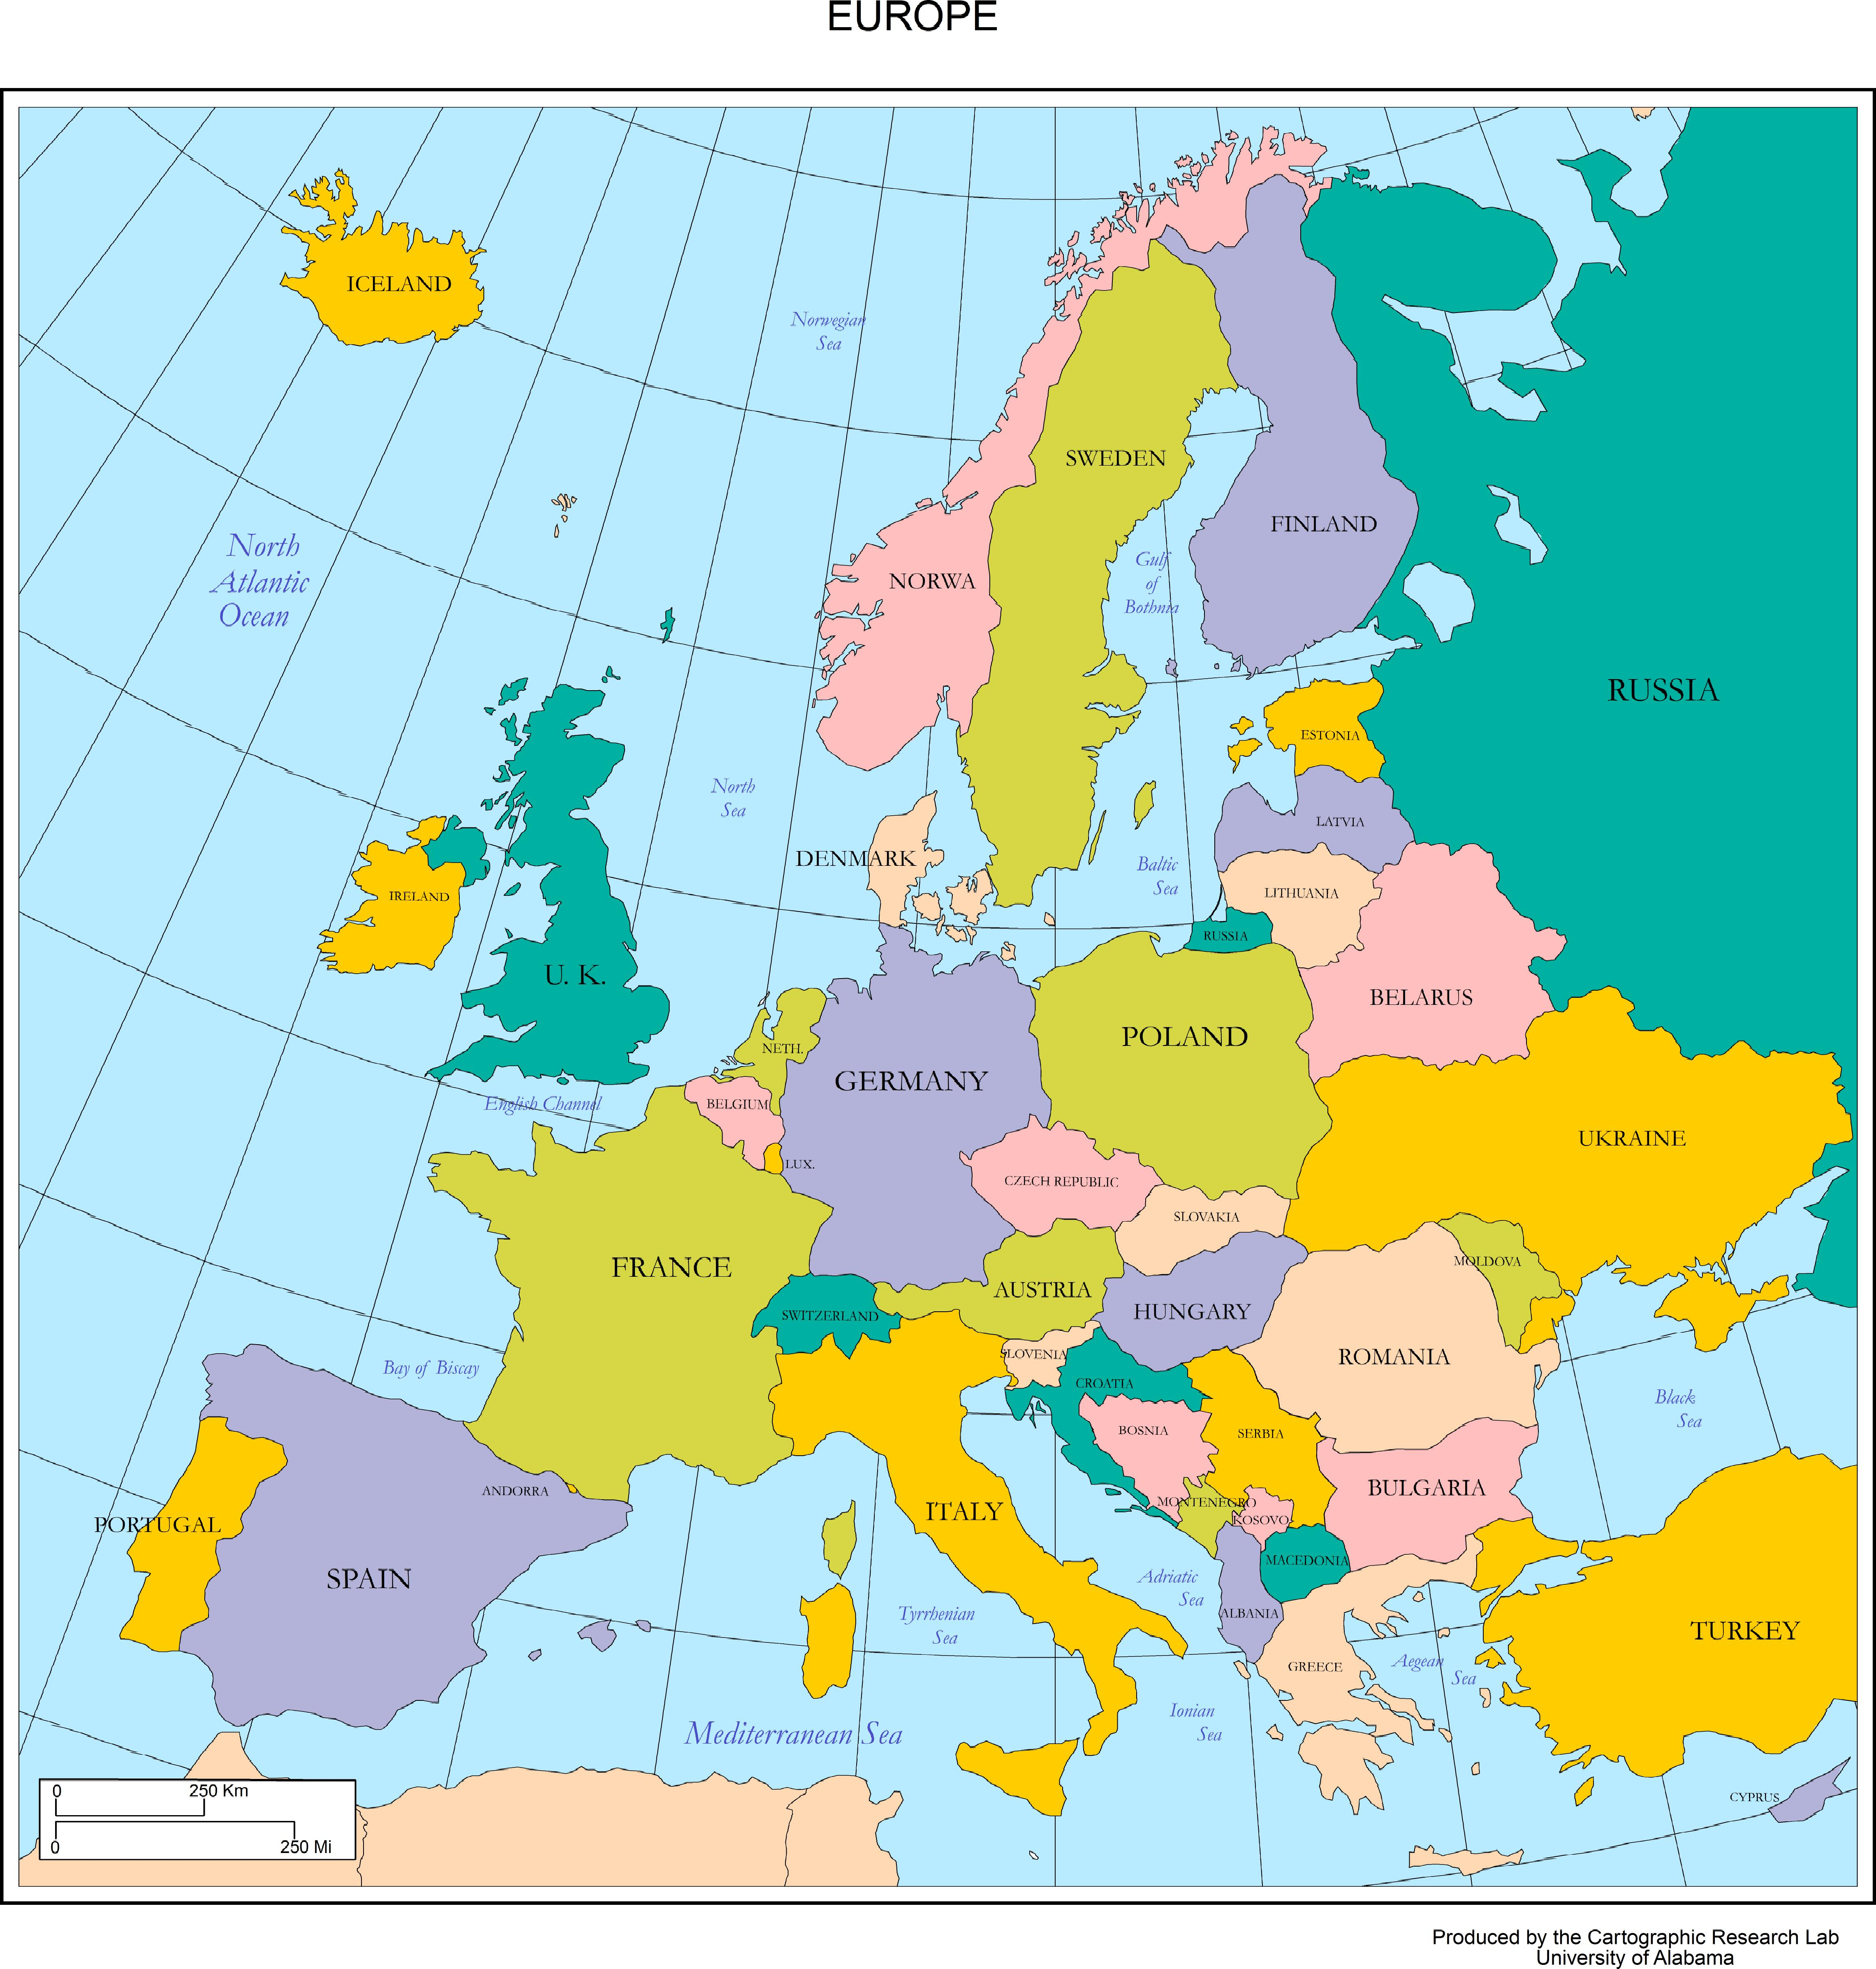
Conclusions
MPS IIIB Birth incidence in Europe (per 100,000)
Growing population sequence data now enables disease incidence estimates for rare monogenic disorders
  Population genetics based estimate of MPS IIIB incidence in Europe agrees with the observed incidence
    (0.33/100,000) this study
    (0.31/100,000) Heron, 2010
There’s plenty of room for improvement
  Must solve VUS problem
    High throughput variant screening
    Improved in Silico methods
  Must solve ethnogeographic problem – finer resolution of populations
  Must account for other types of mutation
NAGLU is a classic example of the relationship between structure/function
  Residues in the active site domain are susceptible
0.004
0.21
0.42
0.36
0.02
0.15
0.78
0.22
0.78
2.6
Baehner, 2005 J Inherit Metabol Dis; 28:1011-1017
Dionisi-Vici, 2002 J Pediatr; 140:321-7
Heron, 2010 Am J Med Genet; 155A:58-68
Malm, 2010 Acta Paediatr; 99:1253-7
Pinto, 2004 Eur J Hum Genet; 12: 87-92
Poorthuis, 1999 Hum Genet; 105:151-6
Poupetova, 2010 J Inherit Dis; 33:387-396
Notes:
Too wordy.

Slide 13
Acknowledgements
HD Bioscience
  Zhonghua Yan
BioMarin Research and Drug Discovery Team
  Larry Hengl
  NAGLU team

