Slide 1

CAGI slide pack guidelines
I agree to my slides being used according to the following terms:
_______Wyatt T. Clark_______
Authors: please include THIS slide at the beginning of your presentation to indicate that you agree with reuse of your slides in CAGI presentations, according to the terms below, and digitally sign by writing your name above.
To disseminate the CAGI results, I encourage all CAGI participants to remix these CAGI slides for inclusion in their oral and poster presentations
CAGI participants may use or publish any content of these slides only in compliance with the CAGI Data Use Agreement
CAGI participants may not cite or publish any content of these slides except with the written permission of the originating author or in the primary CAGI publications
CAGI participants must acknowledge the original authors of these slides and CAGI 2013. Include the acknowledgement banner across the bottom
CAGI participants must include the CAGI credits slide in their presentations
Slides with a red slash (no remix) may not be included in a presentation unless all attendees are registered CAGI participants who signed the data use agreement
Slides with a red X over the entire slide may not be used in any circumstances
Slides with a blue slash (embargoed) may not be used unless the embargo is explicitly lifted
Slides without slash or X may be tweeted unless flagged with the “No tweet” icon.
CAGI participants using these slides must explain the “No tweet” icon, which means that the slide content should not be disseminated outside the presenting conference hall. If the presentation venue permits pervasive tweeting, you may not include these slides in your talk
Note for slide authors: we expect all CAGI participants to abide by these restrictions, and will make best effort to ensure they are followed. However, but bear in mind that we have limited means of enforcing them, and therefore the restrictions cannot be guaranteed.

Slide 2
Evaluation of predictions of the impact of missense mutations in NAGLU on its enzymatic activity in the 4th CAGI challenge
Wyatt T. Clark, Jonathan H. LeBowitz, G. Karen Yu, Mika Aoyagi-Scharber BioMarin Pharmaceutical Inc. San Rafael, CA

Slide 3
Disclosure Information
Presenters have the following financial relationships to disclose:
Employees of: BioMarin Pharmaceutical Inc., San Rafael, CA

Slide 4
Participation in the NAGLU challenge was high
PolyPhen/SIFT/Provean
Structure
PSSM/MSA
Bromberg-1
Yes
No
Yes
Bromberg-2
Yes
No
Yes
Moult
Yes
Yes
?
Lictarge
No
No
Yes
Wei
Yes
Yes
Yes
Mooney-1
Yes
No
Yes
Mooney-2
Yes
No
Yes
Mooney-3
Yes
No
Yes
Jones-1
No
Yes
Yes
Jones-2
No
No
Yes
Jones-3
No
No
No
Jones-4
No
No
Yes
UNC Charlotte
Yes
No
No
Casadio-1
No
Yes
No
Casadio-2
No
Yes
No
Yang
No
No
No
Dunbrack
Yes
Yes
Yes

Slide 5
What is the best way to evaluate performance?
RMSD
Linear, Scale Dependent
Perfectly scaled activity
Pearson’s r
Linear, Scale Invariant
Allows shift/stretch in activity
Spearman’s rho
Non-Linear, Scale Invariant
Ranked correctly according activity
AUC
Binary, Scale Invariant
Disease variants ranked higher/lower than neutral

Slide 6
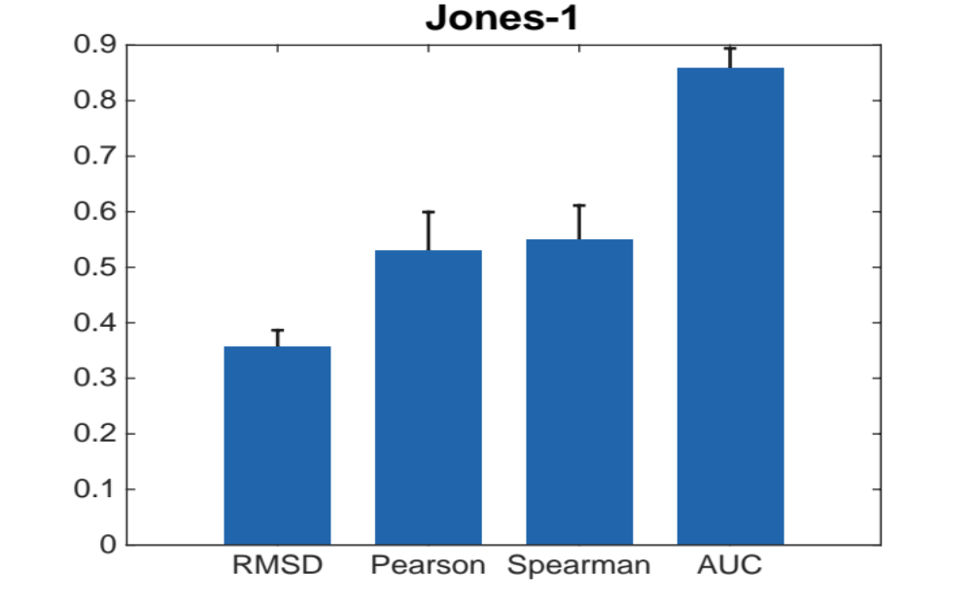
Evaluating an individual model on its own using different metrics is not very informative

Slide 7
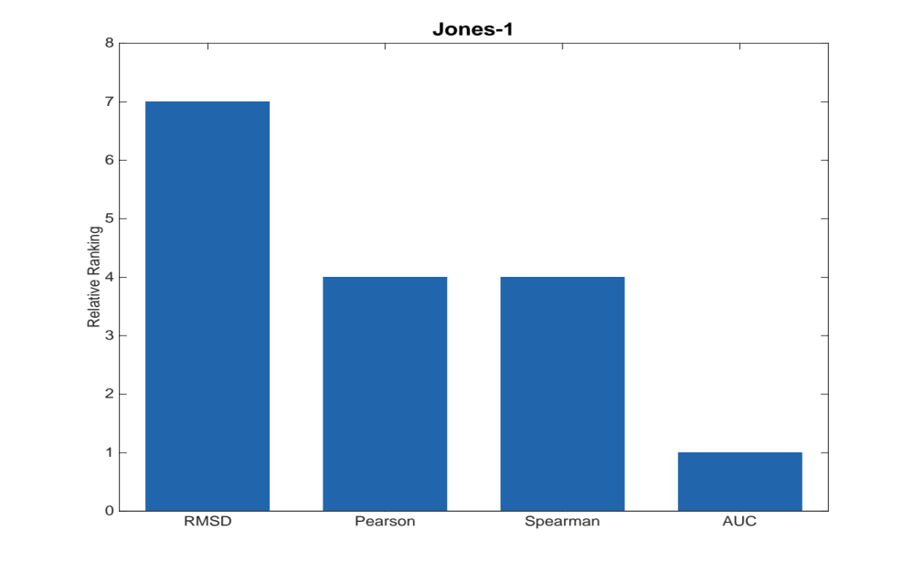
But comparing to other methods can illustrate important characteristics of the model
Drastic change in ranking between RMSD and Pearson indicates a correlation with enzymatic activity, but improper scaling/a shift
Relative Rank

Slide 8
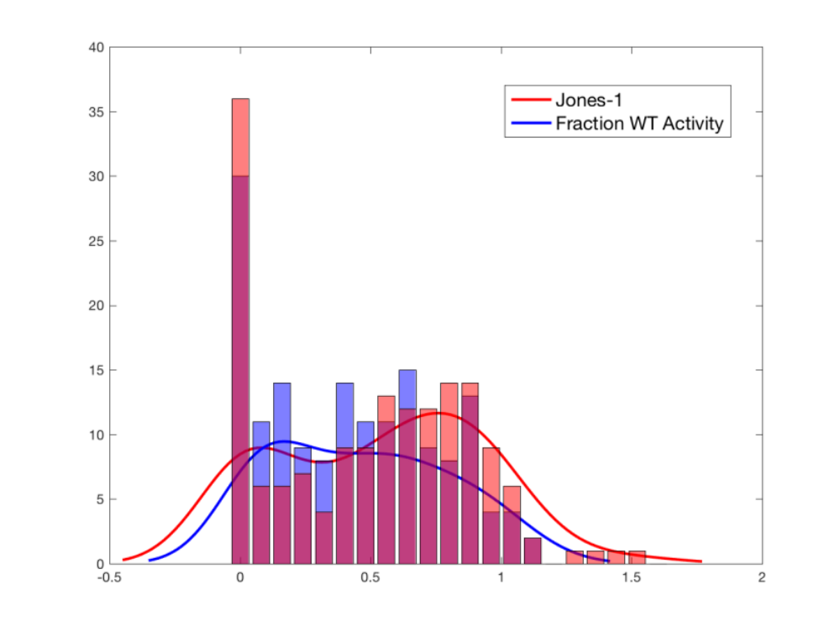
This can be seen when comparing the distribution of scores generated by the model to observed activity values

Slide 9
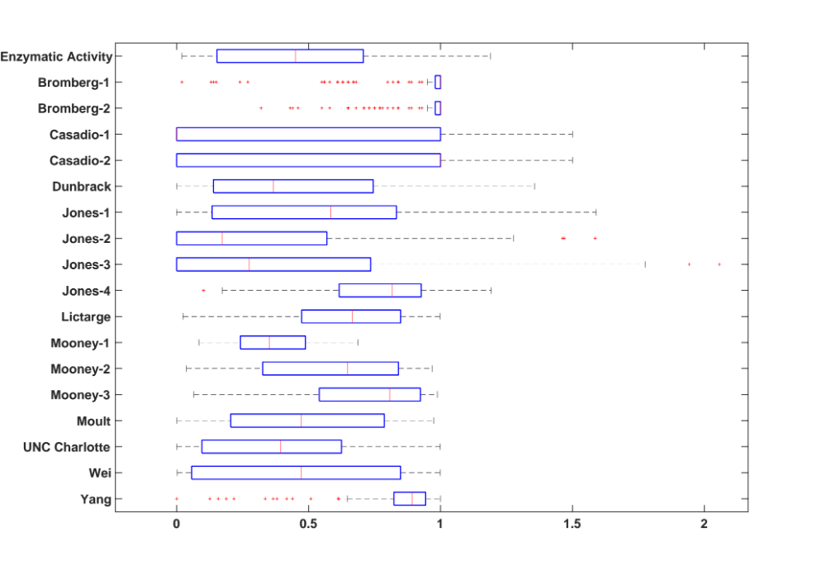
Many models had trouble producing the right distribution of scores

Slide 10
Generally though, ranking are relatively stable regardless of the metric used
S
S
S
S
S
= NAGLU structure used

Slide 11
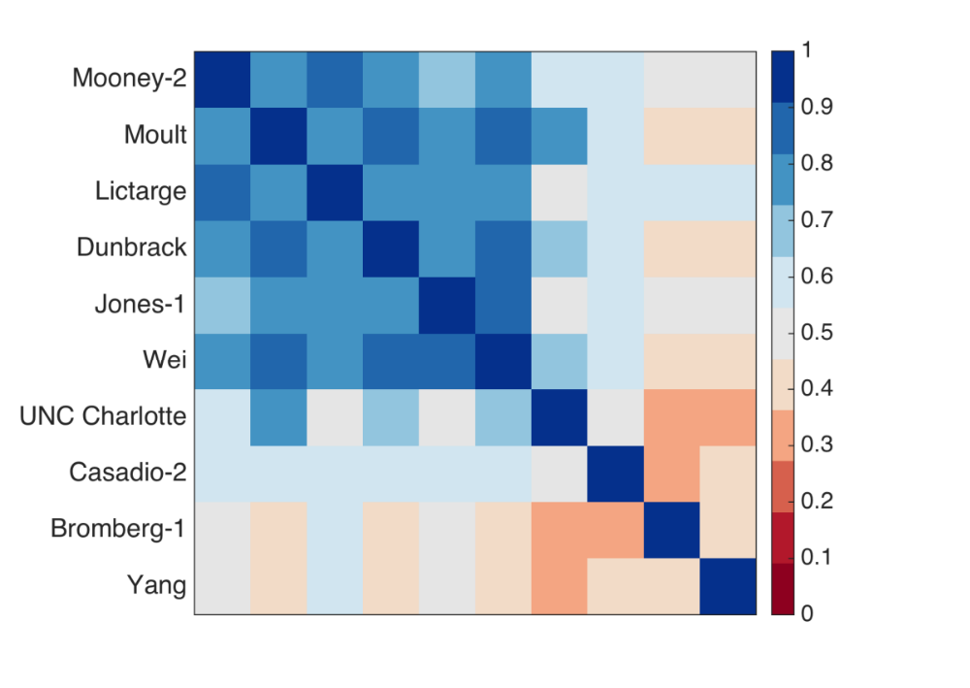
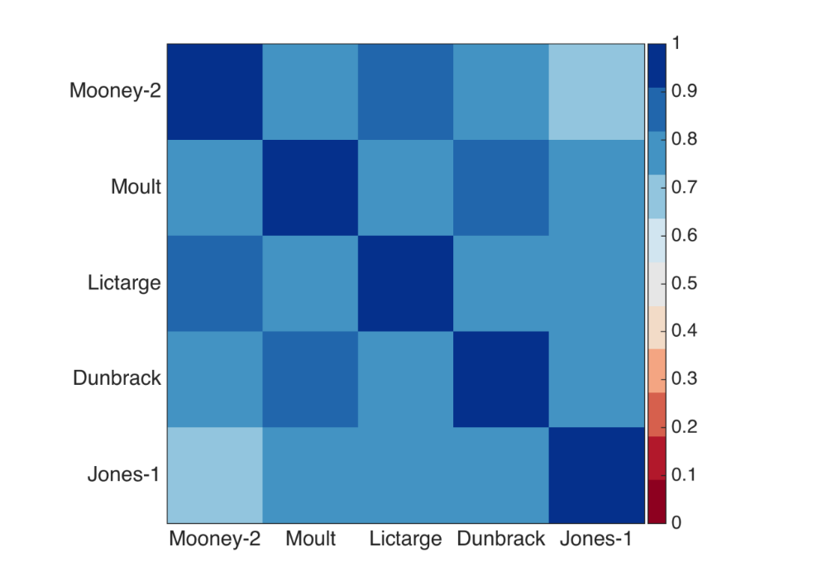
Although top performing models are independent in terms of predictions and evaluation scores*, they are significantly correlated using Pearson’s r
Intensity represents absolute value of Pearson’s r given predicted fWT activity for NAGLU variants
*Using a paired two-tailed t-test, at the 5% significance level

Slide 12
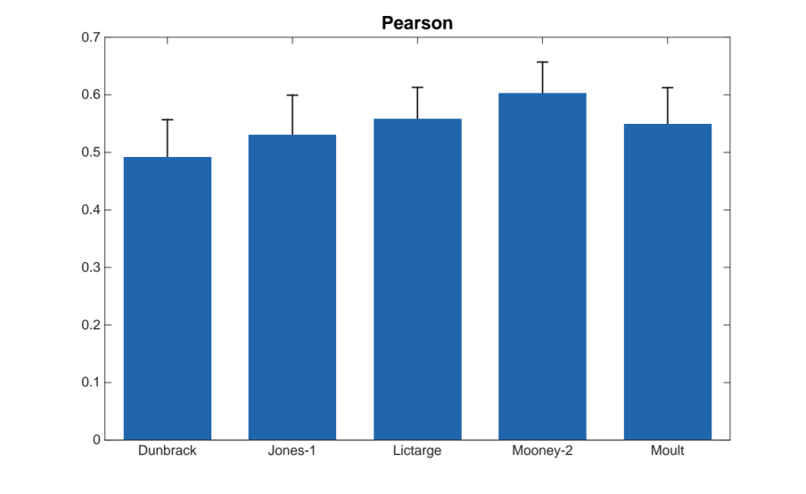
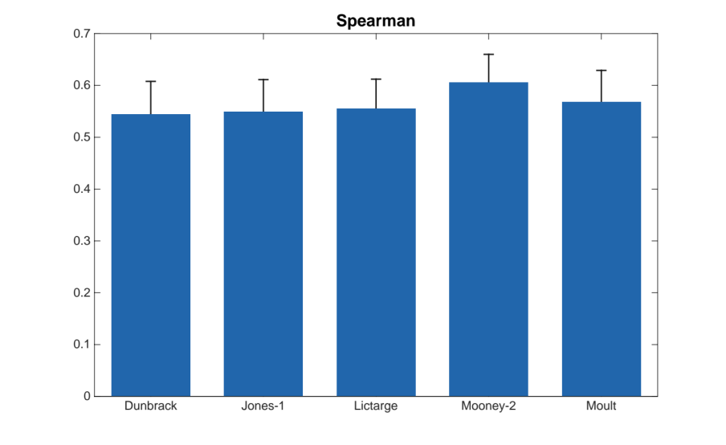
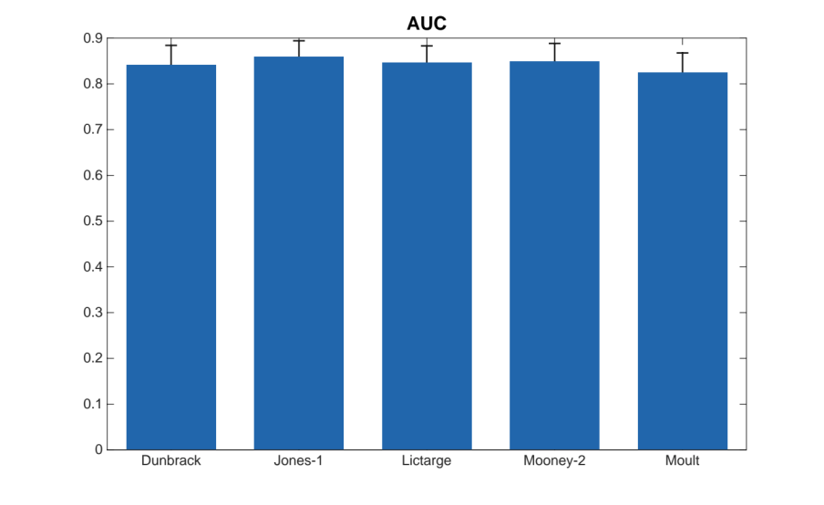
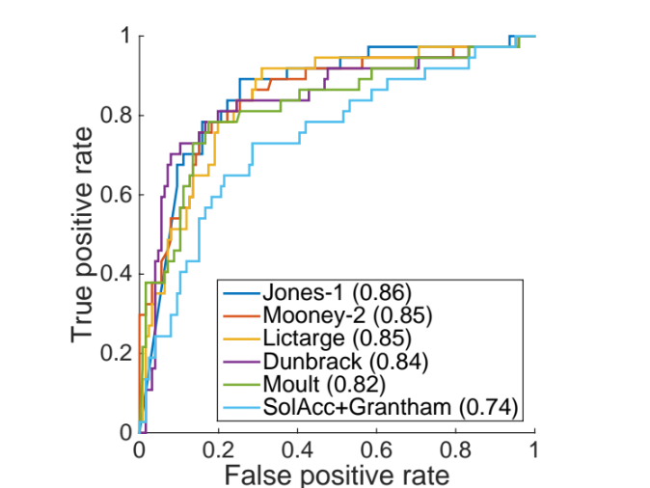
Is this correlation due to the fact they are predicting enzymatic activity well, or have the same biases

Slide 13
Sometimes, it’s useful to just look at the scatter-plot

Slide 14
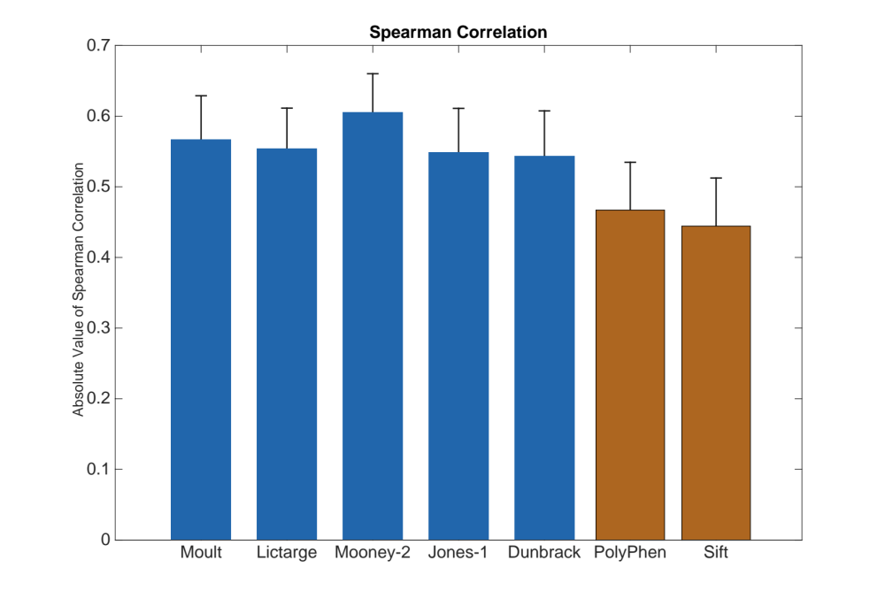
While there is always room for improvement, submitted models do show advances when compared to off the shelf methods

Slide 15
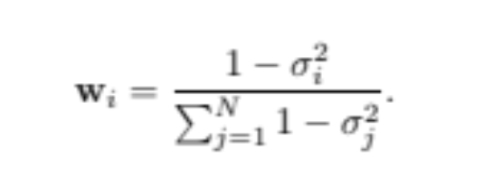
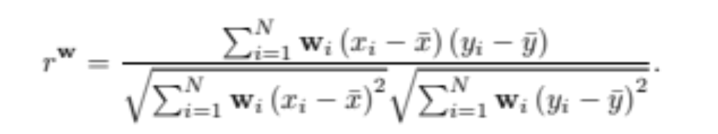
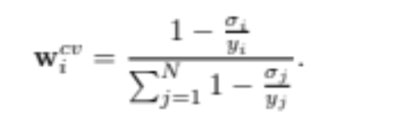
We can take experimental variation into account when evaluating predictions
High Variance = Lower Weight
Variants are assigned weights that are inversely proportional to the standard deviation of coefficient of variation in their observed activity.
Pearson’s r was then calculated by taking into account the weight of each variant

Slide 16
Using CV causes a bigger shift in coefficients than standard deviation

Slide 17
It is also useful to consider which variants are easy or hard for models to predict their enzymatic activity
Easy
Hard
ID | fWT | Avg RMSD (Top 5) | Rank (All Methods)
W649S | 0.03 | 0.03 | 163
G399V | 0.05 | 0.04 | 121
Y455S | 0.03 | 0.04 | 156
L281P | 0.06 | 0.05 | 130
F354S | 0.07 | 0.05 | 120
D559H | 0.07 | 0.05 | 151
S456F | 0.23 | 0.05 | 62
W404C | 0.02 | 0.06 | 162
W361S | 0.07 | 0.06 | 150
Y131S | 0.04 | 0.06 | 152
ID | fWT | Avg RMSD (Top 5) | Rank (All Methods)
P283L | 1.19 | 1.05 | 2
K729R | 0.08 | 0.90 | 4
V369L | 0.14 | 0.88 | 1
E251K | 0.18 | 0.80 | 6
S449N | 0.21 | 0.80 | 3
I290V | 0.21 | 0.78 | 5
A627V | 0.08 | 0.72 | 8
G596C | 1.02 | 0.69 | 7
T339P | 0.05 | 0.63 | 12
R377H | 0.06 | 0.58 | 11

Slide 18
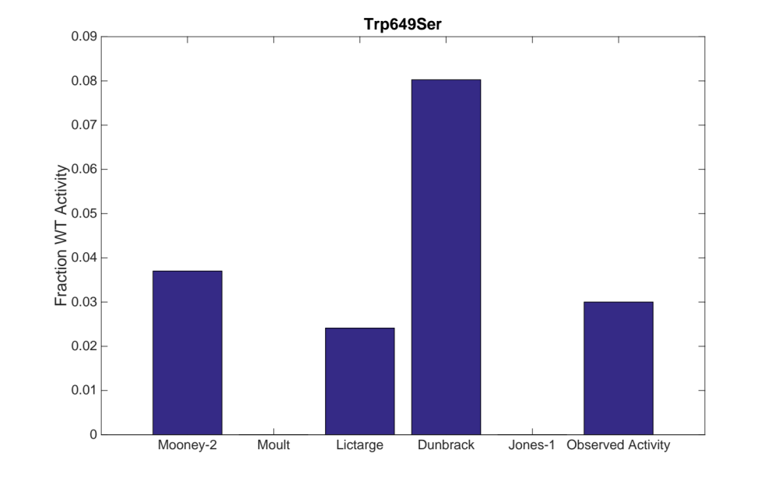
Some variants are easy for the top models to predict enzymatic activity
Two known disease causing mutations at this protein position

Slide 19
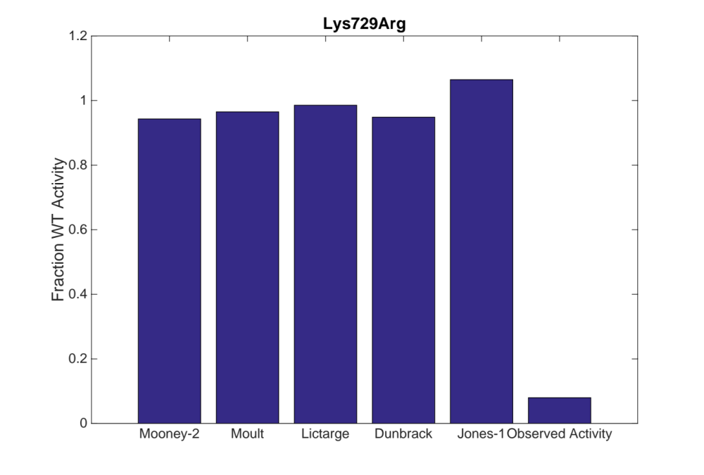
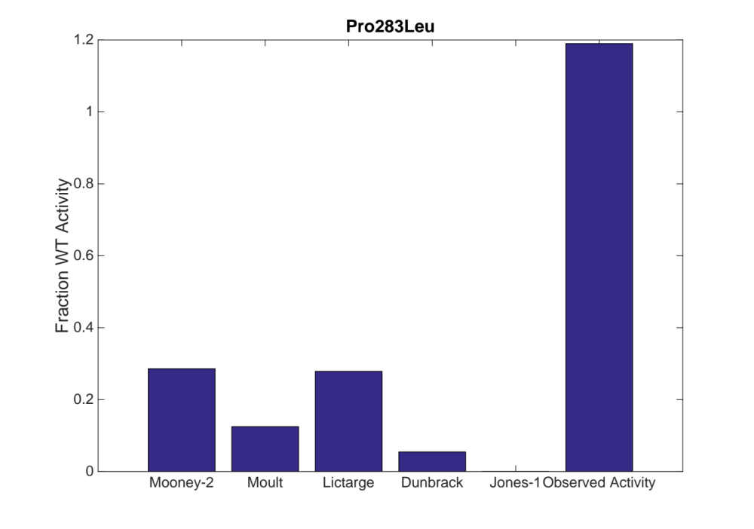
It is difficult for the top models to predict enzymatic activity for some variants
No clear reason why these variants are hard to predict.

Slide 20
Conclusions
Benchmarking predictors using different metrics can reveal characteristics about the predictor
  Improper scaling or shifts in predictions
  Most useful when comparing to other models
Top performing models are highly correlated
  Is this due to similar biases, or accuracy in recapitulating enzymatic activity values?
Top performing models show improvements when compared to off the shelf predictors
We can identify variants which are easy/hard for all models to predict enzymatic activity
  We can only speculate why
  It might be useful to dig into the “black boxes” in order to figure out why

Slide 21
Acknowledgements
CAGI Participants
CAGI Organizers
BioMarin Research and Drug Discovery Team
  Jonathan LeBowitz
  Karen Yu
  Larry Hengl
  NAGLU team
HD Bioscience
  Zhonghua Yan

Slide 22
Supplemental Slides

Slide 23
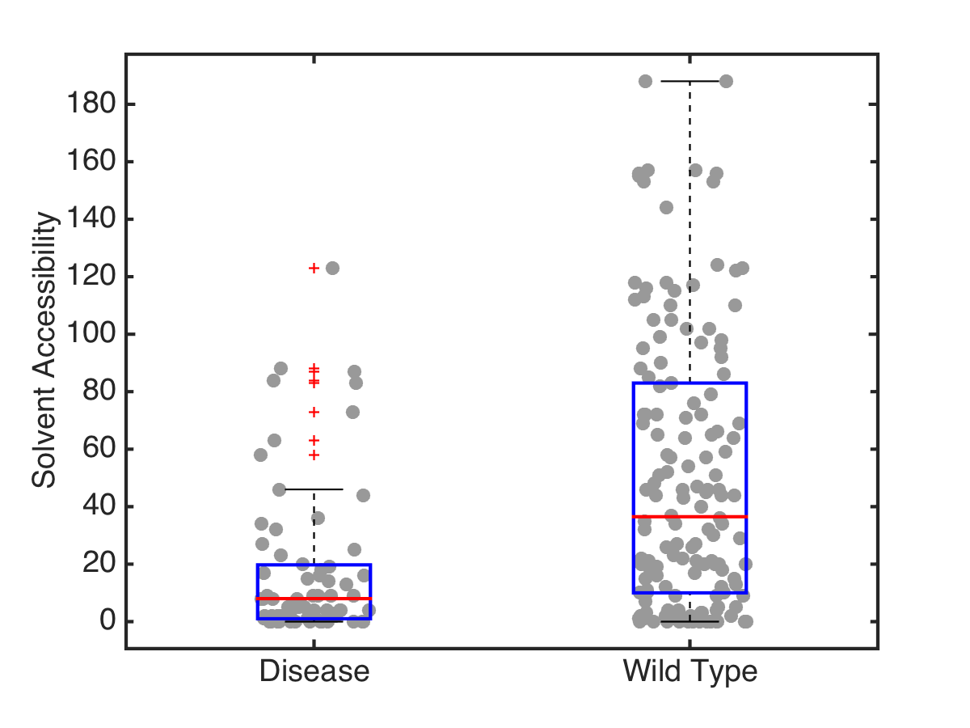
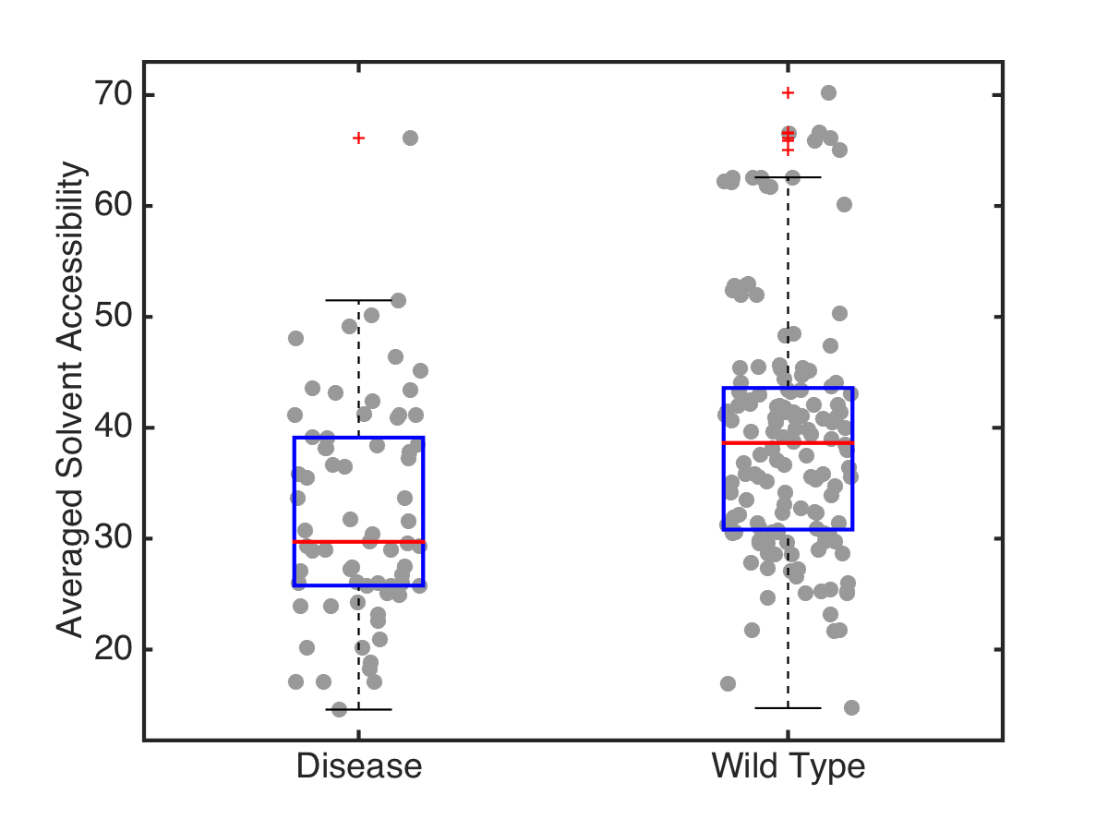
Structural information is useful for inferring impact on enzymatic activity
Pearson’s r=.2743
p=4.6x10⁻⁵
Pearson’s r=.3397
p=3.7x10⁻⁷

Slide 24
Scatter plots

Slide 25
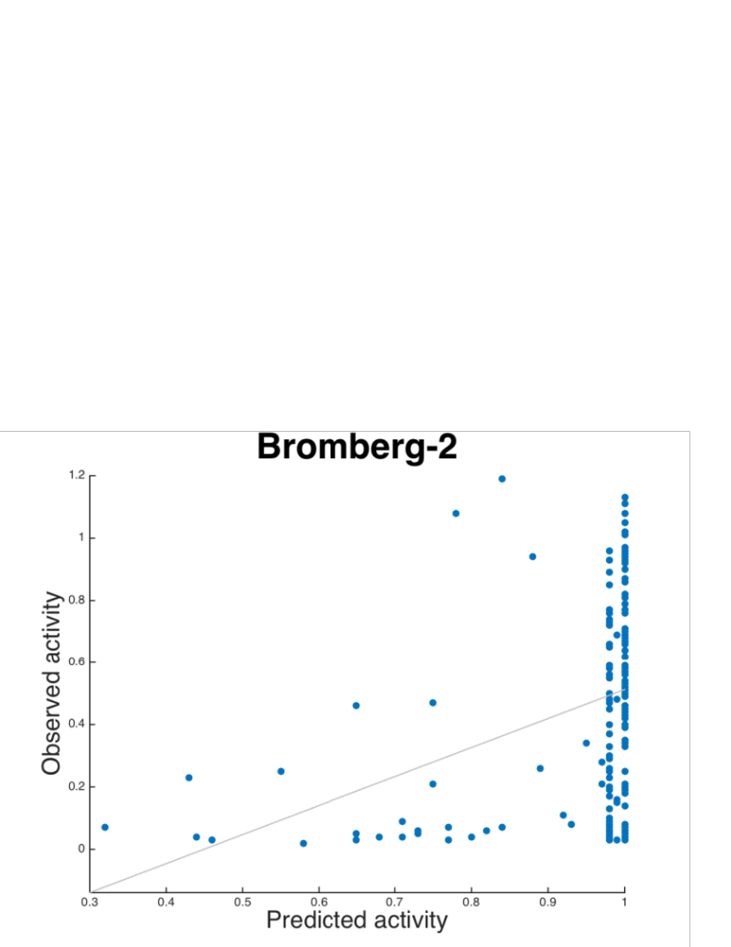

Slide 26
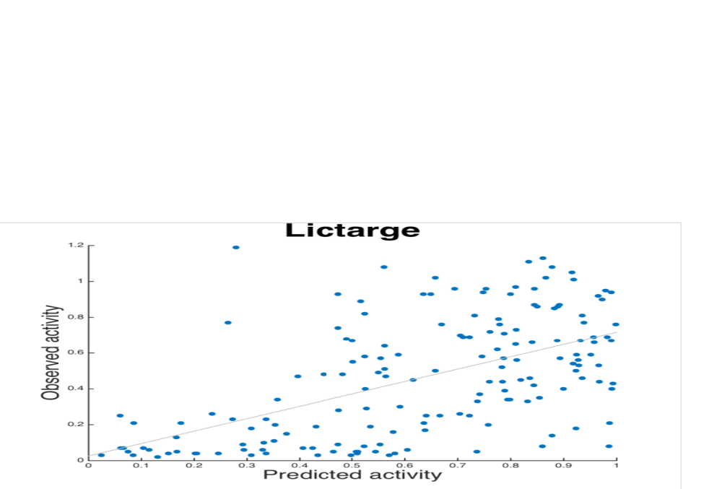

Slide 27
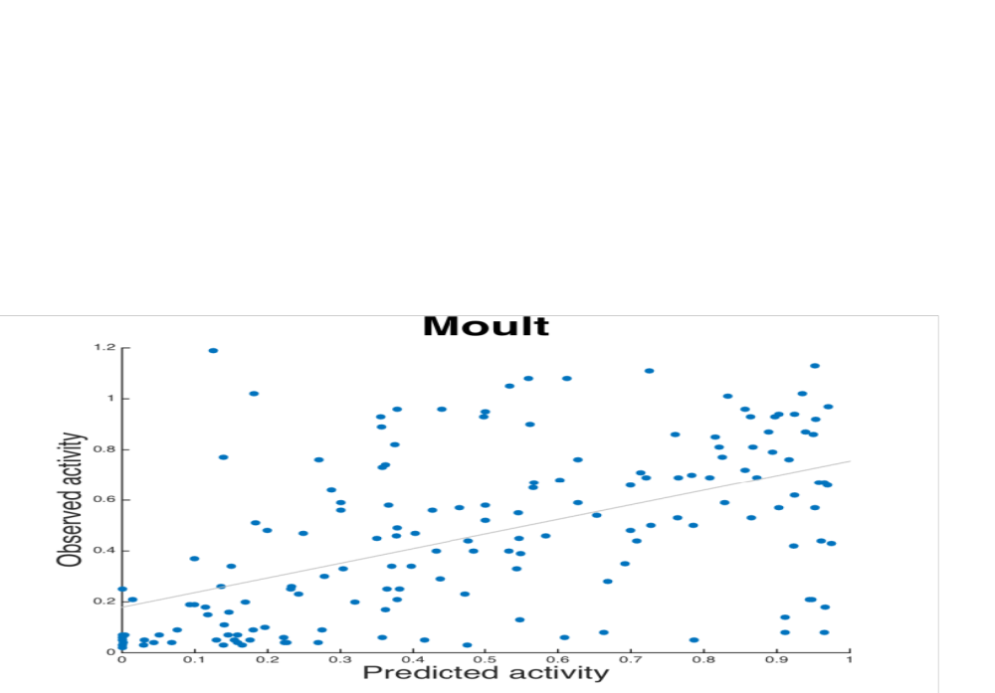

Slide 28
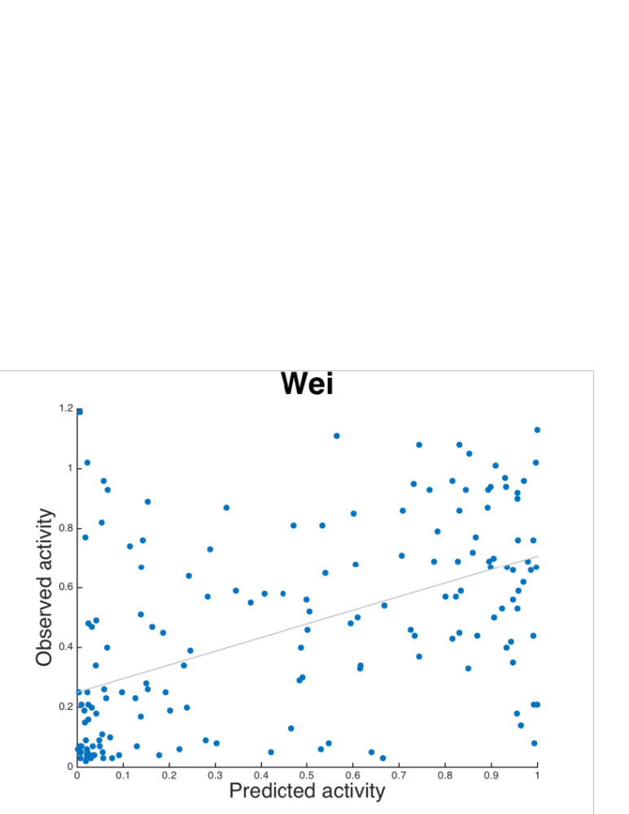

Slide 29
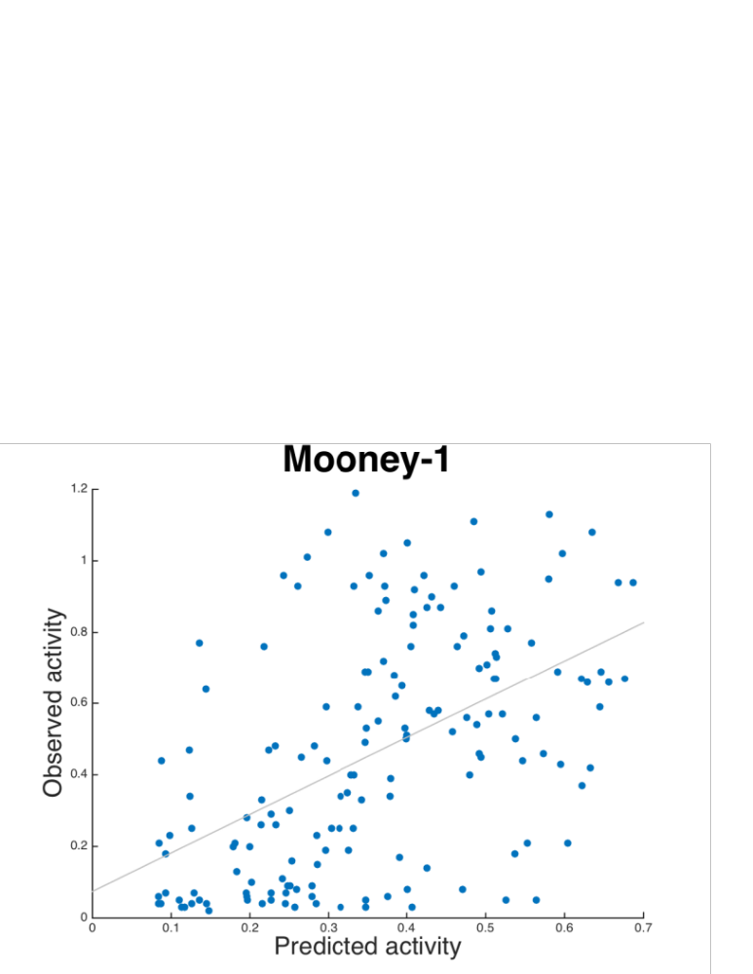

Slide 37
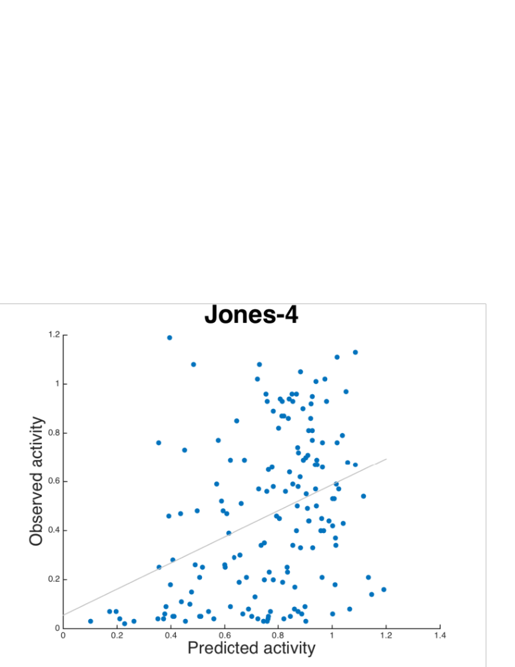

Slide 38
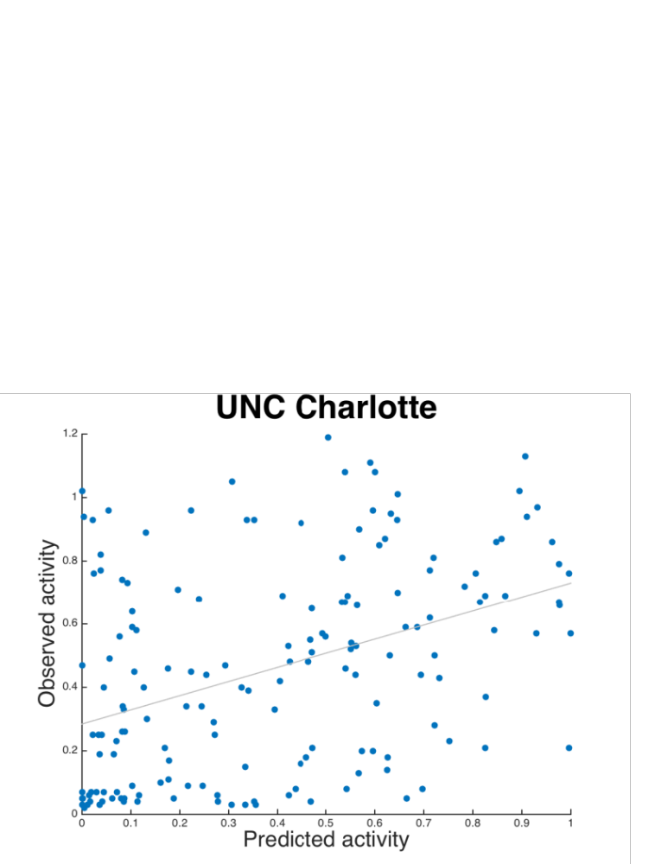

Slide 39
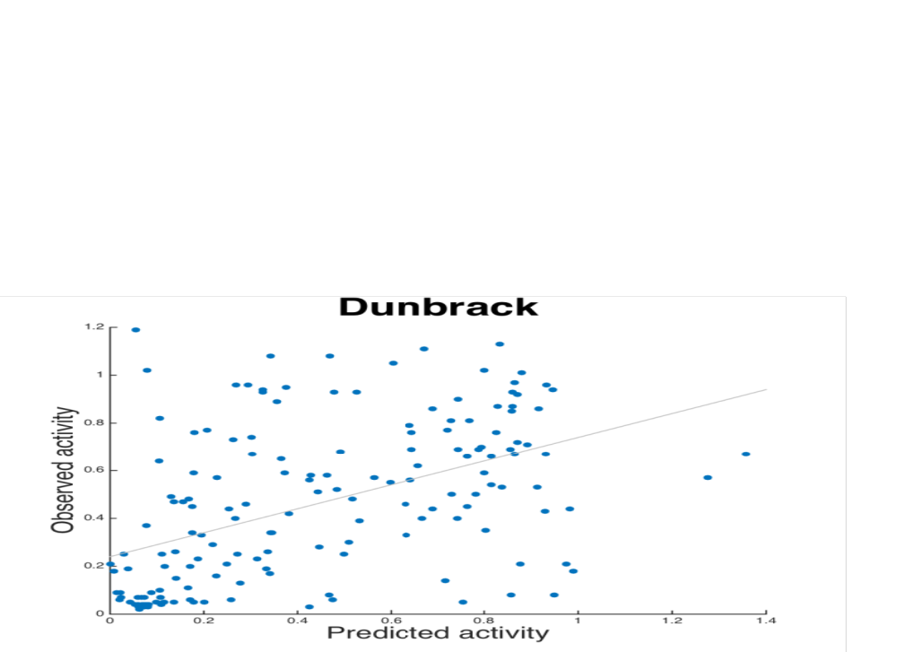

Slide 40
