Slide 1

CAGI slide pack guidelines
I agree to my slides being used according to the following terms:
_______Yao Fu_______
Authors: please include THIS slide at the beginning of your presentation to indicate that you agree with reuse of your slides in CAGI presentations, according to the terms below, and digitally sign by writing your name above.
To disseminate the CAGI results, I encourage all CAGI participants to remix these CAGI slides for inclusion in their oral and poster presentations
CAGI participants may use or publish any content of these slides only in compliance with the CAGI Data Use Agreement
CAGI participants may not cite or publish any content of these slides except with the written permission of the originating author or in the primary CAGI publications
CAGI participants must acknowledge the original authors of these slides and CAGI 2013. Include the acknowledgement banner across the bottom
CAGI participants must include the CAGI credits slide in their presentations
Slides with a red slash (no remix) may not be included in a presentation unless all attendees are registered CAGI participants who signed the data use agreement
Slides with a red X over the entire slide may not be used in any circumstances
Slides with a blue slash (embargoed) may not be used unless the embargo is explicitly lifted
Slides without slash or X may be tweeted unless flagged with the “No tweet” icon.
CAGI participants using these slides must explain the “No tweet” icon, which means that the slide content should not be disseminated outside the presenting conference hall. If the presentation venue permits pervasive tweeting, you may not include these slides in your talk
Note for slide authors: we expect all CAGI participants to abide by these restrictions, and will make best effort to ensure they are followed. However, but bear in mind that we have limited means of enforcing them, and therefore the restrictions cannot be guaranteed.

Slide 2
Genotype-phenotype association prediction

Slide 3
Outline
Data filtering
Gene/variant – phenotype mapping
Estimation of the probability each variant is damaging to protein function
Estimation of the probability each individual has particular phenotype
Created for CAGI 2016
genomeinterpretation.org

Slide 4
1. Data filtering
Filtering Criteria:
Variants with low quality
Variants with population-specific allele frequency > 5% in 1KG or ESP (Exome Sequencing Project)
Synonymous / intergenic / variants in non-protein coding transcripts (VEP annotation)
Variants with allele counts > 20 across individuals
McLaren et al., Bioinformatics 2010
1000 Genomes Project Consortium, Nature 2012
Created for CAGI 2016
genomeinterpretation.org

Slide 5
2. Gene/variant – phenotype mapping
Genes were mapped to the 14 diseases based on Hopkins diagnostic panel, OMIM and GeneReviews.
Inheritance pattern extracted. If none, recessive model was assumed.
Prevalent and penetrance for each gene-phenotype pair were downloaded from Rong Chen’s lab.
The ClinVar (Jan 2015), HGMD (2014.4), OMIM and literatures were interrogated for variants in the panel (extract known pathogenic and benign variants).
Landrum et al., NAR 2014
Online Mendelian Inheritance in Man, OMIM®
The Human Gene Mutation Database (HGMD®)
GeneTests Medical Genetics Information Resource
Created for CAGI 2016
genomeinterpretation.org

Slide 6
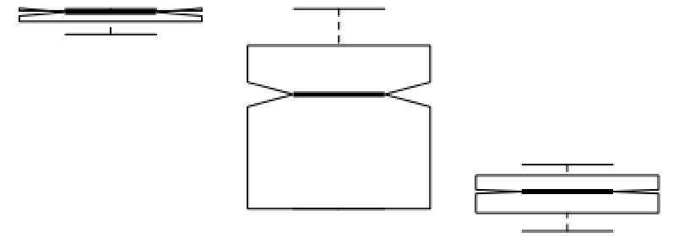
3. Estimation of the probability each variant is damaging to protein function
Damaging probability is calculated for various impact categories:
Nonsense/frameshift variants are scored with ALoFT, and rescaled to 0.7~1
Missense variants: 9 prediction algorithms from dbNSFP v3.0c. Fraction of the algorithms that predict the variant to be deleterious is calculated and rescaled to 0.5~1
Inframe variants are approximated with allele frequency, rescaled to 0.6~1
Splicing donors/receptors are filtered and assigned score 0.9
Intronic variants are annotated with CADD v1.3, and CADD Phred scores are rescaled across all intronic, splice and UTR variants to 0~0.4.
Known pathogenic variants are assigned with 1, whereas benign ones are assigned with 0.01.
1
Damaging Score
Frameshift / nonsense
Intronic/UTR/splice
0
Missense
Liu et al., Human Mutation 2016
Kircher et al., Nature Genetics 2014
Created for CAGI 2016
genomeinterpretation.org

Slide 7
4. Estimation of the probability each individual has particular phenotype
Given G genes known to be associated with phenotype j, the probability of individual i having the phenotype is calculated as the probability that at least one gene causes the phenotype:
To calculate , we consider the inheritance pattern of the gene-phenotype pair. K(g) denotes all variants observed in g.
  1. Dominant (gene harbors at least one damaging variant)
Created for CAGI 2016
genomeinterpretation.org

Slide 8
4. Estimation of the probability each individual has particular phenotype (cont.)
  2. Recessive
* compound heterozygosity (gene harbors at least two damaging mutations)
* single mutation (c - estimation of false negative observation of deleterious variant)
Confidence level
High confidence is assigned to individual with high prediction variance across phenotypes and with high prediction score.
Causal variants
The most likely damaging variants in genes associated with the phenotype
Created for CAGI 2016
genomeinterpretation.org
Notes:
Set to 0.1

Slide 9
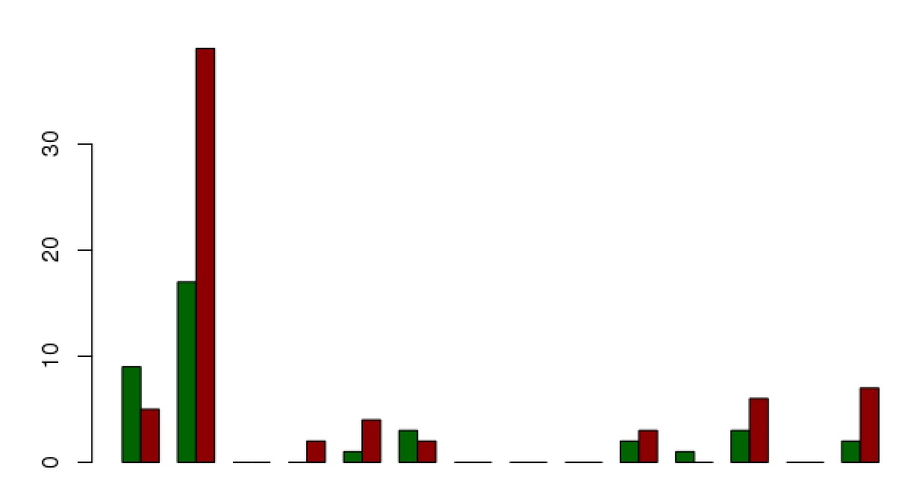
Results
Prediction score:
Within individual, assign phenotype with the highest prediction score:
  13 correct predictions (initial submission)
  38 correct predictions (VCF issue adjusted)
Correct cases
Missed cases
1
2
3
4
5
6
7
8
9
10
11
12
13
14
Phenotype
Created for CAGI 2016
genomeinterpretation.org
Notes:
38 correct predictions (13)

Slide 10
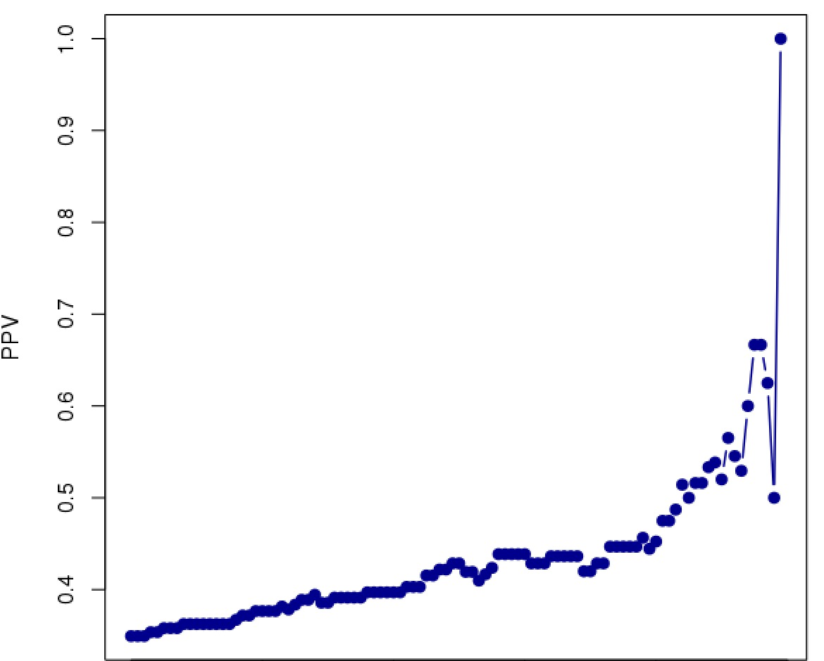
Confidence level:
Get all predictions for a confidence cut-off. If one individual has multiple predictions, take the one with highest confidence, and calculate PPV = TP/(TP+FP)
0.9
1
Low confidence
High confidence
Created for CAGI 2016
genomeinterpretation.org
Notes:
38 correct predictions (13)

Slide 11

Acknowledgement
Aparna Chhibber
Hugo YK Lam
James Warren
Michael Braverman
Narges Bani Asadi
Created for CAGI 2016
genomeinterpretation.org
Notes:
38 correct predictions (13)

