Slide 1

CAGI slide pack guidelines
I agree to my slides being used according to the following terms:
Sohela Shah
To disseminate the CAGI results, I encourage all CAGI participants to remix these CAGI slides for inclusion in their oral and poster presentations
CAGI participants may use or publish any content of these slides only in compliance with the CAGI Data Use Agreement
CAGI participants may not cite or publish any content of these slides except with the written permission of the originating author or in the primary CAGI publications
CAGI participants must acknowledge the original authors of these slides and CAGI 2013. Include the acknowledgement banner across the bottom
CAGI participants must include the CAGI credits slide in their presentations
Slides with a red slash (no remix) may not be included in a presentation unless all attendees are registered CAGI participants who signed the data use agreement
Slides with a red X over the entire slide may not be used in any circumstances
Slides with a blue slash (embargoed) may not be used unless the embargo is explicitly lifted
Slides without slash or X may be tweeted unless flagged with the “No tweet” icon.
CAGI participants using these slides must explain the “No tweet” icon, which means that the slide content should not be disseminated outside the presenting conference hall. If the presentation venue permits pervasive tweeting, you may not include these slides in your talk
Note for slide authors: we expect all CAGI participants to abide by these restrictions, and will make best effort to ensure they are followed. However, but bear in mind that we have limited means of enforcing them, and therefore the restrictions cannot be guaranteed.

Slide 2

Predicting patients’ clinical descriptions and pathogenic variants from the Johns Hopkins’ gene panel sequences
Sohela Shah
Scientific lead- Ingenuity Variant Analysis

Slide 3
The challenge
Hopkins clinical panel
83 gene panel- 106 patients- 14 disease classes, including lung, peroxisomal, aneurysm, and craniofacial.
Predict each patient’s disease class and report the predicted causal variant(s)
  Results compared to interpretation by Johns Hopkins DNA diagnostic laboratory- only genes specific for patient’s disorder analyzed by the laboratory

Slide 4
Ingenuity Variant Analysis
Biological interpretation and ACMG classification
Secure web platform for interpreting called human genomes
Smart interface to flexibly annotate & compare genomes
      Allows scientific iterations
Leverages field’s deepest functional knowledge base
Robust analytical and statistical methods for probands, matched tumors, kindreds, and big cohorts
Shareable, to spark collaborative insight

Slide 5
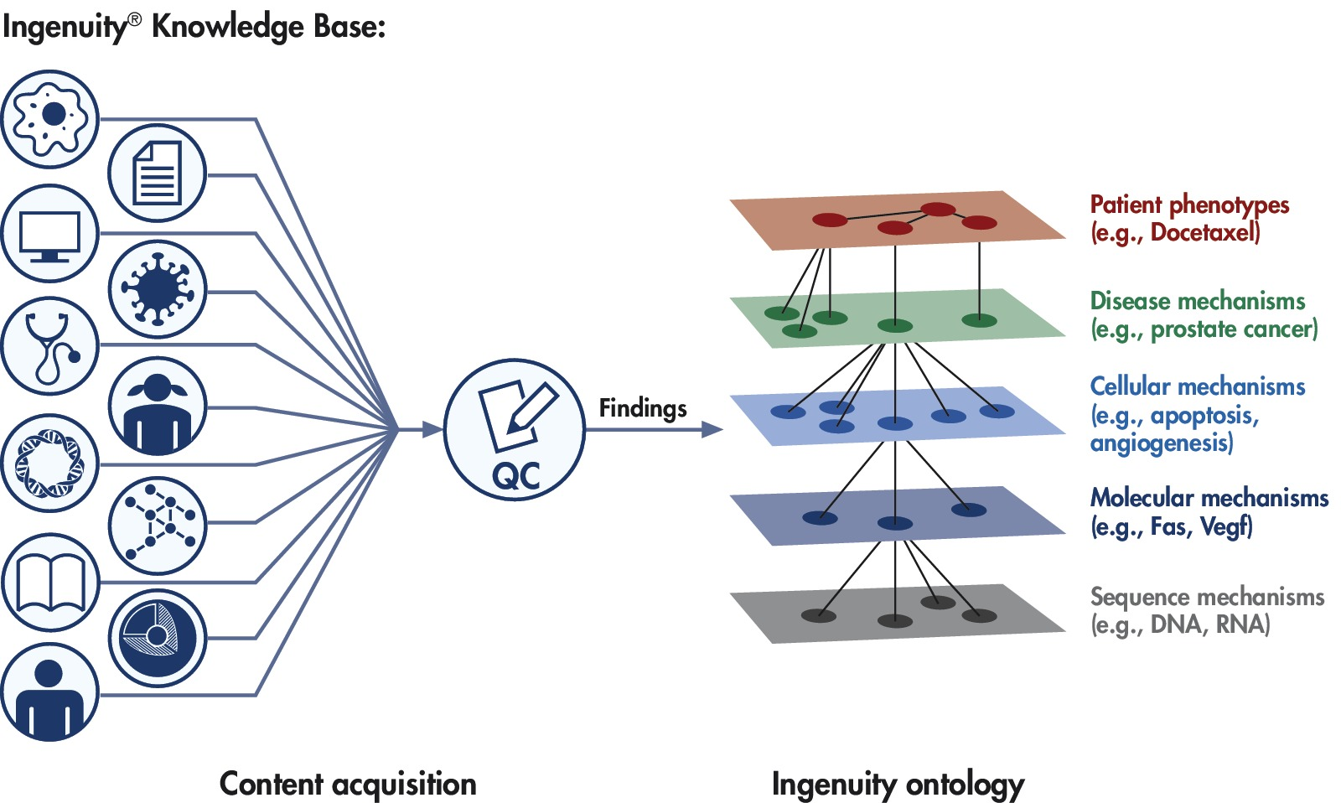
Knowledge is Power
Ingenuity Knowledge Base

Slide 6
Assessing “biological significance” for predicted causal variant
In May 2015: ACMG and AMP published standards for the assessment of sequence variants
Detected variants
Published biomedical literature
Professional association guidelines
Segregation studies
Population frequency
Predictions: PolyPhen, MaxEntScan, etc.
Variant
annotation/ filtering
Clinical data
Custom knowledge
Variant
classification
  Family testing
  Additional info
Benign
Likely
benign
Uncertain
Significance
Likely
pathogenic
Pathogenic
classification & bibliographic references to aid in interpretation
Courtesy of Heidi Rehm, Partners Healthcare

Slide 7
Variant filtering and annotation
Ingenuity Variant Analysis- Filter Cascade
Confidence
Call Quality > 20
Variants not present in highly variable exonic regions
Common Variants
MAF < 0.5
  1000G
  NHLBI-EVS
  ExAC
  Allele Frequency Community
Predicted Deleterious
Pathogenic or Likely Pathogenic (ACMG)
HGMD
LoF- Frameshift, Stop, Splice site
Missense
Biological Context
Phenotype
Disease/Syndrome

Slide 8
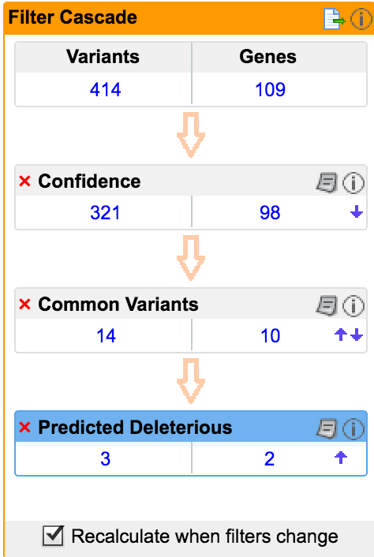
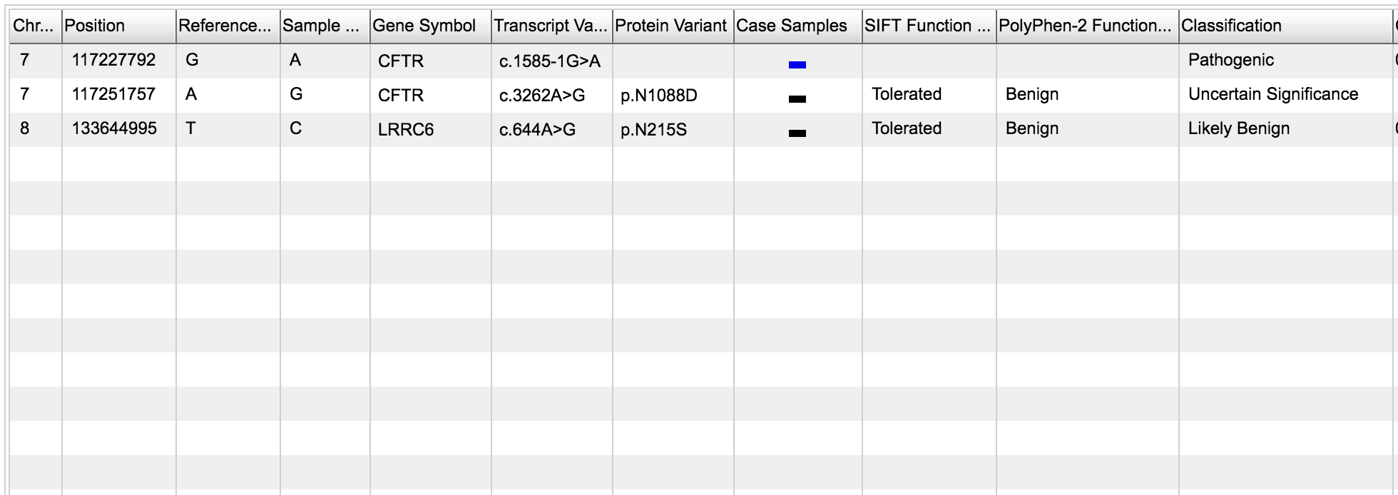
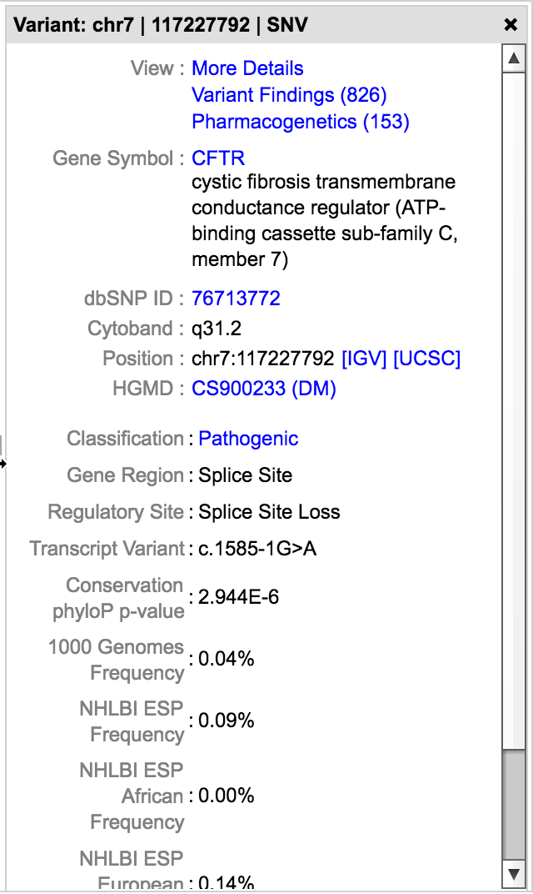
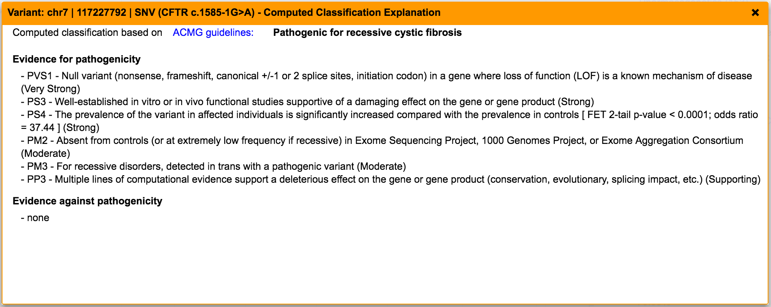
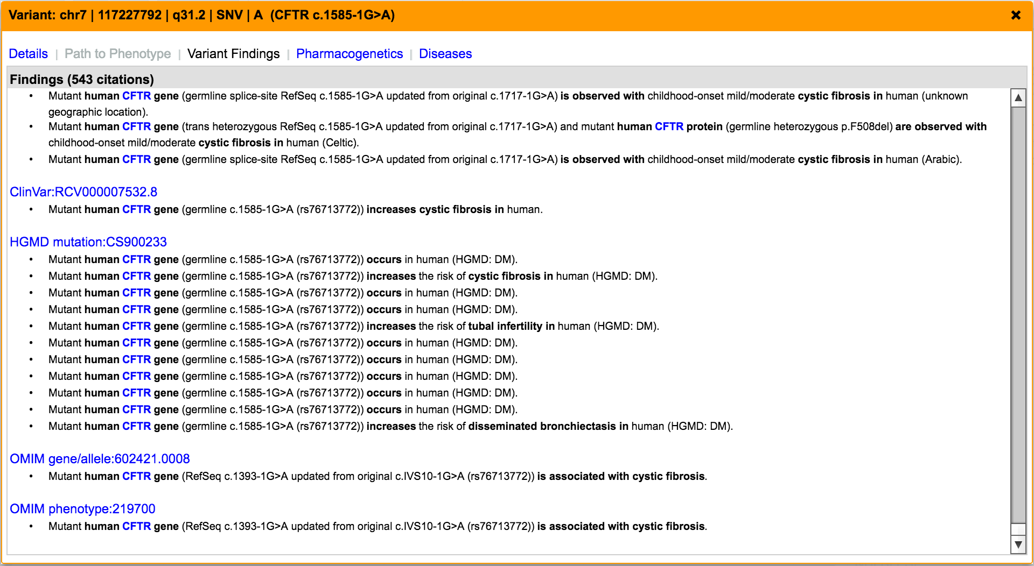
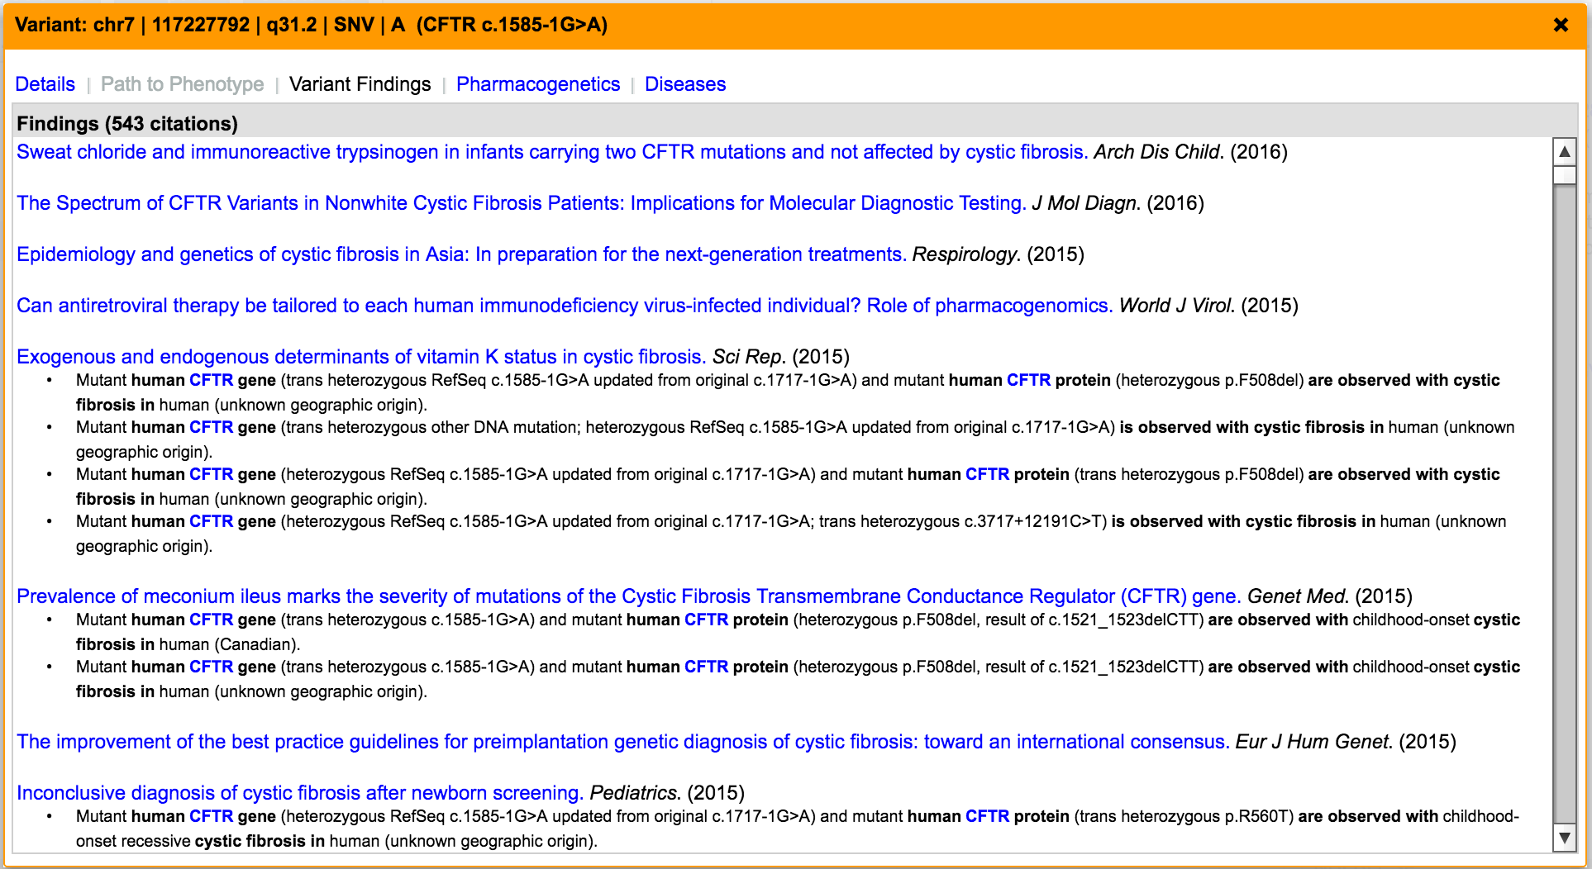
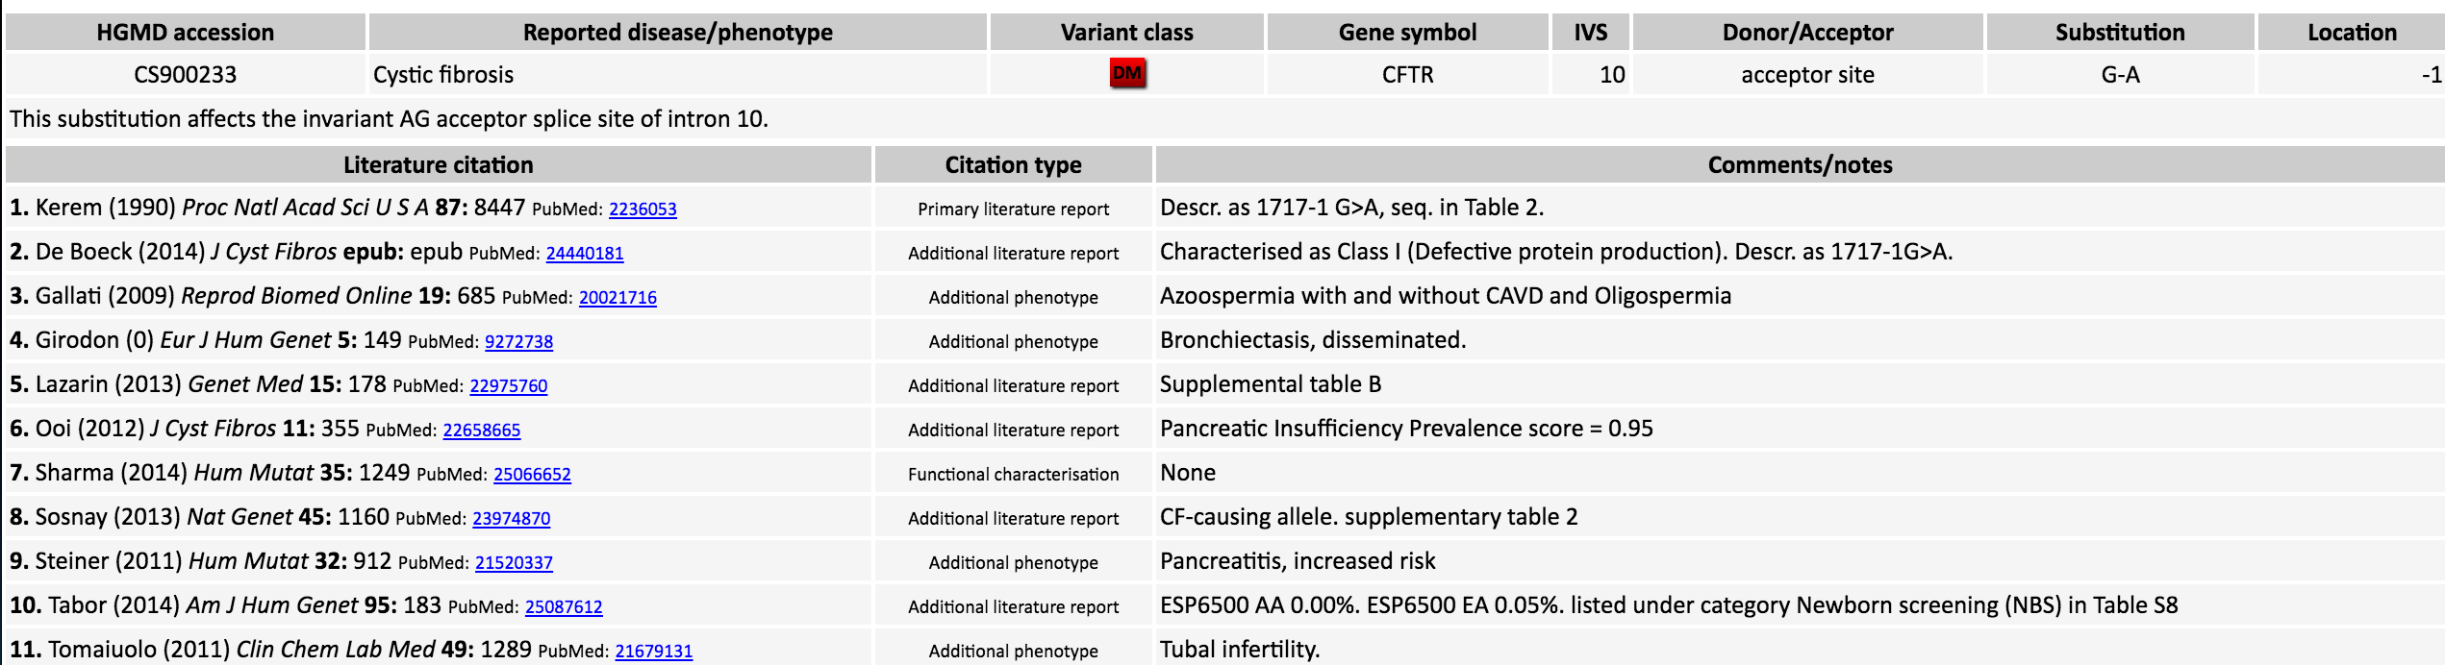
Hopkins- case P1
Disease class- 1. Cystic Fibrosis and related disorders

Slide 9
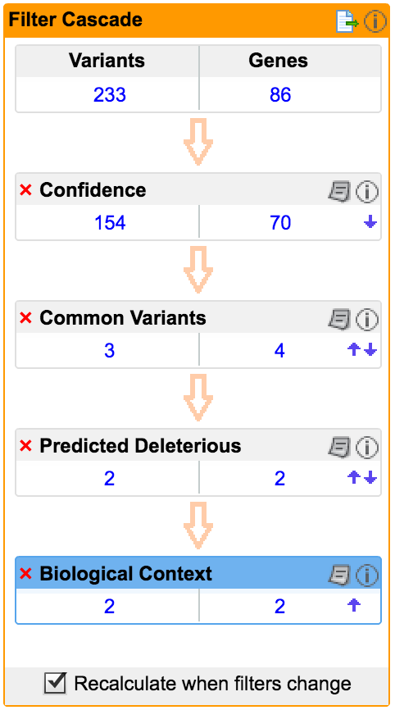
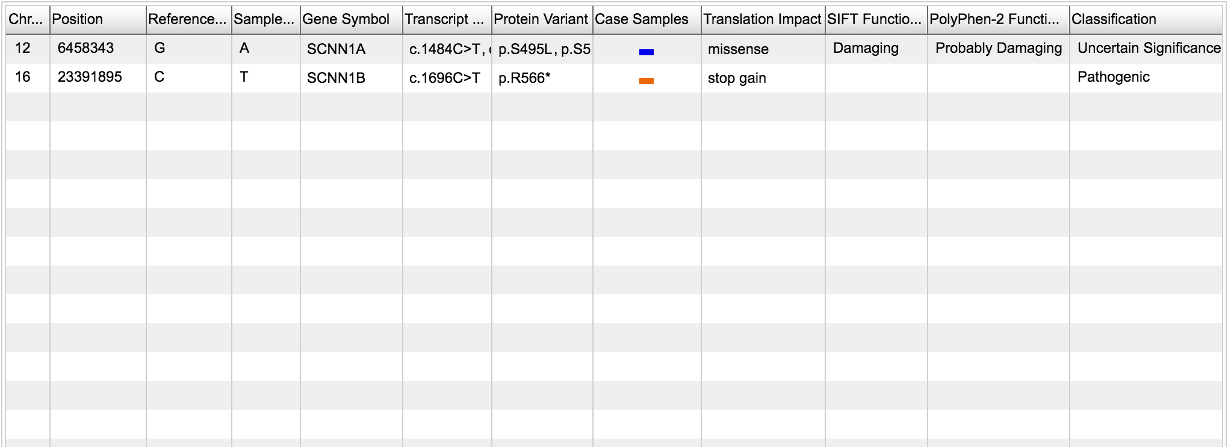
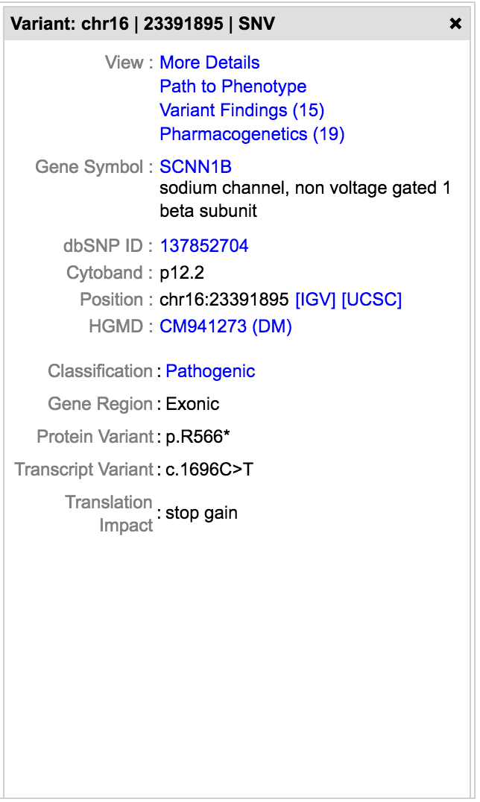
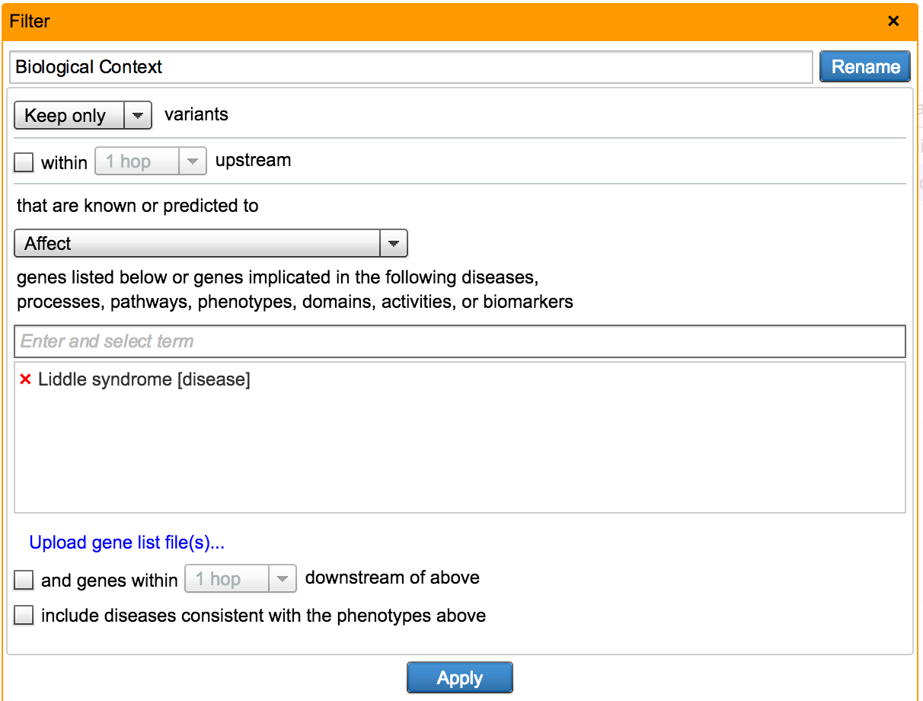
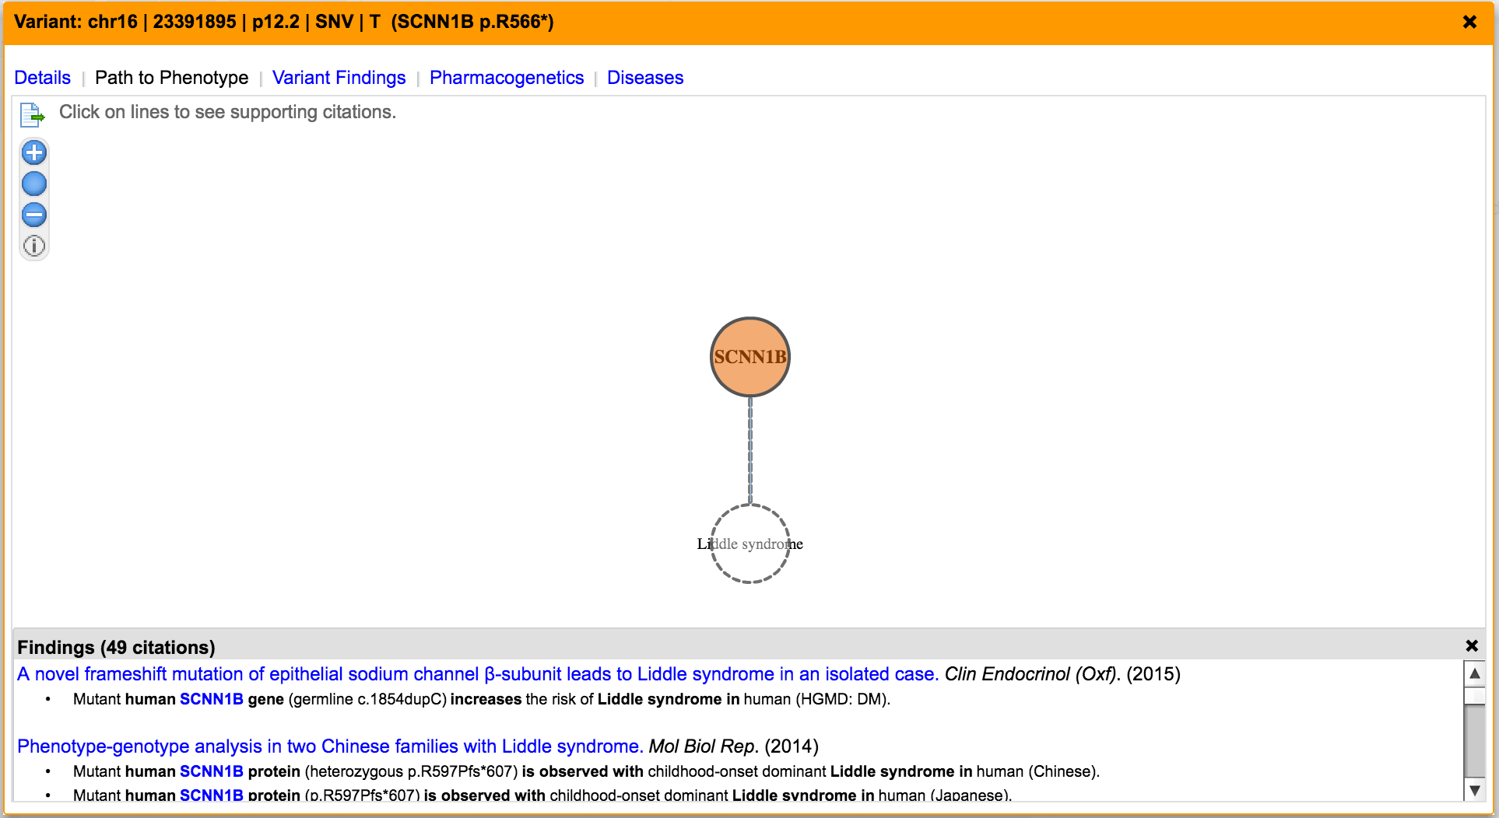
Hopkins- case P30
Disease class- 11. Liddle Syndrome

Slide 10
Summary of findings
Johns Hopkins reported variants- 43
Predicted disease class and causal variant | 22
Identified causal variant for known disease class | 16
Variants missed due to MAF>0.5 | 3
Others (synonymous or intronic) | 2

Slide 11
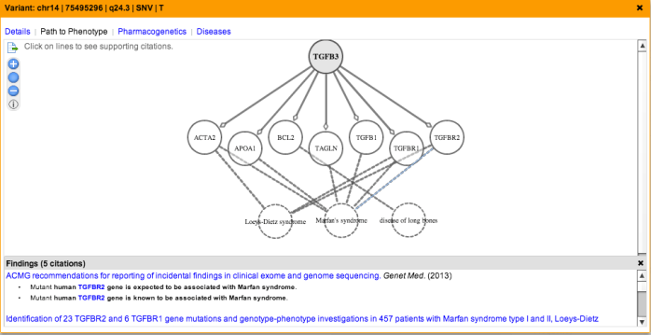
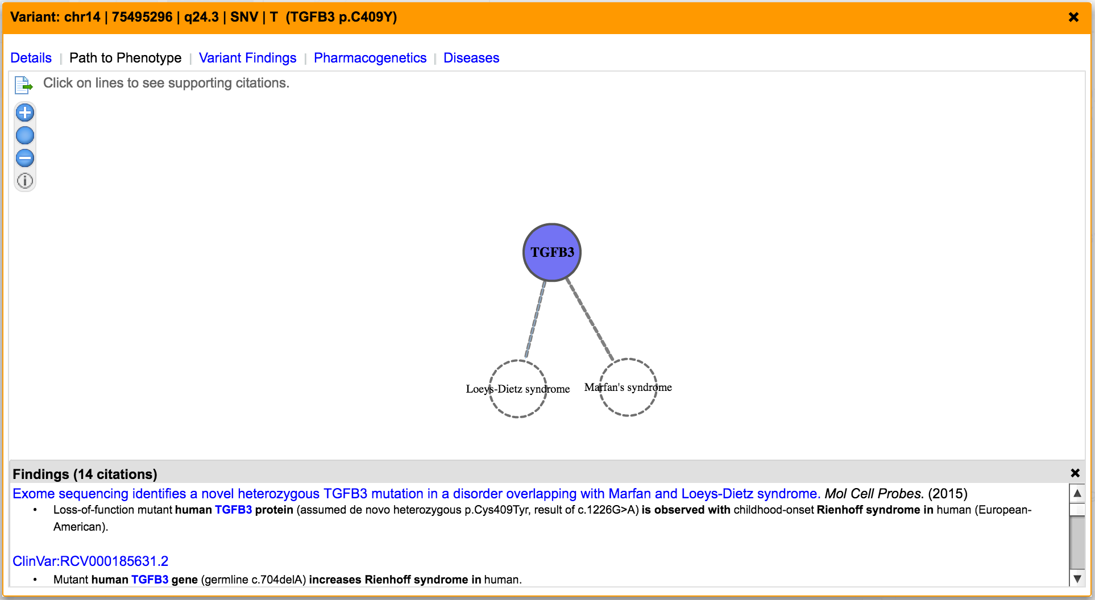
Leveraging the power of biological knowledge
Whole Exome/Genome Sequencing
Link genes to phenotype and disease
  Identify causal variants in known disease genes
Link genes to other genes, functions, and pathways
  Identify causal variants in novel and previously unknown genes underlying inherited/genetic disorders

Slide 12


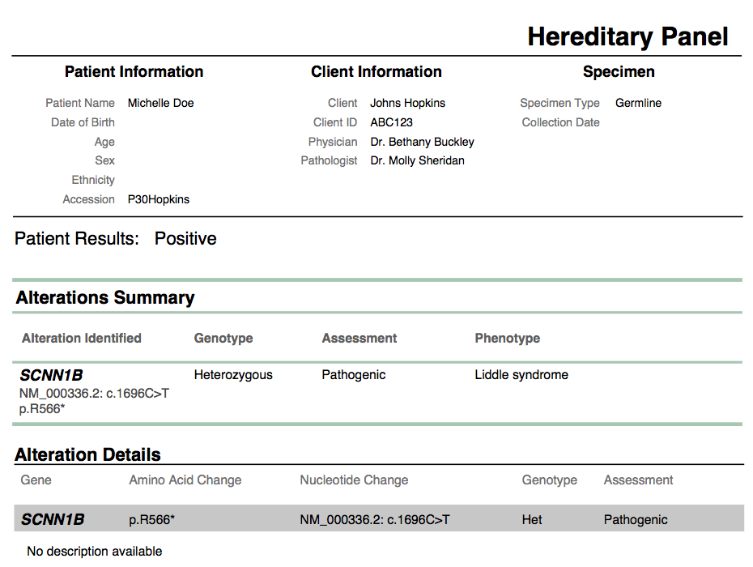
Clinical Reporting
For Molecular Diagnostic Labs
Clinical Insight

Slide 13
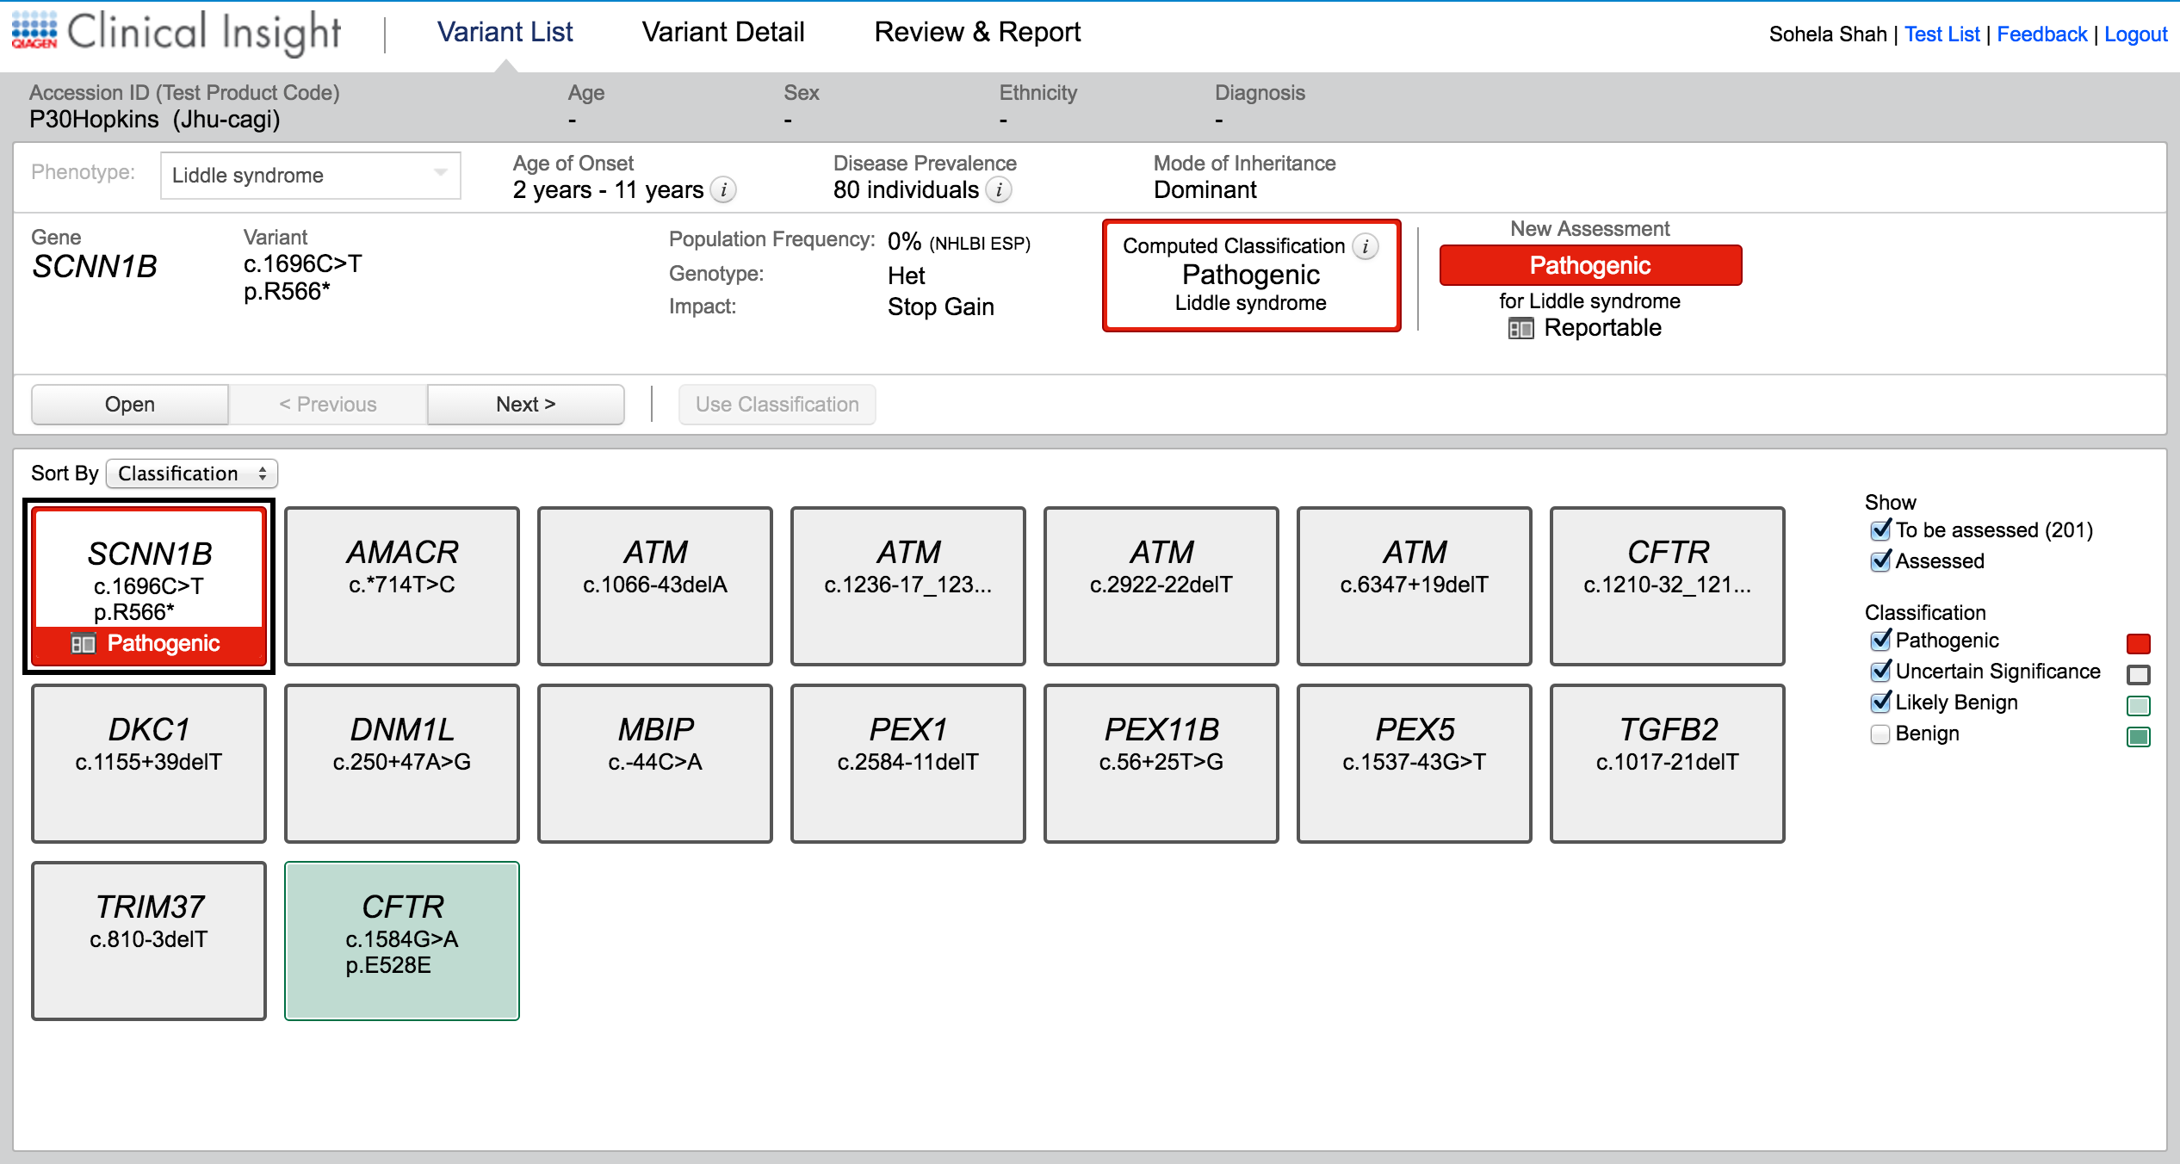
Reviewing variants in QIAGEN Clinical Insight

Slide 14
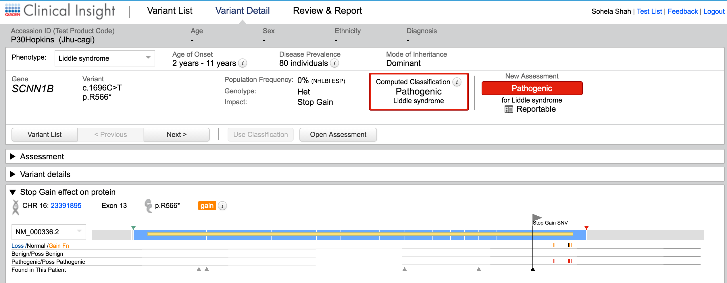
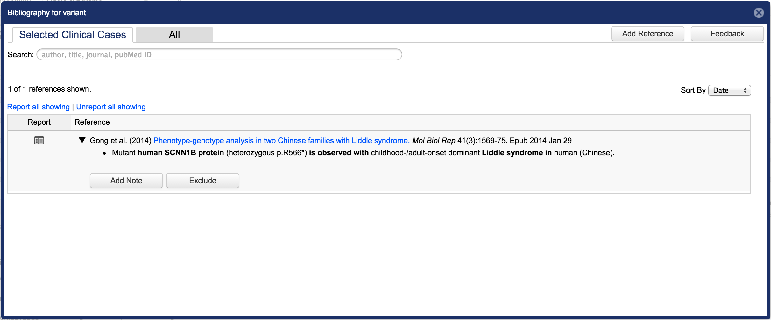
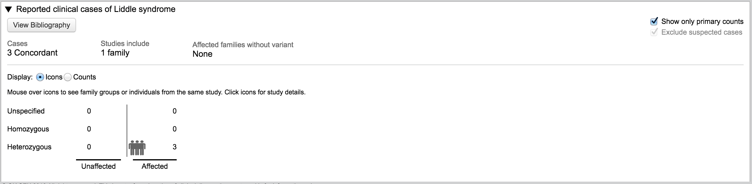
Reviewing variants in QIAGEN Clinical Insight

Slide 15
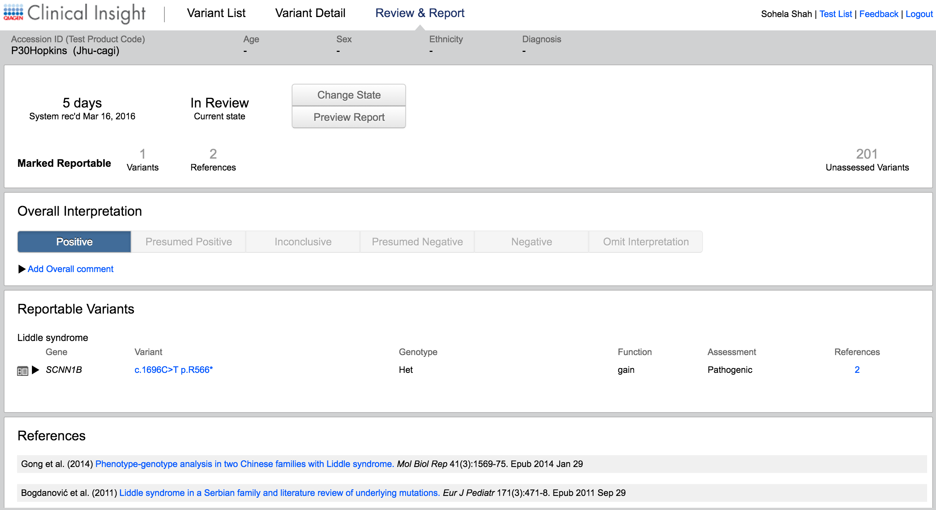
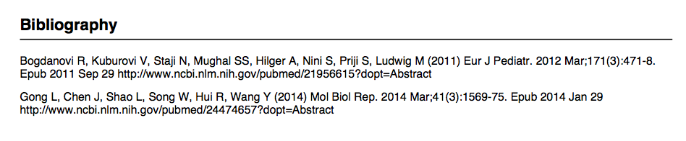
Reporting variants in QIAGEN Clinical Insight

Slide 16
Acknowledgements
It takes a (global) village
Dan Richards
Ramon Felciano
Ingenuity Variant Analysis team
Curation team
Product manager(s)
Engineers
Collaborators
Children’s National Medical Center, Washington, DC
Children’s Hospital of Eastern Ontario
Inova Children’s Hospital

