Slide 1


Hopkins Challenge
Kunal Kundu ^{1, 2}, Lipika R. Pal ¹, Yizhou Yin ^{1, 2}, John Moult ^{1, 3}*
¹ Institute for Bioscience and Biotechnology Research, University of Maryland, 9600 Gudelsky Drive, Rockville, MD 20850, ² Computational Biology, Bioinformatics and Genomics, Biological Sciences Graduate Program, University of Maryland, College Park, MD 20742, USA, ³ Department of Cell Biology and Molecular Genetics, University of Maryland, College Park, MD 20742.

Slide 2

CAGI slide pack guidelines
I agree to my slides being used according to the following terms: ______Kunal Kundu_______
Authors: please include THIS slide at the beginning of your presentation to indicate that you agree with reuse of your slides in CAGI presentations, according to the terms below, and digitally sign by writing your name above.
To disseminate the CAGI results, I encourage all CAGI participants to remix these CAGI slides for inclusion in their oral and poster presentations
CAGI participants may use or publish any content of these slides only in compliance with the CAGI Data Use Agreement
CAGI participants may not cite or publish any content of these slides except with the written permission of the originating author or in the primary CAGI publications
CAGI participants must acknowledge the original authors of these slides and CAGI 2013. Include the acknowledgement banner across the bottom
CAGI participants must include the CAGI credits slide in their presentations
Slides with a red slash (no remix) may not be included in a presentation unless all attendees are registered CAGI participants who signed the data use agreement
Slides with a red X over the entire slide may not be used in any circumstances
Slides with a blue slash (embargoed) may not be used unless the embargo is explicitly lifted
Slides without slash or X may be tweeted unless flagged with the “No tweet” icon.
CAGI participants using these slides must explain the “No tweet” icon, which means that the slide content should not be disseminated outside the presenting conference hall. If the presentation venue permits pervasive tweeting, you may not include these slides in your talk
Note for slide authors: we expect all CAGI participants to abide by these restrictions, and will make best effort to ensure they are followed. However, but bear in mind that we have limited means of enforcing them, and therefore the restrictions cannot be guaranteed.

Slide 3



Building the Gene List
Capture v1b
Capture v2
2
5
64
Primary
Ciliary
Dyskinesia
17
https://ghr.nlm.nih.gov/
http://www.hopkinsmedicine.org/dnadiagnostic/
# Genes
Created for CAGI 2016
genomeinterpretation.org
Kunal Kundu

Slide 4


Variant Annotation
SNVs.vcf
Indels.vcf
Minor Allele Frequency – 1000 Genomes, ExAC and ESP.
Gene Name, Transcript Id, Exon/Intron/UTR.
Mutation type, Splice altering variants.
Predictions from SNPs3D, PolyPhen2, SIFT, CADD and dbscSNVs.
Clinical Phenotypes – ClinVar and OMIM
SNVs.vcf
Indels.vcf
Annotated VCF files
http://www.hgmd.cf.ac.uk/ac/index.php
http://compbio.berkeley.edu/proj/varant/Home.html
Created for CAGI 2016
genomeinterpretation.org
Kunal Kundu

Slide 5
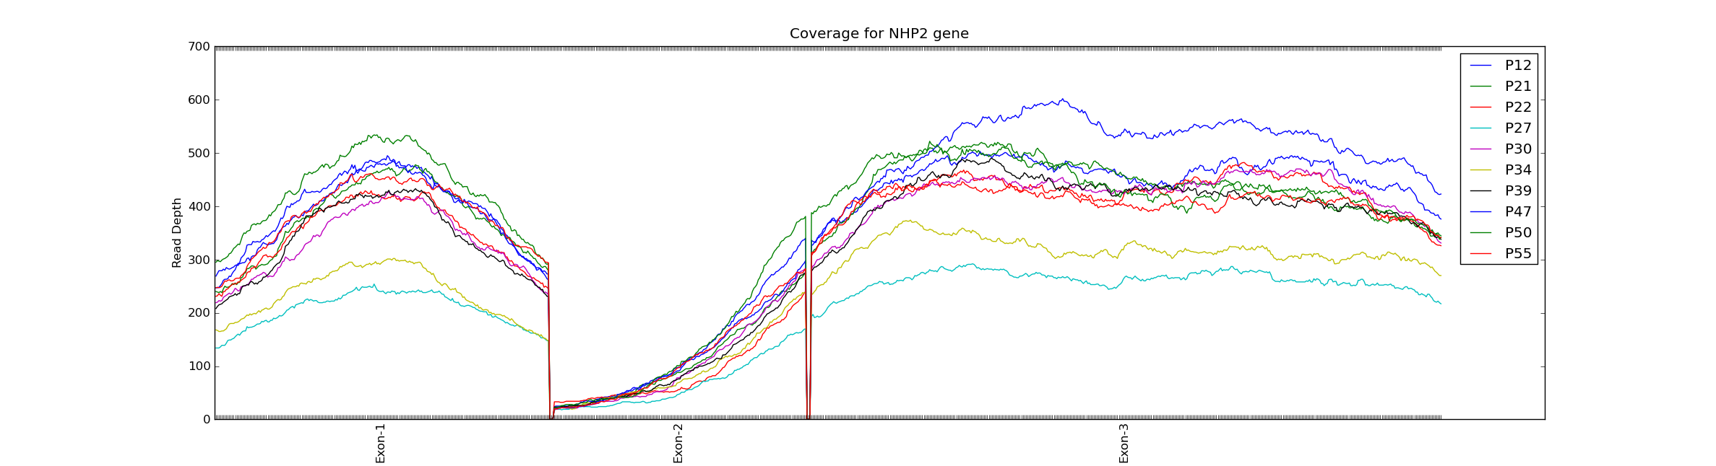
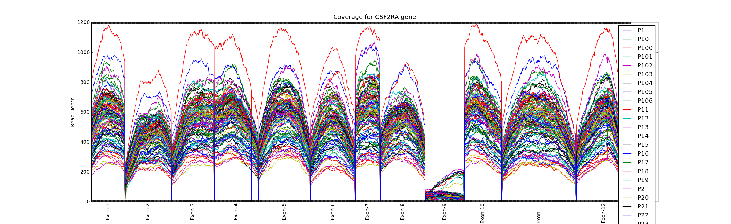
QC: Anomalous Capture Region Coverage
700
NHP2 (capture v2)
600
500
400
Read Depth
300
200
100
Exon-4
Intron-3
Exon-1 & 2
1200
CSF2RA
1000
800
Read Depth
600
400
200
Exon
1
2 3 4 5 6 7 8 9 10 11 12

Slide 6
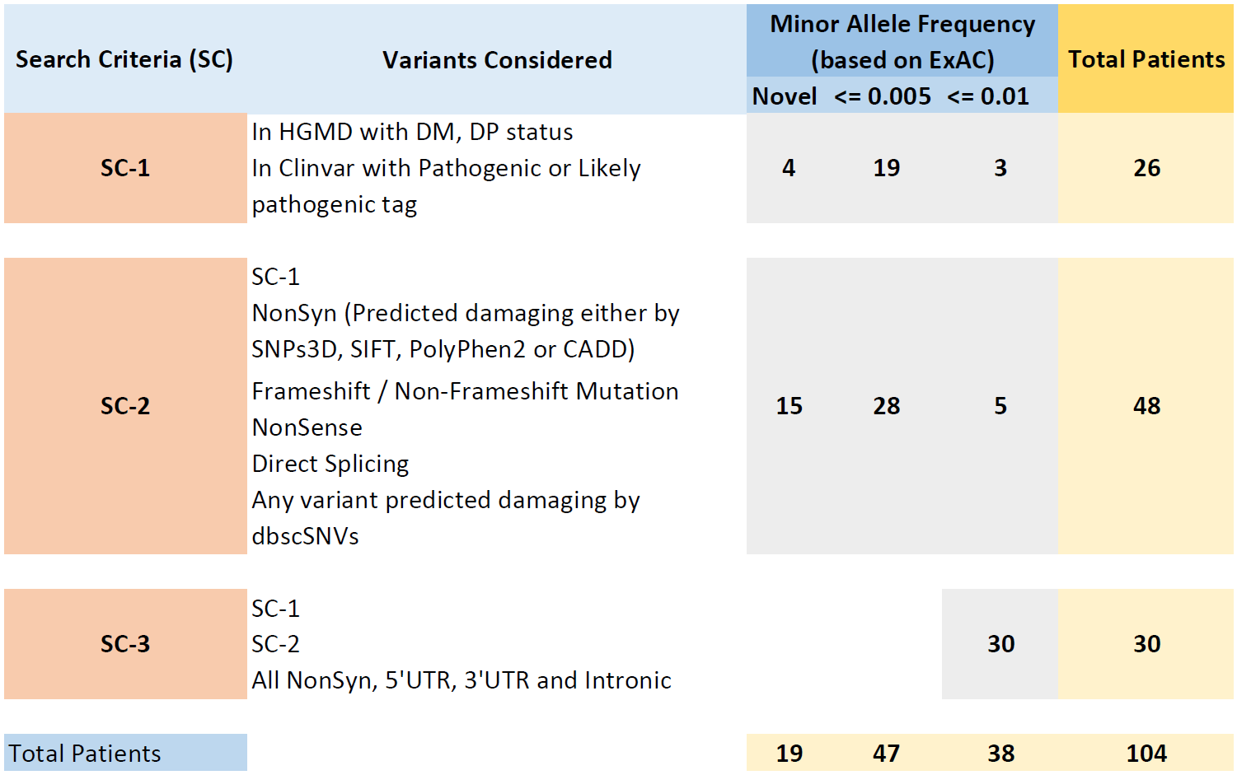
Method: Step-1 Variant Prioritization
PASS; GQ>30
P59
P86
Created for CAGI 2016
genomeinterpretation.org
Kunal Kundu

Slide 7
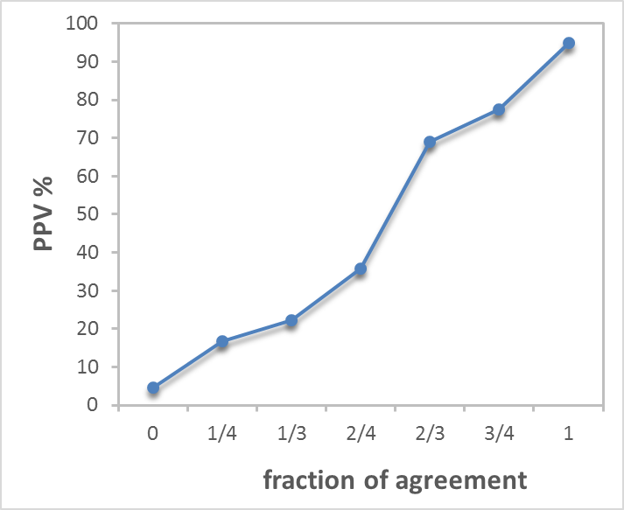
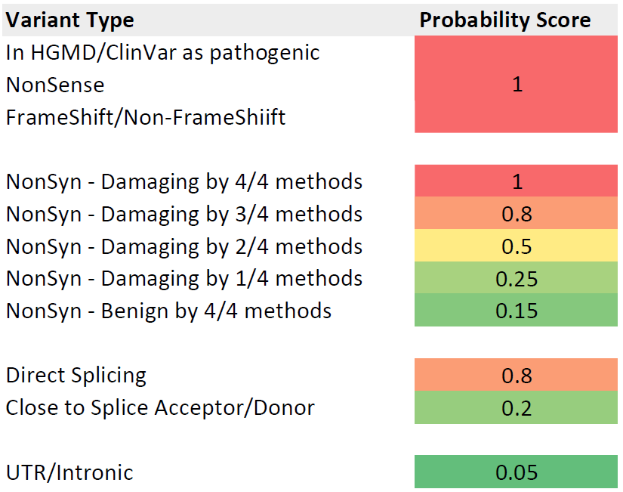
Method: Step-2 Probability Assignment
Calibrated based on HGMD variants and control set of inter-species variants.
Yizhou Yin
Created for CAGI 2016
genomeinterpretation.org
Kunal Kundu
Autosomal Recessive = (Probability Score(v))² + 0.2
Compound Heterozygous = Probability Score(v₁) X Probability Score(v₂) + 0.1

Slide 8
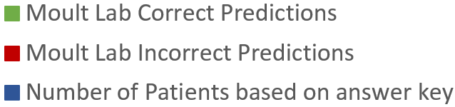
35% of the predictions were correct
36 / 104
38
68 / 104
30
Created for CAGI 2016
genomeinterpretation.org
Kunal Kundu

Slide 9
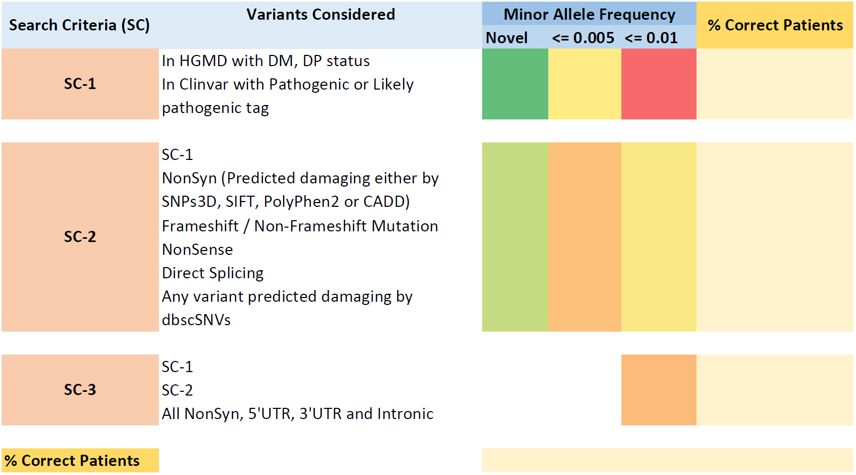
Predictions based on HGMD/ClinVar were more accurate
4/4
7/19
0/3
11/26 = 42%
9/15
7/28
2/5
18/48 = 37%
7/30
7/30 = 23%
36/104
Created for CAGI 2016
genomeinterpretation.org
Kunal Kundu

Slide 10

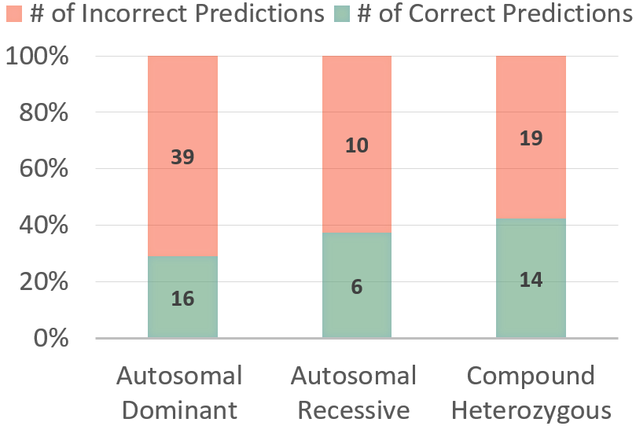
What went wrong?
33 missense in 55 Autosomal Dominant Predicted patients
Created for CAGI 2016
genomeinterpretation.org
Kunal Kundu

Slide 11
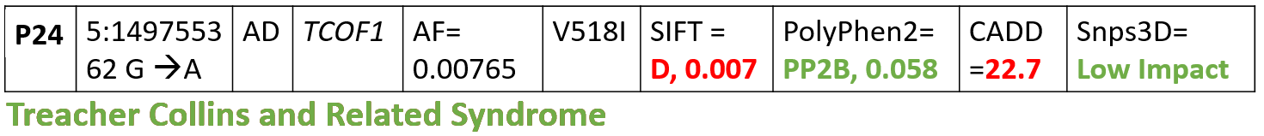
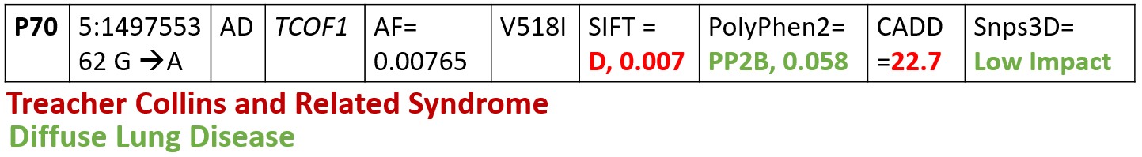
Possible Misdiagnosis?
P46 | 5:149767634 C →T | AD | TCOF1 | AF= 0.000189 | T1010I | SIFT = D, 0.0 | PolyPhen2=PP2D, 0.993 | CADD=26.2 | Snps3D= High Impact
Treacher Collins and Related Syndrome
“In severe cases, underdevelopment of the facial bones may restrict an affected infant's airway, causing potentially life-threatening respiratory problems.”
Diffuse Lung Disease
https://ghr.nlm.nih.gov/condition/treacher-collins-syndrome
Created for CAGI 2016
genomeinterpretation.org
Kunal Kundu

Slide 12
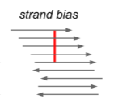
Insights
Sequencing Data Issues
  False Positive Heterozygous calls
  Problem with uniformity in exon coverage
  Missing Variants because of Low Quality (~17% LQ variants / sample; FS filter)
Method development
  Single Gene based deleterious mutation prediction methods.
  Methods for clinically interpreting Intronic and UTR variants.
Can improve the prediction power
  Trio sequencing might help in solving compound het cases.
  Broaden the perspective for exploring disease mechanism. E.g. P93 Structural Variations.
Consistent 16 cases of misdiagnosis
Created for CAGI 2016
genomeinterpretation.org
Kunal Kundu

Slide 13
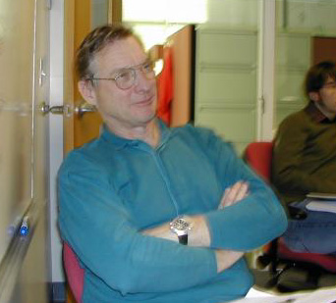
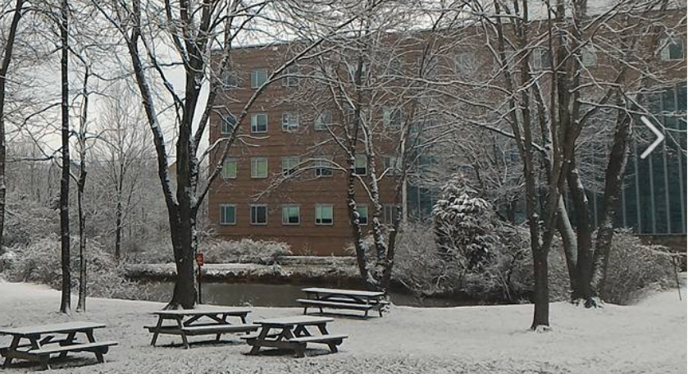
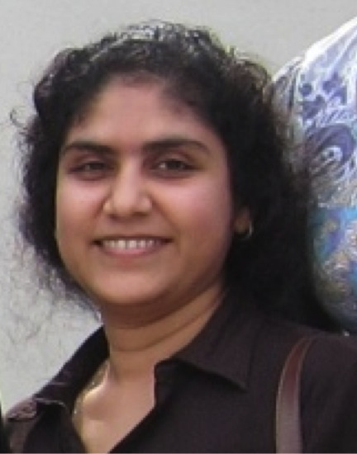
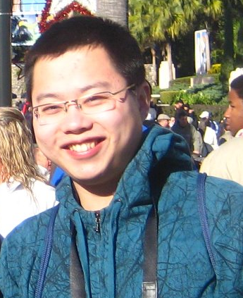
Acknowledgement
Prof. John Moult
03/04/2016
Yizhou Yin
Final Year PhD Student
Lipika Ray, PhD
Research Scientist

