Slide 1

CAGI slide pack guidelines
I agree to my slides being used according to the following terms:
_______David Jones_______
Authors: please include THIS slide at the beginning of your presentation to indicate that you agree with reuse of your slides in CAGI presentations, according to the terms below, and digitally sign by writing your name above.
To disseminate the CAGI results, I encourage all CAGI participants to remix these CAGI slides for inclusion in their oral and poster presentations
CAGI participants may use or publish any content of these slides only in compliance with the CAGI Data Use Agreement
CAGI participants may not cite or publish any content of these slides except with the written permission of the originating author or in the primary CAGI publications
CAGI participants must acknowledge the original authors of these slides and CAGI 2013. Include the acknowledgement banner across the bottom
CAGI participants must include the CAGI credits slide in their presentations
Slides with a red slash (no remix) may not be included in a presentation unless all attendees are registered CAGI participants who signed the data use agreement
Slides with a red X over the entire slide may not be used in any circumstances
Slides with a blue slash (embargoed) may not be used unless the embargo is explicitly lifted
Slides without slash or X may be tweeted unless flagged with the “No tweet” icon.
CAGI participants using these slides must explain the “No tweet” icon, which means that the slide content should not be disseminated outside the presenting conference hall. If the presentation venue permits pervasive tweeting, you may not include these slides in your talk
Note for slide authors: we expect all CAGI participants to abide by these restrictions, and will make best effort to ensure they are followed. However, but bear in mind that we have limited means of enforcing them, and therefore the restrictions cannot be guaranteed.

Slide 2

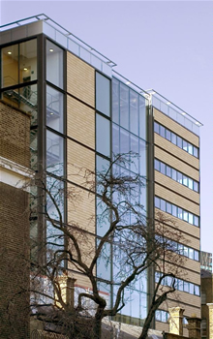
Using SVM Outlier Detection in the Hopkins Gene Panel Challenge
David T. Jones
Dept. of Computer Science & Dept. of Structural and Molecular Biology
University College London d.t.jones@ucl.ac.uk

Slide 3
My naïve take on the Hopkins Gene Panel problem
Treat the problem as 14 independent disease classification problems e.g. like mini versions of the Crohn’s or Bipolar challenges
… but with no available training data (or at least none that I could easily access)
It seemed fairly clear that the challenge was aimed more towards expert analysis (e.g. asking for single causal variant)
But I had no time (or inclination) to research the detailed genetics of 14 disease classes!
What automated techniques could be used?
Created for CAGI4
genomeinterpretation.org
D.T. Jones

Slide 4
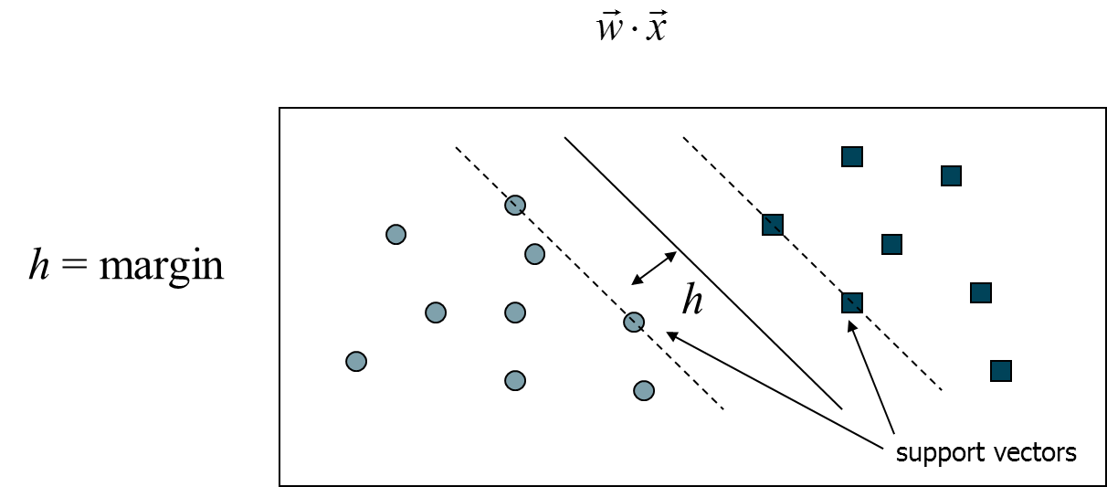
Support Vector Machines
Binary classifiers that maximize margin
  Find hyperplane separating positive and negative examples
  Optimize for maximum margin
  Classify new items using:
Created for CAGI4
genomeinterpretation.org
D.T. Jones

Slide 5
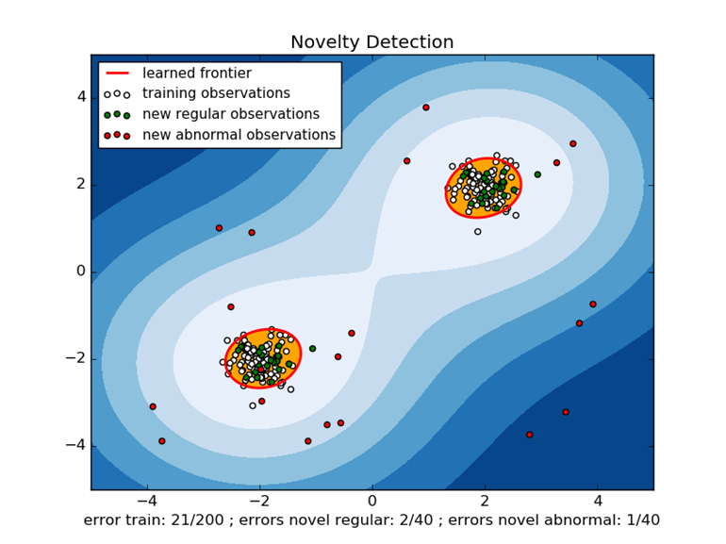
Novelty Detection using
One-class SVMs
One-class SVMs can be used when only positive or negative cases are available, but not both
Given a set of samples, they construct a soft boundary such that new outliers can be detected
Created for CAGI4
genomeinterpretation.org
D.T. Jones

Slide 6
Datasets
In the absence of training data, the 1000 Genomes Project dataset was used as a proxy for a negative case dataset
This is reasonable in the case of rare disorders
Feature sets for each disease class were constructed using overlapping variants in the 1K Genome data for gene variants related to each class, compiled from ClinVar and gene list data (e.g. from Hopkins NGS Panel brochure)
Created for CAGI4
genomeinterpretation.org
D.T. Jones

Slide 7
SVM Models
A NuSVM RBF model was used
  RBF kernel:
  NuSVMs use a single parameter ( ) to control misclassification and fraction of support vectors
ν and γ were adjusted using a grid search to minimize outlier detection (false positives) on 1K Genome data using the 14 different feature sets, producing 14 SVM classifiers
An“estimate” of confidence was produced by calculating the distance to the decision plane and transforming to [0-1) via a logistic function
Created for CAGI4
genomeinterpretation.org
D.T. Jones

Slide 8
Causative Variant Selection
The submission form demanded a single “causative” variant to be specified along with the predicted class
This is obviously a meaningless question in the context of an automatic machine learning method
Rather than putting in fake placeholder data, a simple strategy was used where one feature (variant) at a time was excluded from the feature set and the decision function re-calculated each time.
  SVMs were not retrained
  Variant with the largest change in decision function was submitted
This crude strategy correctly identified the causative variant in 4 cases and scored a “near miss” in 15 other cases (predicted variant in correct gene and reasonably close to causative variant location)
Created for CAGI4
genomeinterpretation.org
D.T. Jones

Slide 9
Results Summary
24 out of 106 patients were correctly classified (23% compared to 7% for random guessing)
  Successes confined mostly to Class 1 (Cystic Fibrosis) and Class 2 (Diffuse lung disease)
Wilcoxon tests show somewhat significant ranking success (0.001< p < 0.03) for Classes 1, 2, 5, 6, 10, 14
Why these classes?
Created for CAGI4
genomeinterpretation.org
D.T. Jones

Slide 10
Results
Created for CAGI4
genomeinterpretation.org
D.T. Jones

Slide 11
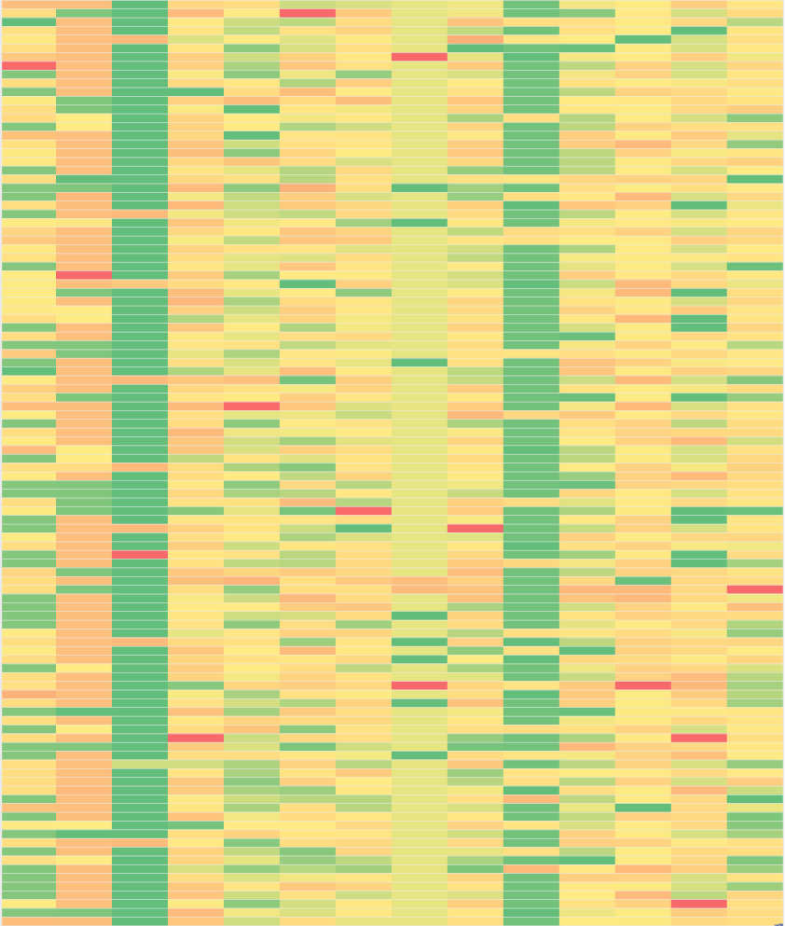
Could do better…
Treating the disease classes independently was clearly stupid
A patient would be extremely unlucky to have multiple rare genetic disorders!
A possible thing to try would be to optimize the SVM parameters in concert under a “softmax” or perhaps L1-norm constraint
To do this properly, however, at least some real training data would be useful
Priors might also have been useful, but possibly not in a CAGI experiment (or in the clinic!)
Weighting by predicted variant effect might well have helped
Predicted Class Probabilities
Patient
Created for CAGI4
genomeinterpretation.org
D.T. Jones

Slide 12
Summary
One-class SVMs seem to have some potential for recognizing unusual distributions of gene variant features in the absence of any positive training data
24 out of 106 patients correctly classified, with a further 7 achievable with a ranking-based selection
A simple leave-out strategy identified the correct causative variant in 4 case, with another 15 near to the correct variant
A serious mistake was treating classes as independent, and some kind of one-from-n classification model should have been used e.g. “softmax”
Other possible improvements could have come from using priors or more relevant variants as features or possibly a different control data sets
Like most data science problems, there really is no substitute for having a decent quantity of real training data – even a small sample of validation data would have helped enormously
Created for CAGI4
genomeinterpretation.org
D.T. Jones

Slide 13
Acknowledgements
Many thanks to the CAGI organisers, assessors, and of course the data providers (and donors)!
Created for CAGI4
genomeinterpretation.org
D.T. Jones

