Slide 1

CAGI slide pack guidelines
I agree to my slides being used according to the following terms: Bethany Buckley
Authors: please include THIS slide at the beginning of your presentation to indicate that you agree with reuse of your slides in CAGI presentations, according to the terms below, and digitally sign by writing your name above.
To disseminate the CAGI results, I encourage all CAGI participants to remix these CAGI slides for inclusion in their oral and poster presentations
CAGI participants may use or publish any content of these slides only in compliance with the CAGI Data Use Agreement
CAGI participants may not cite or publish any content of these slides except with the written permission of the originating author or in the primary CAGI publications
CAGI participants must acknowledge the original authors of these slides and CAGI 2013. Include the acknowledgement banner across the bottom
CAGI participants must include the CAGI credits slide in their presentations
Slides with a red slash (no remix) may not be included in a presentation unless all attendees are registered CAGI participants who signed the data use agreement
Slides with a red X over the entire slide may not be used in any circumstances
Slides with a blue slash (embargoed) may not be used unless the embargo is explicitly lifted
Slides without slash or X may be tweeted unless flagged with the “No tweet” icon.
CAGI participants using these slides must explain the “No tweet” icon, which means that the slide content should not be disseminated outside the presenting conference hall. If the presentation venue permits pervasive tweeting, you may not include these slides in your talk
Note for slide authors: we expect all CAGI participants to abide by these restrictions, and will make best effort to ensure they are followed. However, but bear in mind that we have limited means of enforcing them, and therefore the restrictions cannot be guaranteed.

Slide 2


The Current State of Clinical Molecular Testing
Beth Buckley
DNA Diagnostic
Lab
Johns Hopkins
March 27, 2016
Created for CAGI 2016
genomeinterpretation.org
Beth Buckley

Slide 3
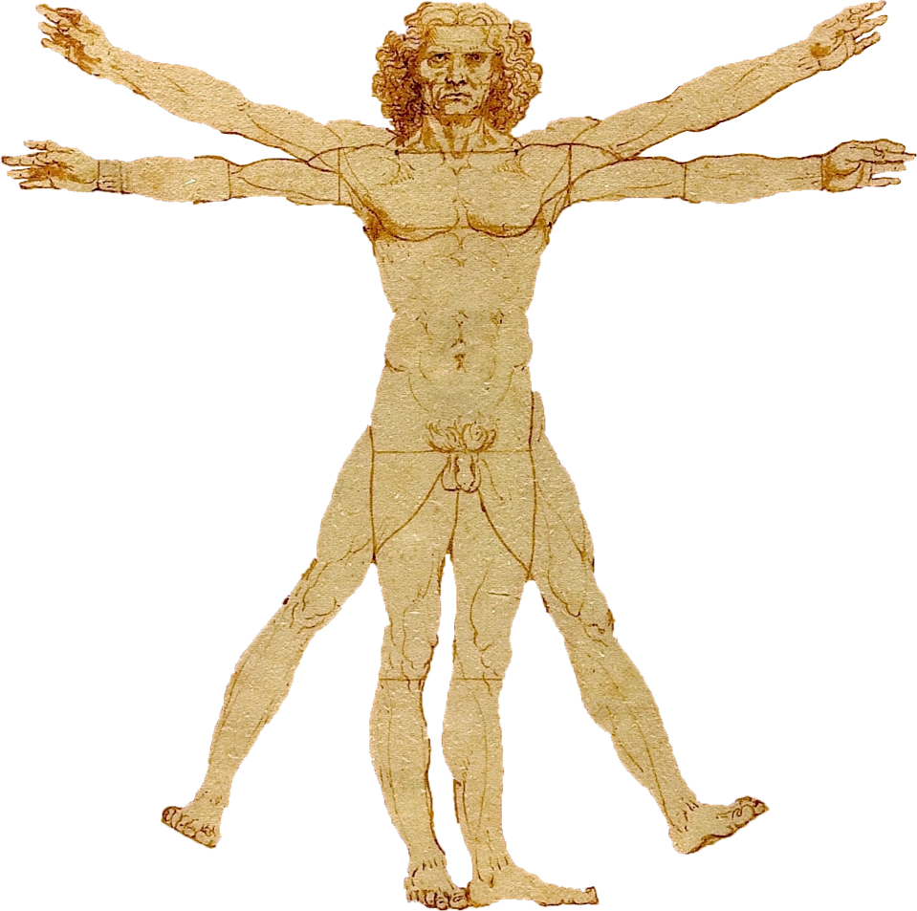
What characterizes a clinical lab?
Variant Interpretation
CAGI challenge dataset
Created for CAGI 2016
genomeinterpretation.org
Beth Buckley

Slide 4
Clinical Testing Goals
Pre-test
  Ensure correct test was ordered
  Ensure that provider understands test sensitivity & specificity
  Maximize clinical utility
Test
  High quality DNA
  Validated test with high analytic sensitivity
  Accurate results
Post-test
  Variant classification according to published guidelines
  Risk assessment
  Effective communication of results
Created for CAGI 2016
genomeinterpretation.org
Beth Buckley

Slide 5
Regulatory Oversight of Clinical Labs
College of American Pathology (CAP)/Clinical Laboratory Improvement Amendments (CLIA)
  Strict QA/QC guidelines for test validation, methods, equipment reagents, competency testing, etc.
  Yearly inspections
  Proficiency testing
State licenses
  Inspections
  Possible additional PT
FDA
  Currently does not regulate laboratory developed tests
Created for CAGI 2016
genomeinterpretation.org
Beth Buckley

Slide 6
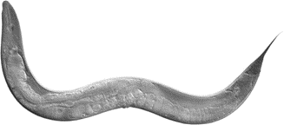
Similar approaches in clinicAL & research labs
Forward Genetics Approach
1. Mutagenize to generate variation
2. Identify animals with phenotype
3. Mapping/linkage analysis via breeding schemes
4. Sequence candidate genes to identify causal variants
Created for CAGI 2016
genomeinterpretation.org
Beth Buckley

Slide 7
Similar approaches in clinicAL & research labs
Forward Genetics Approach
Mutagenize to generate variation (natural mutation rate)
2. Identify animals with phenotype (patient presents with disease)
3. Mapping/linkage analysis via breeding schemes (segregation within family)
4. Sequence candidate genes to identify causal variants (sequence disease relevant genes)
Created for CAGI 2016
genomeinterpretation.org
Beth Buckley

Slide 8
Key differences Between research and clinical testing
Research | Clinical
General protocol | Strict protocols with many QA/QC steps
Sample mix-ups can be resolved | Sample mix-up is catastrophic
More sequencing information is better | ONLY perform ordered clinical test
Time line may be flexible | Strict turn-around-time
Subjects may be non-human | Patients are human subjects
Variants published in Table 1 of a journal article | Variants are reported & become part of patient’s medical record
Created for CAGI 2016
genomeinterpretation.org
Beth Buckley

Slide 9
Additional concerns of a clinical lab
HIPPAA (Health Insurance Portability and Accountability Act)
  Can only share patient information with providers directly involved in care
    Medical record release
    Internal Review Board approval
  Genetic discrimination
  Familial privacy
Incidental findings
  Patient only authorizes us to analyze specific genes
Created for CAGI 2016
genomeinterpretation.org
Beth Buckley

Slide 10
Informed consent
Test purpose & accuracy was explained by physician
A negative test result does not necessarily rule out a genetic condition
Non‐paternity may be revealed.
No clinical tests other than those authorized will be performed
Any remaining sample may be used for quality control purposes or research after de-identification
Results will be released only to parties indicated on the test requisition or their agents
Created for CAGI 2016
genomeinterpretation.org
Beth Buckley

Slide 11
What characterizes a clinical lab?
Variant Interpretation
CAGI challenge dataset
Created for CAGI 2016
genomeinterpretation.org
Beth Buckley

Slide 12
ACMG Variant Classification
Pathogenic
Likely Pathogenic
Variant of Uncertain Significance (VUS)
Likely Benign
Benign
Created for CAGI 2016
genomeinterpretation.org
Beth Buckley

Slide 13
Factors in clinical variant classification
Patient
Natural history of disease (age/sex)
Clinical features
Reason for test
Family history
Ethnicity
Gene
Mechanism of disease
Type of variant
Location of variant
Inheritance of variant
Previous reports
Frequency
Disease databases
Literature
Prediction programs
Splicing
Amino acid substitution
Created for CAGI 2016
genomeinterpretation.org
Beth Buckley

Slide 14
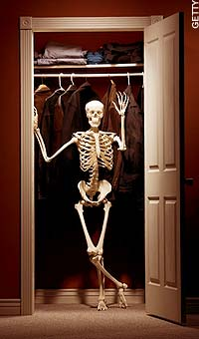
COMPLICATING FACTORS FOR VARIANT CLASSIFICATION
Average healthy individual has:
  100-200 loss of function variants
  10-20 completely inactivated genes
  1-2 de novo exonic variants
  Several hundred rare variants
Reduced penetrance and variable expressivity
  Phenotype may be absent or mild in an individual who carries a pathogenic variant
Created for CAGI 2016
genomeinterpretation.org
Beth Buckley

Slide 15
What characterizes a clinical lab?
Variant Interpretation
CAGI challenge dataset
Created for CAGI 2016
genomeinterpretation.org
Beth Buckley

Slide 16
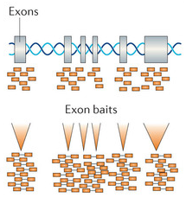
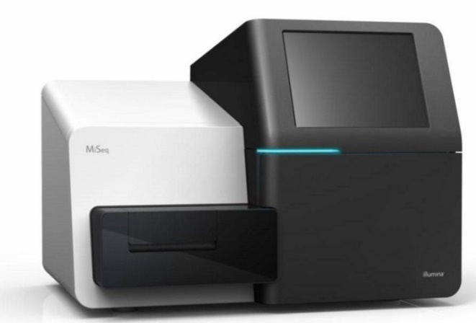
NGS-capture workflow
Hybridize DNA to exon baits to enrich for exonic DNA
  Baits designed to pull down 83 different genes
Raw data → FASTQ
FASTQ → BAM
BAM → VCF
  Variant calling (GATK)
  Phenotype specific bed files generated
VCF → Annotated variants
  Annovar QC cutoffs
Created for CAGI 2016
genomeinterpretation.org
Beth Buckley

Slide 17
Only a subset of captured genes is analyzed in each patient
3 genes analyzed for Neonatal Respiratory Distress phenotype
80 genes not analyzed because they are not relevant to the phenotype
83 genes captured
Created for CAGI 2016
genomeinterpretation.org
Beth Buckley

Slide 18
CAGI data set
We provided challengers with VCF data for all 83 genes in 106 patients
Participants were asked to match each patient to one of 14 disease phenotypes
Participants were asked to identify ‘causal’ variant(s)
  We provided a list of Pathogenic, Likely Pathogenic, or VUS variants identified in patients
Created for CAGI 2016
genomeinterpretation.org
Beth Buckley

Slide 19
CAGI data set
Created for CAGI 2016
genomeinterpretation.org
Beth Buckley

Slide 20
Genetics based approach
DNA Diagnostics Lab
Clinical presentation
Sequence subset of genes
Analyze variants
Does anything explain the phenotype seen in the patient?
Created for CAGI 2016
genomeinterpretation.org
Beth Buckley

Slide 21
Genomics based approach
CAGI Challenge
Expanded data set
Match the phenotype
Created for CAGI 2016
genomeinterpretation.org
Beth Buckley

Slide 22
COMBINED approach
DNA Diagnostics Lab
Clinical presentation
Subset of genes
Bioinformatics approaches
Analyze variants
Does anything explain the phenotype seen in the patient?
Created for CAGI 2016
genomeinterpretation.org
Beth Buckley

Slide 23
Acknowledgements
Johns Hopkins DNA Diagnostic Lab
Garry Cutting - Medical Director
Steven Steinberg - Technical Director
Molly Sheridan - Assistant Director
Barbara Karczeski –Genetic Counselor
CAGI group
Roger Hoskins
Created for CAGI 2016
genomeinterpretation.org
Beth Buckley

Slide 27



Variant databases are flawed
Database:
Actual:
Reported in literature as pathogenic.
Reported in a table of a paper as a polymorphism.
Inaccurate data
Incomplete information
Absent data
Single missense variant in patient with autosomal recessive disease.
Pathogenic
Pathogenic variant seen multiple times in clinical lab, but not reported to database
No Data

