Slide 1

CAGI slide pack guidelines
I agree to my slides being used according to the following terms: _______Author Name Here_______
Authors: please include THIS slide at the beginning of your presentation to indicate that you agree with reuse of your slides in CAGI presentations, according to the terms below, and digitally sign by writing your name above.
To disseminate the CAGI results, I encourage all CAGI participants to remix these CAGI slides for inclusion in their oral and poster presentations
CAGI participants may use or publish any content of these slides only in compliance with the CAGI Data Use Agreement
CAGI participants may not cite or publish any content of these slides except with the written permission of the originating author or in the primary CAGI publications
CAGI participants must acknowledge the original authors of these slides and CAGI 2013. Include the acknowledgement banner across the bottom
CAGI participants must include the CAGI credits slide in their presentations
Slides with a red slash (no remix) may not be included in a presentation unless all attendees are registered CAGI participants who signed the data use agreement
Slides with a red X over the entire slide may not be used in any circumstances
Slides with a blue slash (embargoed) may not be used unless the embargo is explicitly lifted
Slides without slash or X may be tweeted unless flagged with the “No tweet” icon.
CAGI participants using these slides must explain the “No tweet” icon, which means that the slide content should not be disseminated outside the presenting conference hall. If the presentation venue permits pervasive tweeting, you may not include these slides in your talk
Note for slide authors: we expect all CAGI participants to abide by these restrictions, and will make best effort to ensure they are followed. However, but bear in mind that we have limited means of enforcing them, and therefore the restrictions cannot be guaranteed.

Slide 2

Notes on the JHU challenge
Shamil Sunyaev
Broad Institute of M.I.T. and Harvard

Slide 3
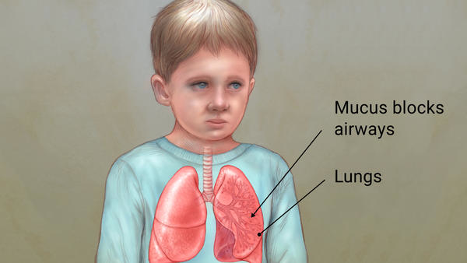
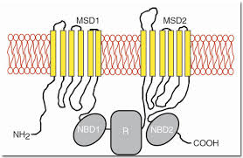
General notes on genetic diagnostics
Genetic diagnostics is not solving the genotype to phenotype problem and is not an attempt for gene discovery
Disease with
known genetic
etiology
Known gene

Slide 4
Sensitivity and specificity
Sensitivity is determined by detectance P(G|Y)
mutation in known genes
phenotype
Specificity is defined by penetrance P(Y|G) and the benign natural genetic variation

Slide 5
Two principle approaches
Biology driven: identify all genes involved in the phenotype and detect variants in these genes
Genetics driven: identify rare putatively functional variants consistent with the mode of inheritance and check genes on biological plausibility

Slide 6
Historic preference for the biology driven approach
Historically, technology obviously favored patient-specific gene panels.
Now, running multiple panels for every patient is economically more efficient (this is the JHU challenge!).
Now, the field is moving to whole exome and, in perspective, whole genome sequencing.

Slide 7
Dominant phenotypes
De novo mutations
We have to sequence trio
0-3 coding non-synonymous mutation per individual

Slide 8
Recessive phenotypes
Rare compound heterozygote and homozygote variants
We sequence the proband
and then test for segregation
3-5 compound heterozygote SNVs and 1-2 homozygote

Slide 9
Dominant transmission
~50 coding non-synonymous variants transmitted

Slide 10
Dominant transmission
Analyzing two remote
affected relatives and then
test for segregation

Slide 11
Advantages and disadvantages
Genetics driven approach potentially has higher sensitivity because of genes not included in the panel.
Genetics driven approach can fix a diagnostic mistake
Biology driven approach generates fewer technical false-positives
Also, why finding things that are not reportable?
The JHU CAGI challenge is the attempt to use genetics driven approach in the biology driven panel testing.

Slide 12
Reporting VUSs ???
Variants lacking evidence or with insufficient evidence.
Heterozygous variants for recessive diseases.
Historically, polymorphic variants caused many false-positives. Now, we have large population databases.
For a small panel, the chance to see a compound heterozygote or de novo mutation is around 10⁻⁵. Heterozygous variants can be found with the chance of ~10⁻².
Can CAGI help to evaluate whether VUSs (or certain categories of VUSs) should be reportable?

Slide 13
Importance of VUSs
Groups 58, 60, and 61 all correctly predicted Zellweger Spectrum Disorders due to two variants in PEX6.
JHU did not report any variants.
One variant is a novel missense change absent from EXaC (high grade VUS). Another one is a novel deletion possibly involved in splicing.
In my opinion, the prediction is likely correct.
Is this reportable clinically?

Slide 14
Consistent “mis-predictions”
Groups 57 (submission 4), 58, 59, and 61 all predicted Pseudohypoaldosteronism type 1 mostly based on a variant in TERT.
The patient’s diagnosis was Cystic Fibrosis and CF-Related disorders.
The TERT variant is known. It leads to telomere shortening and is involved in bone marrow failure.
Interestingly, annotated in ClinVar as involved in pulmonary fibrosis but literature support unclear.
The variant is found in 120 EXaC participants including 2 homozygotes. There is a possibility for partial penetrance or for the inclusion of the CF study into EXaC.
In my opinion, the prediction is likely incorrect. However, the involvement in the pulmonary phenotype is possible.

Slide 15
Consistent “mis-predictions”
Groups 57 (submission 2), 58, 59, and 61 all predicted Loeys-Dietz Syndrome (LDS) with the same variant, a missense variant in FBN1.
The patient’s diagnosis was Diffuse Lung Disease
FBN1 is involved in Marfan syndrome and in other cardiac phenotypes, so the intuition of submitters is clear.
The missense variant is a known low frequency polymorphism annotated as “benign” in ClinVar.
In my opinion, the prediction is likely incorrect.

Slide 16
Consistent “mis-predictions”
Groups 57 (submission 2), 58, 59, and 61 all predicted Ataxia Telangiectasia, based on the same missense variant in SCNN1G.
The patient’s diagnosis was Diffuse Lung Disease
This is a known pathogenic variant observed in two independent patients with bronchiectasis.
The intuition of predictors in unclear.
In my opinion, the prediction is likely incorrect.

Slide 17
Consistent “mis-predictions”
Groups 57 (submissions 3 and 4), 58, 59, and 61 all predicted Cystic Fibrosis and CF-Related disorders, along with one to two out of 4 variants in CFTR
The patient’s diagnosis was Diffuse Lung Disease
All variants are known. One is common and one is intronic. One missense variant is low frequency with no information on pathogenicity. It is seen in EXaC 739 times including 1 homozygote. Another missense variant is low frequency with conflicting evidence. It is seen in EXaC 623 times including 1 homozygote.
There is a possibility that both variants are, in fact, pathogenic and allele frequency in EXaC is inflated. Is this reportable clinically?

