Slide 1

CAGI slide pack guidelines
I agree to my slides being used according to the following terms: _______John-Marc Chandonia_______
Authors: please include THIS slide at the beginning of your presentation to indicate that you agree with reuse of your slides in CAGI presentations, according to the terms below, and digitally sign by writing your name above.
To disseminate the CAGI results, I encourage all CAGI participants to remix these CAGI slides for inclusion in their oral and poster presentations
CAGI participants may use or publish any content of these slides only in compliance with the CAGI Data Use Agreement
CAGI participants may not cite or publish any content of these slides except with the written permission of the originating author or in the primary CAGI publications
CAGI participants must acknowledge the original authors of these slides and CAGI 2013. Include the acknowledgement banner across the bottom
CAGI participants must include the CAGI credits slide in their presentations
Slides with a red slash (no remix) may not be included in a presentation unless all attendees are registered CAGI participants who signed the data use agreement
Slides with a red X over the entire slide may not be used in any circumstances
Slides with a blue slash (embargoed) may not be used unless the embargo is explicitly lifted
Slides without slash or X may be tweeted unless flagged with the “No tweet” icon.
CAGI participants using these slides must explain the “No tweet” icon, which means that the slide content should not be disseminated outside the presenting conference hall. If the presentation venue permits pervasive tweeting, you may not include these slides in your talk
Note for slide authors: we expect all CAGI participants to abide by these restrictions, and will make best effort to ensure they are followed. However, but bear in mind that we have limited means of enforcing them, and therefore the restrictions cannot be guaranteed.

Slide 2
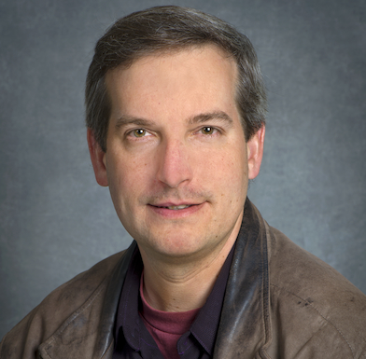
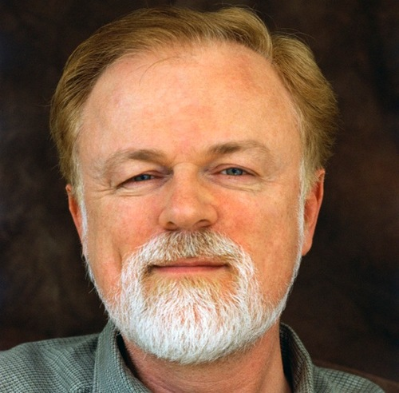
CAGI Hopkins Assessment
John-Marc Chandonia,
Lawrence Berkeley National Laboratory
David Searls,
University of Pennsylvania

Slide 3
Prediction format
Disease Class
 | D1 | D2 | D3
P1
P2
D12 | D13 | D14
Patient
Pred_{(P1,D1)} = [ Probability_{(P1,D1)}, Stdev, Variant, Comment ]
P105
P106

Slide 4
Summary of challenge: 106 patients (43 with clinically relevant variants) in 14 disease classes.
5 groups submitted 11 distinct submissions (4,2,2,2,1).

Slide 5
For the 43 cases where JHU reported a variant, one or more groups got the correct disease in 36 cases.

Slide 6
In most of those cases, predictors found the same variant(s) as JHU

Slide 7
Even when JHU didn’t find a variant, at least one group predicted the disease class in majority of cases

Slide 8
We calculated several metrics for all submissions
Prediction | nCorrect | nCorrect_{tie} | nCorrect_{var} | avgPCorrect | avgPCorrect_{norm} | avgRank | avgError
57.1 | 24 | 24 | 2 | 0.305 | 0.098 | 5.32 | 0.251
57.2 | 9 | 9 | 2 | 0.239 | 0.068 | 7.66 | 0.287
57.3 | 7 | 7 | 0 | 0.236 | 0.068 | 7.78 | 0.289
57.4 | 7 | 6.5 | 0 | 0.426 | 0.074 | 7.1 | 0.42
58.1 | 23 | 23 | 13 | 0.178 | 0.217 | 6.48 | 0.105
58.4 | 26 | 25 | 16 | 0.223 | 0.227 | 6.15 | 0.107
59.1 | 32 | 29.5 | 19 | 0.302 | 0.278 | 5.82 | 0.09
59.2 | 31 | 28.5 | 19 | 0.292 | 0.269 | 5.88 | 0.091
60.1 | 12 | 12 | 8 | 0.072 | 0.102 | 7.14 | 0.08
60.2 | 12 | 12 | 8 | 0.068 | 0.094 | 7.15 | 0.082
61.1 | 38 | 35 | 25 | 0.261 | 0.265 | 5.65 | 0.105
nCorrect = # correct disease classes ( _{tie} = 1/N credit for N-way tie; _{var} = must predict a JHU variant)
avgPCorrect = probability assigned to correct disease ( _{norm} = normalized so all diseases sum to 1.0)
avgRank = average rank of correct disease, with ties assigned median rank
avgError = average difference between assigned P values and 0 or 1(1 = correct disease; 0 = others)

Slide 9
We also looked at which groups got correct disease for each patient, then sorted all combinations by frequency
Ignoring JHU variants
With at least one JHU variant
# of patients |  | Groups predicting correct disease
31 |  | (No group got the correct disease class)
18 |  | [57] (Note: 7 from 57.1)
10 |  | [58, 59, 61]
6 |  | [61]
5 |  | [59]
4 |  | [60]
4 |  | [57, 61]
4 |  | [57, 59, 61]
3 |  | [59, 61]
3 |  | [58, 59]
3 |  | [57, 58, 59, 61]
3 |  | [57, 58]
2 |  | [58, 60, 61]
1 |  | [60, 61]
1 |  | [58, 61]
1 |  | [58, 59, 60, 61]
1 |  | [58]
1 |  | [57, 60]
1 |  | [57, 59, 60, 61]
1 |  | [57, 59]
1 |  | [57, 58, 61]
1 |  | [57, 58, 60]
1 |  | [57, 58, 59, 60, 61]
# of patients |  | Groups predicting correct disease & variant
63 |  | (JHU did not report any variants)
11 |  | [58, 59, 61]
11 |  | (No group got the correct disease class & var)
4 |  | [61]
4 |  | [60]
3 |  | [59, 61]
2 |  | [59]
2 |  | [58, 60, 61]
1 |  | [60, 61]
1 |  | [58, 61]
1 |  | [58]
1 |  | [57, 59, 61]
1 |  | [57, 59, 60, 61]
1 |  | [57, 58, 59, 61]
Each group got at least one patient right that no other groups got
Group 57 got lots of diseases right, but rarely picked a JHU variant

Slide 10
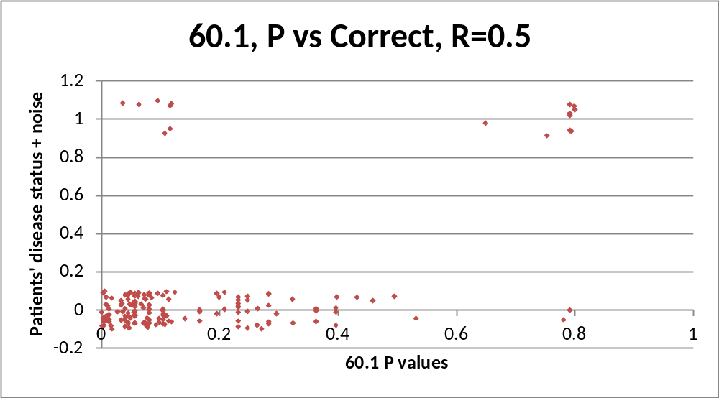
Group 60 made few predictions, but they also made few errors
7 false negatives
9 true positives
2 confident false positives
VCF file annotation field merge issue*

Slide 11
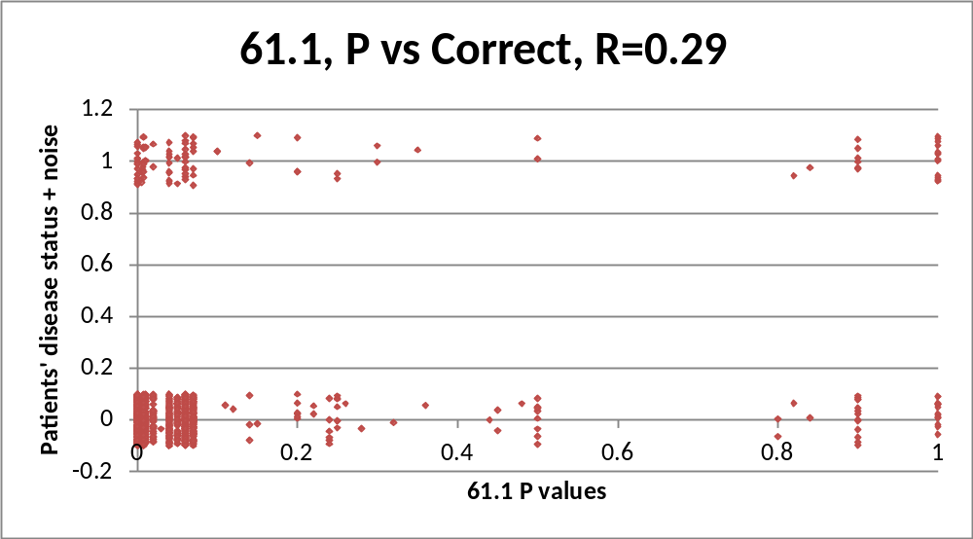
Group 61 had the best correlation with P-values, among groups that made all predictions

Slide 12
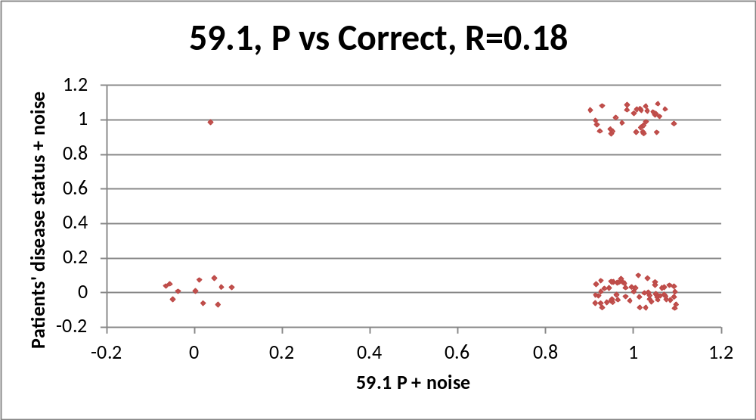
Group 59 made just 1 false negative prediction
1 false negative

Slide 13
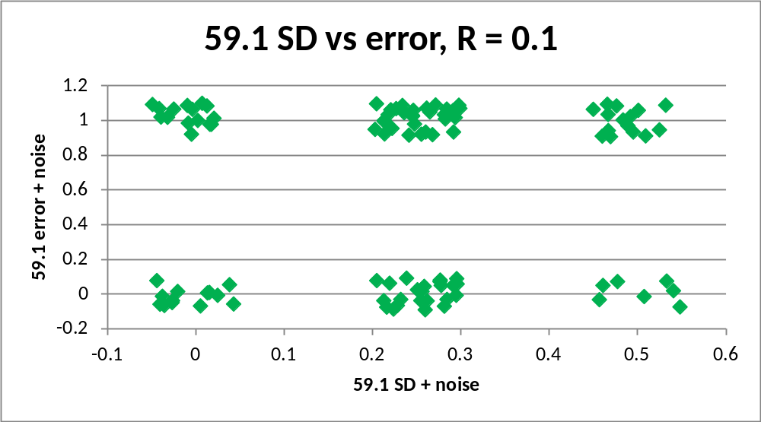
Group 59 was only group with independent SD predictions, for which higher SD → higher error
15
31
15
13
23
7

Slide 14
Summary
Different groups did better according to different metrics
Each group got at least one patient right that no other groups got
Several interesting cases to dig deeper:
  where multiple groups predicted the correct disease with the same variant, but JHU didn’t note any variants
  where multiple groups predicted the wrong disease with the same variant (misdiagnosis?)
  where JHU listed variants but no group correctly predicted the disease (better curated variant list?)

Slide 15
Acknowledgements
John-Marc Chandonia, David Searls (assessment)
Bethany Buckley, Molly Sheridan, and Garry R. Cutting (dataset)
Roger Hoskins, Steven E. Brenner, Stephen Yee, Andrew Neumann (organizers)
Hopkins challenge Predictors

