Slide 1

CAGI slide pack guidelines
I agree to my slides being used according to the following terms: Manuel Giollo
Authors: please include THIS slide at the beginning of your presentation to indicate that you agree with reuse of your slides in CAGI presentations, according to the terms below, and digitally sign by writing your name above.
To disseminate the CAGI results, I encourage all CAGI participants to remix these CAGI slides for inclusion in their oral and poster presentations
CAGI participants may use or publish any content of these slides only in compliance with the CAGI Data Use Agreement
CAGI participants may not cite or publish any content of these slides except with the written permission of the originating author or in the primary CAGI publications
CAGI participants must acknowledge the original authors of these slides and CAGI 2013. Include the acknowledgement banner across the bottom
CAGI participants must include the CAGI credits slide in their presentations
Slides with a red slash (no remix) may not be included in a presentation unless all attendees are registered CAGI participants who signed the data use agreement
Slides with a red X over the entire slide may not be used in any circumstances
Slides with a blue slash (embargoed) may not be used unless the embargo is explicitly lifted
Slides without slash or X may be tweeted unless flagged with the “No tweet” icon.
CAGI participants using these slides must explain the “No tweet” icon, which means that the slide content should not be disseminated outside the presenting conference hall. If the presentation venue permits pervasive tweeting, you may not include these slides in your talk
Note for slide authors: we expect all CAGI participants to abide by these restrictions, and will make best effort to ensure they are followed. However, but bear in mind that we have limited means of enforcing them, and therefore the restrictions cannot be guaranteed.

Slide 2
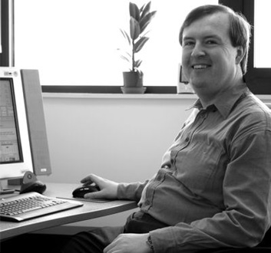

A Retrospective Look at the State of Art for Crohn’s Disease Challenge
Manuel Giollo
David T Jones
26th March, 2016
Manuel Giollo – PhD Computer Science

Slide 3
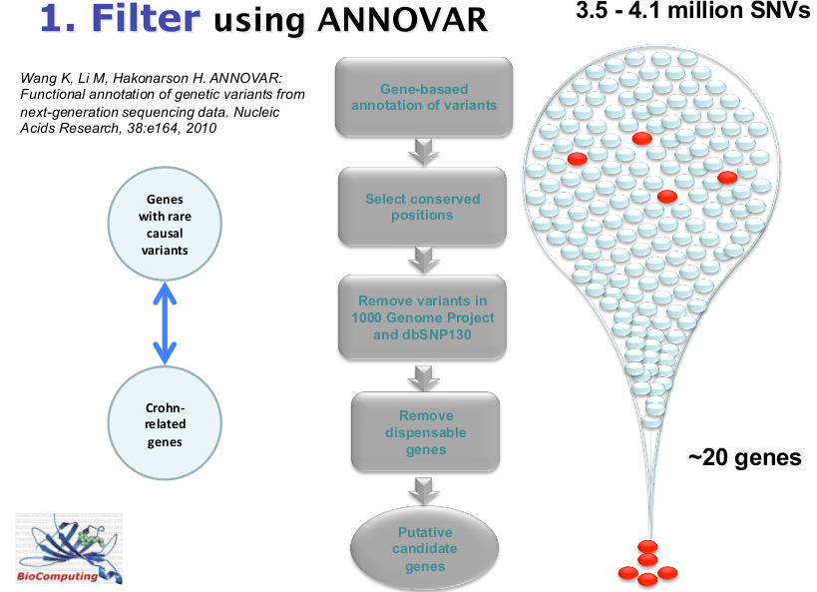
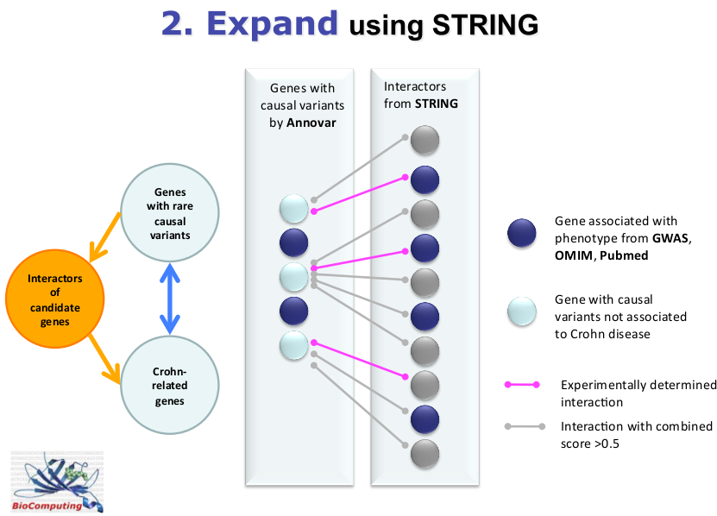
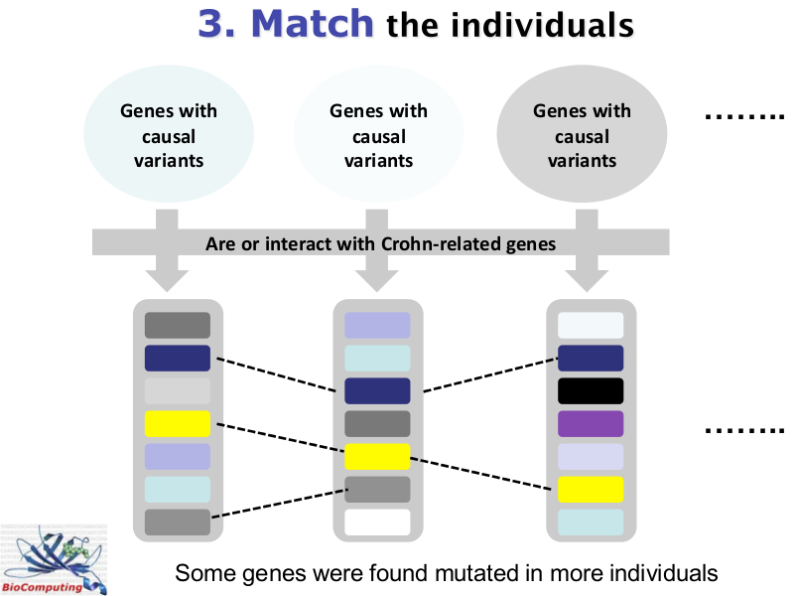
Improvements?
ANNOVAR
Genome Browser
dbSNP
PheGenI
OMIM
SIFT
STRING-DB
ToppGene
Endeavour
TiGER
Network param.
From few SNPs per
Dataset
To several per family
Manuel Giollo – PhD Computer Science

Slide 4
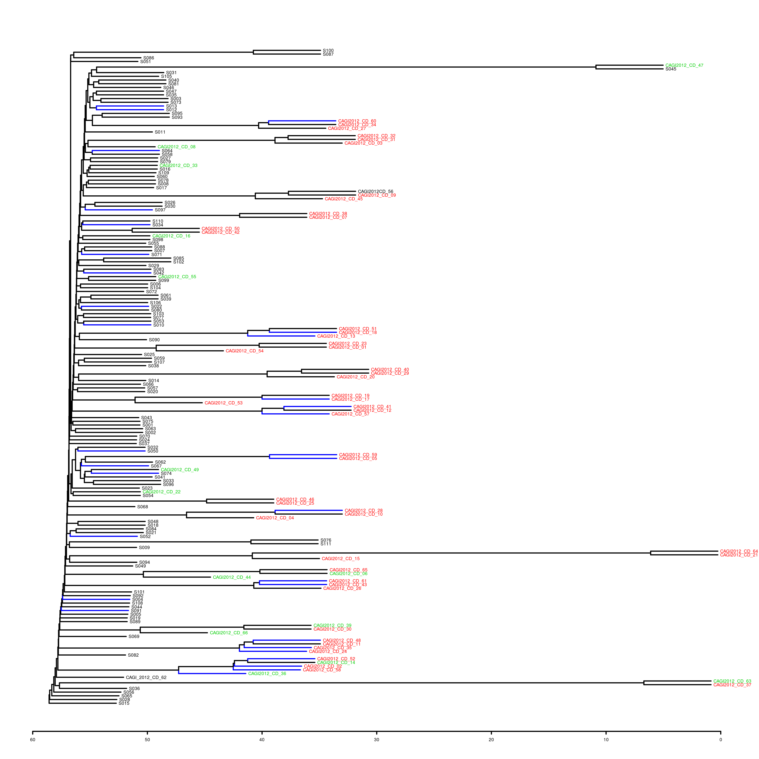
Sample clustering 13/15
CAGI 13
FAMILIES
CAGI 16
SINGLETON
TWINS
Manuel Giollo – PhD Computer Science

Slide 5
Ideas
Little family information w.r.t. CAGI 13
Don't mix CAGI 11 data!!!
I expected 25% of samples to be control → 43% in reality
I just considered variants with frequency < 0.04 on coding regions
Stop using interaction networks
Stop using ANNOVAR → it's a black box
All processing is performed by a R pipeline
Let's use what we did in the past
Manuel Giollo – PhD Computer Science

Slide 6
Old methods
Publication weight
Count mutations located on important Crohn's genes
Weight: log( nr_publications_gene_association )
Binomial count
Look for mutations happening more then expected (Binomial test)
Bonferroni correction
Count the frequency of selected SNVs
Clustering age (family assumption)
Build a dendrogram with CAGI 13 + CAGI15
Use cophenetic distance to determine the most similar patients
Average the age of up to 5 similar samples
I used this for onset estimation
Manuel Giollo – PhD Computer Science

Slide 7
Old methods
Bootstrapped bi-clustering
Use k-means (k=2) to separate samples
Samples in the smaller cluster are considered healthy
Repeat the process and count how many times a patient is predicted as healthy
What if we count NAs?
One can count the number of missing observations in each sample
A measure of how good/important is the sample
There is -0.74 correlation between the NA counting and bootstrapped bi-clustering
Manuel Giollo – PhD Computer Science

Slide 8
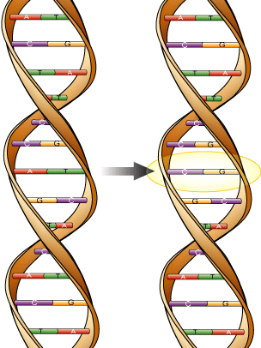
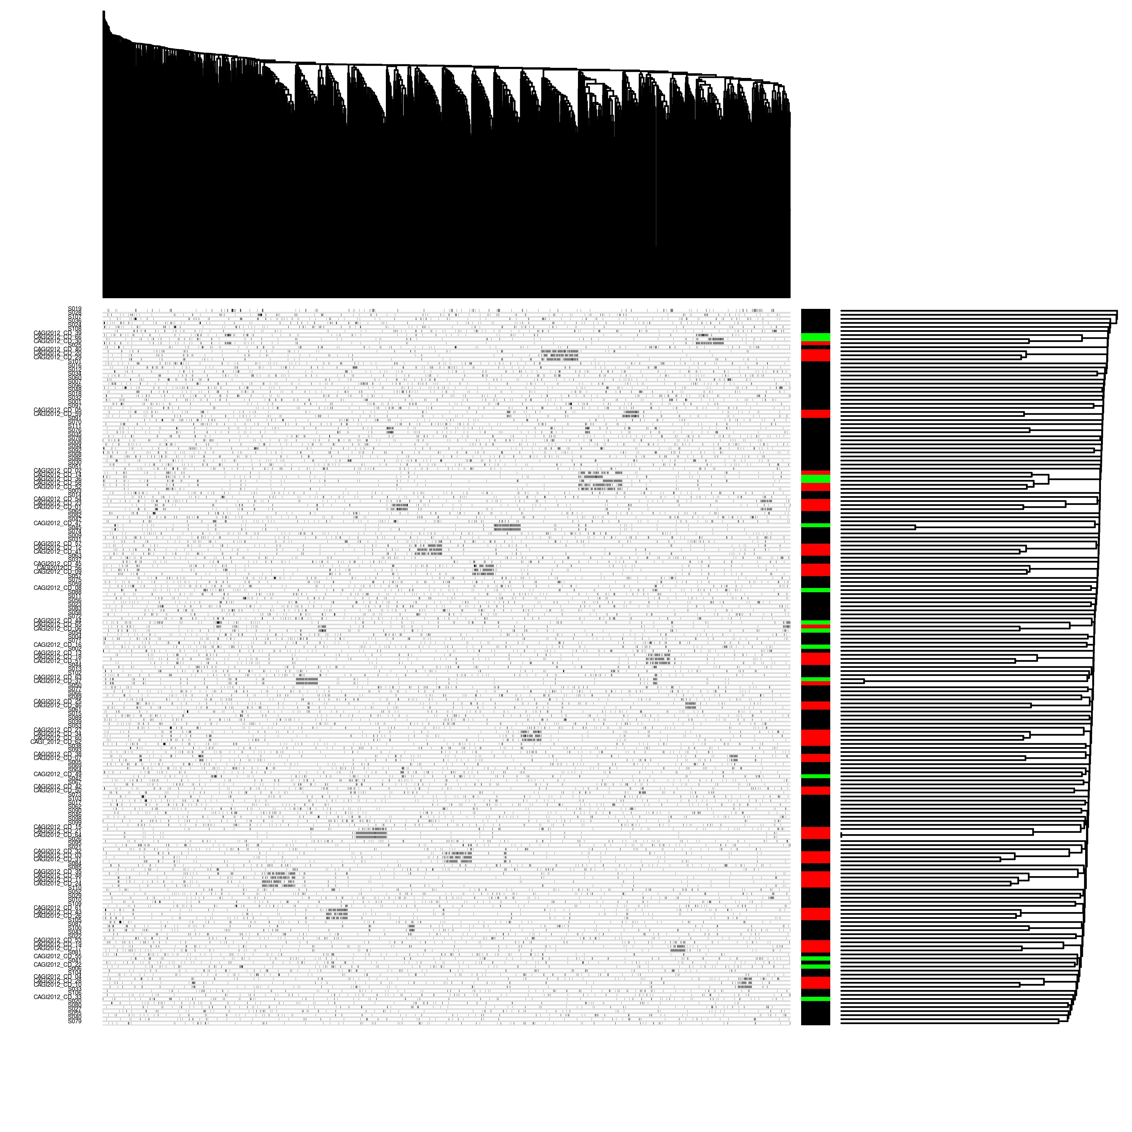

HeatMap 13/15
SNV
Sample
Manuel Giollo – PhD Computer Science

Slide 9
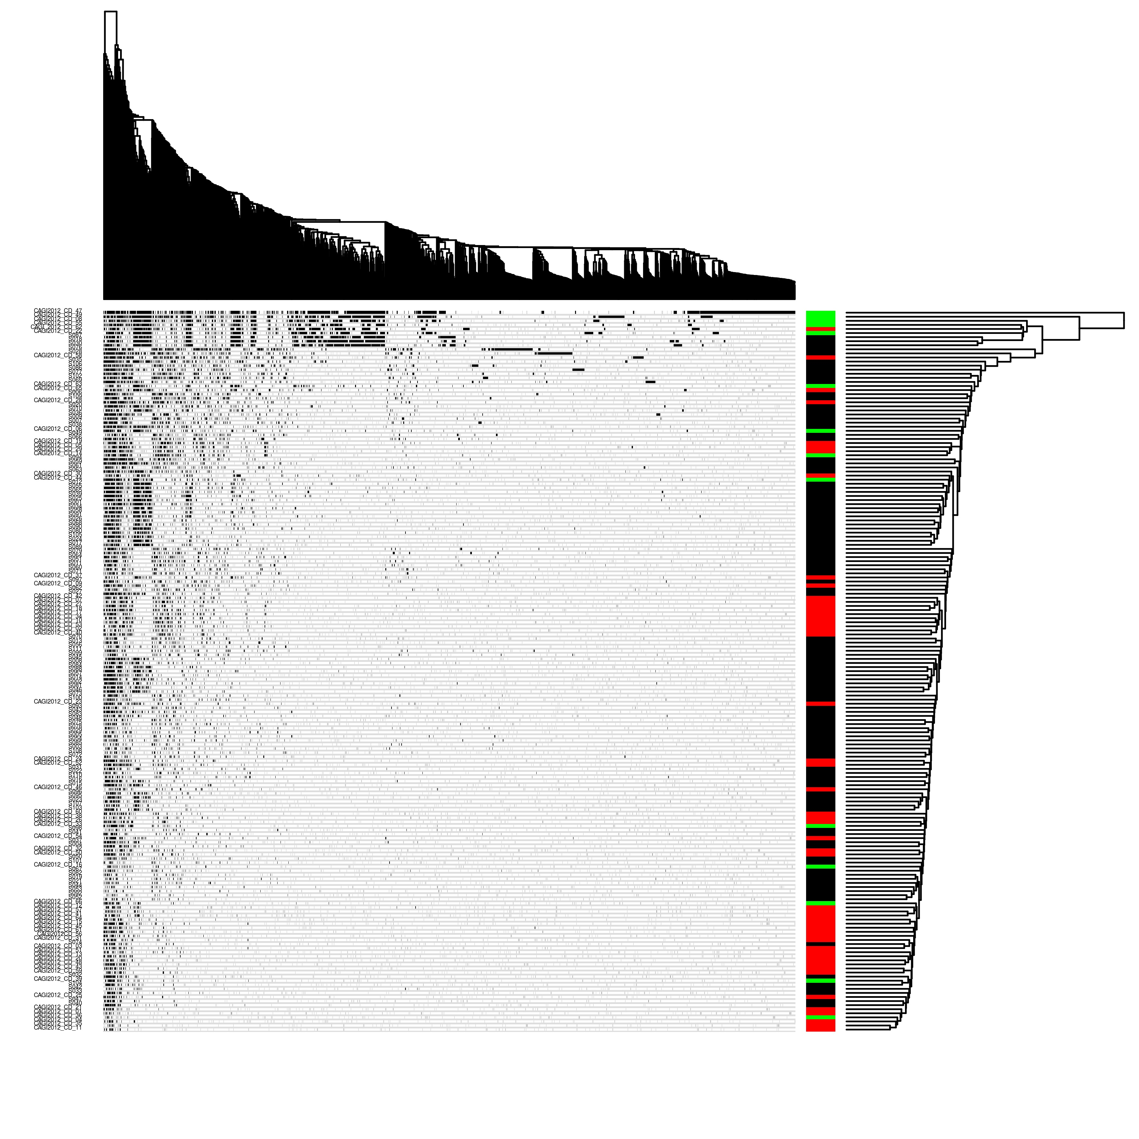
The impact of missing observations
SNV
Sample
Manuel Giollo – PhD Computer Science

Slide 10
New approaches
GWAS OR-weight
Count mutations located on important Crohn's genes
Weight: odds ratio measured in a GWAS
rs2066844
Look for the number of mutations in each sample
Manual
I combined manually the predictions of all previous methods
Manuel Giollo – PhD Computer Science

Slide 11
New approaches
Support Vector Machine
Fisher test to identify useful variants (5x10⁻⁶ p-value threshold)
43 features
Semi-supervised learning combining CAGI 13 and 15 data
RBF kernel
Logistic Regression
Odds ratio of SNVs on CAGI13
Just protective SNVs were selected
Bootstrap
Combine all previous ideas
Manuel Giollo – PhD Computer Science

Slide 12
Using all best methods ever
Method | AUC | Correlation
NA count | 0.7 * | 0.36 *
Publication-weight | 0.56 | 0.05
Manual | 0.63 * | 0.2 *
rs2066844 | 0.59 * | 0.23 *
Binomial count | 0.47 | -0.06
Clustering age | 0.52 | 0.06
GWAS OR-weight | 0.59 * | 0.14
RBF Support Vector Machine | 0.6 * | 0.2
Logistic regression | 0.57 | 0.16
Bootstrap | 0.66 * | 0.29 *
Manuel Giollo – PhD Computer Science

Slide 13
Take home message
CAGI Crohn's disease 16 was an hard challenge
Data quality is still a huge issue (NAs)
Rs2066844 is an important source of information
Using Odds Ratio from past GWAS might help
Manuel Giollo – PhD Computer Science

Slide 14

The end
Questions
Suggestions
Anything else
Manuel Giollo – PhD Computer Science

Slide 15
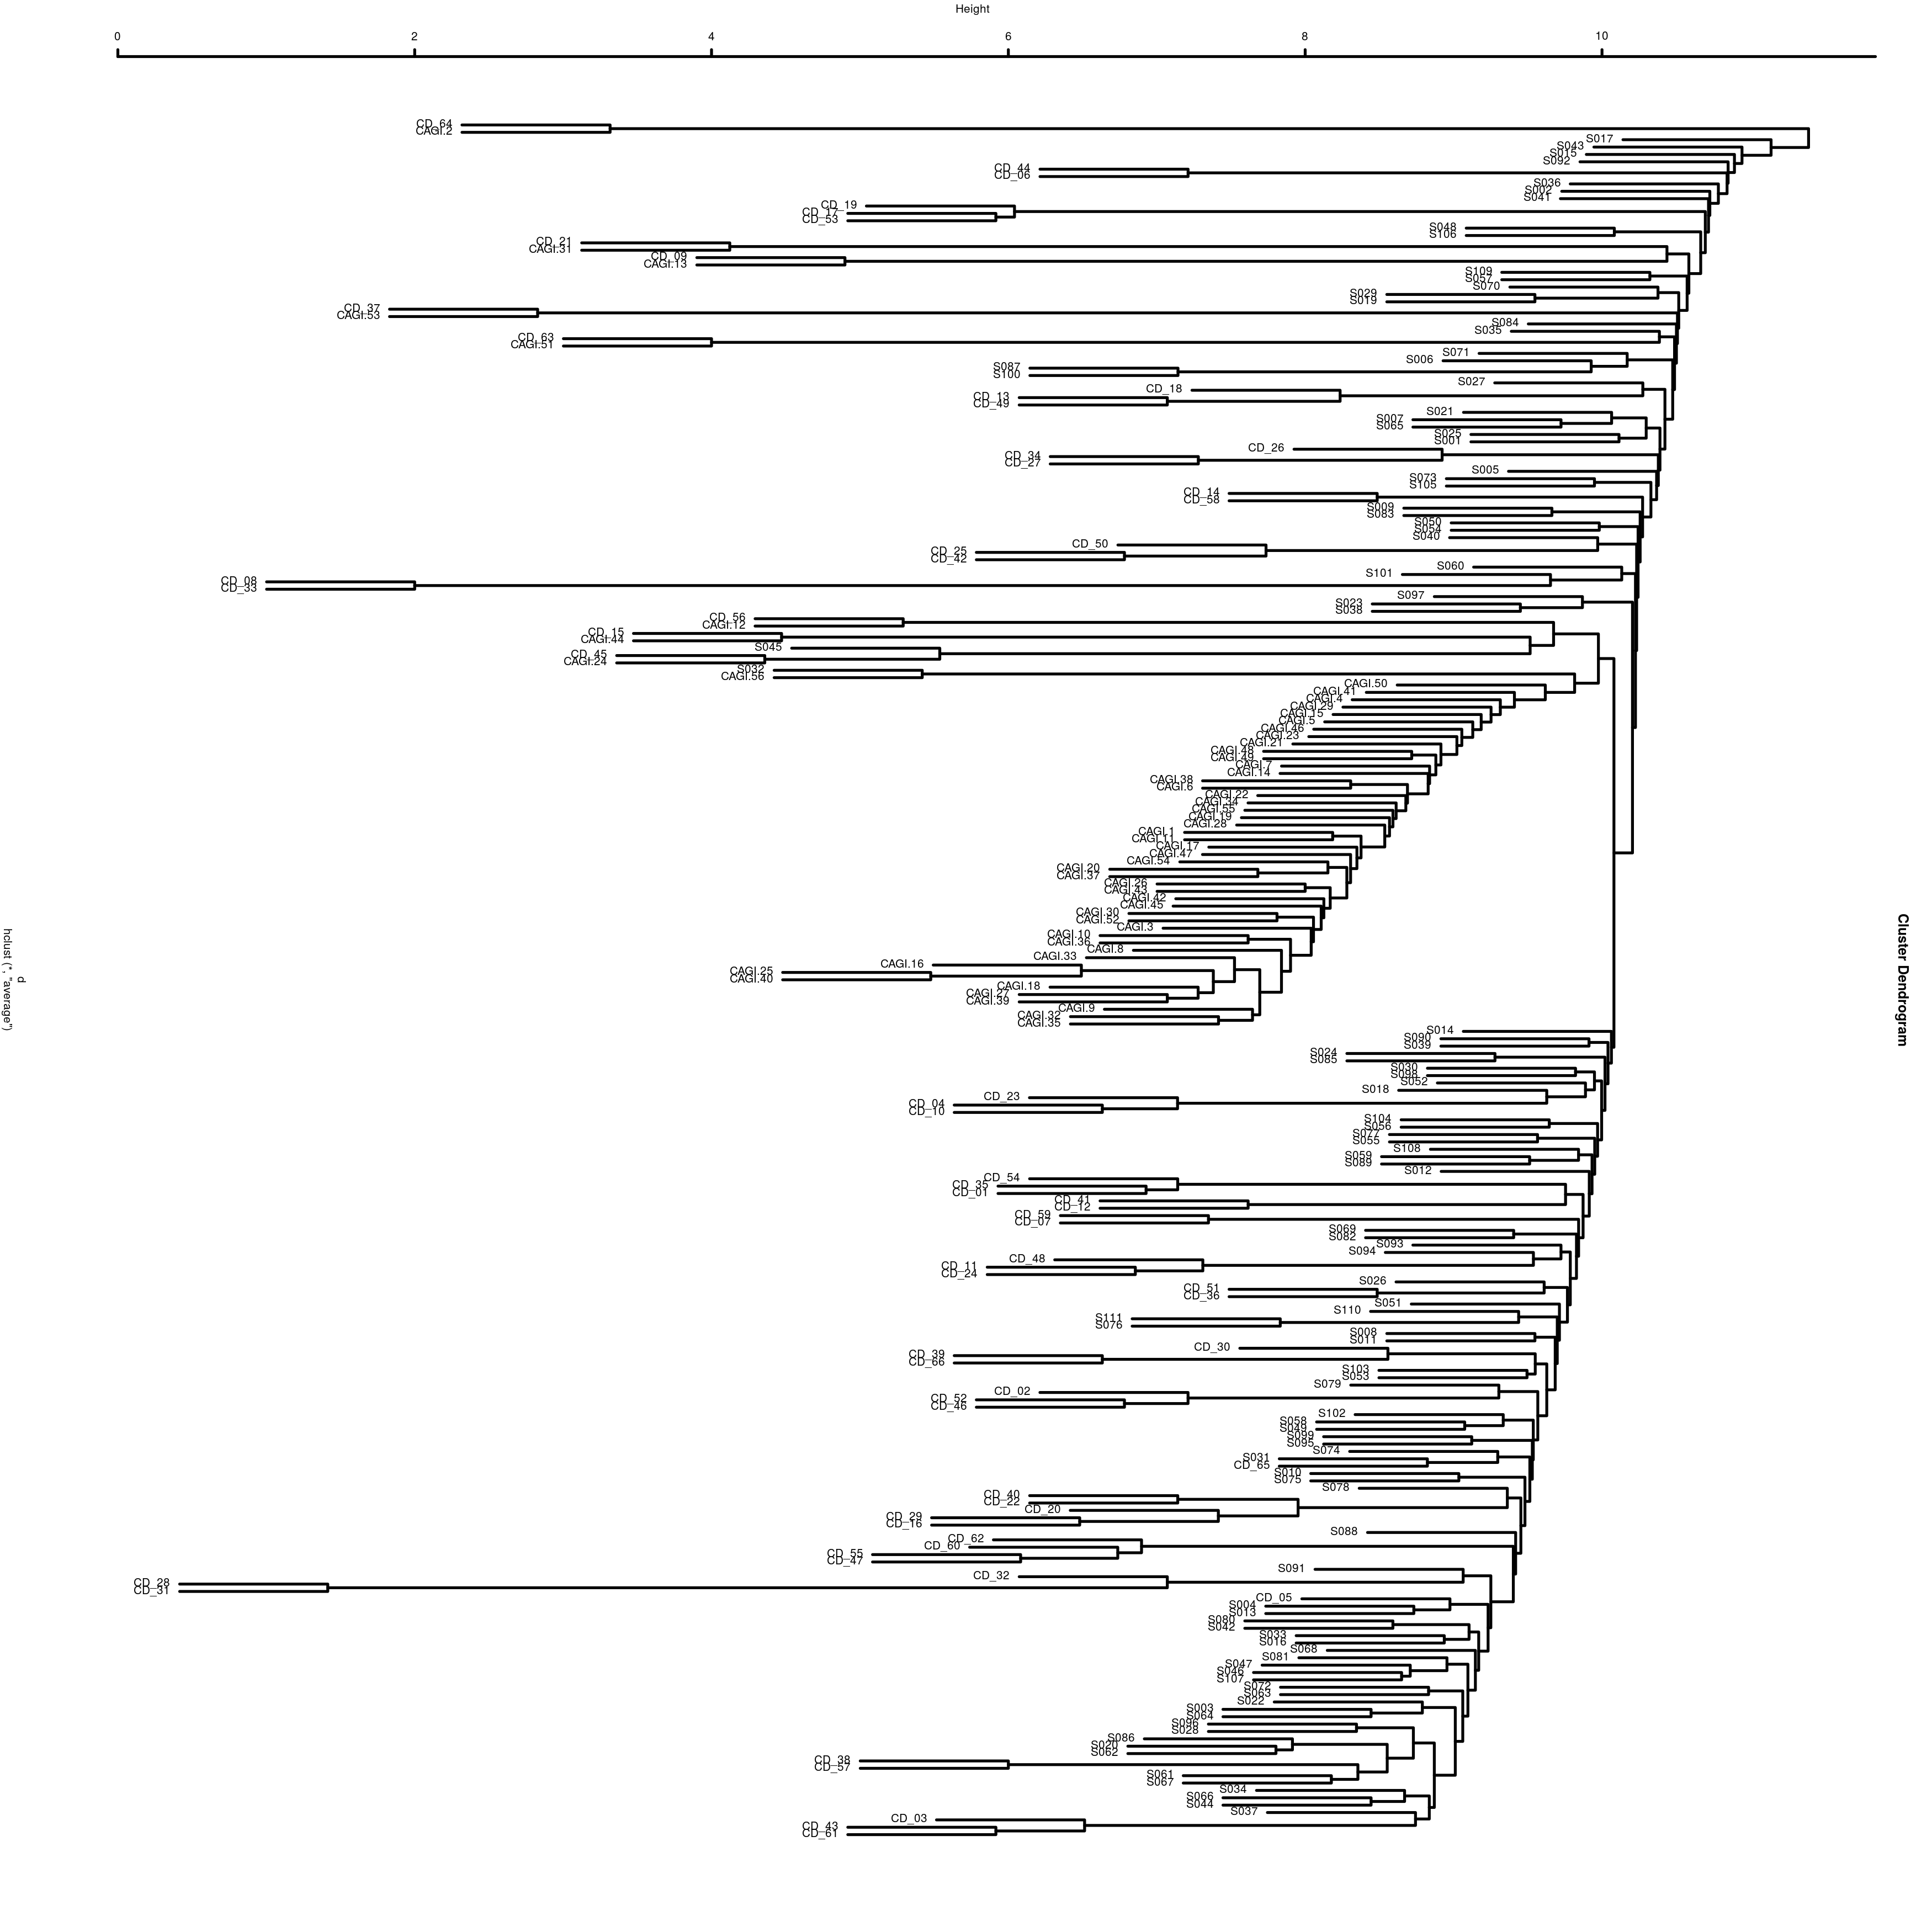
Sample clustering 11/13/16
CAGI 11
Manuel Giollo – PhD Computer Science

Slide 16
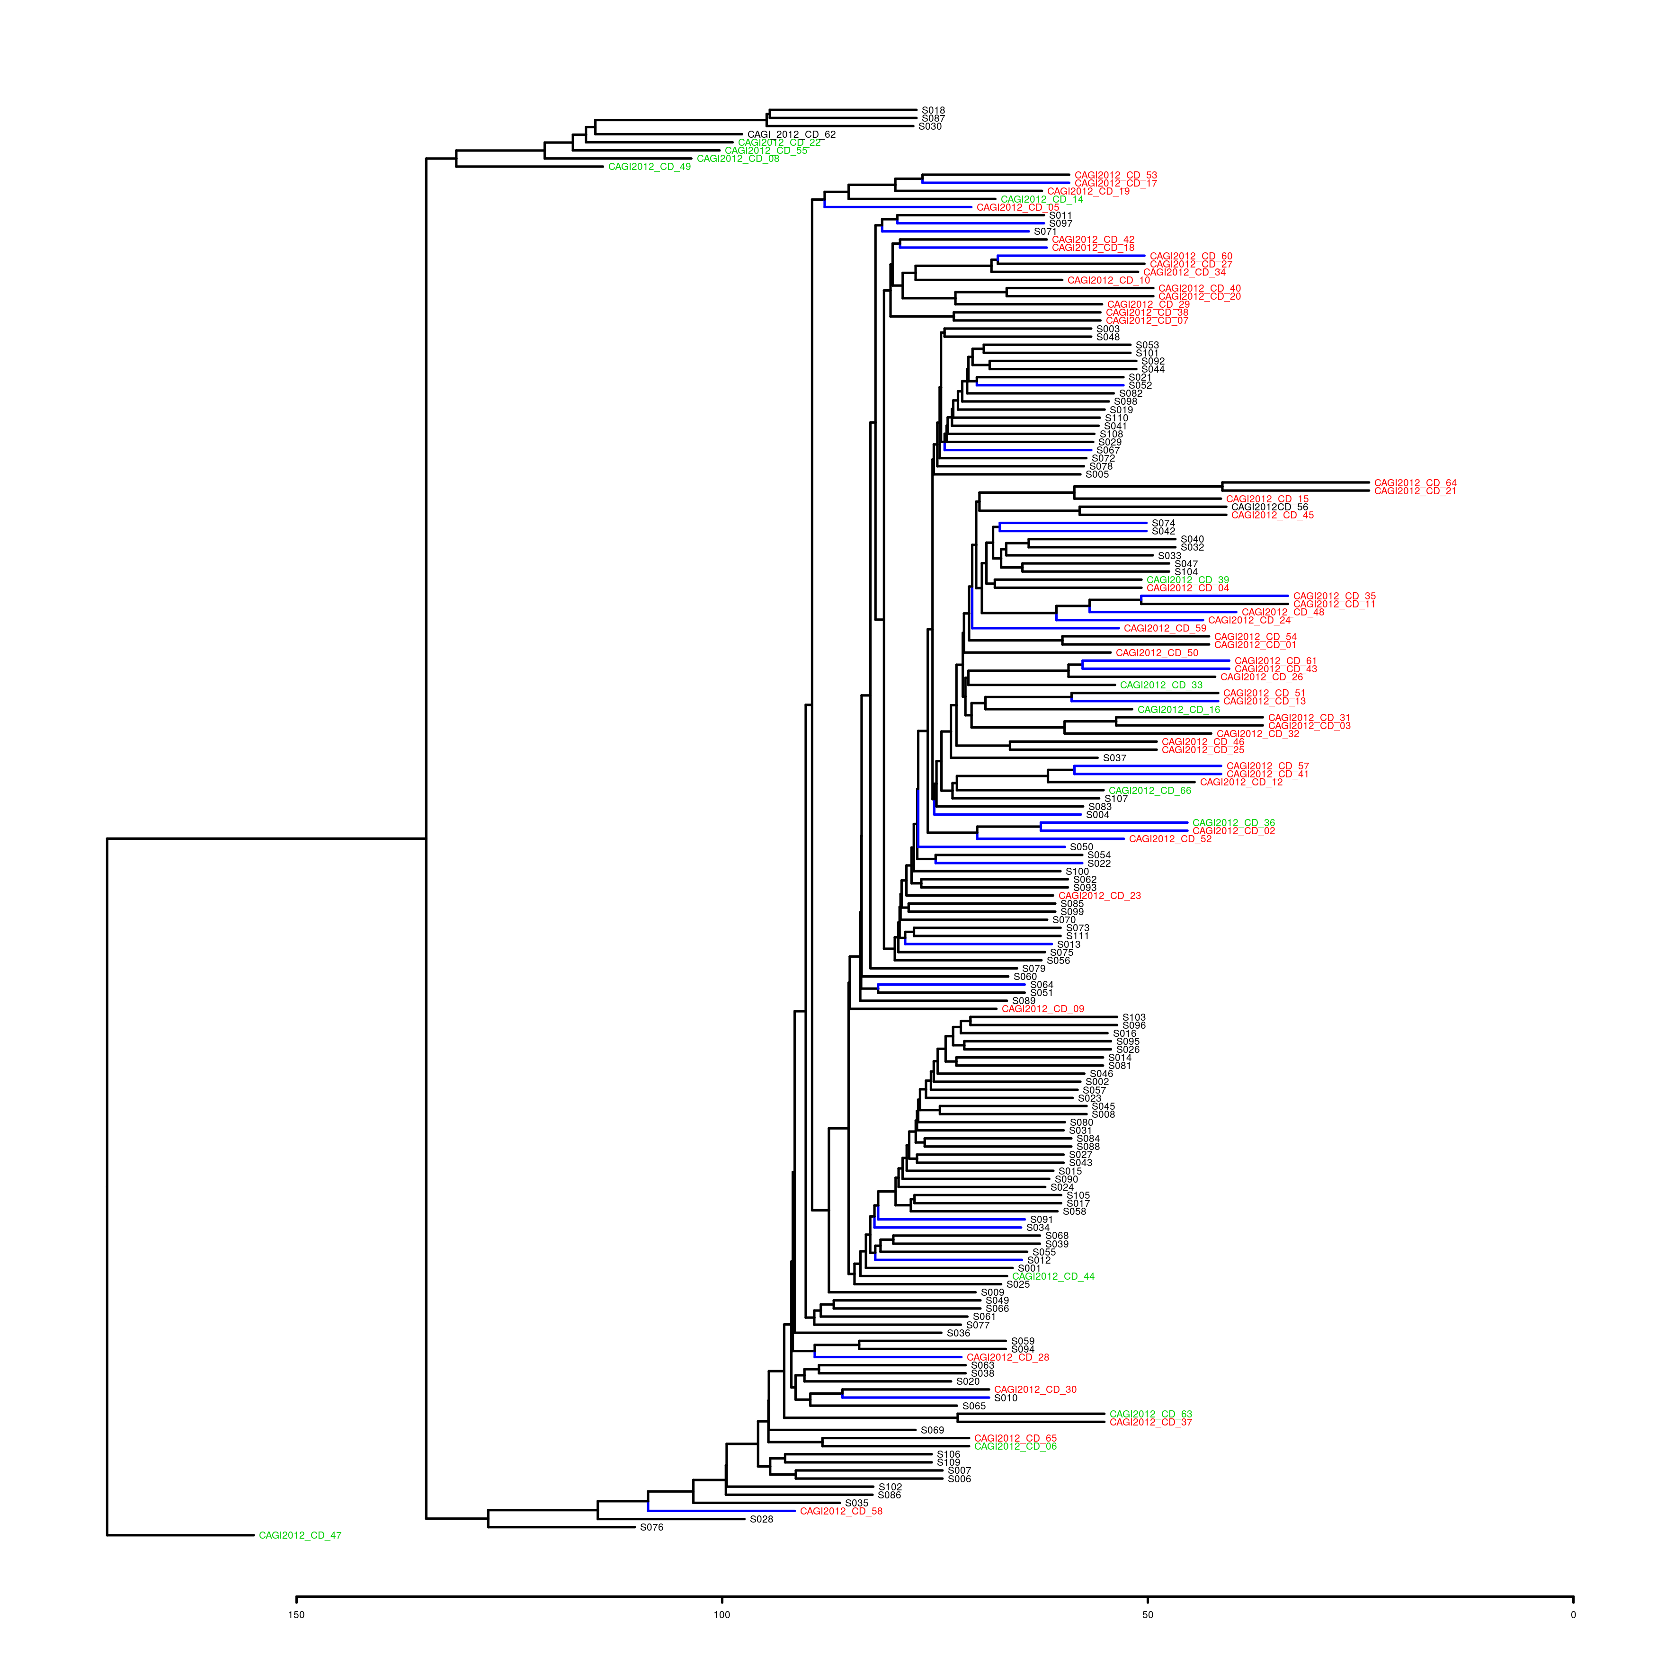
Missing data clustering 13/16
Manuel Giollo – PhD Computer Science

