Slide 1

CAGI slide pack guidelines
I agree to my slides being used according to the following terms: _______Lipika R. Pal_______
Authors: please include THIS slide at the beginning of your presentation to indicate that you agree with reuse of your slides in CAGI presentations, according to the terms below, and digitally sign by writing your name above.
To disseminate the CAGI results, I encourage all CAGI participants to remix these CAGI slides for inclusion in their oral and poster presentations
CAGI participants may use or publish any content of these slides only in compliance with the CAGI Data Use Agreement
CAGI participants may not cite or publish any content of these slides except with the written permission of the originating author or in the primary CAGI publications
CAGI participants must acknowledge the original authors of these slides and CAGI 2013. Include the acknowledgement banner across the bottom
CAGI participants must include the CAGI credits slide in their presentations
Slides with a red slash (no remix) may not be included in a presentation unless all attendees are registered CAGI participants who signed the data use agreement
Slides with a red X over the entire slide may not be used in any circumstances
Slides with a blue slash (embargoed) may not be used unless the embargo is explicitly lifted
Slides without slash or X may be tweeted unless flagged with the “No tweet” icon.
CAGI participants using these slides must explain the “No tweet” icon, which means that the slide content should not be disseminated outside the presenting conference hall. If the presentation venue permits pervasive tweeting, you may not include these slides in your talk
Note for slide authors: we expect all CAGI participants to abide by these restrictions, and will make best effort to ensure they are followed. However, but bear in mind that we have limited means of enforcing them, and therefore the restrictions cannot be guaranteed.

Slide 2
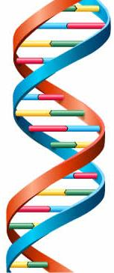

Crohn’s Exomes Challenge Predictions
Moult_Lab
Lipika R. Pal, Kunal Kundu, Yizhou Yin and John Moult*
Institute for Bioscience and Biotechnology Research
University of Maryland at College Park, Rockville, MD
*(jmoult@umd.edu)
March 26th, 2016
Created for CAGI 4
genomeinterpretation.org
Lipika R. Pal

Slide 3
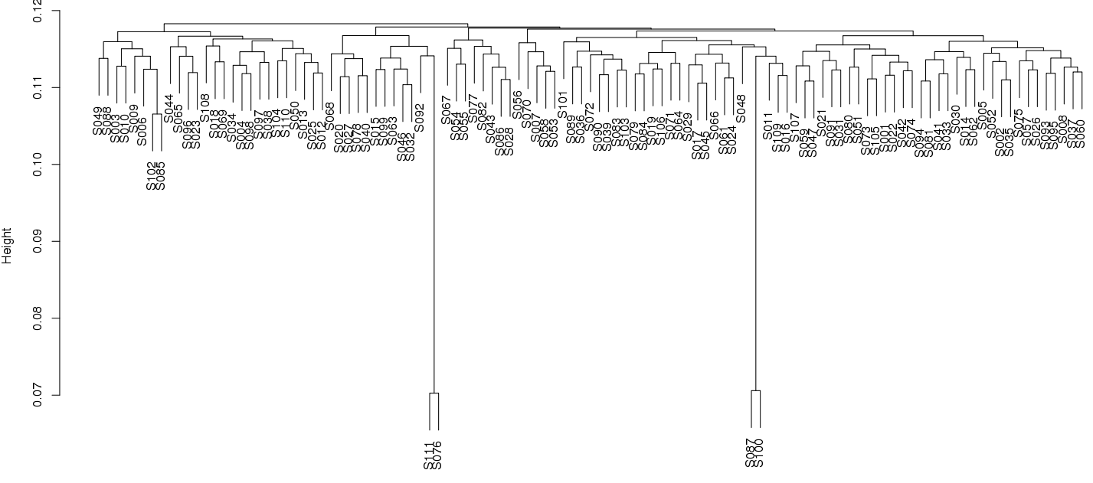
CAGI-4 data for Crohn’s exome:
Created for CAGI 4
genomeinterpretation.org
Lipika R. Pal
Notes:
Little vague about what clustering on what – clustering on all variants, nothing to do with disease

Slide 4
Mechanism landscape of Crohn’s microarray data in 90 GWAS loci:
Pal LR & Moult J, (2015), J. Mol. Biol
Pal LR, Yu C-H, Mount SM & Moult J, (2015), BMC Genomics
Created for CAGI 4
genomeinterpretation.org
Lipika R. Pal
Notes:
We spent a quite a lot of effort in the groyp trying to understand underlying mechanisms, nothing to do with this challenge

Slide 5
Imputation of GWAS markers from exome data:
Transcription factor
5’
UTR
3’
UTR
Enhancer
Exon
Intron
GWAS
marker
GWAS
marker
Given Exome Data
1000 Genome Phase3 reference data
Imputation Programs: ShapeIT and IMPUTE2
Created for CAGI 4
genomeinterpretation.org
Lipika R. Pal
Notes:
90 loci: Compiled from GWAS catalog & 140 loci: Jostins et al., 2012, nature11582.

Slide 6
Imputation of GWAS markers:
Overall 22% missing data in 140 loci dataset
Created for CAGI 4
genomeinterpretation.org
Lipika R. Pal

Slide 7
Theme of the methodology:
Exome Sequencing data
Imputation of GWAS markers
Naïve Bayes
Machine learning methods
Annotation by VARANT
Rare variants
140 loci
90 loci
140 loci
90 loci
90 loci
Created for CAGI 4
genomeinterpretation.org
Lipika R. Pal

Slide 8

Prediction | Number of loci | Type of Methods
1 | 140 | Naïve Bayes (conditional probability based)
2 | 140 | Consensus machine learning, including Naïve Bayes (odds ratio based), Logistic Regression, Random Forest (1000 trees)
3 | 140 | Logistic Regression
4 | 90 | Logistic Regression
5 | 90 | Consensus machine learning as in 2
6 | 90 | Rare variant contributions together with Odds ratio based Naïve Bayes.
Training data: WTCCC1
Testing data WTCCC1 and CAGI2013
Created for CAGI 4
genomeinterpretation.org
Lipika R. Pal
Notes:
Table # of loci, # of methods

Slide 9
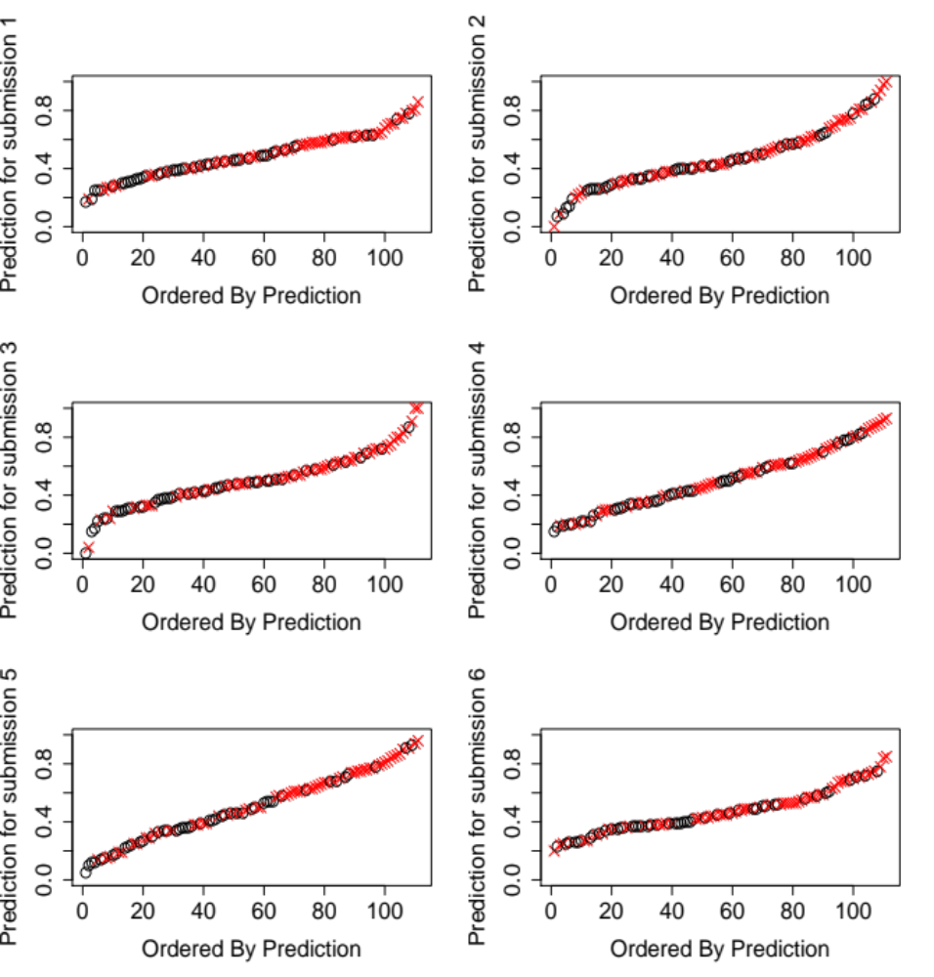
Control
X Case
Created for CAGI 4
genomeinterpretation.org
Lipika R. Pal

Slide 10
Type of relationships in the data evident from different machine learning methods:
Machine learning methods
Naïve Bayes
(Linear relationship)
Consensus Machine learning
(combination of linear and non-linear relationship)
Individual ML method
(Logistic regression)
No significant difference between different machine learning methods
Created for CAGI 4
genomeinterpretation.org
Lipika R. Pal
Notes:
Need to mention about neural net for non-linear and did not perform good. SVM light for SVM for publication.
Looked at outliers of the case and control, what extra loci are lit up…. John will do.

Slide 11
Performance of 90 loci vs. 140 loci
Common to 90 loci and 140 loci
140 loci only
Adaptive Immunity
24
5
Innate Immunity
11
14
Immune Response/Inflammation
1
6
Apoptosis/Autophagy
3
3
Barrier Integrity
8
1
Intracellular Logistics
2
3
Other processes
27
22
Created for CAGI 4
genomeinterpretation.org
Lipika R. Pal
Notes:
Too many words – tighten up.

Slide 12
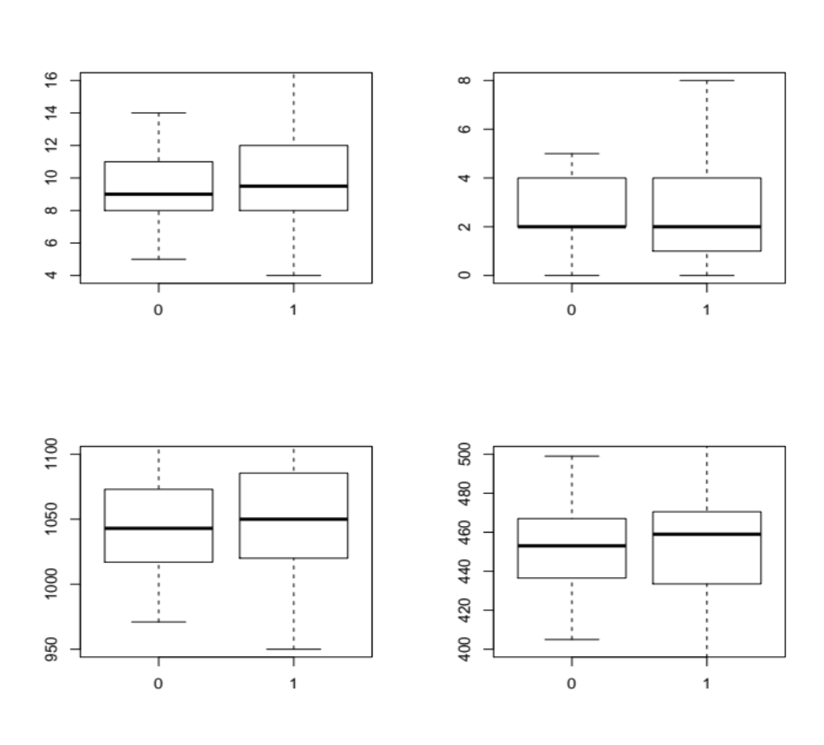
Bias in CAGI-4 Crohn’s exome data?
Heterozygous common impact exome variants in Crohn’s genes
Homozygous common impact exome variants in Crohn’s genes
Control
Case
Control
Case
Heterozygous common impactexome variants in NON-Crohn’s genes
Homozygous common impact exome variants in NON-Crohn’s genes
Control
Case
Control
Case
Created for CAGI 4
genomeinterpretation.org
Lipika R. Pal
Notes:
Change to case and control for 0 and 1
Rare variant role is not nailed. We looked more at genes with common variants, but rare variant gene list could be longer, including common genes. We didn’t do a good job here. – so don’t know really what’s going on here.

Slide 13
Conclusion:
Imputation of GWAS markers from exome sequencing data is helpful.
For Crohn’s disease, machine learning method is not performing significantly different between methods capturing linear vs. non-linear relationship in the data.
140 loci information is performing better than 90 loci.
Loci related with innate immunity and immune response/inflammation are carrying significantly more risk alleles for cases than controls.
We need to understand mechanistic relationships more for better disease risk model.
Created for CAGI 4
genomeinterpretation.org
Lipika R. Pal

Slide 14
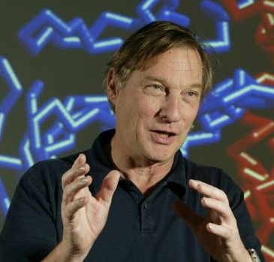
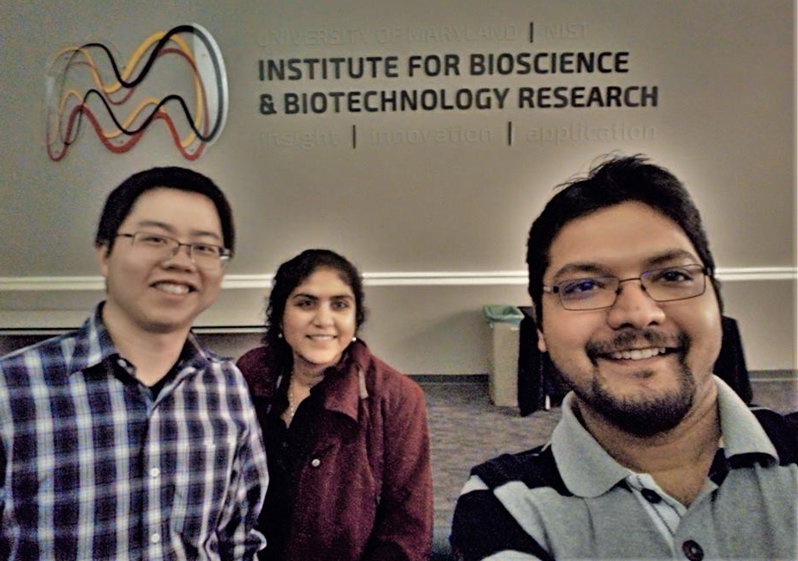
Participants:
John
Yizhou
Kunal
Lipika
Thank You!!
Created for CAGI 4
genomeinterpretation.org
Lipika R. Pal

