Slide 1

CAGI slide pack guidelines
I agree to my slides being used according to the following terms: Johnathan R. Azaria
Authors: please include THIS slide at the beginning of your presentation to indicate that you agree with reuse of your slides in CAGI presentations, according to the terms below, and digitally sign by writing your name above.
To disseminate the CAGI results, I encourage all CAGI participants to remix these CAGI slides for inclusion in their oral and poster presentations
CAGI participants may use or publish any content of these slides only in compliance with the CAGI Data Use Agreement
CAGI participants may not cite or publish any content of these slides except with the written permission of the originating author or in the primary CAGI publications
CAGI participants must acknowledge the original authors of these slides and CAGI 2013. Include the acknowledgement banner across the bottom
CAGI participants must include the CAGI credits slide in their presentations
Slides with a red slash (no remix) may not be included in a presentation unless all attendees are registered CAGI participants who signed the data use agreement
Slides with a red X over the entire slide may not be used in any circumstances
Slides with a blue slash (embargoed) may not be used unless the embargo is explicitly lifted
Slides without slash or X may be tweeted unless flagged with the “No tweet” icon.
CAGI participants using these slides must explain the “No tweet” icon, which means that the slide content should not be disseminated outside the presenting conference hall. If the presentation venue permits pervasive tweeting, you may not include these slides in your talk
Note for slide authors: we expect all CAGI participants to abide by these restrictions, and will make best effort to ensure they are followed. However, but bear in mind that we have limited means of enforcing them, and therefore the restrictions cannot be guaranteed.

Slide 2
Genomics and Human Diseases:
Predicting Crohn's Disease status in CAGI 2015
Eran Bachar, Johnathan R. Azaria, Yanay Ofran, Ron Unger,
Computational Biology
The Mina & Everard Goodman Faculty of Life Sciences Bar-Ilan University
March 4
Created for CAGI 4
genomeinterpretation.org
Johnathan R. Azaria

Slide 3
The 2015 Crohn's Challenge
Exome data is given for 111 people
On average about 44,000 mutations (SNPs) per person, in VCF format
The challenge was to predict which people have Crohn’s Disease (CD) and which are healthy.
Created for CAGI 4
genomeinterpretation.org
Johnathan R. Azaria

Slide 4
Epidemiology
Crohn’s disease (CD) is a chronic relapsing inflammatory condition
usually with flare-ups alternating with periods of remission, and an
increasing disease severity and incidence of complications as
time goes on.
Incidence: 7/100,000 pop/yr
Prevalence: 100/100,000 pop/yr
Crohn’s has a clear genetic component:
Early studies show that the risk to develop Crohn’s is 15–42 times higher if a sibling has Crohn’s
A more relevant evidence comes from twin studies: A meta-analysis of six twin studies with a combined set of 112 MZ and 196 DZ twin pairs reported concordance rates of 30.3% and 3.6% respectively, indicating that a large component of Crohn's disease risk is indeed genetic.
Created for CAGI 4
genomeinterpretation.org
Johnathan R. Azaria

Slide 5
Which genes are involved?
Currently there are about 90 GWAS sites that show statistical significant association
with CD.
Most sites are in non-coding regions, but they can be linked to about 120 genes.
Nod2
TLR4
CARD9
IL23R
STAT3
HLA
TNFSF15
IRF5
PTPN22
ATG16L1
IRGM
Plays a key role in intestinal homeostasis, some mutations in this gene have OR of 3 for hetrozygotes and 30 for homozygotes
Innate immunity
Adoptive immunity
Autophagy
Created for CAGI 4
genomeinterpretation.org
Johnathan R. Azaria

Slide 6
Our basic strategy
Very simple.
Select a list of relevant SNPs or genes.
Calculate the SNP load.
Choose a scale and/or a cut-off to assign Sick and Healthy.
Created for CAGI 4
genomeinterpretation.org
Johnathan R. Azaria

Slide 7
Which gene/SNP list to choose?
A list of genes that are associated with strong GWAS sites ~ 120 genes
A list of genes the appear in biological pathways associated with CD, ~ 400 genes
SNPs that we got from a large ML study of GWAS sites
(Wei et. al. (Am J Hum Genet. 2013 92:1008-1012.)) that resulted in 573 GWAS sites.
Created for CAGI 4
genomeinterpretation.org
Johnathan R. Azaria

Slide 8
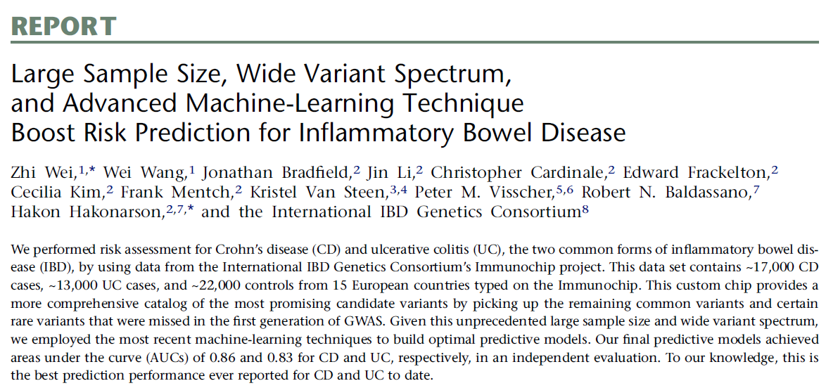
The IBD Genetics Consortium gene list
Am J Hum Genet. 2013 92:1008-1012
Created for CAGI 4
genomeinterpretation.org
Johnathan R. Azaria

Slide 9
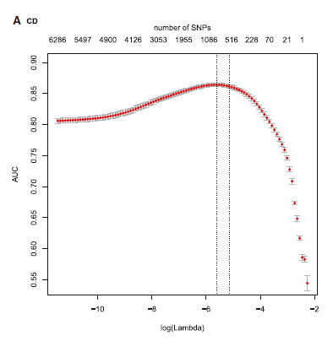
The IBD Genetics Consortium gene list
Using Immunochip, a custom Illumina Infinium chip, they looked at SNPs with p values > 10⁻⁴ and minor allele frequency (MAF) < 0.01, and got 10,799 SNPs. Those were filtered further to get 573 SNPs that achieve AUC of 0.86.
Created for CAGI 4
genomeinterpretation.org
Johnathan R. Azaria

Slide 10
So, if this is so good,
why did we not get such a high score?
Courtesy of Zhi Wei , we got the list of said 573 SNPs with their corresponding weights as calculated by their logistic regression model.
Only 29 SNPs were found in the Exome data
They used a chip that is non-standard, making imputation to coding SNPs difficult (Lipika Ray, personal communication).
Created for CAGI 4
genomeinterpretation.org
Johnathan R. Azaria

Slide 11
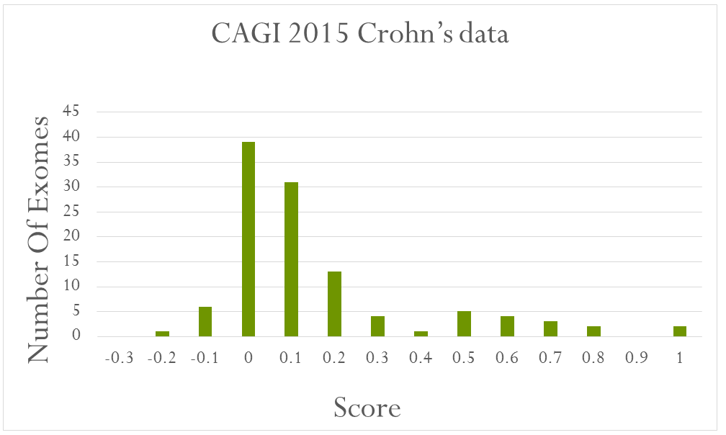
The Histogram of weighted SNP load of CAGI 2015 exomes, based on the 29 coding SNPs.
Weights were doubled for homozygotes
Clearly, the distribution is not symmetric, with a tail towards the higher score
Created for CAGI 4
genomeinterpretation.org
Johnathan R. Azaria

Slide 12
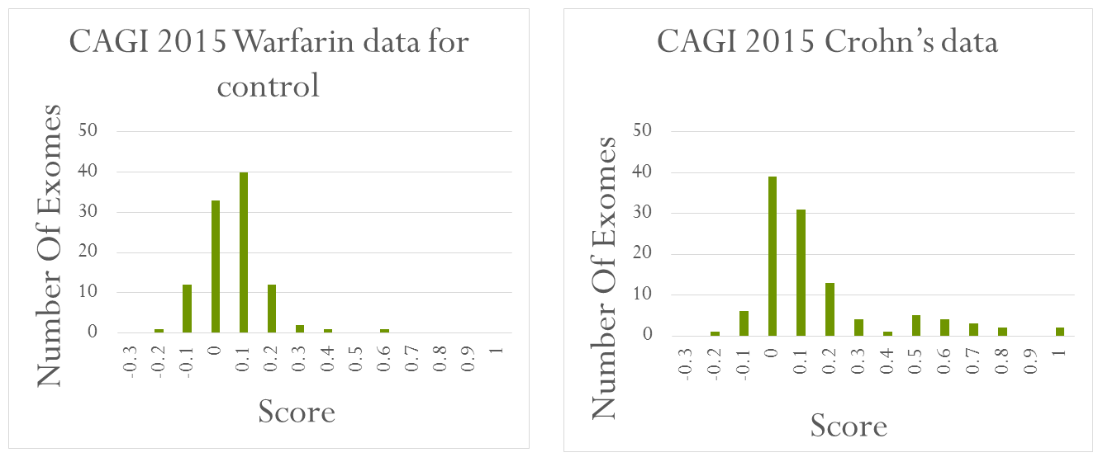
Warfarin exomes don’t show this trend
The Warfarin distribution on these SNPs is clearly different.
Assuming that Warfarin subjects are not CD patients, we can set a cutoff
(>0.2) to identify patients with high confidence.
(in retrospect 16 out of these 21 (76%) were indeed Crohn's patients).
Created for CAGI 4
genomeinterpretation.org
Johnathan R. Azaria

Slide 13
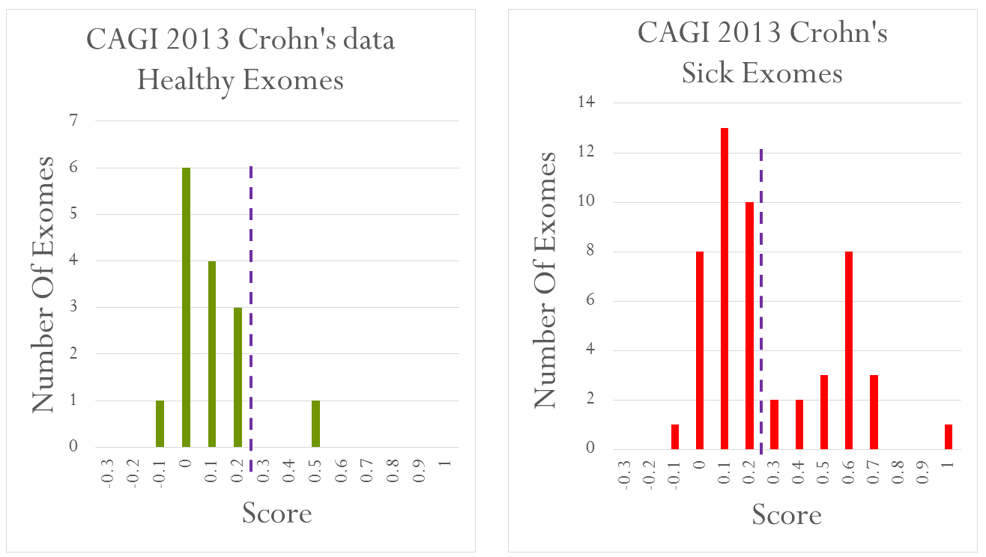
Using CAGI 2013 data as further validation
1 out of 15
19 out 51
Created for CAGI 4
genomeinterpretation.org
Johnathan R. Azaria

Slide 14
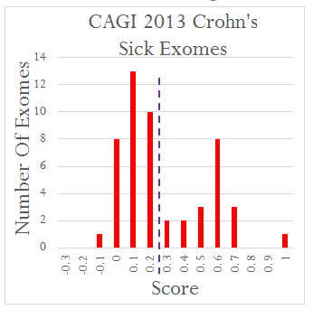
Looking further for CD patients
Clearly, there are CD patients with score <0.2,
and anyhow we assumed that the dataset contains more than 21 patients.
Thus, we had to extend the list of CD patients.
Submission 1
We first used the score distribution, assigned status of 1 to the 21 patients
with score >0.2, and then converted the score into a range of 0.9 to 0.
Created for CAGI 4
genomeinterpretation.org
Johnathan R. Azaria

Slide 15
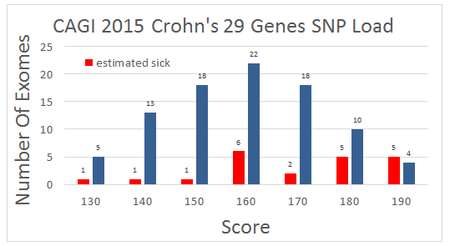
SNP load on the entire 29 genes
harboring the original 29 SNPs
The 21 individuals considered sick
(Score on SNPs <0.2)
90 individuals that were still unassigned
Submission 2:
Using the weighted (using the same weights as for the SNPs) SNP load on the 29 genes as an additional criteria to assign CD patients
Submission 3:
Using the count of SNPs on the 29 genes as an additional criteria to assign CD patients
Created for CAGI 4
genomeinterpretation.org
Johnathan R. Azaria

Slide 16
Using additional Crohn's associated gene lists
Submission 4:
Counting SNPs on a list of 120 genes that were associated with Crohn's in GWAS catalog
Submission 5:
Counting SNPs on about 400 genes found in Kegg pathways related to Crohn's
(according to a method published in Brodi et. al. PLoS One. 2014 9(7):e100887)
Submission 6:
Manually picking the best candidates to be CD patients from all the other submissions
Created for CAGI 4
genomeinterpretation.org
Johnathan R. Azaria

Slide 17
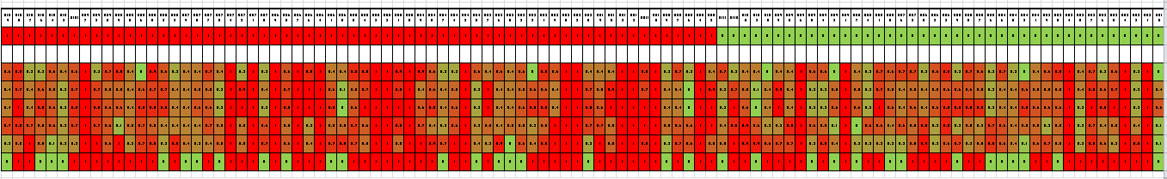
Results
From the answers it was revealed that there are 64 Crohn's patients and 47 healthy.
Sick
Healthy
Exomes
Submission 1
Submission 2
Submission 3
Submission 4
Submission 5
Submission 6
Created for CAGI 4
genomeinterpretation.org
Johnathan R. Azaria

Slide 18
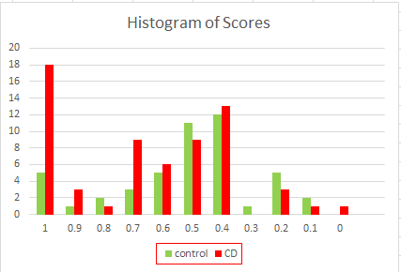
Results
It seems that our best submission was number 2 where we used the weighted
SNP load on the entire 29 genes harboring the original 29 SNPs of Wei et. al.
From the 42 people that got score >=0.7, 31 (74%) were Crohn's patients
Created for CAGI 4
genomeinterpretation.org
Johnathan R. Azaria

Slide 19
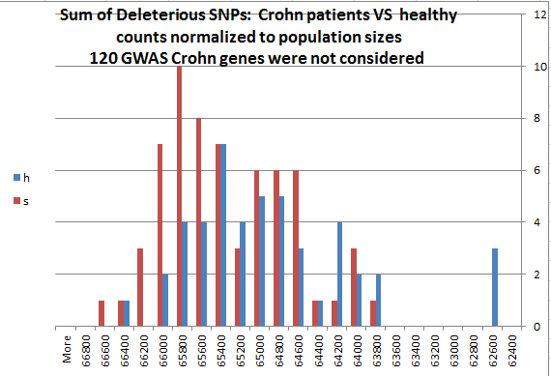
Do CD patients have more deleterious SNPs in their entire exome?
A preliminary observation:
We used SNPeff to evaluate the importance of each SNP. Among the SNPS that are considered deleterious by the program we score 1 point for weak, 2 points for moderate, and 5 points for high impact mutations. Homozygote SNPs were multiplied by 2. We sum the total on all genes in the Exomes, and discarded 120 GWAS Crohn's genes since it is expected that Crohn's patients will have higher score on these genes. The histogram shows a clear shift toward higher values for Crohn’s patients. We are repeating this calculation using other impact annotation programs.
Created for CAGI 4
genomeinterpretation.org
Johnathan R. Azaria

Slide 20
Acknowledgements
Bar-Ilan
Avi Levi
IBBR, University of Maryland
John Moult
Lipika Ray
Created for CAGI 4
genomeinterpretation.org
Johnathan R. Azaria

