Slide 1

CAGI slide pack guidelines
I agree to my slides being used according to the following terms: _______Yanran Wang_______
Authors: please include THIS slide at the beginning of your presentation to indicate that you agree with reuse of your slides in CAGI presentations, according to the terms below, and digitally sign by writing your name above.
To disseminate the CAGI results, I encourage all CAGI participants to remix these CAGI slides for inclusion in their oral and poster presentations
CAGI participants may use or publish any content of these slides only in compliance with the CAGI Data Use Agreement
CAGI participants may not cite or publish any content of these slides except with the written permission of the originating author or in the primary CAGI publications
CAGI participants must acknowledge the original authors of these slides and CAGI 2013. Include the acknowledgement banner across the bottom
CAGI participants must include the CAGI credits slide in their presentations
Slides with a red slash (no remix) may not be included in a presentation unless all attendees are registered CAGI participants who signed the data use agreement
Slides with a red X over the entire slide may not be used in any circumstances
Slides with a blue slash (embargoed) may not be used unless the embargo is explicitly lifted
Slides without slash or X may be tweeted unless flagged with the “No tweet” icon.
CAGI participants using these slides must explain the “No tweet” icon, which means that the slide content should not be disseminated outside the presenting conference hall. If the presentation venue permits pervasive tweeting, you may not include these slides in your talk
Note for slide authors: we expect all CAGI participants to abide by these restrictions, and will make best effort to ensure they are followed. However, but bear in mind that we have limited means of enforcing them, and therefore the restrictions cannot be guaranteed.

Slide 2

Predicting Bipolar Disorder Predisposition from Exome Sequences with AVA,Dx
Yanran Wang, PhD student
Dept of Biochemistry and Microbiology
Rutgers, the State University of New Jersey
Critical Assessment of Genome Interpretation
Mar. 26, 2016

Slide 3

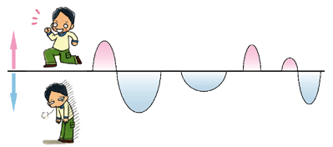
Intro
Data
Sequenced exomes from a bipolar/healthy cohort
Sample size
500 individuals for training
500 individuals for prediction
Challenge
Predict individual disease status: healthy vs. bipolar
Our method
gene scores as features of
machine learning models
Created for CAGI 4
genomeinterpretation.org
Yanran Wang
Notes:
Gene scores = functionality as compared to wild type

Slide 4
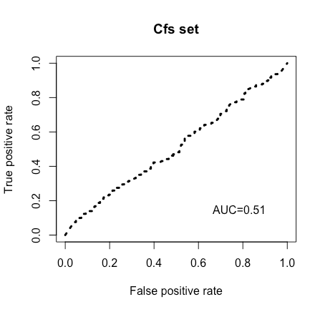
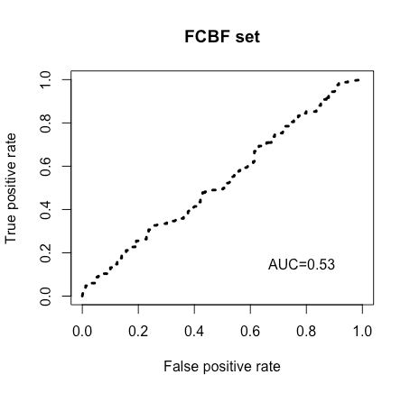
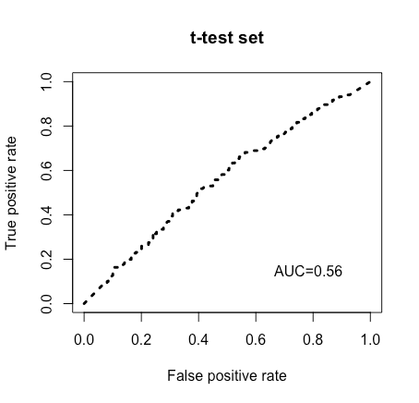
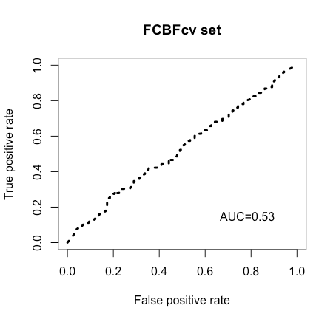
Prediction results
Created for CAGI 4
genomeinterpretation.org
Yanran Wang

Slide 5

Build the Predictor
Training VCFs
ANNOVAR
exonic variants
+ unknown
InDel, Stop loss/gain
synonymous
non-synonymous
Large constant
Small constant
SNAP2
gene_score (feature) for each gene
Feature Selection
selected genes
Training + Testing + Evaluation
AVA, Dx
Created for CAGI 4
genomeinterpretation.org
Yanran Wang
Notes:
Unknown also get a small constant

Slide 6
Data Collection
VCF file
ANNOVAR
exonic variants
 | total variants | exonic variants
Total (1000 individuals) | 501,253 | 294,366 (58.72%)
(each) Individual | 32,364 ± 410 | 16,248 ± 205
Created for CAGI 4
genomeinterpretation.org
Yanran Wang
Notes:
Total variants includes….
Even though these were exome sequences, the data included regulatory gerion and other non-coding regions captured with exome capturer.

Slide 7
Data Collection
exonic variants
+ unknown
InDel, Stop loss/gain
synonymous
non-synonymous
 | InDel | synon | non-synon | stopgain | stoploss | unknown
Total | 0 | 111,792 | 175,726 | 3,962 | 180 | 2,706
Individual | 0 | 8,693 ± 117 | 7,293 ± 100 | 47 ± 5 | 10 ± 2 | 205 ± 12
Non-synon
Synon
Total
Individual
Unknown
Stop
Created for CAGI 4
genomeinterpretation.org
Yanran Wang
Notes:
Total variants includes….
More individual-specific than non-synonymous ones.

Slide 8
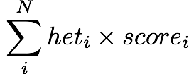
Variant and Gene Scoring
InDel, Stop loss/gain
synonymous
non-synonymous
+ unknown
Large constant
Small constant
SNAP2
Small constant
neutral: 0.055
non-neutral: [0.055, 1]
1
0.05
0.055
×
heterozygous: 0.25
homozygous: 1
gene_score (feature) for each gene
Created for CAGI 4
genomeinterpretation.org
Yanran Wang

Slide 9
Pitfalls (1)
synonymous, intronic, intergenic, and non-directly-protein-function-relevant variants also affect protein function
  Intronic SNVs that are close to splice sites frequently cause misregulation
  Synonymous mutations frequently contribute to human cancer
  Non-synonymous SNVs that minimally alter protein function may also disrupt splicing regulation
  ETC ETC ETC
Created for CAGI 4
genomeinterpretation.org
Yanran Wang
Notes:
Also translation speeds (synonymours)

Slide 10
Example Table
 | 20,204 proteins (features) from Swiss-Prot
 | 1433B | 1433E | 1433F | 1433G | 1433S | 1433T | 1433Z | 1A1L1 | 1A1L2 | …
S1 | 0 | 0 | 0 | 0.05 | 0 | 0 | 0 | 0.015 | 0.0996 | …
S2 | 0.0125 | 0 | 0 | 0 | 0 | 0 | 0 | 0.03 | 0.0996 | …
S3 | 0.0125 | 0 | 0 | 0 | 0 | 0 | 0 | 0.015 | 0.3496 | …
S4 | 0 | 0 | 0 | 0 | 0.0125 | 0 | 0 | 0.03 | 0.3984 | …
S5 | 0 | 0 | 0 | 0.05 | 0 | 0 | 0.0125 | 0.03 | 0.3984 | …
S6 | 0 | 0 | 0 | 0.05 | 0 | 0 | 0 | 0 | 0 | …
S7 | 0.0125 | 0 | 0 | 0.0125 | 0.0125 | 0 | 0 | 0 | 0.0996 | …
S8 | 0.0125 | 0 | 0.0125 | 0 | 0 | 0 | 0 | 0.015 | 0.3984 | …
S9 | 0 | 0 | 0 | 0.0125 | 0 | 0 | 0 | 0 | 0.0996 | …
S10 | 0.05 | 0 | 0 | 0.0125 | 0 | 0 | 0 | 0 | 0.0996 | …
…. | … | … | … | … | … | … | … | … | … | …
Created for CAGI 4
genomeinterpretation.org
Yanran Wang
Notes:
09/25/2015

Slide 11
Pitfalls (2)
Variant genotype (zygosity) and Gene Scoring
Variant phasing is not utilized
Variant functional effect predictions are limited to a single variant. Compared to individual mutations, multiple mutations can be either more deleterious or less deleterious (compensatory mutation)
Created for CAGI 4
genomeinterpretation.org
Yanran Wang
Notes:
Frederick mentions, multiplying variants rather than adding them
5 pictures relate to saying
Only 2 pics.
We cannot account for compound het. 2) we only sum up individual variant, and don’t consider the variant combination.

Slide 12


Feature Selection
gene_score (feature) for each gene (17,167)
Feature Selection
4 Submissions
Correlation-based Feature Selection (Cfs)
training set
Cfs set:
146 genes
FCBF set:53 genes
Fast Correlation-Based Filter Solution (FCBFSearch)
training set
FCBFcv set:176 genes
Student t-test between Bipolar and Healthy gene score distributions
(t-test)
t-test set:760 genes
training set
Created for CAGI 4
genomeinterpretation.org
Yanran Wang
Notes:
500 fold cross validation from FCBF
Cfs evaluates subsets of features on the basis of the following hypothesis: "Good feature subsets contain features highly correlated with the classification, yet uncorrelated to each other”. The acceptance of a feature will depend on the extent to which it predicts classes in areas of the instance space not already predicted by other features.
FCBF is a filter model that aims to iteratively remove both irrelevant and redundant features. Less costly in computation than Cfs.

Slide 13
Feature selection… aside
Selected genes are likely parts of pathogenicity pathways
A complete pathway may not be represented in the selected set due to redundancy filtering
Created for CAGI 4
genomeinterpretation.org
Yanran Wang

Slide 14

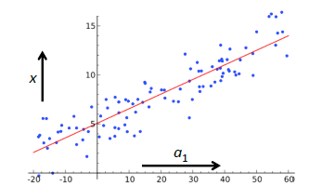
Building the predictor
selected genes
Training + Testing + Evaluation
Linear Regression
Support Vector Machine regression
Random Forest
Mean (AVA,Dx)
Created for CAGI 4
genomeinterpretation.org
Yanran Wang
Notes:
http://kernelsvm.tripod.com
http://opinions5.blogspot.com/2013/08/random-forest-confidence.html

Slide 15
Example Predictions
 |  |  |  | Prediction
 | Linear Regression | SVM Regression | Random Forest | mean | SD
S501 | 0.413 | 0.348 | 0.38 | 0.38 | 0.03
S502 | 0.77 | 0.792 | 0.62 | 0.73 | 0.09
S503 | 0.551 | 0.657 | 0.42 | 0.54 | 0.12
S504 | 0.365 | 0.344 | 0.42 | 0.38 | 0.04
S505 | 0.395 | 0.272 | 0.49 | 0.39 | 0.11
S506 | 0.722 | 0.685 | 0.55 | 0.65 | 0.09
S507 | 0.211 | 0.479 | 0.41 | 0.37 | 0.14
S508 | 0.578 | 0.565 | 0.48 | 0.54 | 0.05
S509 | 0.944 | 0.936 | 0.62 | 0.83 | 0.18
S510 | -0.053 | 0.089 | 0.34 | 0.13 | 0.20
…. | … | … | … | … | …
Created for CAGI 4
genomeinterpretation.org
Yanran Wang
Notes:
SD or SE?

Slide 16
Cross-validation
Created for CAGI 4
genomeinterpretation.org
Yanran Wang

Slide 17
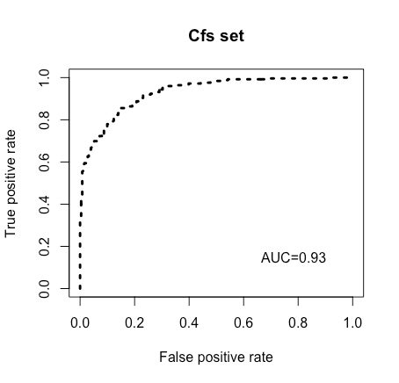
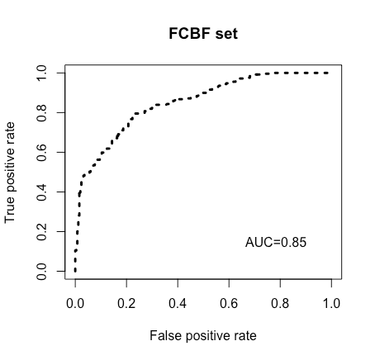
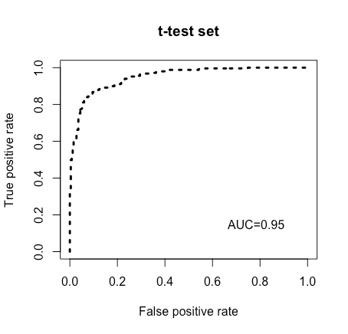
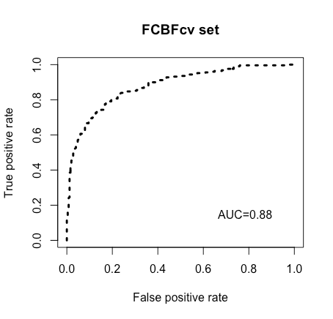

Performance in 500-fold cross-validation
Best!
Created for CAGI 4
genomeinterpretation.org
Yanran Wang
Notes:
Over-fitting!

Slide 18
Pitfalls (3)
Overfitting
Created for CAGI 4
genomeinterpretation.org
Yanran Wang

Slide 19
Use the Predictor
Testing VCFs
ANNOVAR
exonic variants
+ unknown
InDel, Stop loss/gain
synonymous
non-synonymous
Large constant
Small constant
SNAP2
gene_score (feature) for selected genes
AVA, Dx
Predictions
Created for CAGI 4
genomeinterpretation.org
Yanran Wang
Notes:
+ unknown/unmappable

Slide 20
Prediction results
Created for CAGI 4
genomeinterpretation.org
Yanran Wang

Slide 21
Pitfalls: in Summary
Not all variants included
Scoring requires optimization
Data set may be too small for training an accurate model
… what about the environment?
Created for CAGI 4
genomeinterpretation.org
Yanran Wang
Notes:
What about diagnostic accuracy?

Slide 22
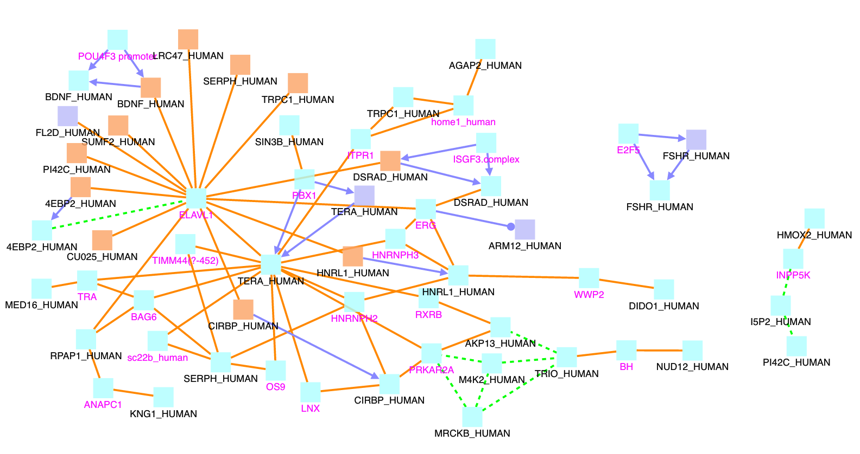
… but the gene set shows promise!
Created for CAGI 4
genomeinterpretation.org
Yanran Wang
Notes:
Network and bipolar inference? Set gene set extraction?

Slide 23

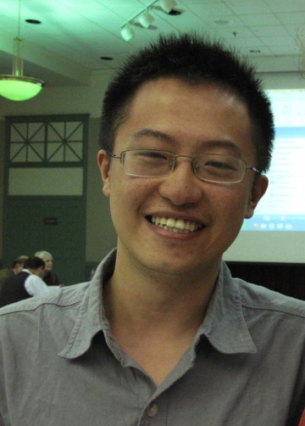







Thank You!
Bromberg Lab
FUNDING
CAGI organizers!!
DATA Providers!!
Assessors!!
Yannick
Mahlich
Rutgers University: Peter Kahn, Jay Tischfield, Jinchuan Xing, Gary Heiman
TU Munich: Burkhard Rost, Guy Yachdav
Regeneron: Shannon Bruse
University of Kiel: Andre Franke, Britt-Sabina Peterson
University of New Mexico: Toru Nyunoya
Chengsheng
Zhu
Yury Astrakhan
Maximilian
Miller
Created for CAGI 4
genomeinterpretation.org
Yanran Wang
Notes:
Max Miller and NIGMS funding
Data provider assessor
Bipolar provider

Slide 24
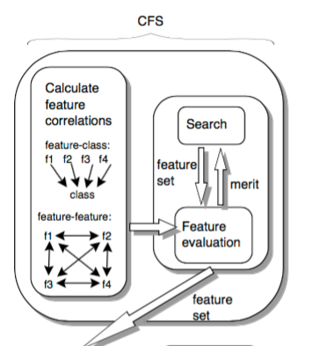
Correlation-based Feature Selection (Cfs)
Cfs measure evaluates subsets of features on the basis of the following hypothesis: "Good feature subsets contain features highly correlated with the classification, yet uncorrelated to each other”.
The acceptance of a feature will depend on the extent to which it predicts classes in areas of the instance space not already predicted by other features.
Hall M A. Correlation-based feature selection for machine learning[D]. The University of Waikato, 1999.

Slide 25
Fast Correlation-Based Filter Solution (FCBFSearch)
A filter model that aim to effectively remove both irrelevant and redundant features.
Less costly in computation than Cfs.
Step 1: Calculate SU value for each feature, order them, select relevant features based on a threshold.
Step 2: Start with the first feature to eliminate all features that are redundant to it.
Repeat Step2 with the next remaining feature until the end of list
Yu L, Liu H. Feature selection for high-dimensional data: A fast correlation-based filter solution[C]//ICML. 2003, 3: 856-863.

Slide 26
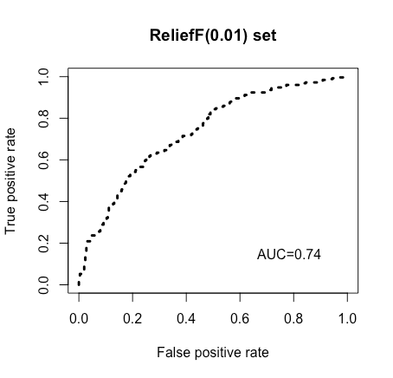
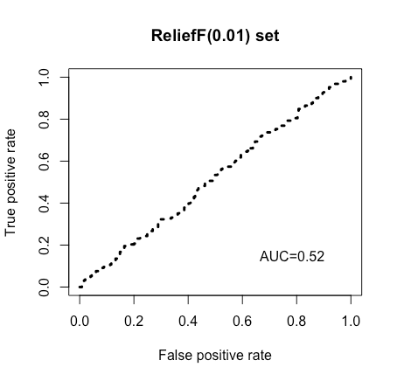
Other feature selection methods (not submitted)
training set
prediction

