Slide 1

CAGI slide pack guidelines
I agree to my slides being used according to the following terms: Marco Carraro
Authors: please include THIS slide at the beginning of your presentation to indicate that you agree with reuse of your slides in CAGI presentations, according to the terms below, and digitally sign by writing your name above.
To disseminate the CAGI results, I encourage all CAGI participants to remix these CAGI slides for inclusion in their oral and poster presentations
CAGI participants may use or publish any content of these slides only in compliance with the CAGI Data Use Agreement
CAGI participants may not cite or publish any content of these slides except with the written permission of the originating author or in the primary CAGI publications
CAGI participants must acknowledge the original authors of these slides and CAGI 2013. Include the acknowledgement banner across the bottom
CAGI participants must include the CAGI credits slide in their presentations
Slides with a red slash (no remix) may not be included in a presentation unless all attendees are registered CAGI participants who signed the data use agreement
Slides with a red X over the entire slide may not be used in any circumstances
Slides with a blue slash (embargoed) may not be used unless the embargo is explicitly lifted
Slides without slash or X may be tweeted unless flagged with the “No tweet” icon.
CAGI participants using these slides must explain the “No tweet” icon, which means that the slide content should not be disseminated outside the presenting conference hall. If the presentation venue permits pervasive tweeting, you may not include these slides in your talk
Note for slide authors: we expect all CAGI participants to abide by these restrictions, and will make best effort to ensure they are followed. However, but bear in mind that we have limited means of enforcing them, and therefore the restrictions cannot be guaranteed.

Slide 2


CAGI - 4
BIPOLAR DISORDER CHALLENGE
Marco Carraro
BioComputing UP, Dept. of Biomedical Sciences,
University of Padova Italy
26/03/2016
Notes:
Strategy used to approach the challenge

Slide 3
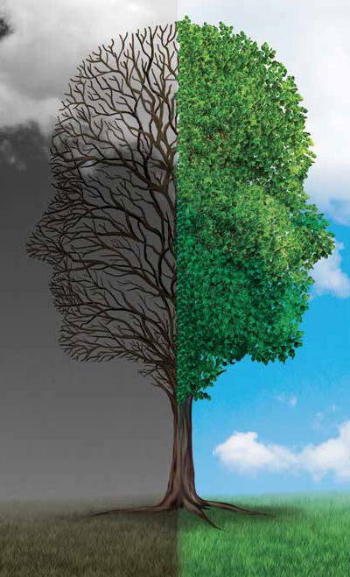
BIPOLAR DISORDER
One of the major causes of disability worldwide
Up to 15% of individuals die from suicide
Little contribution of environmental factors
Estimated heritability reaches up to 90%
500 + 500 individuals
Who is affected?

Slide 4
CHALLENGES to ADDRESS
Little information
on genes involved
Linkage and candidate gene studies failed to identify a single susceptibility gene
GWAS studies identified 19 significant loci
Little information
on genes interaction
How do gene products interact, leading to pathology onset?

Slide 5





OUR STRATEGY
Little information
on genes involved
- mostly automatic
Variant selection
- automatic/manual
- manual (2x)
Little information
on genes interaction
Machine learning
- Neural Network

Slide 6



VARIANT SELECTION - 1
Mostly automatic
Biased distribution of variants
(healthy/affected individual)
500,000 variants
500 individuals with known phenotype
Wilcoxon test
Arbitrary significance threshold
(No correction for multiple testing)
Notes:
Statistically over-represented variants
Variants mostly present in affected individuals

Slide 7
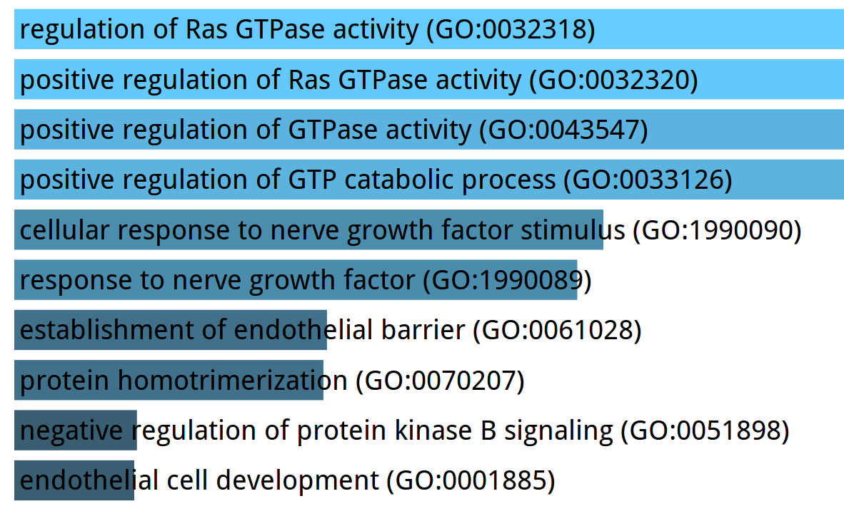
VARIANT SELECTION - 1
Mostly automatic
GO Biological Process Enrichment
10 variants
9 genes
intronic / exonic
Notes:
Variants mostly present in affected individuals

Slide 8
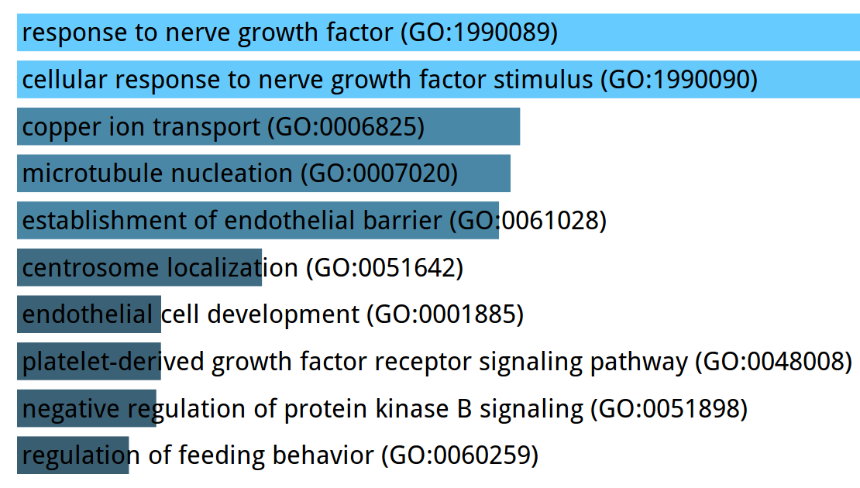
VARIANT SELECTION - 2
Automatic/Manual
Biased distribution of variants
(healthy/affected individual)
Manual curation
(interesting genes)
Wilcoxon test
Arbitrary significance threshold
(Relaxed)
GO Biological Process Enrichment
13 variants (13 genes)
intronic / exonic
30% of previous dataset

Slide 9

VARIANT SELECTION - 3
Manual
Manually curated variants set
26 papers -> exome/genome sequencing
-> GWAS
101 SNPs, affecting 69 genes
1000 individuals
9 SNPs, affecting 7 genes

Slide 10
VARIANT SELECTION - 4
Manual
Manually curated variants set
Knudson hypothesis
( Two-hits )
3 variants
(PDLIM5,NCAN)
2 variants
(DUSP6)
1 variant
(TSPO)
1 variant
(GABRA6)
1 variant
(TIMELESS)
1 variant
(GDAP1)
Regulation of synapse organization
MAPK signaling pathway
Neuroactive ligand receptor interaction
GABA signaling pathway
Circadian clock
Not considered (mitochondrial)

Slide 11
CHALLENGES to ADDRESS
Little information
on genes involved
Linkage and candidate gene studies failed to identify a single susceptibility gene
GWAS studies identified 19 significant loci
Little information
on genes interaction
How do gene products interact, leading to pathology onset?

Slide 12
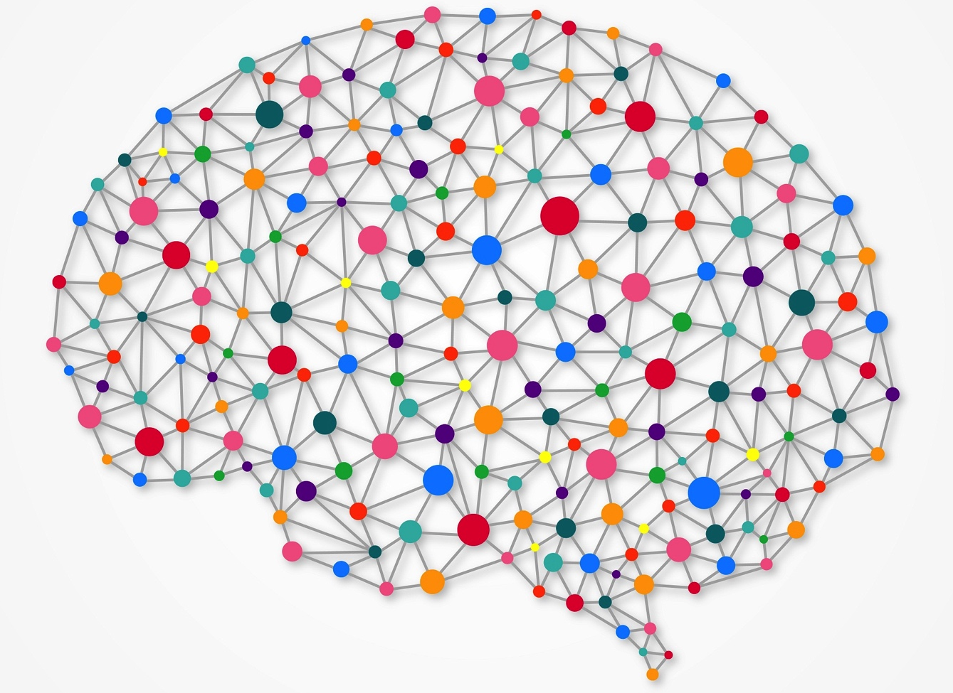
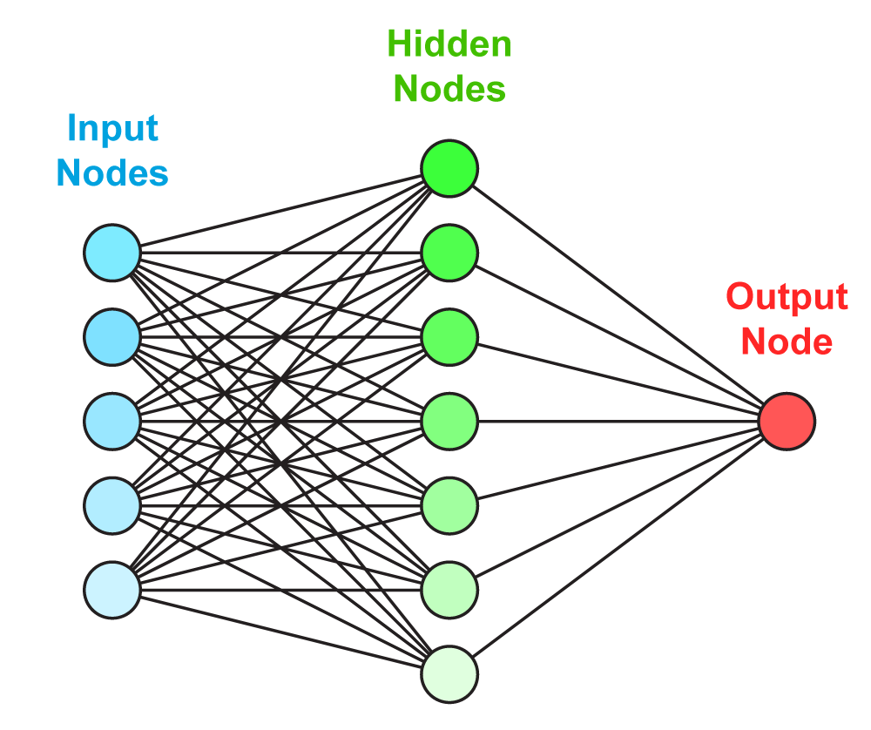
NEURAL NETWORK
Training
500 individuals
with known phenotype
Genotype - variant 1
Genotype – variant 2
Genotype – variant 3
Genotype – variant 4
Genotype – variant 5
Feed-forward multi-layer perceptron
1 hidden layer
5 nodes in the hidden layer

Slide 13
NEURAL NETWORK
Prediction
Genotype - variant 1
Genotype – variant 2
DISEASE
PROBABILITY
Genotype – variant 3
Genotype – variant 4
Genotype – variant 5
1 individual
with unknown phenotype
Feed-forward multi-layer perceptron
1 hidden layer
5 nodes in the hidden layer

Slide 14
LAST PROBLEM WE DID NOT ADDRESS
(yet)

Slide 15
CHALLENGES to ADDRESS
Few information
on genes involved
Linkage and candidate gene studies failed to identify a single susceptibility gene
GWAS studies identified 19 significant loci
Few information
on genes interaction
How gene products interact, leading to pathology onset?
High heterogeneity among different patients

Slide 16
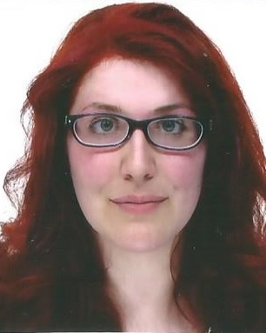
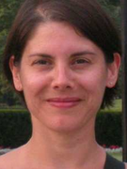
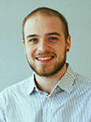
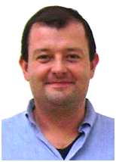
Acknowledgements
Alessandra Gasparini
Dr. Emanuela Leonardi
Francesco Tabaro
Prof. Silvio Tosatto
CAGI Organizers
&
All submitters
http://protein.bio.unipd.it/

Slide 17
Thank You
Marco Carraro
26/03/2016

