Slide 1

CAGI slide pack guidelines
I agree to my slides being used according to the following terms: _______Alexander A. Morgan_______
Authors: please include THIS slide at the beginning of your presentation to indicate that you agree with reuse of your slides in CAGI presentations, according to the terms below, and digitally sign by writing your name above.
To disseminate the CAGI results, I encourage all CAGI participants to remix these CAGI slides for inclusion in their oral and poster presentations
CAGI participants may use or publish any content of these slides only in compliance with the CAGI Data Use Agreement
CAGI participants may not cite or publish any content of these slides except with the written permission of the originating author or in the primary CAGI publications
CAGI participants must acknowledge the original authors of these slides and CAGI 2013. Include the acknowledgement banner across the bottom
CAGI participants must include the CAGI credits slide in their presentations
Slides with a red slash (no remix) may not be included in a presentation unless all attendees are registered CAGI participants who signed the data use agreement
Slides with a red X over the entire slide may not be used in any circumstances
Slides with a blue slash (embargoed) may not be used unless the embargo is explicitly lifted
Slides without slash or X may be tweeted unless flagged with the “No tweet” icon.
CAGI participants using these slides must explain the “No tweet” icon, which means that the slide content should not be disseminated outside the presenting conference hall. If the presentation venue permits pervasive tweeting, you may not include these slides in your talk
Note for slide authors: we expect all CAGI participants to abide by these restrictions, and will make best effort to ensure they are followed. However, but bear in mind that we have limited means of enforcing them, and therefore the restrictions cannot be guaranteed.

Slide 2
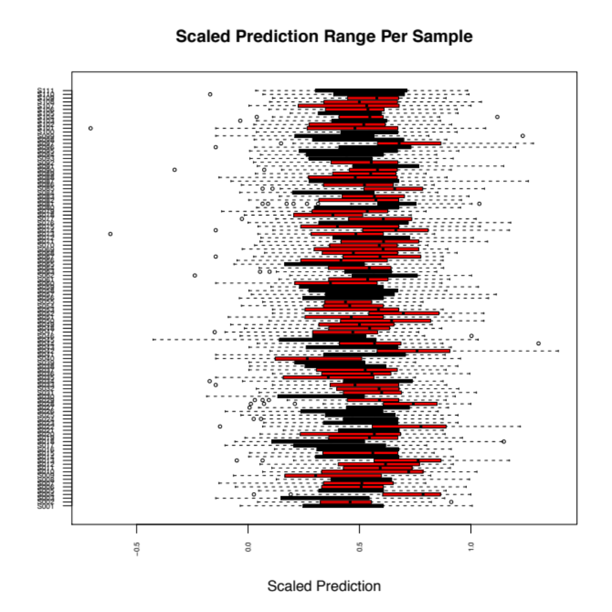
Crohn's Disease

Slide 3
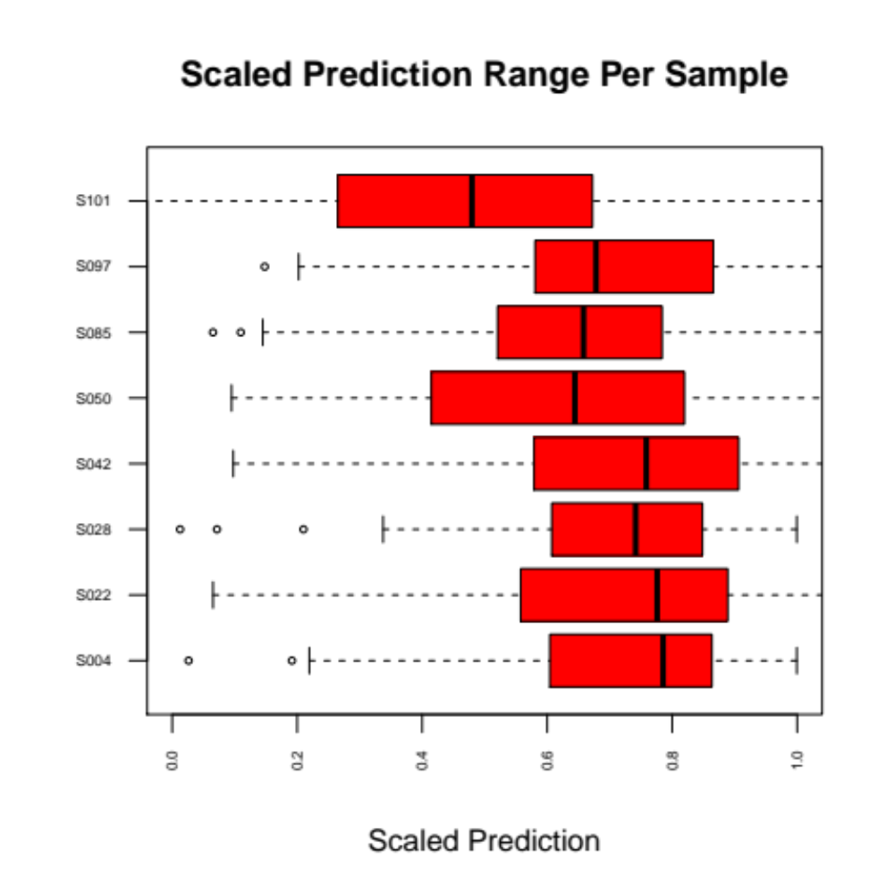
Crohn's Disease

Slide 4
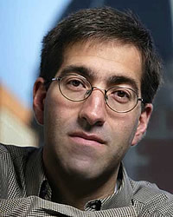
Exome Sequencing Study of Bipolar Disorder
Alexander A. Morgan
Khosla Ventures & Stanford University
Peter P. Zandi
Department of Mental Health
Bloomberg School of Public Health
Johns Hopkins University

Slide 5
Alex Morgan's Disclosures
Personalis, Inc
Carmenta Bioscience
Stimulomics, Inc
DigiSight
Merck
MITRE Corporation
Khosla Ventures
  HeartVista
  AliveCor
  Twine
  Guardant
  Color Genomics
  Jawbone
  Ginger.io
  Catalia Health
  Genalyte
  Lumiata
  Et multa cetera
Notes:
Others like light levels, ambient noise, UV exposure,

Slide 6
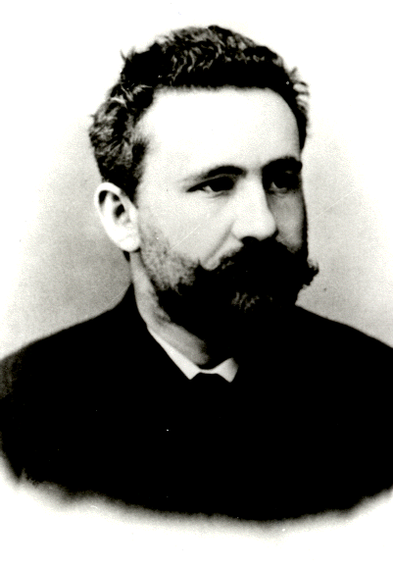
Modern Foundation
Synthesis of the concept of manic-depressive illness as an affective disorder that is distinct from “dementia praecox” (schizophrenia) based on course of illness and characterized as a “morbid process” that is largely of genetic and vascular origin
Emil Kraepelin (1856-1926)

Slide 7
Clinical Trajectory
Symptoms:
Delusions
Hallucinations
Negative
Mania
Depression
Disorganization
Dementia Praecox
Course of Illness
Age
Notes:
Expansive mood for 1 week plus 3 or more of others
Disrupt social functioning and not attributable to physiological effects of substance

Slide 8
Clinical Trajectory
Symptoms:
Delusions
Hallucinations
Negative
Mania
Depression
Disorganization
Manic Depression
Course of Illness
Age
Notes:
Expansive mood for 1 week plus 3 or more of others
Disrupt social functioning and not attributable to physiological effects of substance

Slide 9
Clinical Trajectory
Symptoms:
Delusions
Hallucinations
Negative
Mania
Depression
Disorganization
Bipolar Disorder
Course of Illness
Schizoaffective
Schizophrenia
Age
Notes:
Expansive mood for 1 week plus 3 or more of others
Disrupt social functioning and not attributable to physiological effects of substance

Slide 10
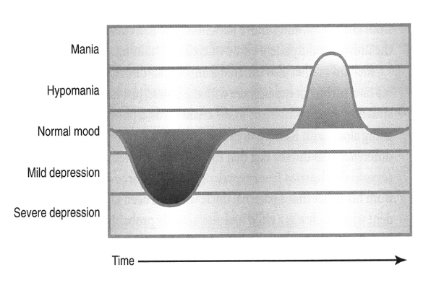
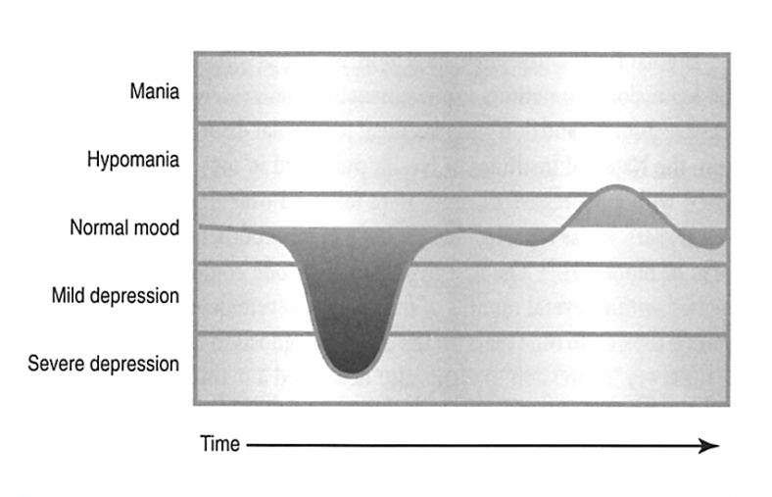
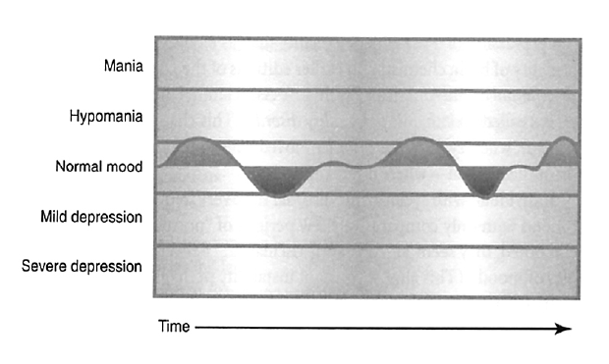
Bipolar Disorder - Spectrum
BPI
Major depressions
Mania
Mixed states
BPII
Major Depressions
Hypomania
No mixed states
Cyclothymia
Frequent fluctuations of mild depressions and hypomanias
Notes:
10

Slide 11
DSM Criteria: Mania
Expansive, elevated or irritable mood for 1 week plus 3 or more of following:
  Decreased need for sleep
  Rapid pressured speech, racing thoughts
  Distractability
  Loss of inhibitions, reckless pleasure seeking
  Behavioral activation, agitation
  Increased goal directed activities
Disrupts social functioning
Not attributable to effects of substances
Notes:
Expansive mood for 1 week plus 3 or more of others
Disrupt social functioning and not attributable to physiological effects of substance

Slide 12
DSM Criteria: Depression
5 or more of the following for 2 weeks
  Depressed mood, pervasive and unrelenting
  Inability to experience pleasure in usual activities: anhedonia
  Sleep and appetite changes: insomnia/hypersomnia, weight loss/gain
  Psychic and physical slowing or agitation
  Fatigue, loss of energy
  Feelings of guilt and worthlessness
  Diminished concentration, indecisiveness
  Recurrent thoughts of death and suicide
Disrupt social functioning
Not attributable to substances or bereavement
Notes:
5 or more of the following for 2 weeks, 1 of which is depressed mood or anhedonia
Disrupt social functioning
Not attributable to physiological effects of substance or due to bereavement

Slide 13
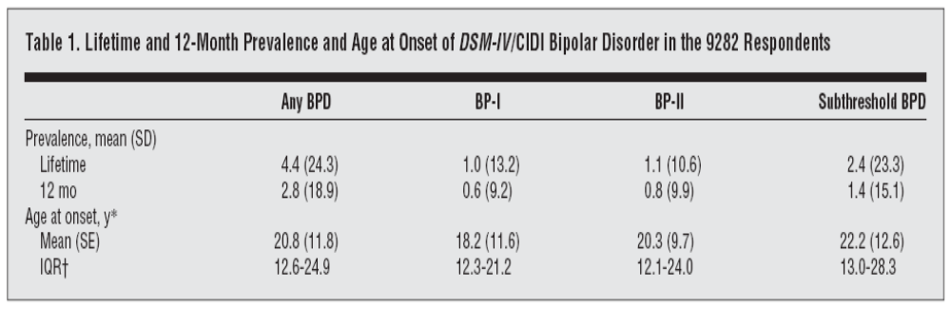
Prevalence of BP
Data from NCS-R Study of a nationally representative sample of 9,282 adults (>18 years of age) between 2001-03
Participants assessed with CIDI v3.0 and diagnoses assigned by DSM-IV
Results highlight the point that the rates of bipolar spectrum disorder are higher than originally thought
Merkangas et al, Arch Gen Psych, 2007

Slide 14
Risk Factors
Risk Factor | Relative Risk
1° Relative with BP | 13.63 (11.81 – 15.71)
Urbanicity | Null
Season of birth | Null
Birth order | Null
Influenza in utero | Null
Birth complications | Null
Autoimmune disorders | Null*
Data from Danish Civil Registration System linked with Danish Psychiatric Central Register; 2,299 bipolar subjects identified from a population-based cohort of 2.1 million followed from 1970-1998
Mortensen al., Arch Psych, 2005

Slide 15
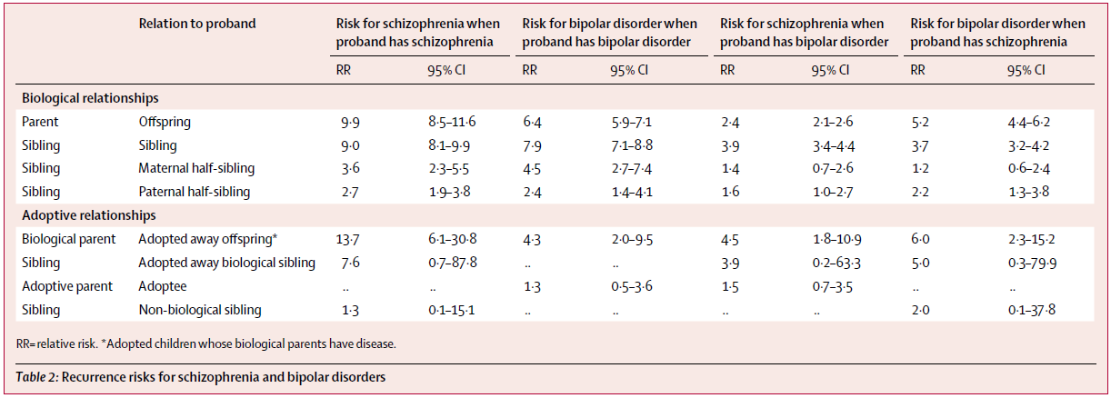
Familial Risk
Data from Sweden Multi-Generational and Hospital Discharge Registeries, with data on 9,009,202 individuals in >2M nuclear families between 1973-2004
Lichtenstein al., Lancet, 2009

Slide 16
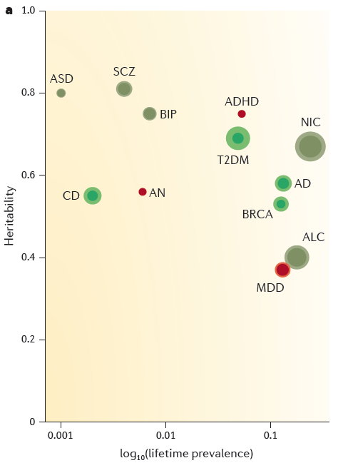
Heritability
Plot of heritability by prevalence of 9 disorders
ASD: Autism; SCZ: Schizophrenia; BIP: Bipolar Disorder; ADHD: Attention Deficit Hyperactivity Disorder; NIC: Nicotine Dependence; AD: Alzheimer’s Disease; ALC: Alcohol Dependence; MDD: Major Depression; AN: Anorexia Nervosa; CD: Crohn’s Disease; T2DM: Type 2 Diabetes; BRCA: Breast Cancer
Sullivan al., Nat Rev Gen, 2012

Slide 17
Gene Mapping - The Early Years
(1998-2008)
Genome-wide Linkage studies
  We reported genome-wide significant findings on chr8q24 in JHU pedigrees (65 families with 182 BP/317 BPUP sib-pairs) (Avramopoulos et al., Mol Psych, 2004)
  No replication in NIMH pedigrees (644 families with 1000 BP and 1285 BPUP sib-pairs) (McInnis et al., Bio Psych, 2003)
Candidate Gene Studies
  Over 350 candidate genes studies based on prior hypotheses about the etio-pathogenesis of Bipolar Disorder (e.g., the monoamine hypothesis)
  We reported a meta-analysis of all candidate gene studies and found no evidence of association (Seifuddin et al., Am J Med Gen, 2012)

Slide 18
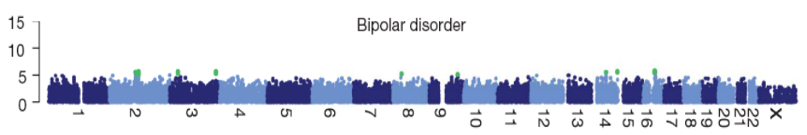
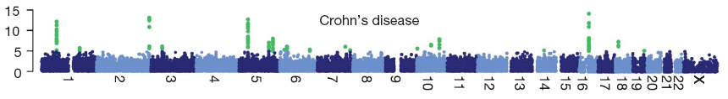
WTCCC GWAS
-log₁₀(P)
chromosome
Data from Wellcome Trust Case Control Study
Genome-wide association study with 500k SNPs in ~2000 individuals for each of 7 major diseases and a shared set of ~3000 controls
Wellcome Trust Case Control Consortium, Nature, 2007

Slide 19
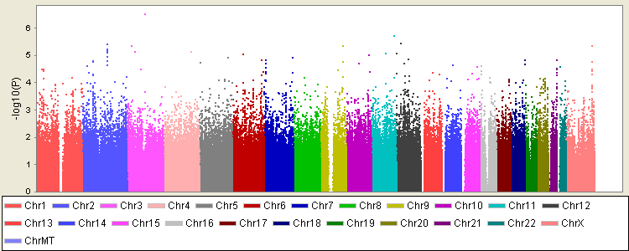
The GAIN Study
Data from 1001 BPI/SABP European American cases (50% female) and 1033 controls genotyped with Affymetrix 6.0 at 724,067 SNPs
No findings were genome-wide significant
Notes:
19

Slide 20
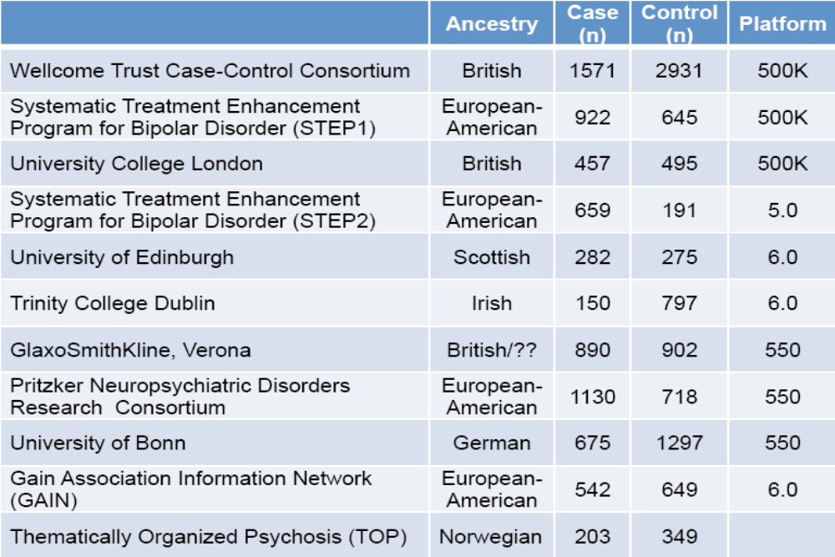
Psychiatric Genomics Consortium
Mega-analysis of 10 GWAS studies on bipolar disorder (7,481 cases and 9,250 controls)
Notes:
20

Slide 21
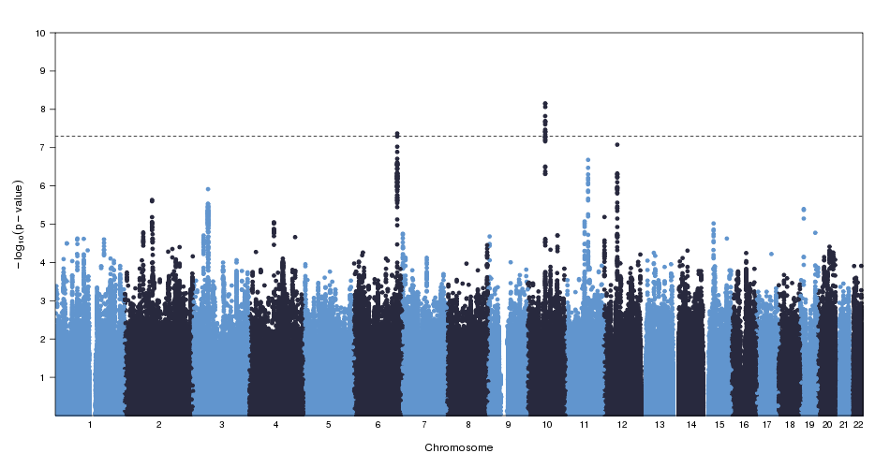
PGC-BD1
a) ANK3: OR=1.35; p=7.1x10E-9
b) SYNE1: OR=1.15; p=4.3x10E-8
c) CACNA1C: OR=1.14; p=1.5x10E-8
d) ODZ4: OR=0.88; p=4.4x10E-8
a
b
c
d
GWAS on 7,481 BP cases and 9,250 controls; imputed to HapMap Phase 2 CEU
Replication sample: 11,974 BP cases and 51,792 controls
Sklar et al., Nature Genetics, 2011
Notes:
21

Slide 22
Embargoed
MACROD2
SLC25A17

Slide 23
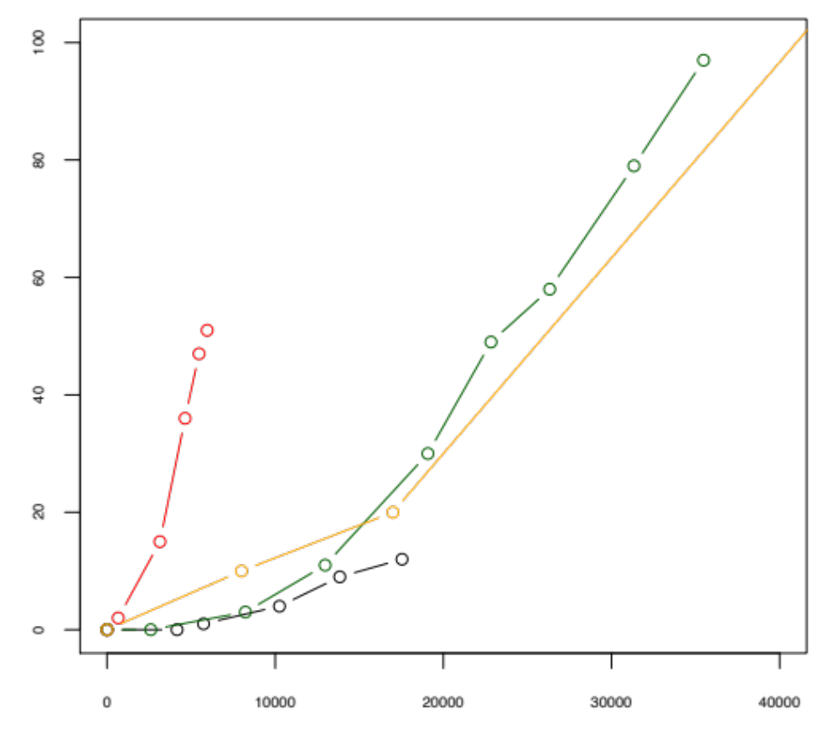
GWAS Hits
SCZ
Height
CD
Number of GWAS Hits (p<10E-8)
BP
Sample Size
Courtesy of E Stahl, 2014

Slide 24
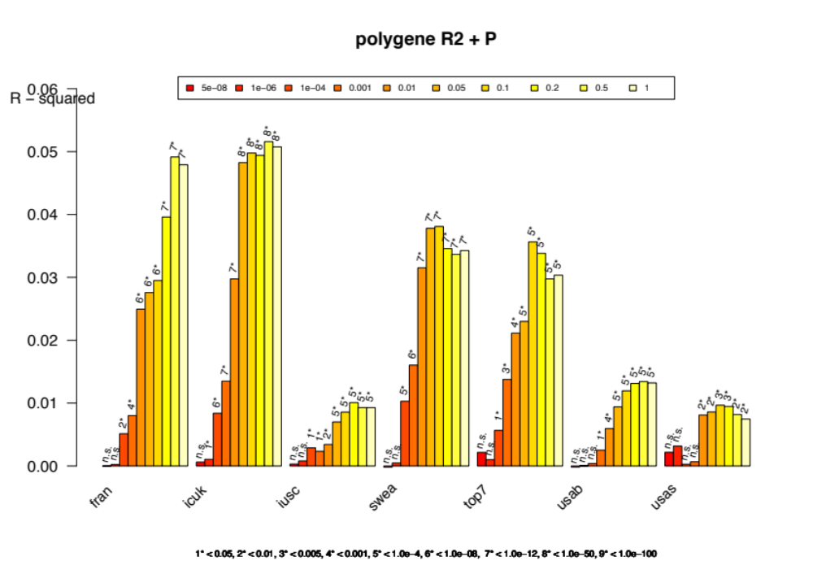
Polygenic Risk
R²
1*<0.05, 2*<0.01, 3*<0.005, 4*<0.001, 5*<1.0e-4, 6*<1.0e-8, 7*<1.0e-12, 8*<1.0e-50
PGC1 into PGC2 samples
PGC-BP In Preparation

Slide 25
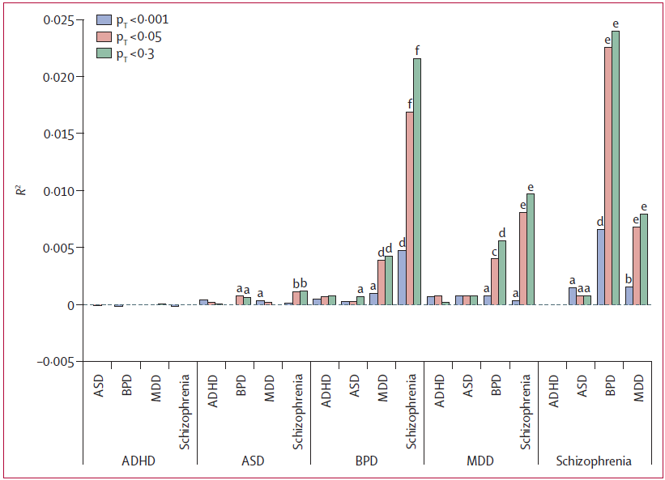
Polygenic Risk - Cross Disorder
(b)
PGC Cross-Disorder GWAS with 33,332 cases and 27,888 controls
PGC Cross-Disorder Group, Lancet, 2013
Notes:
25

Slide 26
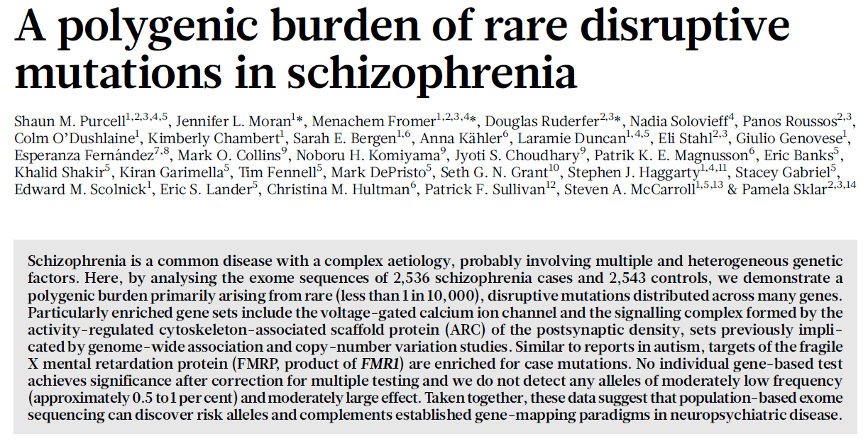
SCZ - Exome Sequencing
Purcell et al., Nature, 2014
Notes:
The other sample of families we have for study was collected as part of an NIMH lead initiative to collect families with BP for genetics studies using common ascertainment criteria.
This is a separate sample of families from the JHU sample.
The initiative is an on-going collaboration between four sites at IU, JHU, WUSL and the intramural program at NIMH.
To date we have collected 151 families with 882 individuals that have been interviewed and genotyped. This represents one of the largest family samples for studying the genetics of BP. In fact, we have collected even more families; these are currently being genotyped and analyzed.
These subjects were assessed by trained interviewers with the DIGS and diagnoses were assigned by psychiatrists using best estimate procedures.
Final diagnoses for the current sample included…

Slide 27
RareBliss
Family Study
  Exome sequence 42 subjects in 8 JHU families with at least 3 affected members with BPI
  Use filtering approach to identify ultra-rare highly penetrant (i.e., near Mendelian) variants
Case-Control Study
  Exome sequence 1,135 cases and 1,142 controls (all European-American and matched on sex) in four rounds
    R1 (94 cases and 49 controls)
    R2 (80 cases and 54 controls)
    R3/R4 (961 cases and 939 controls)
  Variant, gene and gene set level tests
Notes:
The other sample of families we have for study was collected as part of an NIMH lead initiative to collect families with BP for genetics studies using common ascertainment criteria.
This is a separate sample of families from the JHU sample.
The initiative is an on-going collaboration between four sites at IU, JHU, WUSL and the intramural program at NIMH.
To date we have collected 151 families with 882 individuals that have been interviewed and genotyped. This represents one of the largest family samples for studying the genetics of BP. In fact, we have collected even more families; these are currently being genotyped and analyzed.
These subjects were assessed by trained interviewers with the DIGS and diagnoses were assigned by psychiatrists using best estimate procedures.
Final diagnoses for the current sample included…

Slide 28
Samples
Johns Hopkins Families
  1,397 subjects in 242 families collected at 3 sites
  Assessed with either the DIGS or SADS and diagnoses made with best estimate procedures using RDC criteria
  DNA from cell lines
NIMH Genetics Initiative on BP
  4,065 subjects in 821 families collected at 9 sites
  Assessed with the DIGS and diagnoses made with best estimate procedures using DSM-III or DSM-IV criteria
  DNA from cell lines
NIMH Controls (from Molecular Genetics Study of Scz)
  3,292 European-American recruited through Knowledge Networks
  Self-reported psychiatric diagnoses obtained through CIDI-SF (exclude subjects with reported history of BP, depression, hallucinations
  DNA from cell lines

Slide 29
Four Rounds of Sequencing
Round 1
Round 2
Rounds 3/4
Capture:
Nimblegen SeqCap EZ v1.0
~180,000 coding exons, from CCDS build 36.2 (Apr2008)
551 miRNA genes from miRBASE release 10
33.8 Mb genomic target
Single, but indexed
Capture:
Nimblegen SeqCap EZ v2.0
~300,000 coding exons, from RefSeq release 39 (Jan 2010) in CCDS build 37.1 (Sep 2009), in miRBASE v14.0 (Sep 2009) and from customer inputs
36.0 Mb genomic target
2-plex, indexed
Capture:
Nimblegen SeqCap EZ v2.0+Synaptome
All version 2.0 plus
5.7 Mb of custom target covering post-synaptic and BP GWAS genes, and associated promoters
41.6 Mb genomic target
2-plex, indexed
Sequencing:
Illumina GA-IIx
One lane per capture
Sequencing:
Illumina Hi-Seq 2000
One lane per capture
Sequencing:
Illumina GA-IIx, PE76
One lane per capture

Slide 30
Bipolar Exomes
500 Cases & 500 Controls
NimbleGen SeqCap EZ v2.0 Exome arrays with ~3.4 Mb additional extra-exonic for synaptic and BP related genes
Illumina HiSeq2000
Randomized to Train & Evaluation

Slide 31
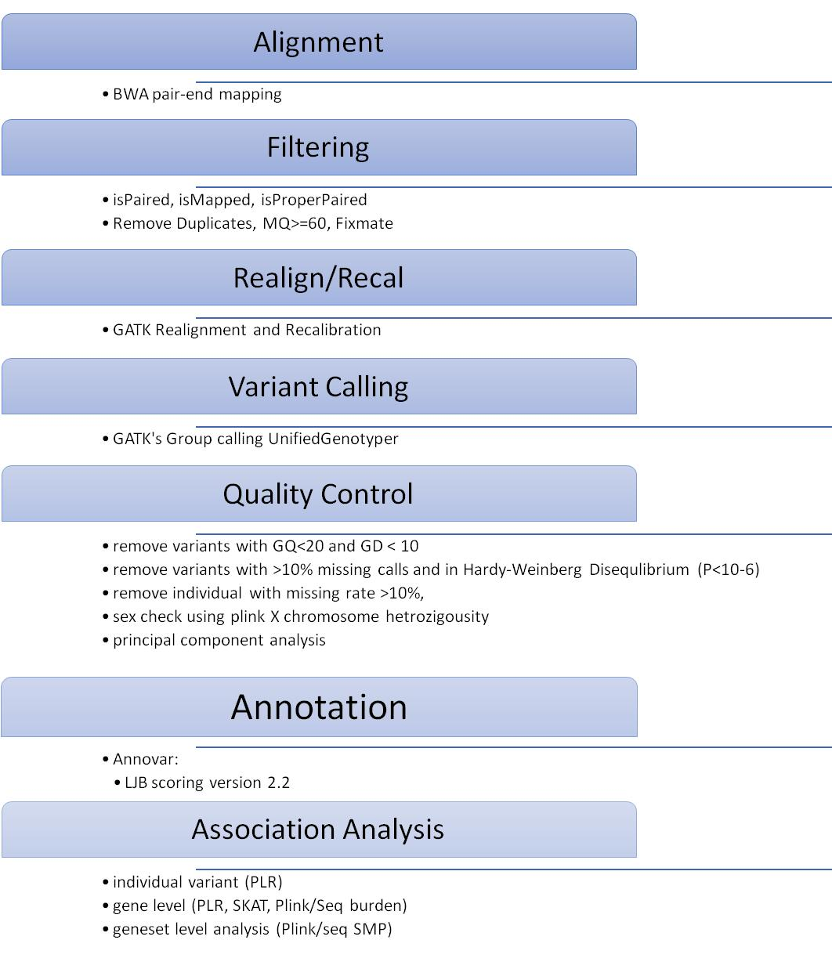
Data Processing
Notes:
The other sample of families we have for study was collected as part of an NIMH lead initiative to collect families with BP for genetics studies using common ascertainment criteria.
This is a separate sample of families from the JHU sample.
The initiative is an on-going collaboration between four sites at IU, JHU, WUSL and the intramural program at NIMH.
To date we have collected 151 families with 882 individuals that have been interviewed and genotyped. This represents one of the largest family samples for studying the genetics of BP. In fact, we have collected even more families; these are currently being genotyped and analyzed.
These subjects were assessed by trained interviewers with the DIGS and diagnoses were assigned by psychiatrists using best estimate procedures.
Final diagnoses for the current sample included…

Slide 32
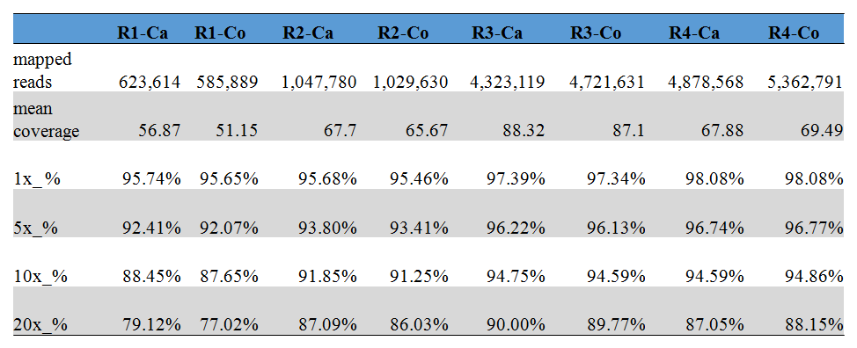
Coverage Statistics
Notes:
The other sample of families we have for study was collected as part of an NIMH lead initiative to collect families with BP for genetics studies using common ascertainment criteria.
This is a separate sample of families from the JHU sample.
The initiative is an on-going collaboration between four sites at IU, JHU, WUSL and the intramural program at NIMH.
To date we have collected 151 families with 882 individuals that have been interviewed and genotyped. This represents one of the largest family samples for studying the genetics of BP. In fact, we have collected even more families; these are currently being genotyped and analyzed.
These subjects were assessed by trained interviewers with the DIGS and diagnoses were assigned by psychiatrists using best estimate procedures.
Final diagnoses for the current sample included…

Slide 33
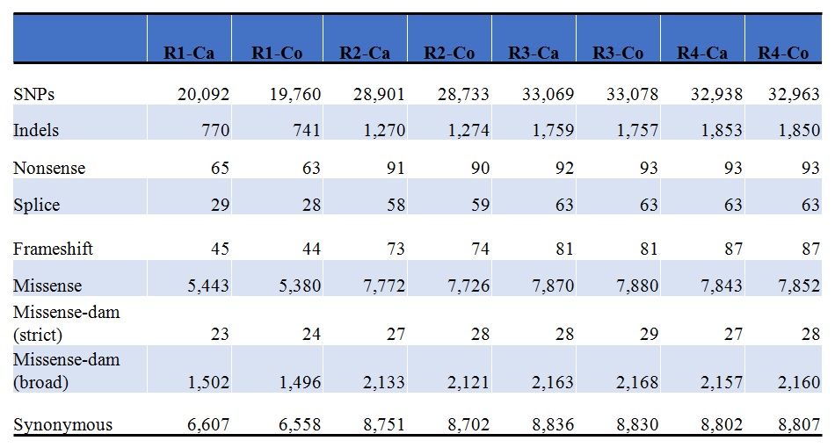
Variant Annotation
Notes:
The other sample of families we have for study was collected as part of an NIMH lead initiative to collect families with BP for genetics studies using common ascertainment criteria.
This is a separate sample of families from the JHU sample.
The initiative is an on-going collaboration between four sites at IU, JHU, WUSL and the intramural program at NIMH.
To date we have collected 151 families with 882 individuals that have been interviewed and genotyped. This represents one of the largest family samples for studying the genetics of BP. In fact, we have collected even more families; these are currently being genotyped and analyzed.
These subjects were assessed by trained interviewers with the DIGS and diagnoses were assigned by psychiatrists using best estimate procedures.
Final diagnoses for the current sample included…

Slide 34
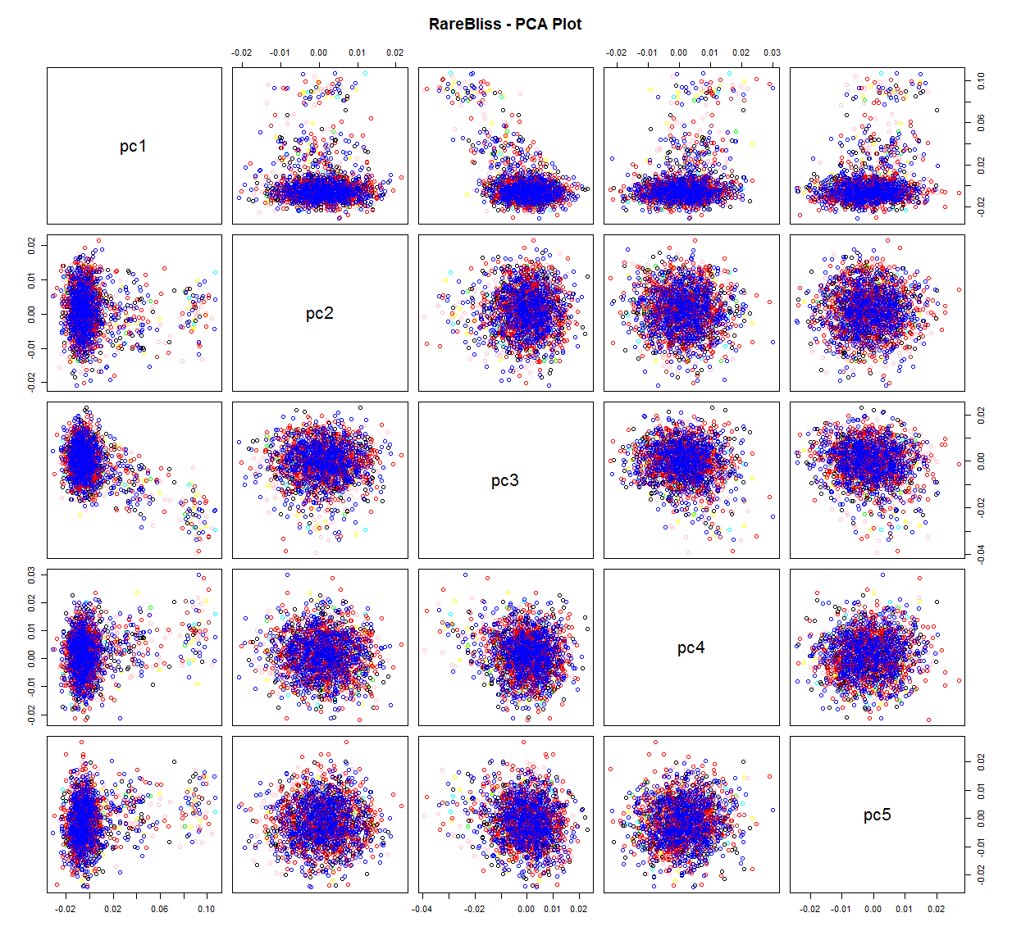
PCA Analysis
Notes:
The other sample of families we have for study was collected as part of an NIMH lead initiative to collect families with BP for genetics studies using common ascertainment criteria.
This is a separate sample of families from the JHU sample.
The initiative is an on-going collaboration between four sites at IU, JHU, WUSL and the intramural program at NIMH.
To date we have collected 151 families with 882 individuals that have been interviewed and genotyped. This represents one of the largest family samples for studying the genetics of BP. In fact, we have collected even more families; these are currently being genotyped and analyzed.
These subjects were assessed by trained interviewers with the DIGS and diagnoses were assigned by psychiatrists using best estimate procedures.
Final diagnoses for the current sample included…

Slide 35
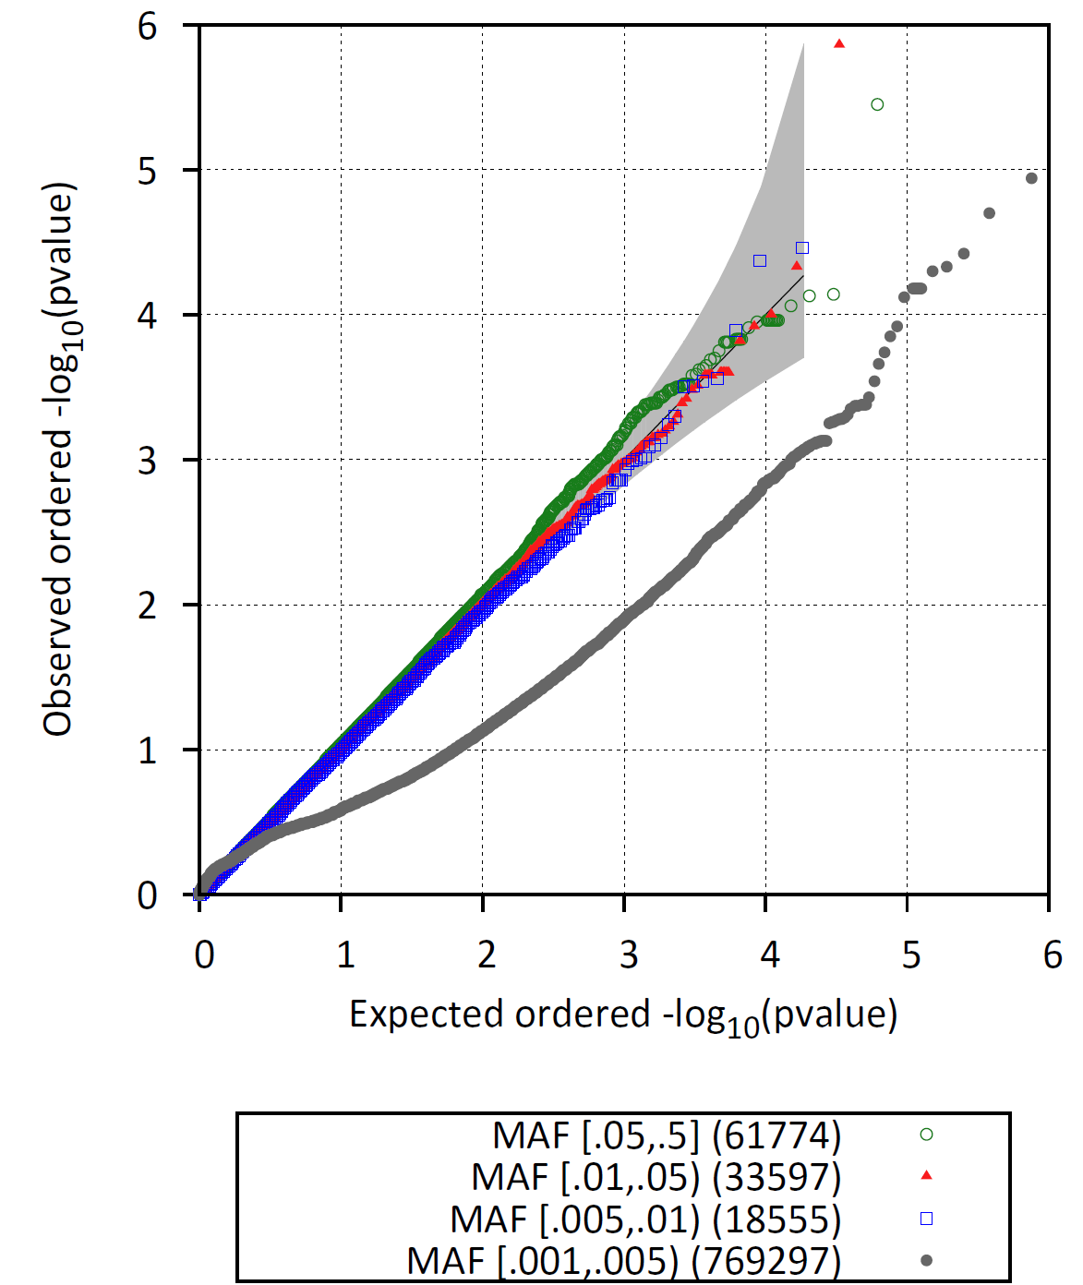
Variant Level Tests
Notes:
The other sample of families we have for study was collected as part of an NIMH lead initiative to collect families with BP for genetics studies using common ascertainment criteria.
This is a separate sample of families from the JHU sample.
The initiative is an on-going collaboration between four sites at IU, JHU, WUSL and the intramural program at NIMH.
To date we have collected 151 families with 882 individuals that have been interviewed and genotyped. This represents one of the largest family samples for studying the genetics of BP. In fact, we have collected even more families; these are currently being genotyped and analyzed.
These subjects were assessed by trained interviewers with the DIGS and diagnoses were assigned by psychiatrists using best estimate procedures.
Final diagnoses for the current sample included…

Slide 36
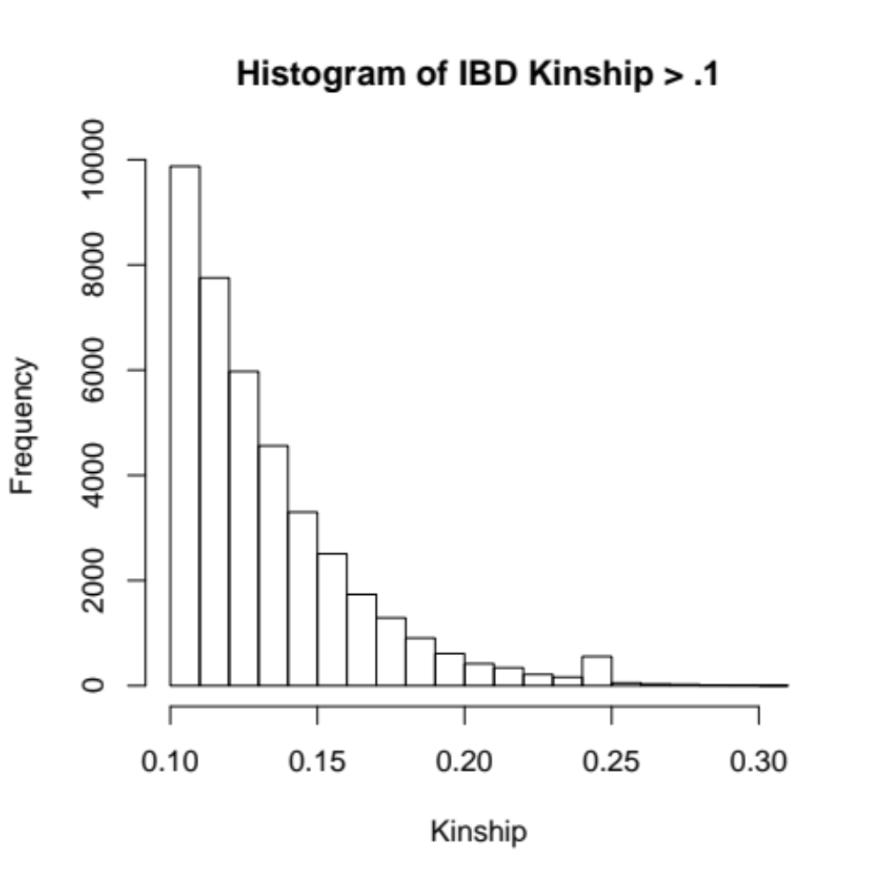
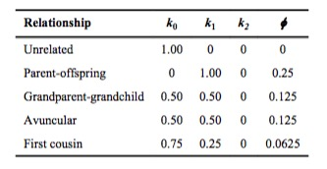
Everyone has kinship > .125 with at least one other person

Slide 37
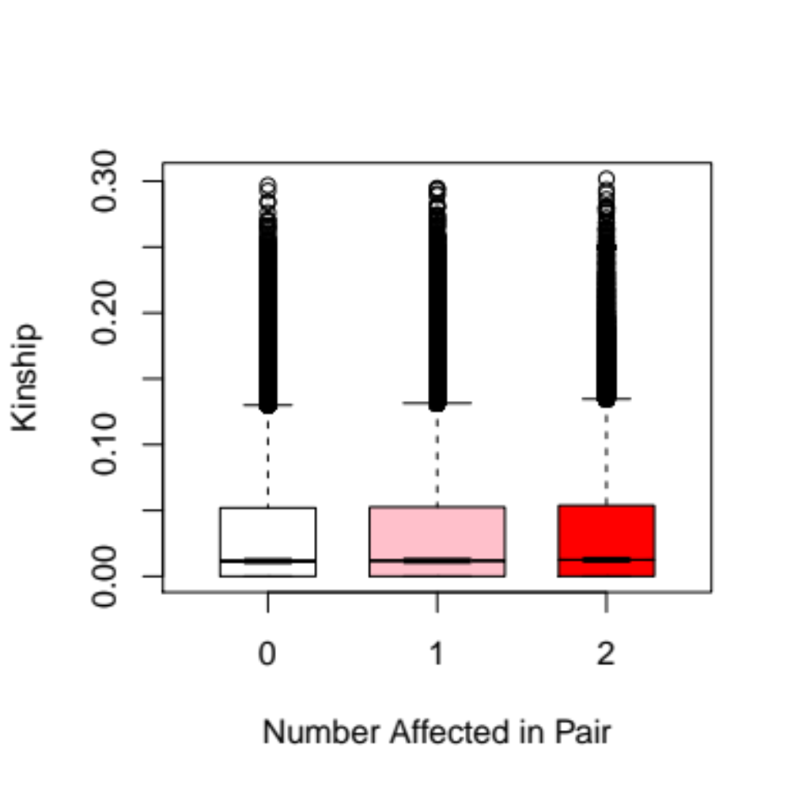
Notes:
If you look at pairs, there isn't an enrichment for a pair to be more ore less affected with BP to have more or less kinship

Slide 38
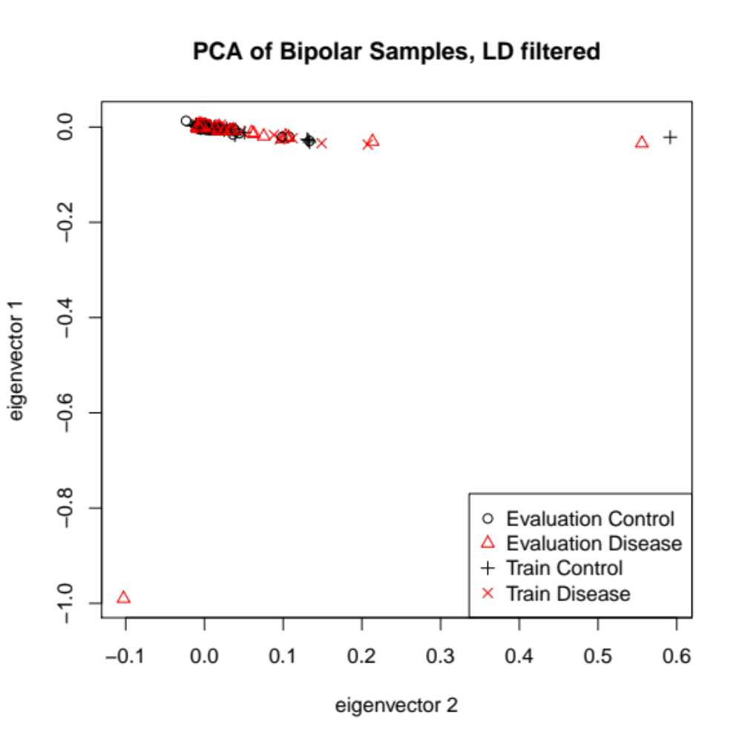

Slide 39
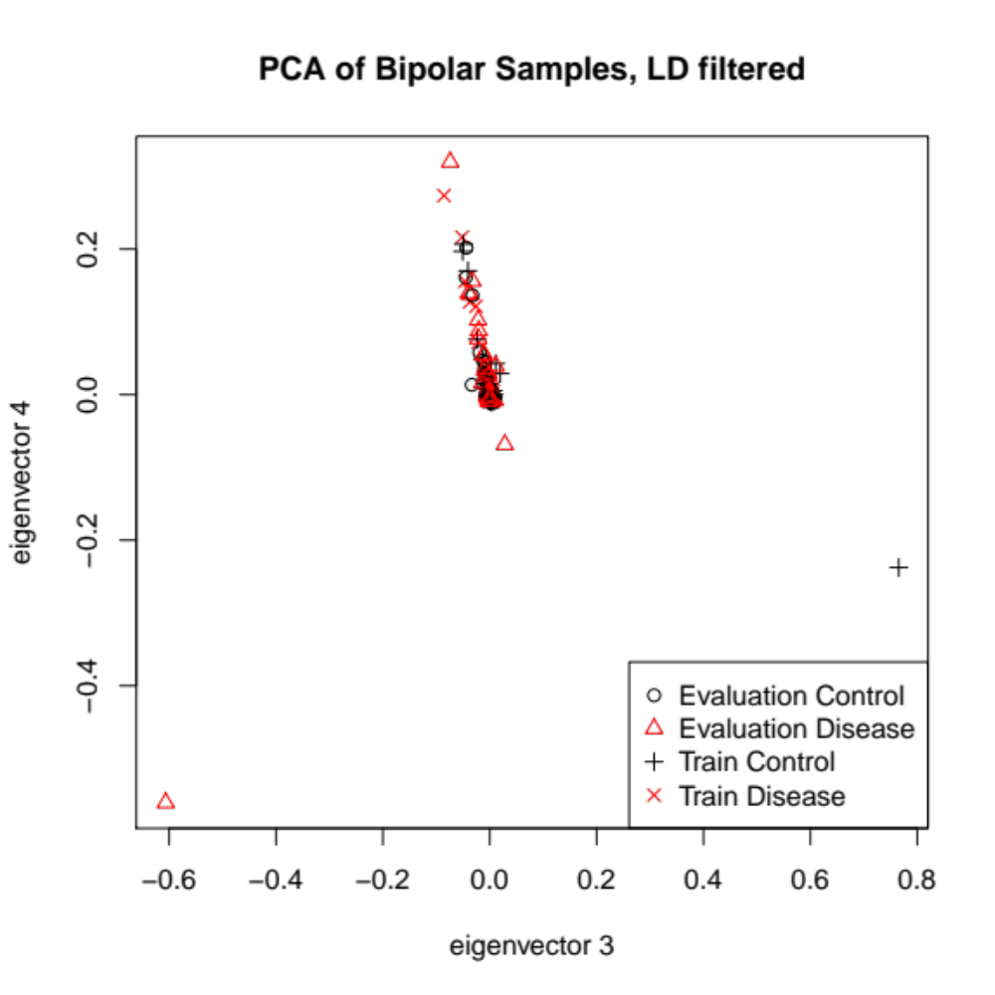

Slide 40


Slide 41
The Predictors
9 Submitting groups
29 Sets of predictions
Notes:
And have collected 111 more exomes, and we had 14 groups submit 46 sets of predictions.
Peter Zandi from Johns Hopkins also shared 1000 exomes of patients with bipolar and healthy controls. This is a bit of a harder problem, and we got 9 groups with 29 sets of predictions.
If this is interesting to you, the results of the evaluation will be presented at the end of March at the CAGI meeting in San Francisco, but I am not allowed to share the results until then.

Slide 42
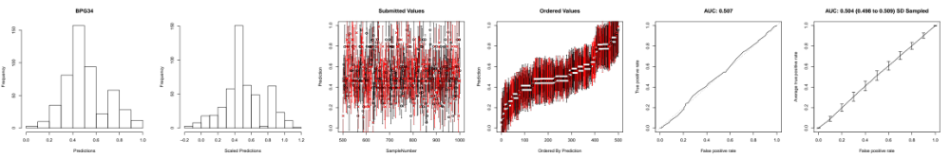
Example Submission

Slide 43
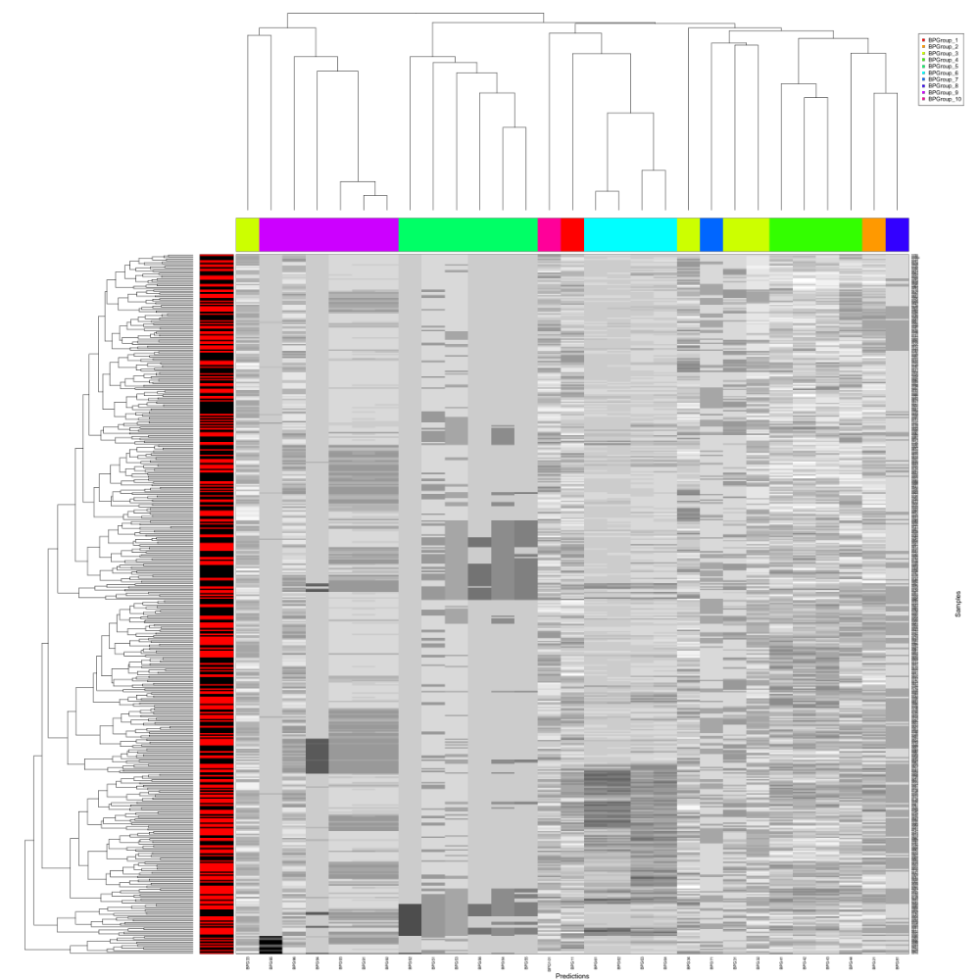

Slide 44
Example Submission

Slide 45
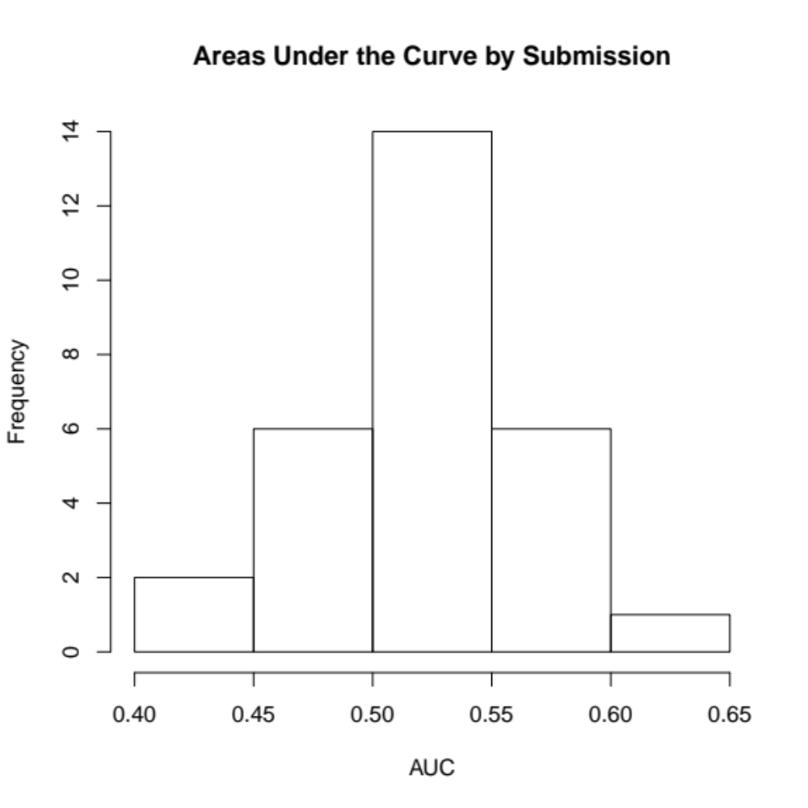

Slide 46
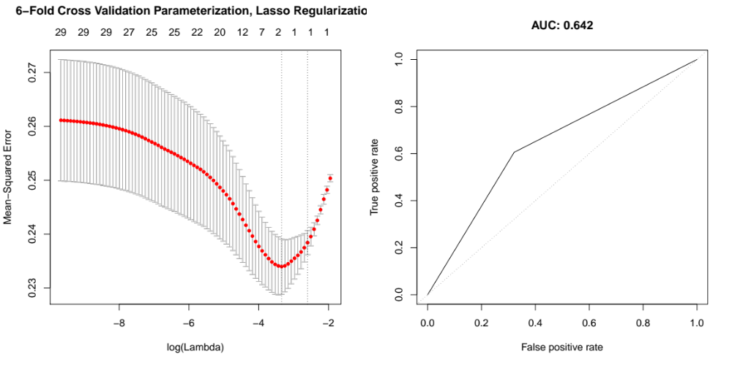
Meta-Classifier

Slide 47
Alex's Takeaways
Data set is "clean"
We don't understand the genetics of Bipolar
Triumph of machine learning and data over genetics knowledge/experience

Slide 48



Data Providers
Johns Hopkins University
Peter Zandi
Fernando Goes
Mehdi Pirooznia
Fayaz Seifuddin
Jennifer Judy
Aravinda Chakravarti
Eran Elhaik
Rachel Karchin
Yun Chen
J Raymond DePaulo, Jr.
Cold Spring Harbor Labs
Dick McCombie
Jennifer Parla
Darrin Lewis
Melissa Kramer
Maureen Bell
JC Yao
Shane McCarthy
Senem Mavruk
Elena Ghiban
Eric Antoniou
Carolann Gundersen
Stephanie Muller
University of Iowa
Jimmy Potash
Virginia Willour
Dunya Jancic
With generous support from the NIMH

